Slide 1
Spatial and temporal analysis
for disease data
Epidemiology skills workshop
Victoria Brookes, Katie Hampson, Mafalda Viana
Notes:
30-minute lecture pairing with the HPAI Kerala hands-on tutorial. Goal: give participants enough conceptual grounding (data types, CRS, projections, the investigation workflow) to follow the tutorial confidently and tackle the afternoon rabies practical independently.

Slide 2
Where this fits: outbreak investigation
CDC's classic outbreak-investigation steps — spatial-temporal analysis is part of Step 6: descriptive epidemiology.
→
→
3
→
1
2
4
STEPS 1–4
STEP 5
STEP 6 — TODAY
STEPS 7–10
Detect & confirm
Find cases
Descriptive epidemiology
Hypothesise & act
Prepare for fieldwork, confirm outbreak, verify the diagnosis and construct a case definition
Search systematically to find and record cases
Who, what, when, where?
Develop, evaluate, and refine hypotheses, reconcile with laboratory and environmental studies, implement control, prevention and surveillance, communicate findings
Everything in this workshop lives inside “place” and “time” — two of the three pillars of descriptive epidemiology (the third is person).

Slide 3
The core question
Are cases occurring with respect to each other – or some feature of the environment – spatially or temporally more frequently than would be expected by chance?
This single question motivates the methods we'll use today.
Notes:
Read the question aloud. Pause. Explain that 'where' matters because clustering suggests a common source, a common environment, or transmission between cases — all of which change what we'd recommend for surveillance and control.

Slide 4
A classic example: London, 1854
John Snow plotted cholera deaths on a street map and noticed they clustered around a single water pump on Broad Street.
THE TAKEAWAY
A map can reveal patterns that a table of case counts cannot.
Removing the pump handle ended the outbreak — and arguably founded modern epidemiology.
Snow didn't have R. You do.
Today we'll build the same kind of investigation with code.
Notes:
Snow's map (1854) is the canonical example of disease mapping. The point isn't to recount the history — keep this slide brief. The point is that even without statistics, plotting cases in space reveals patterns. Tee up: 'But we want more than eyeballing — we want quantitative tools. To get there, we need to understand what spatial data are.'

Slide 5
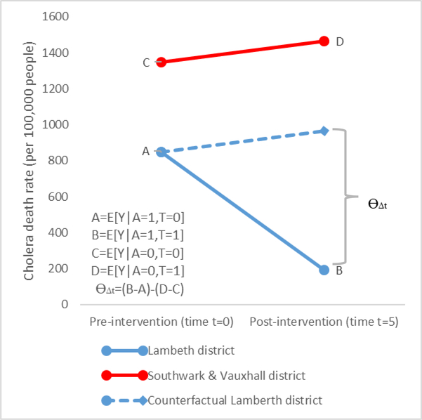
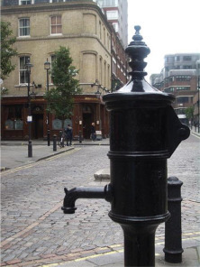
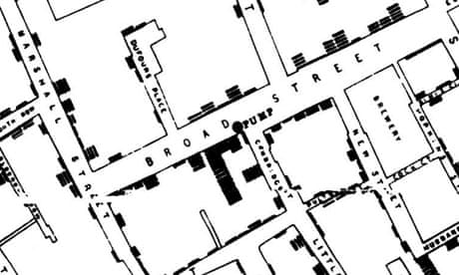
Caniglia EC, Murray EJ. Difference-in-Difference in the Time of Cholera: a Gentle Introduction for Epidemiologists. Curr Epidemiol Rep. 2020 Dec;7(4):203-211. doi: 10.1007/s40471-020-00245-2. Epub 2020 Sep 23. PMID: 33791189; PMCID: PMC8006863.
John Snow 1850s
‘Difference-in-difference’ method to compare cholera mortality rate (deaths/100,000 people) in London
Outbreak in 1849
Houses in the same area were supplied by two different water companies (otherwise all households were similar).
Another outbreak occurred in 1854 after the Lambeth Water company had moved their source upstream (cleaner water).
Demonstrated water source associated with deaths
Removed the pump handle.
https://blog.rtwilson.com/john-snows-cholera-data-in-more-formats/

Slide 6
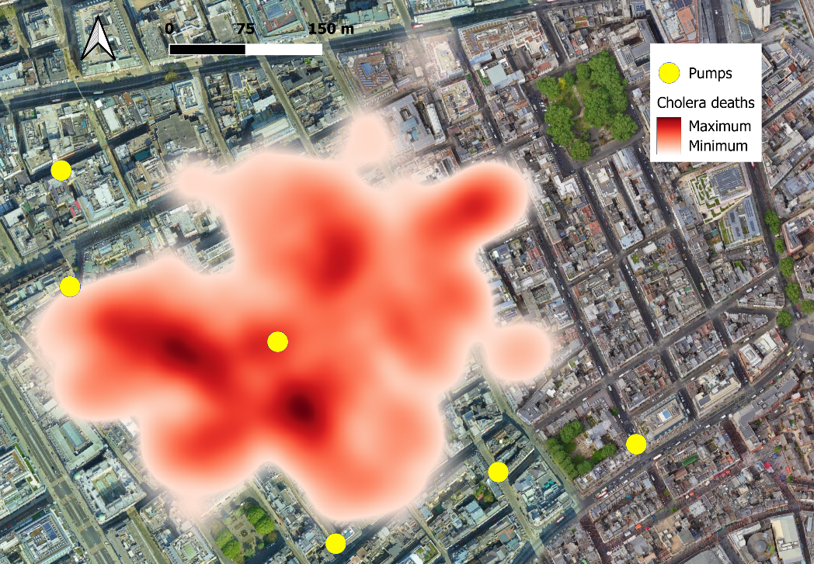
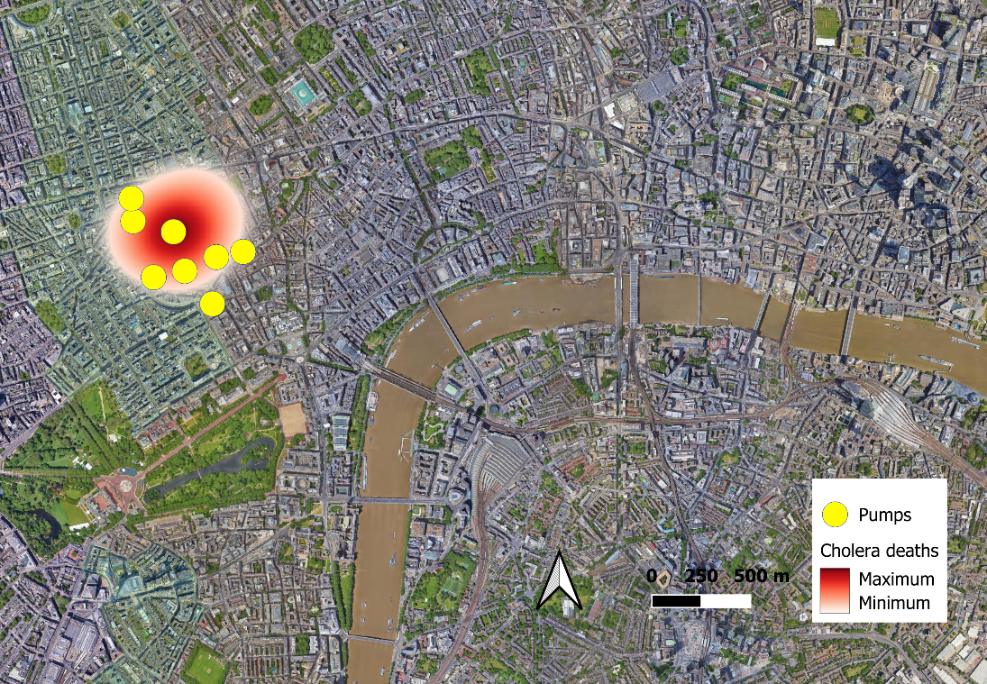

Slide 7
Spatial data come in two flavours
VECTOR
RASTER
Discrete features with exact coordinates
A grid of cells, each holding a value
Points — e.g. a single outbreak location
Lines — e.g. a river or a road
Polygons — e.g. a district or a country
Pixels of uniform size at a given resolution
Each cell carries a measurement
Examples — rainfall, temperature, elevation, vegetation cover
Notes:
Two-bucket framing. Vector = discrete things you can point to. Raster = continuous things you'd measure across a surface. Today's hands-on uses only vector data (outbreak points + district polygons). Rasters are mentioned for completeness since participants may meet them in environmental covariate work later.

Slide 8
Vector data: three building blocks
POINTS
LINES
POLYGONS
Single (x, y) coordinate
Two or more linked coordinates
An ordered ring of lines
Outbreak occurrences,
households, clinics
Roads, rivers,
animal movements
Districts, countries,
land-use zones
Notes:
Three building blocks. The HPAI tutorial uses points (outbreak locations) and polygons (Kerala districts). Connect explicitly: 'Each row in hpai_kerala.csv becomes a POINT once we attach a CRS; the districts shapefile gives us POLYGONS.'

Slide 9
Raster data: a grid of measurements
A raster is a regular grid of cells.
Each cell holds a value for a fixed location at a fixed resolution.
Typical uses in epidemiology:
rainfall, temperature, land cover, population density.
Higher resolution = larger files. A 1 km grid over India is much bigger than a 10 km grid.
e.g. annual rainfall (mm)
Notes:
Mention rasters but don't dwell — they're not in the hands-on. Frame as 'something you'll meet when adding environmental covariates to outbreak analyses; the `terra` package handles them in R'.

Slide 10
Locating things on Earth
A Coordinate Reference System (CRS) is what turns a location into numbers (and vice versa).
Latitude & longitude
A datum
An EPSG code
Angles measuring north–south and east–west position on a globe.
The model of the Earth's shape that the coordinates are referenced to (e.g. WGS 84).
A standardised catalogue number for any CRS. WGS 84 is EPSG:4326 — the one your phone's GPS uses.
In the tutorial: st_set_crs("EPSG:4326") attaches WGS 84 to your point data.
Notes:
Three things make up a CRS. Lat/lon (where on the ellipsoid), datum (which ellipsoid), and conventionally we refer to the whole bundle by an EPSG code. 4326 is the one you'll see most. Avoid getting into geodetic vs geocentric latitude — beginners don't need it.

Slide 11
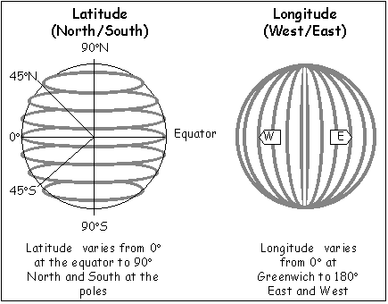

Slide 12
Two kinds of CRS
Coordinate systems split into two families. The same place gets very different numbers.
GEOGRAPHIC
PROJECTED
On the curved Earth
On a flat plane
Coordinates are angles (degrees)
Sydney = (−33.87, 151.21)
No distortion — it's the real Earth
EPSG 4326, 4283, 7844
Coordinates are distances (usually metres)
Sydney = (334000, 6251000)
Some distortion — varies by location
EPSG 3857, 3577, 7855
Geographic CRS for storing and mapping. Projected CRS when you need to measure distance or area.
Notes:
The key distinction. Same place, two CRSs, completely different-looking numbers. Geographic = angles on the round Earth (no flattening yet). Projected = distances on a flat plane (something has been flattened, so something is distorted). Practical rule: store and display in geographic; reproject before measuring distance, buffer, or area. The tutorial stays in EPSG:4326 throughout because every operation is 'which polygon does this point fall in?' — a topological question that doesn't care about distortion.

Slide 13
Projections: 3D world, 2D map
Every flat map of Earth must distort something.
A projection is a rule for flattening the globe. Different projections preserve different things:
Shape — Mercator (handy for navigation)
Area — Mollweide, equal-area projections
Distance — azimuthal equidistant from one point
THE MERCATOR PROBLEM
Greenland looks the same size as Africa.
It isn't. Africa is roughly 14× larger.
If you compute distances or areas from a Mercator map, you will get the wrong answer. Reproject to an equal-area or equidistant CRS first.
Scale is the ratio between map distance and ground distance — it changes with the projection.
Notes:
The key practical point: pick a projection that fits what you want to measure. For the HPAI hands-on we stay in EPSG:4326 (lat/lon) and don't compute distances — so the distortion doesn't bite us. Flag for participants that if they later do buffer analyses or distance-from-feature, they'll need to reproject.

Slide 15
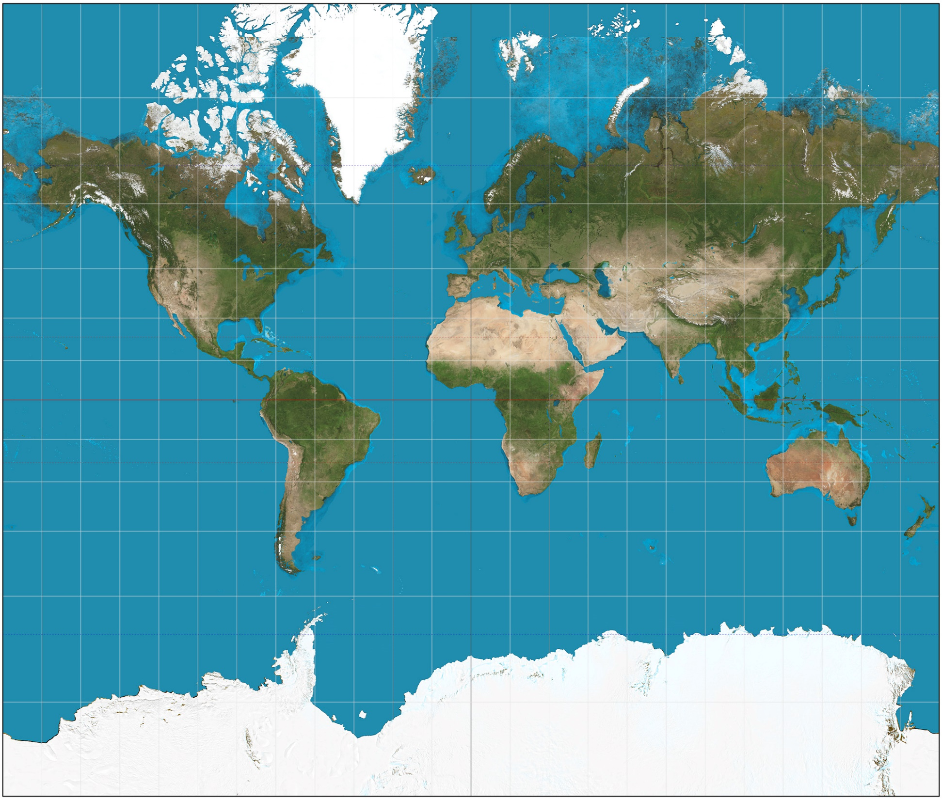
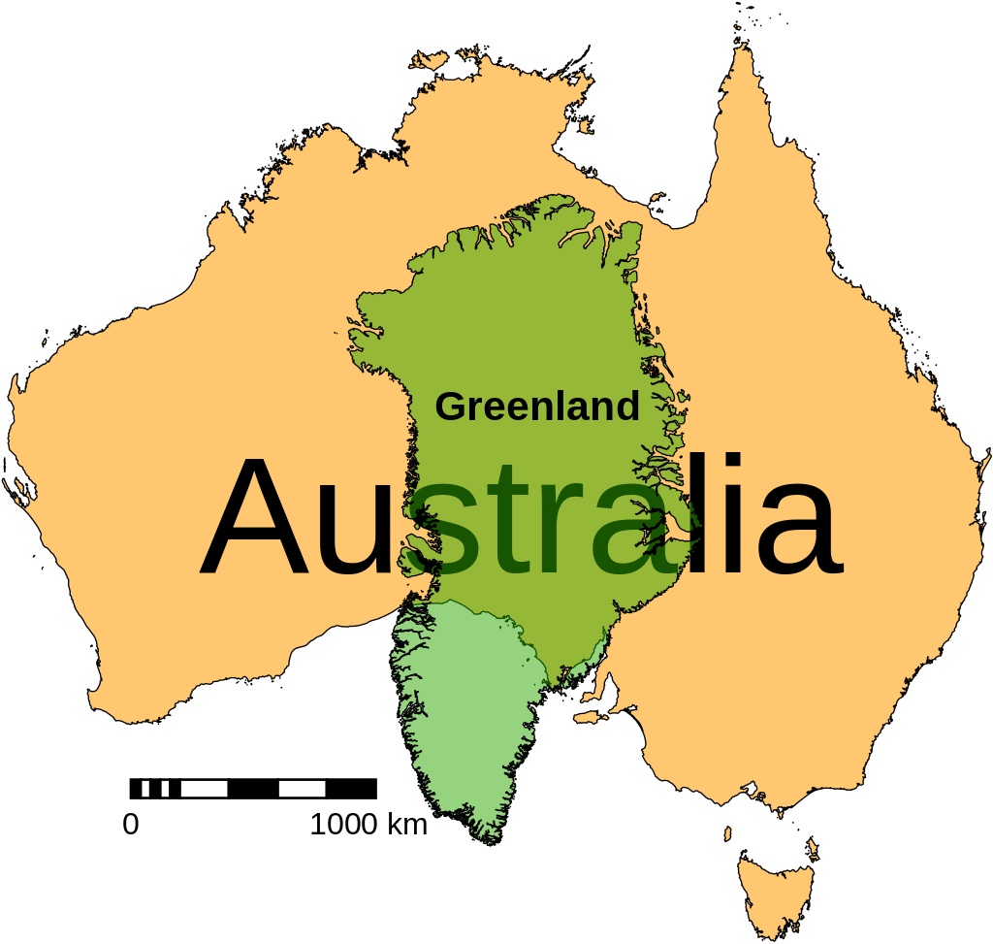

Slide 16
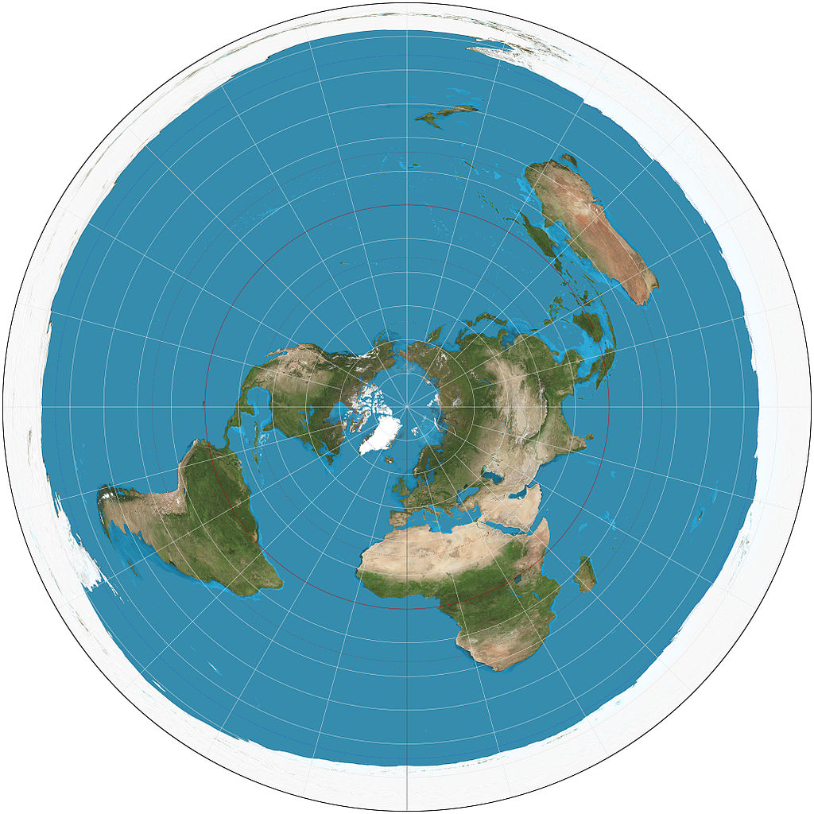
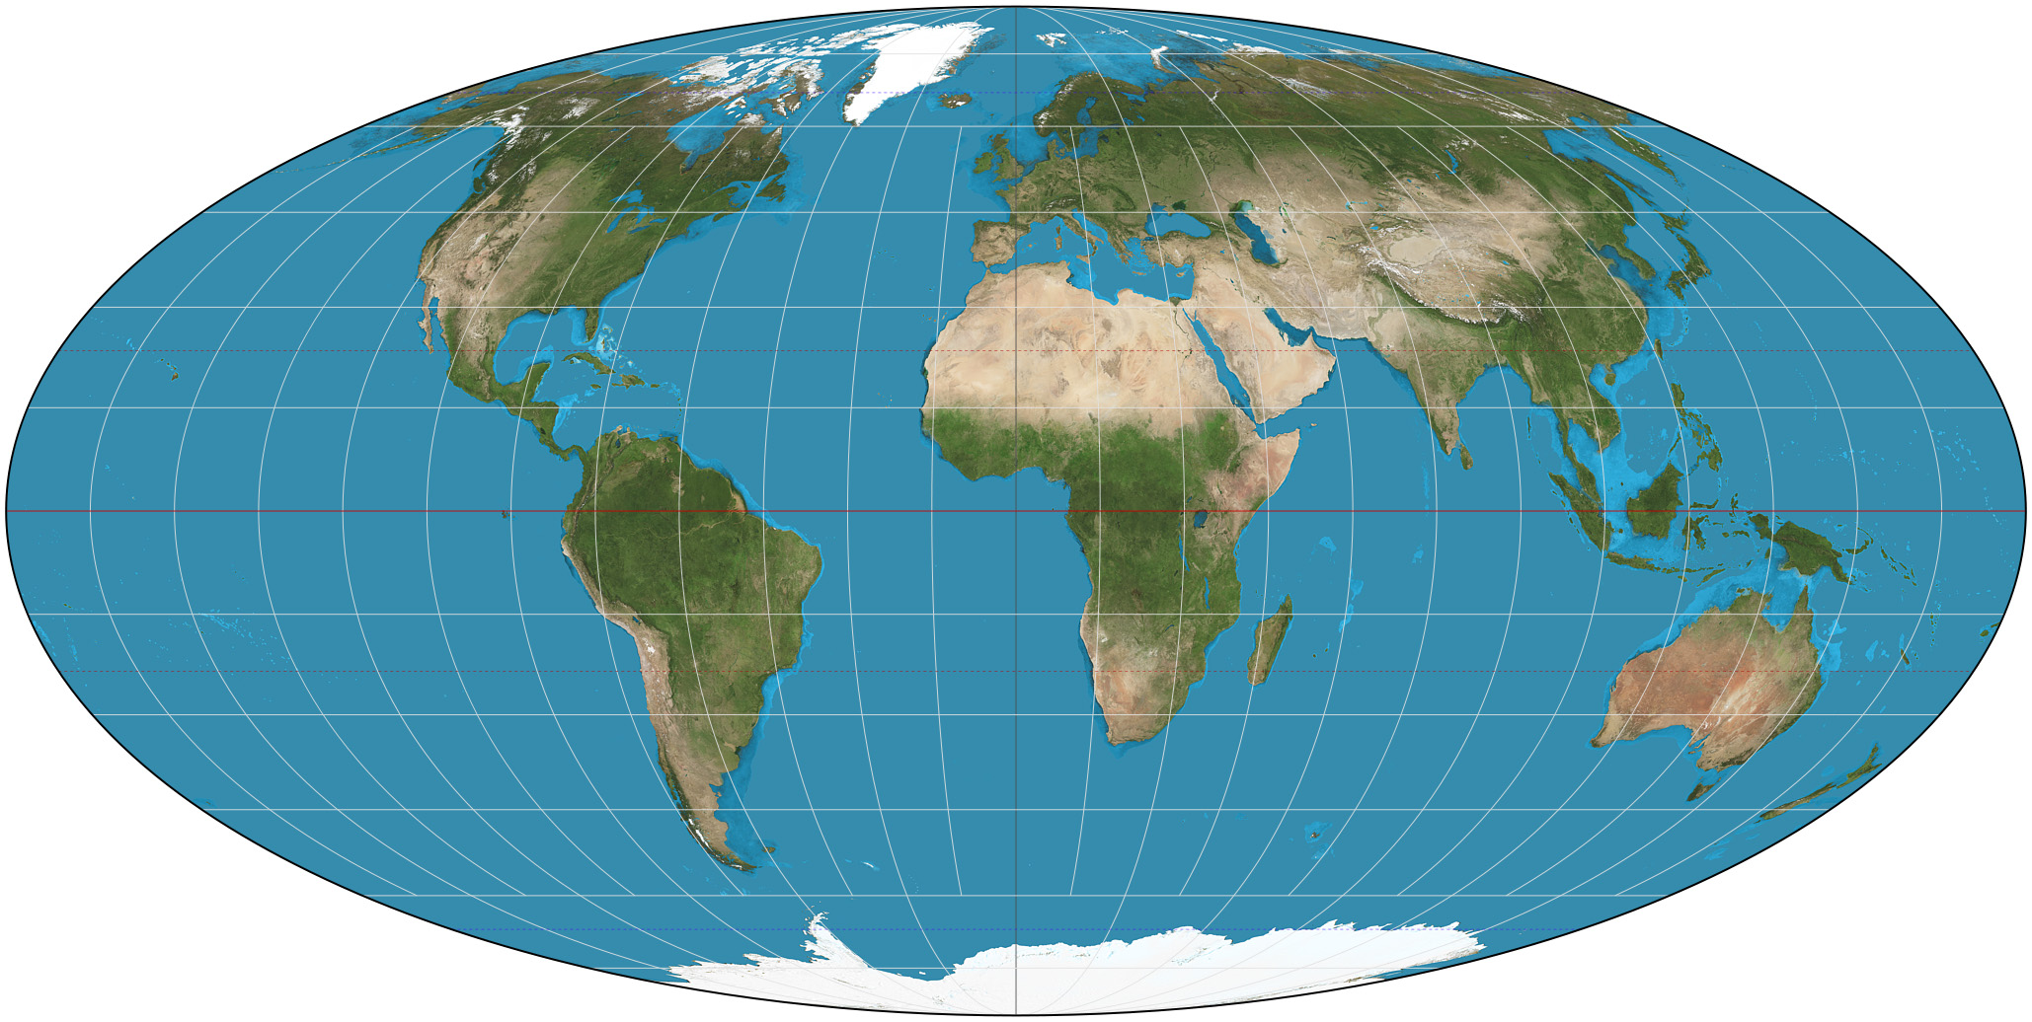

Slide 17
Shapefiles, and reading them in R
A shapefile is not one file — it's a bundle:
IN R
.shp — the geometry (the shapes)
.shx — an index into the shapes
.dbf — the attribute table
.prj — the CRS (optional but always include it)
.cpg — character encoding
.shx — metadata, e.g. who made it
The sf package
library(sf)
districts <- read_sf(
"districts.shp")
hpai_sf <- hpai |>
st_as_sf(
coords = c("lon", "lat")) |>
st_set_crs("EPSG:4326")
If you move a shapefile, move all files together.
sf treats spatial data as a data frame with one extra column (geometry).
Notes:
Two practical points: (1) shapefiles are a four-file bundle, easy mistake to copy only the .shp. (2) `sf` makes spatial data behave like a tibble — you can `filter()`, `mutate()`, `select()` as normal. The 'geometry' column is sticky and travels with the data. Older packages (sp, rgdal) are obsolete; we don't teach them.

Slide 18
Tobler's laws of geography
Two deceptively simple statements …
FIRST LAW — 1970
SECOND LAW — 1999
Near things are related
What's outside still matters
“Everything is related to everything else, but near things are more related than distant things.”
“The phenomenon external to an area of interest affects what goes on inside.”
The basis of spatial autocorrelation, Moran's I, Gi*, and kernel density
Breaks the classic assumption that observations are independent
A caution about arbitrary borders — disease doesn't stop at a district line
Relevant whenever you subset a study area — e.g. Kerala from India
Together: patterns are locally connected, and no study-area boundary is truly closed.

Slide 19
Patterns in space – clusters and spatial autocorrelation
One idea — near things are related — four different ways to test it.
1
2
3
4
GLOBAL
LOCAL
CONTINUOUS
SIGNIFICANCE
Moran's I
Gi* (Getis–Ord)
Kernel density
SaTScan
Is there clustering anywhere on the map?
Where are the hot and cold spots?
What does the risk surface look like?
Is a specific cluster too unlikely to be chance?
Same question — where do we look for signal — four different lenses.

Slide 20
From global to local: Gi*
Moran's I gives one number for the whole map. Gi* gives one for every district.
GLOBAL — MORAN'S I
LOCAL — GI*
One statistic for the whole area
One statistic per district
Tests clustering across the whole study area
Answers: is there any pattern at all?
Output: a single I statistic and one P-value for the whole map
Tests each district against its neighbours
Answers: where are the hot and cold spots?
Output: a z-score and P-value for every district
A high, significant Gi* z-score marks a hot spot; a low, significant one marks a cold spot.

Slide 21
A smooth surface: kernel density
Turns individual points into a continuous surface — no administrative boundaries needed.
1
2
3
Place a bump
Choose a bandwidth
Sum the bumps
Each outbreak point gets a small, smooth probability bump around it.
Bump width controls smoothness — too narrow is noisy, too wide blurs real hotspots.
Overlapping bumps add up into one surface — peaks mark higher-risk areas.
Useful when the point itself is the unit of interest — e.g. household-level cases, not district totals.

Slide 22
Cluster detection: SaTScan
Kulldorff's spatial scan statistic slides a window around the map and tests every candidate cluster.
HOW IT WORKS
WHY IT MATTERS
Scan every candidate cluster
Pinpoints the cluster itself
Move a circular window of varying size across the map
Compare observed vs expected cases inside each window
Keep the window with the highest likelihood ratio — the “most likely cluster”
Test significance with Monte Carlo simulation (thousands of random relabellings)
Doesn't require pre-drawn admin boundaries
Gives location, size, AND significance in one test
A standard tool in outbreak investigation worldwide
Free standalone software: satscan.org
Unlike Moran's I or Gi*, SaTScan tells you exactly where the cluster boundary sits.

Slide 23
Choosing a clustering method
Match the tool to the question you're asking and the data you have.
METHOD
QUESTION IT ANSWERS
INPUT DATA
OUTPUT
Moran's I
Is there clustering anywhere on the map?
Areal counts + neighbours
One global statistic
Gi*
Where are the hot and cold spots?
Areal counts + neighbours
Z-score per area
Kernel density
What does the risk surface look like?
Point locations
Continuous surface
SaTScan
Where's the most likely cluster, and is it real?
Points or areal counts
Cluster location & P-value
No single method is “best” — together they triangulate on where, and how confidently, an observed pattern could be real.

Slide 24
Patterns in time
We've asked where. Now ask when.
Aggregation
Patterns
Autocorrelation
Events → counts per time unit. Day, week, month, year — pick the unit that matches the question.
Pull the series apart into a slow trend, a recurring season, and the noise left over.
Tobler's law on the clock. Events nearby in time tend to be related — outbreaks cluster into episodes.
Same investigative logic — different axis.
Notes:
Bridge slide from spatial to temporal. The three building blocks here are deliberately parallel to the spatial concept slides earlier. Make the link to Tobler explicit: 'You already met Tobler's law for space — Moran's I operationalises it. Autocorrelation in time is exactly the same idea, just on a clock instead of a map.'

Slide 25
Anatomy of a time-series
Most disease time-series can be thought of as the sum of three pieces.
WHAT YOU OBSERVE
TREND
SEASONAL
=
NOISE
R's stl() does this decomposition for you.
Notes:
The classic time-series decomposition framing. The left panel is the messy observed series; the three on the right are the components STL extracts. Big warning for the HPAI dataset: it's episodic, not seasonal — long quiet periods with occasional spikes. STL will technically run but the remainder will dominate, which is itself the diagnostic finding.

Slide 26
PART 2
Let's investigate:
HPAI outbreaks in Kerala
Notes:
Transition slide. From here on we walk through the exact workflow participants will run in the hands-on. Set up the four questions: where, is it clustered, when, and have hotspots shifted.

Slide 27
Where have outbreaks occurred?
01
FIRST IMPRESSION
What does the raw map show?
Plot every outbreak as a point on the Kerala map.
Are points concentrated in one part of the state?
Are they near the coast? Near wetlands? Near major poultry districts?
Even before any statistics, the eye picks up the pattern — just like Snow's map.
1. Convert lat/lon columns into an sf object
2. Attach EPSG:4326 as the CRS
3. Layer points over the districts polygon
Notes:
Step 1 of the investigation. In the tutorial they use `geom_sf(data = hpai_sf, colour = "red")` layered over `geom_sf(data = kerala, fill = "lightgrey")`. The teaching point: BEFORE running any stats, look at the raw map. Pattern recognition by eye is genuinely useful and often surprising.

Slide 28
Aggregate to district counts
02
3
1
0
5
2
0
Points overlap; counts per polygon are clearer.
8
4
1
Use st_intersects() to count points falling inside each district polygon.
Shade each polygon by its count — a choropleth map.
12
6
2
(stylised) outbreak counts per district
A zero is not the same as no disease — it might simply mean no surveillance.
Notes:
Step 2. The choropleth is where most outbreak investigations live. Three things to flag: (a) the choice of break style (jenks/quantile/equal/pretty) changes what the map says — try them; (b) zero counts are ambiguous (genuinely no disease, or no surveillance?); (c) classifying zero-inflated data with quantiles fails because many breaks tie at zero.

Slide 29
Is the pattern clustered?
03
INTERPRETING MORAN'S I
I > 0
Clustered
Moran's I formalises what the eye suspects.
high counts near high, low near low
I ≈ 0
Random
Tobler's first law:
everything is related, but near things more so.
Moran's I asks: are nearby districts' counts more similar than chance would predict?
no spatial signal
I < 0
Dispersed
regular, checkerboard-like
A small P-value tells you the pattern is unlikely to be a coincidence.
Notes:
Moran's I in plain language. Show that it's analogous to a correlation coefficient. Don't dwell on the formula. Caveat: 14 districts is a SMALL sample for Moran's I — the test can miss real clustering (low power). Always combine test result with what you see on the map.

Slide 30
When have outbreaks occurred?
04
THE INVISIBLE-ZERO TRAP
count() drops months with no events.
Aggregate events to counts per time unit.
Those months were zero — and a naive count() makes them disappear entirely.
An epi curve that skips zero months looks misleadingly continuous. Always pad the series with the missing months before plotting.
1. Floor each date to its month (or week, or year)
2. Count events/period
3. Re-insert months with zero outbreaks
4. Plot as a bar chart — the epidemic curve
Notes:
Step 4. The first temporal step. Two teaching moments: (1) the choice of aggregation unit (week/month/year) matters and depends on the question; (2) the invisible-zero trap — when you count() events by month, R drops months with no events from the output entirely. In a 120-month series with outbreaks in 20 months, your epi curve will only show 20 bars. The fix in the tutorial is left_join() with a complete date sequence and replace_na(0).

Slide 31
Is there a seasonal pattern?
05
SEASONAL PROFILE
Lump every January together. Then every February. Etc.
1. Re-aggregate by month-of-year across all study years
2. Plot a 12-bar chart — the seasonal profile
3. Compare with biology, weather, ecology
J
F
M
A
M
J
J
A
S
O
N
D
For HPAI in Kerala: cooler months (Nov–Feb) coincide with migratory waterbirds.
Notes:
Step 5. The classic 'season of year' plot — collapse the long series to 12 month-of-year bars. The illustrative seasonal profile here shows the textbook HPAI pattern: high in cooler dry months when migratory waterbirds arrive, low through the monsoon. The participant's actual finding may differ — that's the exercise.

Slide 32
Trends, decomposition, and ACF
06
TOBLER, AGAIN
Events nearby in time tend to be related.
Pull the series apart and look for nearby-in-time correlations.
Outbreaks rarely happen as isolated single months — they come in episodes lasting weeks or months.
ACF picks this up as a positive bar at lag 1.
Caveat: sparse, zero-inflated outbreak data limits these tools. Use them descriptively, not predictively.
Decomposition with stl() — separate trend, season, remainder (seasonal and trend decomposition using Loess)
Autocorrelation with acf() — does this month predict next month?
Notes:
Step 6. Frame this as Tobler's law on the clock — the temporal twin of Moran's I from step 3. STL gives you a picture of trend, seasonality, and remainder; ACF tells you whether nearby months are correlated. Both are DESCRIPTIVE, not predictive. With HPAI's sparse, episodic pattern, the remainder will dominate STL and the ACF will be modest. That's a finding, not a failure.

Slide 33
Have hotspots shifted over time?
07
Split the data into eras; map each side-by-side.
2015–2020
2021–2024
Split by era (2015–2020 vs 2021–2024)
Count/district within each era
Plot two choropleths on a shared colour scale
Same scale ⇒ the panels are comparable.
If the hotspots have moved, your control strategy may need to move with them.
Notes:
Step 4. Faceted choropleths with one shared colour scale (the key word is *shared*) so the two panels are visually comparable. In the tutorial code this comes from `pivot_longer() |> ggplot() + facet_wrap(~ era)`.

Slide 34
What this can — and can't — tell us
CAN
CANNOT
Describe where and when outbreaks have been reported
Highlight districts and periods where the pattern is unusually concentrated
Generate hypotheses about what's driving the pattern
Tell us whether the geography or seasonality of reported cases has shifted
Tell you why a cluster — in space or in time — exists
Distinguish a real hotspot from a surveillance hotspot
Prove anything causally — that's a separate study design
Compensate for under-reporting; gaps and zeros may mean blind spots
Notes:
The most important slide. The point: spatial AND temporal analysis are generators of hypotheses and tools for prioritising — not verdicts. Always state your caveats when communicating findings, particularly the surveillance-bias one. This connects to learning objective 7 (communicating findings honestly).

Slide 35
Now it’s your turn.
Open the HPAI Kerala tutorial.
You'll walk through these steps in R yourself.
Each section has setup code, an exercise, and a worked solution.
Same workflow this afternoon — different disease, different country.
Notes:
Closing slide. Briefly remind them: this morning's hands-on follows exactly the 4-step workflow on the previous slides. The afternoon rabies practical uses the same skills on a different dataset — they should have everything they need by lunchtime.

