Slide 1
W
W
FUNDAMENTALS
E
E
L
OF
MILLENNIAL
L
C
C
O
O
ENTREPRENEURSHIP
M
M
E
E

Slide 2
ENTREPRENEURSHIP
Entrepreneurship is simply the setting up and running of one’s own business. It involves a person or a group of people identifying a commercial opportunity and acting upon it.
Entrepreneurship is the collection of skills that an entrepreneur possesses. An entrepreneurship builds or creates something of value by using a combination of people their skills, equipment, money, and the markets.

Slide 3
TYPES OF ENTREPRENEURSHIP
Entrepreneurship can be divided into different types on the basis of various criteria such as:
Business type
Technology
Ownership
Size of business
Personal traits

Slide 4
PROCESS OF BEING ENTREPRENEUr
For being a entrepreneur, you must follow these steps:
Generating a core idea
Drafting a business plan
Financing the business venture
Stating the business venture
Managing the business

Slide 5
TEAM:
A team can be divided as a group of people working together towards a similar goal or cause. A team can have people of different backgrounds nationality, age and experiences.
An intelligent entrepreneur knows that a team which stays together is strong and contributes to the organization’s success.
TYPES OF TEAM PLAYER:
COLLABORATOR
CONTRIBUTOR
COMMUNICATOR
CHALLENGER
Focused on the GOAL
Focused on the TASK
Focused on the PROCESS
Focused on the QUESTION

Slide 6


TEAMWORK AND COLLABORATION
TEAMWORK:
Team bring together varied types of people offer fresh perspectives and help find new solutions. Each individual member possesses skill, knowledge, expertise, experience and ability.
COLLABORATION:
Collaboration can be defined as the act of working along with other people to achieve something. Collaboration between different people can work out only when they all work together as one unit.

Slide 7

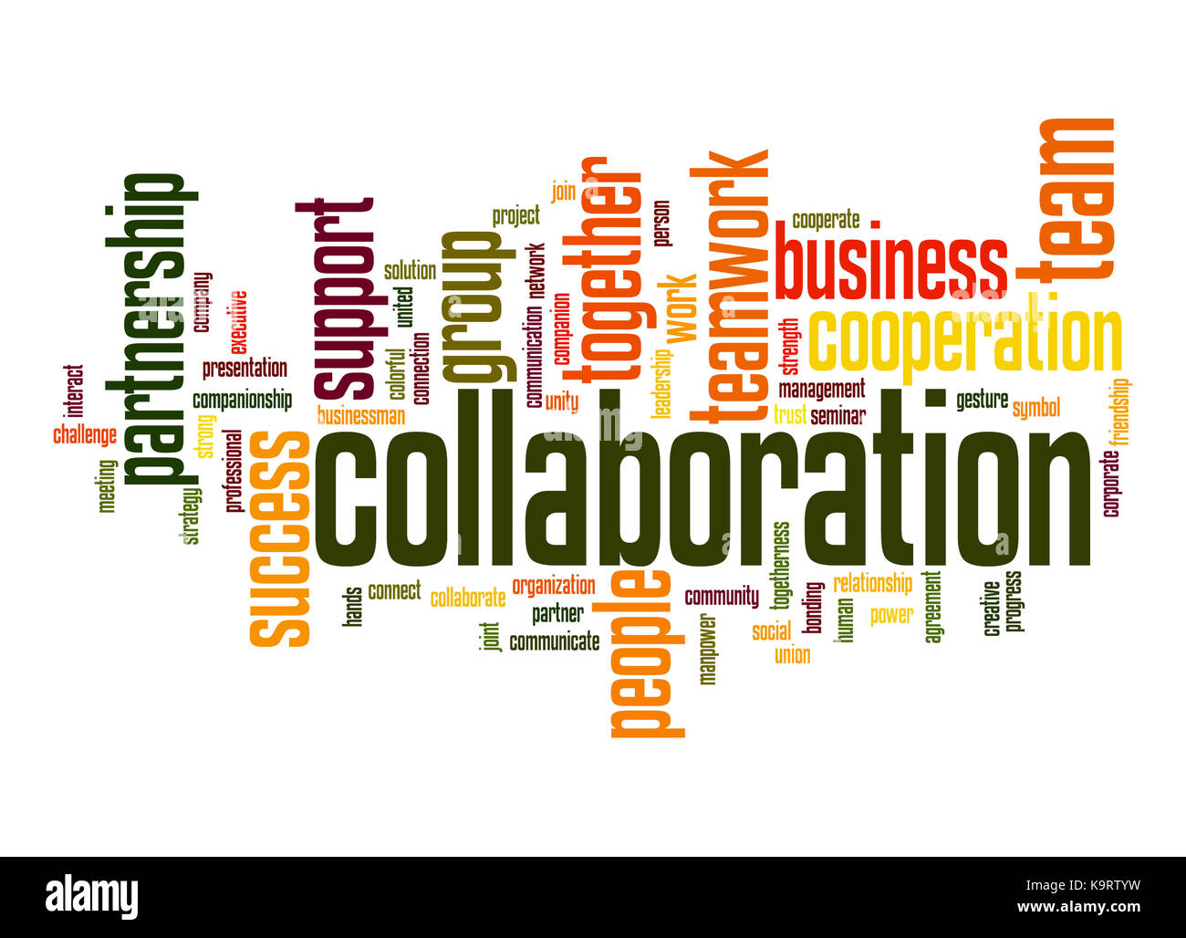
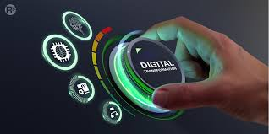
DIGITAL TRANSFORMATION
Digital transformation is a continuous process and at the heart of its digitization. Digitization is the process of converting paper-based information to digital information with the help of various technologies such as internet, AI intelligence and so on.
BENEFITS:
Digital transformation impact can be through better decision –making and results, internal process and capable employees.
GAIN HIGHER MARKET SHARE
MAKE MONEY
BRING DOWN RISK
INCREASE COLLABORATION
LEVERAGE DIGITAL INNOVATIONS

Slide 8
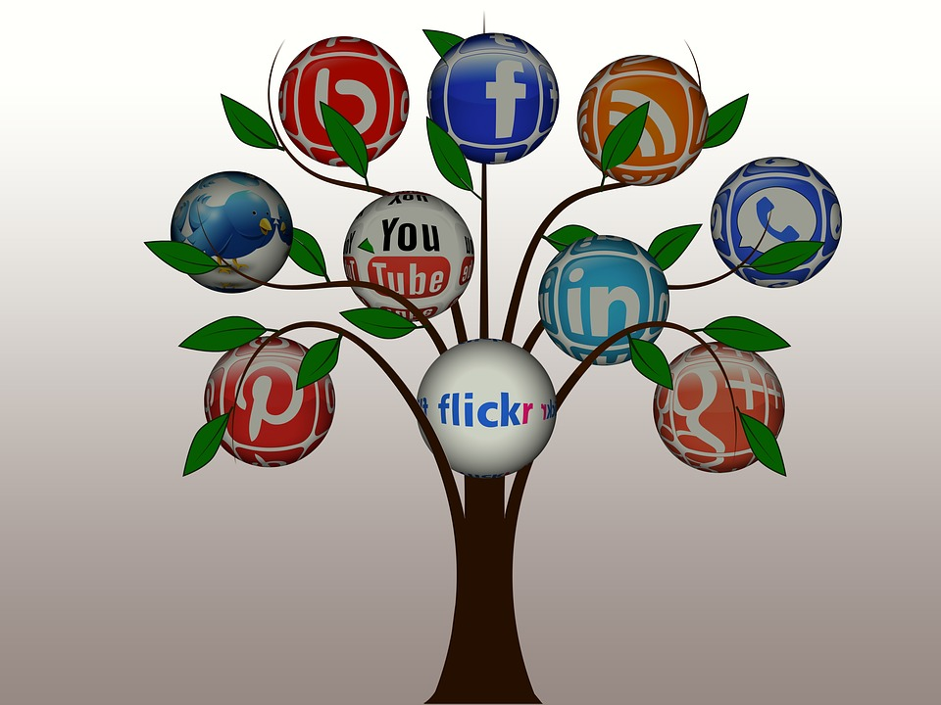
SOCIAL MEDIA
Communication that is based on digital technology such as the internet is known as social media. Social media is truly a powerful and key driver of digital transformation . It plays a very important role in today’s society and a company’s communication strategy.
PLATFORMS:
Some example of social-media are as follows:
Blogs
Social networking application
Instant messaging application
Podcasts
Audio/video/photo-sharing sites
Virtual worlds

Slide 9
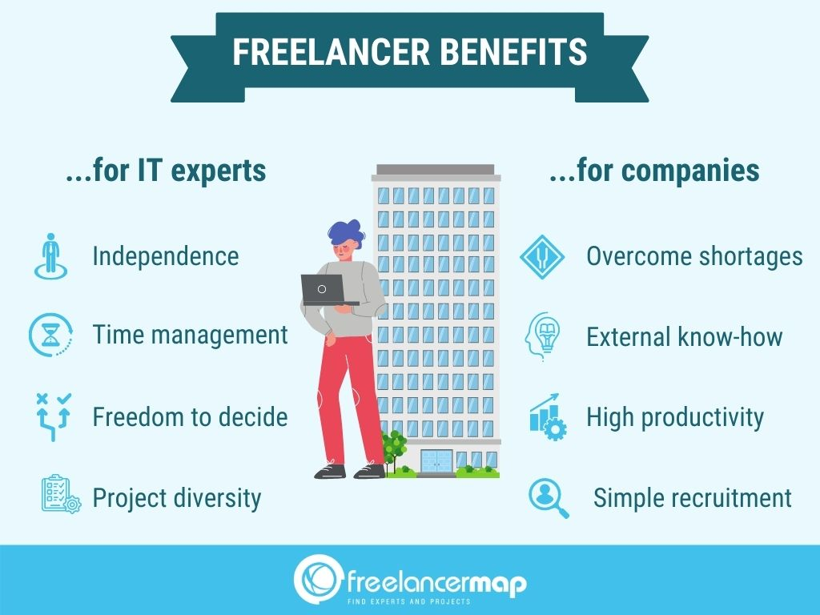
Freelancing
Freelancing is a contact based self employment involving both short term and long term work projects. Freelancing can be undertaken in any job sector ranging from blog writing, marketing or creative arts to shooting video.
Types:
Some types of freelancing are as follows:
Data entry, marketing, fashion designing, web designing, photography and videography, content writing, programming and coding, social media management.

Slide 10
T
H
A
N
Y
K
O
U

