Slide 1





NEXT GEN EMPLOYABILITY PROGRAM
College Name: Sri Krishna Institute Of Technology Team Name: Rabikant_Batch3
https://nextgen.edunetworld.com
nextgenep@edunetfoundation.org

Slide 2
CAPSTONE PROJECT SHOWCASE
Project title: Analysis Of Crypto Currency Growth.
Problem Statement| Project Overview| Solution & Proposed Value Proposition | Wow
Factor | Modelling & Results | Team Intro | Q&A

Slide 3





Problem Statement (1st page)
V
In this dataset, a currency named column is available, which contains the name of all the
currency.
The problem statement here is to know how many currency are available.
Name
Column
In this dataset, a year named column is available, which displays all the available year of the
currency.
The problem statement here is to know, in which all the year is the currency available.
Year Column
In this dataset, a market cap named column is available, which is one measurement of a company's size. It's the total value of a company's outstanding shares of stock, which include publicly traded shares plus restricted shares held by company officers and insiders.
The problem here is to know a share stock of a company.
Market cap
column

Slide 4








Problem Statement (1st page)
V
In this dataset, a Max named column is available, which contains the maximum gain of shares
of the selected currency.
Max Column
The problem statement here is to know the gain value of the currency.
In this dataset, a Average named column is available, which displays the average of the selected
currency.
The problem statement here is to know the average of currency available.
Average Column
In this dataset, min named column is available, which contains the lost shares of the selected
currency.
The problem here is to know the loss value of a currency.
Min column
In this dataset, in this column Everyday Currency Market Cap values are available for all Crypto
Currencies for all the dates.
The problem here is to know the Total Year on Year(YoY) Percentage change in the column.
Market Cap
Column

Slide 5




Problem Statement (2nd page)
V
In this dataset, a Coin with highest M.cap named column is available, which displays the currency with highest market share.
Coin with highest
M.cap Column
The problem statement here is to know the highest share currency.
In this dataset, a Coin with lowest M.cap named column is available, which displays the
currency with lowest market share.
The problem statement here is to know the lowest share currency.
Coin with lowest M.cap Column
In this dataset, min named column is available, which gives the details of highest and the lowest price at which a crypto token or other asset has traded over 52 weeks.
The problem here is to know the fortune of the Crypto currency.
Max of high and
low by date column
In this dataset, in this column the sum of initial values of the currency and the sum of final
values of the currency is available. This could be the initial and final value of the currency.
The problem here is to know the initial and final value till date.
Sum of open and close by date Column

Slide 6
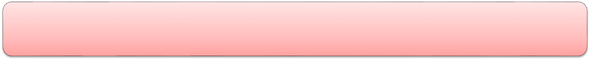
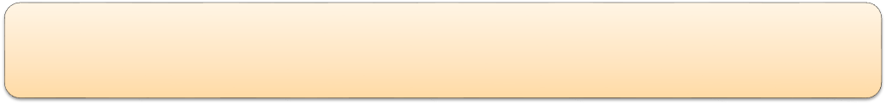
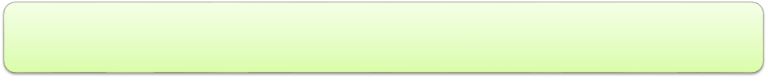
Project Overview
This Dashboard represents the Cryptocurrency project between the year 2013 to 2021.
The data included here is about 23 Currencies.
Total Market cap was 572.15T US dollars.
Bitcoin is having the highest market cap with 362T US dollars.
Aave is having lowest market cap with 0.87T US dollars.
This dashboard also gives the forecast for about 12 months which is up to 90%accurate.

Slide 7
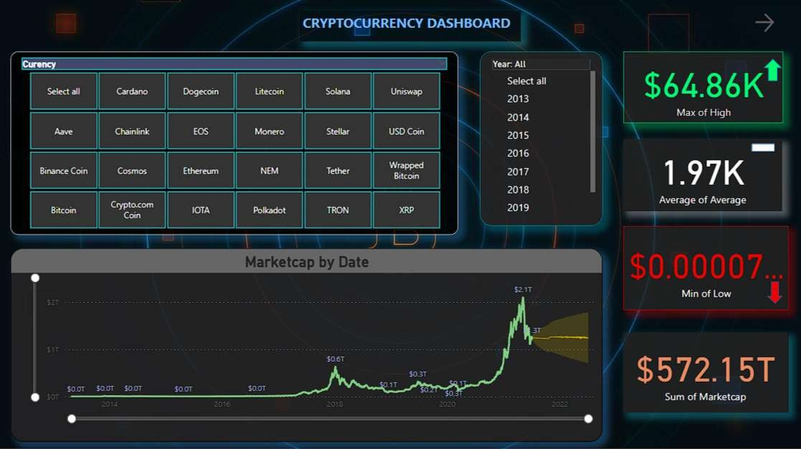
Solution (Dashboard 1)

Slide 8
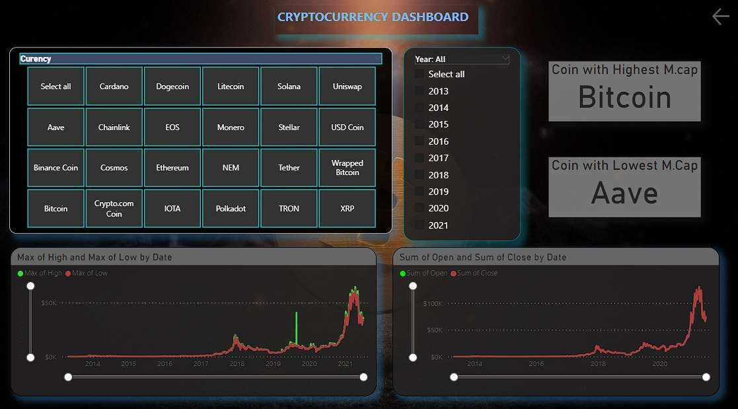
Solution (Dashboard 2)

Slide 9
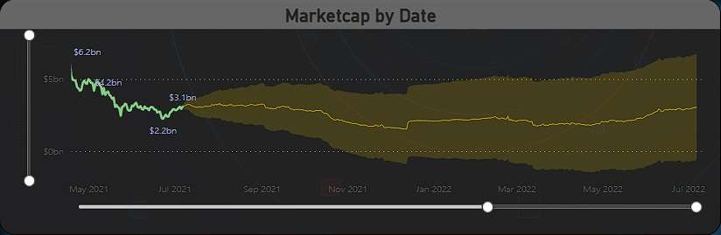
THE WOW IN YOUR SOLUTION
FORECASTING for market capitalization for 12 months with 90% accuracy.
This project shows analysis of 23 Crypto Currency growth for 9 years and also forecasts for about 1 year.

Slide 10
MODELLING & RESULTS
1. There are a total number of 23 Cryptocurrency with 572.15T US dollars Market cap count.
2. The Highest Crypto Currency was Bitcoin with the share holder of 64.86K US dollars.
3.The Lowest Crypto Currency was Aave with the share holder of 25.9K US dollars.
4. The Highest Market Cap was 262T US dollars happened in 2021.
5. The Lowest Market Cap was 811B US dollars happened in 2013.

Slide 11
MEET OUR TEAM
Mentor Name
NARENDRA ELURI
Group Leader
Rabikant Chaudhary Kalwar
Group Member
Piyush Kumar
Group Member
Sharath Chandra C
Group Member
Sewana M
Group Member
Shruthi BR

