Slide 1
.NET Framework
.Net Framework is a software development platform for building and running Windows applications.
.Net framework includes developer tools, programming languages, and libraries that are used to develop desktop and web applications.
.NET Framework is compatible with Windows OS(operating system) only

Slide 2
.NET Core
.NET Core is a latest version of .NET Framework, which is a free, open-source, general-purpose development platform maintained by Microsoft.
It is a cross-platform framework that runs on Windows, macOS, and Linux operating systems
It optimized for modern app needs and developer workflows.
It provides high scalability and performance in comparison to .NET Framework because of its architecture.
It can be used to build different types of applications such as mobile, desktop, web, cloud, IoT, machine learning, microservices, game, etc.

Slide 3
Contd…
It is written from scratch to make it modular, lightweight, fast, and cross-platform Framework.
It includes the core features that are required to run a basic .NET Core app.
Other features are provided as NuGet packages, which we can add it in your application as needed.
In this way, the .NET Core application speed up the performance, reduce the memory footprint and becomes easy to maintain.

Slide 4
.Net Core Features
Open-source Framework:
.NET Core is an open-source framework maintained by Microsoft and available on GitHub under MIT and Apache 2 licenses.
It is a .NET Foundation project.
Cross-platform:
.NET Core runs on Windows, macOS, and Linux operating systems.
There are different runtime for each operating system that executes the code and generates the same output.
Consistent across Architectures:
Execute the code with the same behavior in different instruction set architectures, including x64, x86, and ARM.

Slide 5
Wide-range of Applications:
Various types of applications can be developed and run on .NET Core platform such as mobile, desktop, web, cloud, IoT, machine learning, microservices, game, etc.
Supports Multiple Languages:
We can use C#, F#, and VB programming languages to develop .NET Core applications.
Modular Architecture:
.NET Core supports modular architecture approach using NuGet packages.
It reduces the memory footprint, speeds up the performance, and easy to maintain.
CLI Tools:
.NET Core includes CLI tools (Command-line interface) for development and continuous-integration.
Flexible Deployment:
Applications can be deployed user-wide or system-wide or with Docker Containers.
Compatibility:
Compatible with .NET Framework and Mono APIs by using .NET Standard specification

Slide 6
.net core framework parts
CLI Tools: A set of tooling for development and deployment.
Roslyn: Language compiler for C# and Visual Basic
CoreFX: Set of framework libraries.
CoreCLR: A JIT based CLR (Command Language Runtime).

Slide 7
mono
The Mono framework is an open source implementation of Microsoft’s .NET Framework based on the open standards for the C# language and the Common Language Runtime.
The Mono project has been in active development for over a decade and is used behind the scenes - in many products.
Mono allows C# developers to write cross platform code targeting Windows, macOS, Linux, Android, and iOS.
The technology was originally developed by Ximian, which was acquired by Novell, then at Novell, then at Xamarin and now Microsoft.
Mono provides a complete SDK (compiler, runtimes, libraries) to develop .NET applications on a wide range of platforms.

Slide 8
Contd…
It is most commonly used as a .NET runtime that supports the .NET desktop API profile, as well as an embeddable runtime that is used to power mobile platforms and gaming consoles.

Slide 9
ASP.NET Web form
ASP.NET Web Forms is a part of the ASP.NET web application framework
It is server side web technology developed for web application to create dynamic web pages and web sites with HTML, Server Controls, CSS, JavaScript and server code using Fully Fledged programming languages supported by .NET and web pages have extension .aspx.
Server code to handle the logic for the page.
When users request a page, it is compiled and executed on the server by the framework, and then the framework generates the HTML markup that the browser can render.
An ASP.NET Web Forms page presents information to the user in any browser or client device.
We can develop applications using classes of .NET Framework and any language compatible with (CLR), including Microsoft Visual Basic and C#.

Slide 10
Contd…
It runs inside Internet Information Services (IIS) that runs on all versions of Windows.
It executes on the server and generates output to the browser.
It is compatible to any browser to any language supported by .NET common language runtime. It is flexible and allows us to create and add custom controls.
Web Forms are made up of two components: the visual portion (the ASPX file), and the code behind the form, which resides in a separate class file.
ASP.NET provides various controls like: server controls and HTML controls for the Web Forms.
We can use Visual Studio to create ASP.NET Web Forms.
It is an IDE (Integrated Development Environment) that allows us to drag and drop server controls to the web forms.

Slide 11
Contd…
It also allows us to set properties, events and methods for the controls. To write business logic, we can choose any .NET language like: Visual Basic or Visual C#.

Slide 12
MVC(Model View Controller)
MVC is a pattern for developing software applications which divide the representation of information from the user's interaction with it.
MVC are well architected, testable and easy to maintain.
It separates an application into three main components: Model, View and Controller
Model:
Classes that represent the data of the application and that use validation logic to enforce business rules for that data.
It is the part of the application that handles the logic for the application data.
Often model objects retrieve data (and store data) from a database.

Slide 13
Contd…
Views:
A view display data(database record)that dynamically generate HTML responses.
Multiple views of the same data are possible.
It is the parts of the application that handles the display of the data.
Most often the views are created from the model data.
Controllers:
Classes that handle incoming browser requests(user interaction), retrieve model data, and then specify view templates that return a response to the browser.
Typically controllers read data from a view, control user input, and send input data to the model.

Slide 14
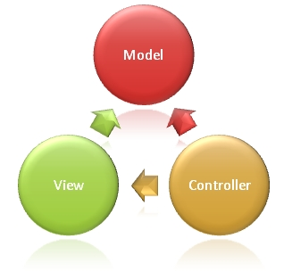

Slide 15
Advantages Of ASP.NET MVC Framework
It manages application complexity by dividing an application into the model, view and controller.
It does not use view state or server-based forms. This makes the MVC framework ideal for developers who want full control over the behavior of an application.
It provides better support for test-driven development.
It is suitable for large scale developer team and web applications.
It provides high degree of control to the developer over the application behavior.

Slide 16
ASP.NET Web API
ASP.NET Web API is a framework that makes it easy to build HTTP services that reach a broad range of clients, including browsers and mobile devices.
ASP.NET Web API is an ideal platform for building RESTful applications on the . NET Framework.
Web API services are used when the application is to be used on a distributed system.
Endpoints automatically serialize the classes to properly formatted JSON out of the box. No special configuration is required.

Slide 17
Contd…
Secure API endpoints with built-in support for industry standard JSON Web Tokens (JWT).
Policy-based authorization gives you the flexibility to define powerful access control rules—all in code.
We define routes and verbs inline with your code, using attributes.
Data from the request path, query string, and request body are automatically bound to method parameters.

Slide 18
ASP.NET Core
ASP.NET Core is a cross-platform, high-performance, open-source framework for building modern, cloud-enabled, Internet-connected apps.
Build web apps and services, Internet of Things (IoT) apps, and mobile backends.
Use development tools on Windows, macOS, and Linux.
Deploy to the cloud or on-premises.
Run on .NET Core.

Slide 19
ASP.NET Core Benefits
A unified model for building web UI and web APIs.
Architected for testability.
Razor Pages makes coding page-focused scenarios easier and more productive.
Ability to develop and run on Windows, macOS, and Linux.
Open-source and community-focused.
Integration of modern, client-side frameworks and development workflows.
A cloud-ready, environment-based configuration system.
Built-in dependency injection.
A lightweight, high-performance, and modular HTTP request pipeline.

Slide 20
Contd…
.NET Core includes CLI tools (Command-line interface) for development and continuous-integration.

Slide 21
.NET Architecture And Design Principles
.NET is tiered, modular, and hierarchal.
Each tier of the .NET Framework is a layer of abstraction.
.NET languages are the top tier and the most abstracted level.
The common language runtime is the bottom tier, the least abstracted, and closest to the native environment.
Common language runtime works closely with the operating environment to manage .NET applications.
The .NET Framework is partitioned into modules, each with its own distinct responsibility.
Finally, since higher tiers request services only from the lower tiers, .NET is hierarchal.

Slide 22
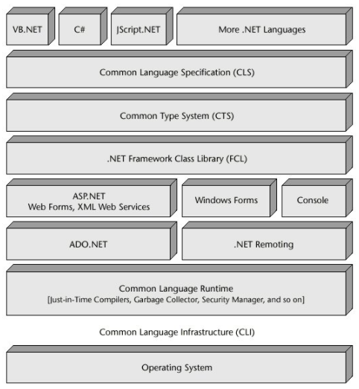

Slide 23
Design principles of .NET
Interoperability
Portability
In-built security mechanism
Robust memory management
Simplified deployment
Asynchronous Programming
High Performance

Slide 24
Compilation And Execution Of .NET Applications: CLI, MSIL and CLR
The Common Language Infrastructure (CLI) is an open specification developed by Microsoft that describes the executable code and runtime environment that allows multiple high-level languages to be used on different computer platforms without being rewritten for specific architectures.
The .NET Framework, .NET Core, and Mono are some implementations of CLI.
Source code written in C# is compiled into an Microsoft Intermediate Language (MSIL) that conforms to the CLI specification. The IL code are stored on disk in an executable file called an assembly, typically with an extension of .exe or .dll
CLR performs just in time (JIT) compilation to convert the IL code to native machine instructions. The CLR also provides other services related to automatic garbage collection, exception handling, and resource management.

Slide 25
Contd…
CLR is the responsibility of the runtime to take care the code execution of the program.
CLR is a framework layer that resides above the OS and handles the execution of all the .Net applications. Programs don’t directly communicate with the OS but go through the CLR.
CLR manages memory, thread execution, code execution, code safety verification, compilation, and other system services.

Slide 26
NET CLI: Build, Run, Test And Deploy .NET Core Applications
The .NET command-line interface (CLI) is a cross-platform toolchain for developing, building, running, and publishing .NET applications.
The .NET Core CLI is installed with .NET Core SDK for selected platforms.
Visual Studio internally uses this CLI to restore, build and publish an application. Other higher level IDEs, editors and tools can use CLI to support .NET Core applications.
We can verify whether the CLI is installed properly by opening command prompt in Windows and writing dotnet and pressing Enter.
If it displays usage and help as shown below then it means it is installed properly.
.NET Core CLI Command Structure:
dotnet <command> <argument> <option>

Slide 27
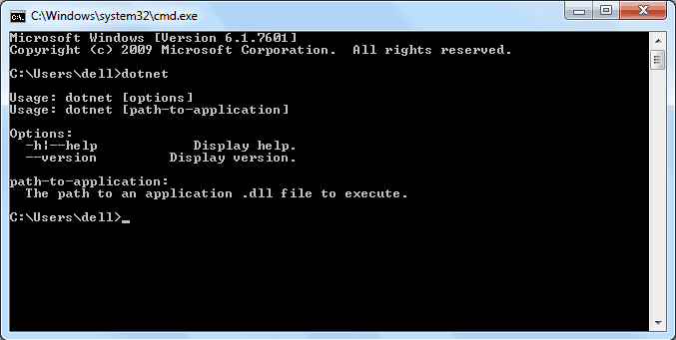

Slide 28
Creating and running the Hello World console application
Execute the following commands on the command line or terminal:
mkdir hwapp
cd hwapp
dotnet new console
The command dotnet new console creates a new Hello World console application in the current folder.
The dotnet new console command creates two files:
Program.cs and
hwapp.csproj

Slide 29
CONTD…
using System;
namespace hwapp
{
public class Program
{
public static void Main(string[] args)
{
Console.WriteLine("Hello World");
}
}
}

Slide 30
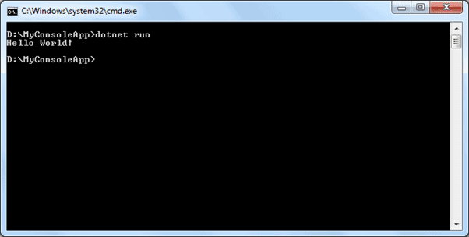
Run Project
Run the Hello World application by executing dotnet run at the command line or terminal.

