Slide 1
Dot NET Framework Introduction
All the capabilities of .NET Framework are exposed via a vast set of managed types.
These types are organized into hierarchical namespaces and packaged into a set of assemblies, which together with the CLR (Common Language Run‐ time) comprise the .NET platform.
Some of the .NET types are used directly by the CLR and are essential for the managed hosting environment.
These types reside in an assembly called mscorlib.dll.

Slide 2
Contd…
The .NET Framework consists of the common language runtime and the .NET Framework class library.
Types include C#’s built-in types, as well as the basic collection classes, types for stream processing, serialization, reflection, threading, and native interoperability (“mscorlib” is an abbreviation for “Multi-language Standard Common Object Runtime Library”).

Slide 3
CONTD…
.NET Framework is a technology that supports building and running the applications.
The .NET Framework is designed to fulfill the following objectives:
Provide a runtime environment that minimizes software deployment and versioning conflicts.
Enable the safe execution of code.
Provide a consistent developer experience across all types of applications in a way that is language- and platform-independent.
Provide a runtime environment that minimizes or eliminates the performance problems of scripted or interpreted environment.

Slide 4
Platform Support
C# is typically used for writing code that runs on Windows platforms.
Xamarin allows cross platform C# development for mobile applications
Microsoft’s ASP.NET Core is a cross-platform lightweight web hosting framework that can run either on the .NET Framework or on .NET Core
It is an open source cross-platform runtime.

Slide 5
C# and the CLR
C# is an object-oriented, component-oriented programming language.
C# depends on a runtime equipped with a host of features such as security, automatic memory management and exception handling.
Common Language Runtime (CLR) is the core of the Microsoft .NET Framework which provides these runtime features (.NET Core and Xamarin frameworks provide similar runtimes).
The CLR is language-neutral, allowing developers to build applications in multiple languages (e.g., C#, F#, Visual Basic .NET, and Managed C++).
C# is one of several managed languages that get compiled into managed code.
Managed code is represented in Intermediate Language or IL.

Slide 6
Common Language Runtime(CLR)
It is the foundation of the .NET framework.
It is the responsibility of the runtime to take care the code execution of the program.
It is a framework layer that resides above the OS and handles the execution of all the .Net applications.
Programs don’t directly communicate with the OS but go through the CLR.
It manages memory, thread execution, code execution, code safety verification, compilation, and other system services.

Slide 7
Cont.…
The CLR converts the IL into the native code of the machine, such as X86 or X64, usually just prior to execution.
This is referred to as Just-In-Time (JIT) compilation.
Ahead-of-time compilation is also available to improve startup time with large assemblies or resource.
The container for managed code is called an assembly or portable executable.
An assembly can be an executable file (.exe) or a library (.dll), and contains not only IL, but type information (metadata).
The presence of metadata allows assemblies to reference types in other assemblies without needing additional files.

Slide 8
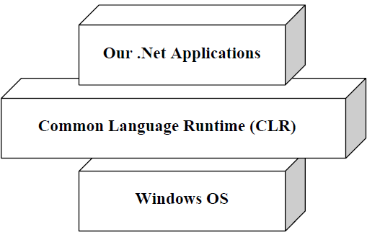
.Net architecture

Slide 9
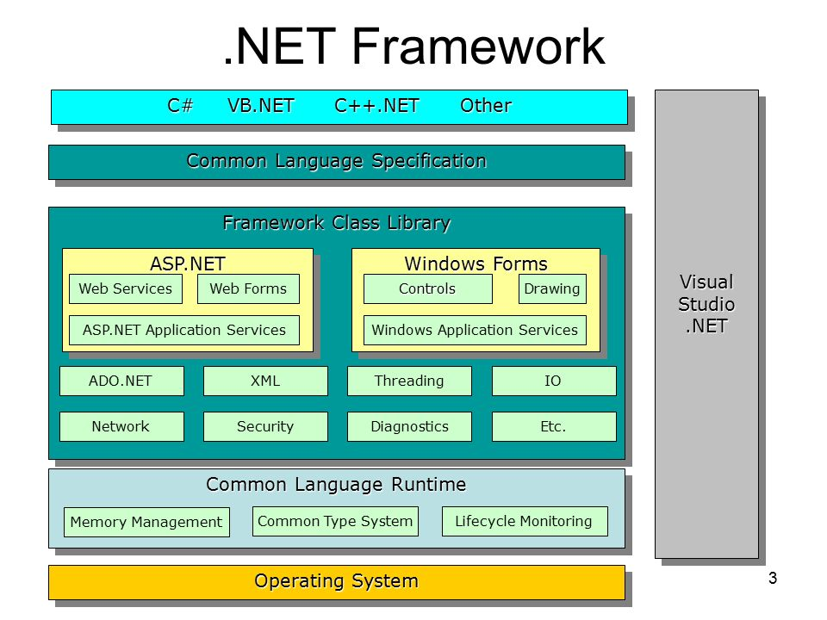

Slide 10
MSIL(Microsoft Intermediate Language) or CIL(Common IL) or IL
All .NET source code is converted to an intermediate code known as MSIL which is interpreted by the CLR.
MSIL is OS and hardware independent code.
MSIL is converted to binary executable code(native code) at the point where the software is installed.

Slide 11

Just-In-Time(JIT) compiler
It compiles the IL code to native executable code(.exe or .dll) that is designed for specific machine and OS.

Slide 12
Framework Class Library
The .NET Framework consists of the CLR plus a vast set of libraries.
The core libraries are sometimes collectively called the Base Class Library (BCL). The entire framework is called the Framework Class Library (FCL).
The .Net Framework class library (FCL) provides the core functionality of .Net Framework architecture.

Slide 13
Cont…
The .Net Framework Class Library (FCL) includes a huge collection of reusable classes, interfaces, and value types that ease and optimize the development process and provide access to system functionality.
This library is categorized into different modules and can access to Windows application, Web development, Network programming ,IO etc.

Slide 14
Common Type System(CTS)
CTS define how types are declared, used and managed in the CLR,
It is also an important part of the runtime's support for cross-language integration.
The common type system performs the following functions:
Establishes a framework that helps enable cross-language integration, type safety, and high-performance code execution.
Provides an object-oriented model that supports the complete implementation of many programming languages.

Slide 15
Cont…
Defines rules that languages must follow, which helps ensure that objects written in different languages can interact with each other.
Provides a library that contains the primitive data types (such as Boolean, Byte, Char, Int32, and UInt64) used in application development.

Slide 16
Common Language Specification
CLS is a set of basic language features that .Net Languages needed to develop Applications and Services.
It is a subset of the CTS. The CLS establishes the minimum set of rules to promote language interoperability.
When there is a situation to communicate Objects written in different .Net Complaint languages.
Those objects must expose the features that are common to all the languages.
It ensures complete interoperability among applications, regardless of the language used to create the application.

Slide 17
Cont…
Microsoft has defined CLS, which are nothing but guidelines, that language should follow so that it can communicate with other .NET languages in a seamless manner.

Slide 18
Compilation
The C# compiler compiles source code, specified as a set of files with the .cs extension, into an assembly.
An assembly is the unit of packaging and deployment in .NET.
An assembly can be either an application or a library.
A normal console or Windows application has a Main method and is an .exe file.
A library is a .dll and is equivalent to an .exe without an entry point.
Its purpose is to be called upon (referenced) by an application or by other libraries.
The name of the C# compiler is csc.exe.

