Slide 1
WBS

Slide 2
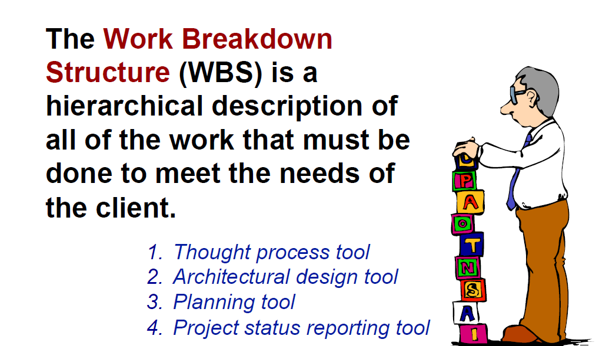
Work Breakdown Structure

Slide 3
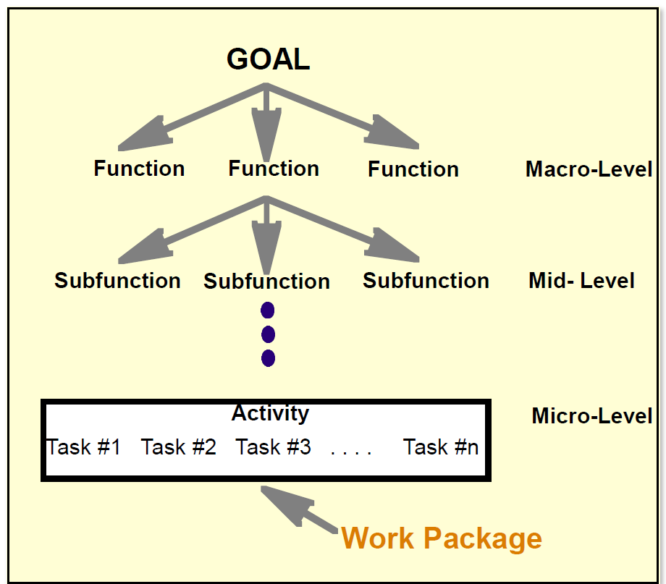
Hierarchical Visualization of the WBS

Slide 4
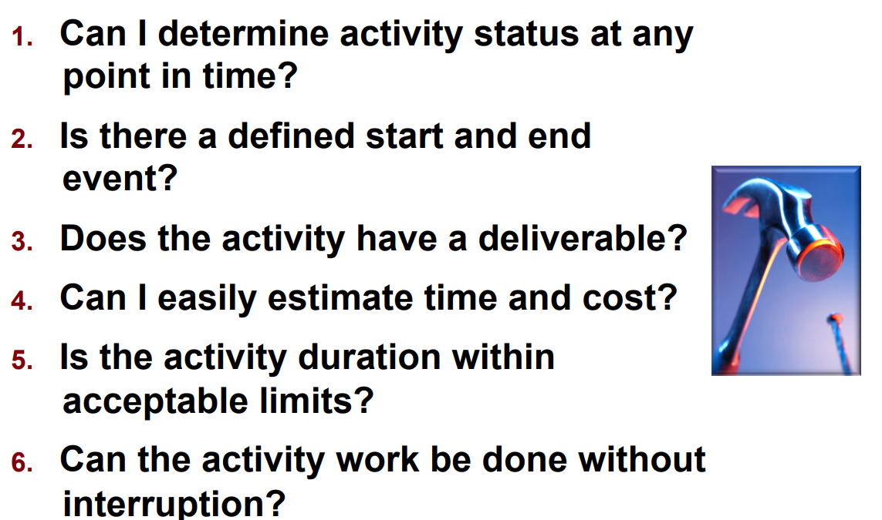
WBS Completion Criteria

Slide 5
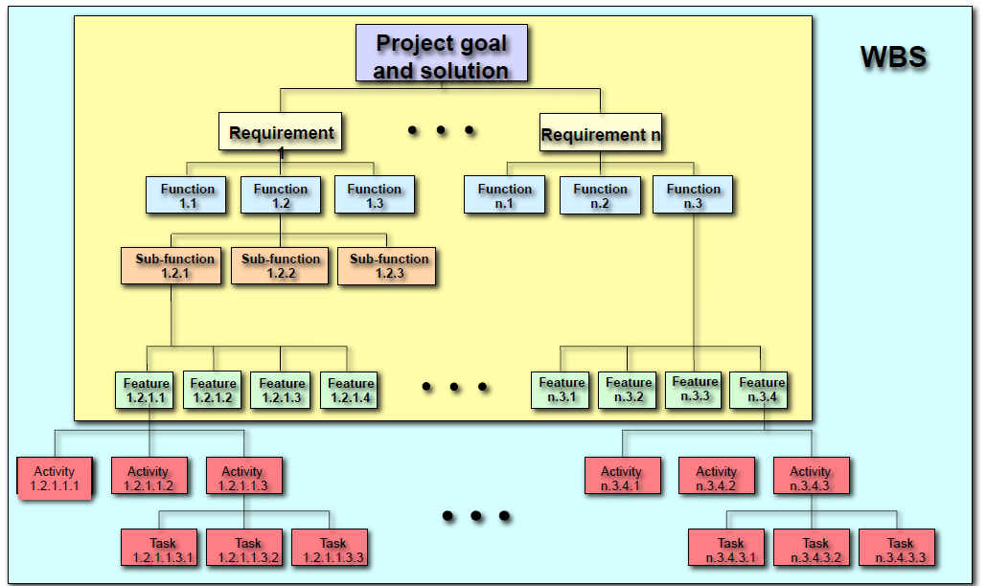
WBS Reflects Goals & Requirements

Slide 6
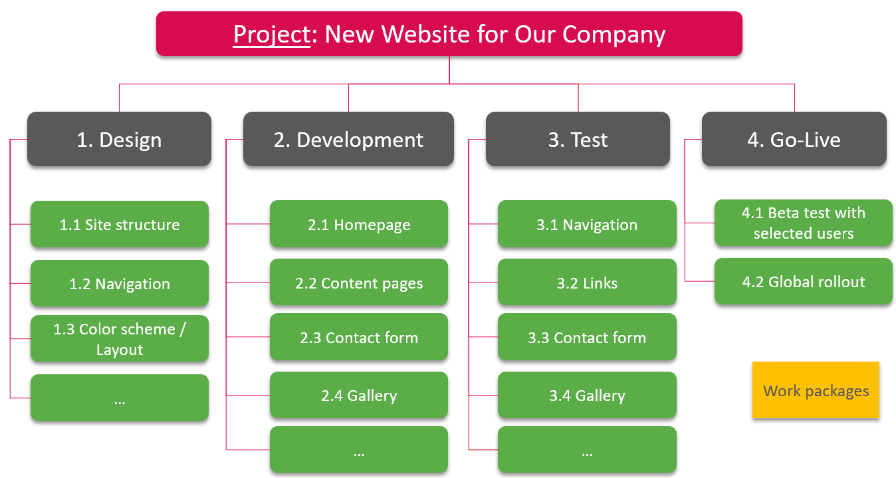
Phase-Oriented Work Breakdown Structure

Slide 7
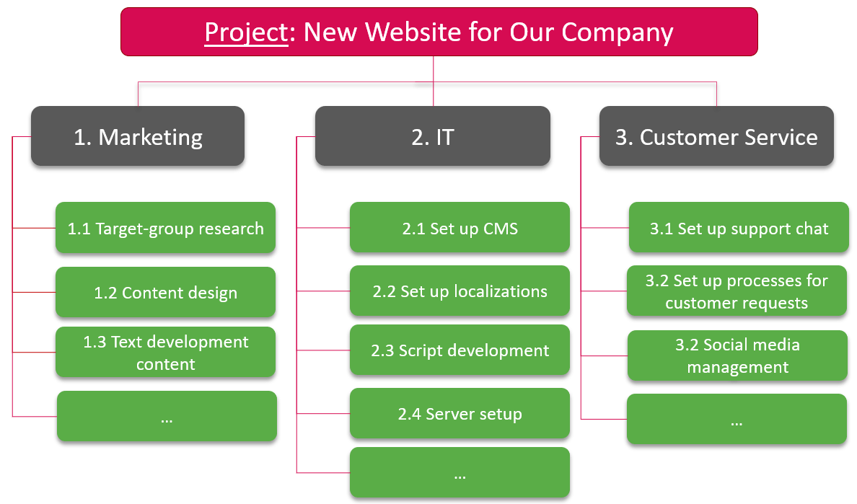
Function-Oriented Work Breakdown Structure

Slide 8
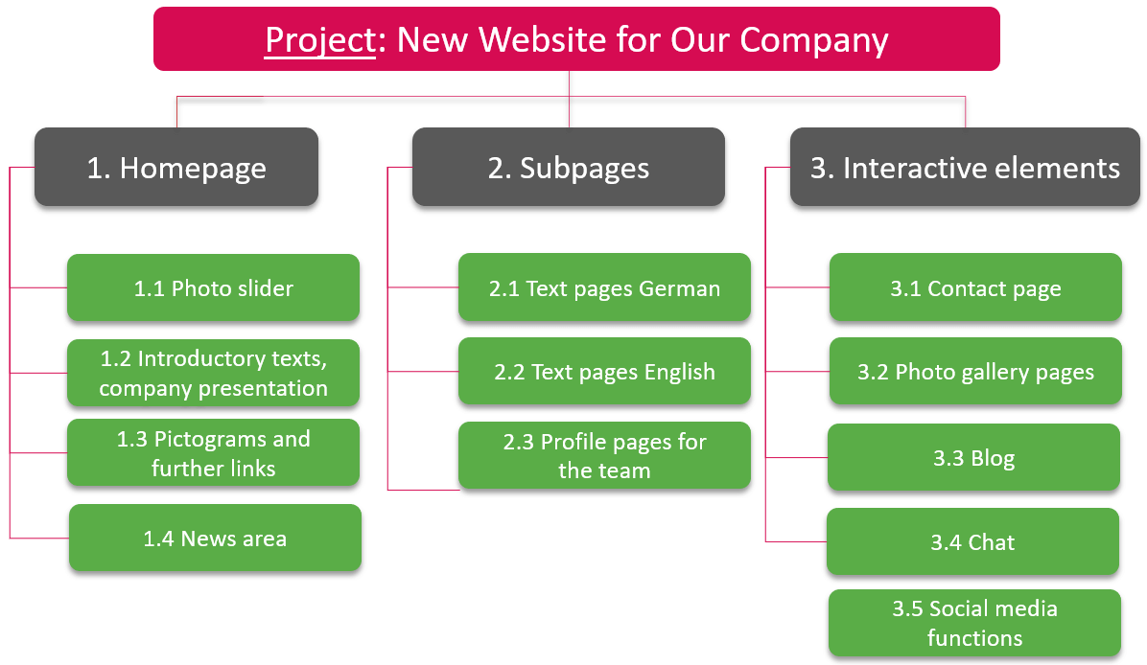
Object-Oriented Work Breakdown Structure

Slide 9
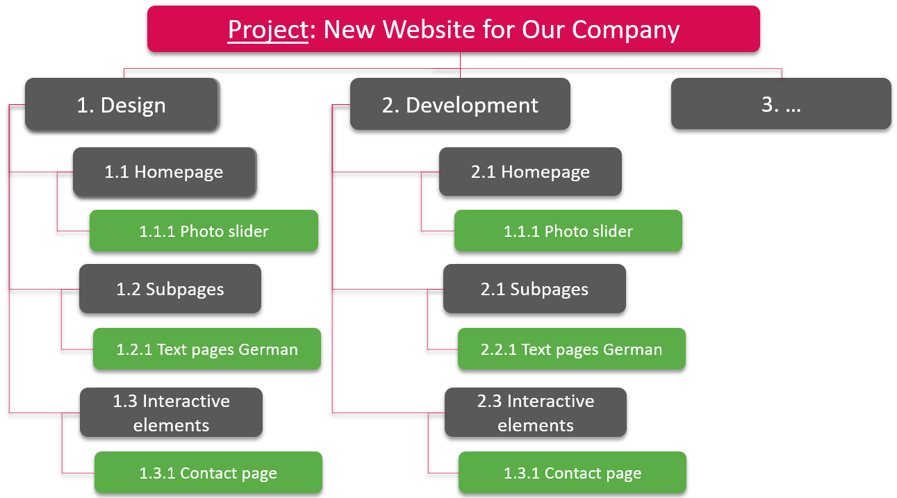
Structuring Combinations in the Work Breakdown Structure
https://www.theprojectgroup.com/blog/en/work-breakdown-structure/

Slide 10
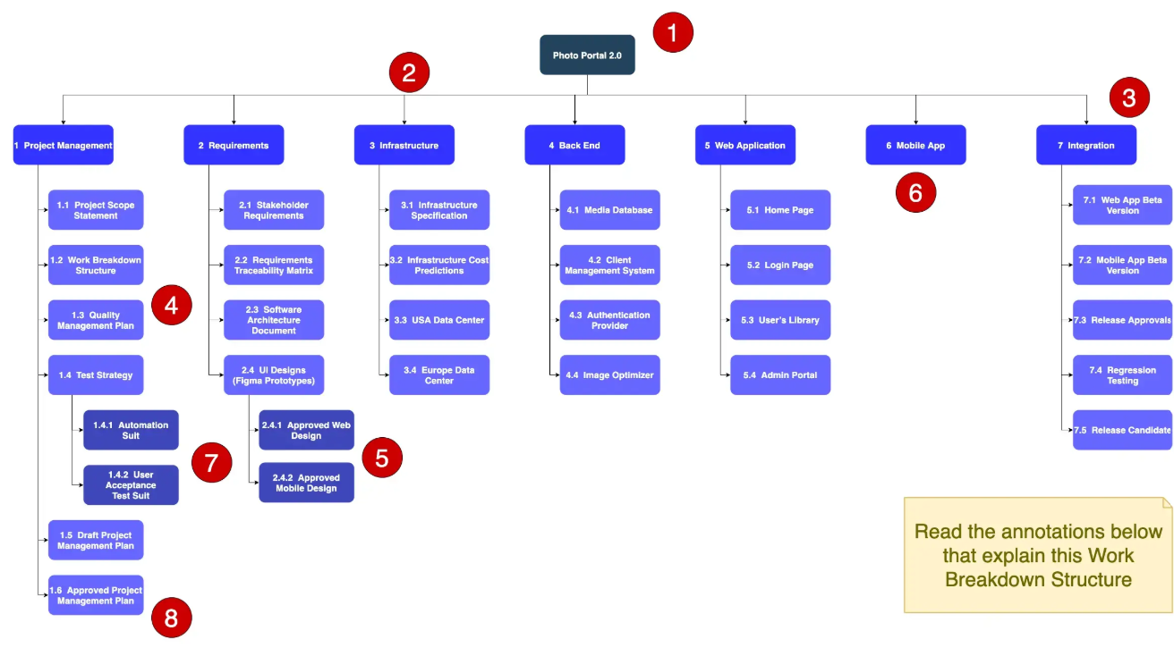

Slide 11
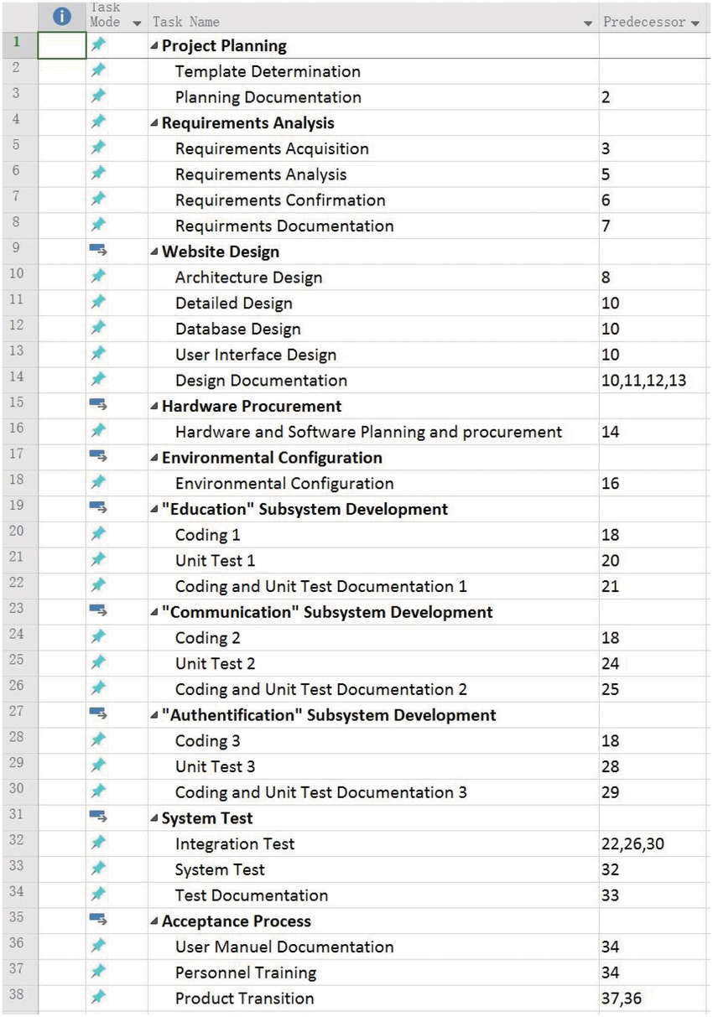

Slide 12
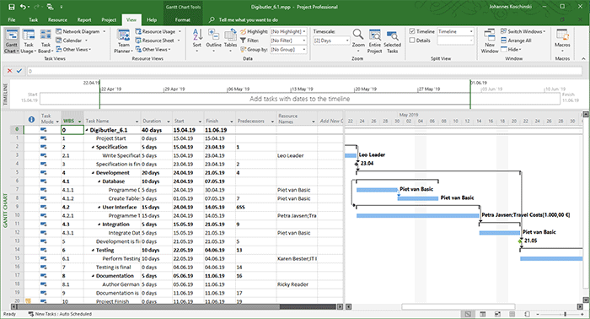
Bar chart structured according to phases with WBS code (column “WBS”) in MS Project

Slide 13
