Slide 1

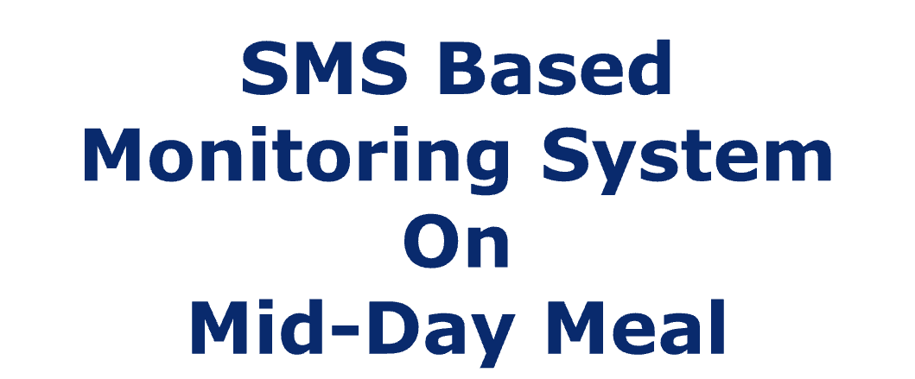

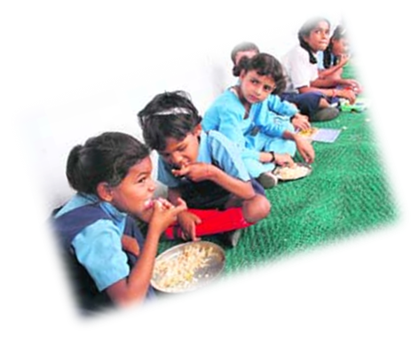
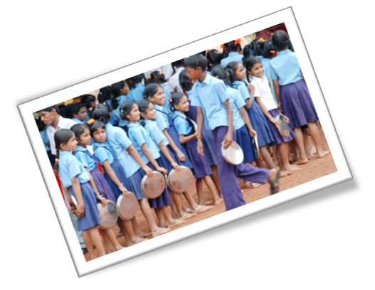
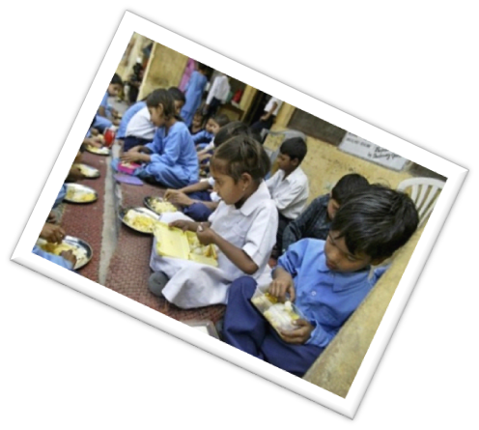
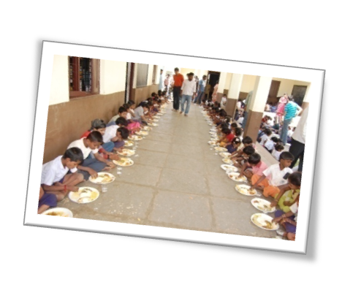

An Initiative of
Department of School Education
Govt. of West Bengal

Slide 2

Why Daily Monitoring System
Rule 9 is about food security allowance to be paid by the State Government, if MDM is not provided in any school for three consecutive days or five days in a month. The State Government shall take action to fix responsibility on the person or agency in accordance with the procedure laid down.

Slide 3
Daily Monitoring System
Web Portal
Short Message Service (SMS)
Mobile Application

Slide 4

Proposed System
User Management
Master Data Management.
Allow the number of Schools which has less than 3 contact details of teachers. (if required)
Uploading of School Contact and Enrolment Information and validation thereof.
Coverage Entry.

Slide 5
Block Level

Slide 6
Block Level
User creation using registered mobile number
Update School Information
Allow Contact Information(for less than three teachers) [if required]
Update School Contact and Enrolment Information
Profile information update (if required)

Slide 7
Contact and Enrolment
The name of the in-charge / headmaster / headmistress, and name of two other teachers of the concerned school with phone number.
Class and category wise total number of students.

Slide 8
Coverage Entry
  Total number of MDM takers as per pre-defined format from registered phone numbers through SMS, web portal or through Mobile Apps.
Nil for number of MDM takers if MDM is not running on that day with a proper cause which has to be selected from the list as provided in the portal.

Slide 9
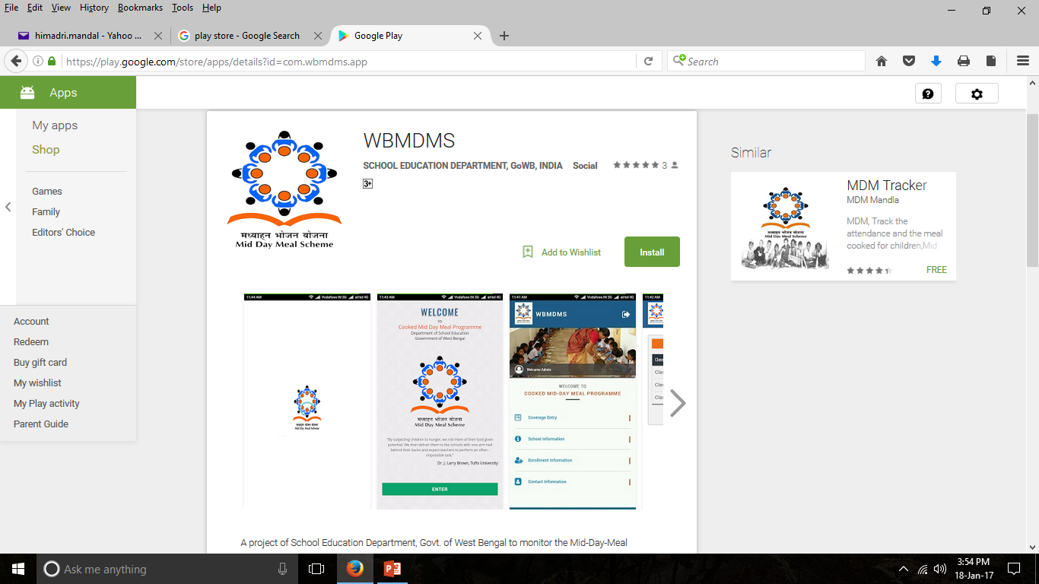

Slide 10
SMS Code
Code | Description | Code | Description
RC | Pre-primary | PC | Class I to IV
VC | Class V | UC | Class VI to VIII
TC | Today Coverage | NM | MDM not running
RN | Reason

Slide 11
REASON FOR MDM NOT RUNNING
Reason Code | Reason Name
5 | HOLIDAY IN SCHOOL
6 | OTHERS

Slide 12
S.M.S PROCESS
SMS TO 15544
(TOLL FREE NO)

Slide 13
FOR F.P SCHOOL AND S.S.K SCHOOL (CLASS:- PP + I TO IV)
WBMDMS TC RC20 PC50

Slide 14

CLASS- V TO VIII
WBMDMS TC VC10 UC30

Slide 15

CLASS:- PP + I TO V
WBMDMS TC RC50 PC20 VC10

Slide 16

CLASS- VI TO VIII
WBMDMS TC UC20

Slide 17
FOR DHANPOTA FDU MADRASAH
WBMDMS TC PC20 VC10 UC20

Slide 18
IF NOT RUNNING MDM FOR HOLIDAY IN SCHOOL
WBMDMS NM RN5

Slide 19
IF NOT RUNNING MDM IN SCHOOL FOR OTHERS REASON
WBMDMS NM RN6

Slide 20

Only register mobile numbers (School contact) & update can be made from the respective mobile number from where message is sent within 30 min.
WBMDMS<space>CU<space>PCXX
WBMDMS CU RC10 PC20
WBMDMS<space>RU<space>RNX
WBMDMS RU RN1

Slide 21
DETAILS OF MDM STAFF
BDO’S EMAIL ID:- bdoharoablock@gmail.com
MDM CELL EMAIL :- mdm.bdoharoa@gmail.com
1) MR. MANIK SARDAR, JT. BDO & NODAL OFFICER:- 9477057134
2) MR. AVIJIT DEBNATH, DEO(MDM) :-9153818852
3) ASHOK JANA, ADEO(MDM) :- 9647385942
4) MR. LAYSEL HAQUE MISTRY, ASSISTANT. A/C :- 9733731555

Slide 22
Thank You

