Slide 1
Agenda
Recap and Q&A
Streamlit Milestones
Hello World
Forms
File Handlers
Visualization
Login

Slide 2
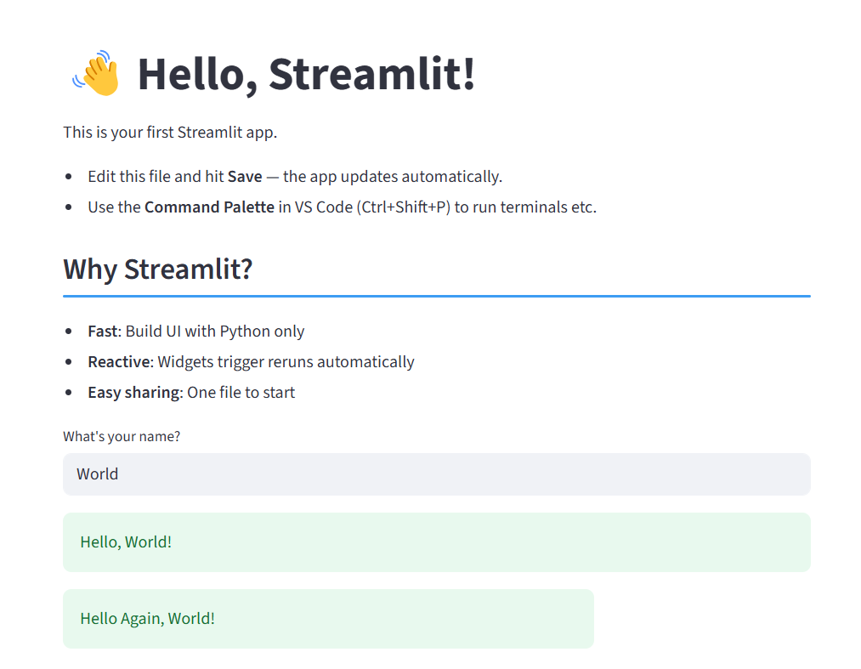
Milestone 1
What will we learn?
Page Config
Title
Subheader
Text_input
success

Slide 3
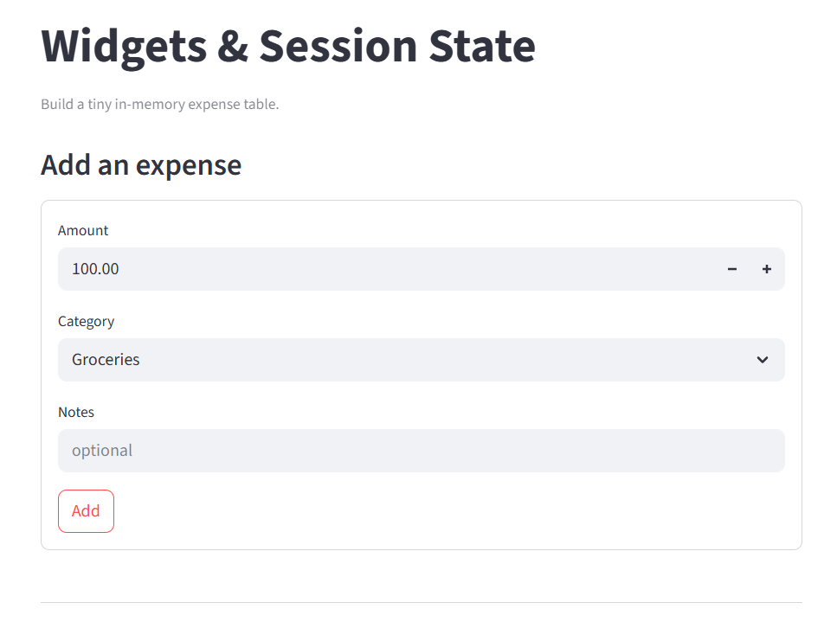
Milestone 2
What will we learn?
Session state
Forms
Selectbox
number_input
button

Slide 4
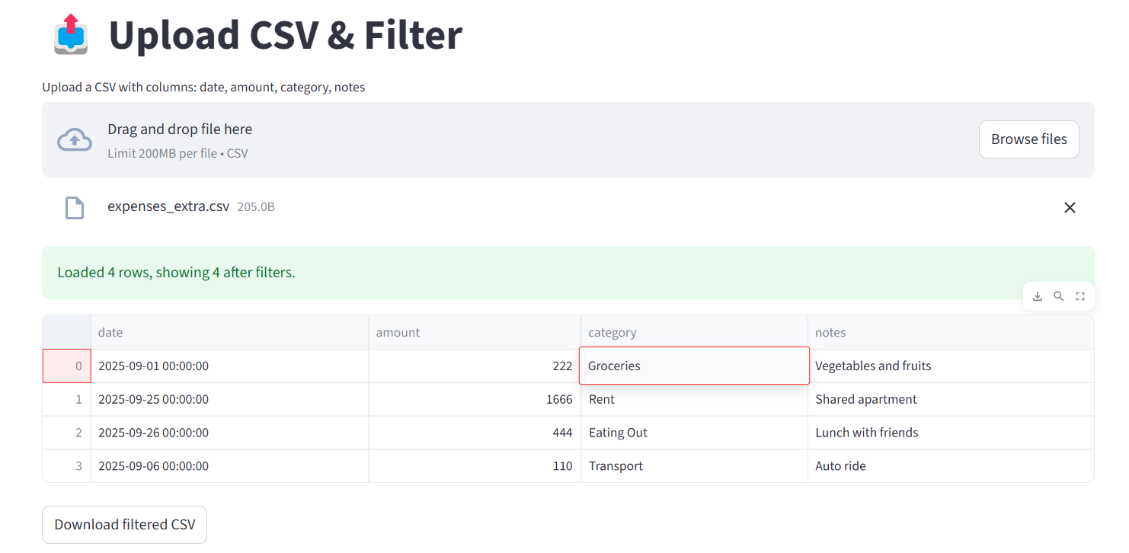
Milestone 3
What will we learn?
File upload
File download
Filtering Data

Slide 5
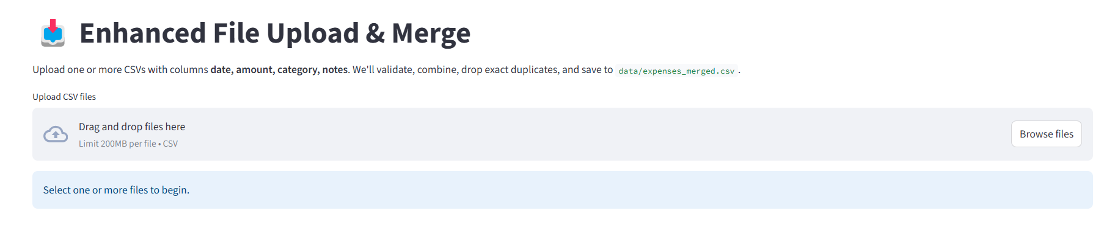
Milestone 4 – Contd from milestone 3
What will we learn?
Merge dataframes

Slide 6
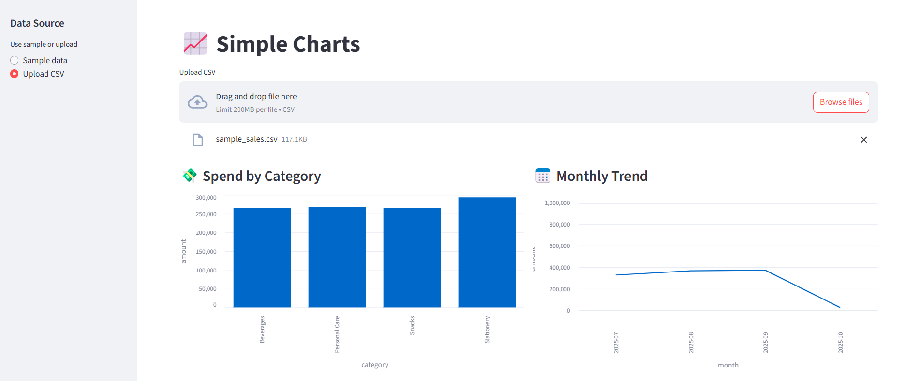
Milestone 5
What will we learn?
bar_chart
line_chart

Slide 7
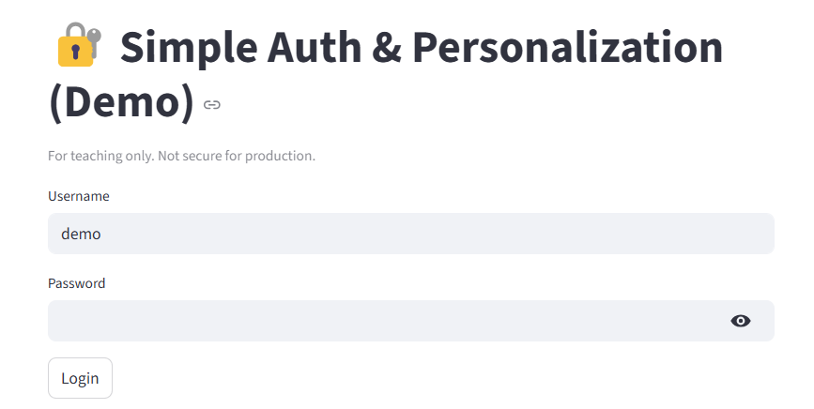
Milestone 6
What will we learn?
Basic login
Rerun
Stop
error

