Slide 1
TELECOM CUSTOMER
CHURN PREDICTION
Exploratory Data Analysis | Machine Learning | Interactive Prediction
PROJECT PRESENTATION

Slide 2
Project Overview
Business problem and project goals
• Business problem: customer churn can reduce recurring revenue and increase acquisition costs.
• Goal: explore customer behavior and predict which customers may leave the telecom service.
• Workflow: data audit and cleaning, EDA, feature engineering, model training, tuning and evaluation.
• Deliverable: an interactive prediction prototype to support customer-retention analysis.
Telecom Customer Churn Prediction | 2

Slide 3
Dataset & Data Quality
Data quality checks before model training
• Raw dataset inspected: 1,300 rows and 23 columns.
• Audit identified duplicate records, inconsistent category labels, placeholder values, mixed numeric formats and missing data.
• Cleaning standardized text and churn labels, converted numeric fields and checked invalid values.
• Duplicate rows were removed; the original raw dataset was preserved.
• Cleaned dataset: telecom_churn_clean.csv.
• Modeling dataset: 1,238 rows after cleaning and target-availability checks.
Telecom Customer Churn Prediction | 3

Slide 4
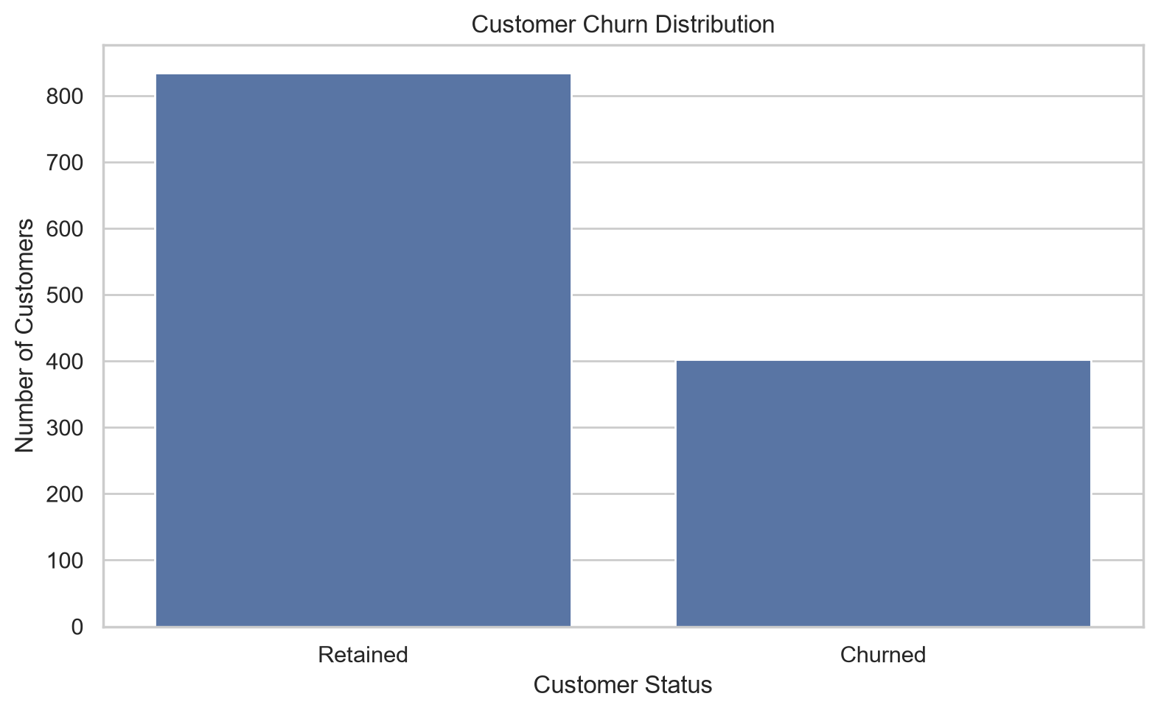
EDA: Churn Distribution
KEY INSIGHT
403 of 1,238 customers are labeled churned (32.6%), making churn an important business concern.
Telecom Customer Churn Prediction | 4

Slide 5
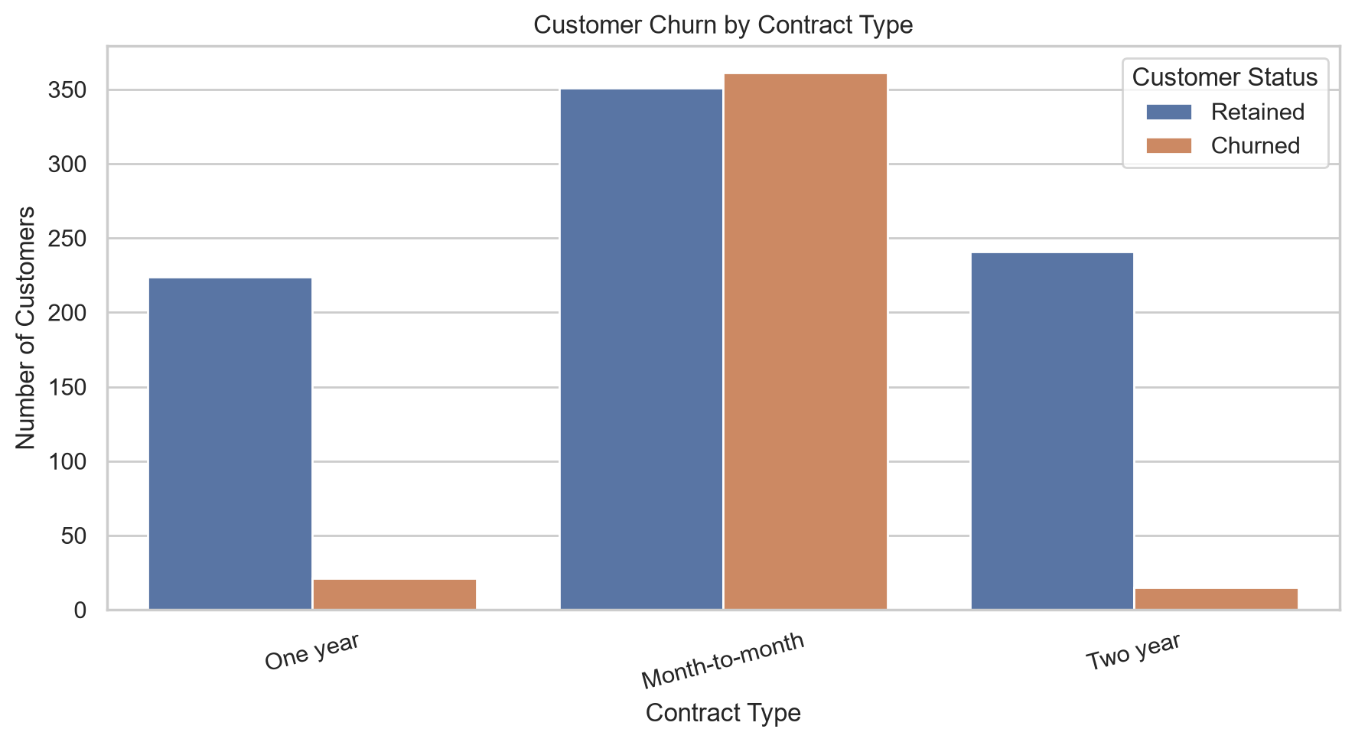
EDA: Churn by Contract
KEY INSIGHT
Month-to-month customers have the highest observed churn rate (50.7%) among contract types.
Telecom Customer Churn Prediction | 5

Slide 6
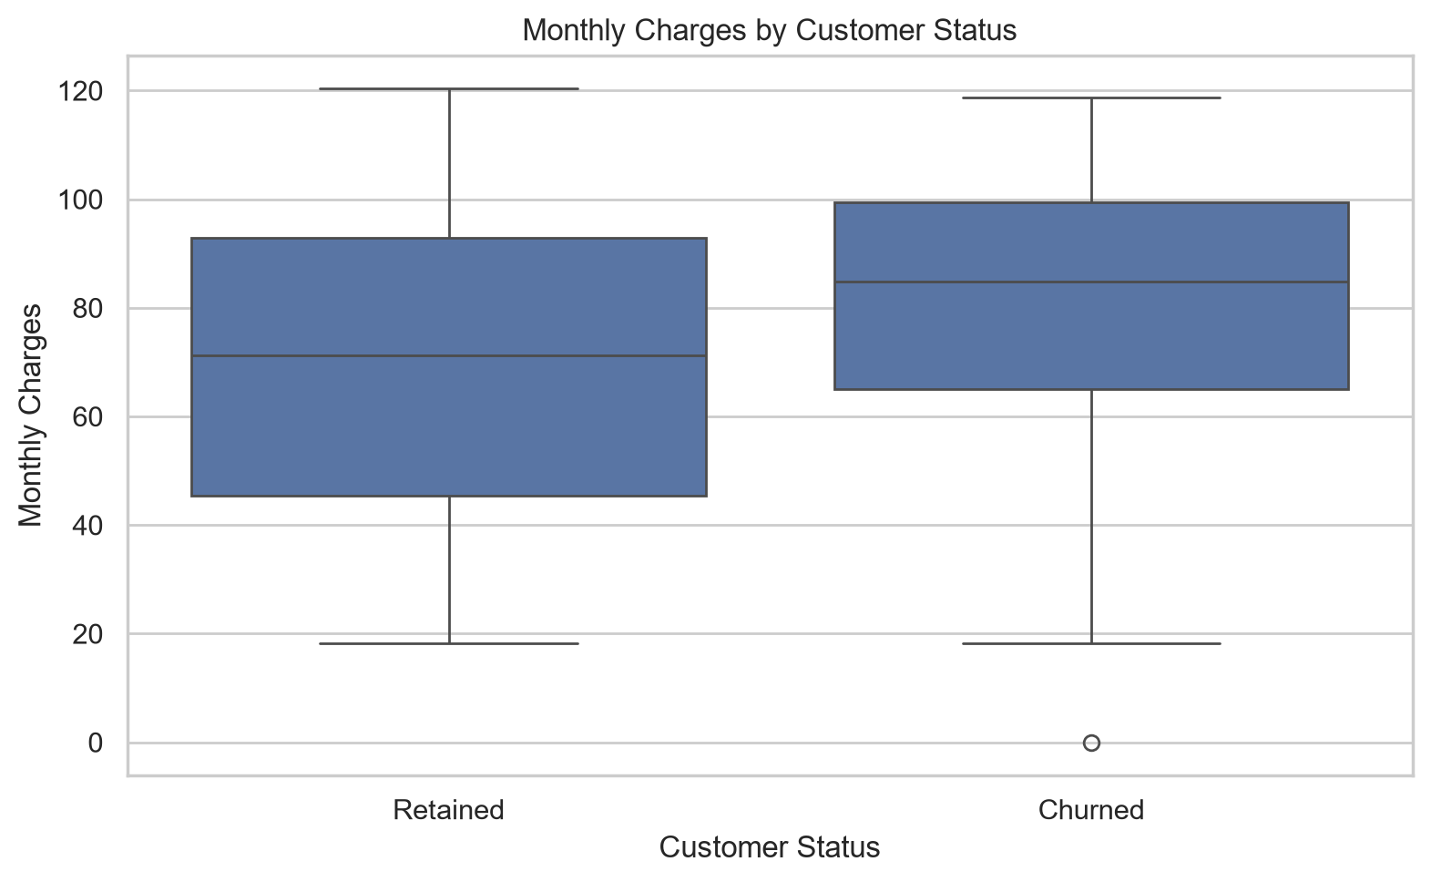
EDA: Monthly Charges
KEY INSIGHT
Median monthly charges are higher for churned customers (84.80) than retained customers (71.27).
Telecom Customer Churn Prediction | 6

Slide 7
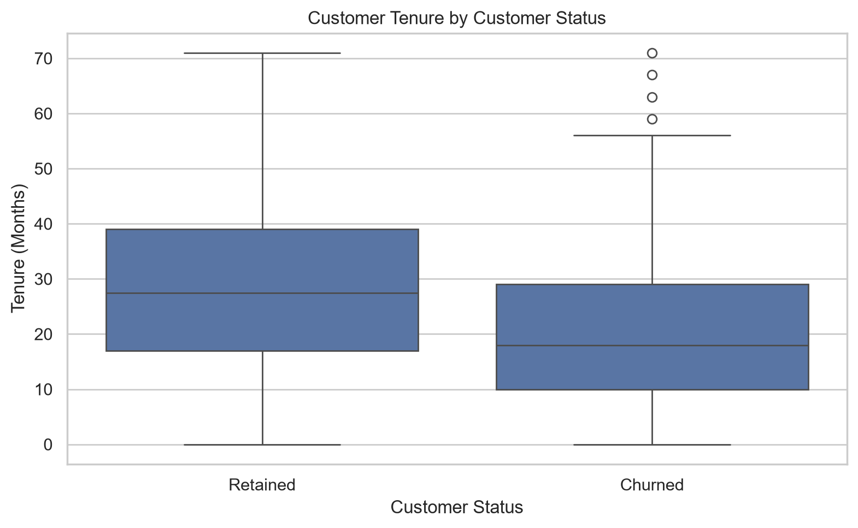
EDA: Tenure and Churn
KEY INSIGHT
Churned customers have shorter median tenure (18 months) than retained customers (27.5 months).
Telecom Customer Churn Prediction | 7

Slide 8
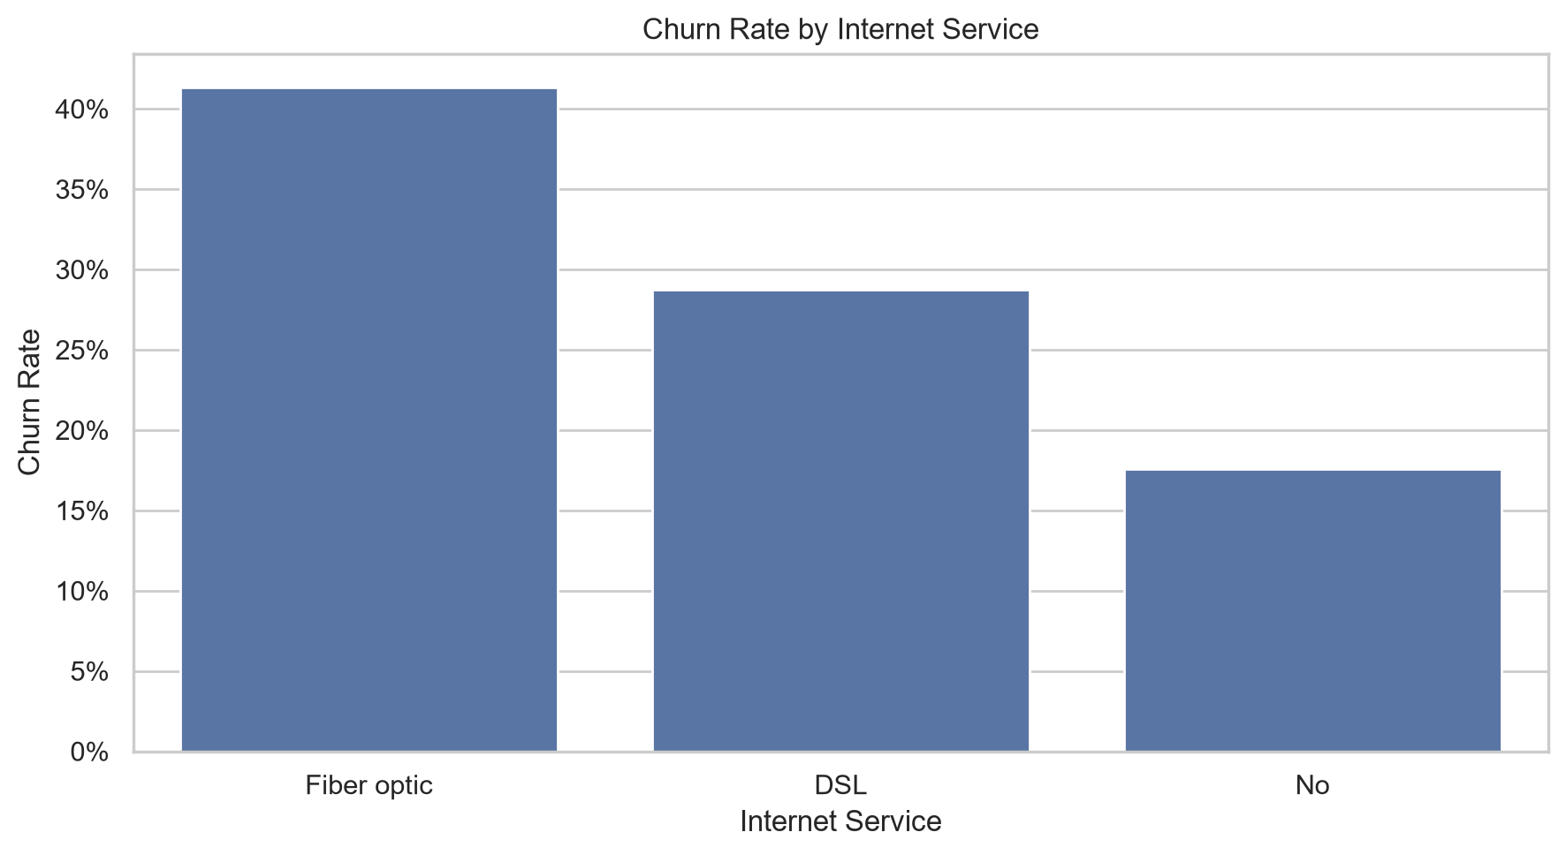
EDA: Churn by Internet Service
KEY INSIGHT
Fiber optic customers have the highest observed churn rate (41.4%) among internet-service groups.
Telecom Customer Churn Prediction | 8

Slide 9
Feature Engineering & Preprocessing
• Engineered features include customer_risk_signals and calculated_monthly_charge.
• Numeric preprocessing: median imputation and standard scaling.
• Categorical preprocessing: most-frequent imputation and one-hot encoding.
• Preprocessing steps are contained within model pipelines to reduce data leakage.
• The train/test split uses stratification to preserve target-class proportions.
Telecom Customer Churn Prediction | 9

Slide 10
Model Development & Evaluation
• Baseline classifiers: Logistic Regression, Decision Tree, Random Forest and XGBoost.
• Random Forest and XGBoost were tuned using cross-validation.
• Evaluation metrics include accuracy, precision, recall, F1 score and ROC-AUC.
• Confusion matrices were generated for both tuned models.
• Recall and F1 are useful churn metrics because missing likely churners may be costly.
Telecom Customer Churn Prediction | 10

Slide 11
Tuned Random Forest: Test Results
Selected for the highest test F1 score among the compared models
73.39%
57.89%
67.90%
62.50%
Accuracy
Precision
Recall
F1 Score
• ROC-AUC: 79.27%.
• Tuned XGBoost achieved 74.60% accuracy, but its F1 score was lower at 55.94%.
• These results depend on the dataset and test split; further validation is recommended before real-world use.
Telecom Customer Churn Prediction | 11

Slide 12
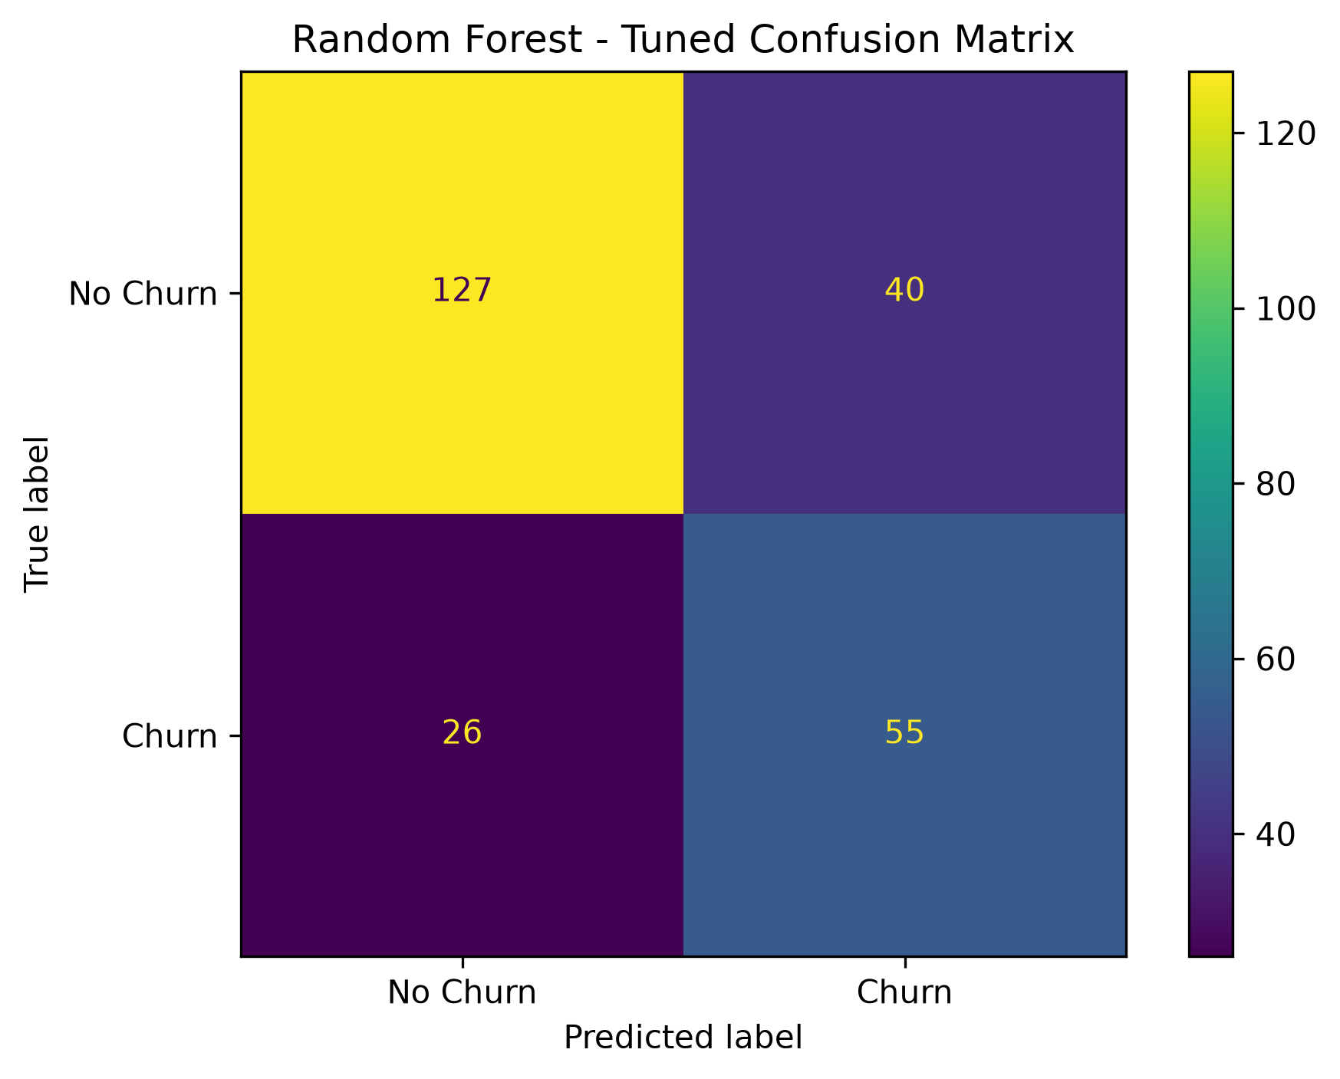
Tuned Random Forest: Confusion Matrix
Selected model. Review false negatives and false positives when planning retention actions.
Telecom Customer Churn Prediction | 12

Slide 13
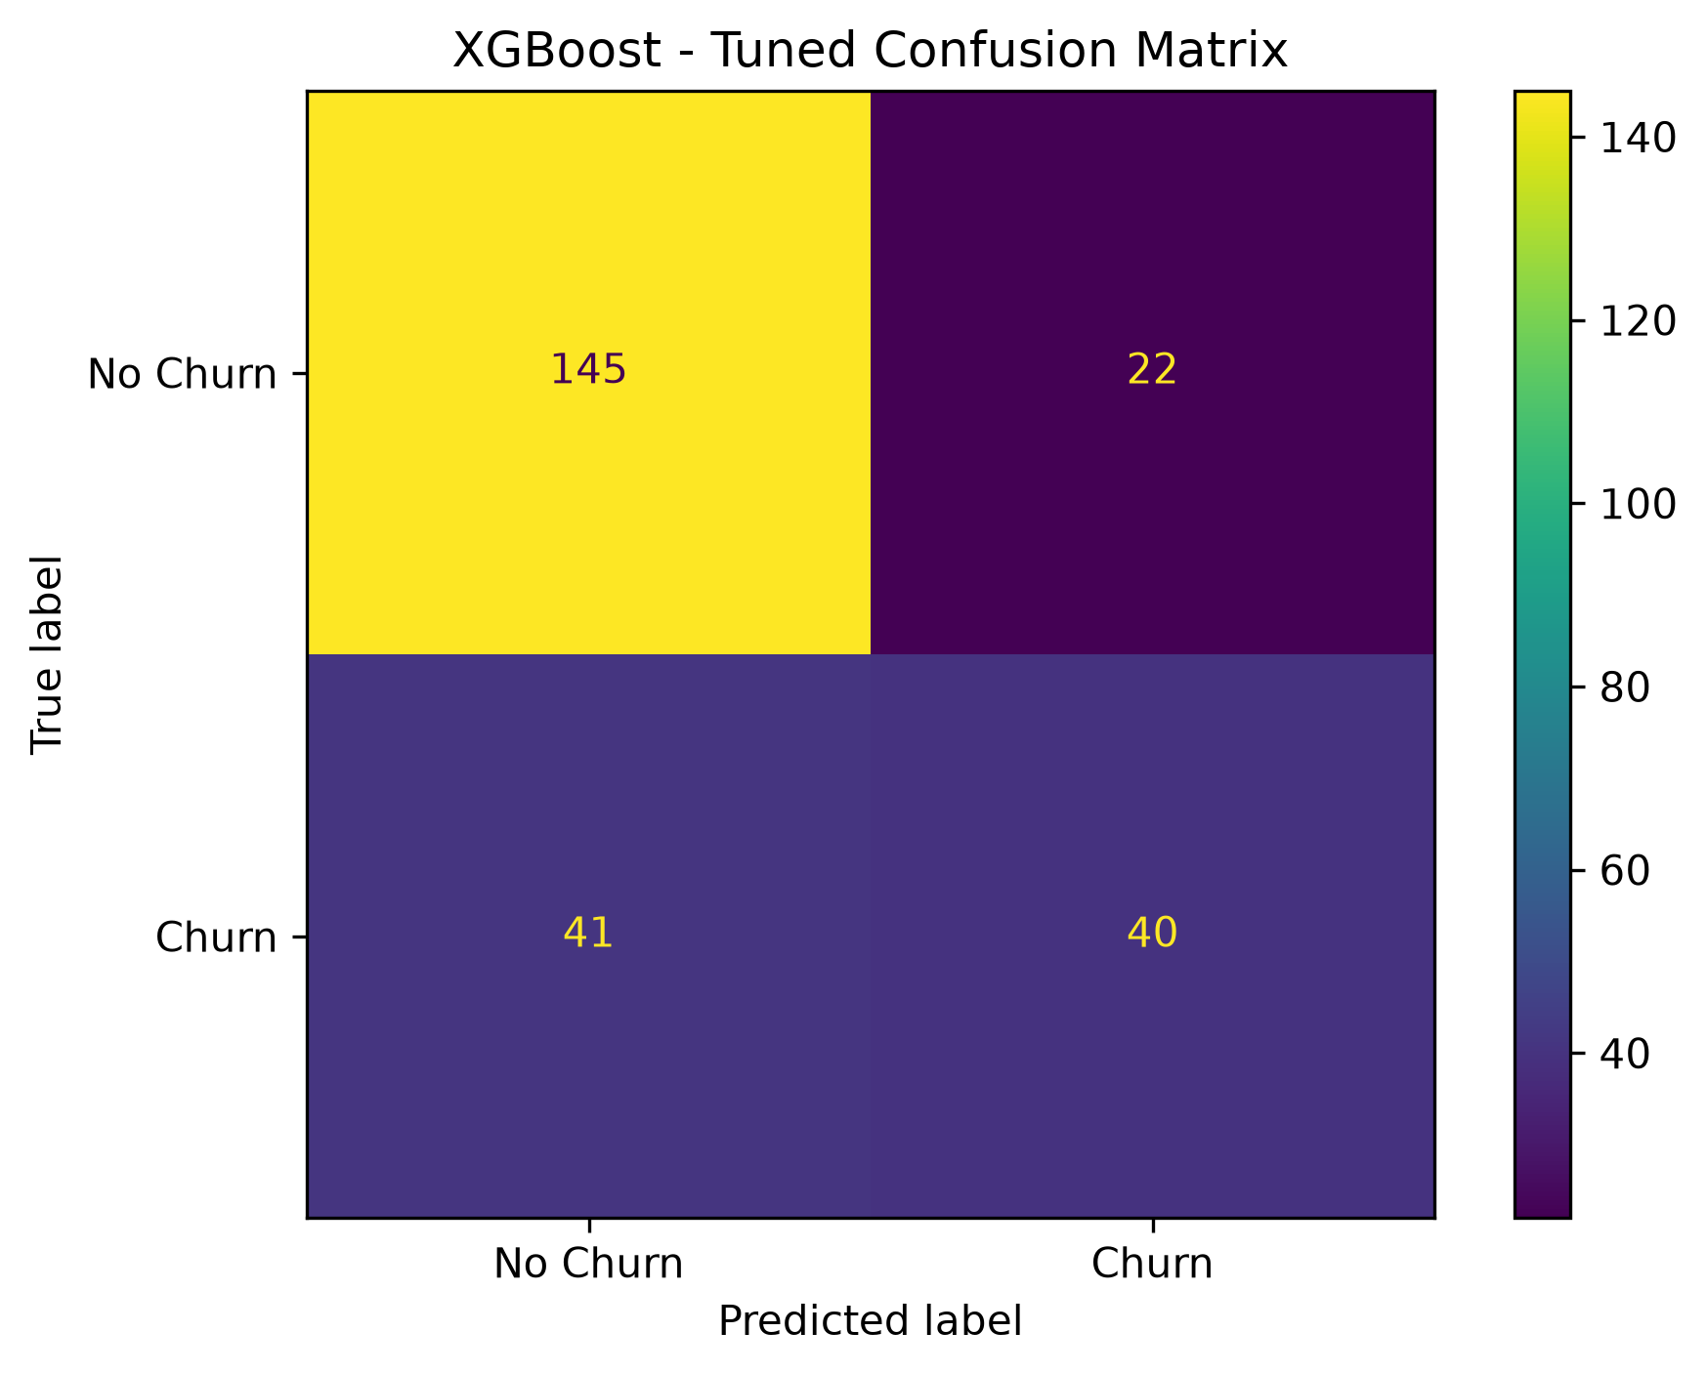
Tuned XGBoost: Confusion Matrix
Comparison model. Its test F1 score is lower than tuned Random Forest in this experiment.
Telecom Customer Churn Prediction | 13

Slide 14
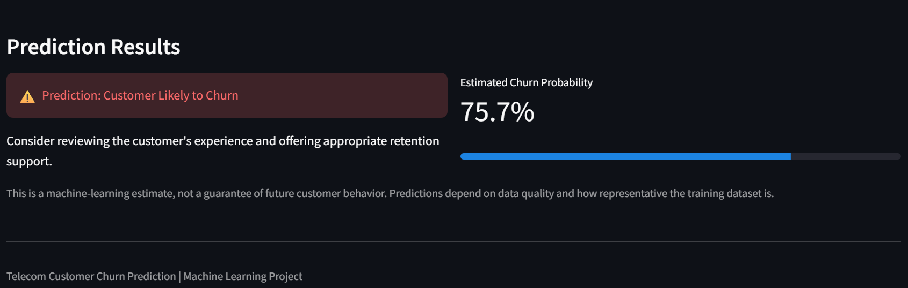
Interactive Prediction Dashboard
• Built with Streamlit to accept customer details through an interactive form.
• The saved machine-learning pipeline generates a churn prediction and probability estimate.
• Screenshot file: reports/screenshots/prediction_result.png.
• A prediction is a model estimate, not a guarantee of future behavior.
Telecom Customer Churn Prediction | 14

Slide 15
Conclusion & Next Steps
• Month-to-month contracts, higher monthly charges and shorter tenure are associated with higher observed churn in this dataset.
• Tuned Random Forest achieved the highest test F1 score among the evaluated models.
• The Streamlit application demonstrates how a trained model can support customer-retention workflows.
• Next steps: validate on newer data, monitor performance, review fairness and assess probability calibration before deployment.
Telecom Customer Churn Prediction | 15

Slide 16
Project Deliverables
• telecom_churn_raw.csv — original dataset.
• telecom_churn_clean.csv — cleaned dataset.
• reports/ — audit, missing-value, model comparison and recommendation outputs.
• reports/plots/ — five EDA charts and two tuned-model confusion matrices.
• models/ — saved baseline and tuned model pipelines.
• app.py — interactive Streamlit prediction dashboard.
• README.md and requirements.txt — project documentation and dependencies.
Telecom Customer Churn Prediction | 16

