Slide 1

PRMPT
Prompt optimization layer for AI coding agents.
Fewer tokens. Same results. Proven on real bug-fix tasks.
commandcode.ai · mcp · codex · claude code

Slide 2
The Problem
Every turn in an AI coding session re-sends the full conversation history to the model.
Context replay is the dominant cost driver — not the task itself.
The larger the repo, the worse it gets. Plan mode? 400K tokens per run.
Developers don't see it. The bill arrives anyway.
Codex raw context on atlas-p3
With PRMPT MCP (same task, passes tests)
303,293 tokens
105,463 tokens

Slide 3
How PRMPT Works
1
2
3
Index
Optimize
Serve
Tree-sitter parses the repo locally. BGE embeddings + call graph
store file relationships. Runs once per repo.
Vague prompt goes in. The pipeline adds probable file locations,
intent clarification, and task structure. No raw prompt hits the LLM.
The enriched prompt + MCP server give the coding agent targeted
context on demand. Token waste eliminated at the source.
→
→
All processing is local. No repo data leaves your machine.

Slide 4
What It's Built On
Electron + React
Desktop app. Overlay triggers on @prompt hook or Ctrl+5. Always on top, never in the way.
Python FastAPI
Prompt optimizer pipeline and code intelligence service. Six-stage: decision, skill selector, context, optimizer, clarifier, planner.
Rust N-API
Native platform bridge. Hooks into keystrokes and system tray without Electron overhead.
Tree-sitter + BGE
Local repo parsing and ONNX vector embeddings. Call-graph expansion via igraph + PageRank. No cloud dependency.
MCP Server (stdio)
JSON-RPC protocol over stdio. Works with Claude Code, Codex CLI, Command Code, and any MCP-compatible agent.

Slide 5
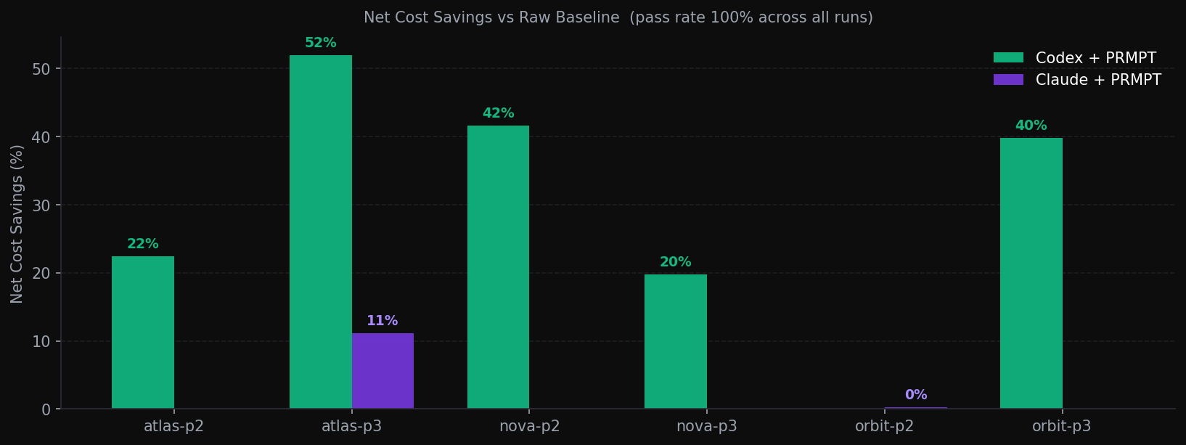
Benchmark Results
60
100%
52%
83%
total runs
pass rate (all variants)
peak Codex savings
Codex variants = win

Slide 6
Why Codex Saves / Why Claude Doesn't
Codex CLI
Claude Code
Codex has no server-side prompt cache. Every token in the context window is billed at full rate.
PRMPT cuts that context window by sending only the relevant files rather than the agent doing its own broad Grep/Glob sweeps.
Result: 8–52% net savings across 6 tasks. The savings scale with repo size.
Claude's prompt cache is aggressive. Repeated context comes back at ~10% of full input cost.
PRMPT's optimization spend ($0.049/task amortized) often exceeds the cache discount, making net savings marginal or negative.
Claude wins when the optimization cost drops (live pipeline) or when cache misses dominate (first run, new repo).

Slide 7
The ROI
Conservative estimate. Anchored to benchmark data.
Metric
Conservative
At 40% savings (atlas-p3 level)
Monthly Codex spend
$400
$400
PRMPT net savings (25% avg)
$100
$100
PRMPT cost estimate
$20/mo
$20/mo
Net benefit to developer
$80/mo
$80/mo
The bigger the repo and the less efficient the model, the higher the savings. Codex is the clearest case today.

Slide 8
What We're Building Next
Live Stateful MCP Sessions
Replace pre-computed prompts with a live agentic loop. The MCP server tracks what the agent already tried and serves different context on retry — ending deterministic dead-loops.
Command Code Integration
Command Code (v0.31.2, installed) supports MCP via .mcp.json. Adapter built. DeepSeek v4 Pro model — 4x credit efficiency. Benchmark running now.
6-User Real-World Test
Three confirmed users, three being selected. Each runs PRMPT on their own live repo for one day. We measure cost, pass rate, and turns — with their consent and a food incentive.

Slide 9
The Ask
We have the measurement. We have the pipeline. We have real savings on Codex.
What we need next is the user signal to confirm the model holds outside a controlled environment.
6 real users. 1 day. Their own repos.
Measure cost delta, pass rate, turns. No fluff.
If it holds: pricing, GTM, the whole thing.
github.com/prmpt

