Slide 1

Updated Petenspiel
The Next Evolution in Virtual Perlenspiel Based Pet Simulators
Diatomic

Slide 2
Audience
Everyone Young & Old
Those craving a relaxed gaming experience

Slide 3
Experience Goals
Emotional Connection to Your Pet
Curiosity
Excitement
Pride & Accomplishment

Slide 4

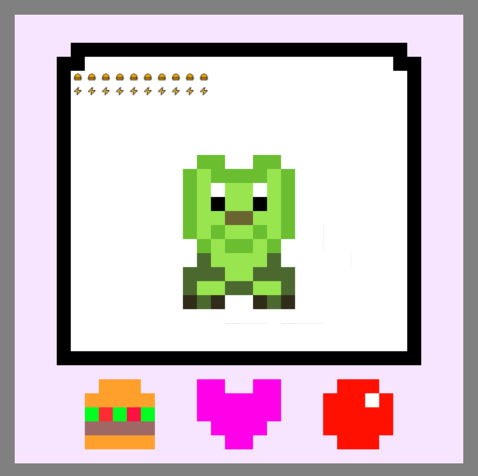
Playtesting
Not much of a game
Added stages
Not enough feedback
Audio
Ah Ha moment

Slide 5
Analytics
Length of play session: ~90 seconds
exhausts all the content
Increase playtime

Slide 6
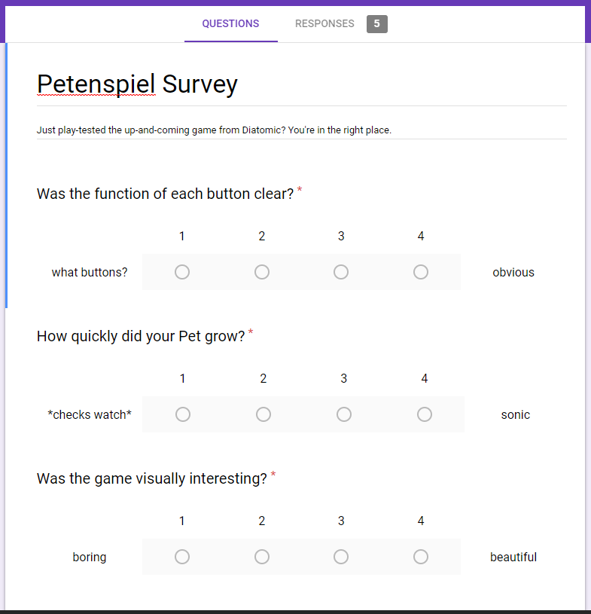
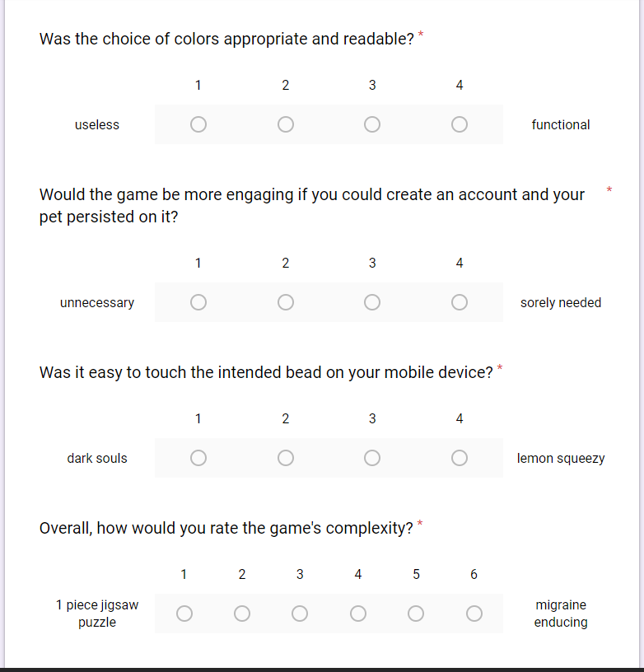
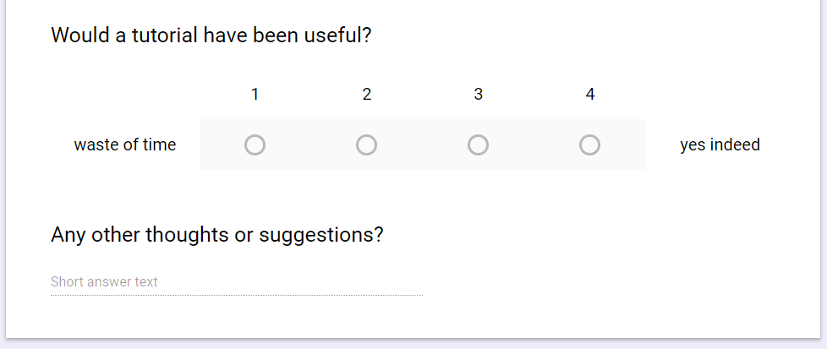
Survey
Make button interactions unique
More content

Slide 7
Critique
More Content
More Content
Less Garbage

Slide 8
Features
Linear game with 4 Stages
Pet Stats (Stage Dependent)
Buttons (Stage Dependent)
Figure out how stats are related to pass the level

Slide 9
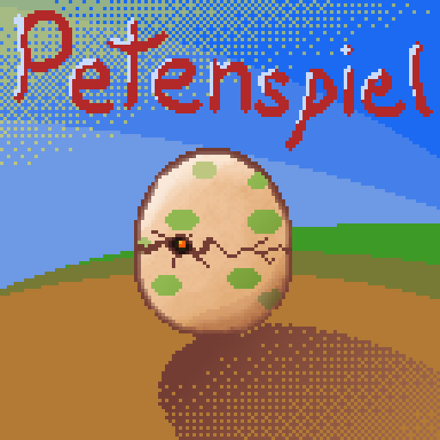
The Experience
Hatch the Egg!
Grow the Snake!
Feed the Dragon!
Uh-Oh…

