Slide 1
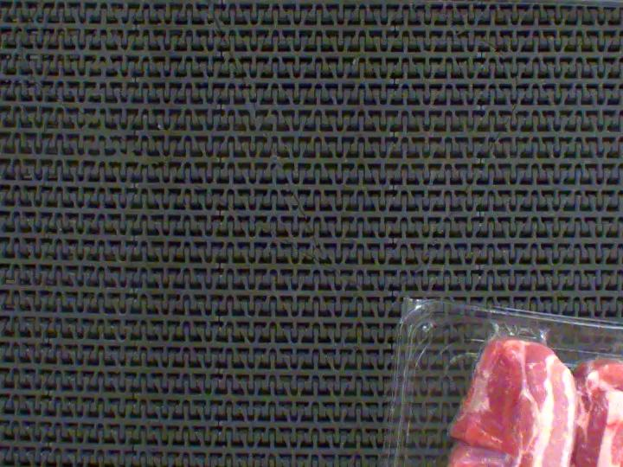
Pork rasher packaging
defect detection
MMA3001
Student ID 33318719
10 October 2026
Automated inspection of visible defects
1
Notes:
Target time: 20 seconds.
This project investigates whether a compact vision model can locate and classify visible defects in pork rasher packaging. I also compared taught regression methods for counting annotated defects. The final detector found some defects, particularly unsealed packaging, but missed more than half overall.
Sources: MMA3001 project brief and dataset description, supplied 2026. Project report, sections 1 and 7.
Image: Hello, Pork Rasher Error Packaging v4, Roboflow, CC BY 4.0. https://universe.roboflow.com/hello-2aqe0/pork-rasher-error-packaging/dataset/4

Slide 2
Dataset and task
Five classes in training
Split | Images
Training | 3,313
Validation | 119
Test | 80
Loose meat
Twisted meat
Packaging error
Unsealed
Wrinkle
37 images excluded during cleaning
Source groups do not overlap across splits
Physical tray independence remains unknown
2
Notes:
Target time: 40 seconds.
The input is a colour image. The main output is a bounding box and class for each suspected defect. All five supplied classes were included in training. The label packaging-error is separate from unsealed and wrinkle in this dataset, even though the words overlap in ordinary usage. Their exact annotation boundary is unclear. I removed overlapping sources before model fitting, retaining 3313 training images, 119 validation images and 80 test images. Different source names may still show the same physical tray.
Sources: report section 2, results/dataset_audit.json and prepared manifest.

Slide 3
Regression baseline and object detection
Count prediction
Defect localisation
Best in family | Validation MAE
Median constant | 0.2437
SVR | 0.2982
Decision tree | 0.3046
Linear regression | 0.3261
Neural network | 0.3421
Pretrained YOLOv8n
Learns image features and predicts boxes with class scores
Two input sizes: 320 and 640 pixels
MAE = mean absolute error in defects per image. Lower is better.
3
Notes:
Target time: 50 seconds.
The regression task predicts the number of annotation boxes in each image. It uses RGB colour statistics and local gradients from a small spatial grid. I evaluated linear regression, decision trees, support vector regression and a small neural network, alongside constant baselines. The median model always predicts one defect and had the lowest validation mean absolute error. For localisation, I used pretrained YOLOv8n, a compact convolutional detector, and adapted it to the five classes. Counting and localisation answer different questions.
Sources: report sections 3 and 4. results/baseline/validation_metrics.csv. Ultralytics https://docs.ultralytics.com/models/yolov8/

Slide 4
Validation selected the 320 pixel model
Validation measure | 320 pixels | 640 pixels
mAP50–95 | 0.1810 | 0.1778
mAP50 | 0.4252 | 0.3266
Best epoch | 13 | 8
Training duration | 20.1 min | 17.3 min
Frozen test settings: 320 pixels and confidence 0.65
Small difference, one seed. The 640 model led slightly on pooled F1.
4
Notes:
Target time: 40 seconds.
Both detector runs used batch size eight and seed 42, with a maximum of 50 epochs and early stopping. The 320 model had slightly better mean average precision across overlap thresholds, although the difference was small and only one seed was tested. The 640 model had slightly better pooled F1 at its own selected threshold. For 320, a validation sweep selected confidence 0.65. The checkpoint and threshold were frozen before final testing. Increasing resolution did not consistently improve results.
Sources: report sections 4–6. results/detector_validation/frozen_selection.json and REVIEW.md.

Slide 5
The detector found 37 of 79 test defects
80.4% precision
46.8% recall
Class | Correct / annotated | Recall
Unsealed | 32 / 49 | 65.3%
Packaging error | 5 / 23 | 21.7%
Loose meat | 0 / 3 | 0%
Twisted meat | 0 / 4 | 0%
Wrinkle | No test examples | Unassessable
Count MAE: constant baseline 0.2875, detector 0.4875
5
Notes:
Target time: 60 seconds.
A correct detection must have the right class and enough box overlap with an unused annotation. On 80 test images, the frozen model produced 37 correct detections and nine false positives, while missing 42 annotations. Precision was 80.4 percent, meaning most retained detections were correct. Recall was 46.8 percent, meaning more than half the actual annotated defects were missed. Unsealed was the strongest class. Zero correct loose-meat and twisted-meat detections are failures, not excluded classes. Wrinkle cannot be assessed because there were no test examples. The detector also lost to the constant baseline for counting.
Sources: report section 7. results/final_test/summary.json. Matching uses class-aware confidence-ordered one-to-one IoU at least 0.5.

Slide 6
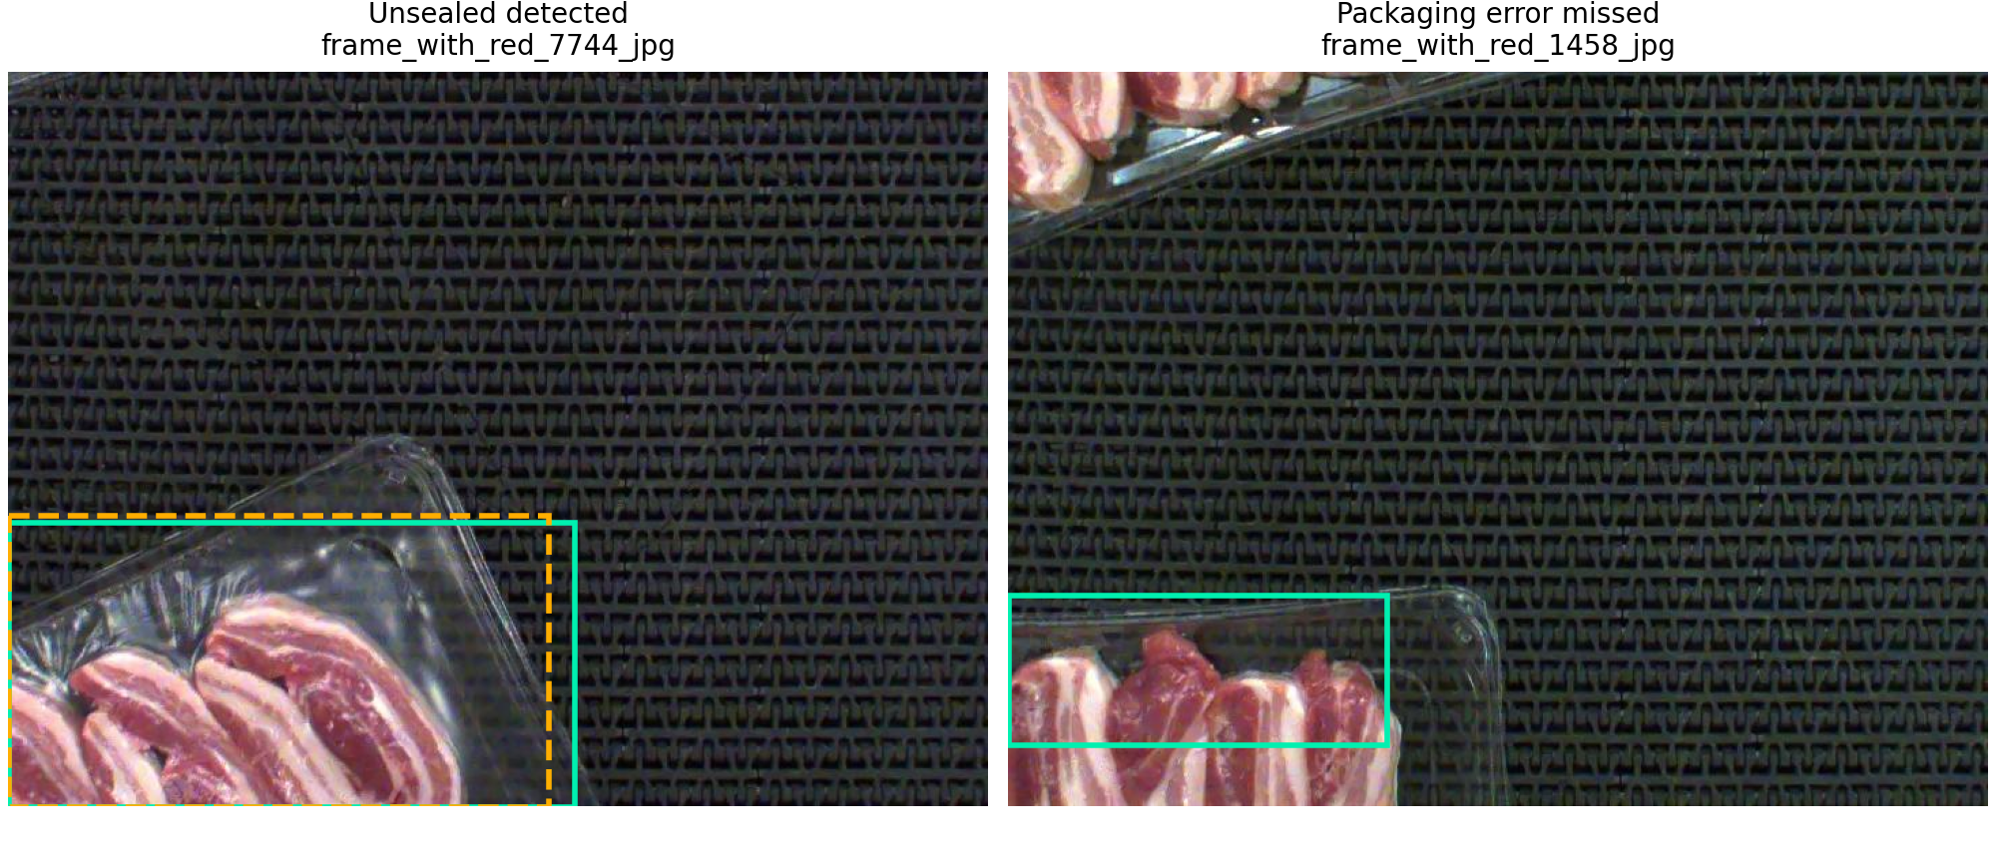
A correct detection and a missed defect
Green: annotation Orange dashed: prediction at confidence 0.65
6
Notes:
Target time: 40 seconds.
These are two selected examples, not a representative sample. The solid green rectangles are supplied annotations. The dashed orange rectangle is a retained model prediction. On the left, the model correctly detected an unsealed region. On the right, it missed a region labelled packaging error. Reflections, partial trays and subtle boundaries could make the task difficult, but we did not measure human accuracy or verify that these factors caused the errors.
Image credit: Hello, Roboflow Pork Rasher Error Packaging v4, CC BY 4.0. https://universe.roboflow.com/hello-2aqe0/pork-rasher-error-packaging/dataset/4. Annotation/prediction overlays from report Figure 2.

Slide 7
Conclusions and personal reflection
Current capability
AI use and my learning
Strongest on unsealed packaging
More than half of test defects missed
Clearer labels and independent tray data are the next priorities
AI generated most initial code and prose
I ran experiments and inspected epoch losses
The network’s decisions still feel like a black box
7
Notes:
Target time: 50 seconds.
The prototype completed the detection workflow, but its limited recall prevents a claim of reliable automated inspection. A simple baseline was also better for counting. Future work should clarify the annotation definitions, collect rare-class examples, and separate physical trays or recording sessions. AI generated most initial code and prose and helped me obtain results quickly. I ran the GPU experiments, checked outputs through shell commands and personally inspected epoch losses. However, I cannot yet fully explain the network’s internal decisions or the differences between classes. The project showed me the gap between running a model and understanding it.
Sources: report sections 8 and 9 and the student’s personal reflection.

Slide 8
Backup for questions
Measure | Meaning | Test result
Precision | Correct among retained detections | 37 / 46 = 80.4%
Recall | Found among annotated defects | 37 / 79 = 46.8%
IoU threshold | Minimum bounding-box overlap | 0.50
mAP50 | Mean average precision at IoU 0.50 | 0.2444
mAP50–95 | Average over several IoU thresholds | 0.0995
No human comparison, no independent tray split, no test examples for wrinkle
8
Notes:
Use after the five-minute presentation if asked.
Precision = 37 / (37 + 9). Recall = 37 / (37 + 42). A false positive can arise from the wrong class, poor box overlap or a duplicate. IoU is intersection area divided by union area. A high confidence is the model score, not a guarantee of correctness. mAP is not the same metric as accuracy or pooled recall. The final test mAP50 is 0.2444 and mAP50–95 is 0.0995.
Why not keep tuning? The final test has now been inspected, so further selection needs a new validation protocol and independent final data.
Source: report sections 4 and 7.

Slide 9
Sources
Monash University, MMA3001 Project Brief and Dataset 3 description, 2026
Monash University, MMA3001 Week 5 regression teaching materials
Hello, Pork Rasher Error Packaging, Roboflow version 4, CC BY 4.0
Ultralytics, YOLOv8 model and training documentation
Project report and saved validation and final-test records, 10 October 2026
9
Notes:
Supporting references. No presentation time allocated. Full source details and experiment paths appear in the report.
Dataset: https://universe.roboflow.com/hello-2aqe0/pork-rasher-error-packaging/dataset/4
Model: https://docs.ultralytics.com/models/yolov8/
Training: https://docs.ultralytics.com/modes/train/
Repository: https://github.com/RaccoonNextDoor/MMA3001-Project-33318719
Local results: results/baseline/validation_metrics.csv, results/detector_validation/REVIEW.md, results/final_test/summary.json.

