Slide 1
Design and Simulation of
WCSPH Simulation of Liquid Sloshing in a Pivoted Rectangular Tank: Grid Convergence, Hydrostatic Verification and Two-Way Coupled Active Control
A003 Hetansh Jain
A008 Aryaman Mavani
A052 Rahil Chawla
Faculty Mentor – Dr. Sunny Nanade
B.Tech Integrated, Mechanical Engineering · Capstone Project 2026–27
Mechanical Engineering Dept., MPSTME, Mumbai Campus
1
Notes:
Good morning, respected panel members. We are Hetansh Jain, Aryaman Mavani and Rahil Chawla, and our capstone project, guided by Dr. Sunny Nanade, is on liquid sloshing in a tank that is tilted by a motor about a single pivot. Over the next twenty minutes we will explain what sloshing is, why it matters to mechanical engineers, how we modelled the tank and the water, how we designed controllers to keep the water calm, and how we checked every result against a detailed simulation of real water. The project is entirely simulation-based, so wherever we use a computing idea, we will relate it to a mechanical one.

Slide 2
Table of Contents
Order of the presentation
Sr. No. | Contents | Slide No.
1 | Introduction | 3
2 | Problem Statement | 5
3 | Literature Review | 6
4 | Research Gap | 8
5 | Objectives | 9
6 | Methodology | 10
7 | The Simulated Tank | 11
8 | The Controllers | 17
9 | Fluid Simulation and Validation | 24
10 | Challenges | 30
11 | Conclusion and Future Scope | 33
Mechanical Engineering Dept., MPSTME, Mumbai Campus
2
Notes:
This is the order of our talk. We start with the introduction, problem statement, literature review, research gap and objectives. We then describe the methodology and the physical system, followed by the controllers and the detailed fluid simulation of the water. We finish with results, challenges, learnings, conclusions and future scope.

Slide 3
Introduction
Sloshing in a road tanker
Sloshing
Carry a full cup of coffee and stop suddenly: the coffee keeps going, climbs the wall and spills. This wave motion of a free liquid surface inside a moving container is called sloshing.
In a partly filled road tanker, the same thing happens with tonnes of liquid, and the liquid pushes back on the tank and the truck.
Braking
The liquid surges forward and the tank pitches; the surge pushes the truck forward as it tries to stop
Acceleration and bumps
The liquid surges backward and keeps rocking after the vehicle motion has ended
Safety risk
The moving liquid shifts the load at the worst moment and lowers stability (Zheng et al., 2017)
Today's fix: baffles
Fixed plates inside the tank add weight and cannot adapt; our project studies an active, motor-driven alternative
Mechanical Engineering Dept., MPSTME, Mumbai Campus
3
Notes:
Sloshing is something we all know from everyday life. If you carry a full cup of coffee and stop suddenly, the coffee keeps moving, climbs the wall and spills. Our project looks at this in a road tanker. When a partly filled tanker brakes, the liquid surges forward and the tank pitches, and that surge pushes the truck forward just as it is trying to stop. When it accelerates or goes over a bump, the liquid surges back and keeps rocking afterwards. The moving liquid shifts the load at the worst moment and lowers the vehicle's stability. Today the usual fix is baffles, fixed plates inside the tank, which add weight and cannot adapt. Our project studies an active alternative: a motor that tilts the tank to cancel the surge.

Slide 4
Main application: road tanker compartment
Our tank is a 1:5 scale model of a tanker compartment pitching under braking
Why a road tanker
When a tanker brakes or accelerates, the tank pitches and the liquid surges along its length.
This is the same motion as our tank tilting about its pivot.
An active tilting cradle under the tank, driven by a motor, could cancel the surge: this is what our controller does.
Why Froude scaling: gravity is the restoring force in sloshing; surface tension (Bo ≈ 22,000) and viscosity (Re ≈ 7.7 × 10⁴) are negligible at this size.
Table 1. Our tank as a 1:5 scale model (Froude scaling, same proportions)
Quantity | Our tank (model) | Tanker compartment
Length (sloshing direction) | 0.40 m | 2.0 m
Width | 0.25 m | 1.25 m
Height | 0.30 m | 1.5 m
Fill depth | 0.20 m (h/L = 0.5) | 1.0 m (h/L = 0.5)
Sloshing frequency | 1.34 Hz | 0.60 Hz
Time scale | 1 s | 2.24 s
Lengths × 5; frequencies ÷ √5; times × √5 (from Eq. 9 of our report)
The liquid sloshes within one compartment (bulkheads separate them), so we scale to a 2 m compartment, not the ~10 m tanker.
Mechanical Engineering Dept., MPSTME, Mumbai Campus
4
Notes:
Before the problem statement, here is why we worked on this. This is a research project, and its main application is a road tanker compartment. When a tanker brakes or accelerates, the tank pitches and the liquid surges along its length, which is the same motion as our tank tilting about its pivot. An active tilting cradle under the tank, driven by a motor, could cancel that surge, and that is exactly what our controller does. Our tank is a 1 to 5 scale model of a 2 metre compartment with the same proportions. Sloshing follows Froude scaling, so every length is multiplied by 5, while frequencies are divided by the square root of 5 and times multiplied by it; this follows directly from the sloshing-frequency formula, Equation 9 in our report, which depends only on gravity, the tank length and the fill depth. We scale to one compartment, not the whole tanker, because bulkheads separate the compartments and the liquid sloshes only within its own compartment; a fuel tanker of about 10 metres has compartments of roughly 2 metres. Our 1.34 hertz sloshing therefore corresponds to 0.60 hertz in the real compartment, close to the roughly 0.5 hertz reported for tankers. Froude scaling is the right law here because sloshing is a wave whose restoring force is gravity; at this size surface tension and viscosity are negligible by comparison.

Slide 5
Problem Statement
From Section 1.3 of our report
A rigid rectangular tank, partly filled with water, rotates about one horizontal pivot at its base under a motor torque: a 1:5 scale model of a road tanker compartment pitching under braking. Simple equivalent models of the water are used to design controllers for such a tank, but their accuracy for this motion is unknown, and so is the accuracy of the detailed simulation used to check them.
1
How accurate is the detailed simulation?
Does the SPH solution converge to a known exact answer as the particles are made smaller?
2
How good is the simple model?
Over a realistic, controller-generated tilt, how well does the equivalent pendulum match the detailed simulation?
3
Do the controllers work on real water?
With the water pushing back on the tank (two-way coupling), how do controllers designed on the simple model perform?
Mechanical Engineering Dept., MPSTME, Mumbai Campus
5
Notes:
Our problem statement, in one paragraph, is on the dark bar. In terms of our main application, the tank is a 1 to 5 scale model of a road tanker compartment that pitches when the vehicle brakes. A rigid tank, partly filled with water, is rotated about a pivot at its base by a motor. Controllers for such a tank are normally designed using a simple equivalent model of the water, but nobody knows how accurate that model is for this kind of motion, or how accurate the detailed simulation is that should check it. This gives us three questions. First, does the detailed simulation converge to a known exact answer? Second, how well does the simple model match it over a realistic motion? Third, how do controllers designed on the simple model behave when the real water pushes back on the tank?

Slide 6
Literature Review
Page 1 of 2
Table 2. Equivalent models, sloshing theory and tank experiments
Sr. | Year | Author | Title | Relevance to our work
1 | 1963 | G. W. Housner [1] | The dynamic behavior of water tanks | Split the water into an impulsive mass and a convective mass on a spring or pendulum. Basis of our pendulum model.
2 | 2006 | ACI Committee 350 [2] | Seismic Design of Liquid-Containing Concrete Structures (ACI 350.3-06) | Closed-form formulas for the two masses, their heights and the first sloshing frequency, used in our code.
3 | 1966 | H. N. Abramson (ed.) [3] | The Dynamic Behavior of Liquids in Moving Containers (NASA SP-106) | Classic study of sloshing in space vehicles; shows why sloshing control matters.
4 | 2005 | R. A. Ibrahim [4] | Liquid Sloshing Dynamics: Theory and Applications | Linear potential theory of sloshing; gives the exact first-mode frequency we use as a check.
5 | 2005 | H. Akyıldız, E. Ünal [14] | Experimental investigation of pressure distribution on a rectangular tank due to liquid sloshing | Measured wall pressures in a pitching rectangular tank at several fill depths and amplitudes.
6 | 2024 | K. Liu et al. [15] | Experimental study on the sloshing of a rectangular tank under pitch excitations | Strong nonlinearity near resonance under pitch excitation; confirms that pitching tanks need careful study.
Mechanical Engineering Dept., MPSTME, Mumbai Campus
6
Notes:
Our literature survey covers four areas. First, the equivalent mechanical models. Housner, in 1963, showed that for design purposes the water in a tank behaves like two masses: one that moves rigidly with the walls, and one that sloshes like a mass on a pendulum. The ACI 350.3 code turned this into closed-form formulas, which we use directly. NASA's 1966 report by Abramson shows why sloshing control matters in space vehicles, and Ibrahim's book gives the exact linear theory we use to check our sloshing frequency. Second, experiments: Akyıldız and Ünal measured wall pressures in a pitching tank, and Liu and co-workers in 2024 showed strong nonlinear behaviour under pitch.

Slide 7
Literature Review
Page 2 of 2
Table 3. SPH for sloshing, verification and sloshing control
Sr. | Year | Author | Title | Relevance to our work
7 | 2006 | A. Souto-Iglesias et al. [7] | Liquid moment amplitude assessment in sloshing type problems with SPH | Compared SPH with rolling-tank experiments; supports SPH as a sloshing tool.
8 | 2011 | A. Rafiee, F. Pistani, K. Thiagarajan [9] | Study of liquid sloshing: numerical and experimental approach | SPH agreed well with laboratory pressures and free-surface shapes.
9 | 2012 | S. Adami, X. Y. Hu, N. A. Adams [21] | A generalized wall boundary condition for SPH | The wall method (ADAMI) used in our SPH tank.
10 | 2008 | I. B. Celik et al. [23] | Procedure for estimation and reporting of uncertainty due to discretization in CFD | The grid convergence index (GCI) method used in our resolution study.
11 | 1997 | J. T. Feddema et al. [24] | Control for slosh-free motion of an open container | Classical model-based slosh control, built on equivalent models.
12 | 2025 | M. Ye et al. [30] | Sloshing suppression with a controlled elastic baffle via deep reinforcement learning and SPH | Closest recent work: learning control with SPH, but it moves a baffle, not the tank itself.
Mechanical Engineering Dept., MPSTME, Mumbai Campus
7
Notes:
Third, particle simulations: Souto-Iglesias and Rafiee compared SPH with laboratory tanks and found good agreement, so SPH is a credible tool. Adami's wall method is the one our solver uses, and Celik's grid convergence index is the standard way to report numerical error, which we use. Fourth, control: Feddema's work is typical of classical slosh control built on equivalent models. The closest recent work is Ye and co-workers in 2025, who combined reinforcement learning with SPH, but they move a baffle inside the tank, whereas we move the tank itself.

Slide 8
Research Gap
What the literature does not cover, and how this project addresses it
Table 4. Gaps in the reviewed literature
Gap in reviewed literature | How this project addresses it
SPH sloshing studies use sideways or roll motion about the tank centre, at one or two resolutions [7, 8, 9] | Pitch about a pivot at the base, at four particle sizes, with a GCI error estimate
Controllers are designed on equivalent models whose validity for this motion is assumed, not checked [24, 25, 26] | The pendulum model is checked against verified SPH over a controller-generated motion
SPH accuracy is usually judged against experiments, without a separate numerical error estimate | SPH is verified against an exact hydrostatic answer: 3.1% error, GCI 6.4%
Learning-based sloshing control with SPH moves baffles inside the tank [29, 30] | Our actuator is the tank's own pivot motor, with the water pushing back (two-way coupling)
Mechanical Engineering Dept., MPSTME, Mumbai Campus
8
Notes:
From this survey we identified four gaps. First, SPH sloshing studies usually move the tank sideways or roll it about its centre, and check only one or two resolutions; we pitch the tank about its base and use four resolutions with a formal error estimate. Second, controllers are designed on equivalent models whose accuracy for this motion is simply assumed; we check that assumption. Third, SPH results are usually compared with experiments without separating out the numerical error; we verify against an exact answer first. Fourth, recent learning-based control with SPH moves baffles, while we control the tank's own pivot motor with the water pushing back.

Slide 9
Objectives
From Section 1.3.1 of our report
1
Build the model
Model the pivoted tank in SPH (Chrono::FSI) with one-way (prescribed motion) and two-way (torque-driven) coupling to the rigid tank
2
Measure the numerical error
Run a four-level particle-size study and estimate the grid convergence index (GCI)
3
Check against exact answers
Compare with the hydrostatic water shift and the first sloshing frequency from potential theory
4
Test the simple model
Measure how well the Housner pendulum matches SPH along a controller-generated motion
5
Compare controllers
Test PID, LQR and a learning controller (PPO) in the two-way coupled SPH tank
Mechanical Engineering Dept., MPSTME, Mumbai Campus
9
Notes:
Our five objectives follow from the problem statement. First, build the tank in the SPH solver with both one-way and two-way coupling. Second, measure the numerical error of the SPH result through a four-level resolution study. Third, check the SPH solution against two exact answers: the hydrostatic shift of the water and the first sloshing frequency from potential theory. Fourth, measure how well the simple Housner pendulum matches the verified SPH result. Fifth, compare three controllers, PID, LQR and a learning controller, in the fully coupled tank.

Slide 10
Methodology
Six steps, from design to validation
1
2
3
4
5
6
Define
Application (road tanker), tank design and requirements
Model
Tank, pivot and motor; pendulum water model; RL environment
Train
PPO, PID and LQR on the fast model
Simulate
SPH water on a GPU at four particle sizes
Verify
Convergence and exact-answer checks
Compare
Controllers in the two-way SPH tank
DESIGN
ANALYSE
VALIDATE
Mechanical Engineering Dept., MPSTME, Mumbai Campus
10
Notes:
Our methodology has six steps, grouped into design, analysis and validation. We first defined the problem and the tank design. We then built the model: the tank, pivot and motor, the simple pendulum model of the water, and a training environment for the controllers. Next we trained and tuned three controllers on the fast model. We then simulated the real water with SPH on a graphics card at four particle sizes, verified the SPH results against exact answers, and finally compared the controllers in the fully coupled tank. All steps read the same configuration file, so the models can never disagree on a dimension or a mass.

Slide 11
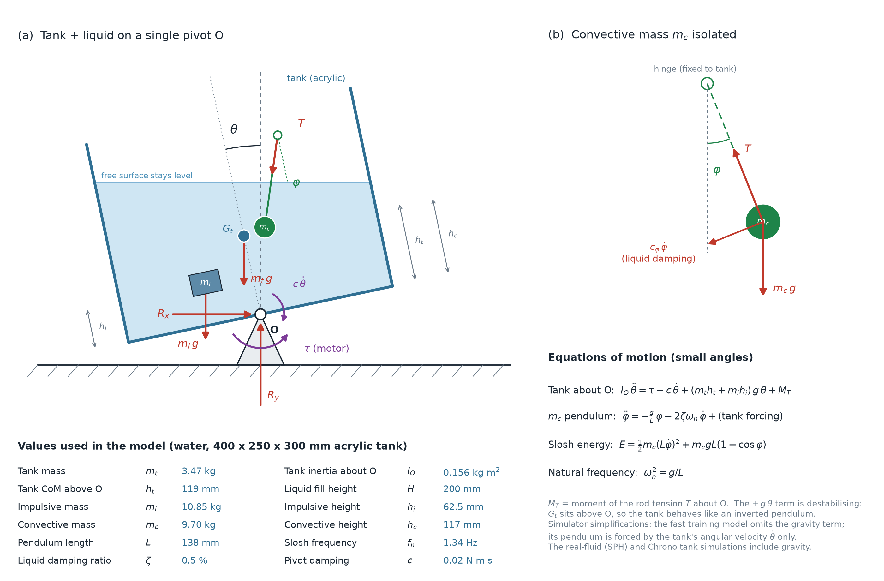
Free-body diagram
The tank on its single pivot O, with the water replaced by its equivalent model
Motor torque τ
applied at the pivot to tilt the tank
Tank weight
acts 119 mm above the pivot: the tank is an inverted pendulum
Water
impulsive mass fixed to the tank, convective mass on a pendulum
Fig. 1. Free-body diagram: motor torque, pivot damping and reactions, tank weight, and the Housner equivalent of the water
Mechanical Engineering Dept., MPSTME, Mumbai Campus
11
Notes:
This is the free-body diagram of our system, drawn from the actual design values. The tank sits on a single pivot, O. The forces on it are the motor torque, the pivot reactions and a small pivot damping, the tank's own weight, and the water. For the free-body diagram, the water is replaced by its Housner equivalent: a mass fixed rigidly to the tank and a second mass hanging on a pendulum. Notice that the tank's centre of mass is 119 millimetres above the pivot. That makes the empty tank an inverted pendulum, which is unstable on its own.

Slide 12
Choosing the tank size and values
Every value has a stated reason (second review)
Table 5. Design choices and their basis
Quantity | Value | Why this value
Tank length L | 0.40 m | Bench-top lab scale (tests use tens of cm to ~1 m [4, 5, 9]); a 1:5 Froude model of a 2 m tanker compartment; cheap to build, fill and film
Width / height | 0.25 m / 0.30 m | Narrower than long, so the first mode lies along the tilt axis; 100 mm freeboard (the surface rises only ~35 mm at 10°)
Wall | 6 mm cast acrylic | Standard sheet; transparent, so the free surface can be seen and filmed
Fill depth h | 0.20 m (h/L = 0.5) | Inside the valid range of the ACI 350.3 formulas; water splits almost evenly into impulsive and sloshing parts
Sloshing damping | 0.5% of critical | Standard value for a smooth-walled water tank (Sivý et al. [13])
Resulting frequency | 1.34 Hz | Easy to film and follow with a modest motor; equals ≈0.6 Hz in a 2 m tanker compartment
Liquid | Water, 1000 kg/m³ | Simplest to begin with: safe, well-known properties, the standard reference liquid. Petrol gives the same 1.34 Hz, with ~25% less mass
Mechanical Engineering Dept., MPSTME, Mumbai Campus
12
Notes:
The second review asked how the tank values were chosen. Each value has a reason. The 0.40 metre length is bench-top laboratory scale: published sloshing tests use tanks from tens of centimetres to about a metre, for example Rafiee and co-workers used a 1.3 metre tank. The tank is narrower than it is long, so the first sloshing mode lies along the axis the motor tilts, and the 0.30 metre height leaves 100 millimetres of freeboard. Filling to half the length keeps us inside the valid range of the ACI formulas and gives a large sloshing mass. The damping of half a percent is the standard literature value, and the result is a 1.34 hertz sloshing frequency that a camera and a modest motor can follow. We chose water over petrol because it is the simplest to begin with: it is safe next to a motor, its properties are precisely known, and it is the standard reference liquid. The method carries over: petrol gives the same 1.34 hertz, only with about a quarter less mass. Because sloshing follows Froude scaling, this tank is also a valid scale model of larger tanks with the same proportions, as we showed at the start.

Slide 13
Modelling the water as a pendulum
The Housner equivalent model (ACI 350.3-06)
The idea
When the tank moves, the water near the bottom moves with it like a solid; only the water near the surface sloshes. Housner (1963) therefore split the water into two masses:
Impulsive mass: fixed rigidly to the tank
Convective mass: hangs on a pendulum and swings
ω² = (3.16 g / L) tanh(3.16 h / L), L_p = g / ω²
A swinging pendulum is far cheaper to compute than real water.
10.85 kg
impulsive mass (moves with the tank)
9.70 kg
convective mass (sloshes)
0.138 m
equivalent pendulum length
1.343 Hz
first sloshing frequency
Note: in our code these formulas use the outer tank size (20.0 kg of water). The two masses add up to 2.7% more than that, which is a known feature of these curve-fitted formulas.
Mechanical Engineering Dept., MPSTME, Mumbai Campus
13
Notes:
This is the key simplification behind the fast model. Housner observed that the water near the bottom moves with the tank like a solid, and only the water near the surface sloshes. So he replaced the water with two masses: an impulsive mass fixed to the tank and a convective mass on a pendulum. The pendulum length is chosen so that it swings at the water's own sloshing frequency, given by the formula shown. For our tank, that is 10.85 kilograms fixed, 9.70 kilograms swinging on a 138 millimetre pendulum, and a natural frequency of 1.343 hertz. Its great advantage is speed. Its limitations are what we test later.

Slide 14
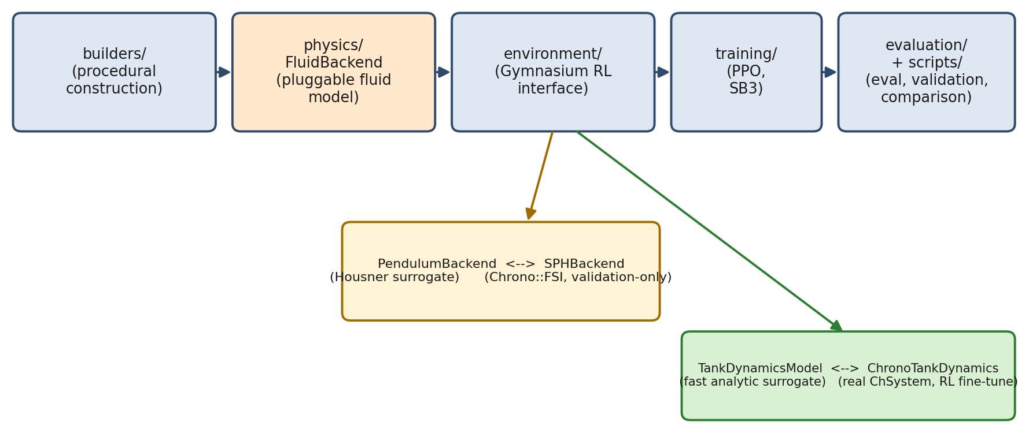
System architecture
Like a modular test rig: parts can be swapped
Fig. 2. Software architecture: the water model (pendulum ↔ SPH particles) and the tank model (fast ↔ full multibody) can each be swapped without changing anything else
Mechanical Engineering Dept., MPSTME, Mumbai Campus
14
Notes:
This is the system architecture. Think of it as a test rig with interchangeable modules. The pipeline runs from the builders, through the physics, to the training environment, the trainer and the evaluation scripts. The orange box is the water: it can be either the fast pendulum or the detailed SPH particle model. The green box is the tank: either the fast equations or the full multibody model. Because they plug into the same sockets, the same controller can be tested on all of them without any change, which is exactly what makes our later checks against real water possible.

Slide 15
Checking the model by hand
Hand calculations in Excel compared with the simulation
Table 6. Hand calculation vs simulation
Quantity | Hand calculation | Simulation | Difference
Tank mass, centre of mass, inertia | Plate formulas + parallel axis | Same values in the model | 0.00%
Housner masses and pendulum length | ACI 350.3-06 formulas | Same values in the model | 0.00%
Pendulum sloshing frequency | 1.343 Hz | 1.30 Hz (measured from the motion) | −3.2%
Sloshing frequency, detailed water | 1.364 Hz (potential theory) | 1.422 Hz (SPH) | +4.2%
Controller design check (LQR) | 8.44 rad/s (Housner) | 8.44 rad/s (closed-loop poles) | 0.04%
Water shift at a held tilt of −10.16° | −11.24 mm (hydrostatic) | −10.89 mm (SPH, 2 mm) | −3.1%
Froude number | Fr = 0.054 (gentle, linear sloshing) | Same value | —
Reynolds number | Re ≈ 7.7 × 10⁴ | Same value | —
Open the workbook: Calculation_vs_Simulation.xlsx
Mechanical Engineering Dept., MPSTME, Mumbai Campus
15
Notes:
We checked the model against hand calculations in an Excel workbook, where every value is a live formula. Where the code uses the same formula, the difference is zero, as it should be. The sloshing frequency measured from the moving pendulum model is within 3.2 percent of its formula, the SPH frequency is within 4.2 percent of potential theory, and the controller design check agrees to 0.04 percent. The Froude number of 0.054 tells us the sloshing is gentle and linear, which is the range in which the Housner model is meant to work.

Slide 16
Is the slosh-energy measure valid?
Checked after the second review
What we found
What we did
The reported slosh energy was kinetic only: E = ½ m v²
For the pendulum this leaves out the potential term m_c g L (1 − cos θ)
Measured: the potential term is 51–66% of the sloshing mode's energy, so kinetic-only under-reports it by about half
Pendulum model: now reports kinetic + potential energy
Ranking unchanged: total-energy settling PPO 1.20 s, LQR 3.72 s
SPH: reported as bulk kinetic energy only; its height-based potential term is dominated by a numerical settling drift, so it is not used
Training reward kept as before: driving kinetic energy to zero still drives total energy to zero
Mechanical Engineering Dept., MPSTME, Mumbai Campus
16
Notes:
The second review asked us to check whether our sloshing-energy measure was valid. We found that it was kinetic energy only. For a swinging pendulum, this misses the potential energy at the top of each swing, and in our runs that potential term was 51 to 66 percent of the total, so the kinetic value alone under-reported the sloshing energy by about half. We now report kinetic plus potential energy for the pendulum model, and the ranking of the controllers did not change. For SPH we report bulk kinetic energy only, because the height-based potential term is swamped by a small numerical settling drift. The reward used for training stays valid, because driving kinetic energy to zero also drives the total to zero.

Slide 17
Why the tank needs active control
The tank is an inverted pendulum, and the water adds large forces
Centre of mass 119 mm above the pivot
Like a pencil balanced on its tip: level is unstable, and any small tilt grows on its own.
Measured: a tilt of 0.0001 rad grew to 0.161 rad in 0.5 s
Free-swing test with no motor, using the detailed water simulation.
The water's torque is about 7× the tank's own
Peak water torque 4.78 N·m against 0.70 N·m from the tank's inertia and weight combined.
Therefore the motor must keep correcting the tilt while the water pushes back on the tank. Doing this without making the water slosh even more is the control problem.
Mechanical Engineering Dept., MPSTME, Mumbai Campus
17
Notes:
Why does the tank need active control at all? Two physical facts. First, the tank's centre of mass is above the pivot, so it is an inverted pendulum, like a pencil balanced on its tip. We confirmed this in the detailed simulation: with no motor, a tiny tilt of one ten-thousandth of a radian grew to 0.16 radians in half a second. Second, the water dominates the loads: its peak torque on the tank was 4.78 newton metres, about seven times the 0.70 newton metres from the tank's own inertia and weight. So the motor must keep correcting the tilt while the water pushes back, without stirring the water up even more.

Slide 18
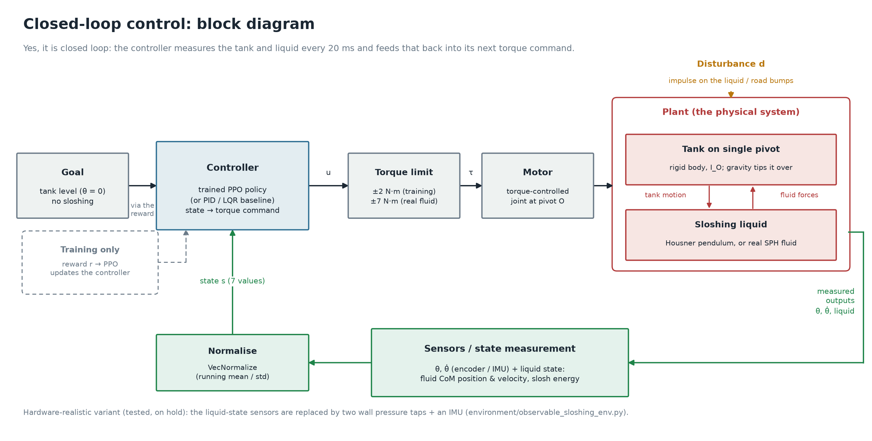
What a controller does
Measure → decide → act, fifty times a second
Closed loop
Like a car's cruise control: it measures, corrects and measures again
Every 20 ms
A new motor torque is chosen, 50 times per second
What it sees
Tank angle and speed, and the water's position, speed and energy
Fig. 3. Closed-loop block diagram
Mechanical Engineering Dept., MPSTME, Mumbai Campus
18
Notes:
A controller is simply a rule that decides the motor torque. This block diagram shows the loop. Every 20 milliseconds the sensors measure the state of the tank and the water, the controller chooses a torque, the motor applies it to the tank, and the tank and water respond. Then the loop measures again. This is a closed loop, exactly like cruise control in a car. The plant in the loop can be the fast model or the detailed SPH water, which is how we test the same controller on both.

Slide 19
The controllers, side by side
Explained for a non-specialist
Table 7. Controller comparison
 | PID | LQR | PPO (learned)
Everyday picture (carrying soup) | Keep the bowl level and hope | Work out the ideal tilt from a formula | An experienced waiter who just knows
What it looks at | Tank angle and its rate | Tank angle and rate, water swing angle and rate | 7 numbers: tank, water position and velocity, slosh energy
How the rule is made | Hand-tuned gains: Kp = 14, Ki = 1.5, Kd = 4.5 | Solved once from the pendulum equations (Riccati) | Trained by trial and error, 500,000 steps
Fast model: time to calm the water | Never reacts | 3.4 s | 1.2 s
Real SPH water | Stays in control; most sloshing left | Loses control in 0.7 s | 15× less sloshing than PID; in control ~5 s
Mechanical Engineering Dept., MPSTME, Mumbai Campus
19
Notes:
For an external reader, here are the three controllers side by side, using the picture of carrying a full bowl of soup. PID keeps the bowl level and hopes for the best: it looks only at the tank angle, with hand-tuned gains. LQR works out the ideal tilt from a formula: it uses the pendulum equations and solves for the best fixed gains. PPO is like an experienced waiter who has carried thousands of bowls: it was trained by trial and error. On the fast model PPO calms the water fastest. On the real SPH water, PID stays in control but leaves the most sloshing, LQR fails, and PPO leaves fifteen times less sloshing than PID.

Slide 20
Why the motor torque is bounded
A real motor has a maximum torque; the limits were measured, not guessed
Table 8. Torque-limit sweep on the real (SPH) closed loop
Limit (N·m) | Survival (steps) | What happens
1.0 | ~60 | Too weak: tank runs away
2.0 | ~40–50 | Marginal, keeps oscillating
4.0 | ~100–125 | Good while it lasts
5.0–6.0 | ~150 | Good while it lasts
7.0 | ~200–300 | Best region found
8.0 | ~200–210 | Good, but shorter
10.0 | ~90–100 | Too strong: over-corrects
Why a bound is needed
Every real motor saturates; without a cap the controller could ask for torque no motor can give.
Fast model, ±2 N·m: PPO's largest torque was only 0.08–0.19 N·m, so the bound never shapes the result.
Real water, ±7 N·m: above the water's 4.78 N·m push-back, and the best value in the sweep. A small industrial servo size.
All three controllers get the same limit.
Mechanical Engineering Dept., MPSTME, Mumbai Campus
20
Notes:
The review asked about the torque bound. Every real motor has a maximum torque, so an unbounded torque would describe a machine that cannot be built. On the fast model the limit is 2 newton metres, but the trained controller never used more than 0.19, so the bound never shapes that result. For the real water, we measured the limit. The water pushes back with up to 4.78 newton metres, so the limit must be higher. The sweep on the left shows that too little torque cannot hold the tank, and too much makes the controller over-correct; 7 newton metres was the best, which is the size of a small industrial servo. All three controllers get the same limit, so the comparison is fair.

Slide 21
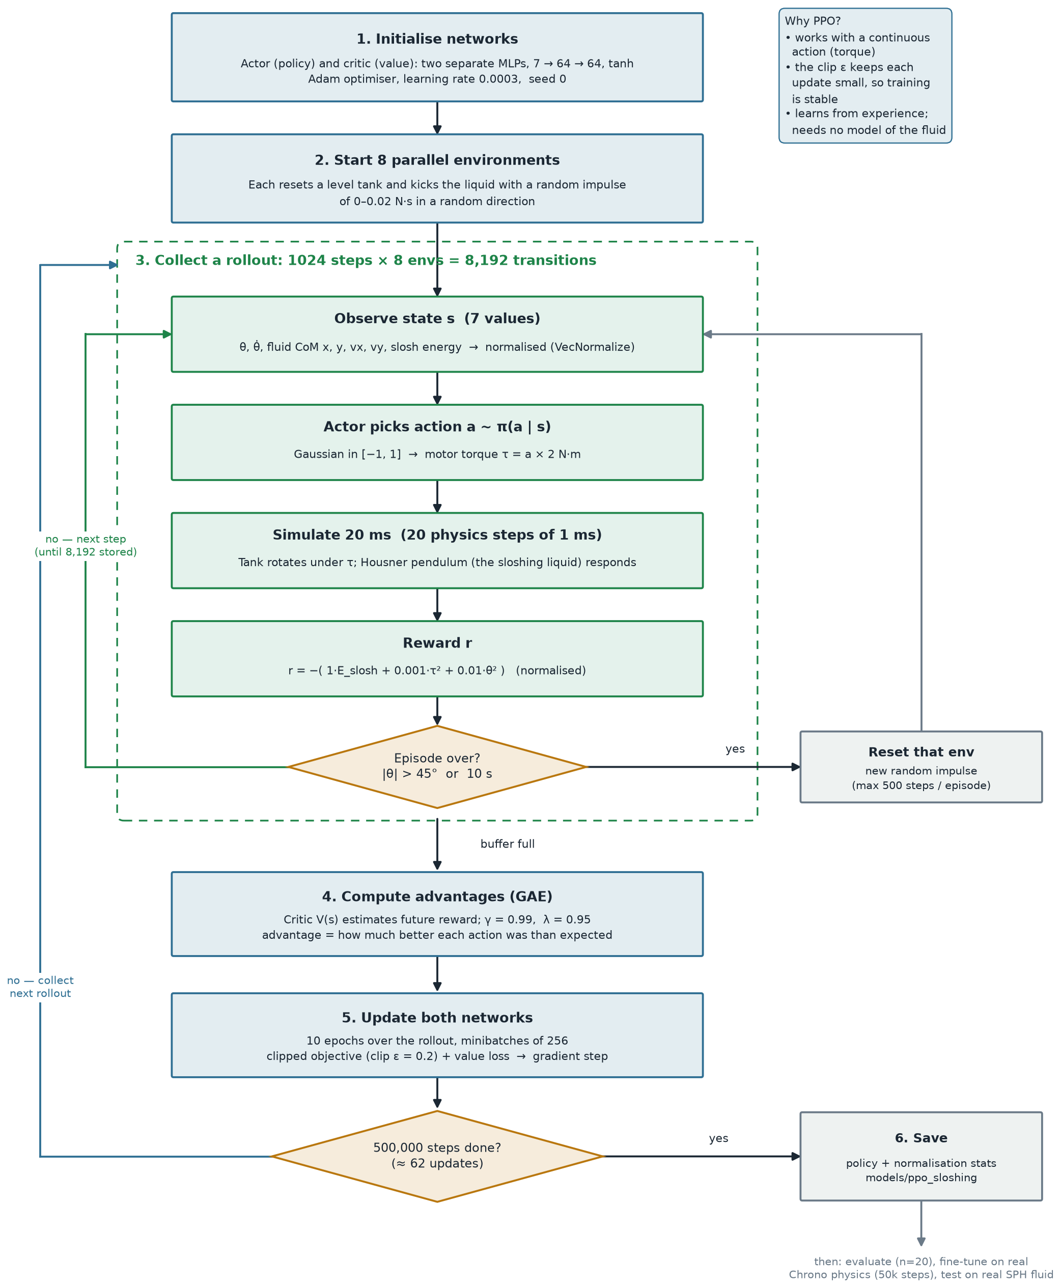
How the controller learns
Trial and error, guided by a score
1
Try
Run the tank for 10 s with a random water kick, choosing a torque every 20 ms
2
Score
Lose points for sloshing energy, motor effort and tilt
3
Learn
Adjust the controller so better actions become more likely
4
Repeat
500,000 steps, 8 virtual rigs at once: about 3–5 minutes
Fig. 4. PPO training flowchart (right)
Mechanical Engineering Dept., MPSTME, Mumbai Campus
21
Notes:
This flowchart is the actual training loop. In plain terms, the controller tries, gets a score, and adjusts itself so that good actions become more likely, then repeats. Inside the dashed box, the rigs run: observe the state, choose a torque, simulate 20 milliseconds, compute the reward, and check whether the run is over. Once 8,192 steps are collected, the advantages are computed, meaning how much better each action was than expected, and both networks are updated. This repeats about 62 times to reach 500,000 steps, and the trained controller is then saved.

Slide 22
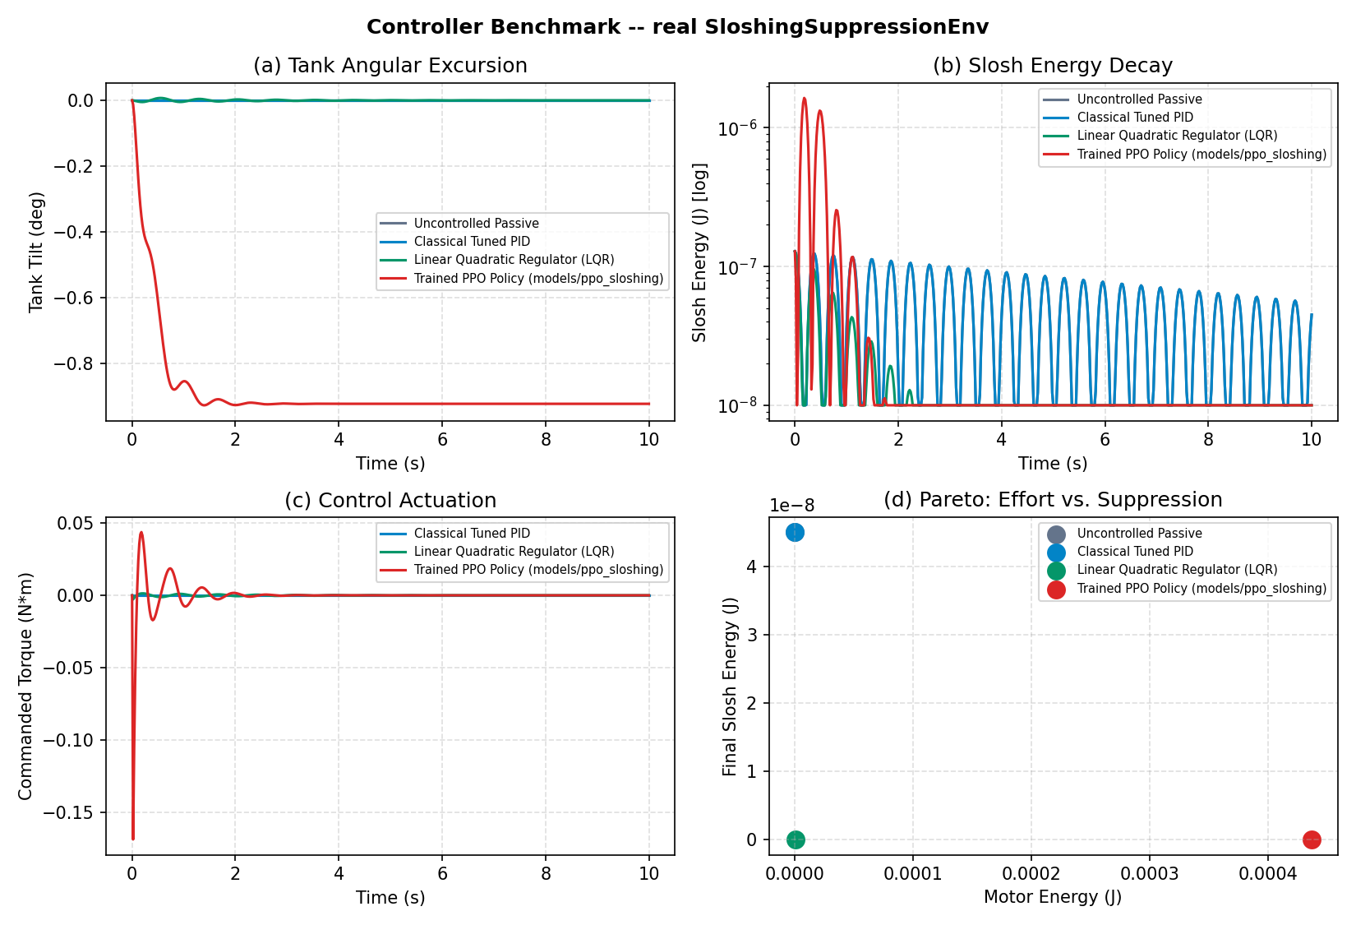
Result on the virtual rig
All controllers, same water kick, same 10 s run
1.24 s
PPO calms the water fastest; LQR takes 3.42 s
PID does nothing
The kick hits the water, not the tank, so an angle-only PID sees no error at all
−0.9° tilt
PPO leaves the tank slightly tilted, because its score cares far more about sloshing than tilt
Fig. 5. Controller benchmark on the fast model
Mechanical Engineering Dept., MPSTME, Mumbai Campus
22
Notes:
This is the first result, on the fast model. All controllers faced the same water kick, which plays the role of a braking jolt on the tanker. The learning controller calmed the water in 1.24 seconds, about three times faster than LQR at 3.42 seconds. The PID result is interesting: it applied zero torque the whole time. The disturbance hits the water, not the tank, so the tank angle never changes and the PID sees nothing to correct. That is a real finding: a controller that only watches the tank angle cannot see this kind of disturbance. PPO also leaves the tank tilted by about 0.9 degrees, because its score cares a hundred times more about sloshing than about tilt.

Slide 23
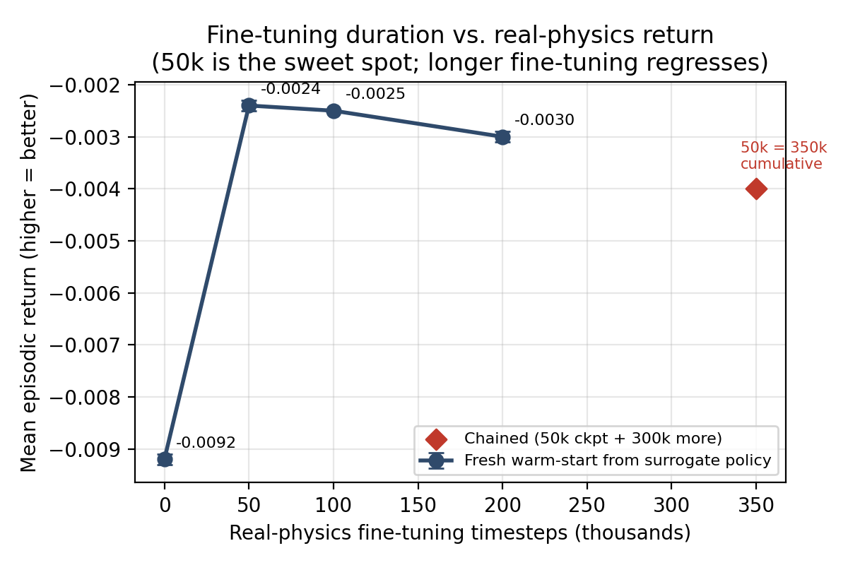
From the fast model to full physics
The controller had to be re-tuned for the full model
~11.5× more effort
Needed on the full multibody tank (friction and contact the fast model leaves out)
50,000 extra training steps
On the full model made it ~3.8× better
More was worse
100k, 200k and 350k steps all did worse, so 50k was kept
Fig. 6. Score on the full multibody model against extra training length
Mechanical Engineering Dept., MPSTME, Mumbai Campus
23
Notes:
When the controller trained on the fast model was moved to the full multibody tank, it still calmed the water but needed about 11.5 times more control effort, most likely because of pivot friction and contact effects that the fast model leaves out. Extra training on the full model fixed most of that: 50,000 steps made it about 3.8 times better. We tried four training lengths, and the shortest was the best; 100,000, 200,000 and 350,000 steps all did worse. So more training is not automatically better, and every result must be checked.

Slide 24
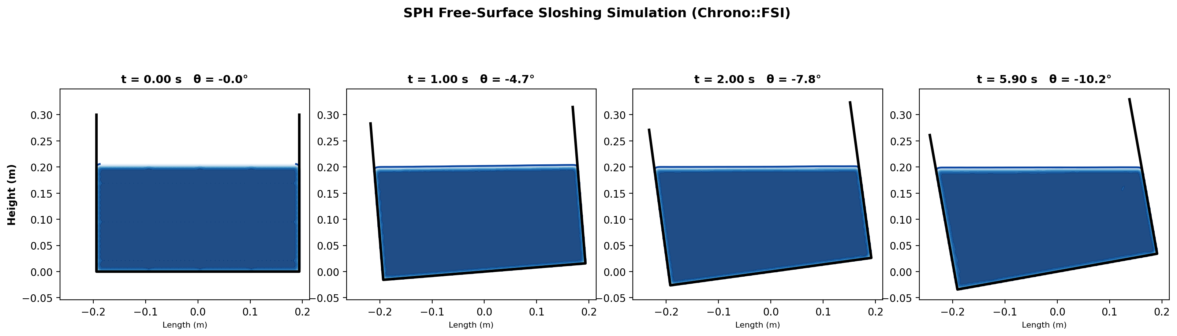
Simulating real water with particles
Smoothed Particle Hydrodynamics (SPH), on a graphics card
Fig. 7. SPH water at 2 mm particle size (about 2.26 million particles): the surface stays level while the tank tilts around it
Mechanical Engineering Dept., MPSTME, Mumbai Campus
24
Notes:
Next we check everything against real water. We used smoothed particle hydrodynamics, or SPH, in the open-source solver Chrono FSI. SPH represents the water as millions of small particles. Each carries mass and velocity, and neighbouring particles push on each other through pressure, smoothed over a small radius. Unlike a mesh-based CFD solver, there is no mesh to deform, which suits a free surface and a rotating tank. The image shows our finest run, with 2.26 million particles: the water surface stays level while the tank tilts around it, which is the correct physics. SPH needs an NVIDIA graphics card, which our laptop did not have, so we used free Google Colab, an RTX 5060 desktop and a college RTX 3090. Even on the RTX 3090, the 10 millimetre runs are 33 times slower than real time, and the 2 millimetre run took 9.1 hours for six seconds of motion, which is why the controller is trained on the fast model.

Slide 25
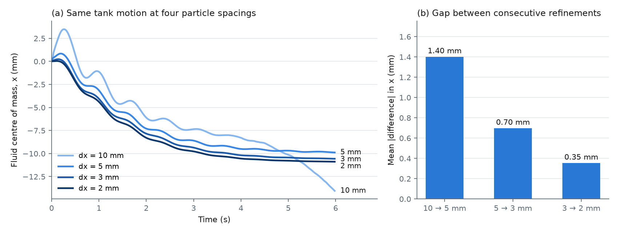
Check 1: convergence
A grid-independence study, using particle size instead of mesh size
Fig. 8. Same tank motion at four particle sizes; the change between sizes keeps getting smaller (1.40 → 0.70 → 0.35 mm)
Mechanical Engineering Dept., MPSTME, Mumbai Campus
25
Notes:
Now the results. The first check is the equivalent of a mesh-independence study in FEA or CFD. In FEA or CFD, the part is split into small pieces called a mesh, and the answer can depend on how small those pieces are. So we make the mesh finer and finer until the answer stops changing; then we know the result comes from the physics, not from our choice of mesh. SPH has no mesh, so here the particle size plays that role. We ran exactly the same tank motion with particles of 10, 5, 3 and 2 millimetres. On the right you can see that the difference between one size and the next is 1.40, then 0.70, then 0.35 millimetres. The change keeps getting smaller as the particles get smaller, which shows that the answer is converging, and our grid convergence index calculation confirms it. The 10 millimetre curve is clearly the odd one out, so it is too coarse for accurate predictions. Coarse particles also under-fill the tank: the initial particle arrangement holds 20 percent less water at 10 millimetres, but only 2.2 percent less at 3 and 2 millimetres.

Slide 26
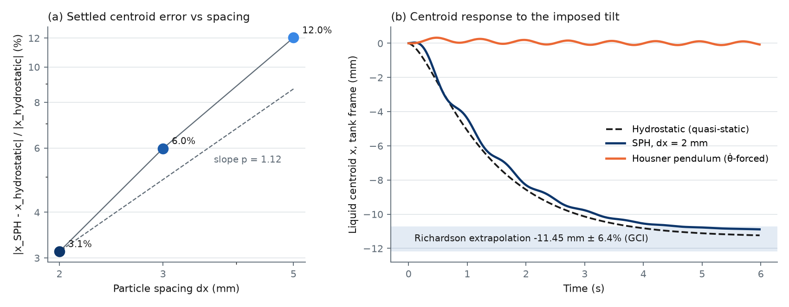
Check 2: exact answer
When the tank is tilted and held, the water must settle level
Fig. 9. (a) Error against the exact hydrostatic value falls to 3.1% at 2 mm; (b) SPH follows the exact answer (correlation 0.999), the pendulum does not (0.48)
Mechanical Engineering Dept., MPSTME, Mumbai Campus
26
Notes:
The second check compares SPH with the exact hydrostatic answer. When the tank is tilted slowly and held, the water surface must end up level, and the formula tells us exactly where the water's centre of mass must go. On the left, the error falls steadily as the particles get smaller, to 3.1 percent at 2 millimetres. On the right, the blue SPH curve follows the dashed exact answer almost perfectly, with a correlation of 0.999. The orange Housner pendulum barely moves, with a correlation of only 0.48. This is the pendulum's blind spot: it cannot represent the water re-levelling.

Slide 27
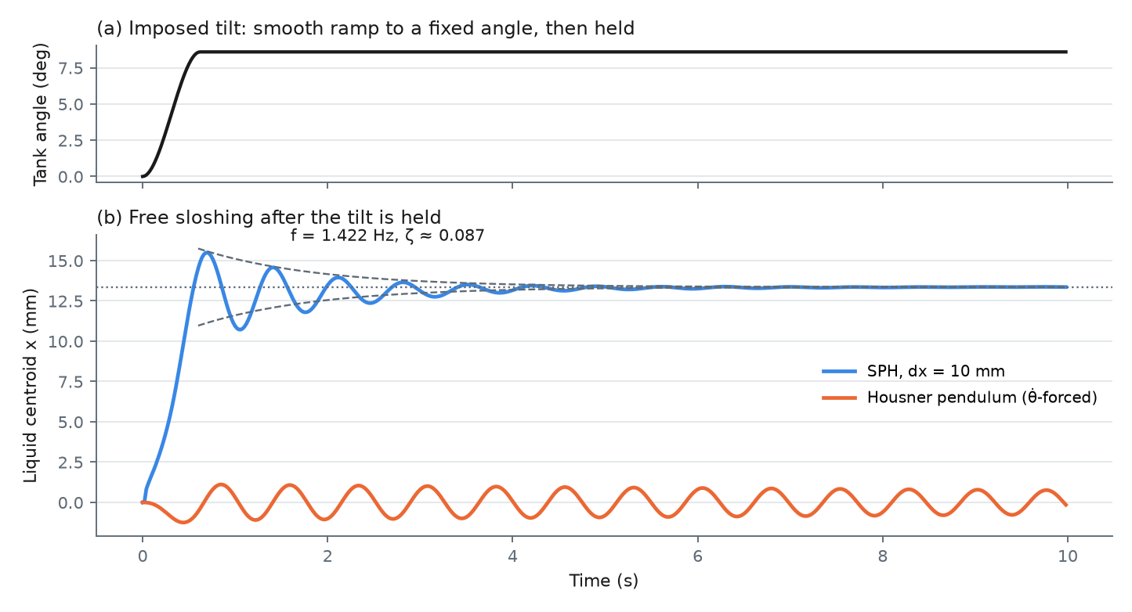
Check 3: sloshing frequency
Tilt the tank, hold it, and let the water oscillate freely
1.422 Hz
Measured in the SPH water (+4.2% vs potential theory, +5.9% vs Housner)
ζ ≈ 0.087
The SPH wave decays ~17× faster than in real water (ζ ≈ 0.005), mostly because of numerical damping at 10 mm
Different shape
SPH water shifts downhill and stays there; the pendulum oscillates about zero
Fig. 10. Free sloshing after a held tilt of 8.59° (10 mm particles)
Mechanical Engineering Dept., MPSTME, Mumbai Campus
27
Notes:
The third check is the sloshing frequency. We tilted the tank smoothly to 8.6 degrees, held it, and let the water oscillate freely. The SPH water oscillated at 1.422 hertz, within 4.2 percent of potential theory and 5.9 percent of the Housner formula, so the frequency is right. Two differences stand out. First, the SPH wave dies out far too quickly, with a damping ratio of 0.087 against about 0.005 for real water, because coarse particles add numerical damping. Second, the shape differs: the real water shifts downhill and stays there, while the pendulum just oscillates about zero.

Slide 28
Two-way coupled control
Single 300-step (6 s) runs in the torque-driven SPH tank
Table 9. Two-way coupled control results (report Table 8)
Controller | Steps before trip | Final energy (J) | Max. torque (N·m) | Motor energy (J)
PID (tank angle) | 300 (no trip) | 0.0157 | 4.26 | 1.12
LQR (pendulum model) | 34 | 0.587 | 3.62 | —
PPO (best checkpoint, 514560) | 252 | 0.0010 | 4.69 | 1.19
~15× less
sloshing energy than PID with the learning controller
~5 s
how long the learning controller stays in control (≈11 s at 2 m tanker scale)
LQR fails
its gains come from the pendulum model, which misses re-levelling
Mechanical Engineering Dept., MPSTME, Mumbai Campus
28
Notes:
Now the real test: each controller drives the motor and the SPH water pushes back on the tank, which is full fluid-structure interaction. A safety check stops a run if the tank spins faster than 1 radian per second. For the learning controller we tested all 25 saved versions and used the best one. PID kept the tank within limits for the whole six seconds, but left 0.0157 joules of sloshing energy. LQR, whose gains were designed on the pendulum model, failed after only 34 steps. This is a direct consequence of the blind spot we just saw: the pendulum model cannot see the re-levelling of the water, so the gains are wrong for real water. The learning controller left only 0.001 joules, about 15 times less than PID, with similar torque and motor energy, but it tripped the safety limit after about five seconds. Scaled to a 2 metre tanker compartment, times grow by the square root of 5, so this window corresponds to about 11 seconds at full scale.

Slide 29
Interactive simulations
Click to open our live simulations in a web browser
3D Sloshing Lab
Interactive Project Report
Recorded: replay of the real SPH water in the tilting tank
Live: drive the tank yourself with the fast model
Road: the tank on a truck bed over a bumpy road
Resolution: compare the four particle sizes
Live demo: set the motor torque, press “Kick it”, and try to calm the water
Validation of the fluid model against real SPH
Closed-loop results on real fluid, every key number
Answers to the second review
Click to open: 3D Sloshing Lab
Click to open: Interactive Project Report
Opens in any web browser; works without internet
Opens in any web browser; works without internet
Mechanical Engineering Dept., MPSTME, Mumbai Campus
29
Notes:
Everything we have shown can also be explored interactively in a web browser. The 3D Sloshing Lab replays the real SPH water inside the tilting tank, lets you drive the tank yourself, shows the tank on a truck bed over a bumpy road, and compares the four particle sizes. The interactive report has a live demo where you set the motor torque, kick the water and try to calm it yourself, along with all our results. Both open directly from our presentation folder in any web browser, and need no internet connection.

Slide 30
Challenges
Engineering problems we hit, and how we solved them
Table 10. Challenges and solutions
Challenge | Cause (in plain words) | Solution
No CUDA graphics card on the laptop | The SPH solver runs only on NVIDIA GPUs | Rehearsed on Colab, then built the solver on an RTX 5060 and an RTX 3090
Fluid solver crashed immediately | Time step too large for the speed of pressure waves (a stability limit) | Split each 20 ms step into many small steps
Crash despite a safety check | The check ran every 20 ms; the blow-up happened inside one step | Check the tank speed after every small step
5 mm run crashed at step 100 | The wall stayed 4 particles thick, so it became physically thinner | Scale wall layers and time step with particle size
9-hour runs at risk | A shared lab computer can restart mid-run | Save every 25 steps; skip finished runs
Mechanical Engineering Dept., MPSTME, Mumbai Campus
30
Notes:
We faced several real engineering challenges. The first was simply hardware: the SPH solver needs an NVIDIA graphics card, which our laptop did not have. The first solver crash was a classic stability limit: the time step was too large compared with how fast pressure waves travel through the particles, similar to the Courant condition in CFD. A safety check that ran only every 20 milliseconds was too coarse, because the blow-up developed within one step. The 5 millimetre run crashed until we scaled the wall thickness and time step together. Finally, nine-hour runs on a shared computer needed regular saving.

Slide 31
Our results in plain words
What each result means, without the jargon
1
The detailed water simulation can be trusted
Made finer and finer, it settles on the exact textbook answer, within about 3%
2
The quick model gets the rhythm right, but not the lean
It predicts how fast the water sloshes (within 6%), but not that the water leans to one side when the tank is held tilted
3
A controller designed only on the quick model fails on real water
LQR lost control in 0.7 s
4
The learning controller calms real water best
15 times less sloshing than PID, but it stays in control for only about 5 seconds
5
Cheap training, then a short check on detailed physics, works
50,000 extra steps made it 3.8× better; more made it worse
Mechanical Engineering Dept., MPSTME, Mumbai Campus
31
Notes:
The review asked for the outputs to be easier to understand, so here are our results in plain words. First, the detailed water simulation can be trusted: as we make it finer, it settles on the exact textbook answer. Second, the quick model gets the rhythm of the sloshing right but not the lean of the water when the tank is held tilted. Third, a controller designed only on that quick model fails on real water. Fourth, the learning controller calms real water best, but only for about five seconds. And fifth, training cheaply and then checking briefly on detailed physics is an effective way to work.

Slide 32
Significance of the results
What the results show, and where they can be used
1
Learning control works on realistic water
Not only on the model it was trained on: 15× less sloshing than tuned PID on SPH water
2
Model-based control can fail when the model is too simple
LQR on the pendulum model diverged in 34 steps on real water
3
A practical design recipe
Train cheaply, fine-tune briefly on realistic physics, and stop early
4
Known limits for the cheap model
Trust it for the sloshing frequency (within 6%), not for sustained tilt
5
For our main application, the road tanker
An active tilting cradle can be designed and trained this way, and checked on detailed fluid before it is built
Mechanical Engineering Dept., MPSTME, Mumbai Campus
32
Notes:
What is the significance of these results? First, learning control works on realistic water, not only on the model it was trained on. Second, a classic model-based controller can fail when its model is too simple, which is a warning for anyone designing on equivalent models. Third, we have a practical recipe: train cheaply, fine-tune briefly on realistic physics, and stop early. Fourth, we now know where the cheap model can be trusted. Fifth, for our main application, a road tanker, this gives a route to an active tilting cradle: design and train it on the cheap model, check it on detailed fluid, and only then build it.

Slide 33
Conclusion
Three questions, three answers
1
Is the detailed water simulation accurate?
Yes, for the slow response: it converges as particles shrink and comes within 3.1% of the exact answer (GCI 6.4%).
2
Can the fast model be trusted?
For the sloshing frequency, yes (within 6%). For a tank held at an angle, no: it misses the water re-levelling.
3
Do the controllers work on real water?
LQR designed on the pendulum fails; PID is stable but leaves more sloshing; PPO leaves ~15× less, but stays stable for only ~5 s.
Mechanical Engineering Dept., MPSTME, Mumbai Campus
33
Notes:
To conclude, here are our three questions, answered. First, the detailed SPH simulation is accurate for the slow response: it converges steadily and comes within 3.1 percent of the exact answer. Second, the fast pendulum model gets the sloshing frequency right, within 6 percent, but misses the water re-levelling, which dominates when a controller tilts the tank slowly. Third, on real water, the LQR designed on that pendulum fails, PID is stable but leaves more sloshing, and the learning controller leaves about 15 times less sloshing but is stable for only about five seconds.

Slide 34
Limitations
Stated openly, alongside the results
Simulation and data
Control tests
No experimental validation: verified against exact answers only
Only bulk quantities (centre of mass, energy); no wall pressures
Damping at 10 mm is mostly numerical
Water viscosity, surface tension and air are not modelled
Two-way runs only at the coarse 10 mm size
One run per controller
The learning controller is stable for only ~5 s
Controllers read the water's position directly, which a real tank cannot easily measure
Mechanical Engineering Dept., MPSTME, Mumbai Campus
34
Notes:
We also state our limitations openly. This is a simulation study, verified against exact answers but not yet validated by experiment. We extracted bulk quantities, not wall pressures. The damping at 10 millimetres is mostly numerical, and real viscosity, surface tension and air are not modelled. On the control side, the two-way runs were done only at the coarse 10 millimetre size, with one run per controller, the learning controller is stable for only about five seconds, and the controllers read the water's position directly, which a real tank cannot easily measure.

Slide 35
Future Scope
Next steps from Chapter 6 of our report
1
Physical validation
Build the acrylic pitch rig at this size, measure wall pressure and surface height, then scale up to a tanker compartment
2
Frequency and damping convergence
Repeat free sloshing at 5, 3 and 2 mm to separate real and numerical damping
3
A better simple model
Add the hydrostatic tilt term to the pendulum model and redesign LQR on it
4
Stronger control tests
Repeat the two-way tests at 5 mm with real viscosity, several runs per controller and better walls
5
Hardware-ready control
Use wall-pressure sensors instead of the water's position (a first version was tried)
Mechanical Engineering Dept., MPSTME, Mumbai Campus
35
Notes:
For future work, the first priority is a physical rig of the same size, to validate the simulation with measured wall pressures and surface heights, and then a larger test towards a real tanker compartment. Second, repeat the free-sloshing test at finer particle sizes to separate real from numerical damping. Third, give the simple pendulum model the missing hydrostatic tilt term and redesign the LQR on it. Fourth, repeat the control tests at a finer resolution with more runs. And finally, move towards hardware by using wall-pressure sensors instead of the water's position.

Slide 36
References
Selected; the full list of 35 references is in the report
[1] G. W. Housner, “The dynamic behavior of water tanks,” Bull. Seismol. Soc. Am., vol. 53, no. 2, 1963.
[2] ACI Committee 350, ACI 350.3-06, American Concrete Institute, 2006.
[4] R. A. Ibrahim, Liquid Sloshing Dynamics, Cambridge Univ. Press, 2005.
[9] A. Rafiee et al., “Study of liquid sloshing: numerical and experimental approach,” Comput. Mech., vol. 47, 2011.
[10] A. Tasora et al., “Chrono: An open source multi-physics dynamics engine,” Springer LNCS, 2016.
[15] K. Liu et al., “Experimental study on the sloshing of a rectangular tank under pitch excitations,” Water, vol. 16, 2024.
[21] S. Adami et al., “A generalized wall boundary condition for SPH,” J. Comput. Phys., vol. 231, 2012.
[23] I. B. Celik et al., “Procedure for estimation and reporting of uncertainty due to discretization in CFD,” J. Fluids Eng., vol. 130, 2008.
[30] M. Ye et al., “Sloshing suppression with a controlled elastic baffle via DRL and SPH,” arXiv:2505.02354, 2025.
[33] J. Schulman et al., “Proximal policy optimization algorithms,” arXiv:1707.06347, 2017.
Mechanical Engineering Dept., MPSTME, Mumbai Campus
36
Notes:
These are the key references; the full list of 35 is in our report.

Slide 37
Thank You
Questions are welcome
A003 Hetansh Jain · A008 Aryaman Mavani · A052 Rahil Chawla
Full project on GitHub: https://github.com/RacerRed505/LiquidSloshingRL-Capstone
Mechanical Engineering Dept., MPSTME, Mumbai Campus
37
Notes:
Thank you for your attention. We would be happy to answer any questions.

