Slide 1
Artificial Intelligence

Slide 2
Introduction to AI
Artificial Intelligence is a way of making a computer, a computer-controlled robot, or a software think intelligently, in the similar manner the intelligent humans think.
A computer program that can sense, learn, reason, act and adopt to the real world without any explicit programming.

Slide 3
Examples of AI
Web search
Computational biology
Finance
Ecommerce
Robotics, driverless cars
Social network
Chabot, virtual assistants

Slide 4
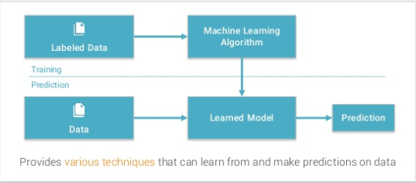
Machine learning
Machine learning is an application of artificial intelligence (AI) that provides systems the ability to automatically learn and improve from experience without being explicitly programmed.

Slide 5
It involves computational methods that use learning algorithms to build a model from data in
Supervised – Learning with a labeled training set
Ex: spam email detector
Unsupervised – Discovering patterns in unlabeled data
Ex: cluster similar documents based on the text contents
Reinforced mode – learning based on feedback or reward
Ex: learn to play chess by wining or loosing

Slide 6
Deep Learning
Part of machine learning field of learning representations of data. Exceptional effective at learning patterns
Utilizes learning algorithms that derive meaning out of data by using a hierarchy of multiple layers that mimic the neural networks of our brain.
If you provide the system tons of information, it begins to understand it and respond in useful ways.
Ex: Speech recognition, computer vision, Natural Language Processing

Slide 7
Python
Python is one of the most widely used programming languages in the AI field of Artificial Intelligence thanks to its simplicity. It can seamlessly be used with the data structures and other frequently used AI algorithms.
It has more documentation, examples, bigger community, support etc
Easy to learn and has a very good collection of libraries for AI programming
like: PIL, MatplotLib , Numpy, Tensorflow etc

Slide 8
Computer vision
Computer vision is the automated extraction of information from images.
Computer Vision is a Field That Includes Methods for
Acquiring
Processing
Analyzing
Understanding Images
Produce Numerical information

Slide 9
Computer vision Applications
Face recognition and enhancement
Automated driving
Visual tracking systems

Slide 10
Natural Language Processing
It is a sub-field of Artificial Intelligence (AI)
Aim is to build intelligent computers that can interact with human being like a human being !!
Applications:
Chatbots, Virtual digital assistants,Text to speech etc.

