Slide 1

Plotting in R ggplot2

Slide 2

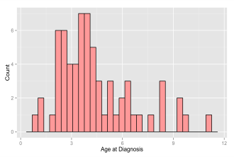
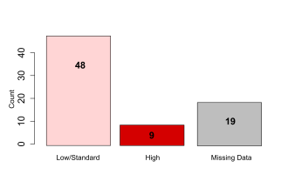
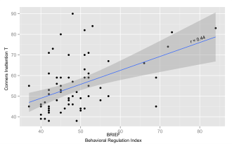
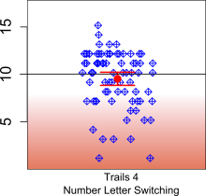
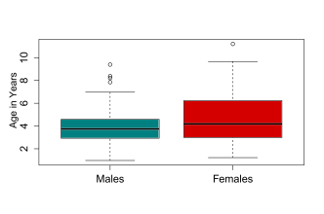
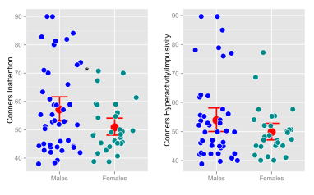
ggplot2
install.packages("ggplot2")
library(ggplot2)
Cheatsheet: http://zevross.com/blog/2014/08/04/beautiful-plotting-in-r-a-ggplot2-cheatsheet-3/

Slide 3
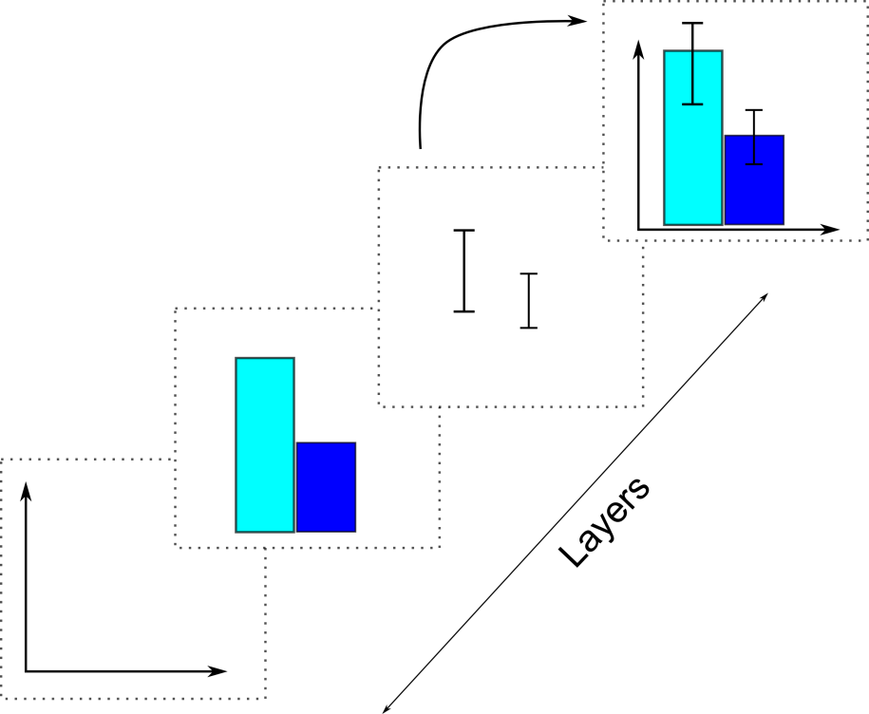
Plotting with ggplot
In ggplot, graphs are made up of layers that are placed on top of each other
Figure adapted from Andy Field, Discovering Statistics Using R

Slide 4
Each layer contains visual objects (e.g., bars, axes etc.)
Visual elements are referred to as geoms
Geoms are added to the plot using the + sign

Slide 5
Plotting with ggplot
Visual objects in a plot (bars, error bars, texts) are referred to as geoms() (geometric objects)
When defining a layer, tell R what geom you want displayed
Geoms have aesthetic properties to determine what they look like (e.g., red bars)
Aesthetic properties are referred to as aes()

Slide 6
geoms
geom_bar()
Creates a layer with bars
geom_point()
Creates a layer showing data points
geom_line()
Creates a layer that connects data points
geom_smooth()
Creates a layer containing a line that summarizes the data
geom_histogram()
Creates a layer with a histogram
geom_text()
Creates a layer containing text
geom_density()
Creates a layer with a density plot
geom_errorbar()
Creates a layers with error bars displayed on it
geom_abline() / geom_vline()
Creates a layer with a user-defined horizontal line
The “()” means that the geom accepts aesthetics so that you can determine how you want your layer to look.
geoms are added with the + sign

Slide 7
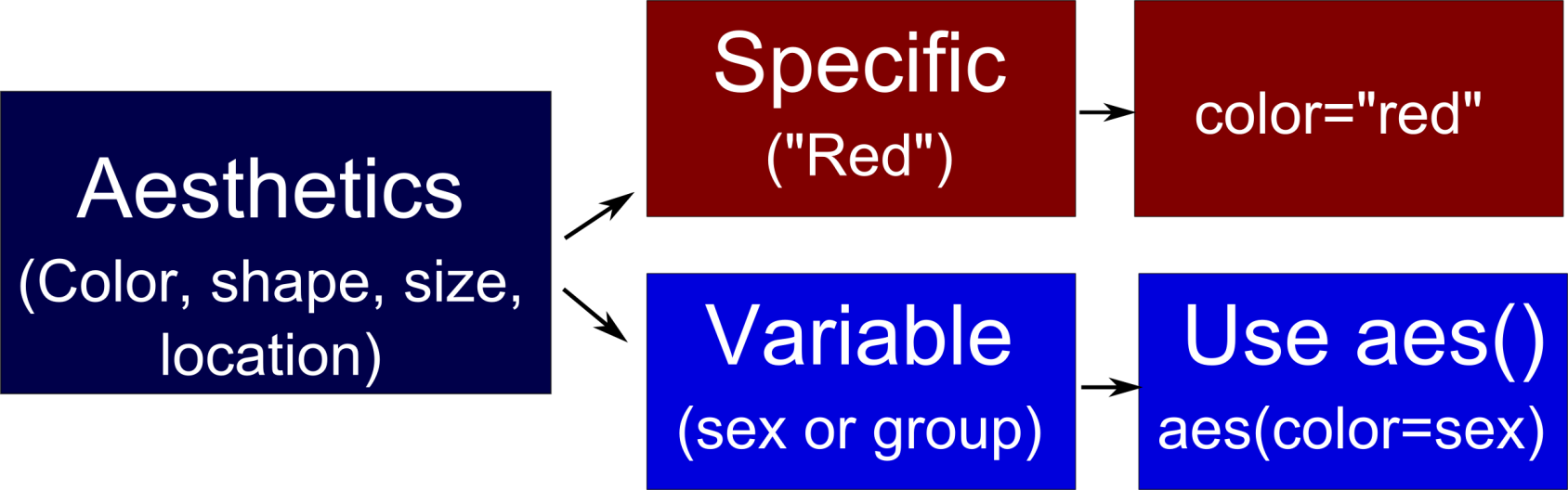
Plotting with ggplot
The world is your oyster!
Specify line type, shape, color (including a color-blind-friendly color palette) etc…

Slide 8
Plotting with ggplot
Basic command structure
MyPlotName <- ggplot(my.dataframe, aes(variable for x axis, variable for y axis, color=sex) + additional geoms
object
function
Reference data frame
Define aesthetics
Foundation of your ggplot
Does NOT work as a stand-alone
Add layers to your foundation

Slide 9
Our first plot!
Make a scatter plot showing the correlation between hsa-let-7e-3p and MYC
Include a regression line and axes labels
Color code by gender

Slide 10
Breaking down the plot
Scatterplot > geom_point()
To color-code by gender, we can reference the variable gender
geom_point(aes(gender))
X variable = hsa.let.7e.3p
Y variable = MYC
Regression line = geom_smooth(method="lm")
Xlab(" hsa-let-7e-3p ")
Ylab("MYC")
Remember your abline with your lm object?
geom_smooth is ggplot’s version of this

Slide 11
Creating a scatterplot
scatter1 <- ggplot(myplot.df, aes(x=hsa.let.7e.3p, y=MYC)) +
geom_point(aes(col=gender)) +
geom_smooth(method="lm") +
xlab(“hsa-let-7e-3p")+ylab(“MYC")
Name of the layered plot object
Call function
Reference dataframe
Determine x and y variables
Determine aesthetics
Set color based on group
Add points to plot
Add regression line
Set axes labels

Slide 12
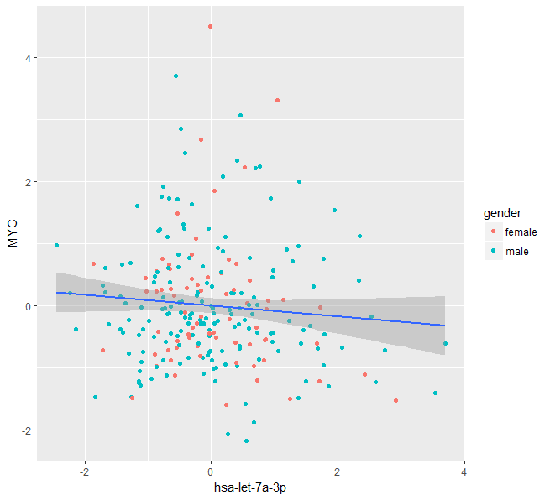
Your plot
Size of circles should be bigger
Background should be white
Legend title should be changed to “Legend” in bold
You want Males in blue, Females in red
Note: you can suppress the standard error region by typing geom_smooth(method = “lm”, se=FALSE)

Slide 13
TIP
If you specify your color based on the group.factor within the basic layer of the plot ggplot(df.valid, aes(x=has.let.7e.3p, y=MYC, col=gender)); you will get two regression lines

Slide 14
Change color of your factor variable
Because group.factor is mapped to the colors of the scatters, we need to use scale_color_manual()
We also have to use this geom to change the name of our legend, because it’s the very same factor variable we want to manipulate
Add the geom scale_color_manual to your code using the “+” :
scatter2 <- scatter1 + scale_colour_manual(values=c(“male" = "blue", “female" = "red"), name="Legend")

Slide 15
Change size of your circles
Changing the size of the circles can be done within the geom “geom_point()”
scatter3 <- scatter2 +
geom_point(aes(col=group.factor), size=3)
Note that if your colors are not based on a factor, you can change the colors of the circles within geom_point(aes(size=3, color="red"))
If you put size within aes() your legend will include “5”

Slide 16
TIP
You can change the color of your linear regression line and the SE area with geom_smooth(color = "color1-refers to regression line", fill="color2-refers to SE region")

Slide 17
Change Plot Settings
The geom “theme()” allows you to adjust the theme settings of your plot
Add the geoms theme() to your code using the “+” signs :
scatter4 <- scatter3 +
theme_bw() +
theme(legend.title = element_text(size=16, face="bold"))
Changes background to black and white
Changes legend properties

Slide 18
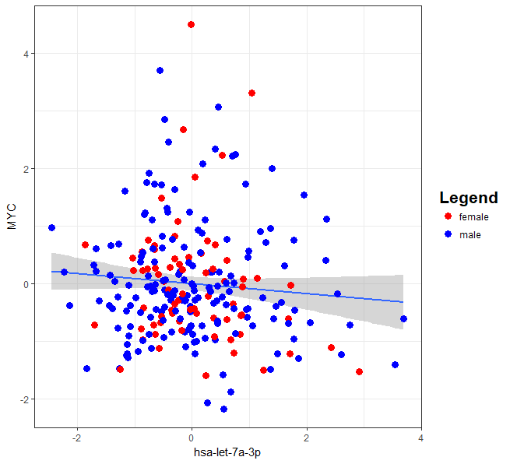
Your plot
Background and outline changed with geom theme()
Factor colors and labels changed with geom scale_color_manual()
Size changed within geom_point ()

Slide 19
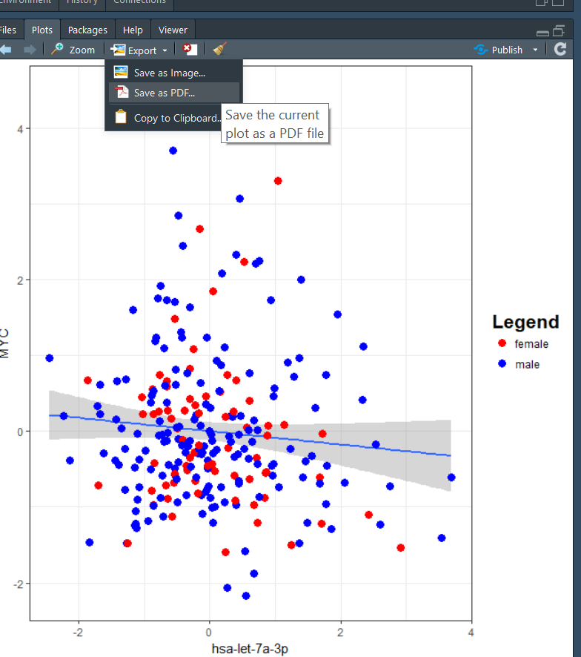
Export your plot to pdf

