Slide 1
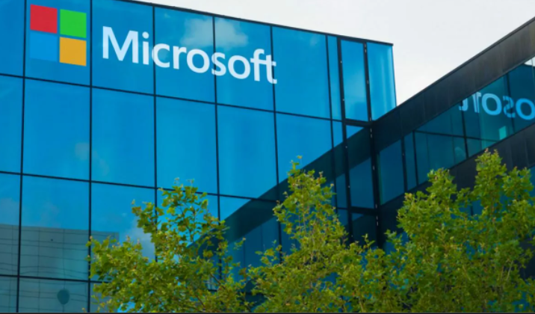
ANALYSIS OF MOVIES FOR MICROSOFT

Slide 2
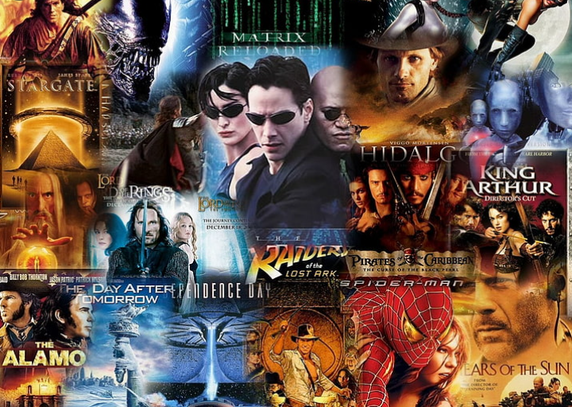

Slide 3
SUMMARY
This is a data analysis report on movies, their performance at the box office and factors that influence the success of movies .

Slide 4
OUTLINE
Business Problem
Data
Methods
Results
Conclusions

Slide 5
BUSINESS PROBLEM
Microsoft, has decided to create a new movie studio to tap into the HollywooD money.
which genre of movies offer higher returns?
What time of the year should movies be released?
Identify out the cost of production.
Before Microsoft can embark on movie creation, this analysis provides insights on successful movie genres, financial risks to be incurred and the most favourable durations to release movies throughout the year.

Slide 6
DATA
Data used in this analysis is available in these files: imdb.title.basics.csv.gz, rt.movie_info.csv.gz, tn.movie_budgets.csv.gz, imdb.title.ratings.csv.gz and bom.movie_gross.csv.gz’
Each data set has different variables. Describing movie names, genres, ratings, production budget, time of year the movie was released.

Slide 7
METHODS
Datasets for this analysis were provided in .csv and/ or .tsv format.
Data was cleaned, descriptive analysis and visualization done using python.

Slide 8
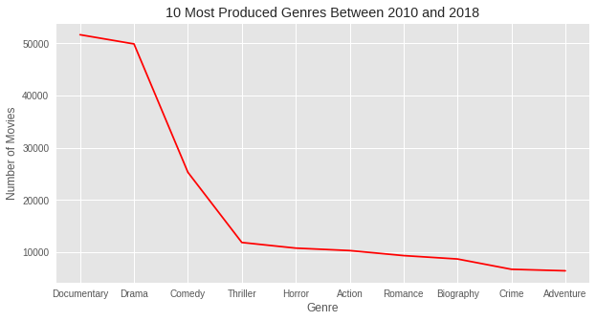
RESULTS
The five most popular genres include: Documentary, Drama, Comedy Thriller, Action.

Slide 9
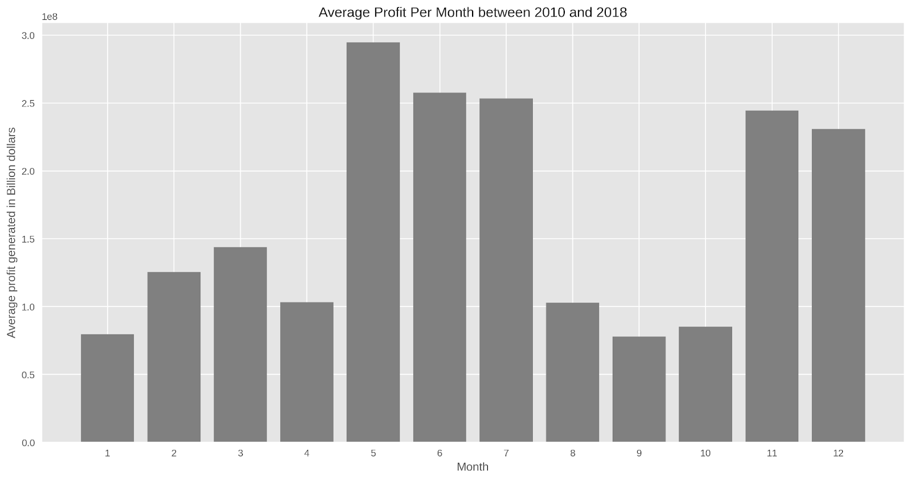
RESULTS
The best months to release
movies include the summer
months
of (May, June, July) and
holiday season
(November and December)

Slide 10
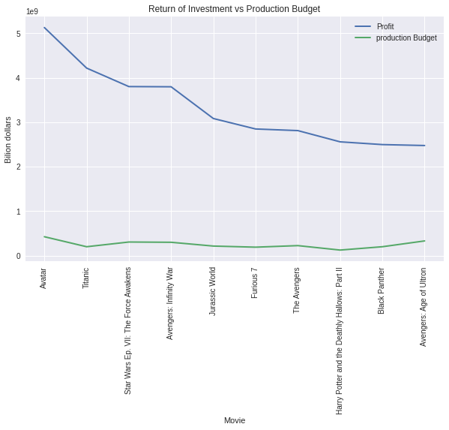
RESULTS
Investment of approximately
400 million dollars yields
Maximum profits
Investment of approximately
400 million dollars yields
Maximum profits

Slide 11
CONCLUSION
Insights from this data analysis suggest that for Microsoft to break through in movie business, they should consider:
Producing documentaries, dram, comedy, thriller action
Release movies in Summer, November and December
Invest at least 400 million per movie as production coat
Project Limitations
Missing values
Redundancy-Duplicate values in the datasets

Slide 12
THANK YOU
RACHAEL OSORO
rachael.osoro@students.moringaschool.com
Github Rachael-Osoro

Slide 13
THANK YOU
RACHAEL OSORO
rachael.osoro@students.moringaschool.com
Github Rachael-Osoro

