Slide 1

Reusable Code in R Markdown
Ron Blum @

Slide 2
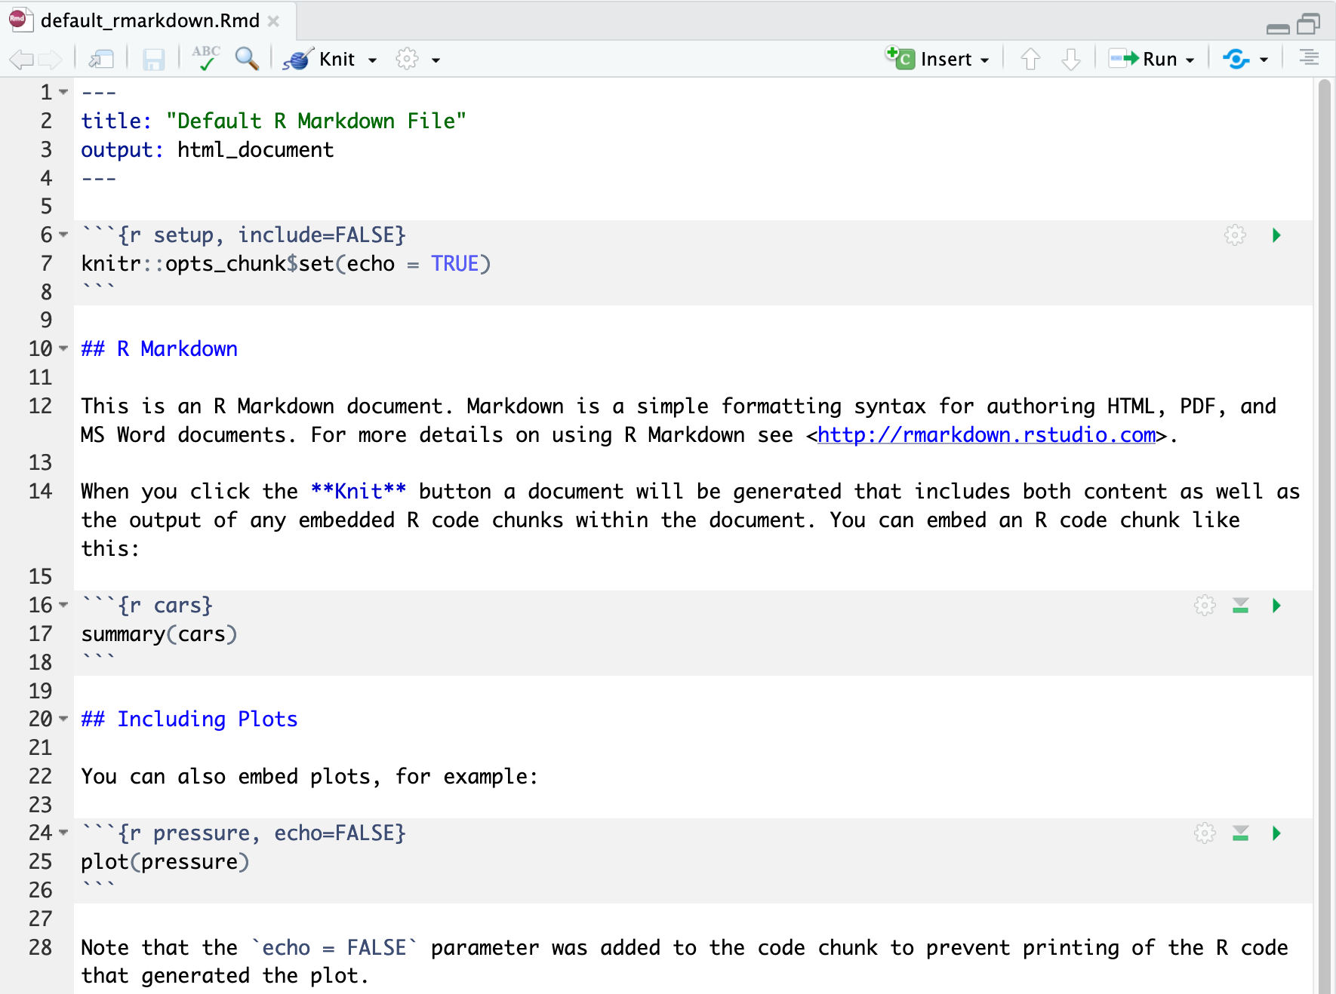
Sample R Markdown file

Slide 3
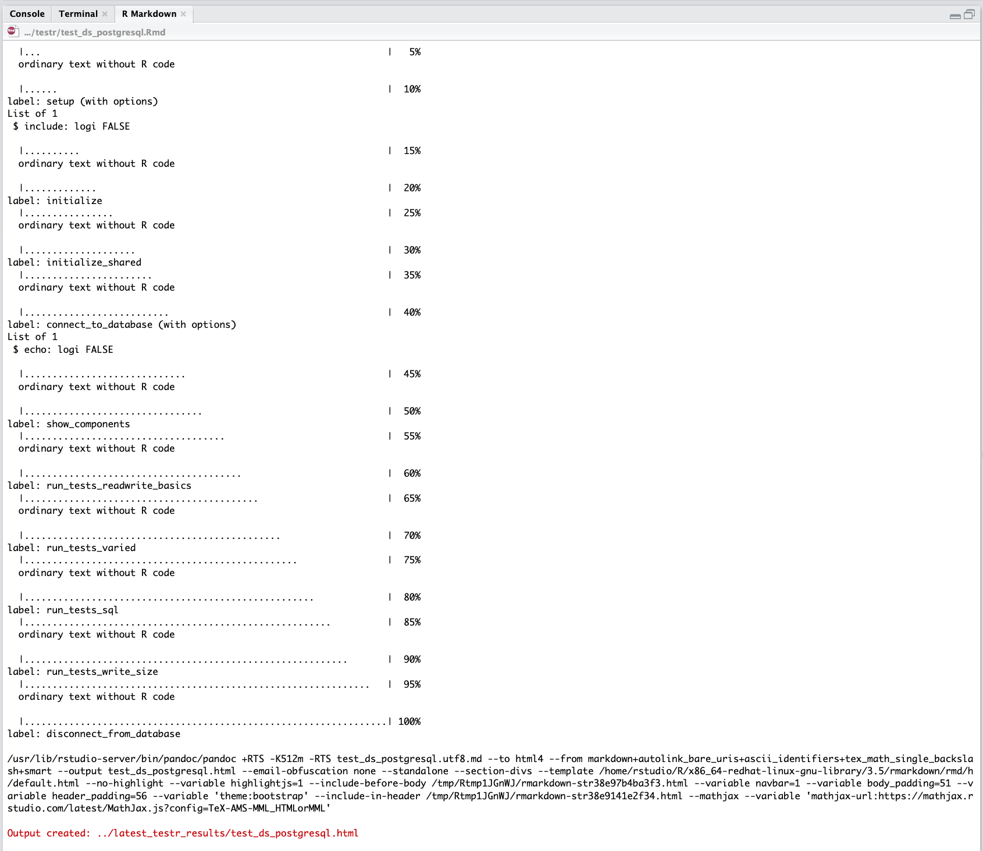
The R Markdown pane presents its status

Slide 4
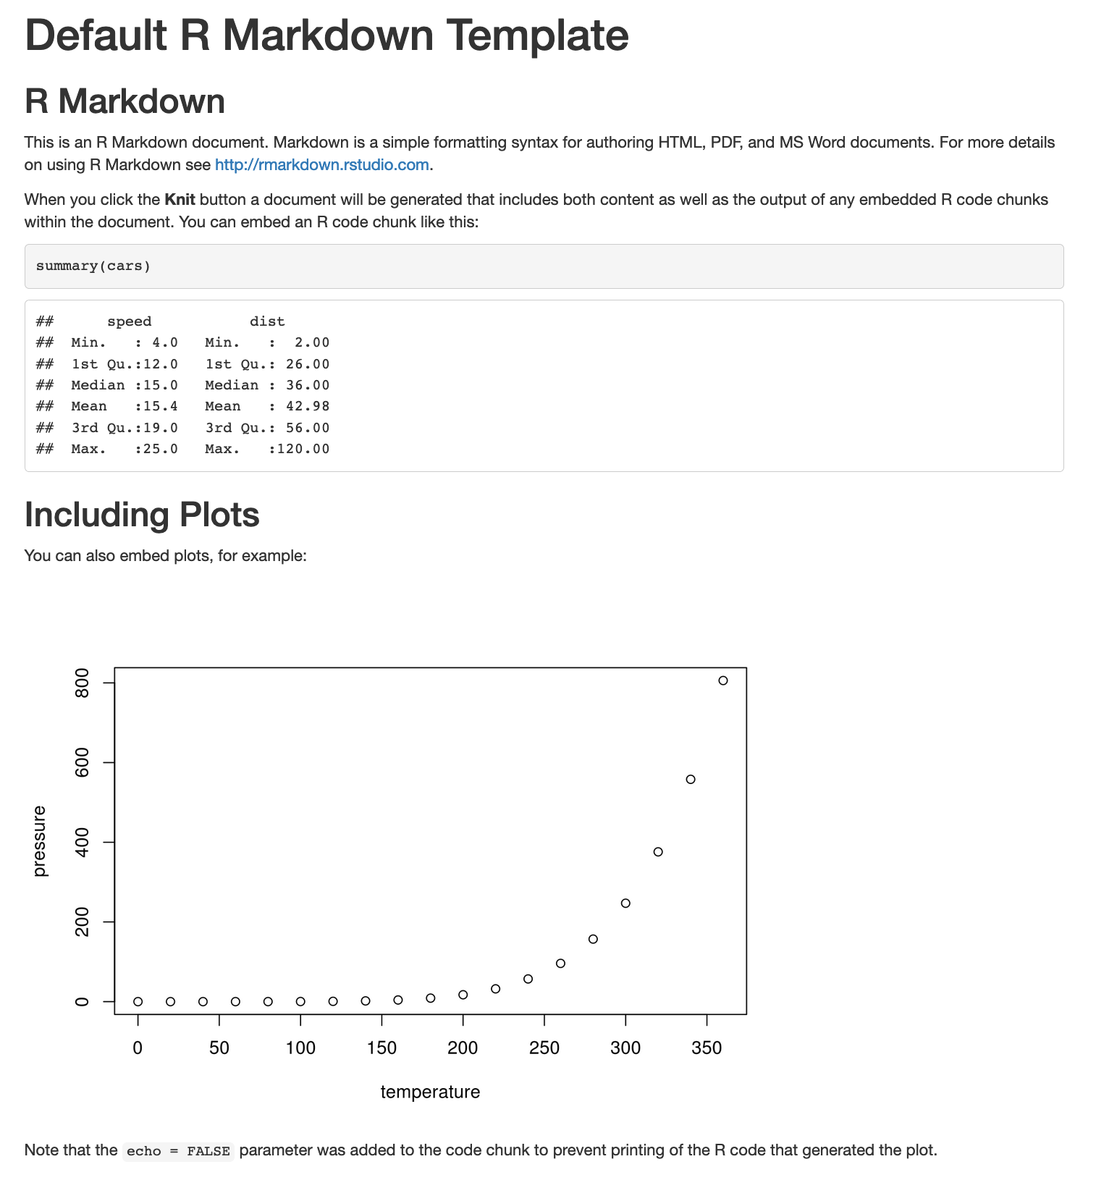
Results! In HTML, PDF, Word, etc.

Slide 5
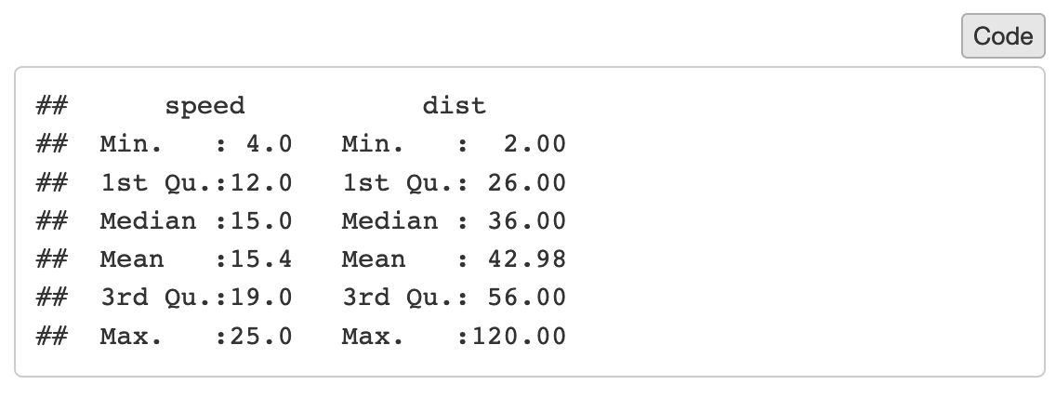
Just the facts, ma’am

Slide 6
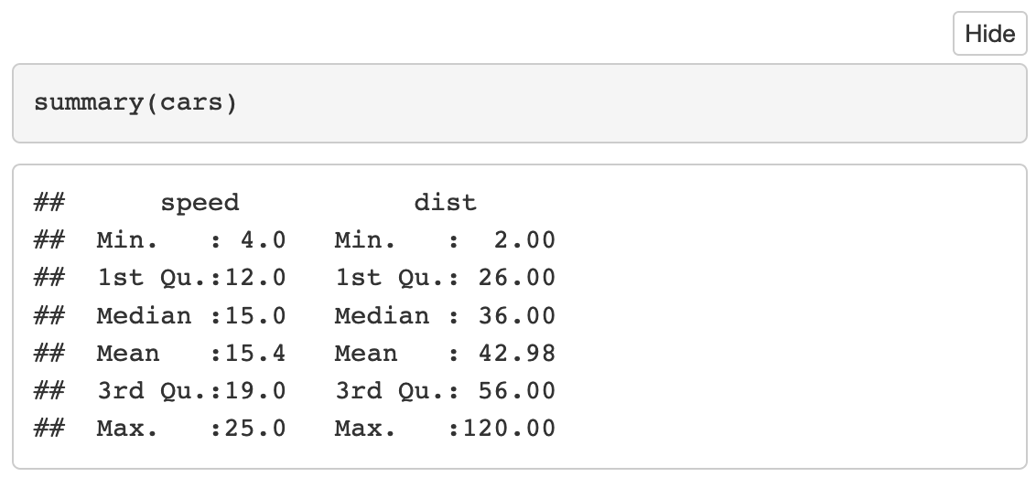
Pay no attention to that man behind the curtain

Slide 7
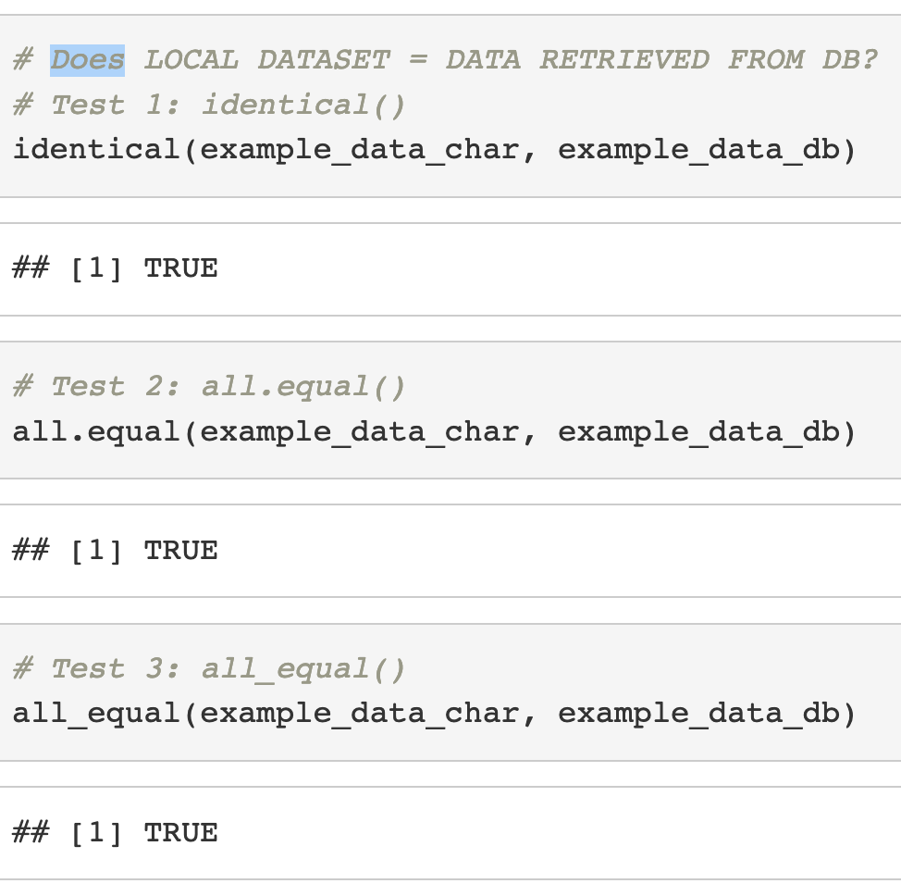
Goal: Run database tests and see if they pass

Slide 8
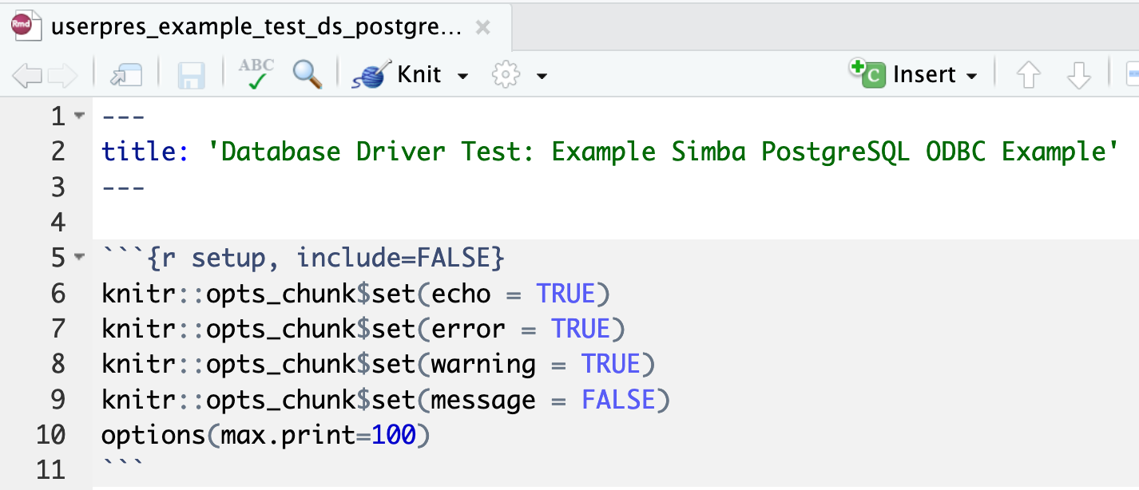
Some standard setup at the top

Slide 9
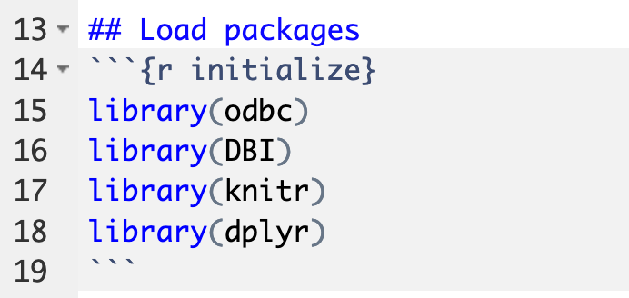
We load some much-needed packages

Slide 10
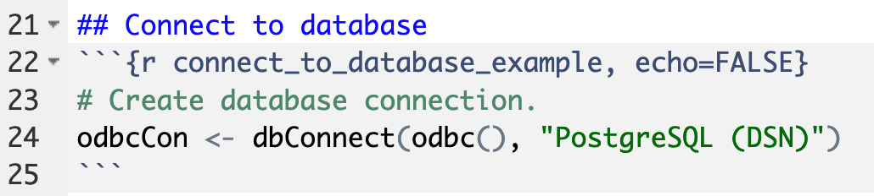
And now it’s time to connect to the database

Slide 11
Let’s start straightforwardly
by hard-coding

Slide 12
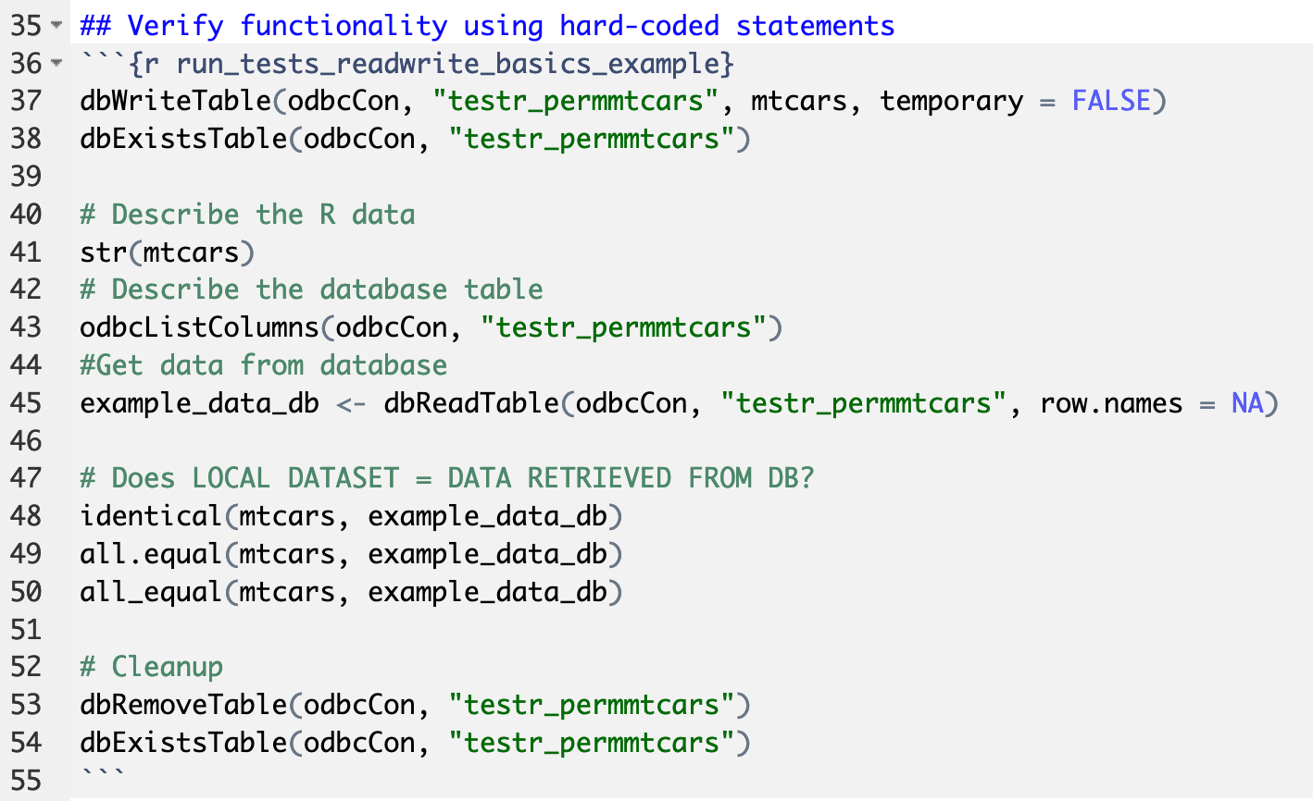
Hard-coded tests for reading and writing data

Slide 13
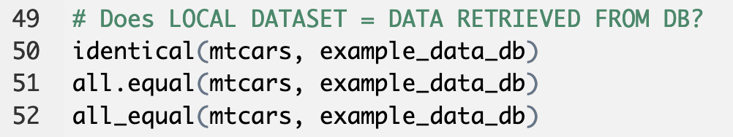
The actual tests

Slide 14
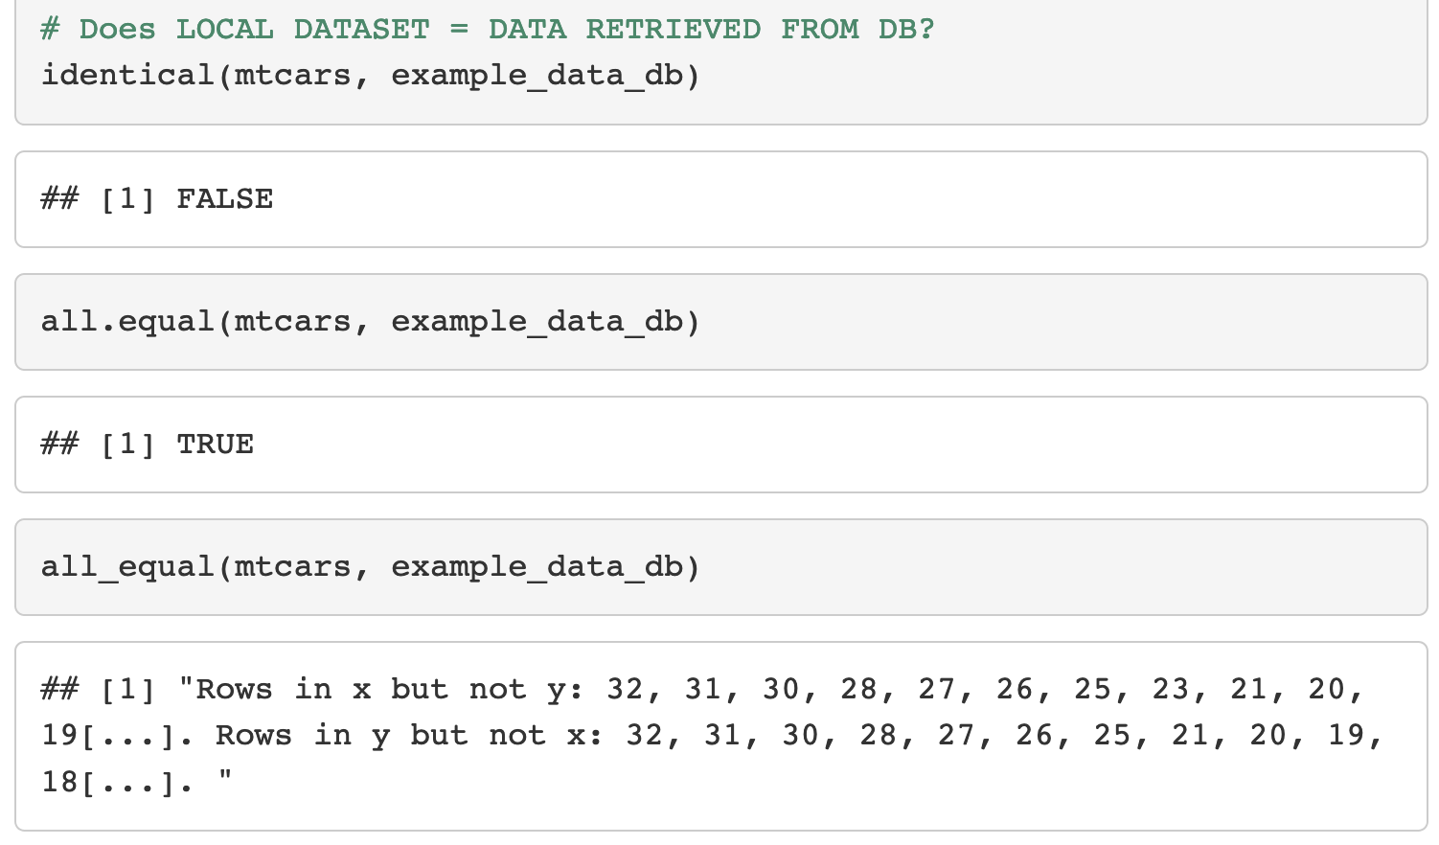
And the test results

Slide 15
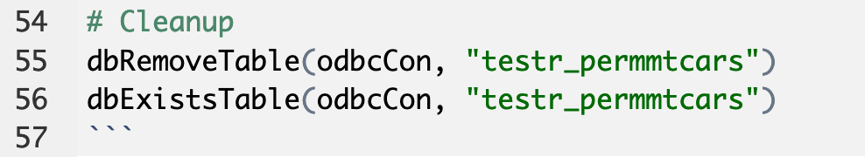
It’s always polite to clean up after ourselves

Slide 16
Now let’s try this
with reusable code

Slide 17
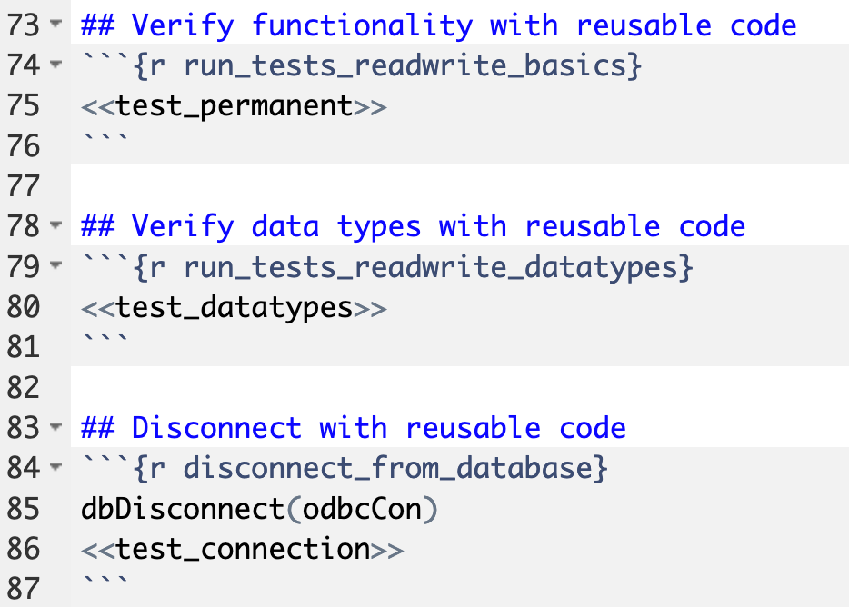
The parent wants to do some testing without doing any work

Slide 18
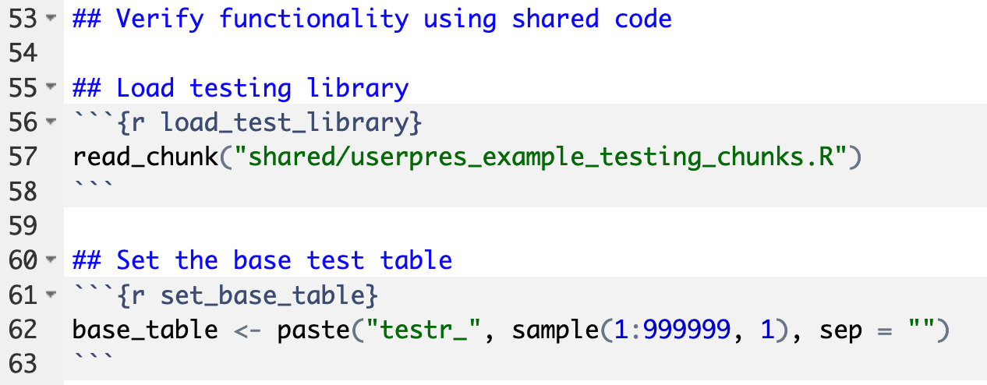
First we’ll read in the child file

Slide 19
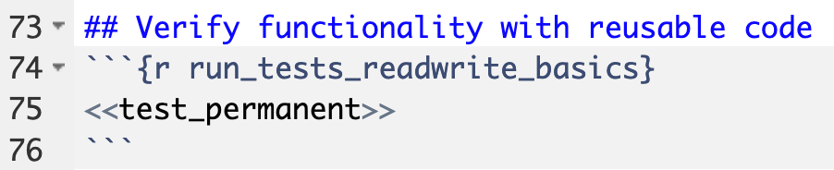
Parent asks child: Can you read and write?

Slide 20
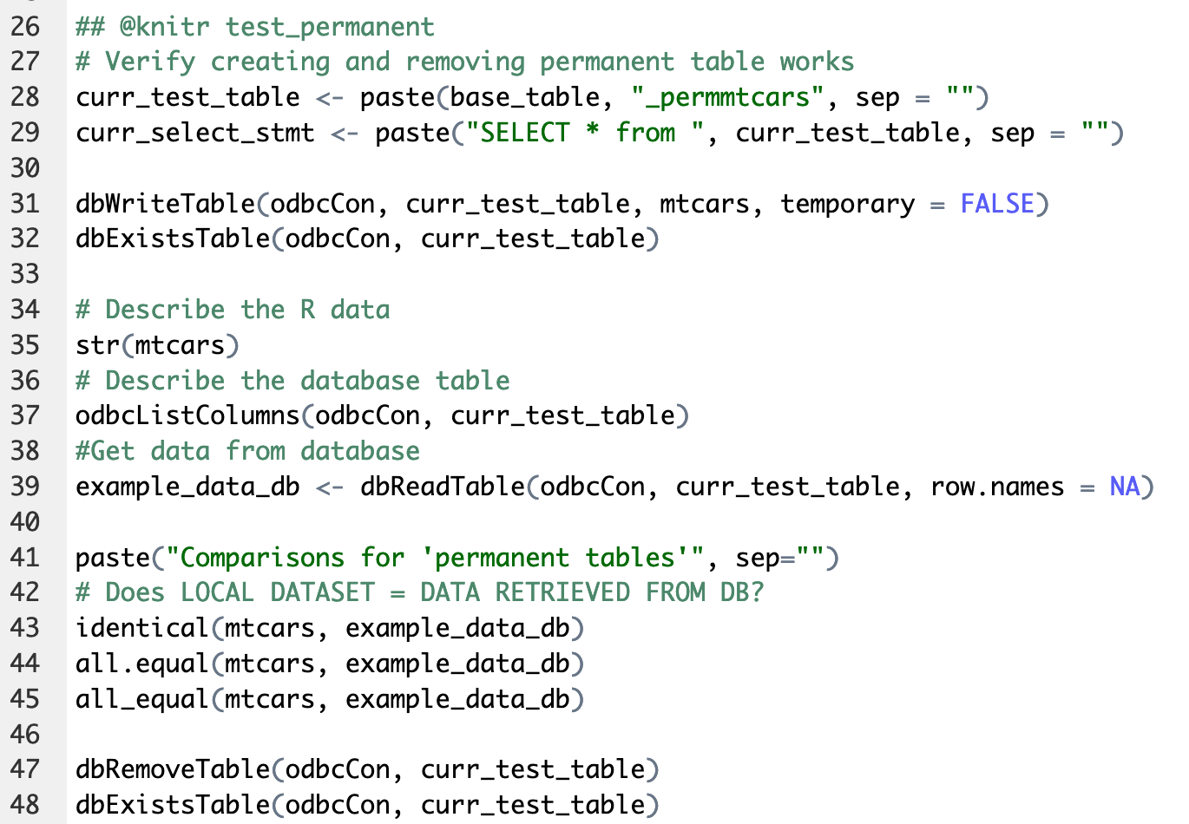
Child says: I’ll try

Slide 21
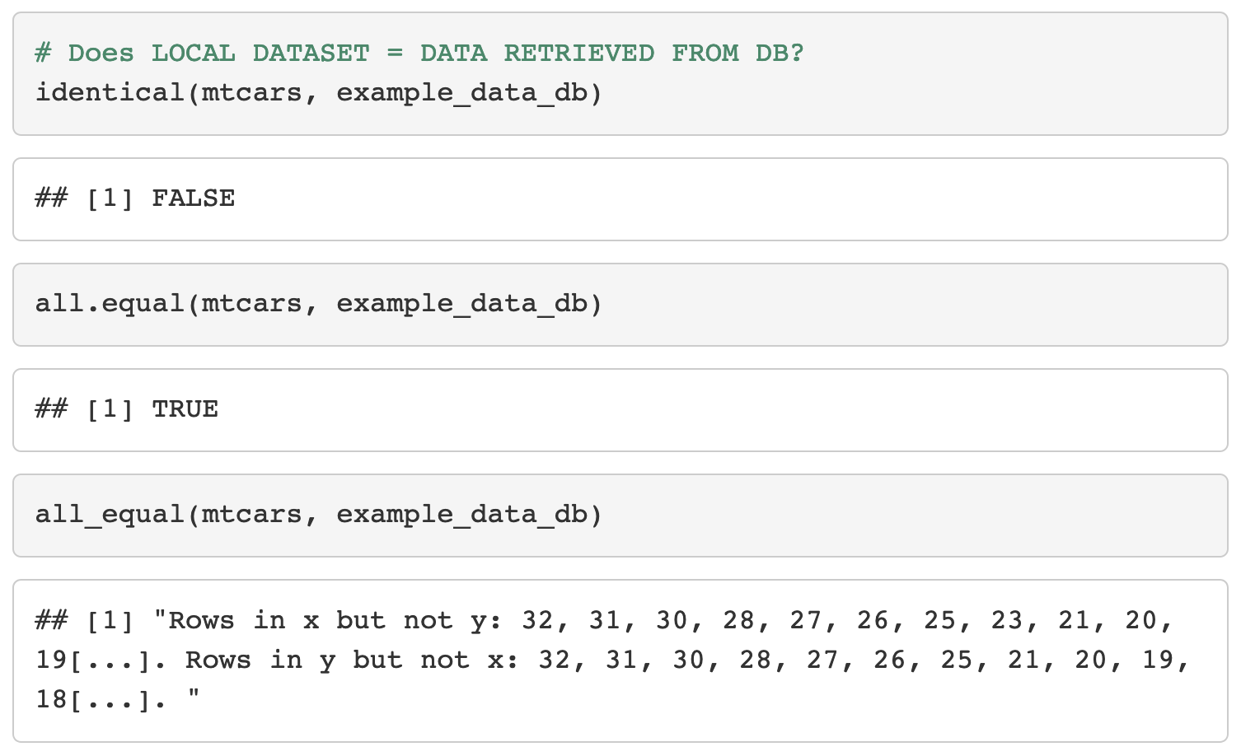
And the child comes to the same conclusion as the parent

Slide 22
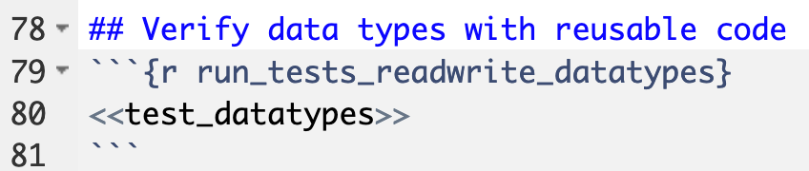
Parent asks child: Can you take a look at different data types correctly?

Slide 23
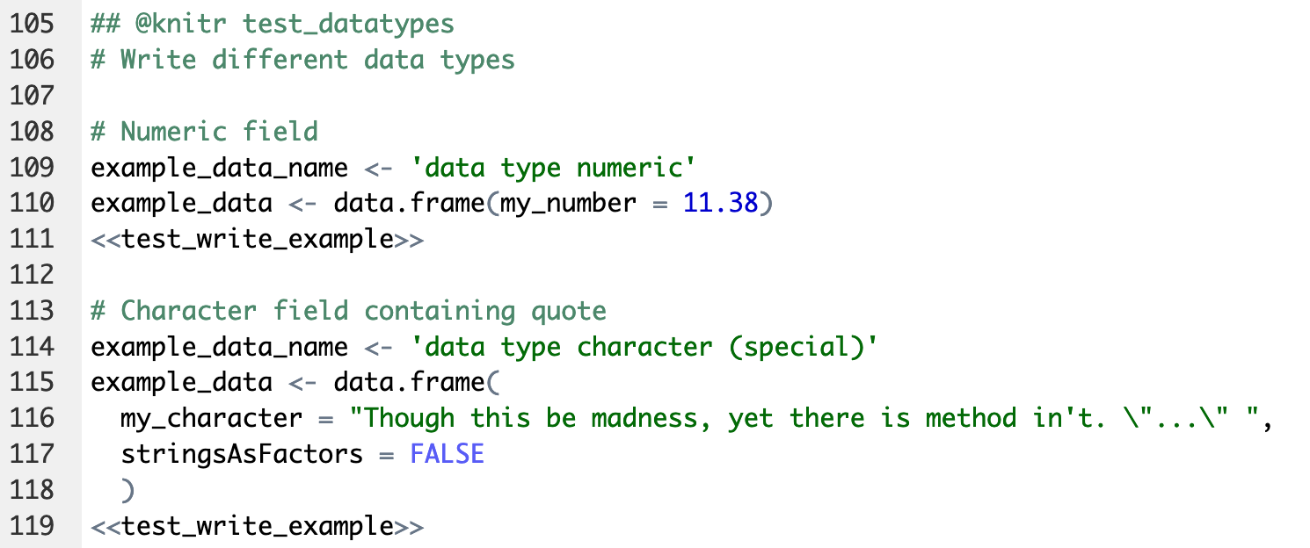
Child says: Yes, but I’m going to repeat myself

Slide 24
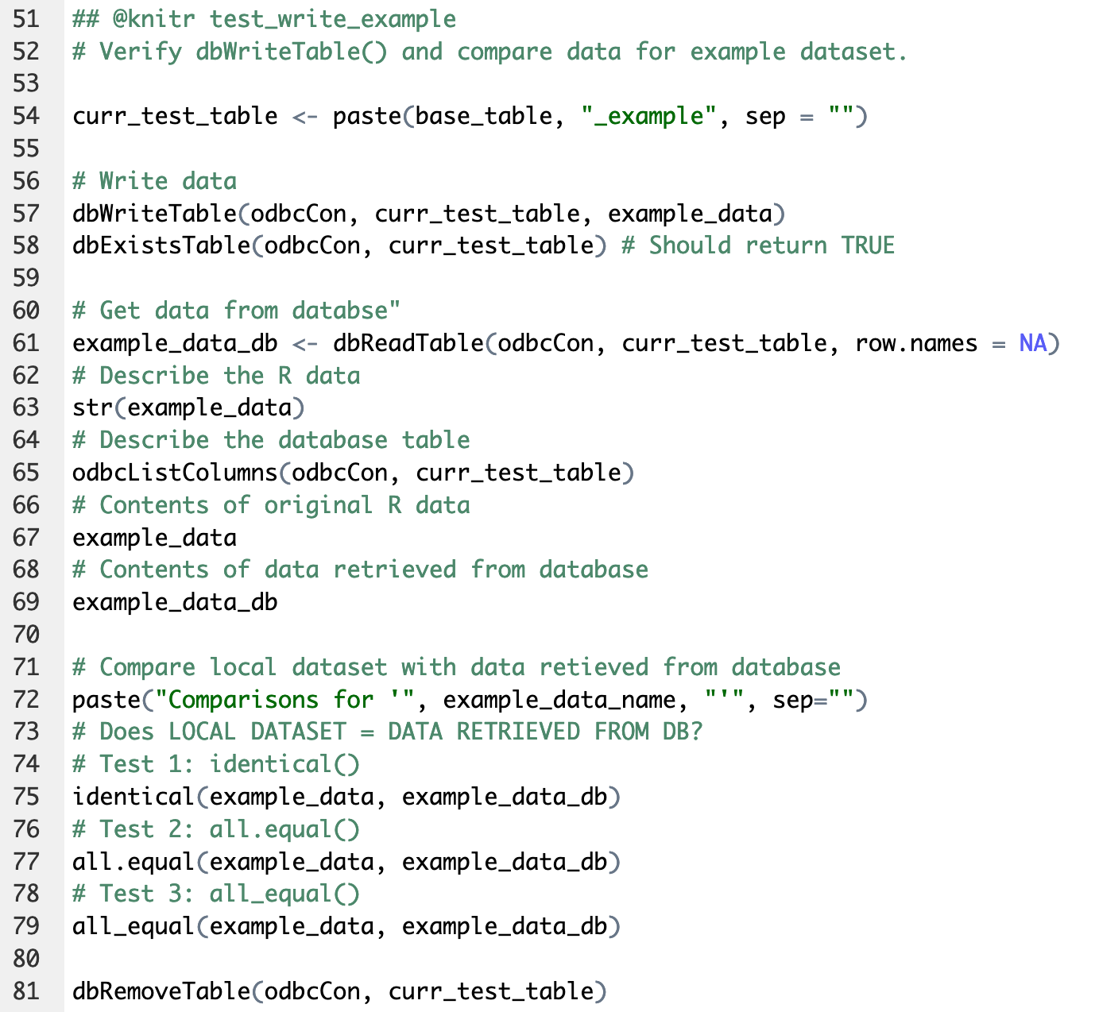
Child says: This is what I’ll do every time

Slide 25
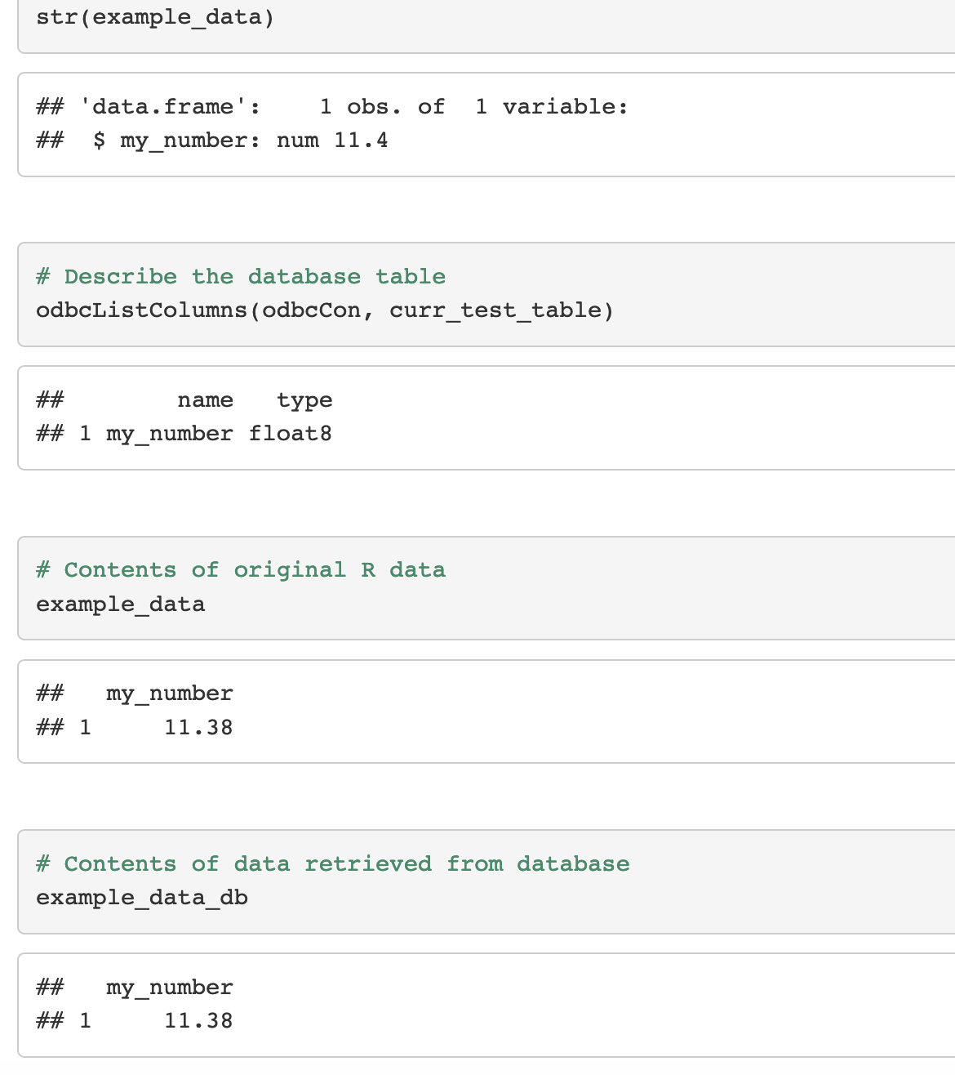
Child says: Here are the test details

Slide 26
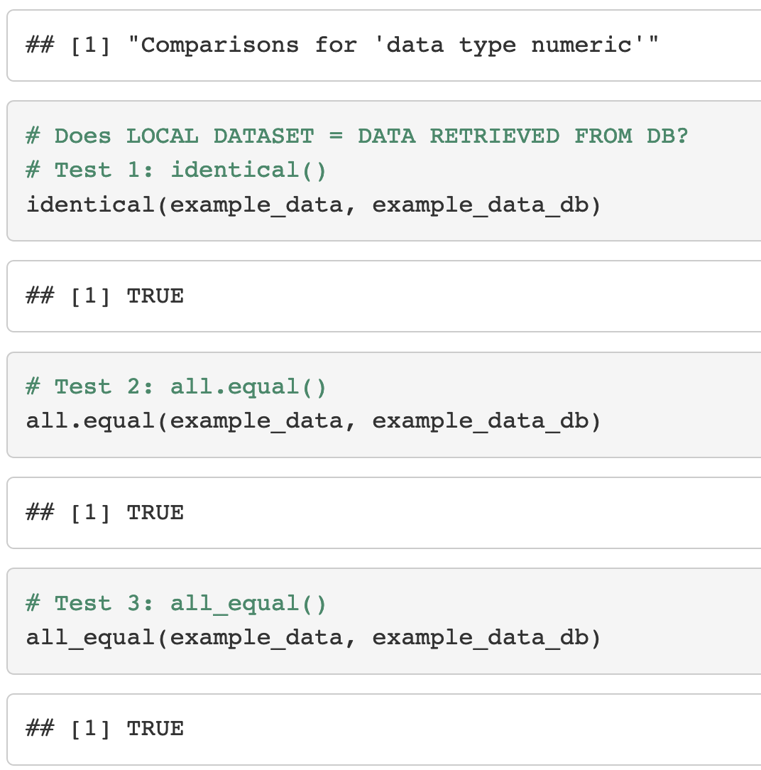
Child says: Numeric data works!

Slide 27
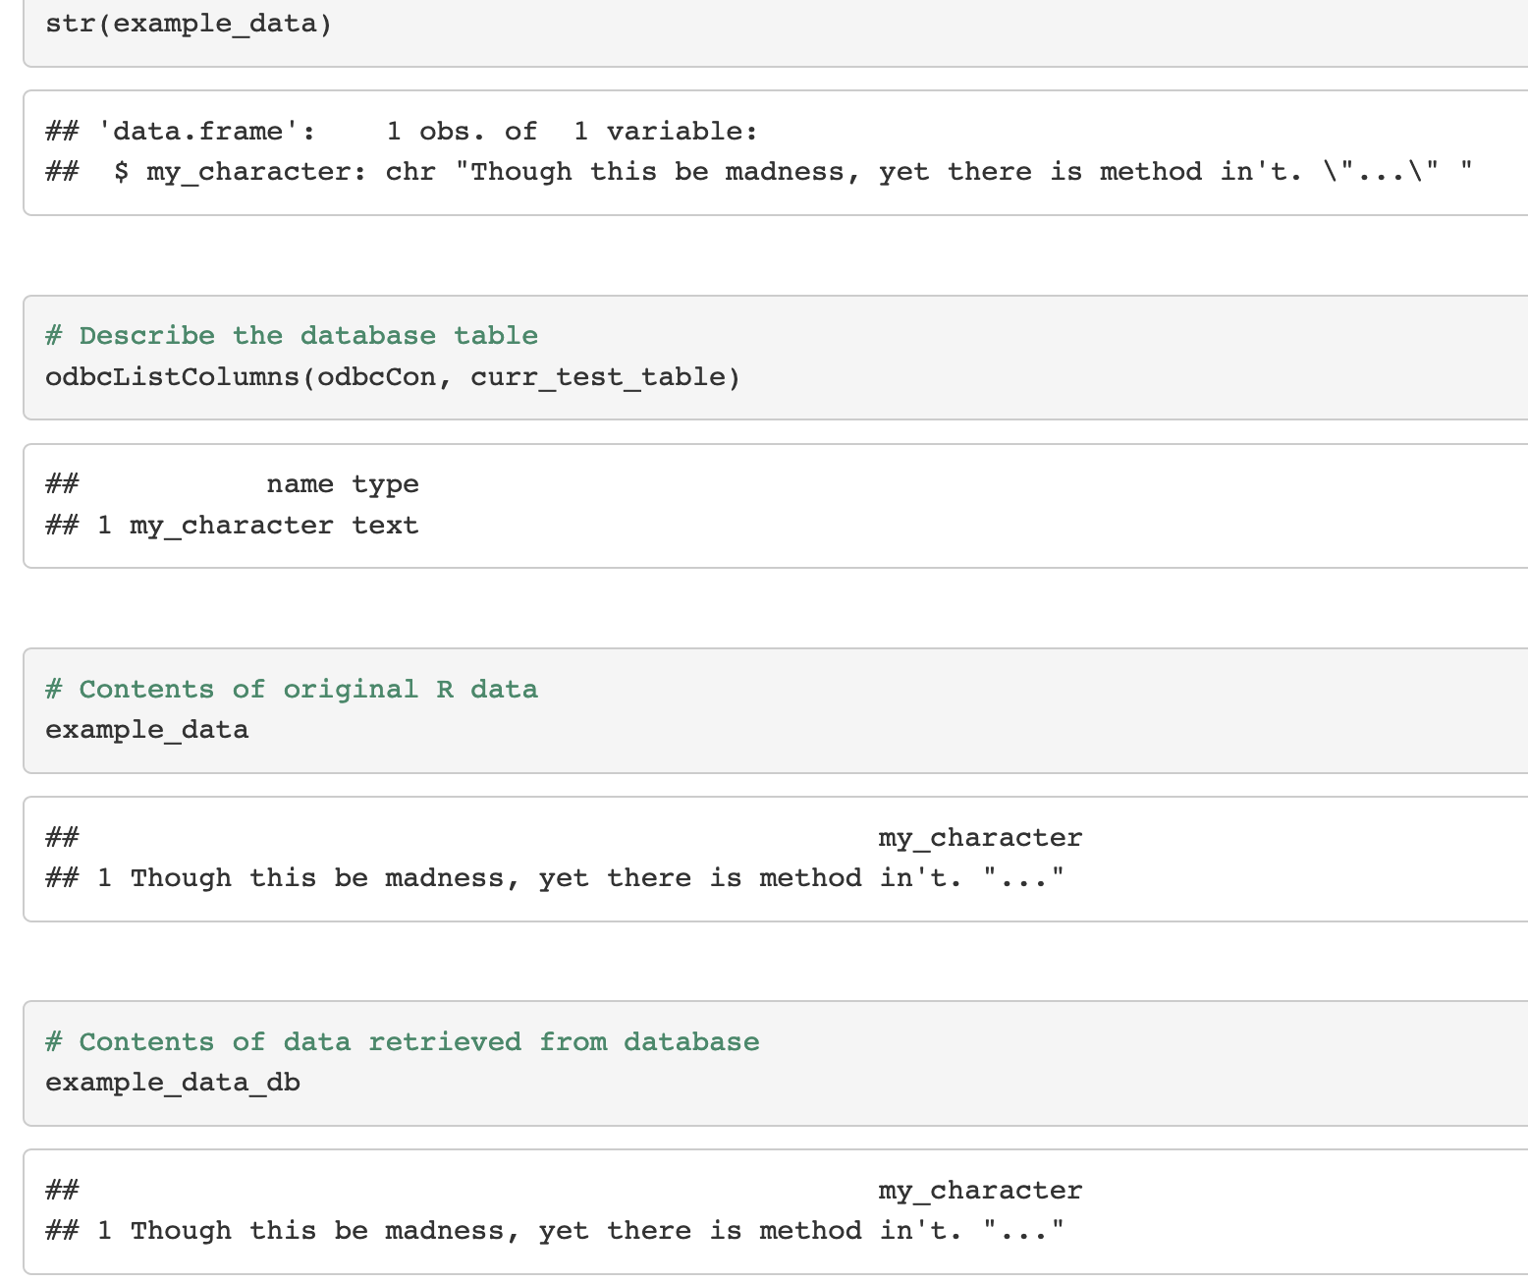
Child says: I can show my work

Slide 28
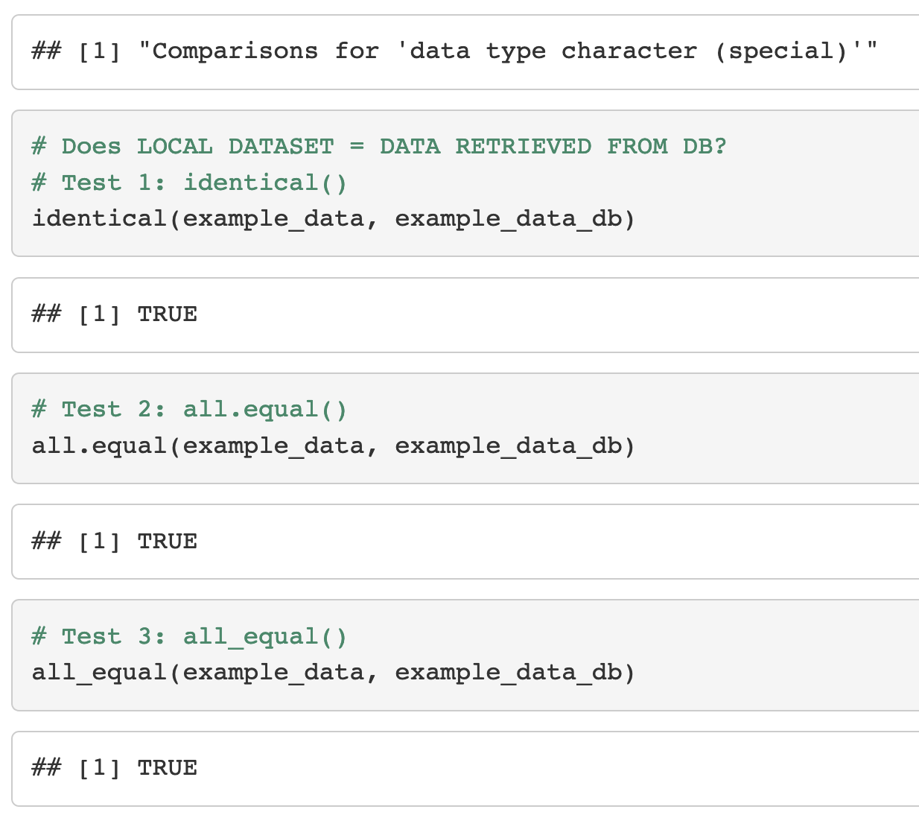
Child says: Even special characters work!

Slide 29
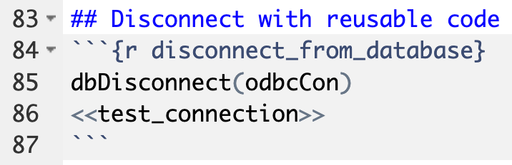
Parent says: Good job. Let’s get ice cream.

Slide 30
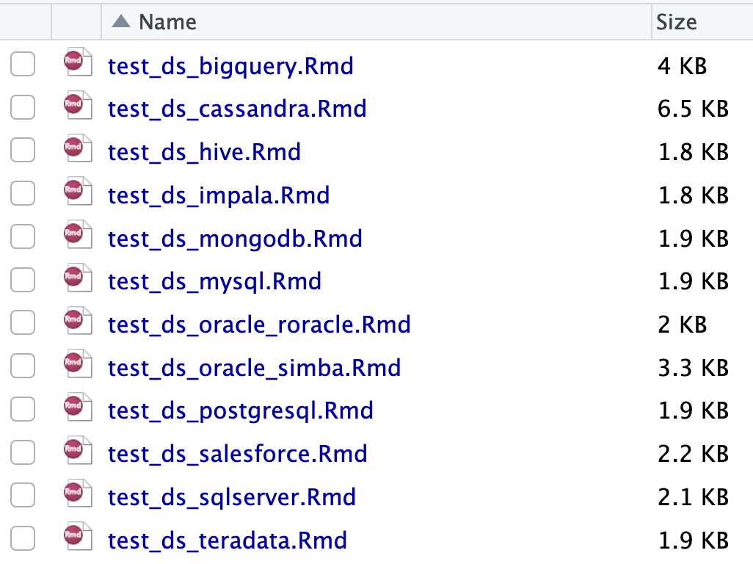
This kid deserves a lot of ice cream

Slide 31
Thank you from
the child,
the parent,
and me!

