Slide 1
Algorithms, Big-O, Psuedocode, Searching, Sorting

Slide 2
What are Algorithms?
Any series of steps taken to solve a problem is an algorithm.
Some problems occur a lot in programming: sorting sets of data, searching data for particular values, finding relationships between data, etc.
Solving a problem requires balancing resources available
Memory space
Execution time
Algorithms are typically generic steps independent of the data provided. Sort(x), it doesn’t matter if x is numbers or people.

Slide 3
Measuring Algorithms
Algorithms are designed independent of the inputs they are given. An algorithm isn’t designed differently if it only sorts 5 objects instead of 500.
…but we have to respect resources used. The same algorithm will likely take longer to sort 500 elements than it would to sort 5.
…but how much longer? How quickly/slowly do the time requirements grow as the number of inputs grows?
Algorithms are measured by the relative rates that they consume resources as their inputs grow. We sometimes call this efficiency or complexity.

Slide 4
Big-O Notation
An algorithm does something to inputs that are provided. More inputs, more steps to complete.
Inputs are called “n”. Algorithms are expressed as a function describing how quickly they grow as ‘n’ increases.
The function O is used to express how the algorithms grow as ‘n’ approaches infinity. Sometimes called the “worst-case” growth.
For example, O(n) function grows linearly with n. As n increases, the number of steps required increases a proportionate amount.

Slide 5
Big-O and Math
Big-O can involve a bit of limit calculus and algebra. This is the science of computer science.
In most circumstances, you can avoid the crunchy mathematical details if you understand the rules involved.
Deducing the complexity of an algorithm can be done through pattern recognition much of the time.
We’ll try to keep it approachable, but algorithms are important.

Slide 6
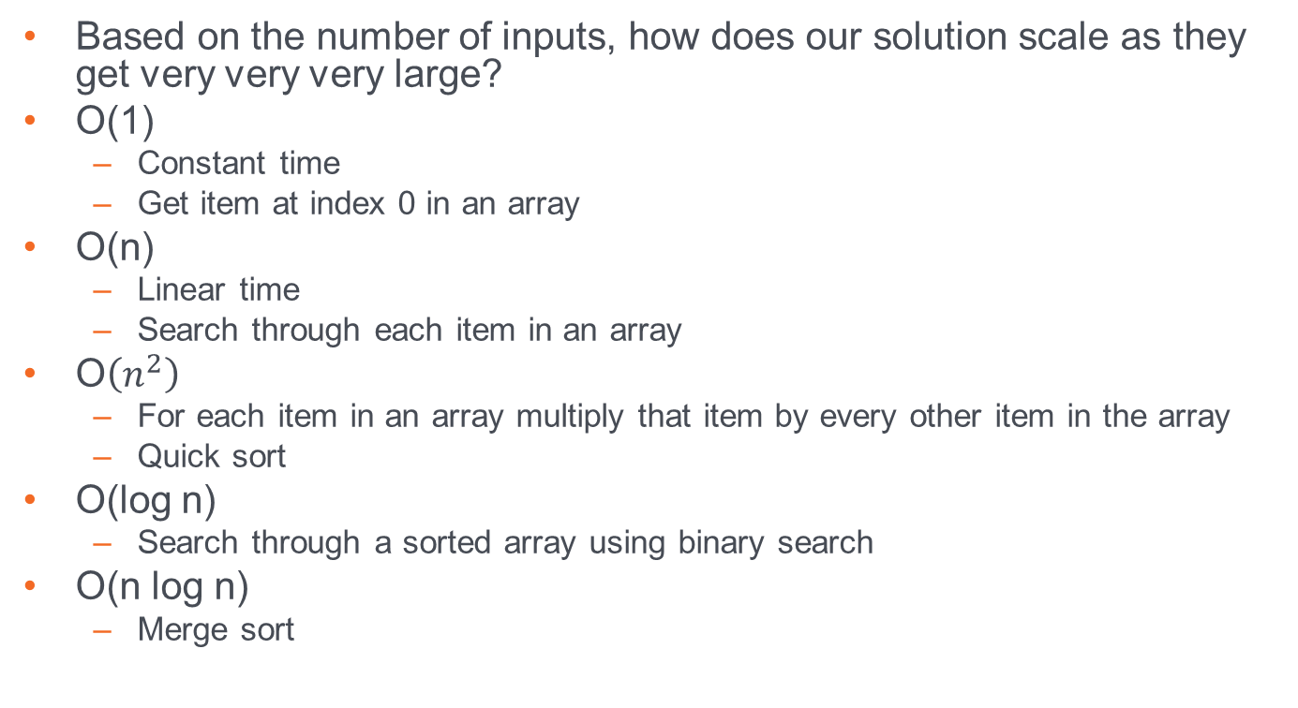
Big-O
Based on the number of inputs, how does our solution scale as they get very very very large?
O(1)
Constant time
Get item at index 0 in an array
O(n)
Linear time
Search through each item in an array
O$\left(n^{2}\right)$
For each item in an array multiply that item by every other item in the array
Quick sort
O(log n)
Search through a sorted array using binary search
O(n log n)
Merge sort

Slide 7
Binary Search
public static int binarySearch(int[] sortedArray, int input) {
int beginIndex = 0;
int endIndex = sortedArray.length;
System.out.println(Arrays.toString(sortedArray)+" searching for "+input);
while(beginIndex < endIndex){
int midIndex = (endIndex + beginIndex)/2;
int midpoint;
if (midIndex < sortedArray.length)
midpoint = sortedArray[midIndex];
else {
midpoint = 0;
return -1;
}
System.out.println("BeginIndex = "+ beginIndex+ " EndIndex = "+ endIndex);
System.out.println("Midpoint = "+midpoint +" midIndex = "+midIndex);
if(input == midpoint) {
return midIndex;
}else if (input > midpoint) {
beginIndex = midIndex+1;
}else {
endIndex = midIndex;
}
}
return -1;
}

Slide 8
Sorting Arrays
An algorithm is just a step-by-step approach to solving a problem.
You have an array of numbers, and you want to sort them from lowest to highest. How do you do it?
There’s no programming tricks here. Talk it out, like you’re explaining it to a child.
Do you…
Search for the lowest value first
Move it to the front
Repeat for the remainder?
Or do you…
Check every two adjacent elements and…
swap them if the right is smaller then the left
Repeat until done?

Slide 9
Selection Sort
Sort by selecting the lowest value and moving them to the front.
int[] arr = {6,2,3,1,4,5};
// for each element in the unsorted array…
for(int i = 0; i < arr.length - 1; i++){
// find the index of the smallest value
int minIndex = i;
for (let j = i+1; j < arr.length; j++) {
if (arr[j] < arr[minIndex])
minIndex = j;
}
// swap the value at the current index and the index of
// the smallest value
int larger = arr[i]; // save the old/larger value
arr[i] = arr[minIndex]; // move the smaller value forward
arr[minIndex] = larger; // move the larger value back
}

Slide 10
Bubble Sort
Sort by swapping every 2 unsorted values
int[] arr = {6,2,3,1,4,5};
for (int i = 0; i < arr.length-1; i++)
for (int j = 0; j < arr.length-i-1; j++)
if (arr[j] > arr[j+1]) {
// swap arr[j+1] and arr[i]
int temp = arr[j];
arr[j] = arr[j+1];
arr[j+1] = temp;
}

Slide 11
Psuedo Code
algorithm palindrome is input: string phrase output: true/false result
length = length of phrase c = 0
while (c <= length/2) if (phrase[c] != phrase[length - 1 - c]) return false c = c + 1
return true

