Slide 1
Encapsulation, Stack and Heap, this keyword, Wrapper classes

Slide 2
Access Modifiers
Public: visible to all classes, everywhere
Protected: visible to all classes in the same package, and any subclasses
Package-Private (default): visible to all classes in the same package
Private: visible only within the current class
Access modifiers on variables can be bypassed by more-visible methods that return or set their values

Slide 3
Accessing Class Members
package one;
public class Dog {
double size = 6.5;
void myMethod(){
System.out.println(“Running my method.”);
}
}
public
public
package two;
import one.Dog;
public class TestDog{
public static void main(String[] args){
Dog dog = new Dog();
//Access size
dog.size = 10.5;
//Access myMethod
dog.myMethod();
}
}

Slide 4
Accessing Class Members
PACKAGE-PRIVATE
!!
package one;
public class Dog {
double size = 6.5;
void myMethod(){
System.out.println(“Running my method.”);
}
}
package one;
package two;
import one.Dog;
public class TestDog{
public static void main(String[] args){
Dog dog = new Dog();
//Access size
dog.size = 10.5;
//Access myMethod
dog.myMethod();
}
}

Slide 5
Accessing Class Members
Private
!!
package one;
public class Dog {
private double size = 6.5;
private void myMethod(){
System.out.println(“Running my method.”);
}
}
package two;
public class TestDog{
public static void main(String[] args){
Dog dog = new Dog();
//Access size
dog.size = 10.5;
//Access myMethod
dog.myMethod();
}
}

Slide 6
Encapsulation
Encapsulation: an OOP design principle
Classes should allow minimum necessary access to their members.
Access to class variables should be done through methods that can perform validation
Getters and Setters / Accessors and Mutators
private int someVar;
public int getSomeVar() { return someVar; }
public void setSomeVar(int in) { this.someVar = in; }
Capitalization and naming of getters/setters is important.
getVariableName() and setVariableName(). Some libraries expect this pattern to be followed.

Slide 7
Accessing Class Members
package one;
public class Dog {
private double size = 6.5;
public double getSize(){
return this.size;
}
public void setSize(double size){
this.size = size;
}
}
This allows us to access the private field indirectly
!!
package two;
public class TestDog{
public static void main(String[] args){
Dog dog = new Dog();
dog.setSize(9.0);
System.out.println(dog.getSize());
}
}

Slide 8


this()…
When you call a constructor only one of the constructors in each class runs unless one of the constructors calls this(…)
this is a reference to the current class, so this() is an invocation of one of the current class’ constructors.
this() can be used in place of - it must be the first instruction of the constructor.
package one;
public class Dog {
private double size = 6.5;
public Dog(){this(12);}
public Dog(int size){
this.size = size;
}
}

Slide 9
Class Relationships
OOP seeks to, whenever possible, eliminate redundant/repetitive code and promote re-use
To this end, a class can…
“inherit” states and behaviors from another
“Is-A(n)” relationship (More on this in a few weeks)
create/contain an instance of another
“Has-A(n)” relationship, “Composition”
Classes inherit, not the objects themselves-
states are inherited, not their specific values.
(More on this in a few weeks)

Slide 10

HAS-A
public class Collar {
String color = “orange”;
}
public class Dog {
//instance variable- state of a Dog object
public double size = 6.5;
public Collar collar = new Collar();
}
public class TestDog{
public static void main(String[] args){
Dog dog = new Dog();
}
}

Slide 11
Modules
Java Platform Module System (JPMS)
Introduced with Java 9
Collection of associated packages, resources, and a module descriptor
Module descriptor specifies
Name of module
Dependencies
i.e. other modules that your module relies on
The packages available to other modules
And more…

Slide 12
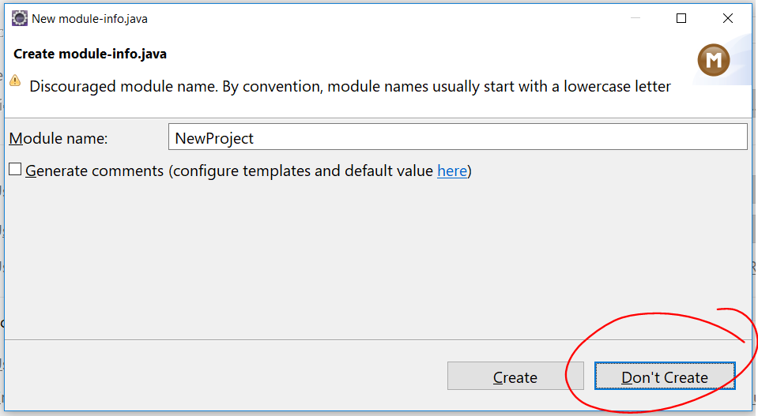
Module Descriptor
Created from module-info.java
module moduleName{
//module directives go in here
//technically all of these are optional
//you would specify things like
exports mypackage;
requires modulesNeededInModuleName;
}
For our purposes though you can simply select Don’t Create

Slide 13

Background…
Recall how we typically call/invoke an instance method
First we declare/define it.
public class Dog{
public void bark(){
System.out.println(“woof!”);
}
}
public class TestDog{
public static void main(String[] args){
Dog daisy = new Dog();
daisy.bark();
}
}
Running these instructions
Then we call the instance method on our object.

Slide 14
Now this…
So what if we want the instructions in our method to affect the state of the object that the method is called on…
That’s why we have the this keyword- a reference to the current object.
So let’s see this in action.

Slide 15
This in action
Let’s create a Dog class with an instance variable size. Let’s also create a grow method…
public class Dog{
public double size = 5.5;
public void grow(){
this.size += 1;
}
}
public class TestDog{
public static void main(String[] args){
Dog daisy = new Dog();
daisy.grow();
}
}
Here we use the this keyword to indicate that we want to modify the size of the Dog object grow() is called on.
Running these instructions
Then we call the instance method on our object.

Slide 16
Clarifications
If you are sitting there going- but couldn’t we have just said:
You are correct.
So then why?
Using this makes it even more clear that you are referring to an instance variable.
Also, we could have created a local size variable- having two variables of the same name we need a way to differentiate between them.
public class Dog{
public double size = 5.5;
public void grow(){
size += 1;
}
}

Slide 17
This in action
Now the word size refers to the parameter, size.
public class Dog{
public double size = 5.5;
public void growToSize(double size){
this.size = size;
}
}
public class TestDog{
public static void main(String[] args){
Dog daisy = new Dog();
daisy.growToSize(7.7);
}
}
So we use the this keyword to refer to the actual size instance variable.

Slide 18
CLASSPATH
Only one class can be compiled at a time
If one class that is being compiled references another class, the compiler will search for the relevant compiled .class file.
public class Test2 { Test1 test = new Test1(); }
The “Classpath” is a list of all the directories where the compiler is allowed to look for dependent classes.
Will search in the current folder by default
Can search in other folders by compiling with the “-classpath folder1:folder2: …” flag
CLASSPATH can also be set as an OS environment variable.
IDEs will manage projects – every file in a project will be included in the classpath for that project. External libraries can be added as well (sometimes called the Build Path)

Slide 19
Recall
All variables only hold a single value
Primitives reserve a fixed amount of memory to hold a single value of a specific type
and then everything else are Reference variables…
Primitive types
Whole Numbers
byte
short
***char
int
long
Decimal Numbers
float
double
Other
boolean

Slide 20
Reference Variables…
Reference variables store the memory address or reference to an object in memory.
Objects have to reserve enough memory to hold all the variables stored for that single object.
The memory reserved for an object might contain references to other objects in memory, which contain their own objects…
This confusion and messiness is why Java lets you ignore memory management.
The reference variable is not the object, it’s the door through which the object is accessed

Slide 21


Let’s take the following program
public class Dog {
//instance variable- state of a Dog object
public double size = 6.5;
}
public class TestDog{
public static void main(String[] args){
int number = 9;
Dog dog = new Dog();
Dog dog2 = new Dog();
dog2.size = 40.0;
}
}
Stack
dog2
dog
number = 9
main
size =6.5
40
size =6.5
Heap

Slide 22
Class vs. Object vs. Reference
A class is a template used to instantiate objects. It's also called a type in some circumstances, such as when used with a reference variable.
An object is an instance of a class in memory. Accessed through a reference, not directly.
A reference variable is a variable that stores the reference to an object in memory.
Animal someVar = new Animal(); 1 2 3
The class/type of the reference variable
The name of the reference variable
The instantiation of a new object using the "new" keyword to invoke a constructor. A reference to the new object is stored in “someVar”.

Slide 23
Wrapper Classes
Allow you to treat primitives like objects
Each object created from the following classes wraps a single primitive value of the corresponding type
Byte
Short
Integer
Float
Long
Double
Boolean
Character

Slide 24
Autoboxing
NOTE: This is autoboxing.
public class TestWrapperClasses{
public static void main(String[] args){
int number = 9;
//Declare wrapper class variables
Integer num = number;
Integer num2 = new Integer(9);
Integer num3 = 9;
printMe(9);
}
public static void printMe(Integer o){
System.out.println(o);
}
}
Console Output:
9

Slide 25
Unboxing
NOTE: This is unboxing.
public class TestWrapperClasses{
public static void main(String[] args){
Integer number = 9;
int num = number;
int num2 = unbox(number);
System.out.println(num);
System.out.println(num2);
}
public static int unbox(int o){
return o;
}
}
Console Output:
9
9

Slide 26
==
Let’s examine the difference between “two objects are the same” and “two objects are equivalent”
The == operator is applied to the references to see if they are the same

Slide 27
Example:
public class EqualsExample {
public static void main(String[] args) {
Value value1 = new Value();
Value value2 = new Value();
Value value3 = value2;
if(value1 == value2){
System.out.println(“Value1 and value2 are equal”);
}else{
System.out.println(“Value1 and value2 are not equal”);
}
if(value2 == value3){
System.out.println(“Value2 and value3 are equal”);
}
}
}
public class Value{
int value = 10;
}
Console Output:
Value1 and value2 are not equal.
Value2 and value3 are equal.

