Slide 1
Treats and Tricks on Data Distribution.

Slide 2
Overview
Abstract
Introduction
Literature Review
Existing System
Proposed System
System Analysis
Modules
Screen Shots
Conclusion
References

Slide 3
Abstract
Public clouds have democratised the access to analytics for virtually any institution in the world
Virtual Machines (VMs) can be provisioned on demand, and be used to crunch data after uploading into the VMs
we present a big data provisioning service that incorporates hierarchical and peer-to-peer data distribution techniques to speed-up data loading into the VMs used for data processing

Slide 4
Introduction
Big data processing engines have experienced a huge growth
Processing large data sets is the vast infrastructure required to store and process the data
Cloud computing presents the possibility of having a large scale on demand infrastructure that accommodates to varying workloads
The main technique for data crunching was to move the data to the computational nodes, which were shared

Slide 5
Literature Review
Data partitioning function is used to make the storage easy in cloud
If it is not present then creates a folder and store the file in that folder
The partitioned files are encrypted, that is encoded with the public key and stored in cloud
Partitioning takes place automatically when the data is fed for storing in cloud
Original file is also reconstructed when there is need to access the same

Slide 6
EXISTING SYSTEM
The last challenge is the coordination of attributes issued from different authorities. When multiple authorities manage and issue attributes keys to users independently with their own master secrets, it is very hard to define fine-grained data access policies over attributes issued from different authorities.
Collision of data

Slide 7
PROPOSED SYSTEM
We propose a solution based on combining hierarchical and Peer to Peer (P2P) data distribution techniques for significantly reducing the system setup time on an on demand cloud
Dynamic topology to speed-up transfer times with software configuration management
Data partitioning splits the data input into multiple chunks

Slide 8
ADVANTAGES OF PROPOSED SYSTEM
Data confidentiality: Unauthorized users who do not have enough credentials satisfying the access policy should be deterred from accessing the plain data in the storage node. In addition, unauthorized access from the storage node or key authorities should be also prevented.
Security of data.
Collision-resistance: A large sets of data can be uploaded

Slide 9
System Analysis
Hardware Requirements
System : Pentium IV 2.4 GHz.
Hard Disk : 40 GB.
Monitor : 14’ Colour Monitor.
Mouse : Optical Mouse.
Ram : 512 Mb.

Slide 10
Software Requirements
Operating system : Windows 7
Coding Language : C#.net
Data Base : SQL Server2008

Slide 11
Modules
User
Admin
File Upload
File Download
File Partition

Slide 12
Admin Login
Admin makes use of provider’s resources to store, retrieve and share data with multiple users
Admin can be either an individual or an enterprise
Admin can check the uploaded file he can neglate or upload the file
Admin can check the user details

Slide 13
File Uploads
This is an entity that stores data from senders and provide corresponding access to users
We also assume the storage node to be semi-trusted that is honest-but-curious

Slide 14
File Downloads
This is an entity that retrieve data from servers corresponding access from user
The user can able to get files from server using authorizations granted by the admin

Slide 15
User
User should register their details and get the secret key for login and user can download the clients uploaded files
The users are able to access the content stored in the cloud, depending on their access rights which are authorizations granted by the admin

Slide 16
File Partition
User can upload and download Large data files are partitioned and stored in cloud servers, partitioning helps in breaking down larger files into smaller modules and it reduces burden on storage server.
Partitioned takes automatically when file is uploaded and then while retrieving the file it is merged and provided to user

Slide 17
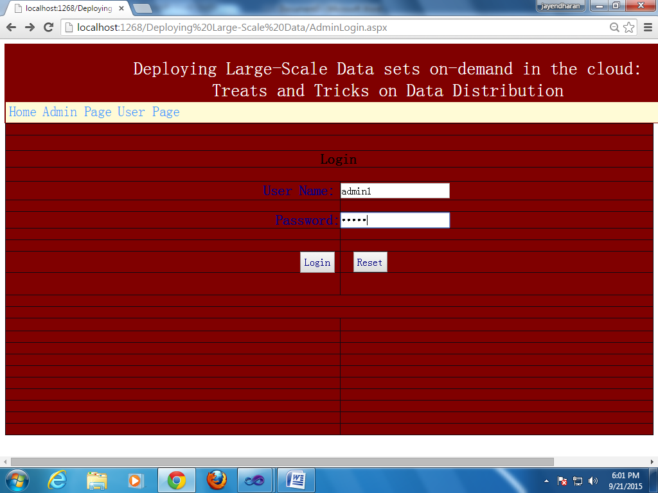
Admin login

Slide 18
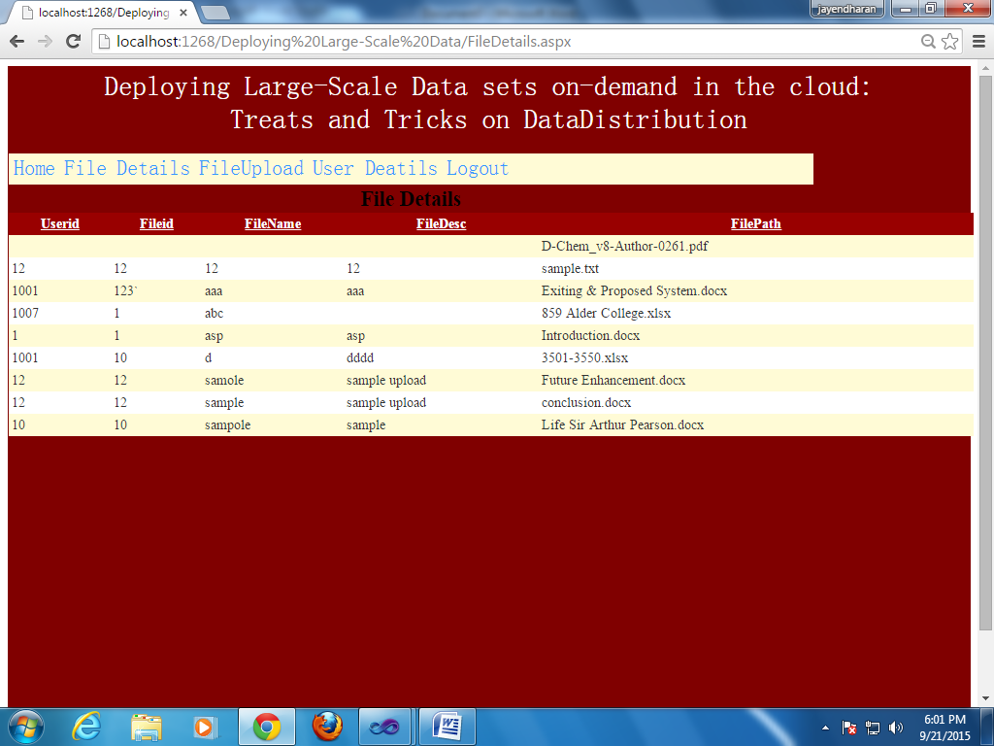
View Files

Slide 19
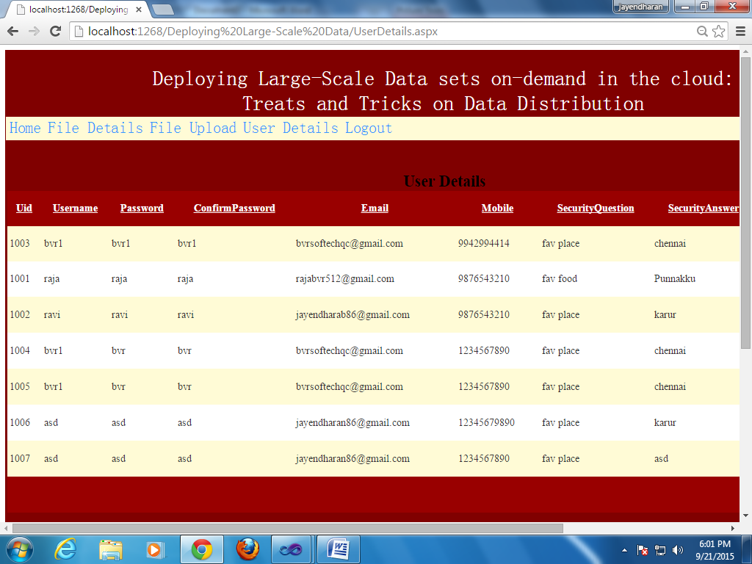
User Details

Slide 20
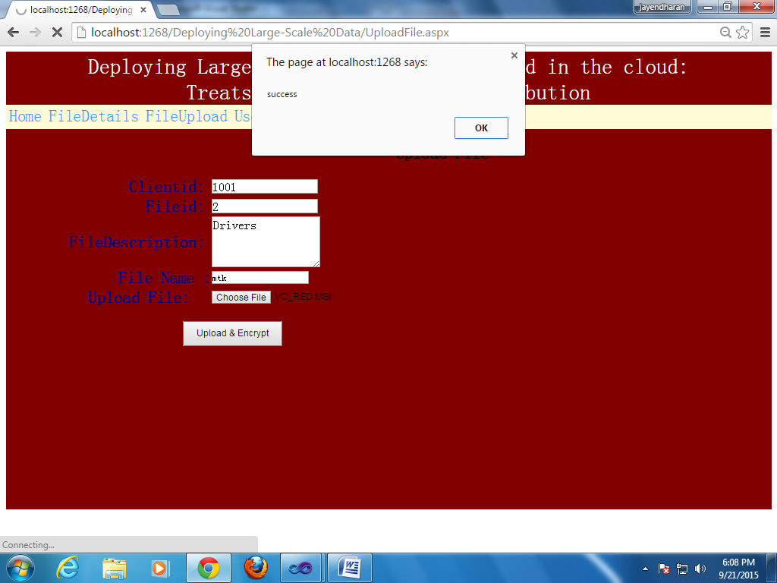
File Upload

Slide 21
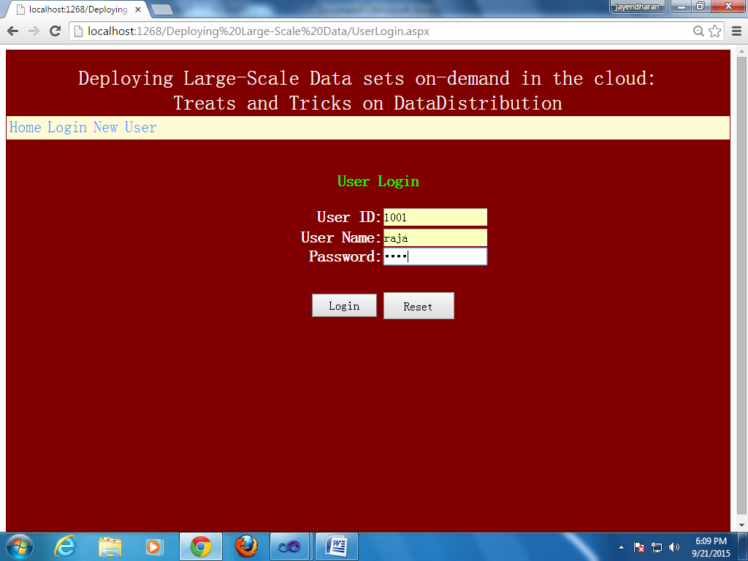
Client Login

Slide 22
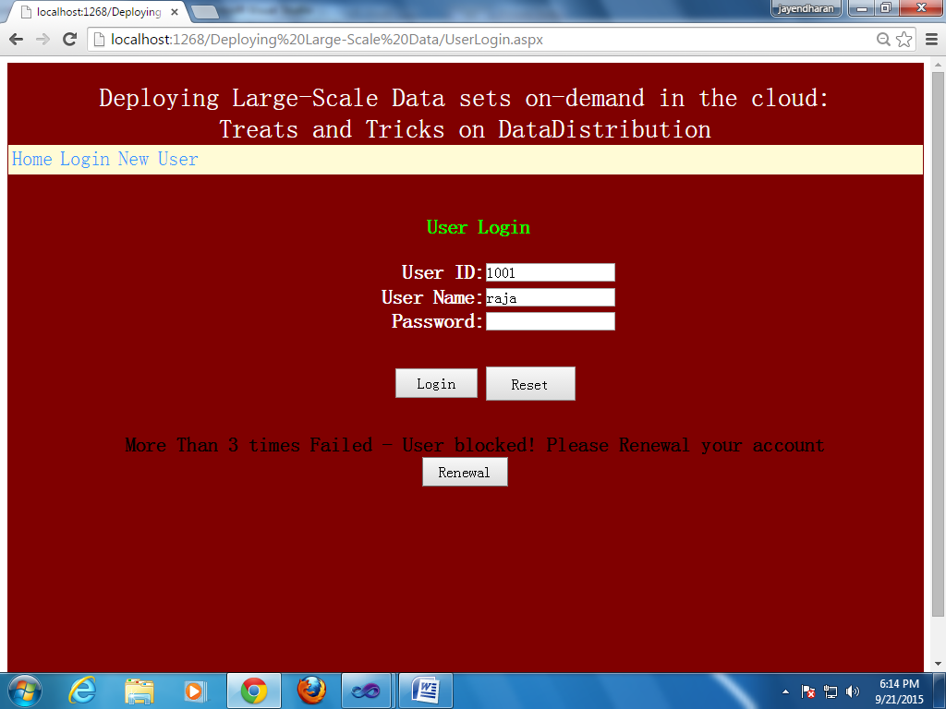
Account Blocked

Slide 23
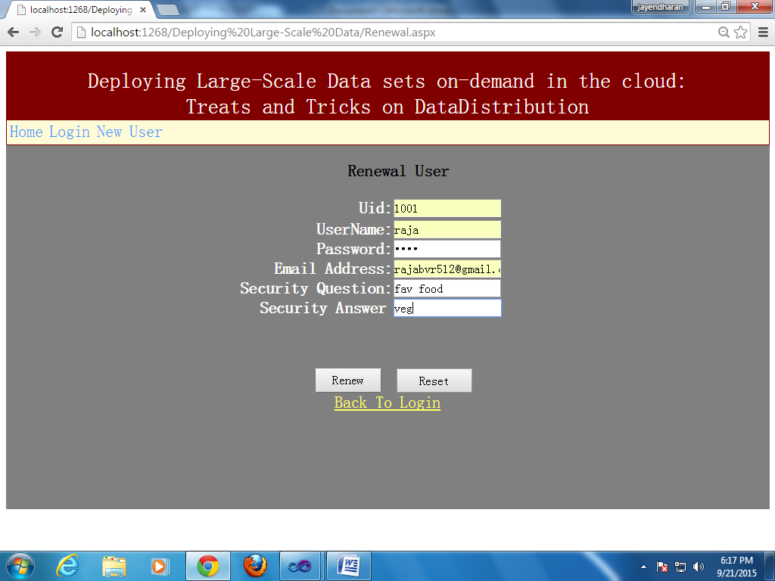
Renewal Page

Slide 24
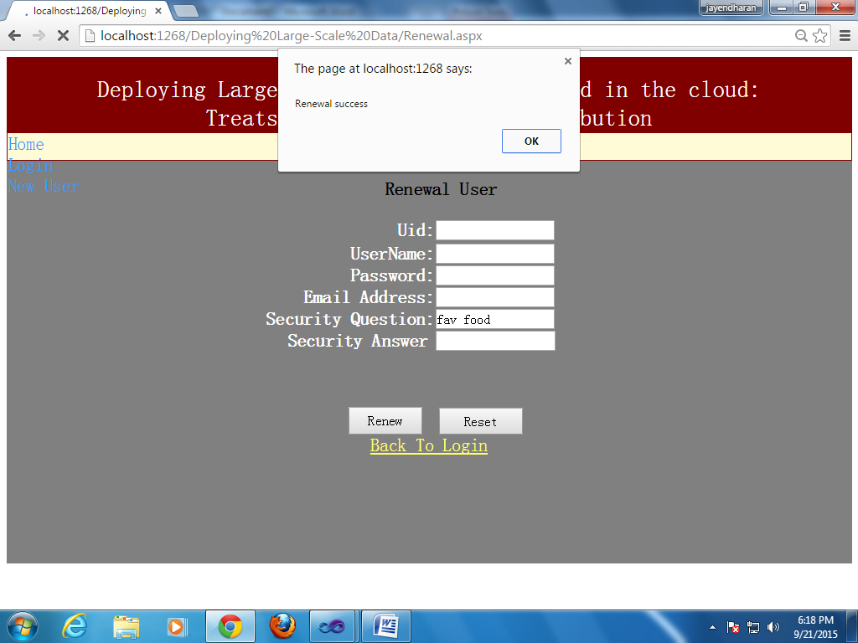
Renewal Success

Slide 25
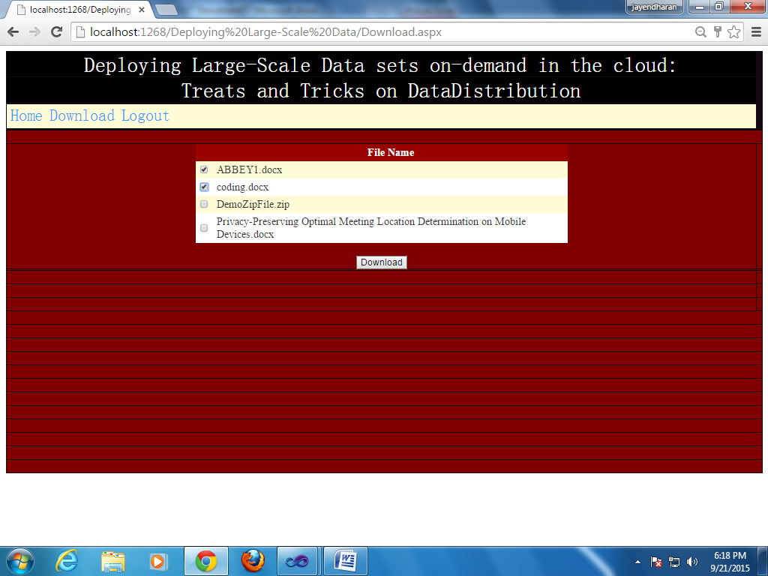
Download Files

Slide 26
Conclusion
In this we can split the larger program into smaller program for avoiding memory wastage in cloud while uploading
It reduces the wastage of memory
It reduces the time of downloading a file by compressing the file

