Slide 1
IBM University Engagement Project Submission
“Exploring the Power of Agentic AI with IBM Granite and IBM Bob”

Slide 2

Project Tile – [Interview Trainer Agent]
Domain of Project – [ Education / Career Development ]
Student Name | Recent Passport Photo | Email ID | Mobile number [WhatsApp]
RACHAITA BHATTACHARJEE |  | rachaitabhattacharjee@gmail.com | 9348263080

Slide 3
Problem Statement -
Problem Statement: Interview Trainer Agent
The Challenge: An Interview Trainer Agent, powered by RAG (Retrieval-Augmented Generation), prepares users for job interviews by generating tailored question sets and preparation strategies based on their profile name, experience level, and job role.
It retrieves role-specific interview questions, industry expectations, behavioral scenarios, and HR guidelines from recruitment portals, professional networks, and company interview databases.
Users can input their resume or job title, and the agent provides targeted questions, model answers, and improvement tips. It supports both technical and soft skill assessment, ensuring a comprehensive interview prep experience.
This AI-driven assistant builds user confidence, sharpens responses, and increases success rates in competitive hiring environments.
Technology: Use of IBM Cloud Lite services / IBM Granite is mandatory.

Slide 4
Proposed Solution -
Proposed Solution: AI-Powered Interview Trainer
The proposed solution is an AI-powered Interview Trainer Agent built using IBM Granite 4 H Small, IBM Watson Machine Learning, IBM Bob, Node.js and Express.js.
The system conducts a structured mock interview by asking one question at a time and evaluating each candidate response using IBM Granite.
Core workflow:
1. Interview Setup Agent/Module: Collects job role, experience level and interview type.
2. Interview Question Generator: Generates relevant interview questions.
3. Answer Evaluation: Evaluates the candidate's response and assigns a score out of 10.
4. Feedback Generator: Provides strengths, improvement areas and a model answer.
5. Interview Progress Manager: Tracks questions and ensures the interview stays within the defined maximum number of questions.

Slide 5
Technology Used
IBM Bob – Used for agent-oriented development and workflow exploration.
IBM Granite 4 H Small – Used for interview question generation, reasoning and answer evaluation.
IBM Watson Machine Learning / watsonx.ai – Used for accessing and deploying the Granite model.
IBM Cloud – Provides cloud infrastructure and AI services.
Node.js – Backend runtime.
Express.js – Backend API server.
HTML, CSS, JavaScript – Frontend interface.
GitHub – Source code management.
Render – Cloud deployment.

Slide 6
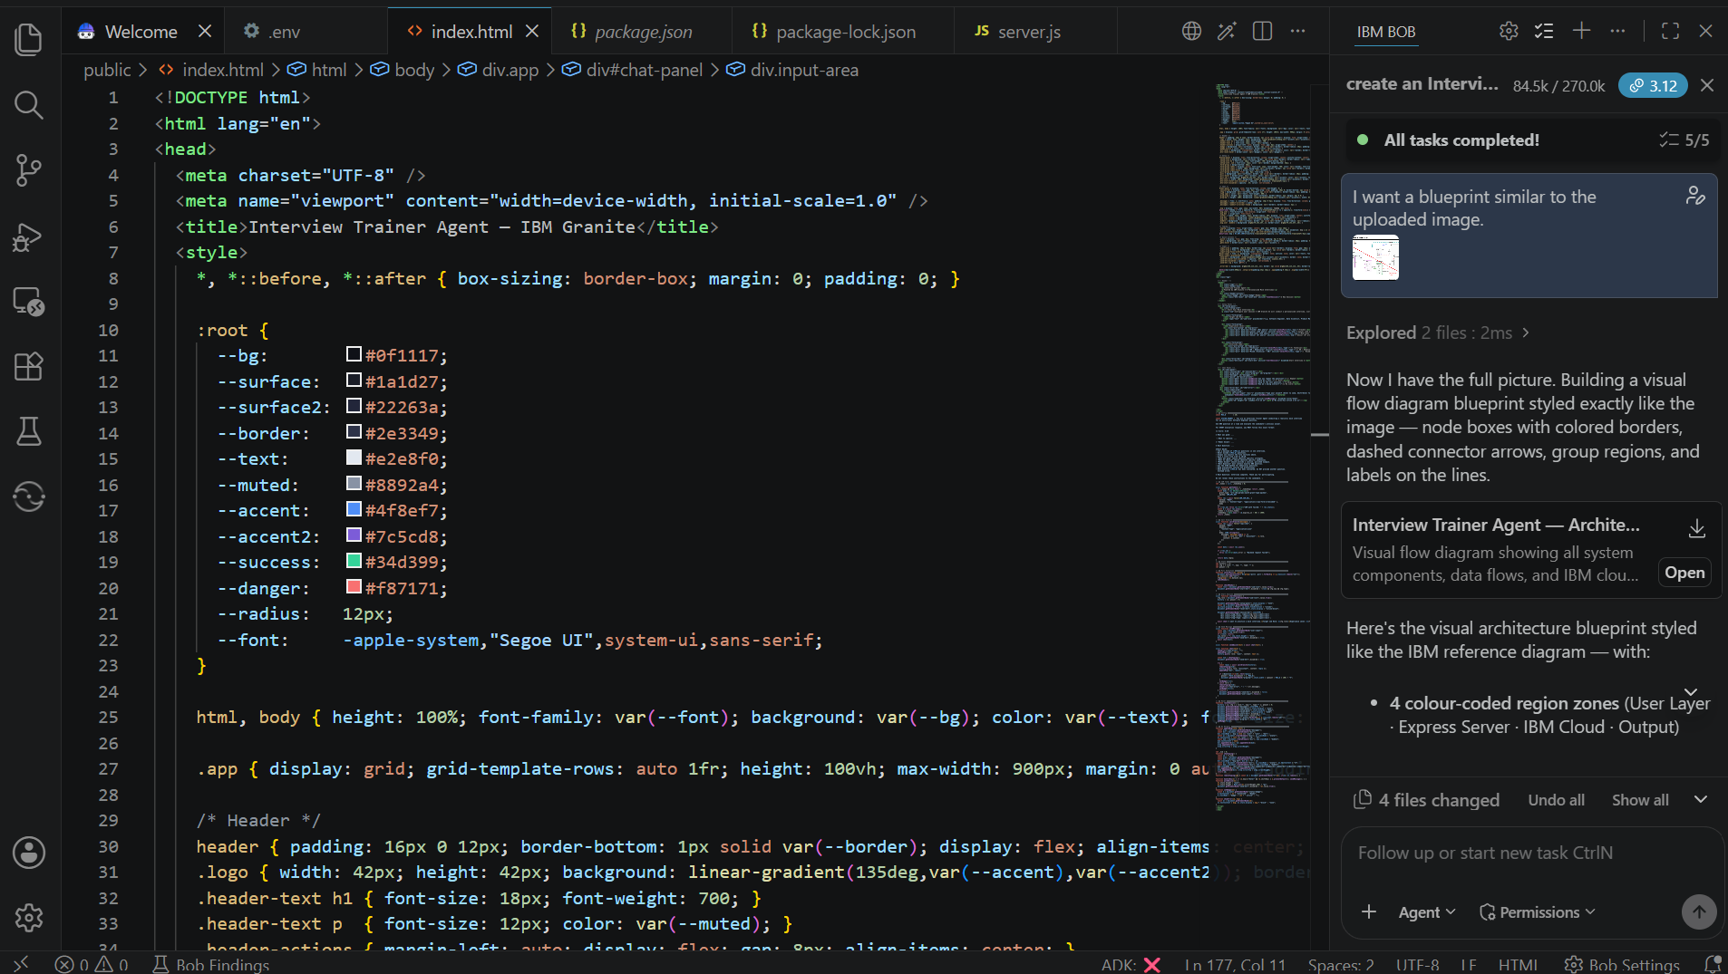
Required Files created using IBM bob -
server.js
public/index.html
package.json
package-lock.json
.env
.gitignore
README.md

Slide 7
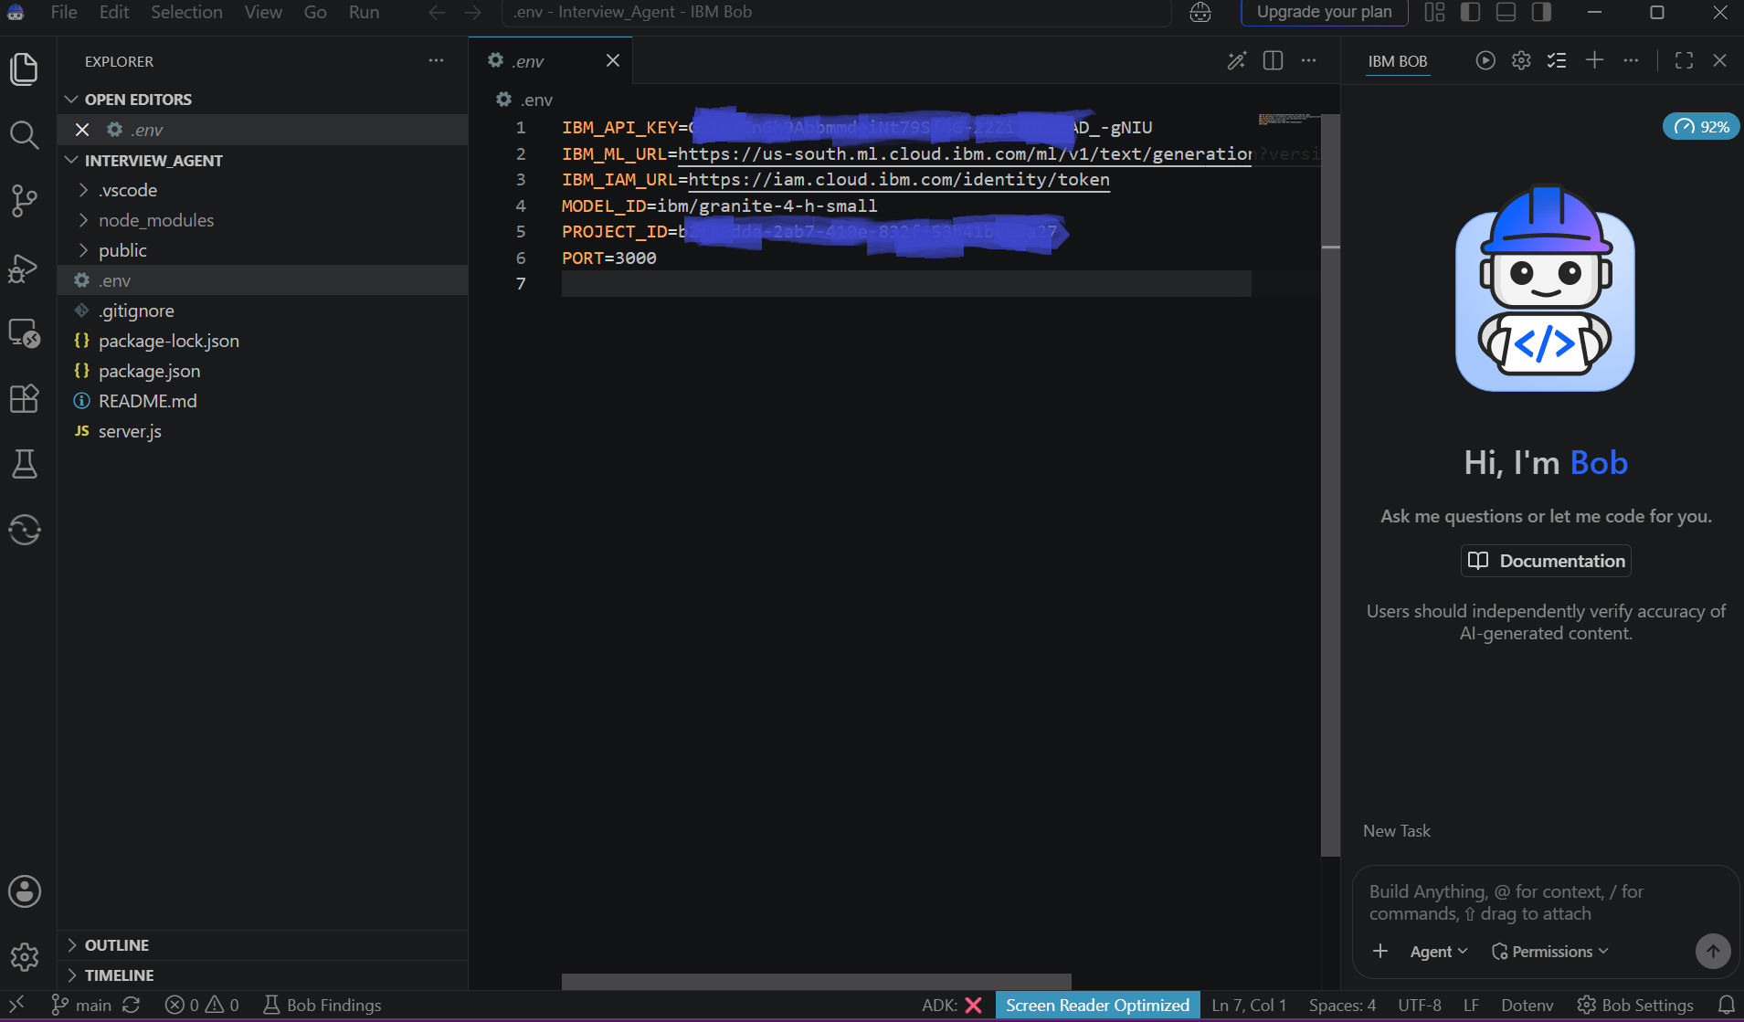
IBM Bob Screenshots:

Slide 8
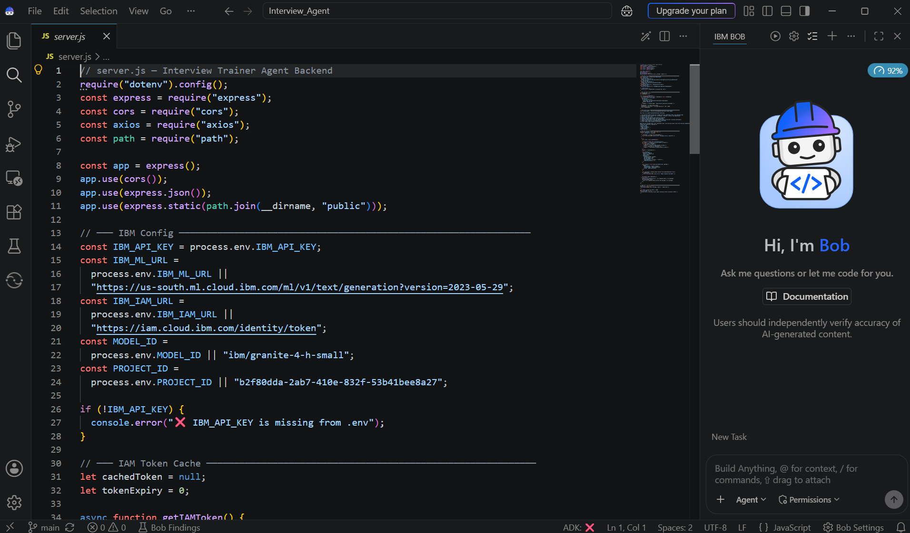

Slide 9
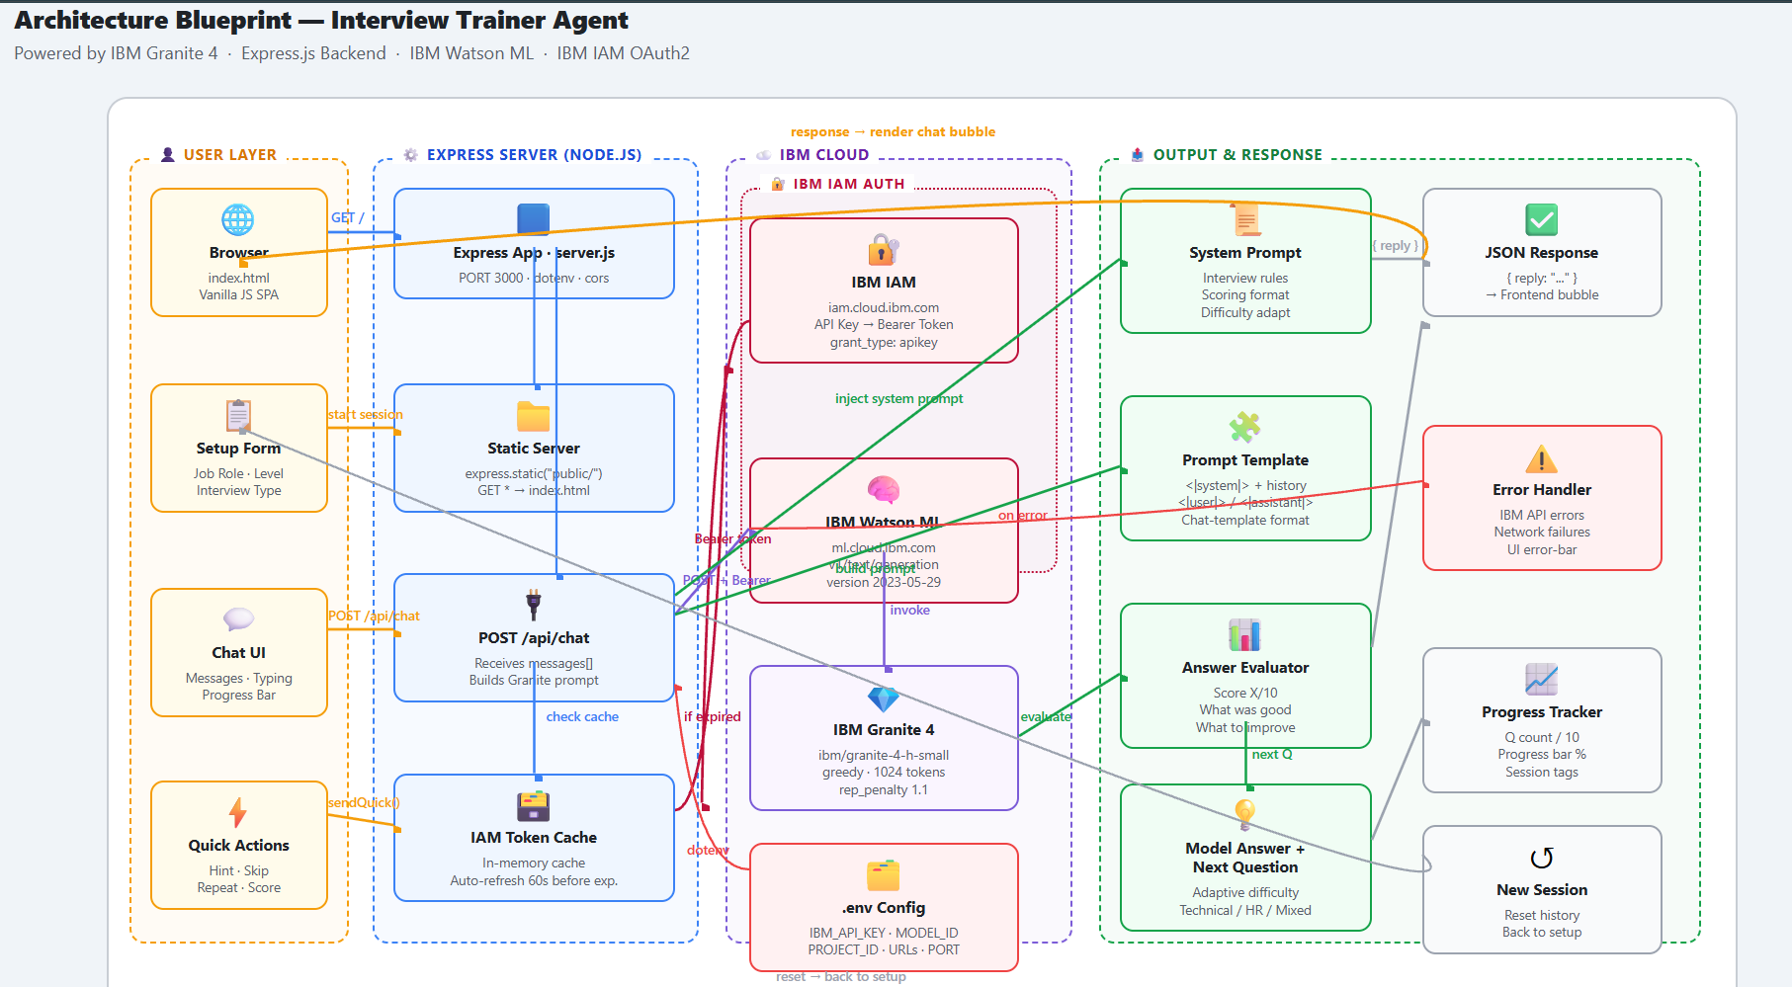
Architecture blueprint for IBM bob:

Slide 10

Role of Agentic AI in the solution
Role of Agentic AI in Interview Trainer
Agentic AI enables the Interview Trainer to function as an intelligent and context-aware interview assistant rather than a simple chatbot.
Then:
Generates interview questions based on the selected role and interview type.
Maintains context throughout the interview.
Evaluates candidate responses.
Provides personalized feedback.
Generates model answers.
Dynamically continues the interview based on previous responses.
Tracks interview progress and question count.
Overall, Agentic AI makes the interview process interactive, adaptive, personalized and goal-driven.

Slide 11
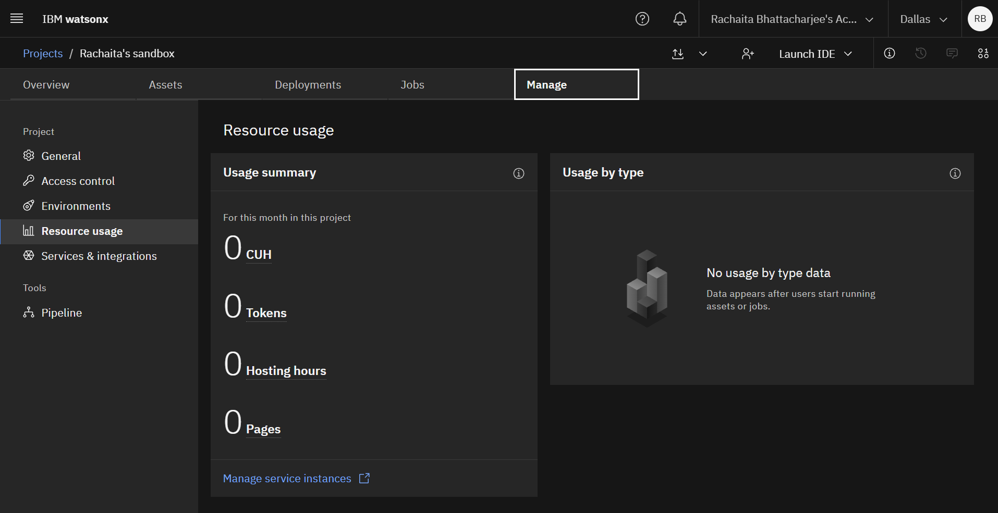
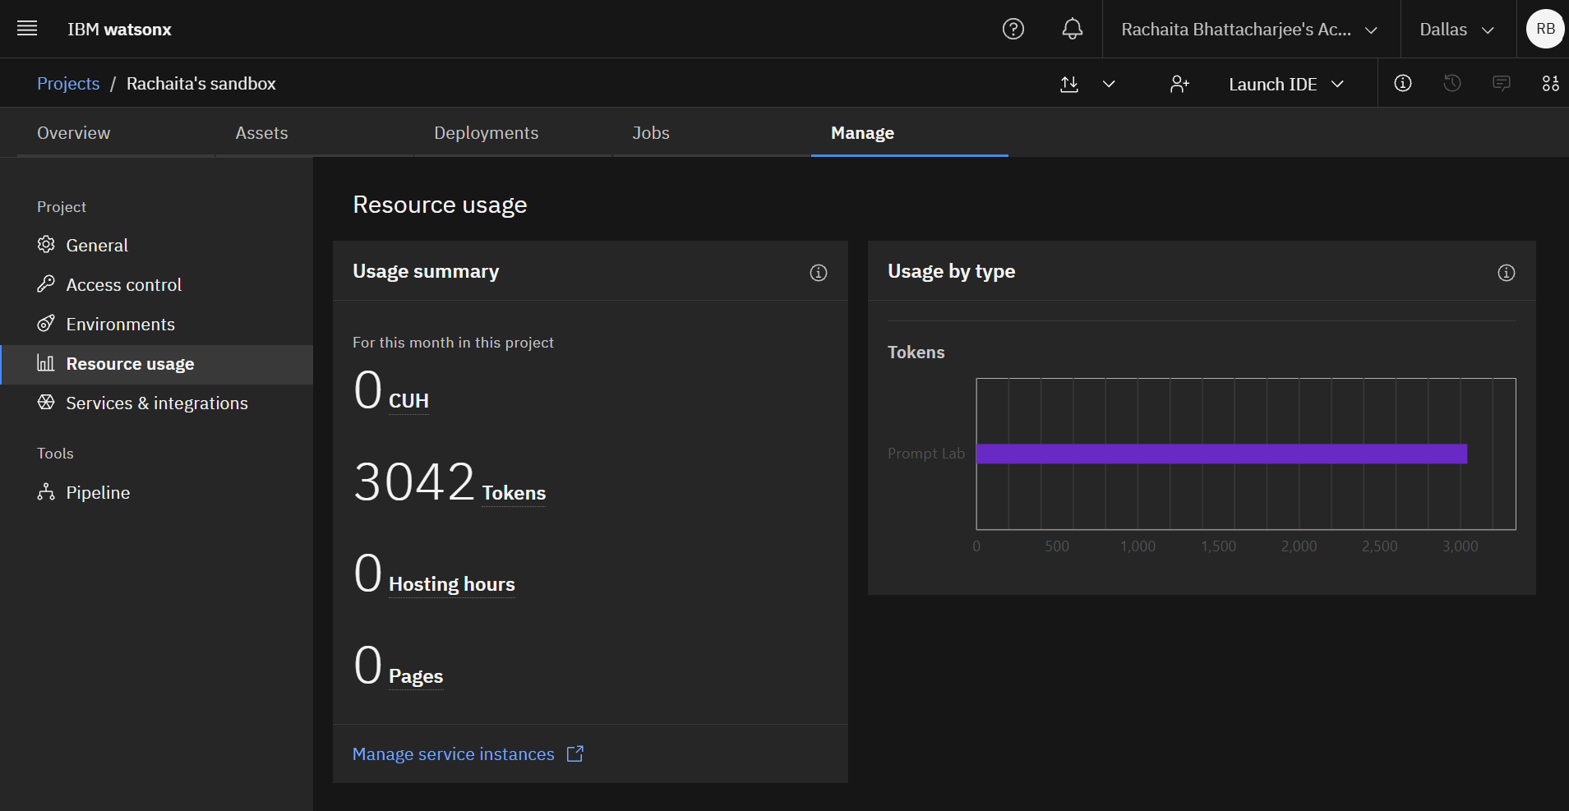
Token Usage
3042 token are used
Before Prompt
After the Prompt
·
·
·

Slide 12
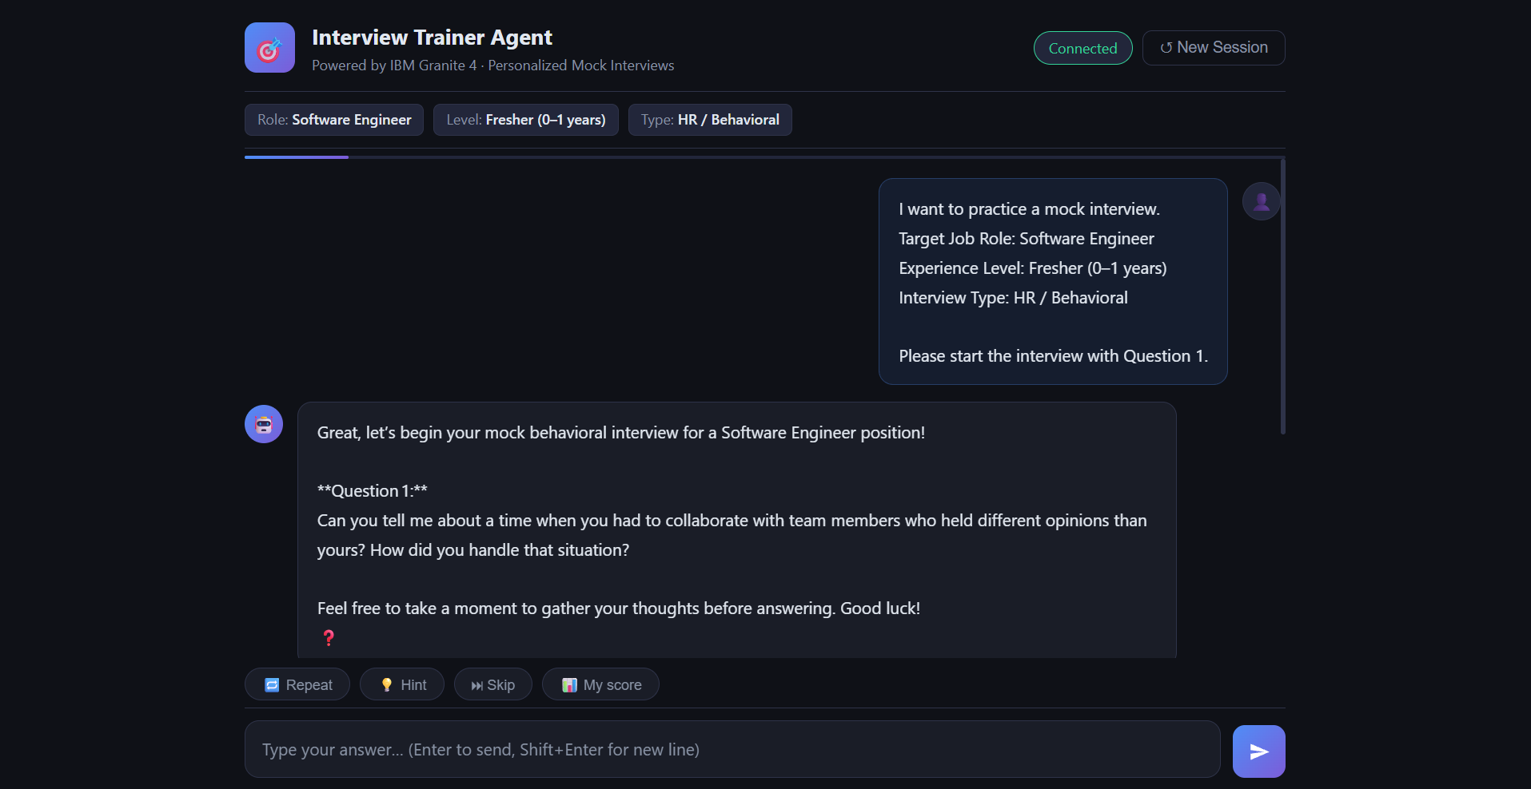
Project Output Screenshot
·
·
·

Slide 13
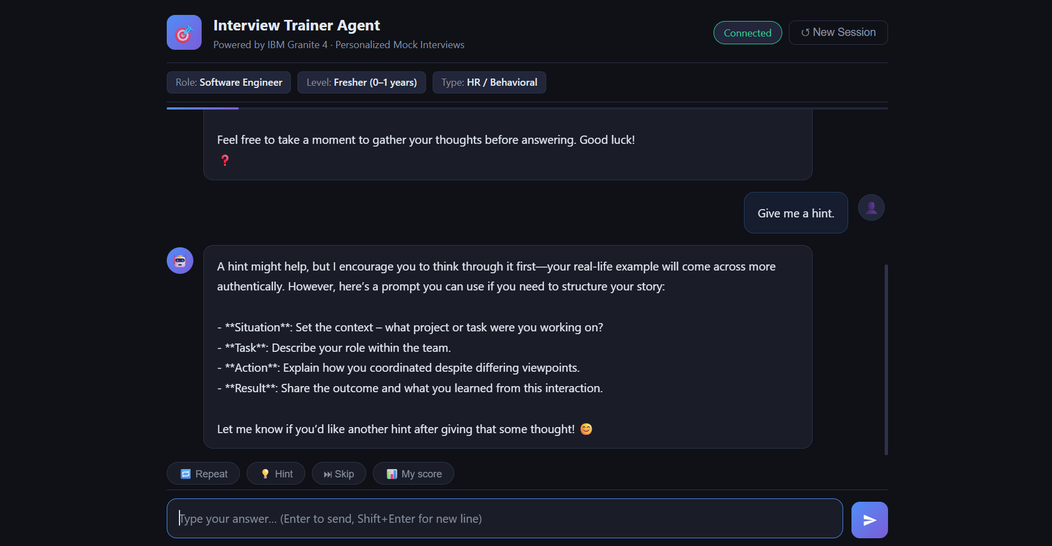
Project Output Screenshot
·
·
·

Slide 14
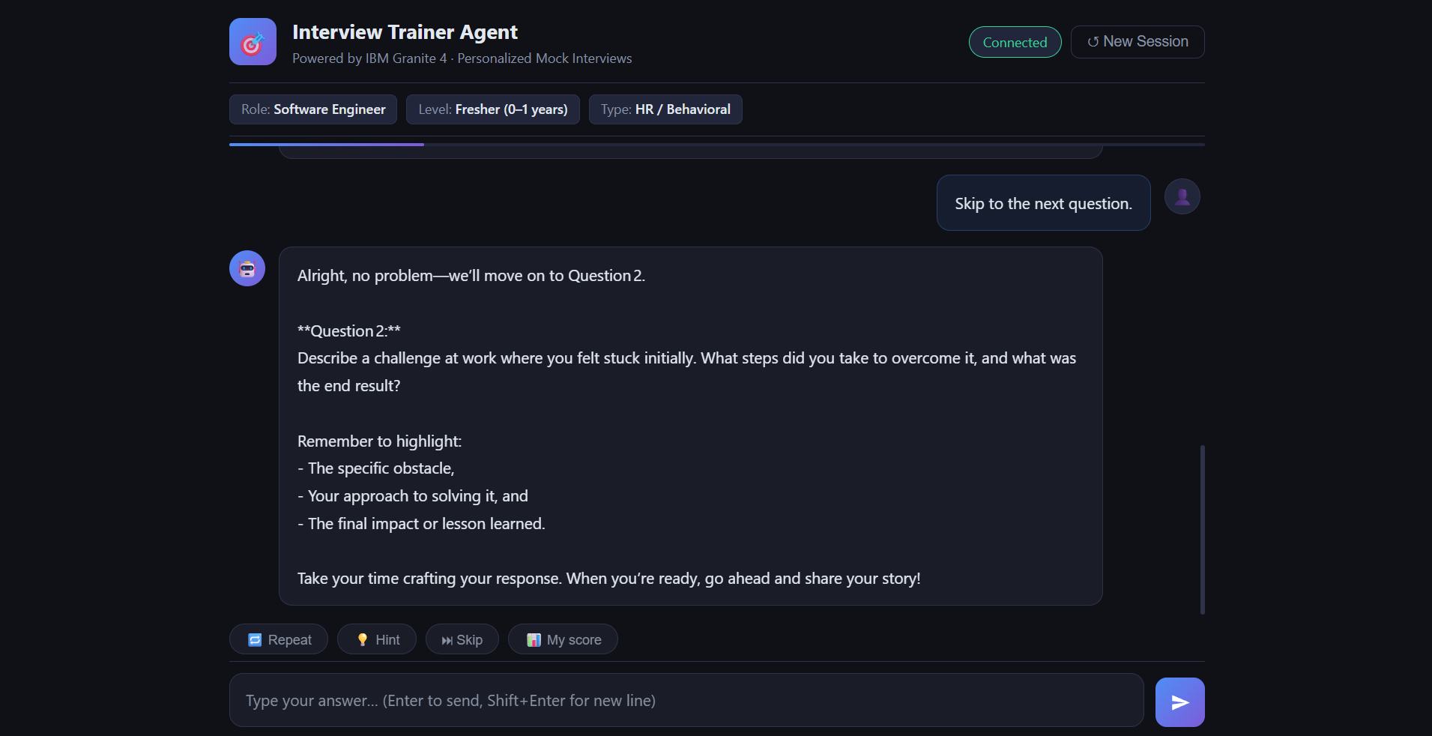
Project Output Screenshot
·
·
·

Slide 15
Novelty and Uniqueness
AI-Powered Interview Simulation: Provides a realistic conversational interview experience.
Personalized Interviews: Questions are adapted based on job role, experience level and interview type.
Structured AI Evaluation: Every answer receives a score, strengths, improvement suggestions and a model answer.
Adaptive Interview Flow: The next question is generated based on the ongoing interview context.
Controlled Interview Length: The system maintains a maximum number of interview questions.
End-to-End Cloud Deployment: The complete application is deployed as a publicly accessible web application.

Slide 16
Git Hub Link
GitHub Repository:
https://github.com/Rachaita0806/Interview_Agent
·
·

Slide 17
Future Scope
Resume-Based Interviews: Generate questions based on the candidate's uploaded resume.
Voice-Based Interviews: Allow candidates to answer questions using their voice.
Multilingual Support: Support interviews in multiple languages.
Advanced Interview Analytics: Track performance, strengths and weaknesses over multiple sessions.
Coding Interview Agent: Add coding questions and automated code evaluation.
Specialized Interview Agents: Create separate agents for HR, technical, behavioral and domain-specific interviews.
·
·
·

Slide 18
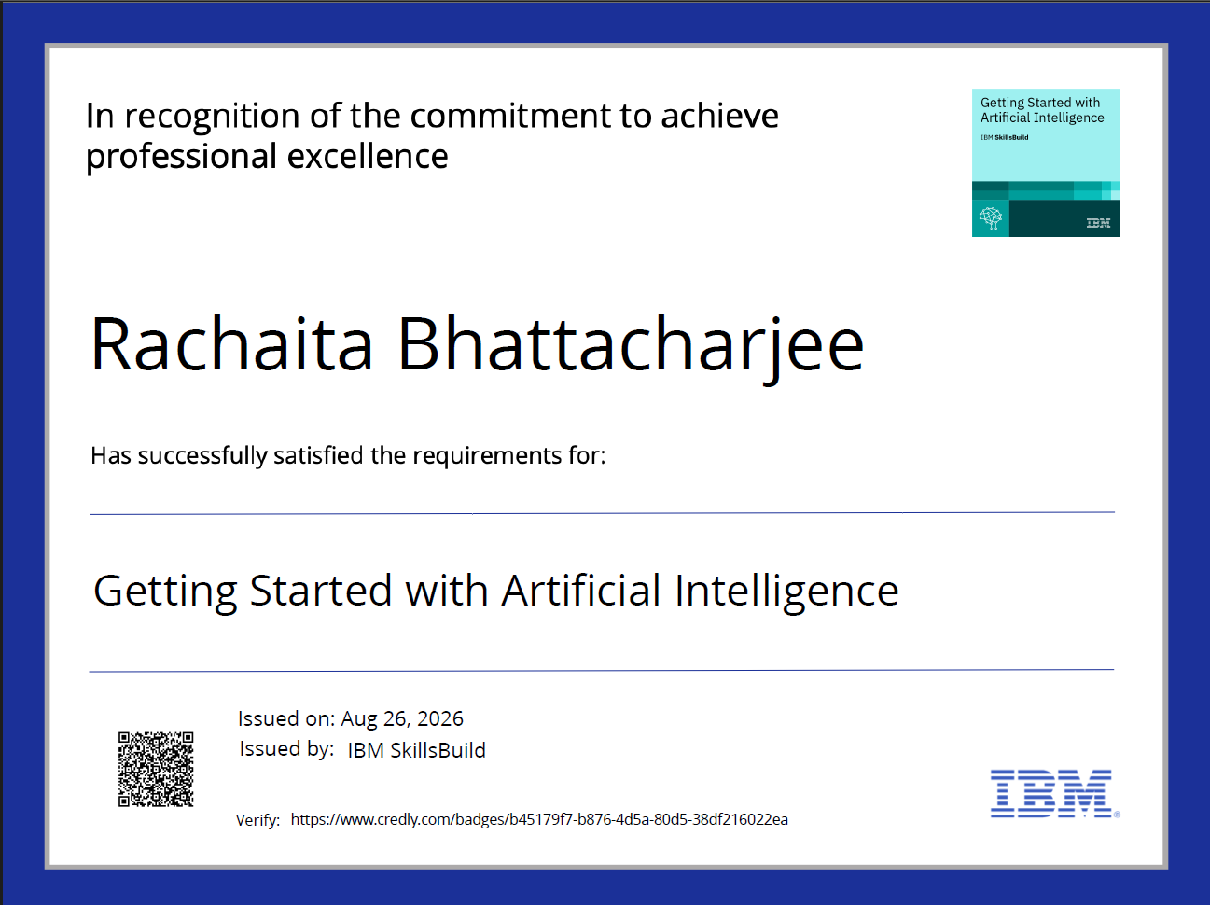
Certificates Earned:

Slide 19
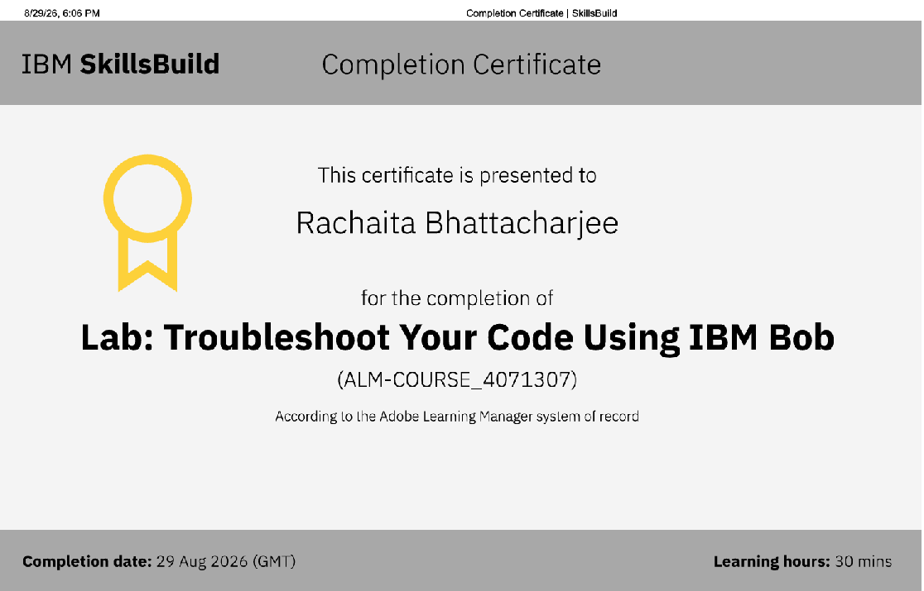
Certificates Earned:​

Slide 20


