Slide 1
Online Airline Reservation
System(OARS)

Slide 2

Team Members
B. Kirthika(46008167)
K. Bhargav Chowdary(46008221)
S. Sivaraj(46008173)
Priyanka Kasturi(46009537)
Shikhar Goswami(46008556)
Amrita Raul(46009376)
B. Sindhuja(46009517)
Sneha Pareek(46009381)

Slide 3
Objectives
Introduction
Use case diagram
Class Diagram
Activity diagram
Modules
Screenshots
Future Enhancement

Slide 4
Introduction
This project is aimed at developing an Online Airline Reservation System (OARS) for applicants.
This is a web based application that can be accessed via internet.
An airline portal is an enterprise solution for managing customer and flight information for an airline.
The primary function of the portal is to manage flight information and perform reservations and cancellations.
However, the duties in an airline also involve performing allied tasks, such as querying the status of flights, managing accounts of executives who perform the reservations, and generating reports to interpret airline performance

Slide 5
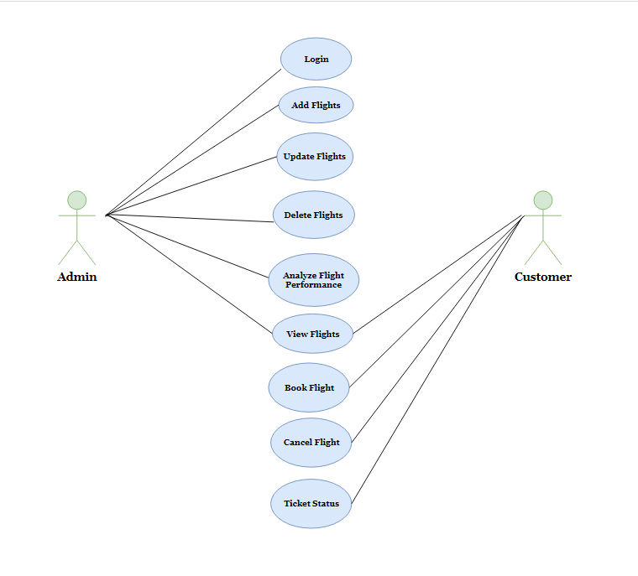
Use Case Diagram

Slide 6
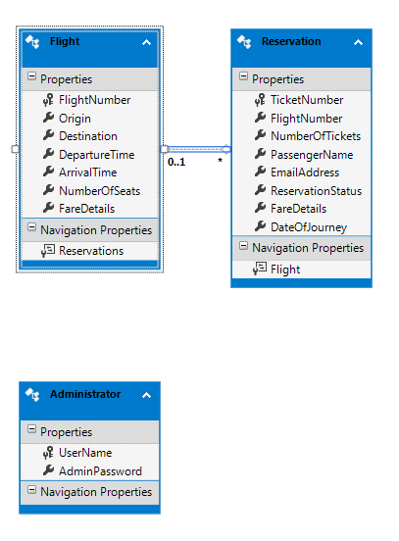
Class Diagram

Slide 7
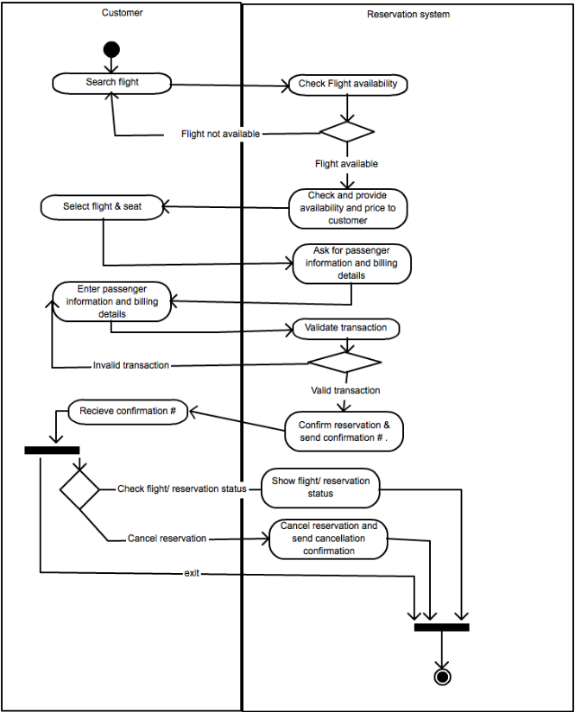
Activity Diagram

Slide 8
Online Airline Reservation System Modules
The system will have two users – Admin and Customer
Role of Admin:
Add Flights
Delete Flights
Update Flights
Search Flights
Analyzing flight performance
Role Of Customer:
Reservation of flights
Cancellation of Flights
View flight
View ticket status

Slide 9
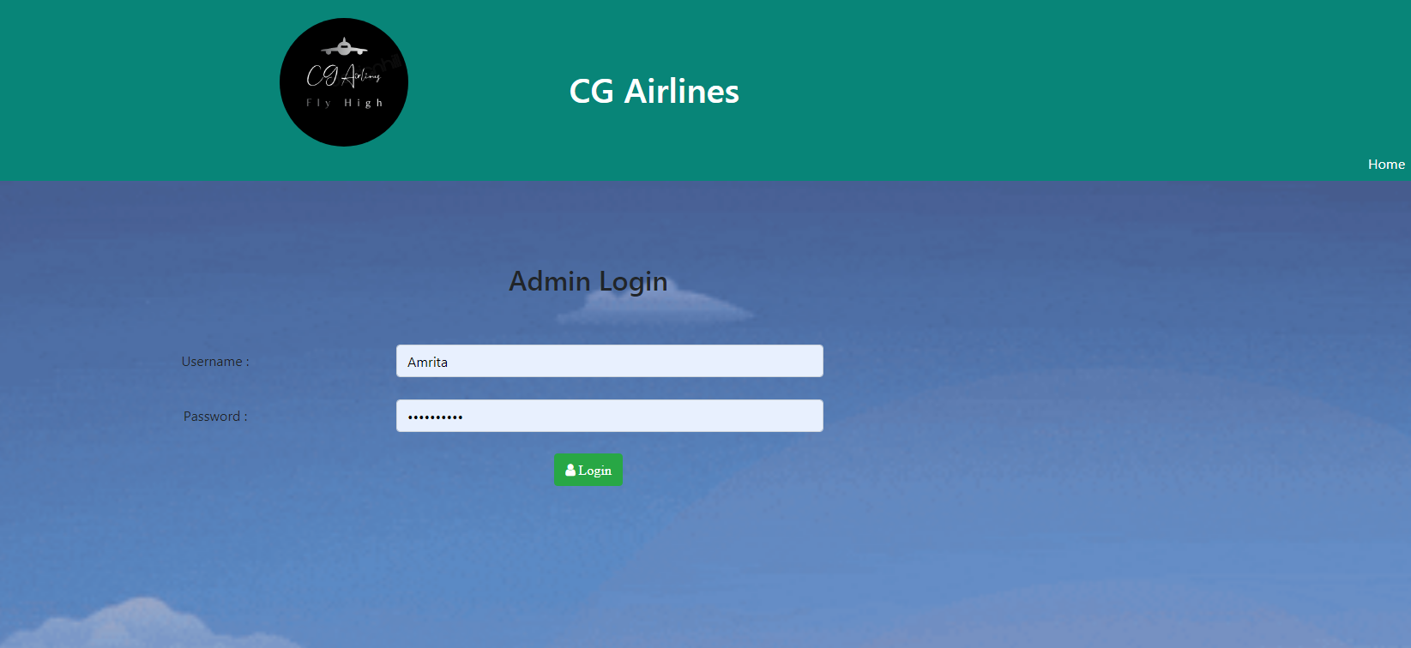
Screen shots

Slide 10
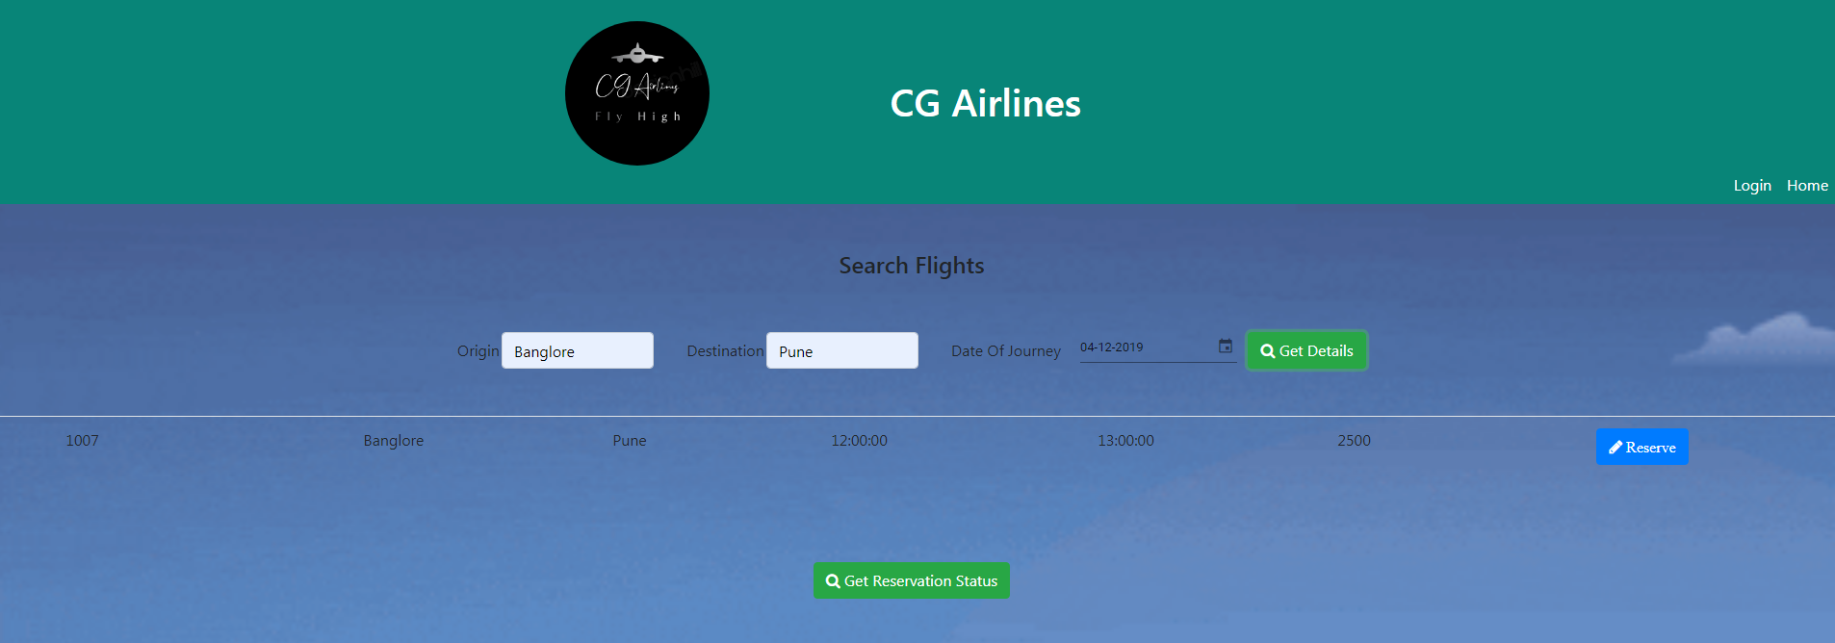

Slide 11
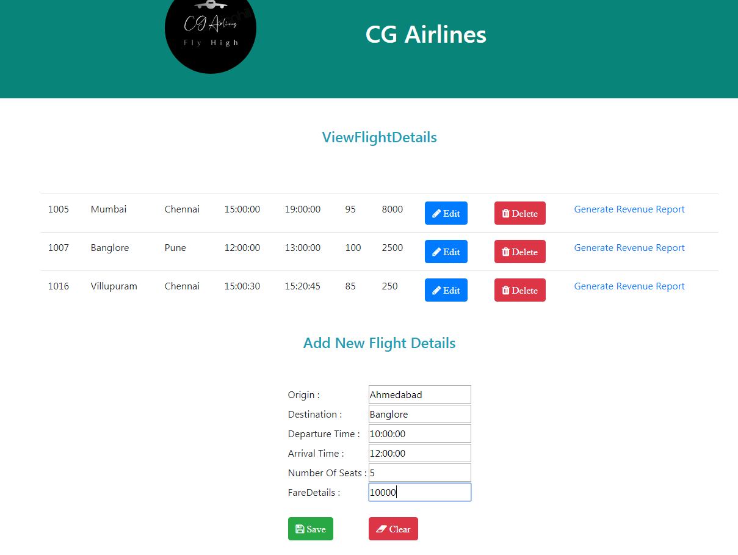

Slide 12
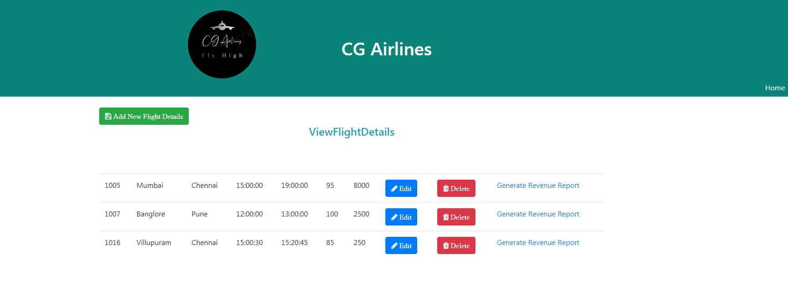

Slide 13
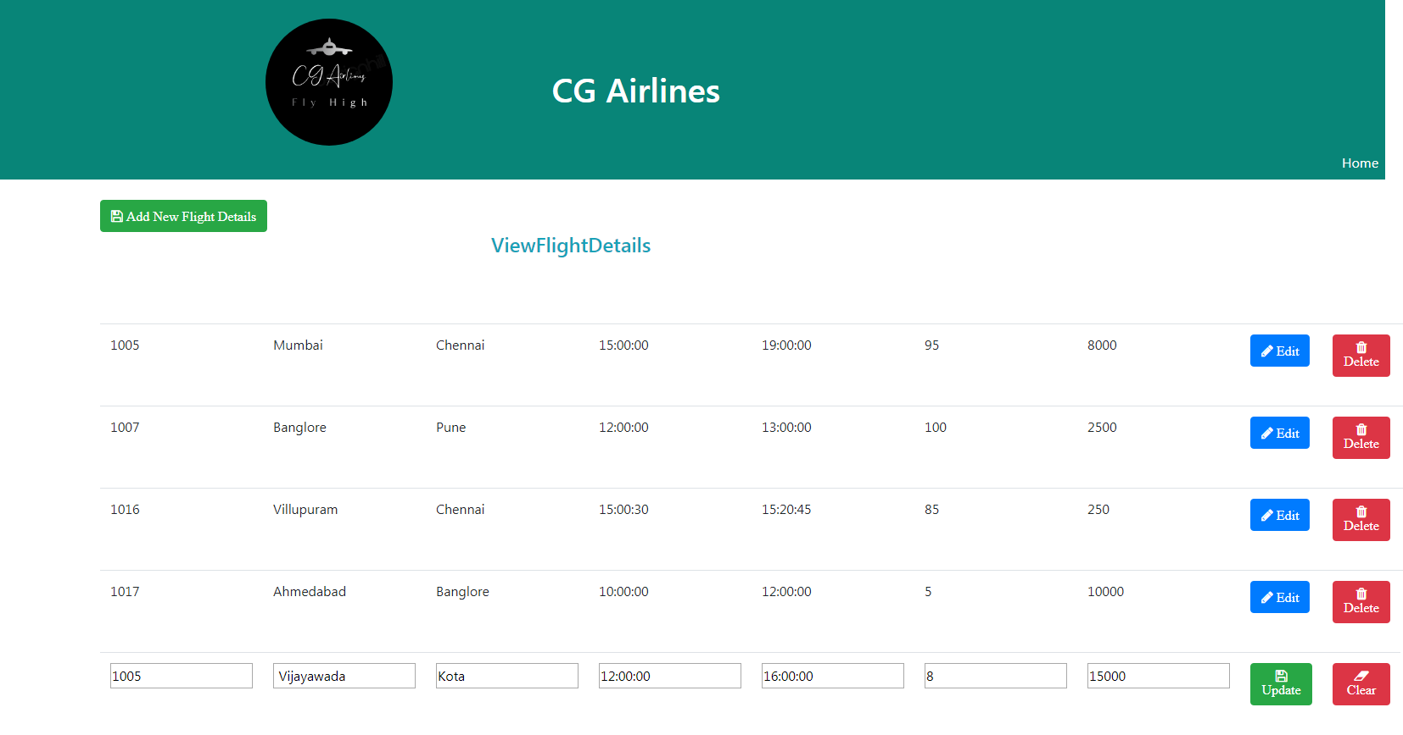

Slide 14
Future Enhancements
Seat reservation facility according to passengers request.
Payment Gateway can be added.
User Friendly GUI
Customer Login can be added.

Slide 15
Thanks

