Slide 1
PHISHING AWARENESS
Simulation Project
Internship Project Report
Naviotech Solution Pvt. Ltd.
Submitted by: Rachana Appani
B.Tech CSE (Cybersecurity) | Malla Reddy Engineering College for Women
Tool Used: GoPhish | Internship: June 2026
Notes:
Introduce the project: phishing simulation done as part of Naviotech internship using GoPhish on Kali Linux.

Slide 2
Project Overview & Objectives
🎯
🛠️
📧
Objective
Tool Used
Scenario
Simulate a real-world phishing attack in a controlled lab environment to study user behavior and awareness levels.
GoPhish – open-source phishing framework running on Kali Linux VM via Oracle VirtualBox.
Instagram security alert phishing email sent to a simulated target group of 2 users (Premium Member & VIP).
Notes:
The goal was to simulate phishing, measure click/submit rates, and document findings for awareness training.

Slide 3
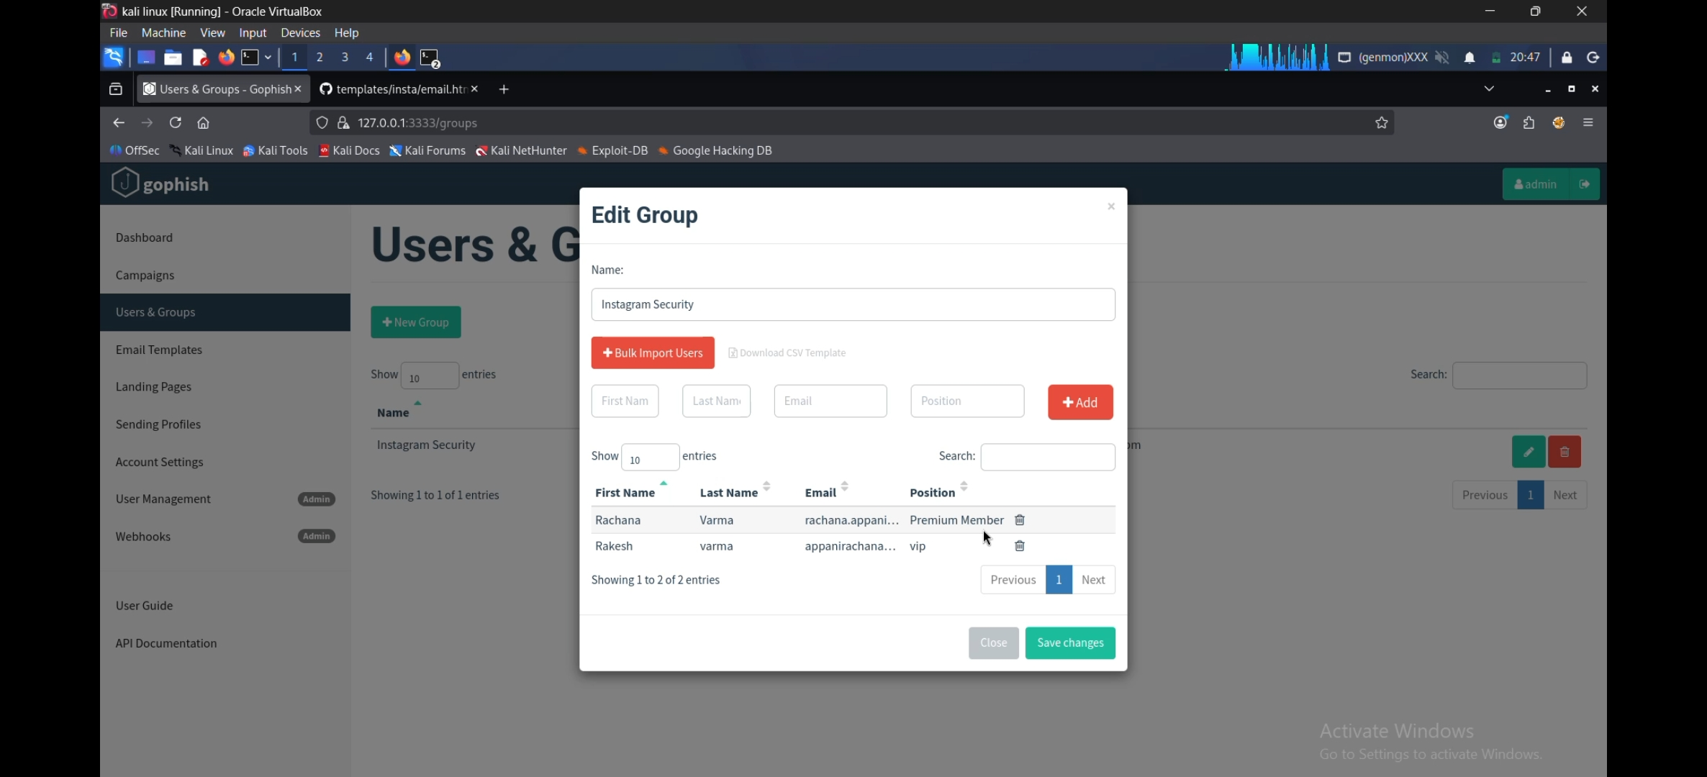
Step 1 – Target Group Configuration
Group: Instagram Security
Name | Email | Role
Rachana Varma | rachana.appani05@gmail.com | Premium Member
Rakesh varma | appanirachana@gmail.com | VIP
2 targets added manually
Simulating real employees at different access levels to test how each responds to the phishing email.
Notes:
Created a group called 'Instagram Security' with 2 simulated users. Both received the phishing email.

Slide 4
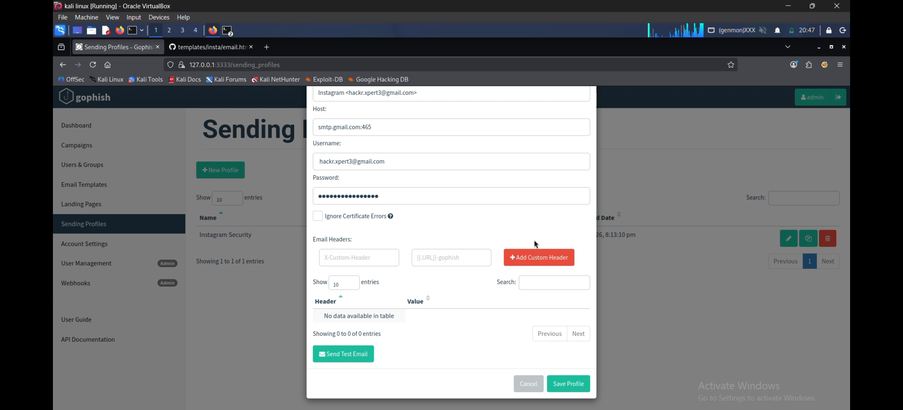
Step 2 – Sending Profile (SMTP Configuration)
Profile: Instagram Security
Field | Value
From | Instagram <hackr.xpert3@gmail.com>
Host | smtp.gmail.com:465
Interface | SMTP
Auth | Gmail App Password
SSL | Port 465 (Implicit TLS)
Why this matters:
The sender name 'Instagram' with a spoofed-looking email mimics real social engineering tactics used by attackers to gain trust.
Notes:
Configured SMTP via Gmail. Used a deceptive sender name 'Instagram' to simulate how attackers disguise email origins.

Slide 5
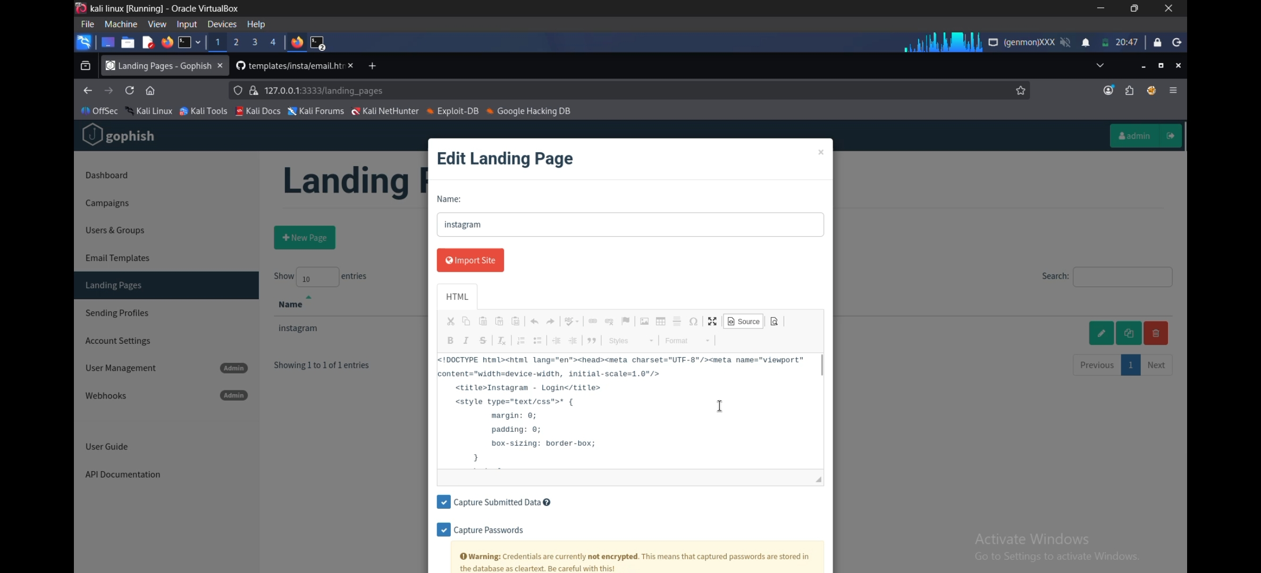
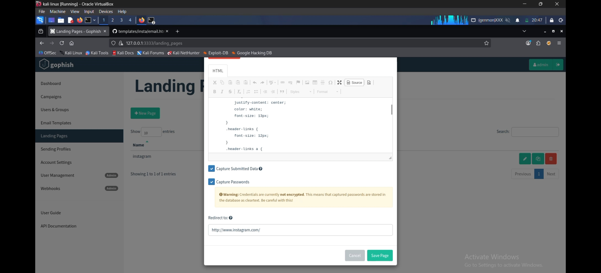
Step 3 – Fake Landing Page (Instagram Clone)
HTML Source (Custom Instagram Login Clone)
Capture Settings + Redirect to real instagram.com
✅ Capture Submitted Data | ✅ Capture Passwords | 🔁 Redirect: http://www.instagram.com/ (after submission)
Notes:
Built a convincing fake Instagram login page using GoPhish's landing page editor. Capture passwords was enabled (for demo only). Redirects to real site after submission to avoid suspicion.

Slide 6
Step 4 – Phishing Email Template
Instagram
Why it works:
Subject: ⚠️ Unusual login attempt on your account
From: Instagram <hackr.xpert3@gmail.com>
Hi {{.FirstName}},
We detected a suspicious login to your Instagram account from an unrecognized device.
If this wasn't you, please verify your account immediately:
[ Secure My Account ]
🎭
Impersonation
Sender name set to 'Instagram' to appear legitimate
⚠️
Urgency
Suspicious login alert creates panic and prompts quick action
🔗
CTA Link
Embedded phishing link disguised as a security action button
👤
Personalization
GoPhish {{.FirstName}} merge tag used for custom greeting
Notes:
The email template impersonated Instagram with an urgent security alert. GoPhish merge tags used for personalization.

Slide 7
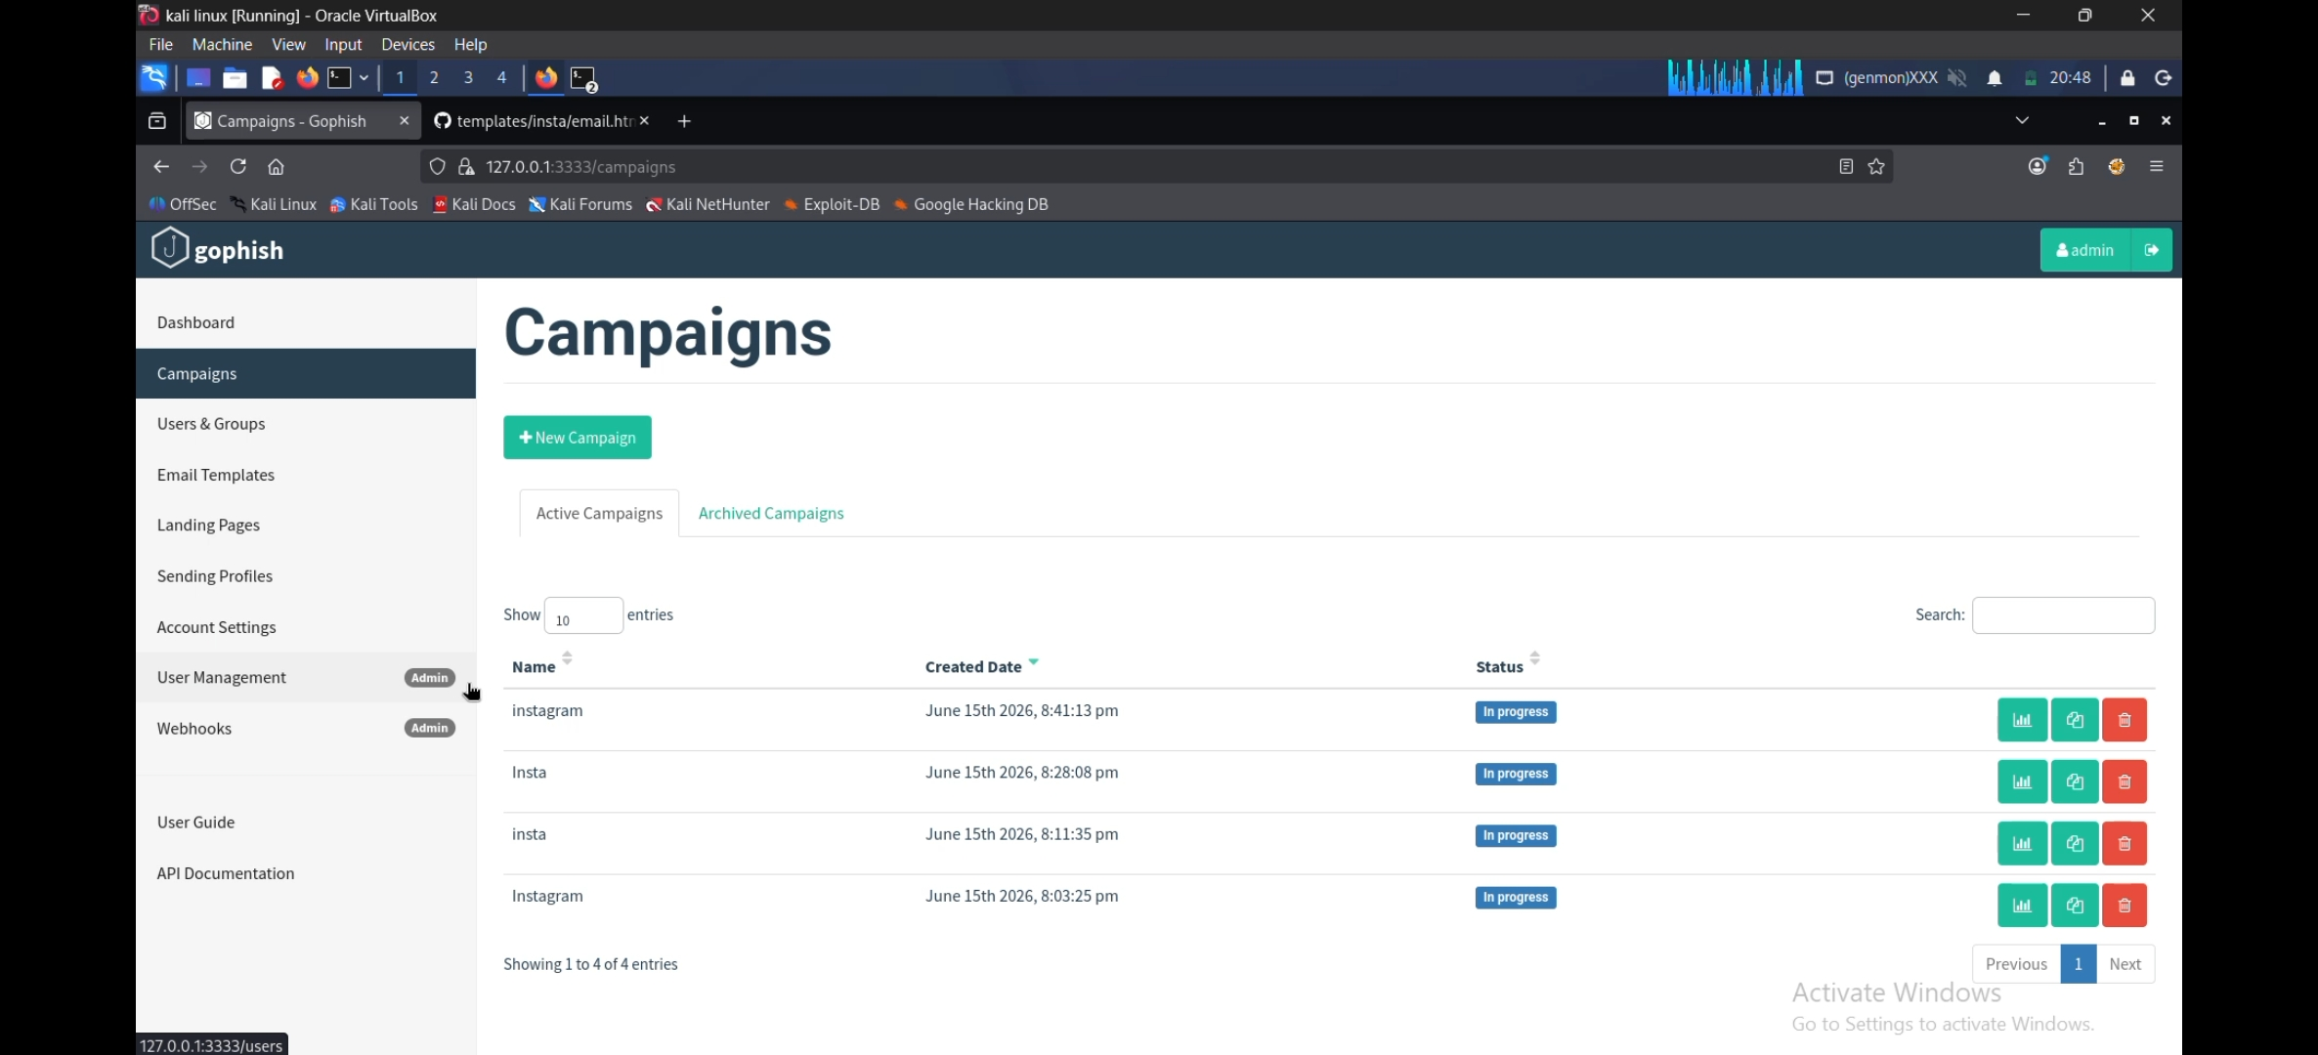
Step 5 – Campaigns Executed
4 Test Campaigns Run
Campaign | Date | Status
instagram | June 15, 2026 | In Progress
Insta | June 15, 2026 | In Progress
insta | June 15, 2026 | In Progress
Instagram | June 15, 2026 | In Progress
Multiple iterations were run to refine the email template and test GoPhish configuration before the final campaign.
Notes:
4 campaigns run total – iterative testing approach to fine-tune template before final execution.

Slide 8
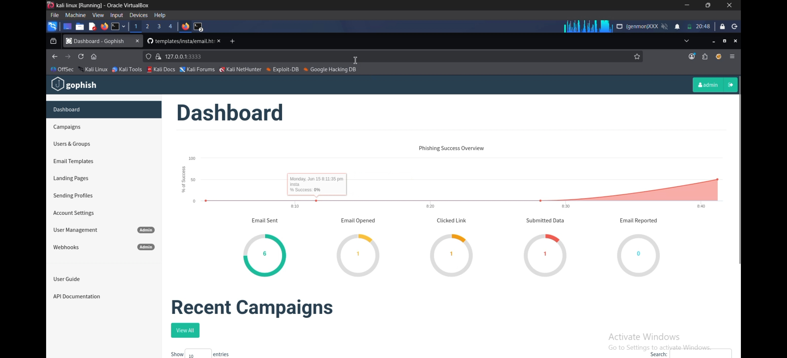
Campaign Results – Dashboard
GoPhish real-time tracking from the final 'instagram' campaign
6
1
Emails Sent
Submitted Data
1
0
0
Email Opened
Reported
Email Reported
1
Clicked Link
Notes:
Dashboard shows 6 emails sent, 1 opened, 1 link clicked, 1 credential submitted. 0 reported = low security awareness.

Slide 9
Victim Interaction Timeline
Target 1: Rachana Varma
Target 2: Rakesh varma
rachana.appani05@gmail.com | Premium Member
appanirachana@gmail.com | VIP
✅ Campaign Created
✅ Campaign Created
June 15, 8:41:13 pm
June 15, 8:41:13 pm
📧 Email Sent
📧 Email Sent
June 15, 8:41:19 pm
June 15, 8:41:17 pm
🔗 Clicked Link
⏸️ No further action
June 15, 8:41:44 pm
Did not click
🚨 Submitted Data
June 15, 8:42:19 pm
Notes:
Timeline shows Rakesh completed the full attack chain – clicked link within 25 seconds and submitted credentials within 1 minute. High-risk behavior.

Slide 10
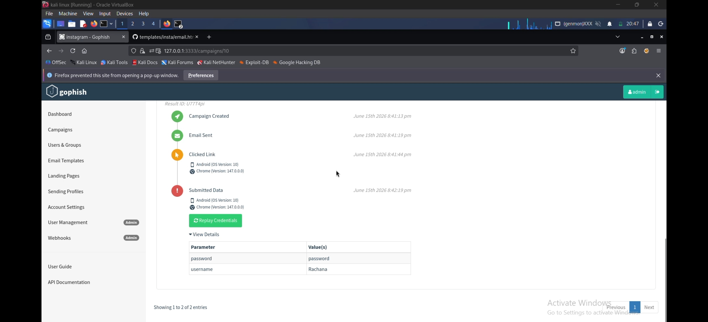
🚨 Credentials Successfully Captured
What was captured:
Parameter | Value
username | Rachana
password | password
⚠ Device: Android OS 10, Chrome 147.0.0.0
⚠ Submitted within 1 minute of email delivery
⚠ User was redirected to real Instagram after submission
⚠ Passwords stored in GoPhish DB as cleartext (lab only)
⚠️ For authorized lab use only — not intended for real attacks
Notes:
Credentials successfully captured. Username 'Rachana' and password 'password' submitted. Demonstrates real risk of phishing. This is a controlled simulation only.

Slide 11
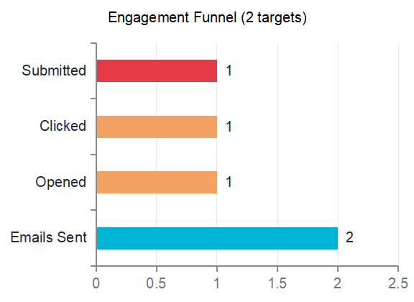
Key Findings & Attack Analysis
50%
50%
Click Rate
Submit Rate
1 out of 2 users clicked the phishing link
1 out of 2 users submitted real credentials
0%
25s
Report Rate
Time to Click
Neither user reported the suspicious email
Rakesh clicked within 25 seconds of receiving the email
Notes:
High click and submit rates. No one reported it. Demonstrates that social engineering through urgency and impersonation is highly effective.

Slide 12
Full Phishing Attack Chain
1
Attacker Setup
2
Phishing Email Sent
3
Victim Clicks Link
GoPhish configured with Gmail SMTP, fake sender identity 'Instagram'
Urgent 'suspicious login' email delivered to 2 targets on June 15
Rakesh clicked the embedded link within 25 seconds on Android/Chrome
4
Fake Login Page
5
Credentials Captured
6
Silent Redirect
Presented with convincing Instagram clone page to enter credentials
Username & password submitted and stored in GoPhish database
User redirected to real Instagram — completely unaware of compromise
Notes:
Full MITRE-style kill chain from setup to credential theft. Key insight: social engineering bypassed all technical controls.

Slide 13
MITRE ATT&CK Mapping
T1566.001
Initial Access
T1598.003
Reconnaissance
Spearphishing Attachment/Link
Phishing for Information
Sent phishing email with embedded credential-harvesting URL
Collected credentials via fake Instagram login form
T1056.003
Credential Access
T1078
Defense Evasion
Web Portal Capture
Valid Accounts (Setup)
Landing page captured username & password in cleartext
Used legitimate Gmail SMTP to send; bypassed spam filters
T1534
Lateral Movement
T1204.001
Execution
Internal Spearphishing
User Execution – Link
If real, captured creds enable lateral movement
Victim executed the attack by clicking the phishing link
Notes:
Mapped attack techniques to MITRE ATT&CK framework. This demonstrates deep understanding of threat actor TTPs.

Slide 14
Recommendations & Countermeasures
🎓
🔐
📧
Security Awareness Training
Enable MFA
Email Filtering & DMARC
Conduct regular phishing simulations and training sessions to educate employees on spotting suspicious emails.
Multi-Factor Authentication prevents attackers from using stolen passwords. Even if phished, account stays safe.
Deploy DMARC, DKIM, and SPF to reject emails with spoofed sender domains. Use spam filters with link inspection.
🔍
📋
🧪
Suspicious Link Verification
Incident Reporting Culture
Regular Phishing Tests
Train users to hover over links, check domain names carefully, and avoid clicking urgent email CTAs directly.
Establish easy reporting mechanisms (1-click report button). Reward employees who report phishing attempts.
Run quarterly simulations using tools like GoPhish to measure employee susceptibility and track improvement.
Notes:
Six key recommendations based on simulation findings. MFA + training are the most impactful quick wins.

Slide 15
Lessons Learned & Challenges Faced
🌐
Network/Traffic Visibility
📧
Email Deliverability
Learned the importance of routing all relevant traffic (browser + VM) through the same monitoring path — a gap that, in a parallel pentest exercise, caused a web app to go undetected when only Kali VM traffic was inspected and browser traffic bypassed it.
Gmail SMTP intermittently triggered spam filters and security warnings — required adjusting headers and testing with 'Send Test Email' before launching the real campaign.
🪤
Believable Pretexting
🔓
Cleartext Credential Storage
Early email drafts felt too generic. Iterated through 4 campaign versions to land on urgency + impersonation language that actually drove a click within 25 seconds.
GoPhish stores captured credentials in cleartext by default — reinforced why production systems must never log credentials unencrypted, even temporarily.
🧭
Redirect Strategy
⏱️
Speed of Compromise
Configuring a redirect to the real instagram.com after submission was key to realism — victims had no visual cue anything was wrong.
The full attack chain (click → credential theft) completed in under 60 seconds — a strong real-world argument for why detection speed matters as much as prevention.
Notes:
Key practical lessons: traffic visibility gaps, deliverability tuning, pretext design, default insecure credential storage, redirect realism, and speed of compromise.

Slide 16
Skills Demonstrated
Offensive Security
Tools & Platforms
Analysis & Reporting
GoPhish campaign configuration
Social engineering / pretexting
Credential-harvesting page design
SMTP spoofing & sender impersonation
Kali Linux
Oracle VirtualBox
Gmail SMTP (App Passwords)
HTML/CSS landing page editing
MITRE ATT&CK technique mapping
Engagement funnel / metrics analysis
Timeline reconstruction
Professional report & deck writing
Notes:
Summarize the technical, analytical, and tooling skills practiced during this project — useful for resume/portfolio framing.

Slide 17
Conclusion
Phishing Remains Organizations' #1 Threat
50%
50%
0%
<60s
Click Rate
Credential Loss
Reported
Time to Compromise
GoPhish simulation successfully demonstrated a full, end-to-end credential phishing attack chain in a controlled, authorized lab environment
50% of simulated users clicked the link and submitted credentials — closely reflecting real-world industry phishing-test averages
0 users reported the phishing email, exposing a critical gap in detection and reporting culture
The attack succeeded purely through social engineering — impersonation, urgency, and a convincing clone page — with no technical exploit required
Human behavior remains the weakest link; technology controls (SPF/DKIM/DMARC, MFA, filtering) must be paired with continuous awareness training
This project strengthened hands-on skills in offensive tooling (GoPhish), attack-chain analysis (MITRE ATT&CK), and professional security reporting
Rachana Appani | Cybersecurity | Naviotech Internship 2026
Notes:
Final wrap-up — phishing is still the #1 initial access vector globally. This project demonstrated real attack mechanics, measured user behavior, mapped to MITRE ATT&CK, and produced actionable recommendations and personal skill growth.

