Slide 1

Airbnb Europe Data Visulation Project
An interactive data visualization project exploring European Airbnb listings through dynamic charts, pricing insights, and market trends across major cities.
Presented By : Rachana Patil matrculation no (48596983)

Slide 2
PROJECT OVERVIEW
Building Interactive Insights
Our Mission
Key Objectives
Transform raw Airbnb data into actionable insights through an interactive dashboard that reveals pricing patterns, market dynamics, and guest preferences across European cities.
Visualize pricing distribution and trends
Analyze room availability and accommodation types
Map guest satisfaction metrics
Compare city-level market characteristics

Slide 3
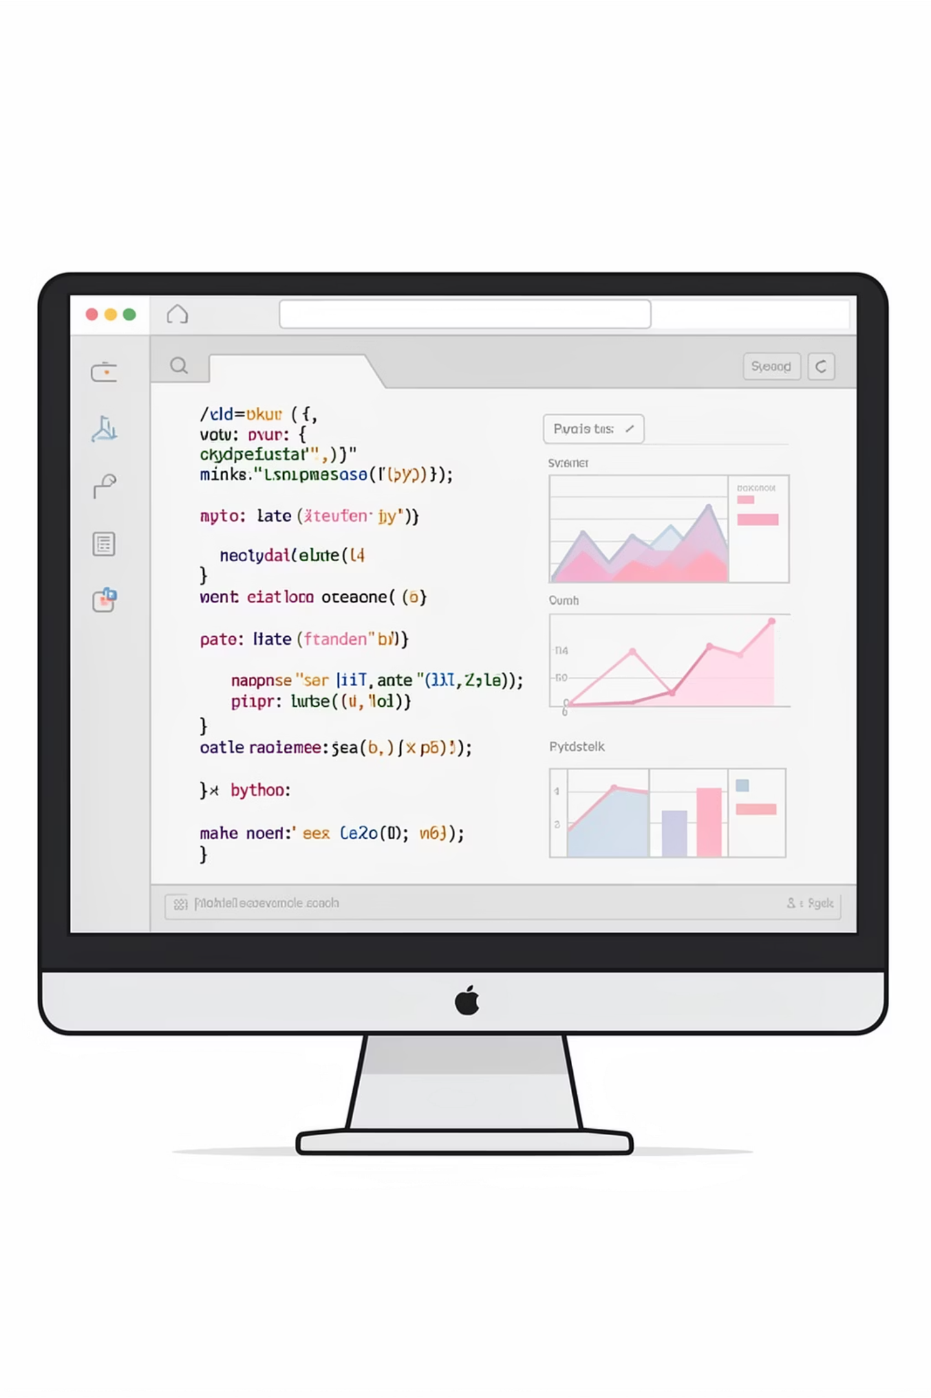

Technology Stack
Streamlit
Python & Pandas
Fast, interactive web app framework for data visualization with real-time user controls and seamless deployment.
Powerful data manipulation and analysis capabilities for processing thousands of Airbnb listings efficiently.
Plotly
Advanced interactive charting library delivering responsive, publication-quality visualizations with hover details and zoom controls.

Slide 4
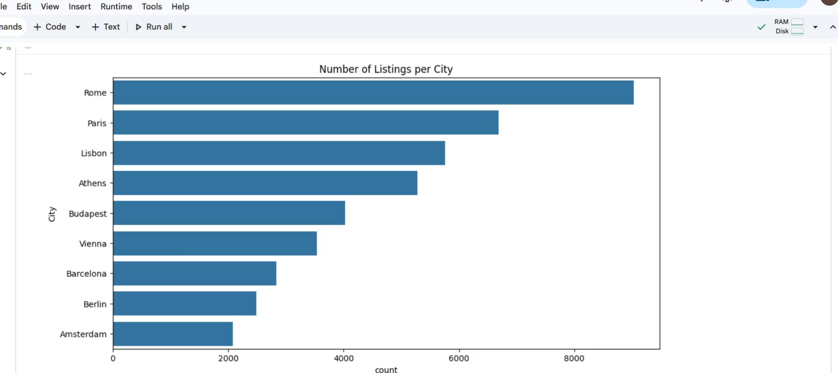
Dataset Scope
European Market Coverage
Our dataset encompasses comprehensive Airbnb listings across major European metropolitan areas, capturing diverse accommodation types from studio apartments to luxury villas.
The data includes pricing, room configurations, guest ratings, and geographical distribution—providing a 360-degree view of the European short-term rental market.

Slide 5




FOCUS AREAS
Visualization Priorities
Pricing Analysis
Room Insights
Distribution patterns and outlier detection
Bedroom counts and accommodation types
Satisfaction Metrics
City Distribution
Guest ratings and review scores
Geographic listing concentration

Slide 6
Dashboard Visualizations
We developed 10 interactive visualization dashboards in Google Colab, each designed to reveal specific patterns and insights within the European Airbnb marketplace.
1
Price Distribution Histogram
Reveals typical nightly rates and pricing spread across all listings
2
Top Cities by Listing Count
Bar chart identifying markets with highest accommodation density
3
Bedrooms vs Price Correlation
Scatter plot showing relationship between size and cost
4
Room Type Pricing Analysis
Comparison of average prices across accommodation categories
5
Guest Satisfaction vs Price
Explores whether higher prices correlate with better reviews

Slide 7
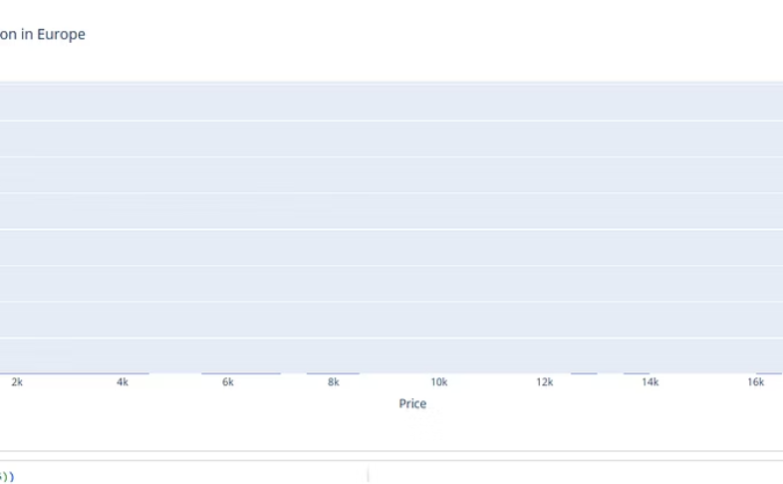
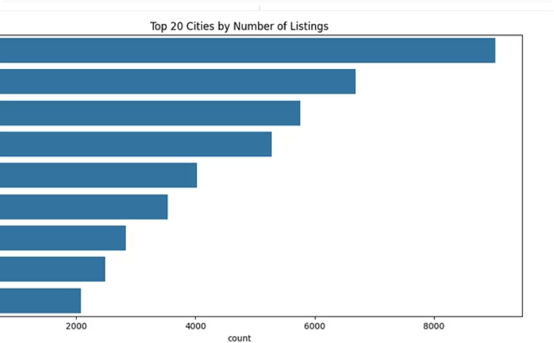
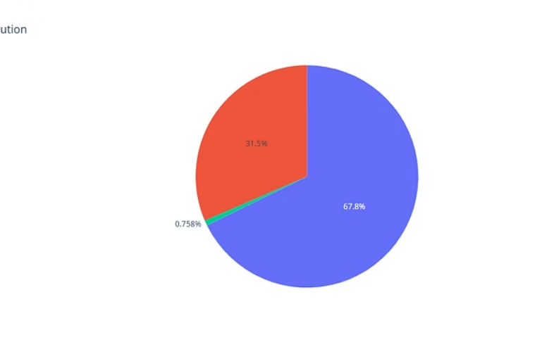
Key Visualizations Showcase
Price Distribution
City Rankings
Size vs Price
Histogram revealing concentrated pricing between €50-150 per night with long tail toward luxury options
Bar chart comparing listing volumes across major European destinations
Scatter visualization showing positive correlation between bedrooms and nightly rates

Slide 8
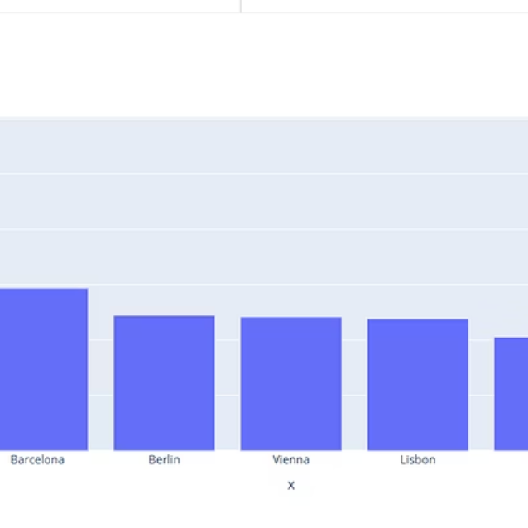
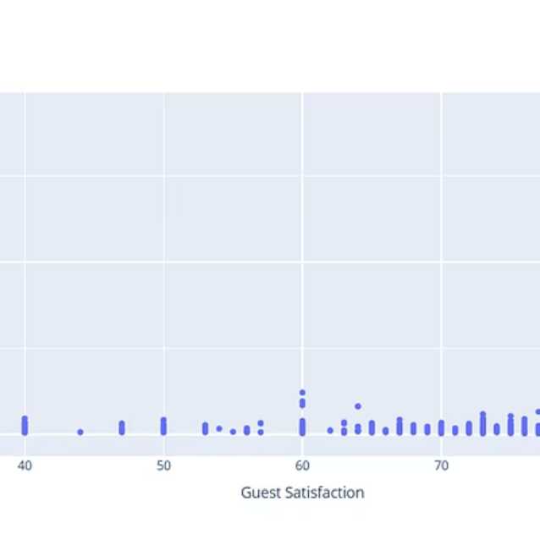
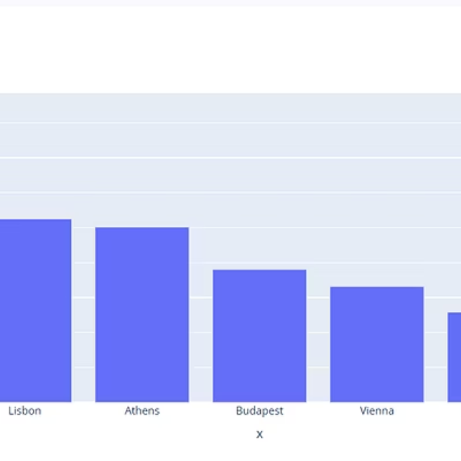
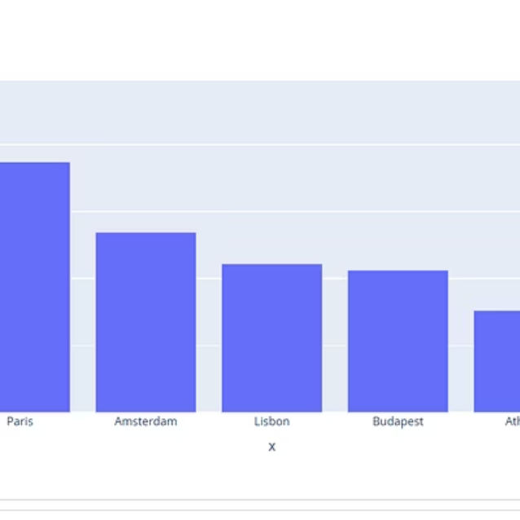
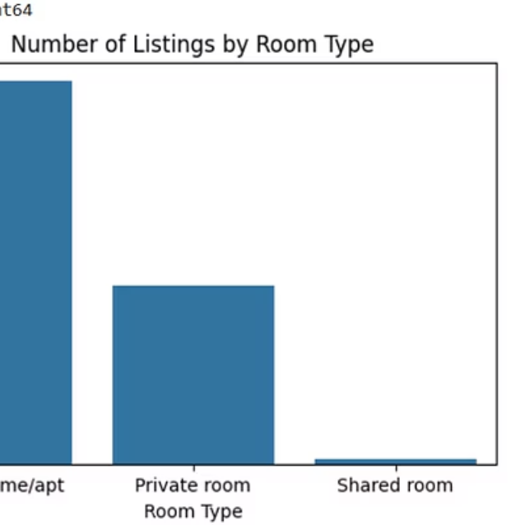
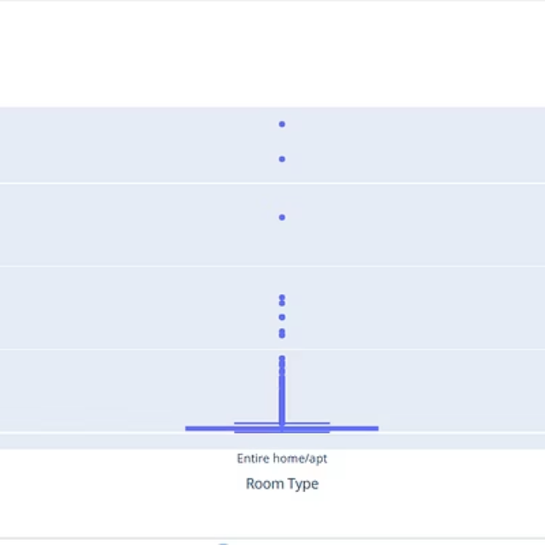
Additional Dashboard Views
Each visualization layer provides unique insights—from room type pricing breakdowns to satisfaction score distributions—enabling comprehensive market understanding.

Slide 9

Key Insights Discovered
Pricing Patterns
Most listings cluster in the mid-range bracket, with premium properties commanding significantly higher rates in tourist-heavy cities like Paris and Amsterdam.
Market Concentration
Major capital cities dominate listing counts, but emerging markets show rapid growth and competitive pricing strategies.
Size-Price Relationship
Clear positive correlation between bedroom count and nightly rates, though outliers suggest location and amenities also drive premium pricing.
Satisfaction Trends
Guest ratings remain consistently high across price points, indicating quality standards are maintained throughout the market spectrum.

Slide 10
PROJECT COMPLETE
Impact & Next Steps
Achievements
Ready to Explore
Successfully delivered an interactive, user-friendly dashboard that transforms complex Airbnb data into actionable insights for hosts, investors, and market analysts.
The dashboard is live and ready for stakeholder review. All visualizations are interactive, with filtering capabilities and drill-down options for deeper analysis.
"Data visualization turns numbers into narratives, revealing stories hidden within the data."
Future Enhancements
Real-time data integration via Airbnb API
Predictive pricing models using machine learning
Seasonal trend analysis and forecasting
Competitive benchmarking tools

