Slide 1

Code Refactoring and Bug Fixing
on
Note Taking Application

Slide 2
About me
Background:
I am passed out student of Electrical and Electronics Engineering from VTU in 2017.
I have around 3+ years of experience as DevOps Engineer (at phData Inc) and Software Engineer (at Legato Health
Technologies/Carelon)
I have graduated from Brunel University London and awarded the PG Diploma Certificate in Data Science and Analytics in 2023
Why you want to learn Data Science:
I am interested to learn Data Science as I am keen to explore data and extract insights from data by solving multiple problems of real world.
Any work experience
Yes
Github profile url: https://github.com/RachanaVishwa/Code-Refactoring-bugfixing
Twitter url: https://twitter.com/Rachusarang

Slide 3
Agenda
Business Problem
Scenario: A team of enthusiastic data scientists embarked on a mission to develop a Note Taking Application using Python, Flask, and HTML. However, their lack of experience in backend development has led to challenges in making the application fully functional.
Task: Refactor the existing codebase and ensure the proper functioning of the Note Taking Application.
More Details:
The application's home route contains a text field and a button. Users can add a note, and all the notes should be displayed as an unordered list below the text field on the same page.
Use case domain understanding
Flask is a lightweight WSGI web application framework. It is designed to make getting started quick and easy, with the ability to scale up to complex applications.
Objective of the Project
To Refactor the existing codebase and ensure the proper functioning of the Note Taking Application.

Slide 4
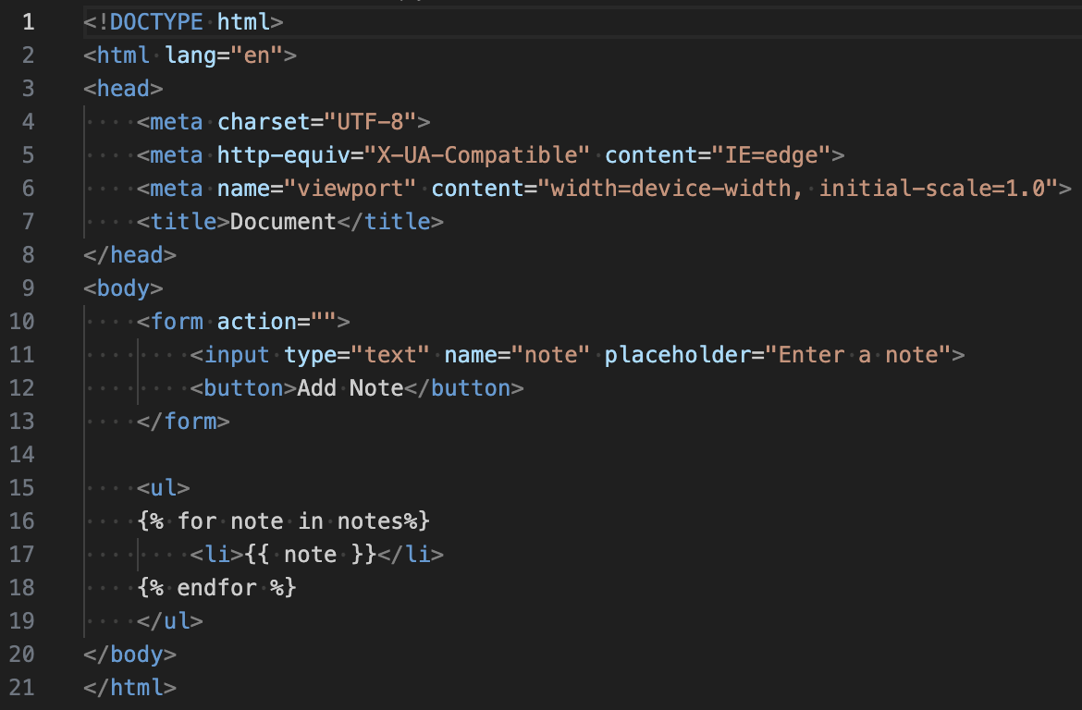
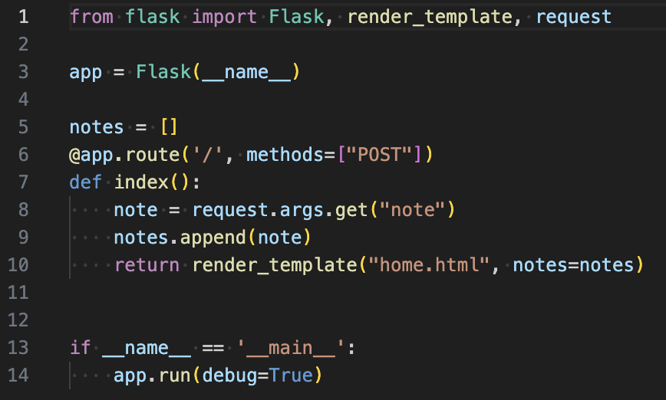
Codebase given for Refactoring and Bug Fixing
HTML Program
Application Program

Slide 5
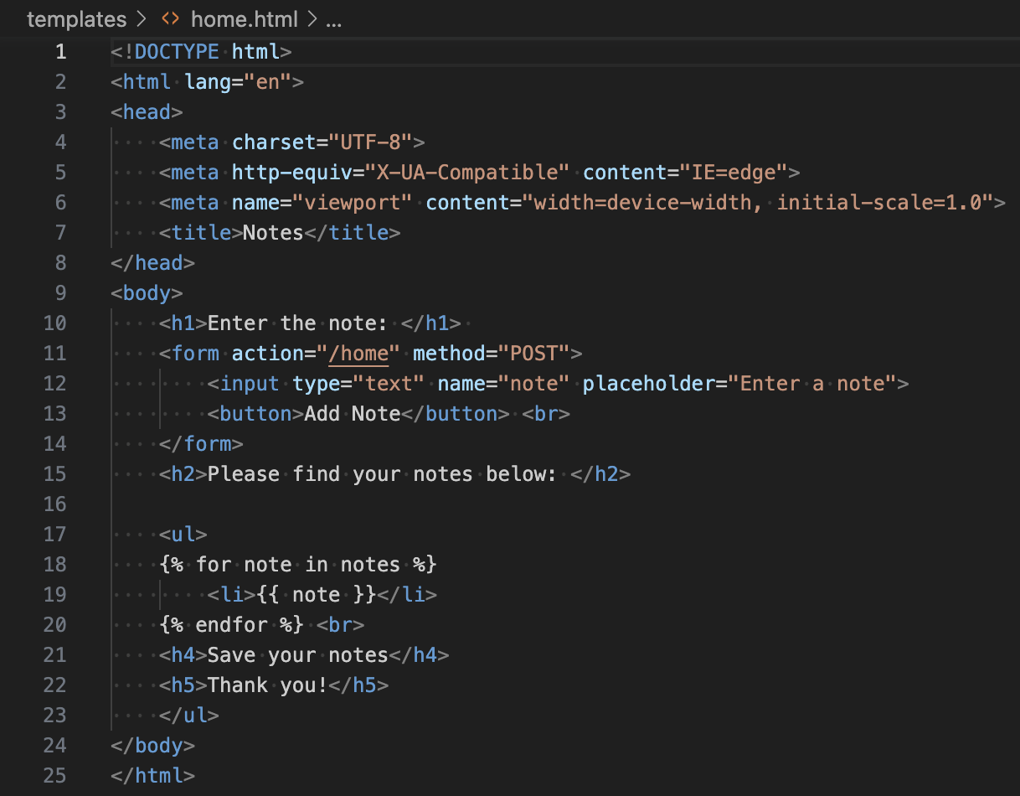
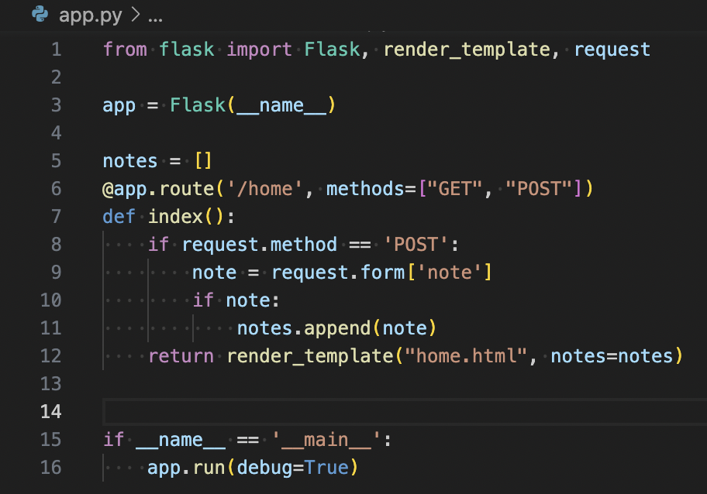
Codebase after Refactoring and Bug Fixing
HTML Program
Application Program

Slide 6
Bugs Identified and Fixed -
@app.route('/', methods=["POST"]) → @app.route('/home', methods=["GET", "POST"])
Using GET request to retrieve information from /home URL and using POST request to send data to /home URL in application server program.
note = request.args.get(“note”) → note = request.form[‘note’]
To send data from frontend to backend, form tag should be used in application server program
<form action=””> → <form action=”/home” method=”post”>
Specifying the path and the method in the form tag in markup language program

Slide 7
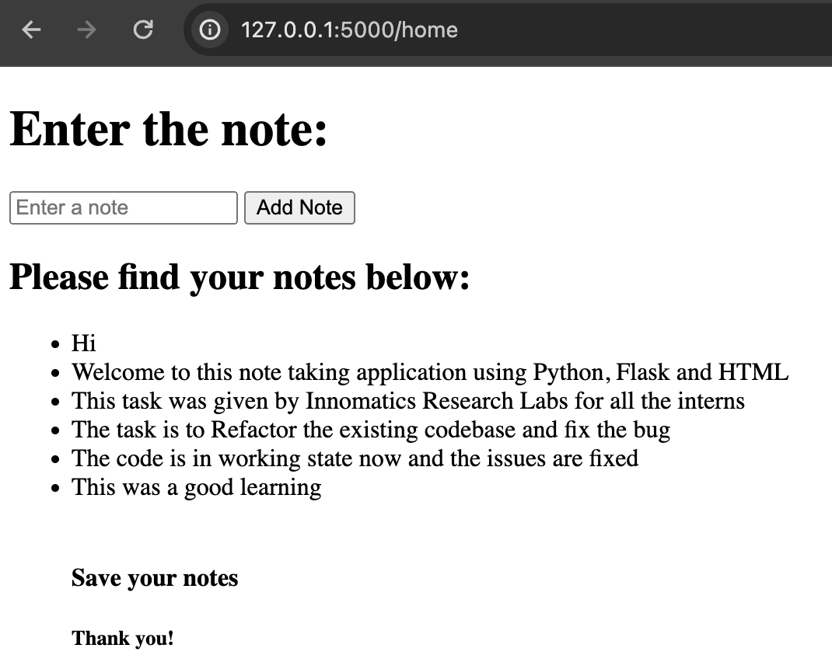
End result of the task:
Working of the app:
After saving and running the python program, go to 127.0.0.1:5000/home in your browser.
Enter all the notes in the placeholder to ‘Enter a note’ and press ‘Add Note’.
All the notes entered in the placeholder will be displayed below as bullet points.

Slide 8

THANK YOU

