Slide 1

Stock Price Forecasting using ARIMA model
Team members:
Venkata Rachana Yekkirala
Sameera Koppana
Shaik Nasir Sohail

Slide 2

INTRODUCTION
Definition: Stock price forecasting is the process of predicting future stock prices based on historical data.
Significance: It plays a vital role in investment decisions, risk management, and financial planning.
ARIMA Model: We'll explore the ARIMA model, a powerful tool for time series forecasting in financial markets.

Slide 3

Tickers and data range
Stocks = American Express – AXP, Goldman Sachs – GS, Morgan Stanely – MS, PNC
Market Index = GSPC
Start Date = '2010-01-01’
End Date = '2023-11-04’
Data source = Yahoo Finance

Slide 4
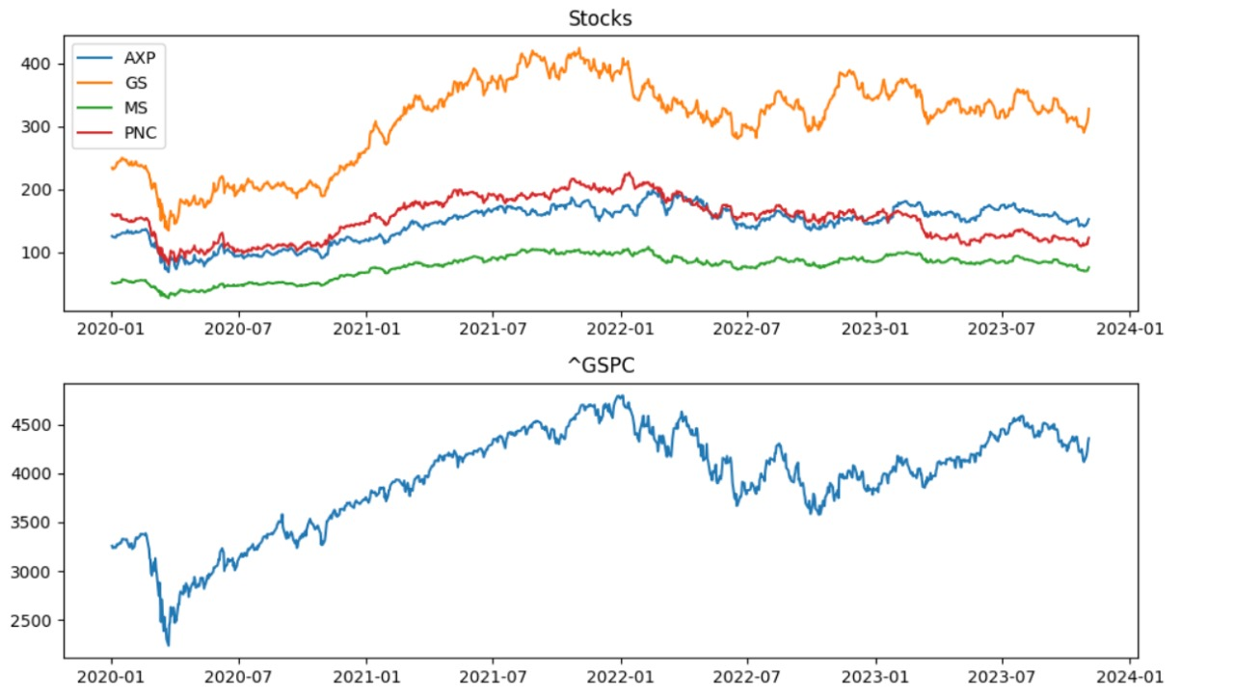

Slide 5
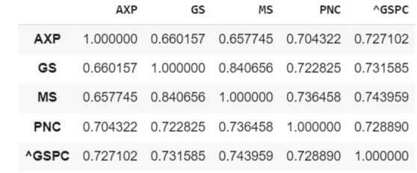

Slide 6
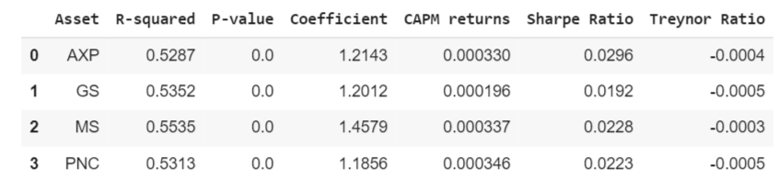

Slide 7
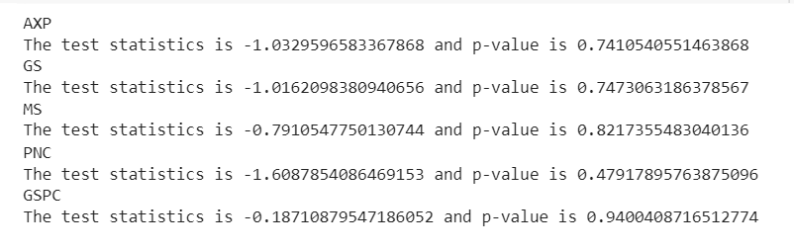

Slide 8

The ARIMA Components:
Auto Regressive (AR): Past values in the time series influence future values.
Integrated (I): Differencing to make the time series stationary.
Moving Average (MA): Past white noise terms influence future values.

Slide 9
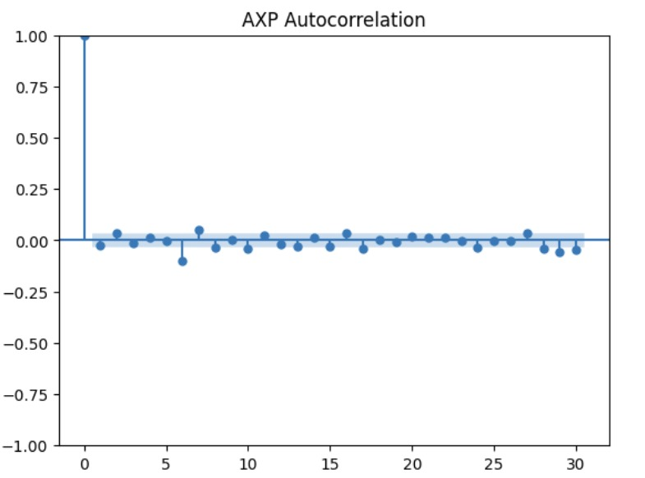
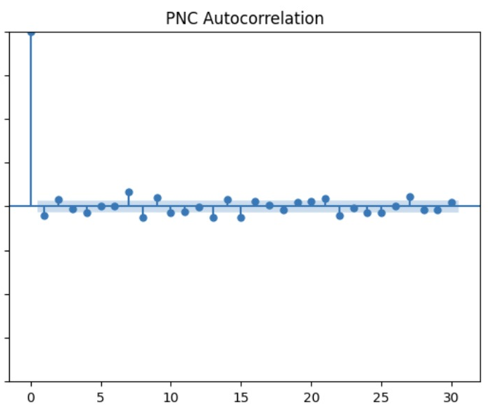
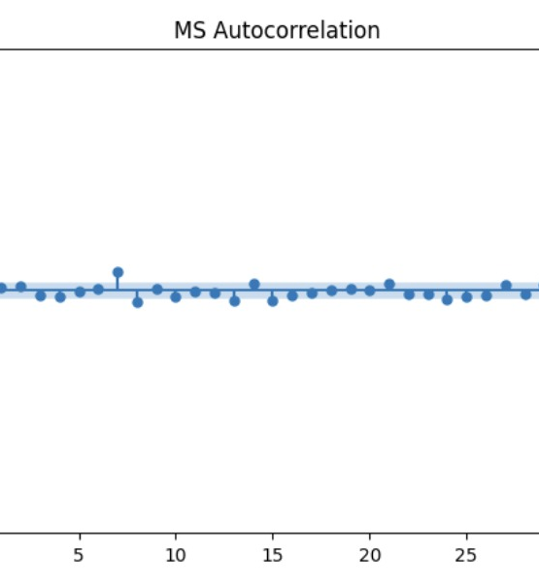
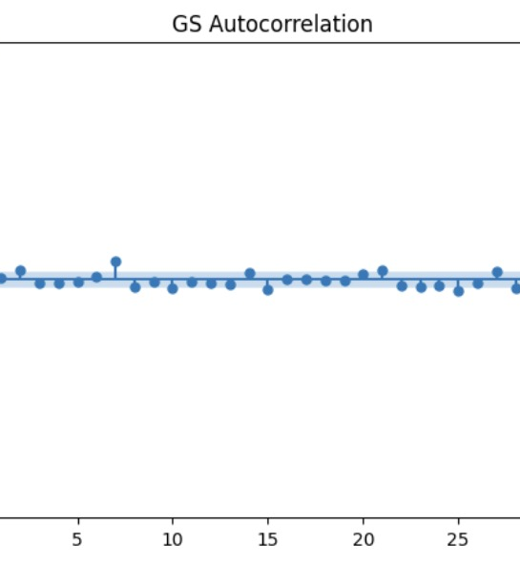

Slide 10
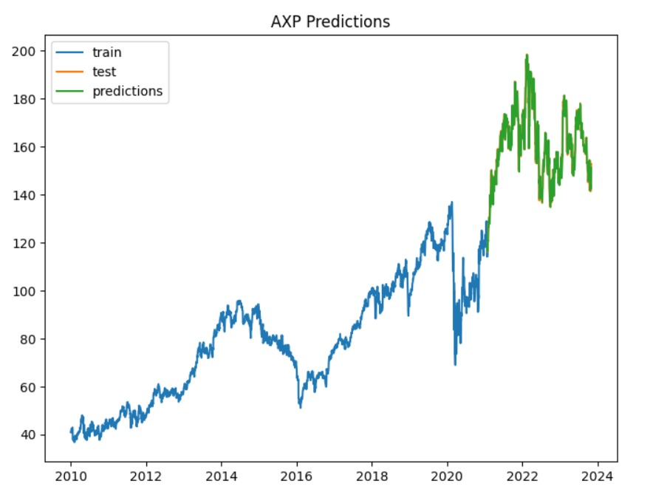

Slide 11
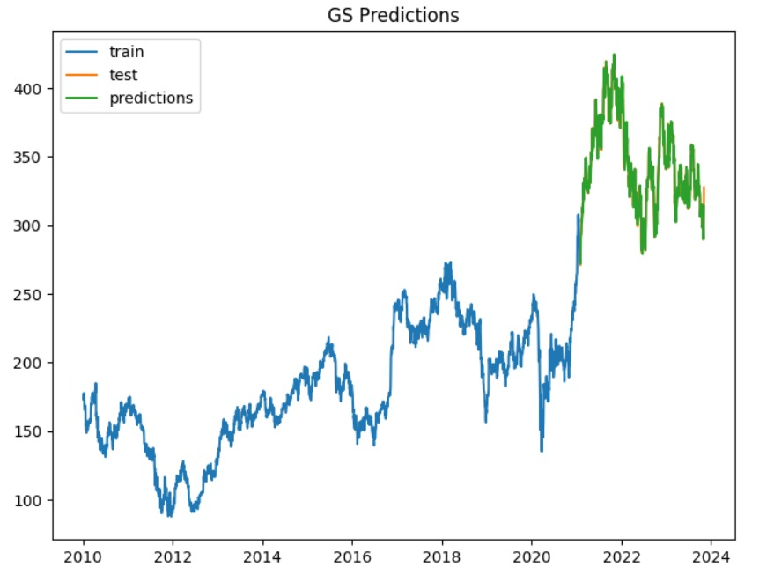

Slide 12
Thank You

