Slide 1
Agile Software Engineering
ASSIGNMENT 6
RACHANA MS

Slide 2
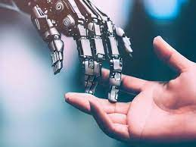
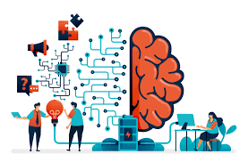
Artificial Intelligence
AI is intelligence demonstrated by the machine,where the human intelligence is put into the machine.
In computer science, the field of artificial intelligence as such was launched in 1950 by Alan Turing.

Slide 3
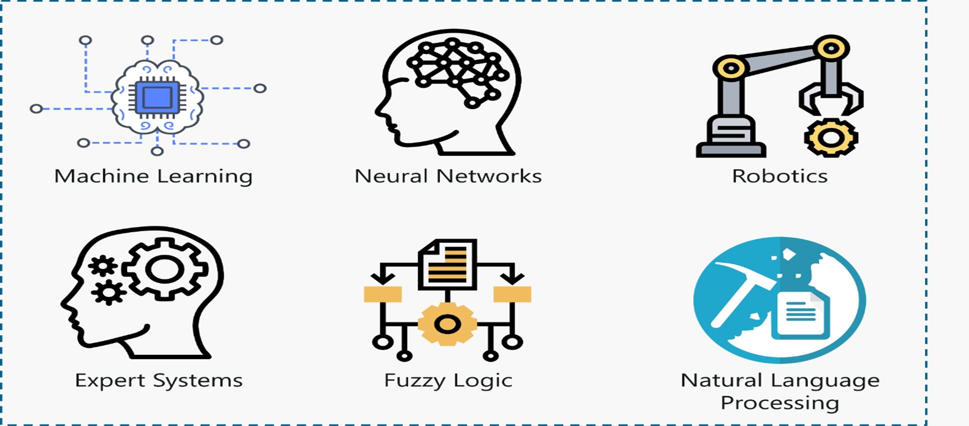
Branches of AI

Slide 4
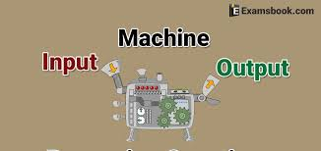
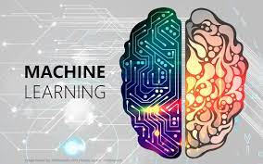
Machine Learning
Machine learning means making the computers to learn like human beings
We give input and output to the machine leaning algorithm and it builds a model. It predicts the future

Slide 5
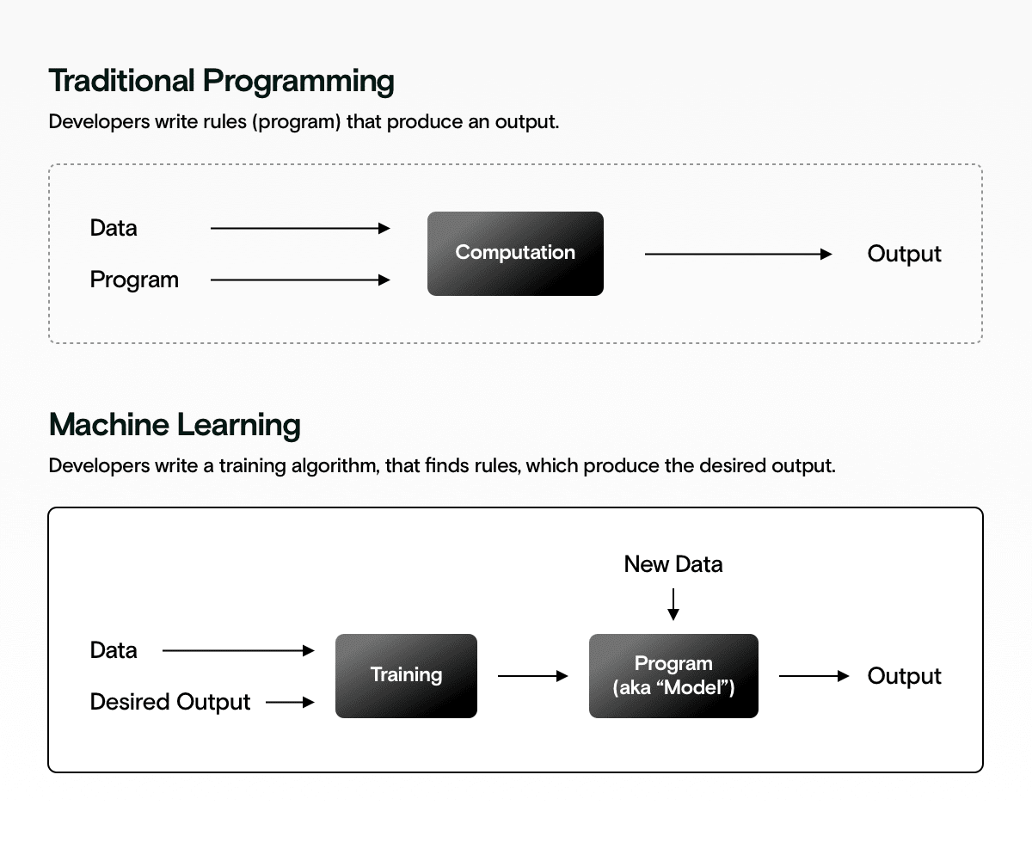

Slide 6
Features ,Labels & Model
X=2 F(x)=4…..Input 2 and Output 4
X=3 F(x)=6
X=4 F(x)=8
X=5 F(x)=10
What is X=10 ?
Ans:20
F(x)=2x… Is the Model
Inputs are called Features.
Output are called Labels.
Function is called Model

Slide 7
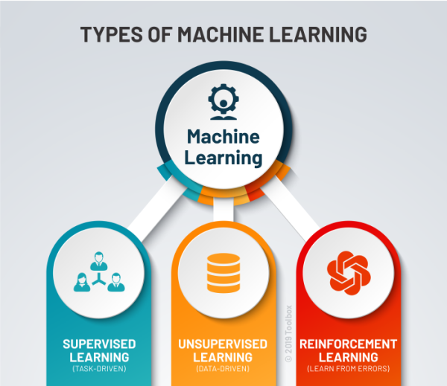

Slide 8
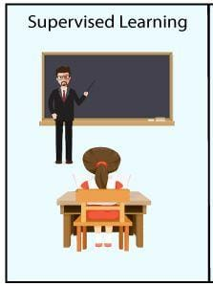
Supervised Learning
Learning from others is called Supervised Learning
Supervised learning will have features and labels.
There are two algorithms:-
1.Regression
2.Classification

Slide 9
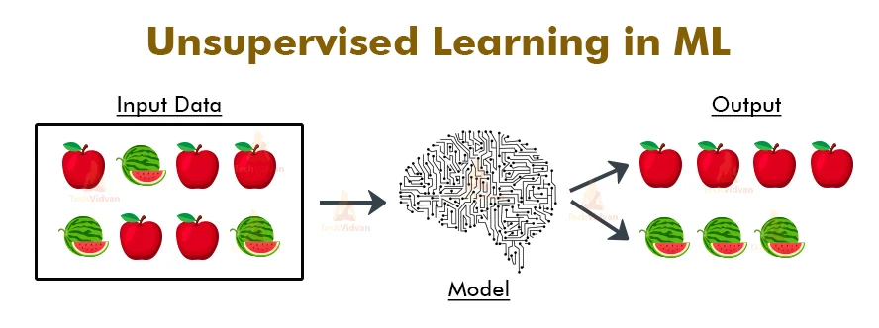
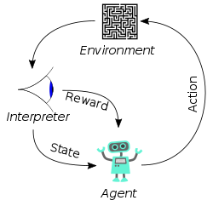
Unsupervised learning and Reinforcement learning
Learning on our own is called UNSUPERVISED LEARNING
Machine Learning method in which the user is rewarded for the desired behaviour or punished for the undesired behaviour – REINFORCEMENT LEARNING

Slide 10
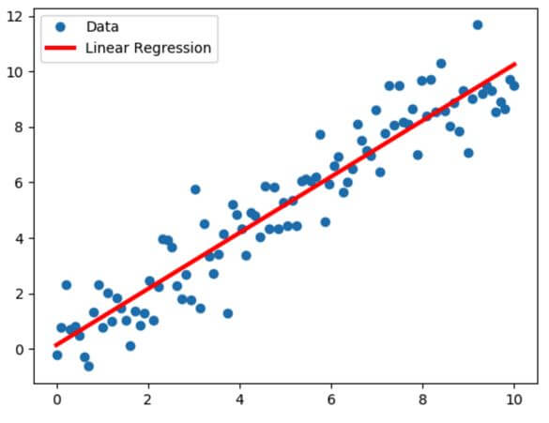
Regression
Regression Algorithm means which have a continuous data.
In regression we use only:
Linear regression - Linear regression is one of the easiest and most popular Machine Learning algorithms. It is a statistical method that is used for predictive analysis. Linear regression makes predictions for continuous/real or numeric variables such as sales, salary, age, product price, etc.
Non-Linear regression

Slide 11
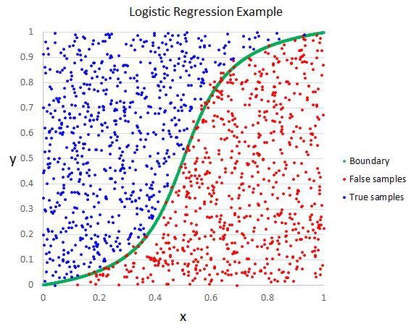
LOGISTIC REGRESSION - Logistic regression is a statistical analysis method to predict a binary outcome, such as yes or no, based on prior observations of a data set.

Slide 12
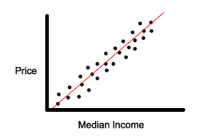
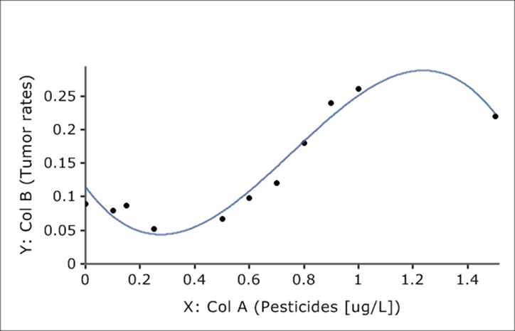
Linear Regression
Non linear regression

Slide 13
Classification
Classifying the data either one like Yes Or No, Ture Or False etc.
In classifying we use:
Logical Regression.
Decision Tree.[DT]
Random Forest.[RF]
K Nearest Neighbour[KNN]
Support Vector Machine[SVM]
Naïve Bayes

Slide 14
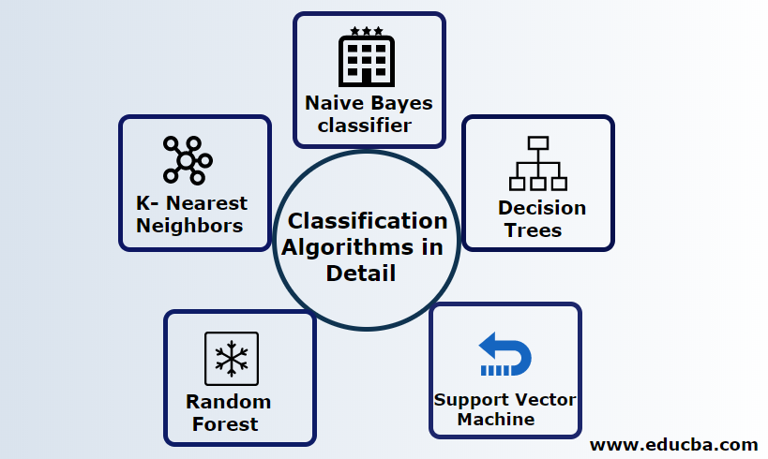

Slide 15
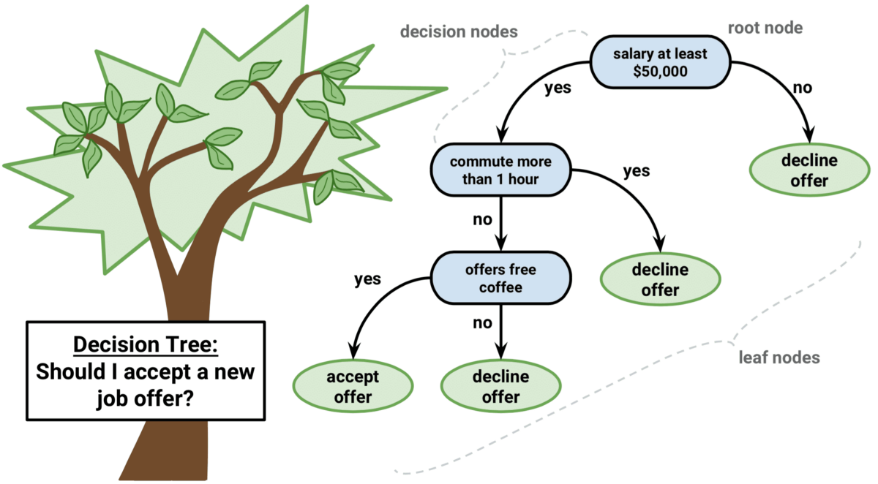
Decision tree
Decision Tree is the most powerful and popular tool for classification and prediction. A Decision tree is a flowchart-like tree structure, where each internal node denotes a test on an attribute, each branch represents an outcome of the test, and each leaf node (terminal node) holds a class label

Slide 16
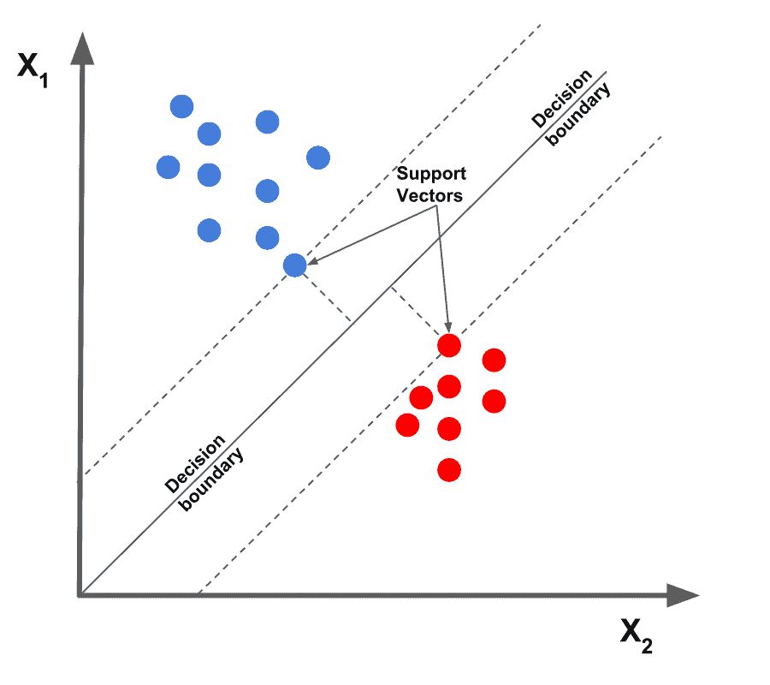
Support Vector Machine
Support Vector Machine or SVM is one of the most popular Supervised Learning algorithms, which is used for Classification as well as Regression problems. However, primarily, it is used for Classification problems in Machine Learning.

Slide 17
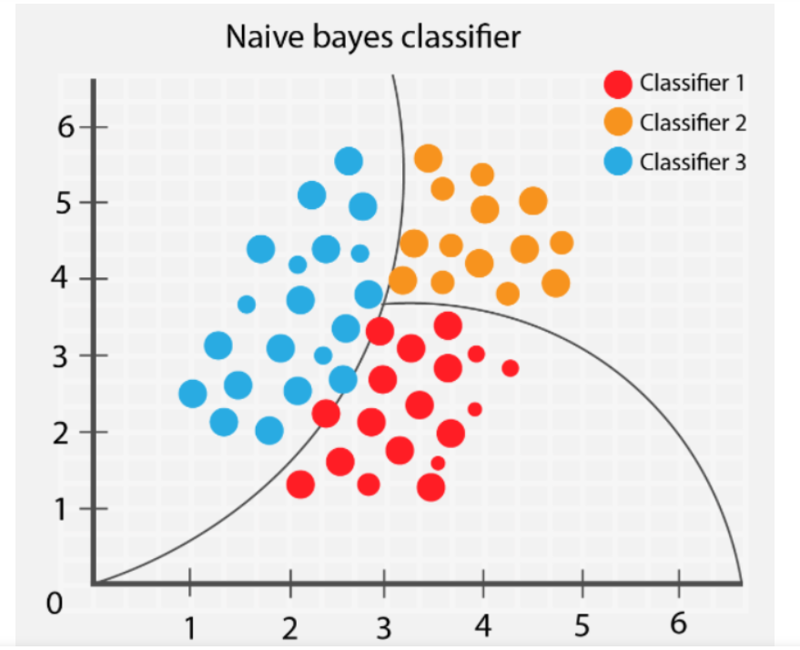
Naïve Bayes
Naïve Bayes algorithm is a supervised learning algorithm, which is based on Bayes theorem and used for solving classification problems.
It is a probabilistic classifier, which means it predicts on the basis of the probability of an object.
Naïve Bayes Classifier is one of the simple and most effective Classification algorithms which helps in building the fast machine learning models that can make quick predictions

Slide 18
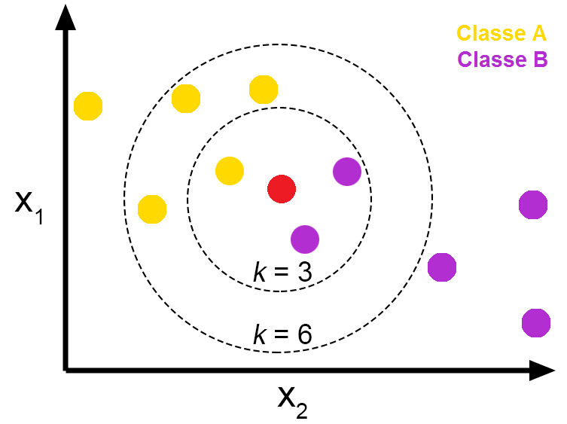
K-Nearest Neighbour
K-Nearest Neighbour is one of the simplest Machine Learning algorithms based on Supervised Learning technique.
K-NN algorithm can be used for Regression as well as for Classification but mostly it is used for the Classification problems.
K-NN is a non-parametric algorithm, which means it does not make any assumption on underlying data.
It is also called a lazy learner algorithm because it does not learn from the training set immediately instead it stores the dataset and at the time of classification, it performs an action on the dataset.

Slide 19
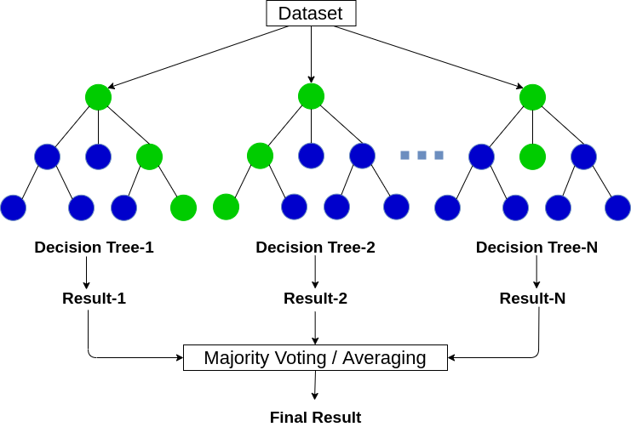
Random Forests
Random forest is a Supervised Machine Learning Algorithm that is used widely in Classification and Regression problems. It builds decision trees on different samples and takes their majority vote for classification and average in case of regression

