Slide 1

DAX Function
ZERO TO DEVELOPER
BY Rachana

Slide 2
CONTENTS
PREREQUISITES
Data vs Lookup tables
Primary vs Foreign key
Cardinally
Filter Flow
MAINLY FOCUS ON
Naming Conventions
Evaluation series order
DAX Shortcuts
DAX Comments
ERROR Handling
Variables
CALCULATE
Introduction
Pillars
TABLE FUNCTION
Filter Data function
Table Joins
Relation Functions
DAX
Introduction
Engines
Data Types
Operators
Vertipaq
Calculated Columns
Measures
Evaluation context
SCALAR Function
Aggregate functions
Iterator Functions
Round Functions
Information Function
Logical function

Slide 3
TIME INTELLIGENCE
Data Table
Calender
Performance Till Date
Time Period Shift
Running Total Functions
PERFORMANCE TUNING
Performance Analyser
DAX Studio

Slide 4
PREQUITISITIES

Slide 5

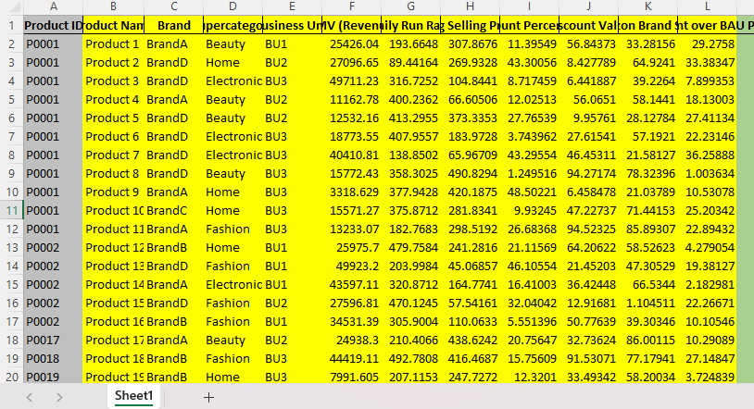
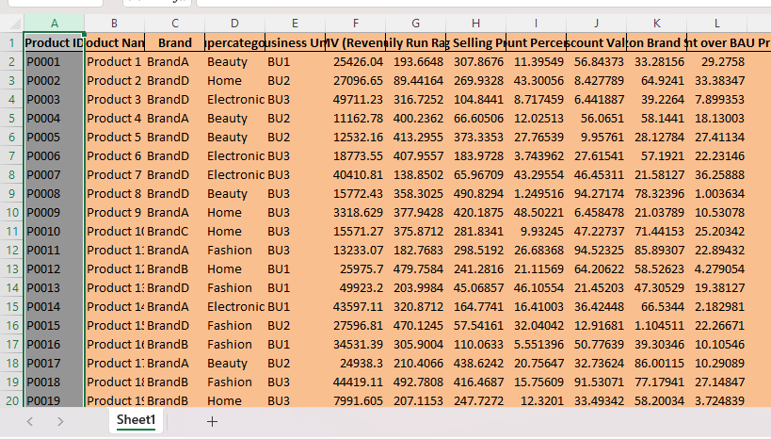
DATA VS LOOKUP TABLES
Data Tables:Cantain measurable values or metrics about the business(quantity,revenue)
Lookup Tables:Provides descriptive attributes about the each deminsion in the project(customer,product)

Slide 6
Cardinality
Refers to the uniquess of values in a column.It ca be of many types
Filter Flow
One to many
Many to one
Many to Many
One to One
For our purpose ,all relationships in the data model should follow a ‘Oe to many relationship carinality,one instance for each primary key to many instances of each foreign key
Filter Flow always runs downstream from lookup to data Table
Filter cannot flow’upstream”(against the direction)

Slide 7
DAX

Slide 8
DAX
DAX also know as Data Analysis Expression is a functional language i.e the executes flows with functiona calls,it is used in
POWER BI
Analysis Services Tabular
Power Pivot
IT resembles excel because it was born with Power Pivot
Formatting
Formatting Code is a parameter importance in DAX
SUMX(FILTER(VALUES(‘Date’[Year],’Date[‘Year]<2005),
IF(‘DATE[‘Year’]>=2000,
[Sales Amount]*100)

Slide 9
DAX Engines
Dax is powered by two internal engines(formula engine and storage engine) which work together to compress and encode raw data and Evaluate Dax queries
Formula Engine
Receives,interprets and executes all DAX Requests
Works with the datacache sent back from the storage engine to evaluate the DAX queryand return a result
Storage Engine
Compresses and encodes raw data, and only communicates with the formula engine(doesn’t understand the DAX language)Receives a query plan from Formula Engine,
Receives a query plan from Formula Engine, executes it, and returns a datacache Receives,

Slide 10
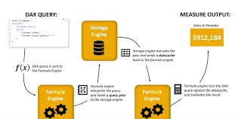

Slide 11
Data Types
DAX TYPE HANDLINGOperators are not strongly typedThe result depends on the inputs
example:
OPERATOR OVERLOADING
"4" + "8" = 124 & 8 = "48“
Pay attention to undesired conversionsData
Integer (64 bit)
Whole Number
Decimal (Floating Point)
Currency (Fixed Decimal Number)
Date, DateTime,
Time TRUE / FALSE (Boolean)
String (Unicode String)

Slide 12
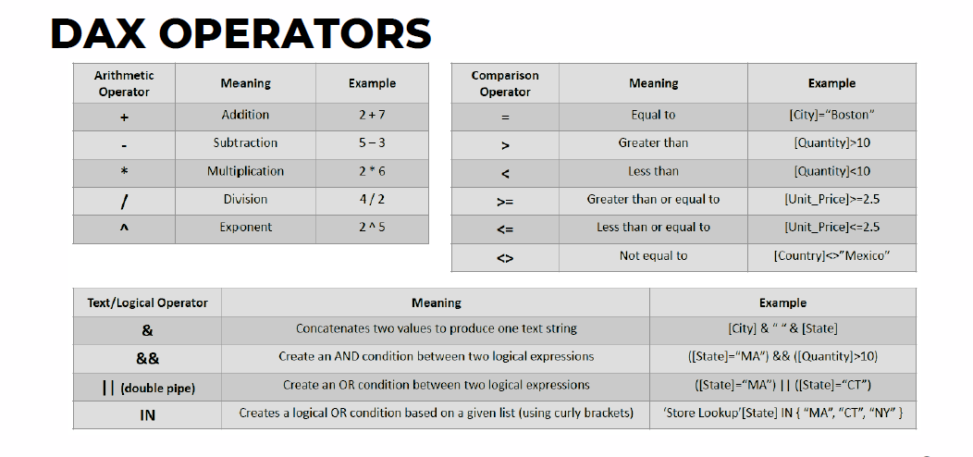

Slide 13
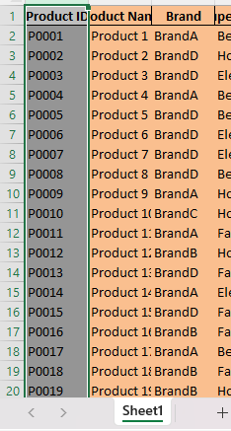
Vertique
Vertipaq uses acolunar data structure,which stores data as individual columns(rather than rows or full tables)to quickly and efficiently evaluate DAX queries
VALUE ENCODINGEncoding is used to reduce the amount of memory needed to evaluate a DAXMathematical process used to reduce the number of bits needed to store integer
HASH ENCODING
:Identifies the distinct string values and creates a new table with indexes
RUN LENGTH ENCODINGReduces the size of a dataset by identifying repeated values found in adjacent rows

Slide 14
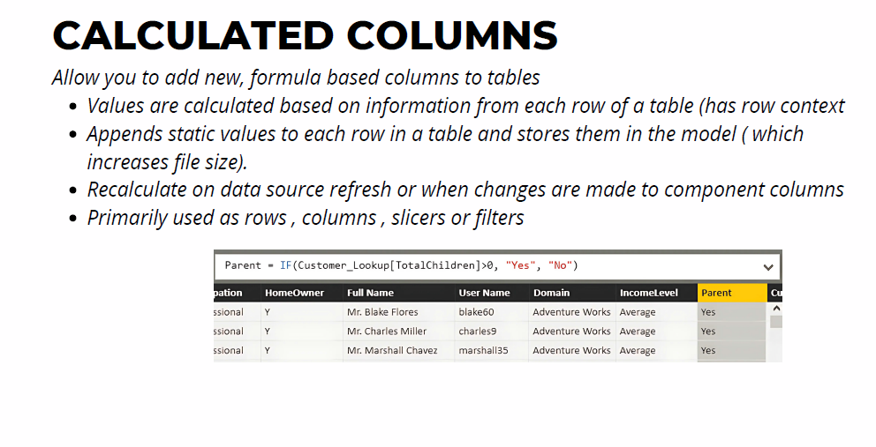

Slide 15
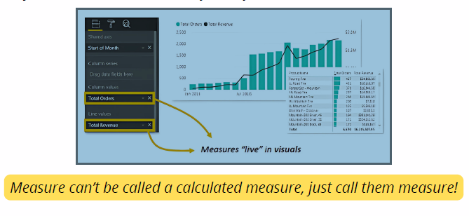
Measures
Values are calculated based on information from any filters in the report(has filter context
Does not create new data in the tables themselves
Recalculate in response to any change to filters within the report
Almost always used within the values field of a visual

Slide 16
MEASURES VS CALCULATED
MEASURES
CALCULATED
Values are calculated based on information from any filters in the report(has filter context)
Does not create new data in the tables themselves doesn't increase file size
Recalculate in response to any change to filters within the report
Almost always used within the values field of a visual
Values are calculated based on information from each row of a total row context
Appends static values to each row in the table and stores them in the model (which increase file size
Recalculate on data source refresh or when changes are made to components columns
Primarily used as rows, columns, slicers or filters

Slide 17
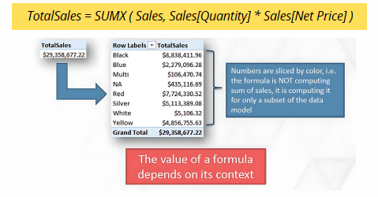
Evaluation Context
Evaluation contexts are the pillars of DAX i.e, Filter and Row
Filter context
Filter tables
Raw Context
Iterates rows

Slide 18
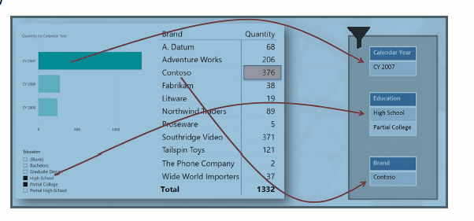
FILTER CONTEXT
Filter context filters the tables in your data model
Dax create filter context when dimensions are added to rows, columns, slicers and filters
CALCULATE can be used to systematically create or modify existing filter context
Filter context always travels from the ONE side to the MANY side of a table relationship

Slide 19
