Slide 1
CAEX 3.0
Documentation of Metamodel

Slide 2
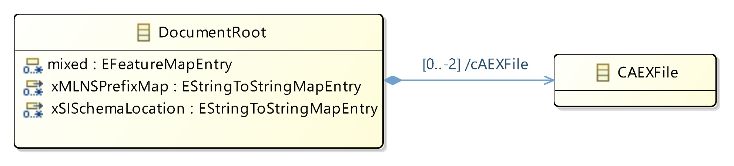
CAEX Document
No Changes Since CAEX 2.15

Slide 3
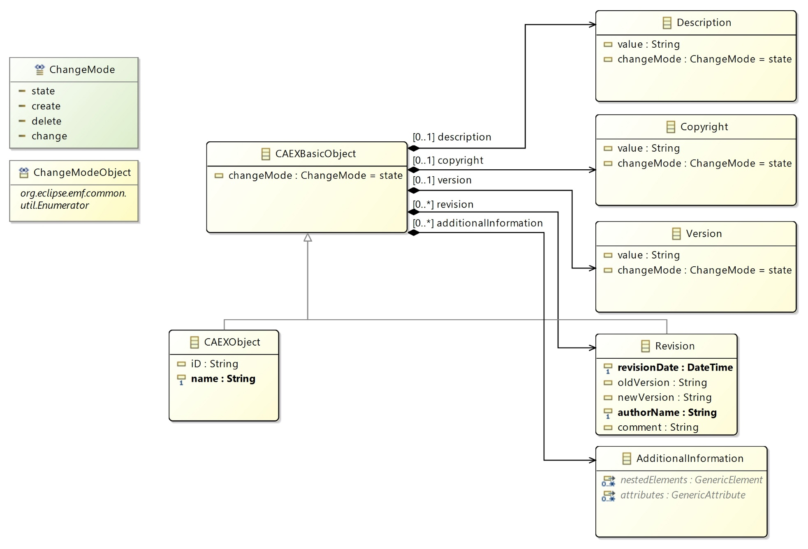
CAEX Objects
No Changes Since CAEX 2.15

Slide 4
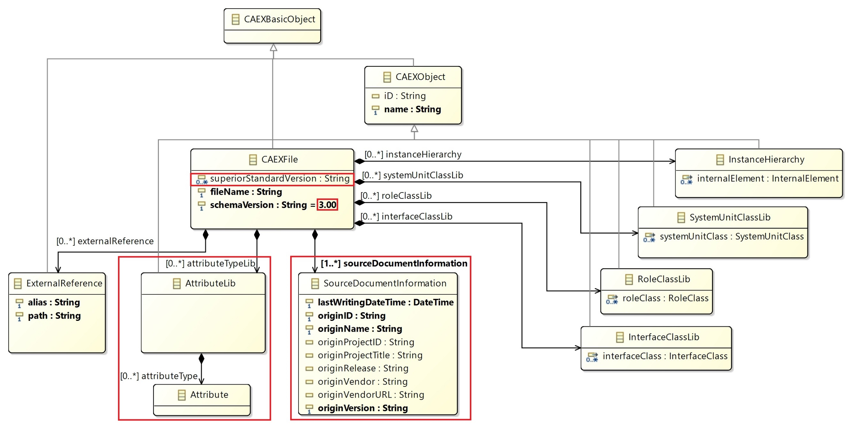
CAEX File
Changes
Since CAEX 2.15

Slide 5
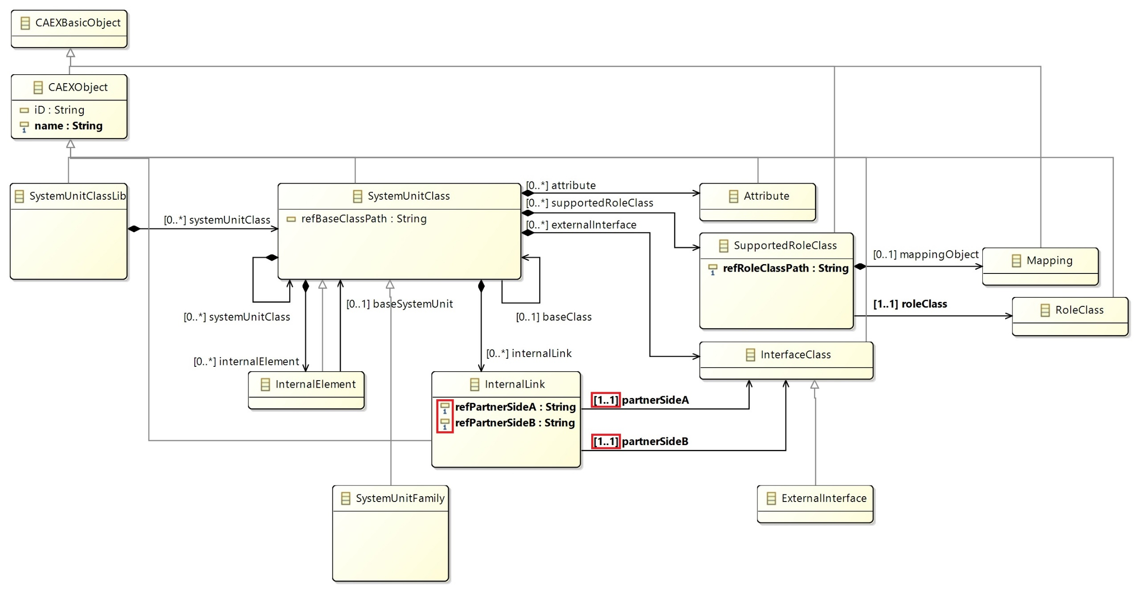
System Unit Class Library
Changes
Since CAEX 2.15

Slide 6
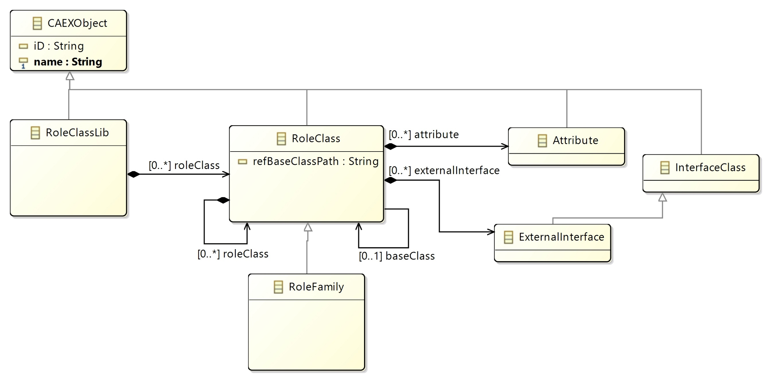
Role Class Library
No Changes Since CAEX 2.15

Slide 7
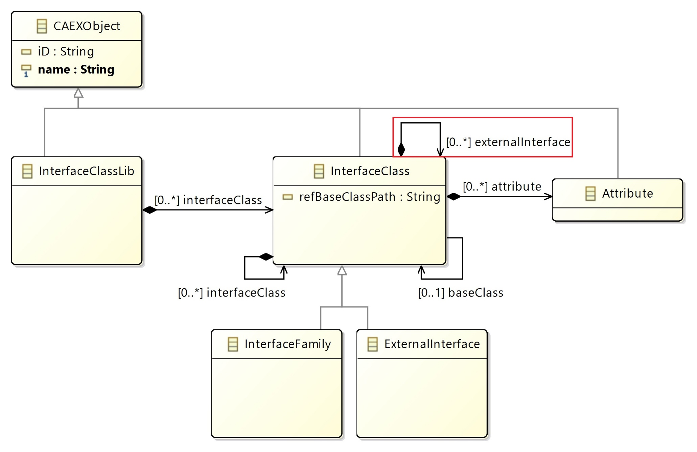
Interface Class Library
Changes
Since CAEX 2.15

Slide 8
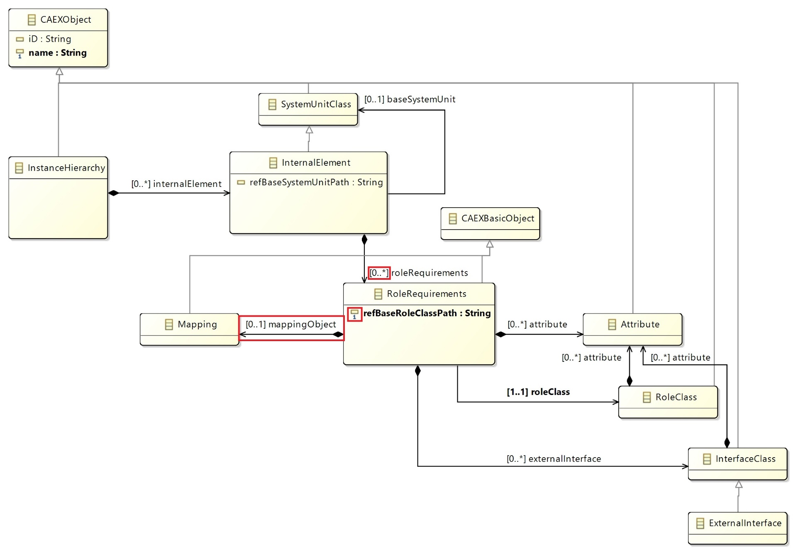
Instance Hierarchy
Changes
Since CAEX 2.15

Slide 9
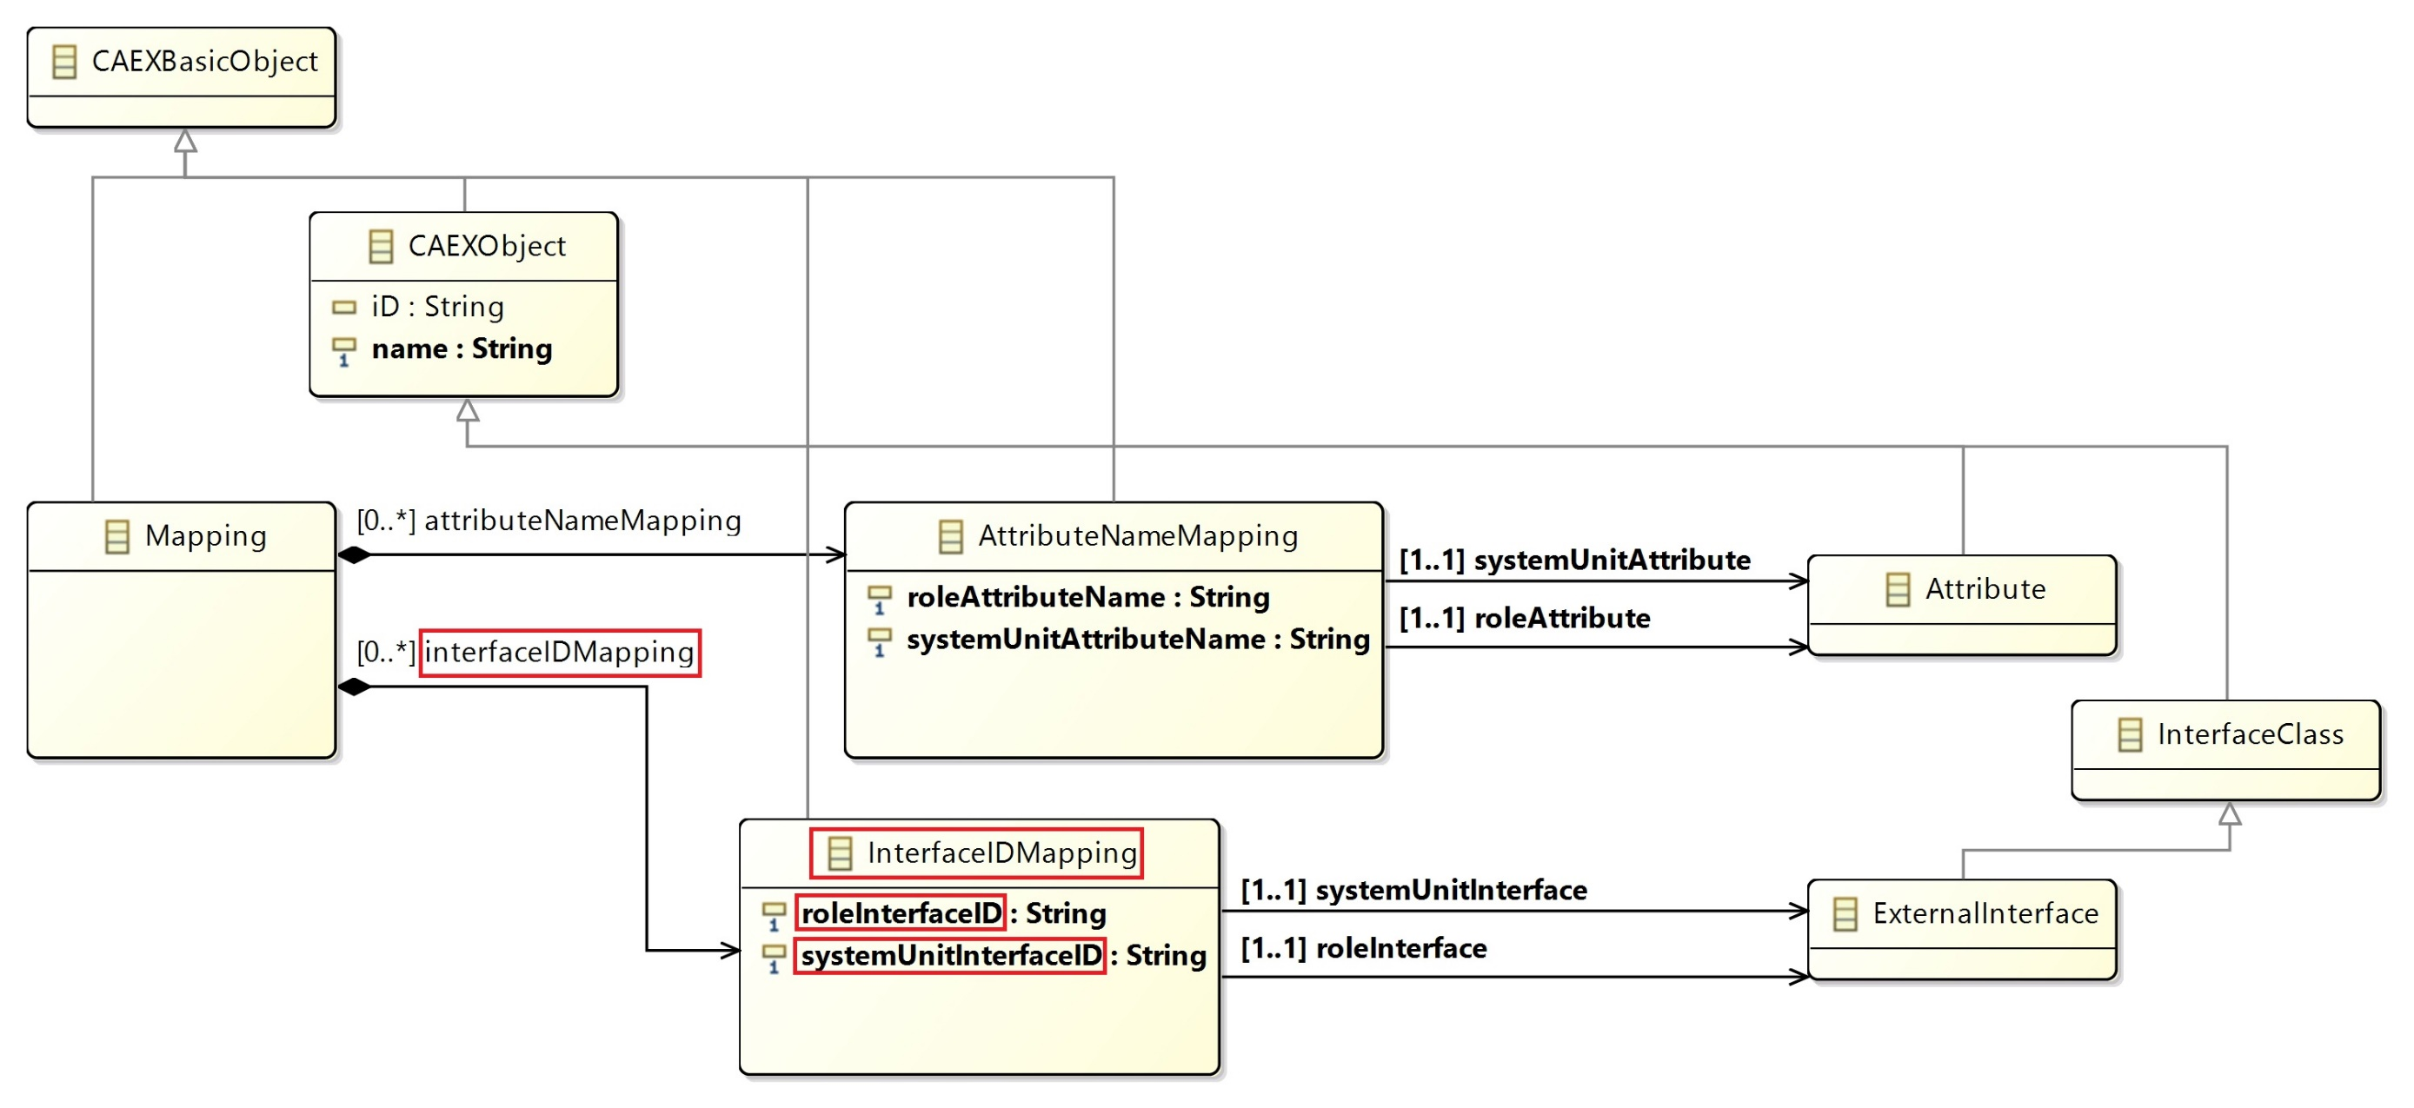
Mappings
Changes
Since CAEX 2.15

Slide 10
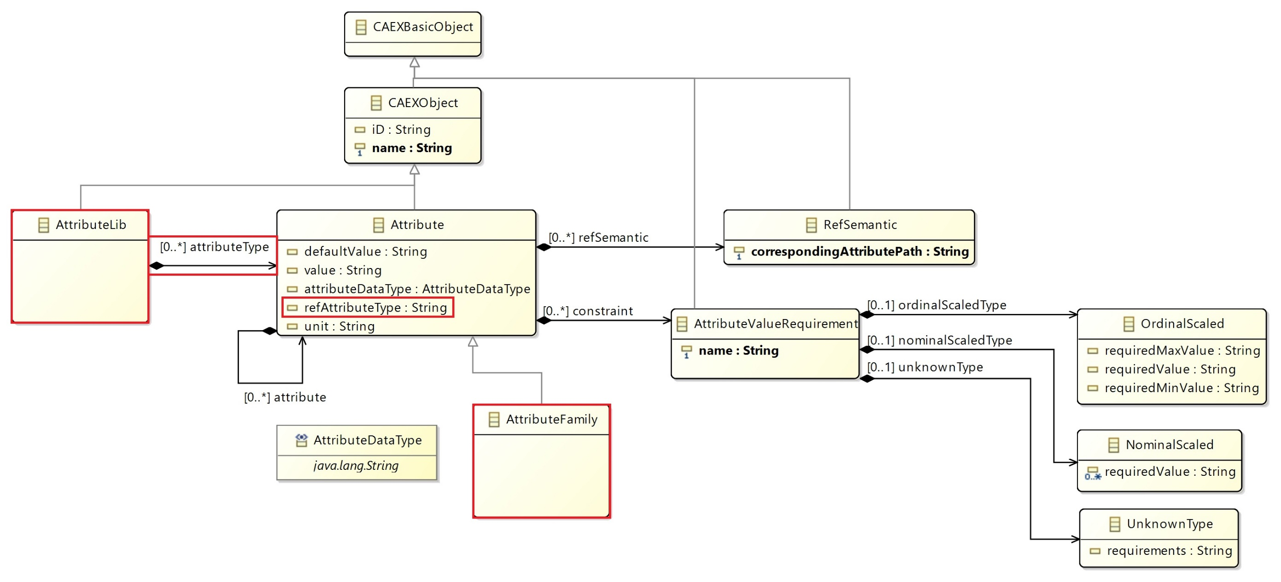
Attributes
Changes
Since CAEX 2.15

