Slide 1
CAEX 2.15
Documentation of Metamodel

Slide 2
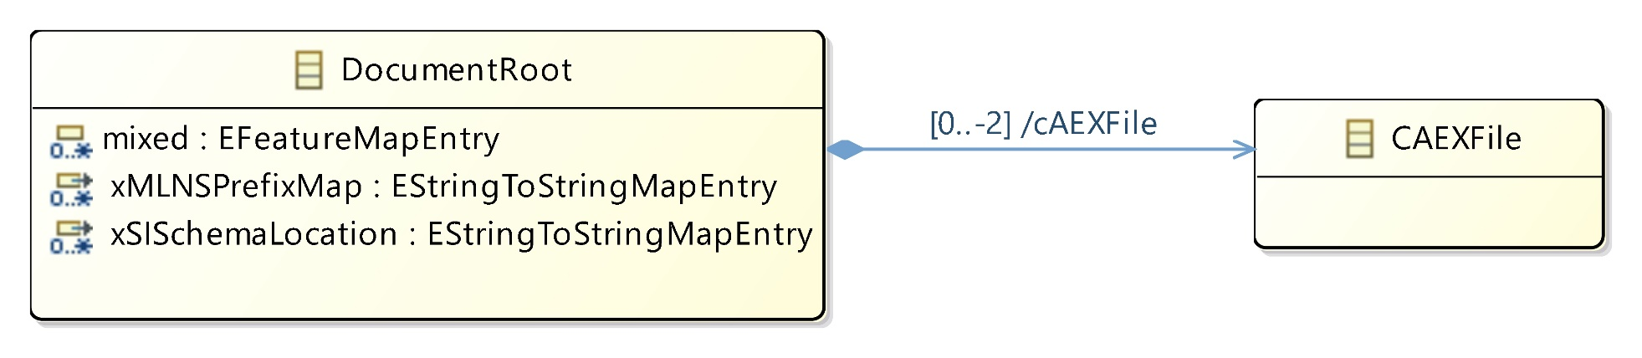
CAEX Document

Slide 3
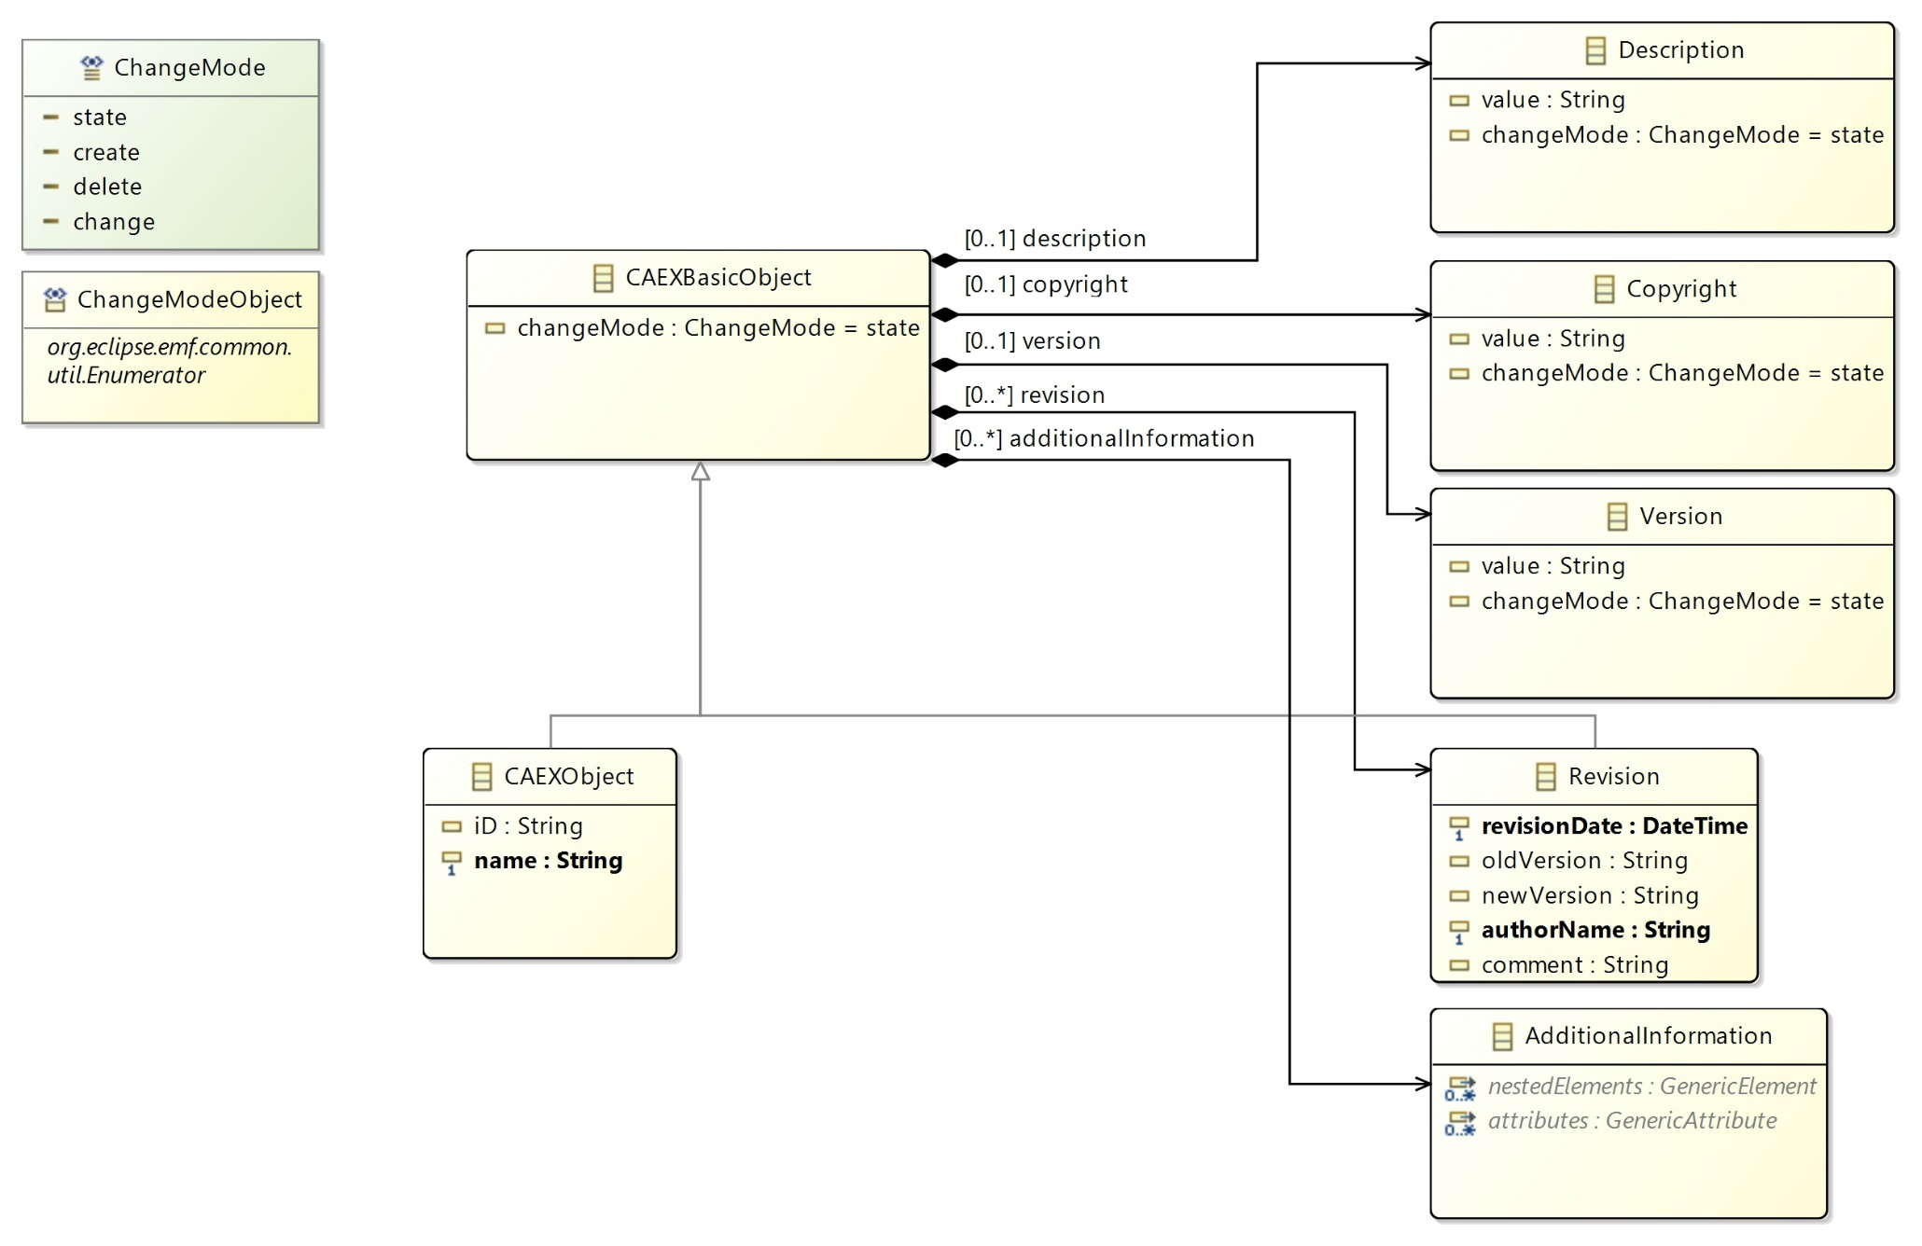
CAEX Objects

Slide 4
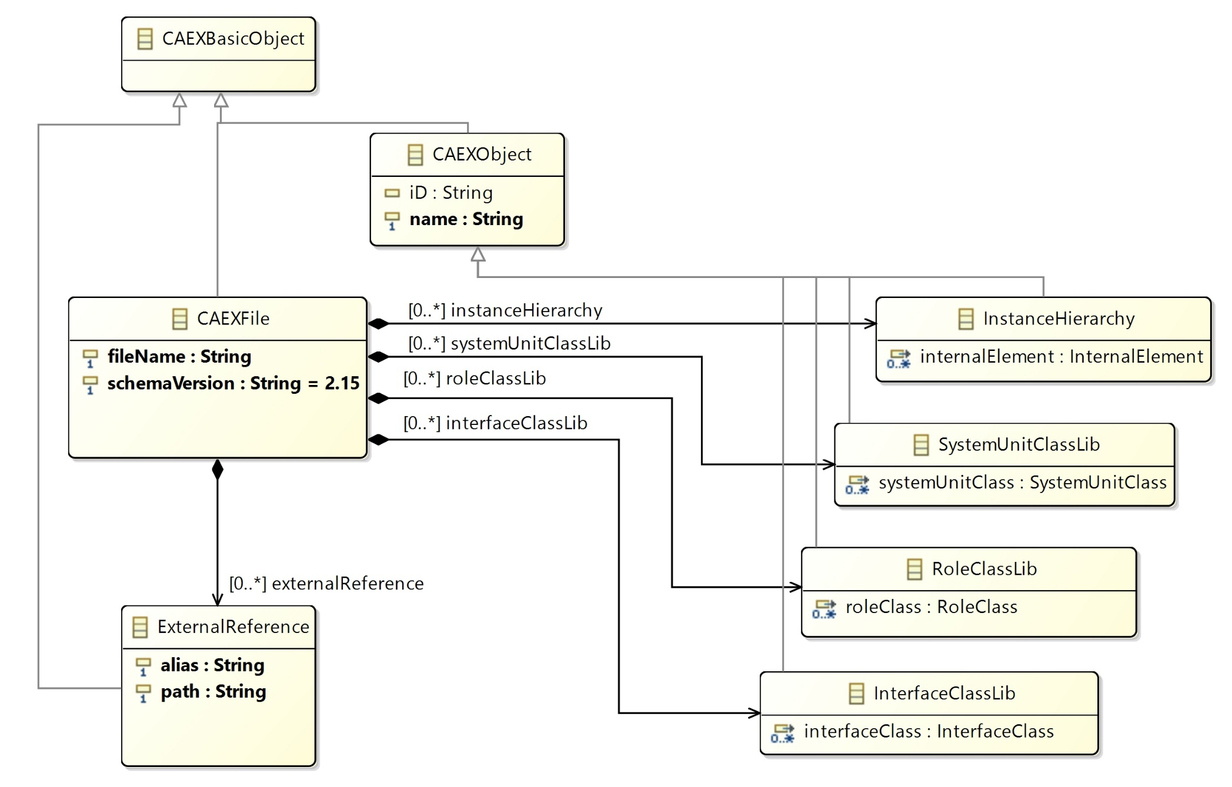
CAEX File

Slide 5
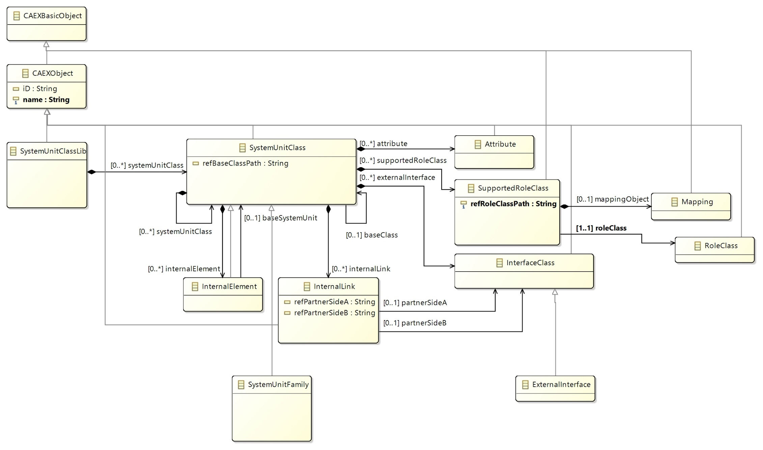
System Unit Class Library

Slide 6
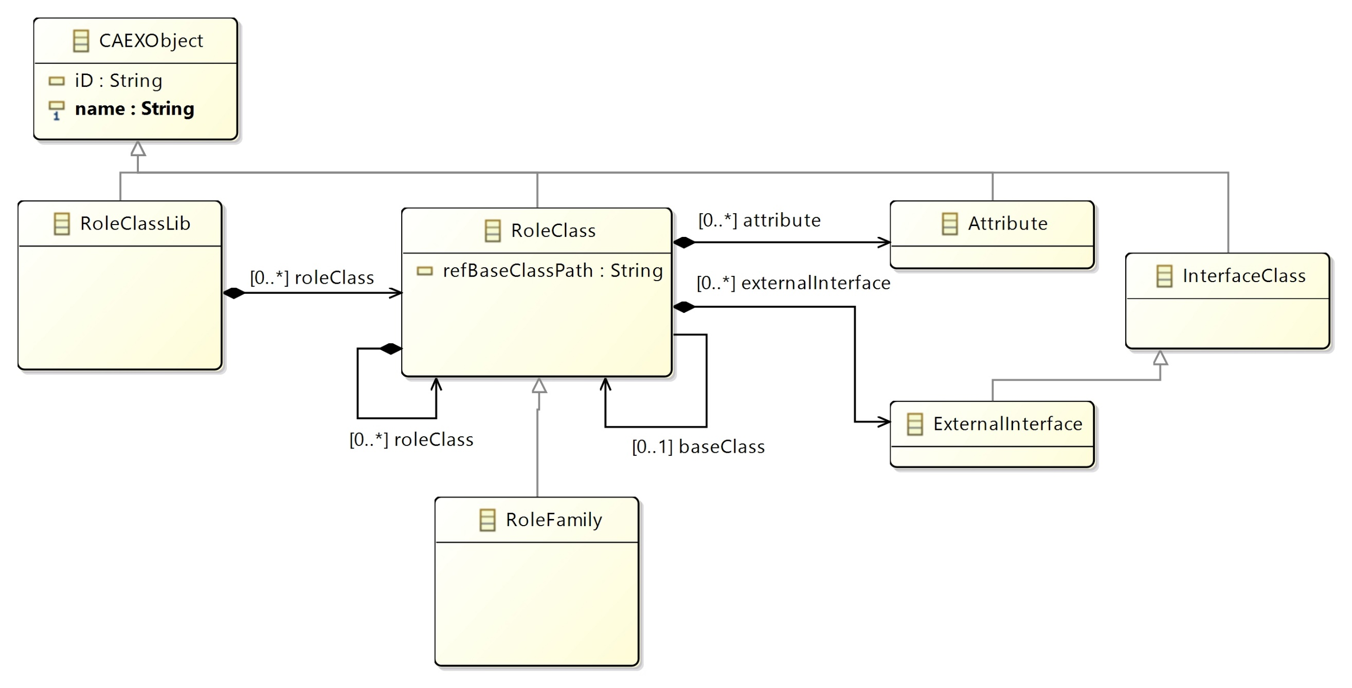
Role Class Library

Slide 7
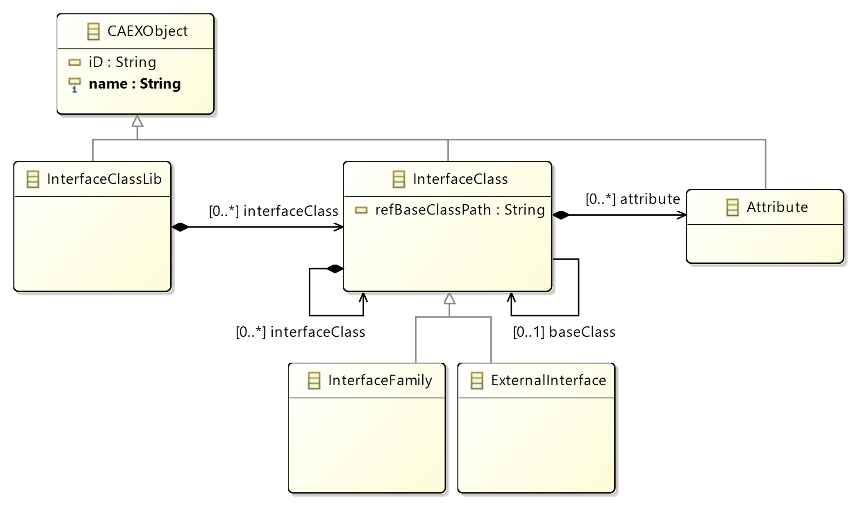
Interface Class Library

Slide 8
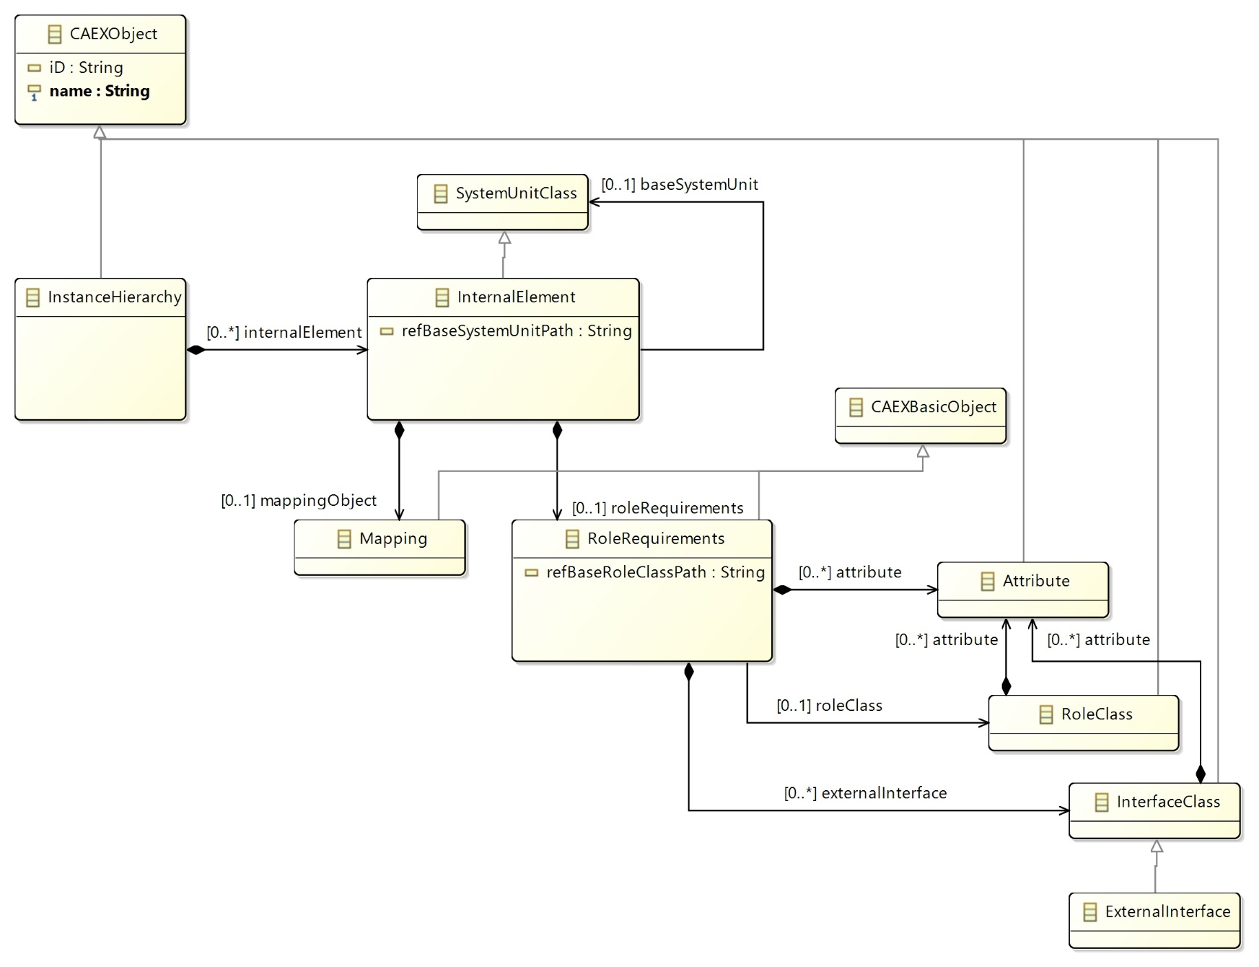
Instance Hierarchy

Slide 9
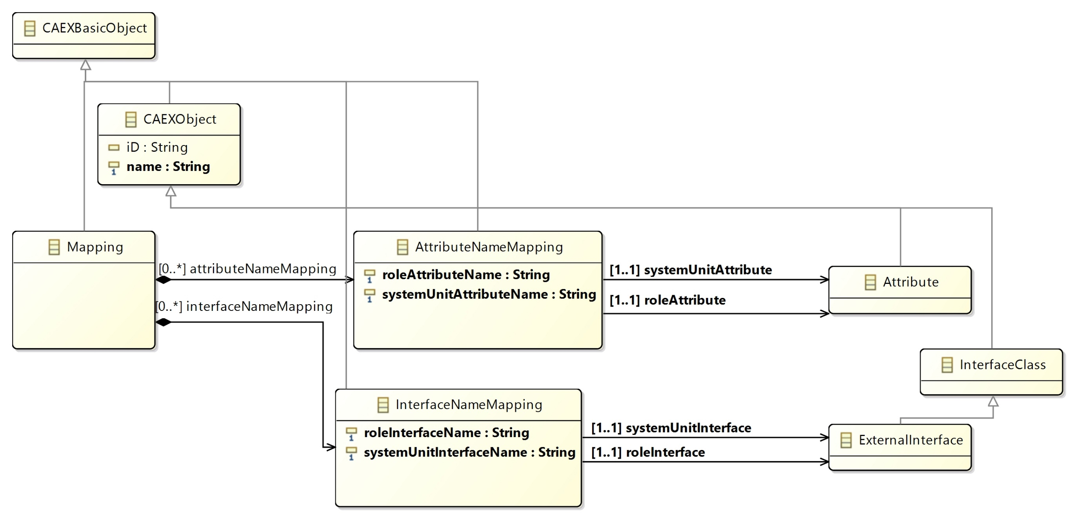
Mappings

Slide 10
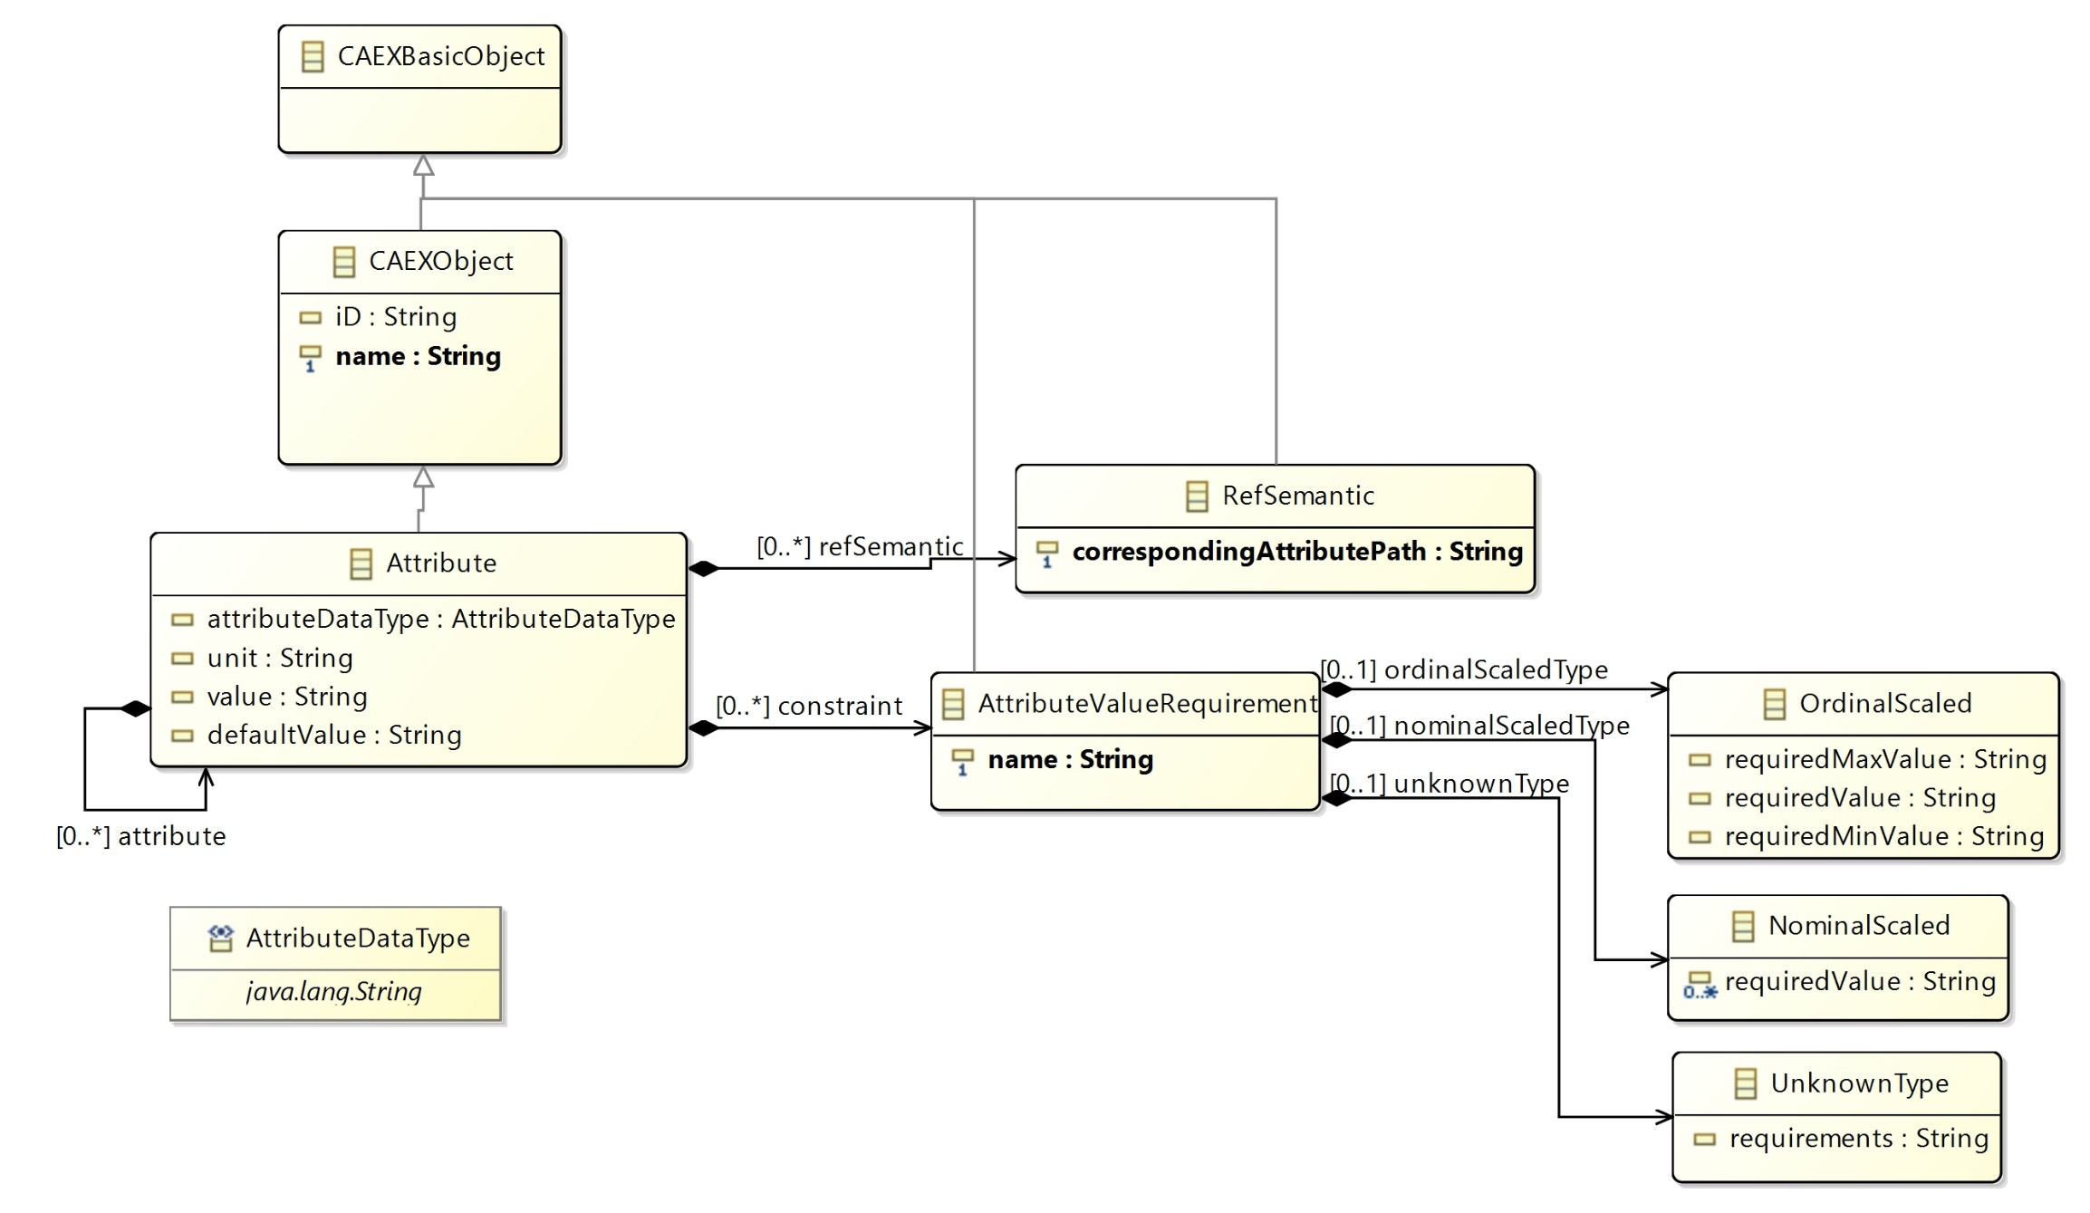
Attributes

