Slide 1
E-commerce project

Slide 2
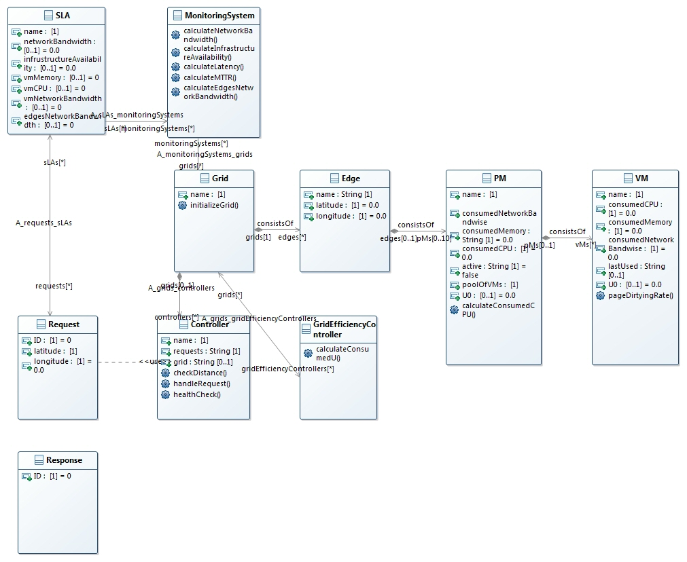
Grid infrastructure

Slide 3
Algorithm. Controller

Slide 4
Controller
Controller monitors the status of all edges in the grid
When request arrives, controller checks requests SLA status, position and characteristics;
Controller chooses after measuring Manhattan distance, 2 closest edges, than sends request to the closest one available, chooses the PM, PM loads VM;
4. In case of failure:
- migrate the failed VM to the next PMs in edge
if no such available in edge & request timed out – retry
else – send to another edge from the list
5. In case of cascading failures, retry all failed PMs.
Notes:
Generate the failures in random manner (choose the distribution)

Slide 5
Implemented SLAs
 | SLA 1 | SLA 2 | SLA 3
VM characteristics
Cores | 1 | 2 | 2
CPU | 3 GHz | 4 GHz | 2 GHz
Memory | 4 GB | 8 GB | 3 GB
Network bandwidth | 54 Mb/sec | 108 Mb/sec | 27 Mb/sec
Network bandwidth between edges | 600 Mb/sec | 600 Mb/sec | 600 Mb/sec
Latency | 70ms | 90 ms | 140 ms
Availability of infrastructure | >99.95% | >98.95% | >85%

Slide 6
Mistakes handling: baseline
Baseline algorithm changed from self-healing to retry due to simulation limitations
Reasons for change:
- self-healing implies the monitoring of the mistakes and detecting the most “vulnerable” edges/PMs.
- self-healing implies the possible task division

Slide 7
Mistakes handling: baseline
In case the Edge/PM fails, retry the request until it times out
When the request times out, return mistake

Slide 8
Mistakes handling: improved baseline
Do retry, calculate the time
when haft of the time for response passed and no response received, do job migration to the nearest PM/Edge

Slide 9
Baseline VS Improved baseline
Better fault-tolerance
We already have job migration algorithm implemented when the user moves, thus we can use this algorithm easily for improving baseline

