Slide 1
E-commerce WS2016 Final Presentation
Group 4
Alex Eigner
Zoia Inshakova
Malinda Perera

Slide 2
Agenda
Algorithm for mistakes handling. Baseline VS improved algorithm
Controller logic & infrastructure
SLAs application
Results presentation & analysis

Slide 3
Algorithm for mistakes handling
Baseline | Improved baseline
Retry | Retry with job migration
Retry every failure for 5 times (PM/Edge) If request was not handled: request failed | Retry every failure for 2 times (PM/Edge), then - migrate to the closest Edge If request was not handled: request failed

Slide 4
SLA application
 | SLA 1 | SLA 2 | SLA 3
Cores | 1 | 2 | 2
CPU | 3 GHz | 4GHz | 2GHz
Memory | 4 GB | 8 GB | 3 GB
Network bandwidth | 54 Mbit/sec | 108 Mbit/sec | 27 Mbit/sec
Network bandwidth between edges | 600 Mbit/sec | 600 Mbit/sec | 600 Mbit/sec
Latency | 70 ms | 90 ms | 140 ms
Availability of infrastructure | >99.95% | >98.95% | >85%

Slide 5

SLAs Application
SLA
Every request contains SLA
If the request needs more resources than defined in SLA - request rejected

Slide 6
Infrastructure
SLA
1
*
Request
VM
PM
Edge
1 1
* runs on 1
* contains 1
*
*
generates
contains
1
1
Simulator
Controller

Slide 7
Infrastructure
stores all edges
allocates VMs to proper edges
monitors energy consumption of the grid
monitors latencies in the grid
(energyUtilisation)->min during migration
Controller
Edge
based on energy utilisation, allocates VMs to PMs

Slide 8
Controller Logic
Controller has the list of all edges
Controller seeks the nearest edge to the user & sends request to the edge
Controller receives request & checks SLA compliance
Simulator generates request
Edge sends the request to the PM with lowest expected energy utilisation
When the user moves, the request is migrated
Edge sends the reply

Slide 9
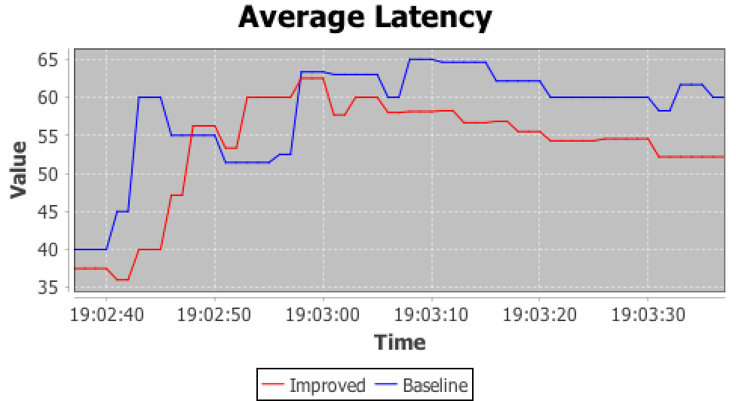

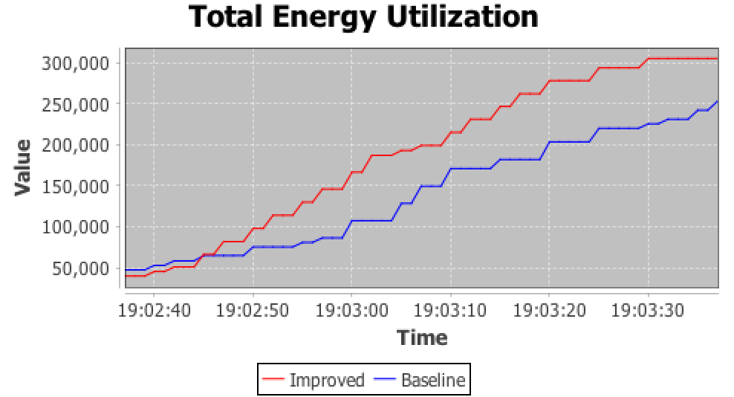

Print screens of the output results
+++Final statistics for the baseline [retry]+++
Total Edge Failures [Baseline]: 1164
Total Edge Fixes [Baseline]: 132
+++Final statistics for the baseline [retry]+++
Total PM Failures [Baseline]: 0
Total PM Fixes [Baseline]: 0
+++Final statistics for the improved version [retry + job migration]+++
Total Edge Failures [Improved]: 135
Total Edge Fixes [Improved]: 5
+++Final statistics for the improved version [retry + job migration]+++
Total PM Failures [Improved]: 497
Total PM Fixes [Improved]: 11

Slide 10
Results analysis
 | Baseline | Improved Baseline
Requests handled
Mistakes handled
Mistakes not handled
Average latency
Energy utilisation

