Slide 1
ARCH 594/508: AI Research Seminar/Studio—AI in Architecture
Spring 2026
Generative AI
Narjes Abbasabadi, Ph.D. Assistant Professor
Email: nabbasab@uw.edu
Department of Architecture
College of Built Environments
University of Washington
Website: https://silab.be.uw.edu

Slide 2
Today's Agenda
1. Generative AI
2. Lab Activity: (Generative AI)

Slide 3
What is Generative AI?
Generative AI refers to models that learn patterns from data and produce new outputs that resemble that data.
Unlike predictive models, which estimate a value, generative models create new artifacts, such as:
  images
  text
  geometry
  spatial layouts
The key idea is:
  The model learns a distribution of possible designs, and then samples from that distribution.

Slide 4
Types of Generative Models
There are several major families of generative models:
GANs (Generative Adversarial Networks):
  Two networks compete—one generates, one evaluates.
VAEs (Variational Autoencoders):
  Learn a compressed latent space and generate variations.
Diffusion Models:
  Current state-of-the-art; generate data by gradually removing noise.
LLMs and Multimodal Models:
  Generate across text, image, and increasingly geometry.

Slide 5
Types of Generative Models
In architecture, these models can generate:
  floor plans
  façades
  massing
  spatial configurations

Slide 6
Diffusion Models
Diffusion models work by:
  Starting with random noise
  Iteratively removing noise
  Converging to a structured output
They learn how data “looks” at different levels of noise and reconstruct it step by step.

Slide 7
Diffusion Models
Their strength is:
  high visual quality
  stability
  controllability through prompts or conditions
This is why most current image-based AI tools rely on diffusion.

Slide 8
Text-to-Image Models
Text-to-image models allow us to generate images from textual descriptions.
  For example:
  “Mid-rise housing with green terraces and strong daylight access”
The model translates semantic intent to visual form.

Slide 9
Text-to-Image Models
In architecture:
  early ideation
  atmosphere and concept exploration
  visual narratives

Slide 10
Prompting as Design
Prompting becomes a form of design specification.
A prompt encodes:
  intent
  constraints
  style
  performance hints
For example, adding:
  “passive cooling”
  “south-facing shading”
begins to embed design logic into language.

Slide 11
Prompting as Design
iterative
sensitive to wording
not fully controllable

Slide 12
Limitations of Prompting
Pure prompting has key limitations:
  limited geometric control
  no direct performance evaluation
  biases from training data
  often produces non-buildable outputs
So while it is powerful for exploration, it is insufficient for architectural decision-making.

Slide 13
Limitations of Prompting
Pure prompting has key limitations:
  limited geometric control
  no direct performance evaluation
  biases from training data
  often produces non-buildable outputs
So while it is powerful for exploration, it is insufficient for architectural decision-making.
This is why we need integration with:
  parametric systems
  simulation tools
  structured representations

Slide 14
From Images to Architecture
One of the biggest challenges is:
  AI generates images, but Architects need geometry + systems
Bridging strategies include:
  converting images into geometry (segmentation, tracing)
  mapping latent representations into parametric systems
  using graph-based spatial representations
This translation step is critical.

Slide 15
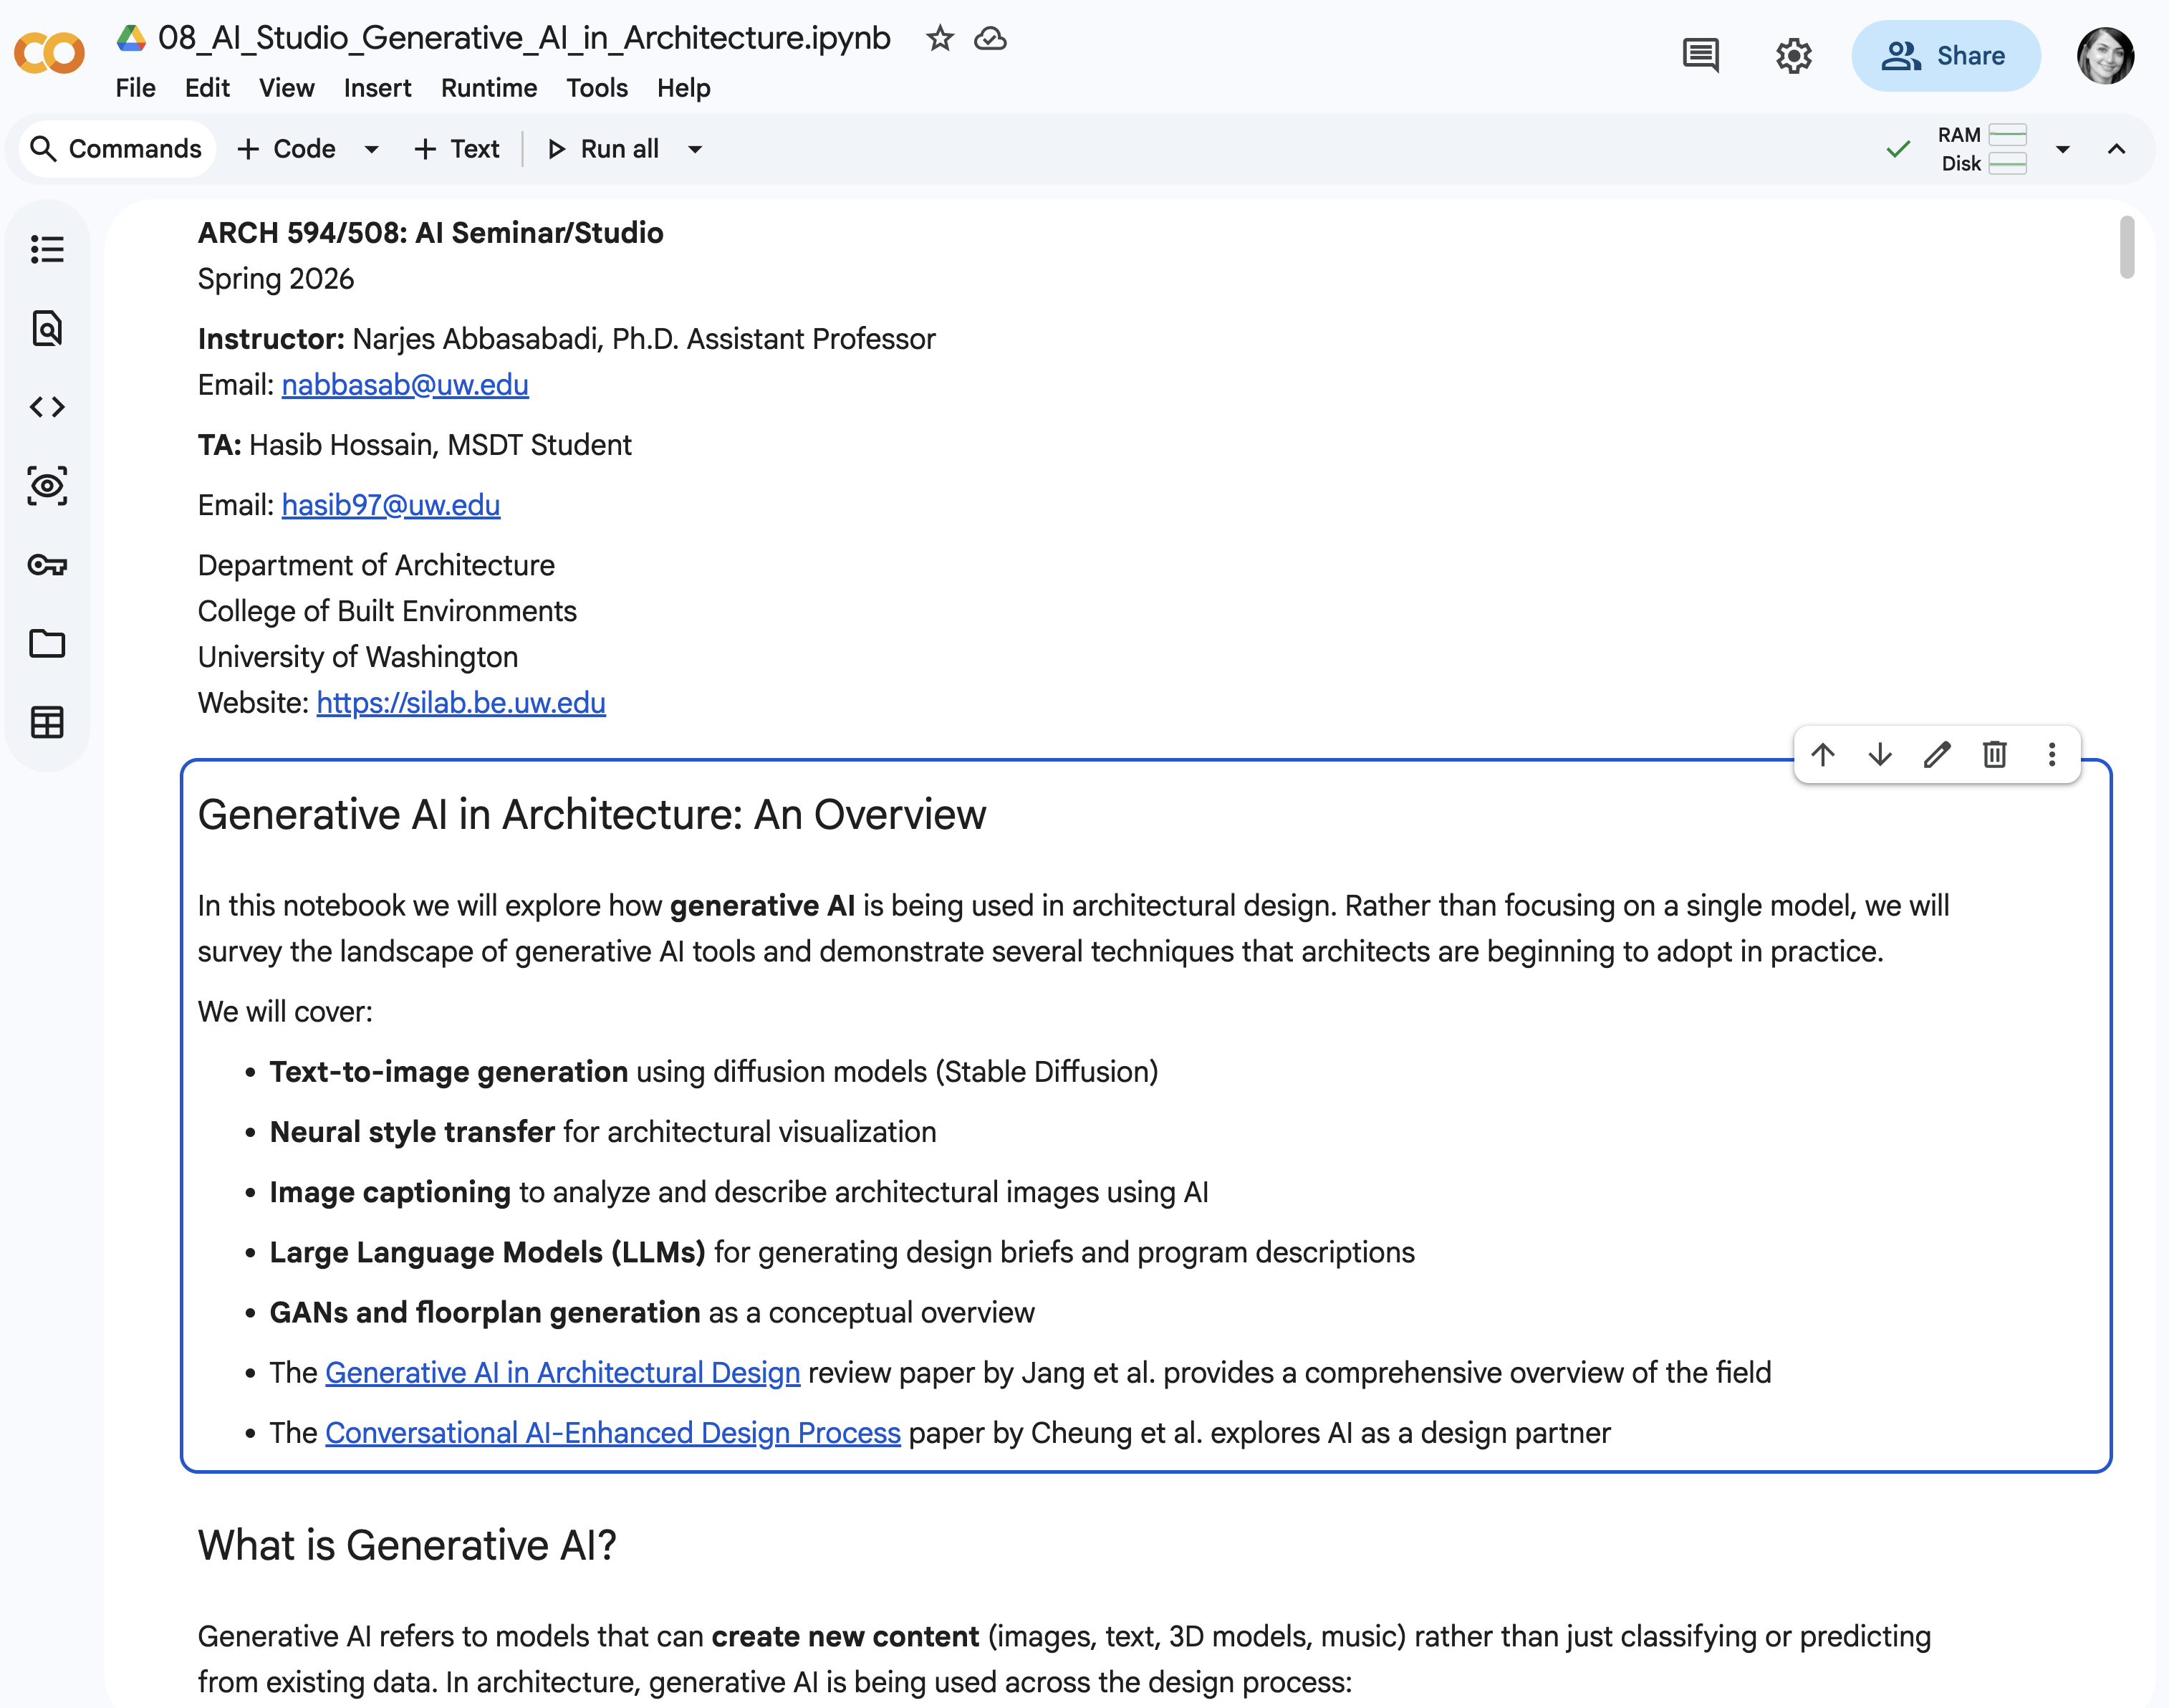
Workflow from the Notebook
Your notebook demonstrates a typical generative workflow:
  Define a prompt or condition
  Generate outputs
  Process outputs
  Extract usable information
  Integrate into a design system
Design is not a single act here….it is a pipeline.

Slide 16
Code as Design Medium
In this workflow, code becomes central.
Instead of manually crafting each design, we:
  define rules
  generate multiple outputs
  evaluate systematically
This means design becomes:
  programmable
  reproducible
  scalable

Slide 17
Generative AI in Architectural Design
Jang, Roh, and Lee's 2025 review of 161 studies on how generative AI is reshaping design workflows, data pipelines, and evaluation practice.
Automation in Construction 174 (2025) 106174
161
papers reviewed
96%
gap reduction
68.9%
in schematic design

Slide 18
How the review was conducted
How fast are AI model architectures being adopted in architectural design?
Which design phases, tasks, and objectives are receiving AI support?
What input/output data types dominate current workflows?
How are researchers evaluating systems when design quality is subjective?
PRISMA-guided search across WoS and Scopus, plus snowball reference/citation search. Final corpus: 161 eligible studies spanning 2014-2024.

Slide 19
AI Adoption in Architecture
Adoption is accelerating - and no longer slowly
The review shows a dramatic collapse in the delay between an AI model's invention and its use in architecture.
GANs lead the literature with 81 papers (50.31%), while diffusion models (23 papers) and transformers (9 papers) rise quickly after 2022.
96.09%
reduction in theory-application gap
62y
earliest gap
2.5y
latest gap

Slide 20
Where AI enters the architectural workflow
AI activity is heavily front-loaded into early design.
Most publications address conceptual exploration, optioning, rendering, and sustainability analyses in the schematic phase.
Later phases remain thinner: DD is growing, but CD tasks such as specifications and construction drawings are still rare.
68.94%
Schematic design
21.74%
Design development
7.45%
Pre-design
1.86%
Construction docs

Slide 21
Most studied tasks and objectives
Generate plan/elevation layouts - 28 papers
Explore design concepts - 21 papers
Align architectural and structural design - 20 papers
Analyze solar / thermal / wind comfort - 14 papers
Evaluate embodied carbon or energy use - 13 papers

Slide 22
Most studied tasks and objectives
The most common transformation is image-to-image generation, which reflects a strong preference for planar visual outputs such as layouts, drawings, and renderings.
Variables matter when AI is used as a surrogate model for sustainability or parameter optimization.
Graphs and 3D models appear less often, but the authors highlight them as promising paths toward richer design semantics and more controllable workflows.
52.8%
image input
68.32%
image output
13.0%
multimodal input

Slide 23
Evaluation is diverse & fragmented
Most papers rely on a single evaluation type; only 27 combine methods.
Dataset validation is the most common method, followed by author visual interpretation.
The review identifies 105 unique metrics across 161 studies - a warning sign that the field still lacks shared benchmarks.
60.9%
comparative
34.2%
author assessment
17.4%
third party
8.7%
machine

Slide 24
Conclusion
It reduces hype by revealing where AI is genuinely mature and where later-phase claims remain thin.
It offers a domain-specific vocabulary for discussing model architecture, design objective, data format, and evaluation strategy together.
1. Adoption timeline
2. Design process map
3. Data ecology
4. Evaluation lens
Shows which model families entered architectural design and when.
Locates AI activity across pre-design, SD, DD, and CD.
Tracks how images, variables, text, graphs, and 3D models flow.
Explains how researchers judge systems without a single right answer.

Slide 25
Key gaps and future opportunities
The paper ends with a clear message: AI is moving faster than the field's standards, controls, and later-phase integration.
Generative AI in architecture is not just about novel images - it is about building reliable, controllable, benchmarked design systems.
Expand beyond early design
AI is concentrated in schematic design. DD and CD need stronger support for drawings, specs, and coordination.
Build shared benchmarks
The field needs domain datasets and metrics that measure usability, dimensional accuracy, and contextual fit - not only borrowed computer vision scores.
Improve human-in-the-loop control
Prompting alone is not enough. Designers need interfaces and models that understand intent without repeated trial and error.
Create practice-ready frameworks
Future systems should connect AI with BIM, domain knowledge, and robust workflows rather than isolated image generators.

Slide 26
Key takeaways
161
papers
96.09%
gap down
68.9%
SD
Generative AI has become a serious design technology - but it is still strongest at seeing, sketching, and comparing, not yet at fully documenting buildings.
Architectural AI adoption is accelerating fast enough that curricula and professional practice cannot treat it as a future topic.
The current center of gravity is schematic design: concept generation, layout generation, rendering, and sustainability surrogate modeling.
Images dominate the field, but graph, multimodal, and BIM-linked approaches point toward the next generation of more controllable systems.
Evaluation remains the weakest common language; the field needs shared benchmarks and domain metrics.
The real opportunity is not replacing architects - it is augmenting design reasoning with trustworthy, workflow-aware AI.
52.8% / 68.32%
image input / output
60.9%
comparative eval

Slide 27
Generative + Agentic AI
The Conversational, agentic AI-enhanced architectural design process: three approaches to multimodal AI-enhanced early-stage performative design exploration paper by Cheung et al. explores AI as a design partner

Slide 28
Main Reading Assignments
The Generative AI in architectural design: Application, data, and evaluation methods review paper by Jang et al. provides a comprehensive overview of the field:
  https://www.sciencedirect.com/science/article/pii/S0926580525002146
The Conversational, agentic AI-enhanced architectural design process: three approaches to multimodal AI-enhanced early-stage performative design exploration paper by Cheung et al. explores AI as a design partner
  https://link.springer.com/article/10.1007/s44223-025-00092-5

Slide 29

Lab Activity: Generative AI
Open up a web browser. Google “google colab” click on the first entry. You may also access the website by following https://colab.research.google.com/
Go to Canvas and download the file called “AI_Studio-Seminar_Generative_AI_in_Architecture.ipynb”

Slide 30
Next Class
  Agentic AI

