Slide 1
ARCH 594/508: AI Research Seminar/Studio—AI in Architecture
Spring 2026
MACHINE LEARNING FUNDAMENTALS
Key Statistical and Probability Concepts
Narjes Abbasabadi, Ph.D. Assistant Professor
Email: nabbasab@uw.edu
Department of Architecture
College of Built Environments
University of Washington
Website: https://silab.be.uw.edu

Slide 2
Today's Agenda
Machine Learning
Key Statistical and Probability Concepts
An Introduction to ML

Slide 3
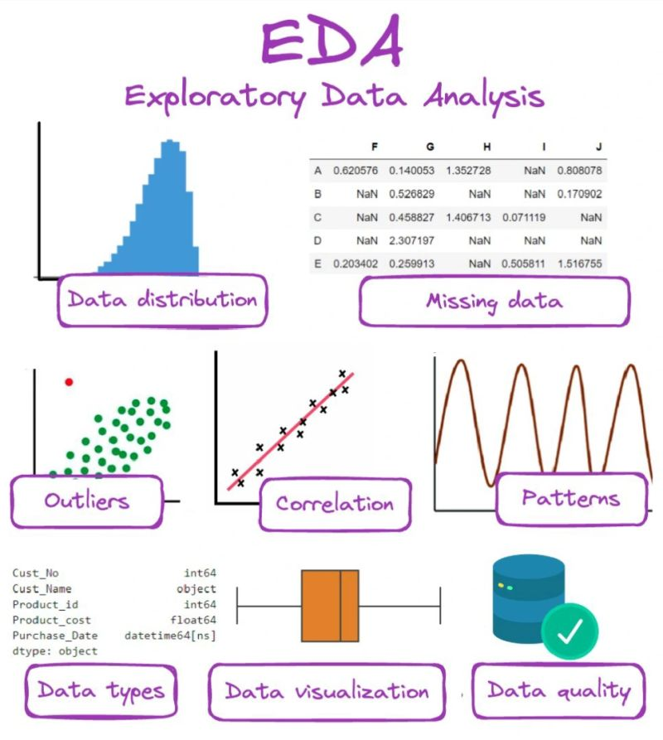
Review
Exploratory Data Analysis (EDA)
EDA involves analyzing data sets to understand data structure, summarize their main characteristics, often using visual methods. It helps to discover patterns, spot anomalies, and test hypotheses.
Key tasks include:
  Using statistics to explore data
  Visualizing data using graphs and charts
  Identifying trends, correlations, and distributions
Image Source: https://www.markovml.com/blog/exploratory-data-analysis

Slide 4
Review
Statistics
Statistics is the study of data collection, analysis, interpretation, and presentation.
  Two types:
    Descriptive: Summarizing data.
    Inferential: Drawing conclusions from data.

Slide 5
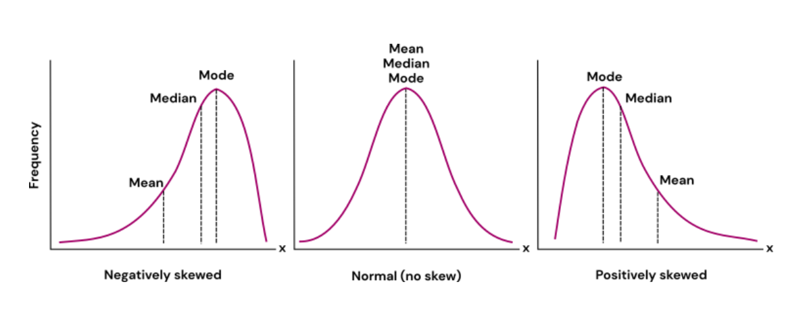
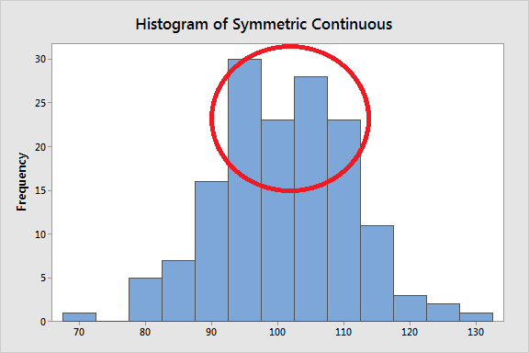
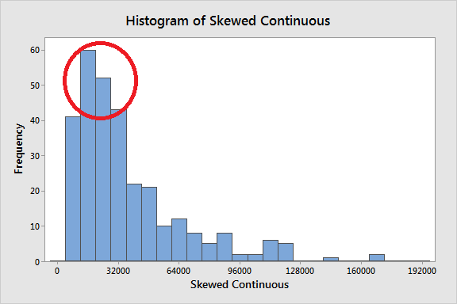
Review
Descriptive Statistics
Measures of Central Tendency: Mean, Median, Mode.
Measures of Spread: Variance, Standard Deviation, Range.
Visualization Tools: Histograms, Boxplots, etc.
Image Source: https://statisticsbyjim.com/basics/measures-central-tendency-mean-median-mode/
Image Source: https://ledidi.com/academy/measures-of-central-tendency-mean-median-and-mode
Notes:
Measures of Central Tendency:
Mean: The average of a set of numbers. Add them up and divide by how many numbers there are.
Median: The middle value when you arrange the numbers in order. If there’s an even number of values, it’s the average of the two middle ones.
Mode: The number that appears most often in a set of numbers.
Measures of Spread:
Variance: Tells us how spread out the numbers are. How far each number in a dataset is from the mean (average). It’s the average of the squared differences between each number and the mean.
Standard Deviation: A measure of how spread out the numbers are, similar to variance but easier to interpret because it’s in the same units as the data.
Range: The difference between the largest and smallest numbers in a set. It shows how wide the data is spread.

Slide 6
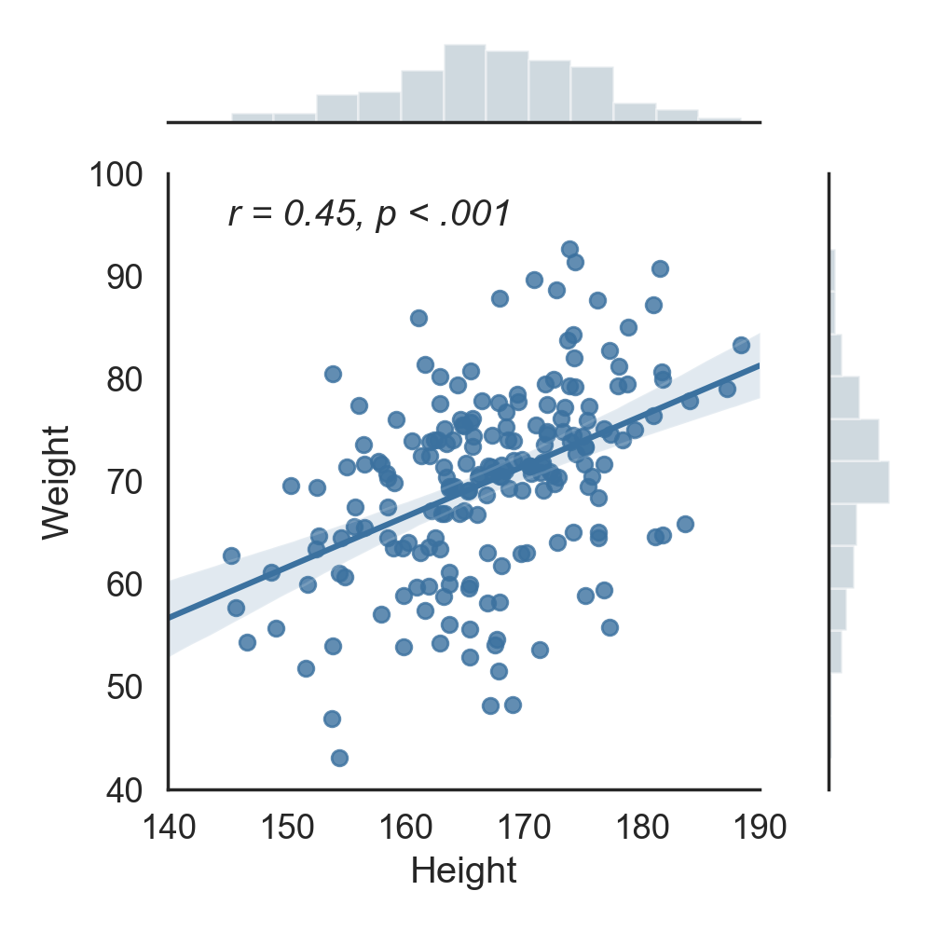
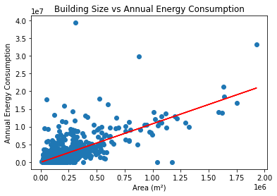
Review
Correlation
Correlation is a statistical technique that measures the strength of the relationship between two variables.
It is used to understand how one variable may predict or be associated with another.

Slide 7
Review
Correlation
Direction of Relationship:
  Positive Correlation: When one variable increases, the other variable tends to increase as well.
  Negative Correlation: When one variable increases, the other variable tends to decrease.
Strength of Relationship:
The correlation coefficient (usually denoted as "r") measures the strength of the relationship between the variables. It ranges from -1 to +1, where:
  +1 indicates a perfect positive correlation.
  0 indicates no correlation.
  -1 indicates a perfect negative correlation.

Slide 8
Review
Correlation
NOTE:
Causation is Not Correlation: A crucial aspect of correlation is that it does not imply causation.
Two variables may be correlated without one causing the other. They could be influenced by a third factor, or the correlation might be coincidental.

Slide 9
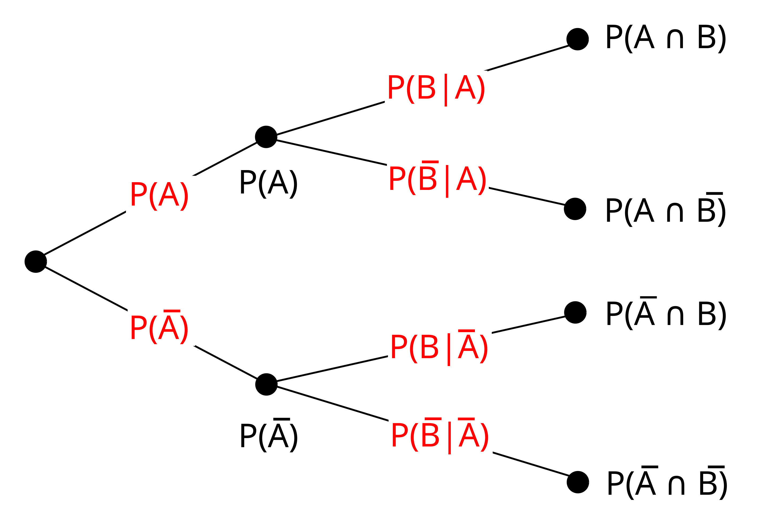
Introduction to Probability
Probability is a measure of the likelihood that an event will occur.
Source: https://en.wikipedia.org/wiki/Tree_diagram_(probability_theory)

Slide 10
Why Are Probability Important?
Applications in Data Science: Gives us the mathematical tools for
  Calculating the likelihood of different outcomes.
  Quantifying uncertainty.
  Hypothesis testing.
  Predictive analytics.
  Machine learning algorithms.

Slide 11
Introduction to Probability
Key terms include:
  Experiment: A process leading to an outcome.
  Event: A specific outcome or set of outcomes.
  Probability: A number between 0 and 1 representing the likelihood of an event.

Slide 12
Conditional Probability
Conditional probability measures the probability of an event occurring given that another event has already occurred.

Slide 13
Learning Associations
Association rule
P (Y | X ) the probability of event Y given event X
  Conditional probability
Example in Retail:
Basket analysis:
Probability that somebody who buys X also buys Y where X and Y are products/services.
P ( chips | beer )

Slide 14
Random Variables
A random variable is a variable whose possible values are numerical outcomes of a random phenomenon.
There are two types:
  Continuous random variables: Take any value within a range (e.g., height, temperature).
  Discrete random variables: Take specific values (e.g., rolling a dice).

Slide 15
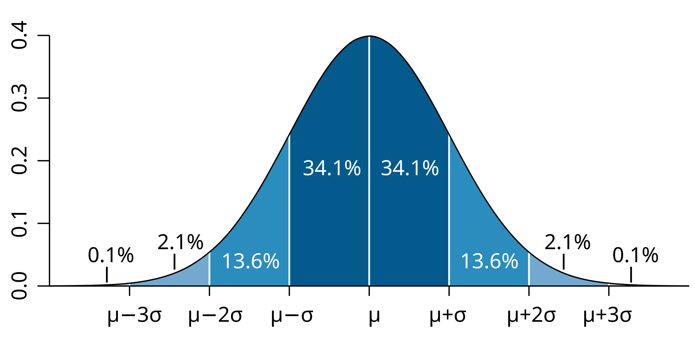
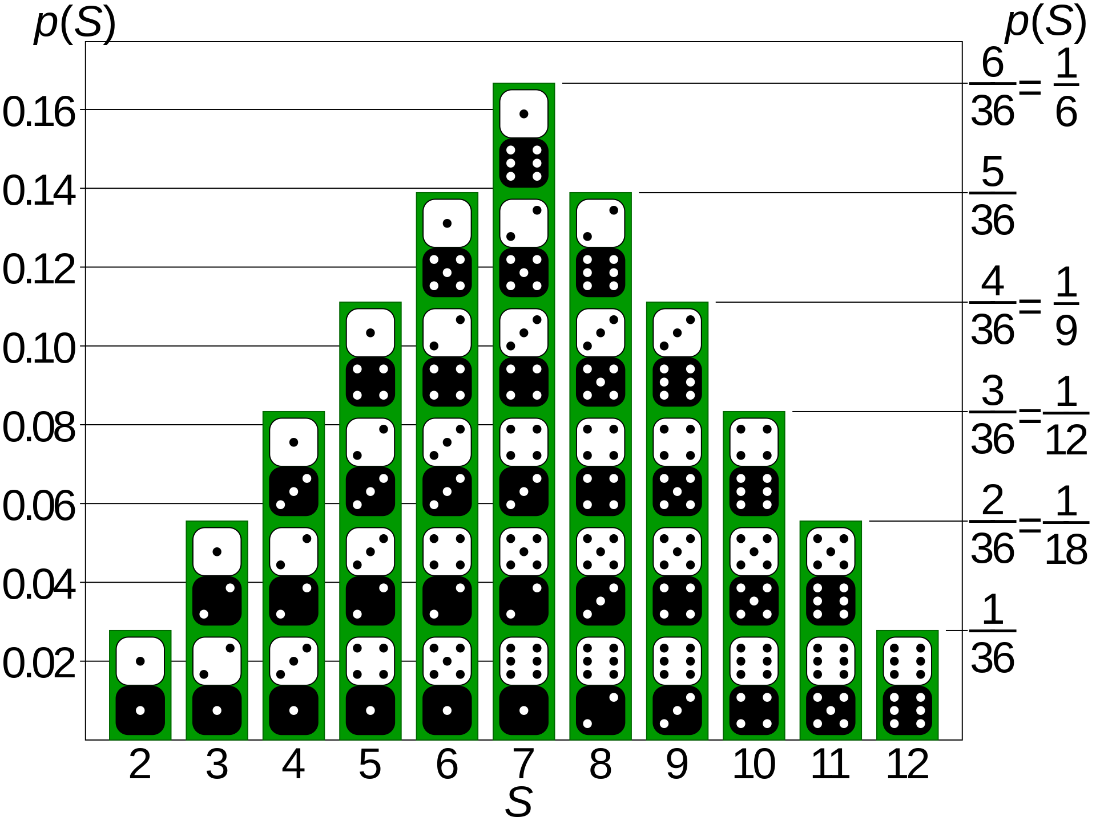
Probability Distributions
Probability distributions describe how the probabilities are distributed over the values of the random variable.
The probability density function (pdf) of the normal distribution, also called Gaussian or "bell curve", the most important absolutely continuous random distribution.
The probability mass function (pmf) P(S) specifies the probability distribution for the sum S of counts from two dice.

Slide 16
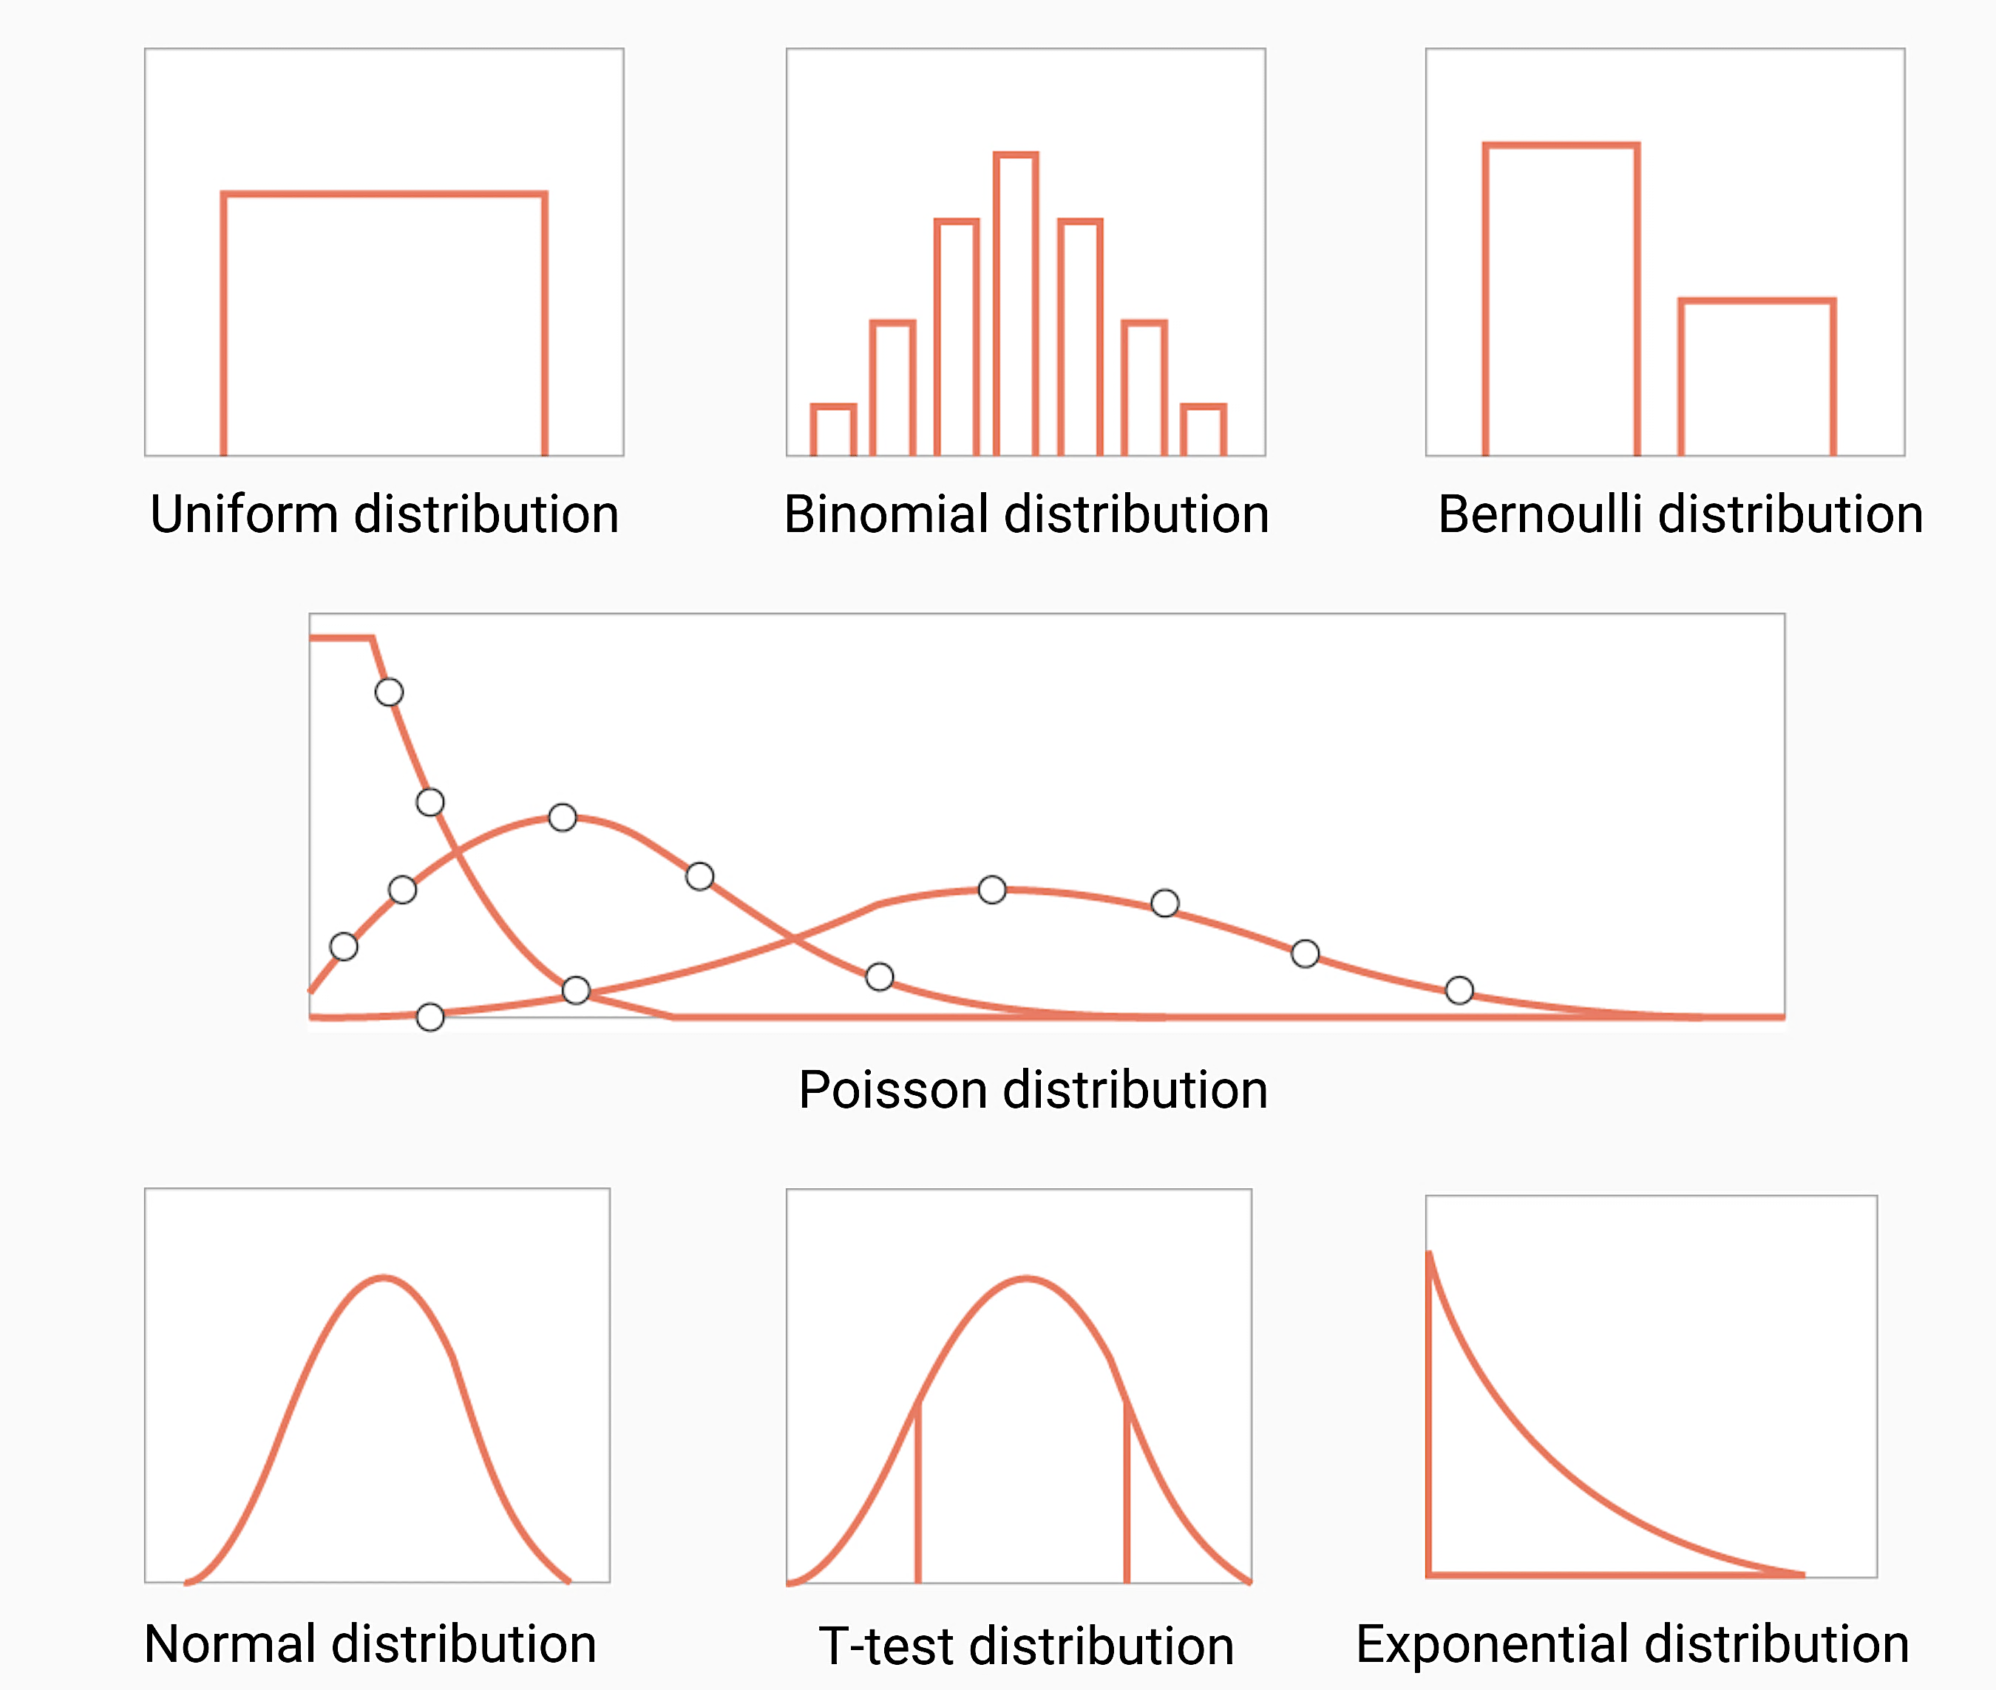
Other Key Distributions
Normal distribution: A continuous distribution that is symmetric and bell-shaped, used in many natural phenomena.
Uniform Distribution: All outcomes are equally likely.
Binomial distribution: For discrete outcomes with two possible results (success/failure).
Poisson Distribution: Counts the number of events happening in a fixed interval.
Exponential Distribution: Describes the time between events in a Poisson process.
https://datasciencedojo.com/blog/types-of-statistical-distributions-in-ml/

Slide 17
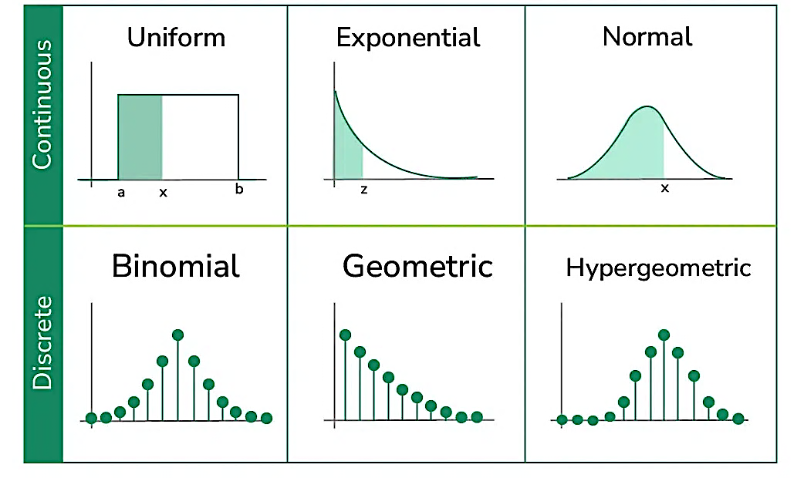
Types of Probability Distributions
Continuous Distributions:
  Example: Normal, Exponential, Uniform.
Discrete Distributions:
  Example: Binomial, Poisson, Geometric.
Image Source: https://www.geeksforgeeks.org/probability-distribution/

Slide 18
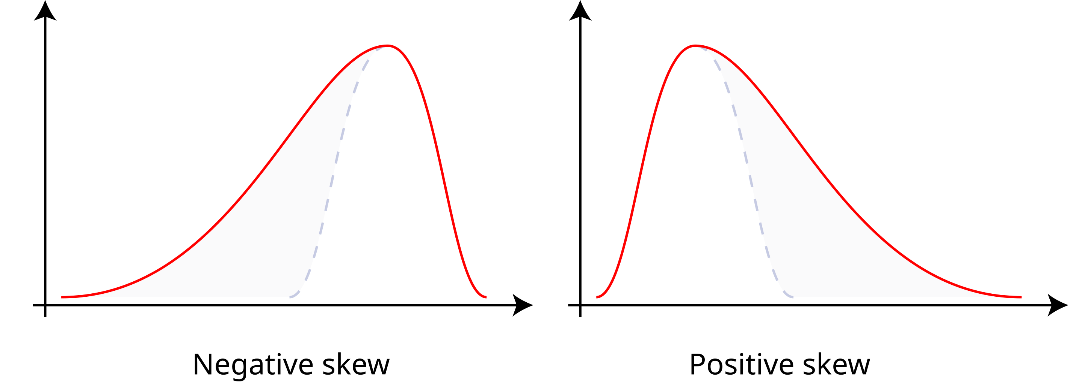
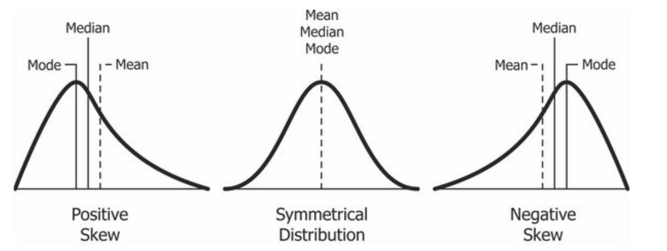
Types of Probability Distributions
Skewness: In probability theory and statistics, skewness is a measure of the asymmetry of the probability distribution of a real-valued random variable about its mean.
  can be positive, zero, negative, or undefined.
Image source: https://en.wikipedia.org/wiki/Skewness

Slide 19
Bayes' Theorem
It is fundamental in statistics, machine learning, and decision-making under uncertainty, allowing us to update probabilities based on new information.
Bayes' Theorem describes the probability of an event based on prior knowledge of related conditions.

Slide 20
Bayesian Decision Theory
Bayesian Decision Theory is a statistical approach to decision-making under uncertainty.
It integrates Bayesian probability, which interprets probability as a degree of belief or subjective probability, into the decision-making process.
This theory uses Bayes' Theorem to update the probability estimate for a hypothesis as more evidence or information becomes available.

Slide 21
Bayesian Decision Theory
Bayesian Decision Theory is a statistical approach to decision-making under uncertainty.
It integrates Bayesian probability, which interprets probability as a degree of belief or subjective probability, into the decision-making process.
This theory uses Bayes' Theorem to update the probability estimate for a hypothesis as more evidence or information becomes available.
Example: Imagine you have a hunch about who is likely to buy ice cream. You think kids love ice cream more than adults. In the Bayesian approach, you start with this hunch. Then, as you see who actually buys ice cream (your data), you update your belief. In the end, you have a new, informed opinion that blends your original thought with the actual ice cream buying patterns you observed.

Slide 22
Bayes’ Rule
prior
likelihood
posterior
formula
evidence
Where P(C∣x) is the posterior probability of class C given predictor x.
P(C) is the prior probability of class C.
P(x∣C) is the likelihood which is the probability of predictor x given class C.
P(x) is the prior probability of predictor.

Slide 23
p-value
A p-value, short for "probability value," is a statistical measure used in hypothesis testing to assess the strength of evidence against a null hypothesis.
It helps you determine whether the results of a statistical test are statistically significant or if they could have occurred by random chance.
How to interpret it:
Low p-value (e.g., ≤ 0.05): If the p-value is small, it means your results are probably not due to chance. You might have found something significant.
High p-value (e.g., > 0.05): If the p-value is large, it suggests your results could be due to chance. You might not have found something significant.

Slide 24
Conclusion
Exploratory Data Analysis (EDA): Understanding patterns and anomalies in data.
Pandas DataFrames: Practical and efficient data manipulation and analysis.
Data Cleaning, and Preparation: Ensuring data accuracy and readiness.
Data Visualization: Uncovering trends and communicating insights.
Key Statistical Concepts: Interpreting data with foundational statistics.
Correlation: Identifying relationships between variables.
Probability: Measuring of the likelihood that an event will occur

Slide 25


Main Textbooks
Abbasabadi, N., Ashayeri, M,. (Eds). (2024). Artificial Intelligence in Performance-driven Design: Theories, Methods and Tools, Wiley.
Alpaydin, E., (2020). Introduction to Machine Learning, 4th Edition, The MIT Press

Slide 26
Readings
Alpaydin, E., (2020). Introduction to Machine Learning. 4th Edition, The MIT Press. – Chapter 3 / Bayesian Decision Theory

Slide 27
Next Class
  Machine Learning: Regression

Slide 28
QUESTIONS?

