Slide 1
ARCH 594/508: AI Research Seminar/Studio—AI in Architecture
Spring 2026
MACHINE LEARNING
Supervised Learning: Regression
Narjes Abbasabadi, Ph.D. Assistant Professor
Email: nabbasab@uw.edu
Department of Architecture
College of Built Environments
University of Washington
Website: https://silab.be.uw.edu

Slide 2
Agenda for today’s class
Machine Learning Fundamentals
  Introduction on ML Types and Applications
  Supervised Learning
  Prediction
  Regression
  Feature Selection
  Model Evaluation
  Computational Hands-On Activity
  Regression

Slide 3
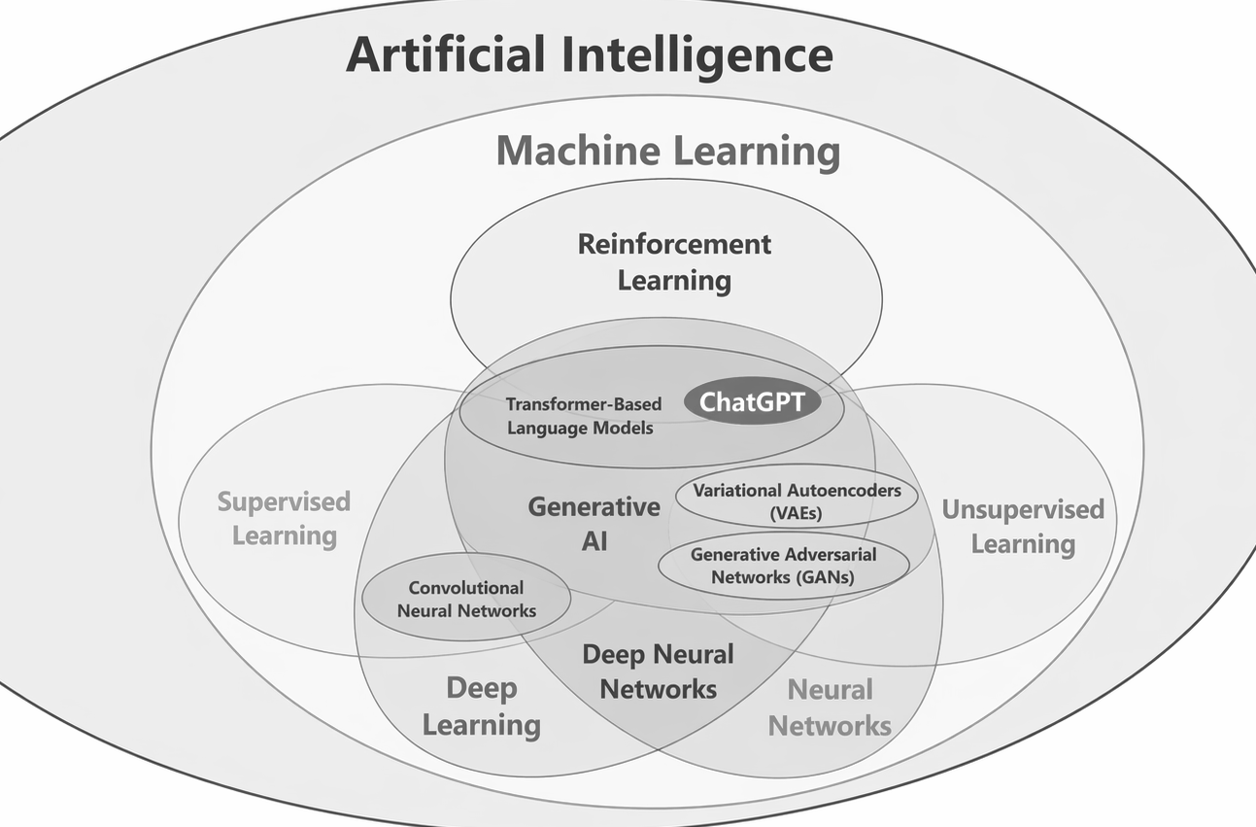

Slide 4

What is ML?
Machine learning is a subset of AI, enabling systems to learn in changing environments without explicit programming for all scenarios.
Alpaydin, E., (2020). Introduction to Machine Learning, 4th Edition, The MIT Press

Slide 5

ML and Optimizing Performance
Machine Learning: relies on inference and pattern recognition, not explicit rules.
Role of Statistics: Infer from samples, guide modeling.
Role of Computer Science: Develop efficient algorithms to solve and evaluate models.
Image: https://www.einfochips.com/blog/how-to-develop-machine-learning-applications-for-business/

Slide 6
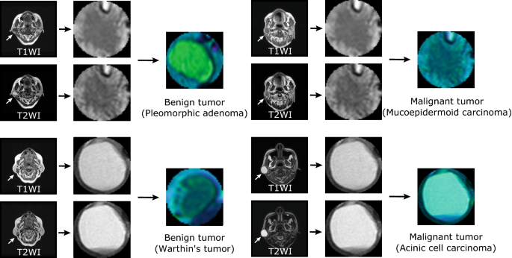
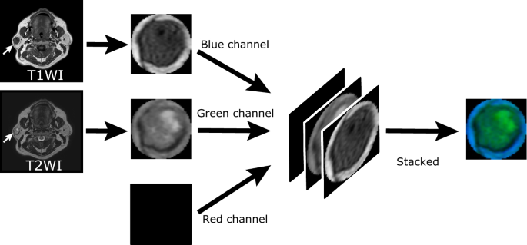
Why “Learn”?
Routine Tasks: No learning needed (e.g., payroll processing)
Machine Learning is Essential When:
  No Human Expertise Exists (e.g., Navigating on Mars)
  Expertise is Hard to Explain (e.g., Recognizing speech)
  Evolving Solutions (e.g., Network routing adapting to traffic)
  Need for Personalization (e.g., User-specific biometrics)
deep-learning with anomaly detection
https://www.nature.com/articles/s41598-020-76389-4

Slide 7
Machine Learning main Components
Data:
past/historical observations
Hypotheses/models:
created to capture and represent the patterns in data
Prediction:
employing models to anticipate/forecast future observations

Slide 8
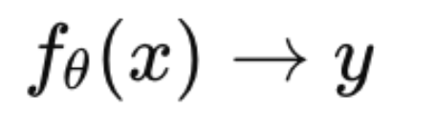
Introduction to Machine Learning
  AI / Data-driven Modeling → Statistical / Function approximation
Machine learning involves predicting outcomes using features.
Two main components:
Outcome (what we predict)
Features (used to make those predictions).

Slide 9

Data and Prediction in Machine Learning
Algorithm: Take feature values as input and predict the outcome.
Feature 1
Feature 2
Feature 3
Algorithm
Outcome
Feature p

Slide 10

Machine Learning Pipeline
Model Building
Model Evaluation and Tuning
Model Validation
Data Preprocessing and Exploration
Feature Extraction
Model Training
Deployment /
Prediction
Model Building / Algorithm Selection

Slide 11
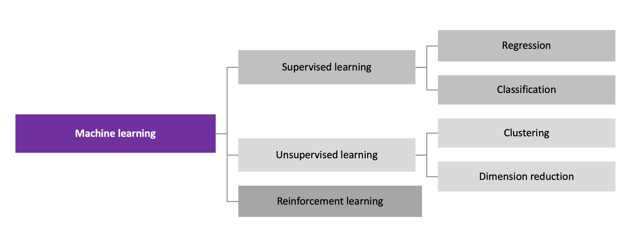
machine learning Major Types and Applications
Notes:
Machine Learning can be categorized into three main types, each addressing unique learning scenarios:
Supervised Learning: Machine learning where models learn from labeled data to make predictions.
Classification: Predicting discrete categories or labels (e.g., spam or not spam).
Regression: Predicting continuous numerical values (e.g., housing prices).
Unsupervised Learning: Learning patterns from unlabeled data without predefined outputs. Example: Grouping customers into clusters based on purchasing behavior.
Reinforcement Learning: Learning optimal actions through trial and error by receiving rewards or penalties. Example: Training a robot to navigate a maze by rewarding it for reaching the exit.

Slide 12
Supervised Learning
Definition: Supervised learning is a type of machine learning where algorithms learn patterns and associations between input features and their corresponding output or target values using labeled training data.
Types:
  Regression: Model predicts continuous values.
  Classification: Model predicts discrete class labels.
Notes:
…..
what is the difference of labeled data and unlabeled data?
Labeled Data: This data has both input features and their known outcomes. For example, in an image dataset, each picture is labeled with what it contains, like "cat" or "dog."
Unlabeled Data: This data only includes input features without known outcomes. For instance, it lacks labels like "cat" or "dog" for each image.

Slide 13
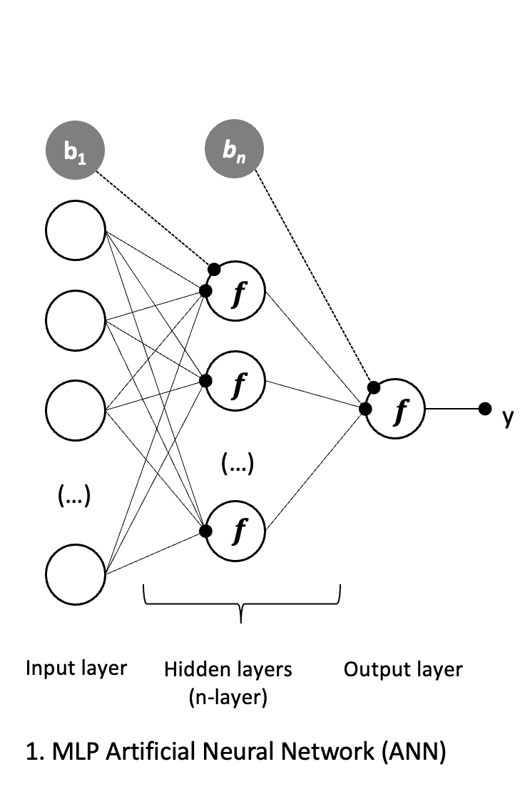
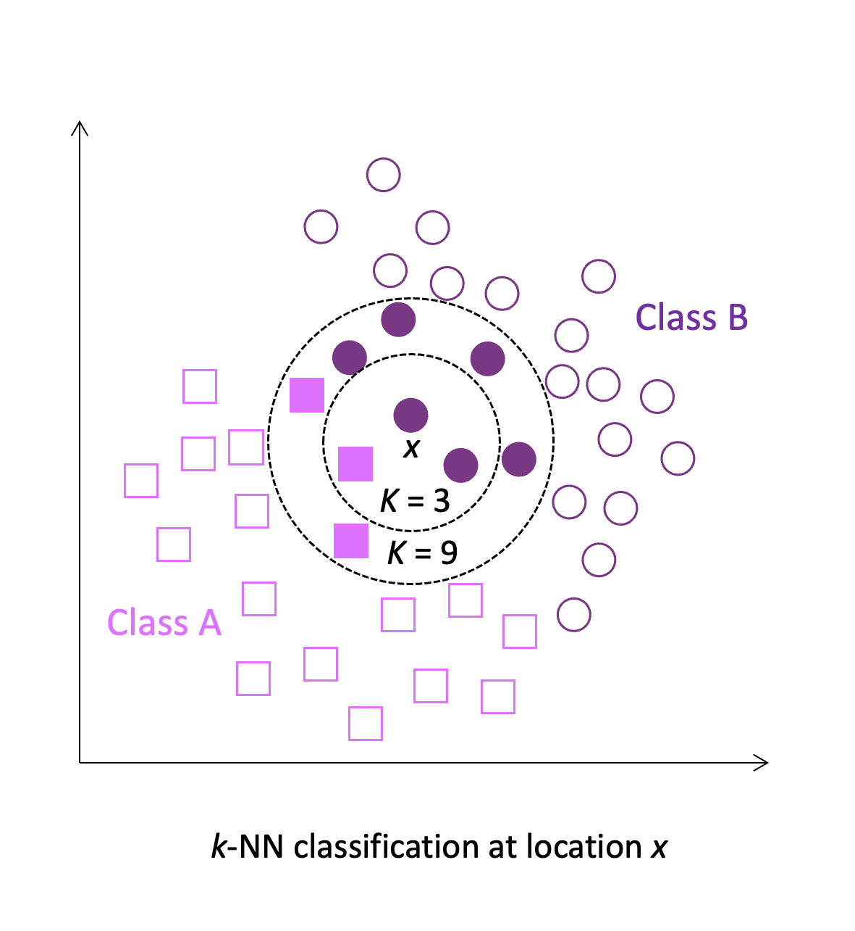
Supervised Learning: Example
Regression (e.g., predicting energy consumption in buildings)
Classification (e.g., Categorizing buildings by energy efficiency levels or identifying anomalies in energy consumption data by labeling features as normal or abnormal energy usage)

Slide 14
Unsupervised Learning
Definition: Unsupervised Learning uses unlabeled data for exploration and pattern discovery.
Key Components:
  Unlabeled data: input data patterns without known outcomes.
  Learning patterns: Algorithm focuses on unveiling hidden structures, clusters, or relationships within the data.
Techniques in Unsupervised Learning:
  Clustering: Grouping similar data points.
  Dimensionality Reduction: Reducing complexity by extracting essential features.

Slide 15
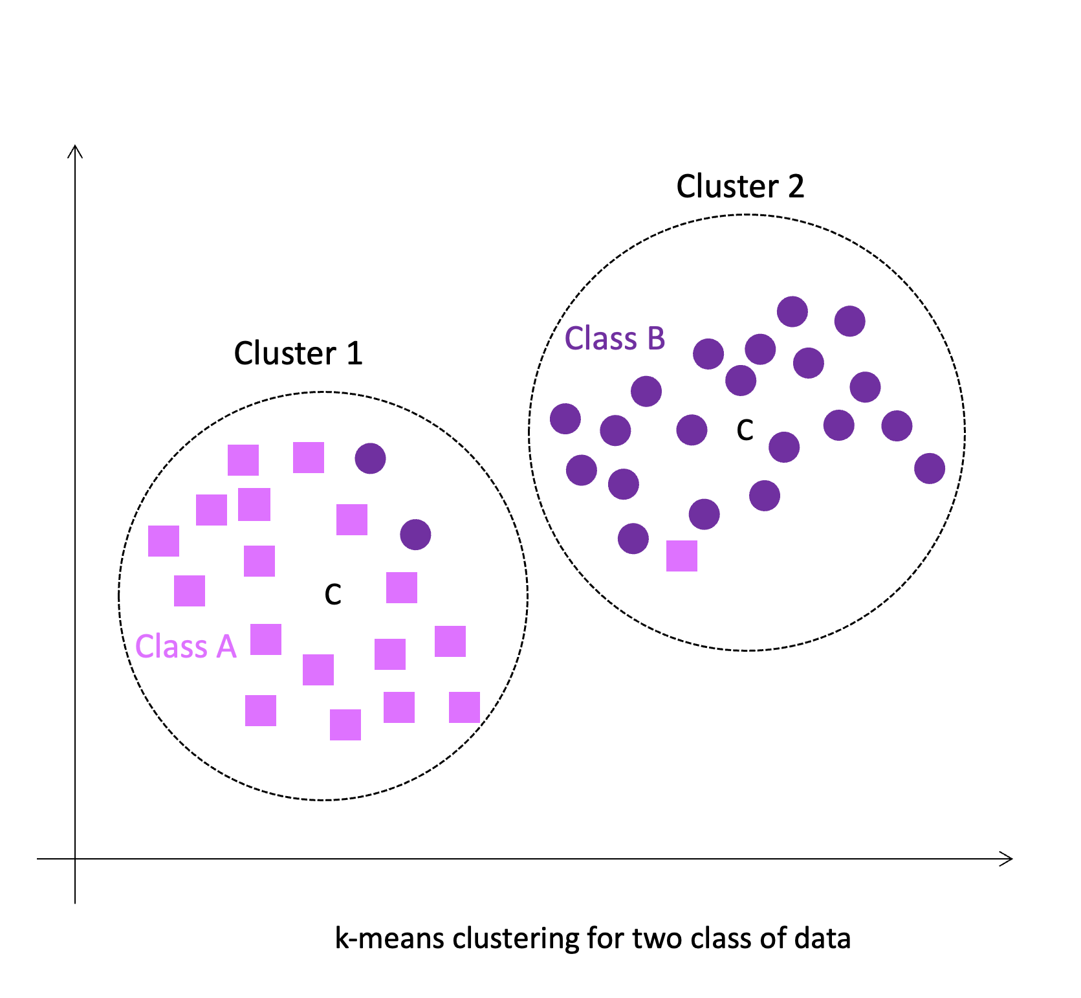
Unsupervised Learning Applications
Clustering (e.g., grouping similar buildings based on their energy consumption profiles).
Dimensionality reduction (e.g., reducing data complexity by highlighting the most critical features).
Notes:
Supervised learning plays a pivotal role in UBEM, especially in the context of predictive modeling. It enables the development of accurate models that forecast future energy consumption in urban buildings. For instance, a supervised learning model can take into account historical energy consumption data, building characteristics, and external factors like weather patterns to predict future energy needs. This capability aids urban planners, architects, and energy managers in designing and retrofitting buildings for optimal energy efficiency.
Additionally, classification in supervised learning can help categorize buildings based on energy efficiency, aiding in urban development policies and initiatives focused on sustainability.

Slide 16
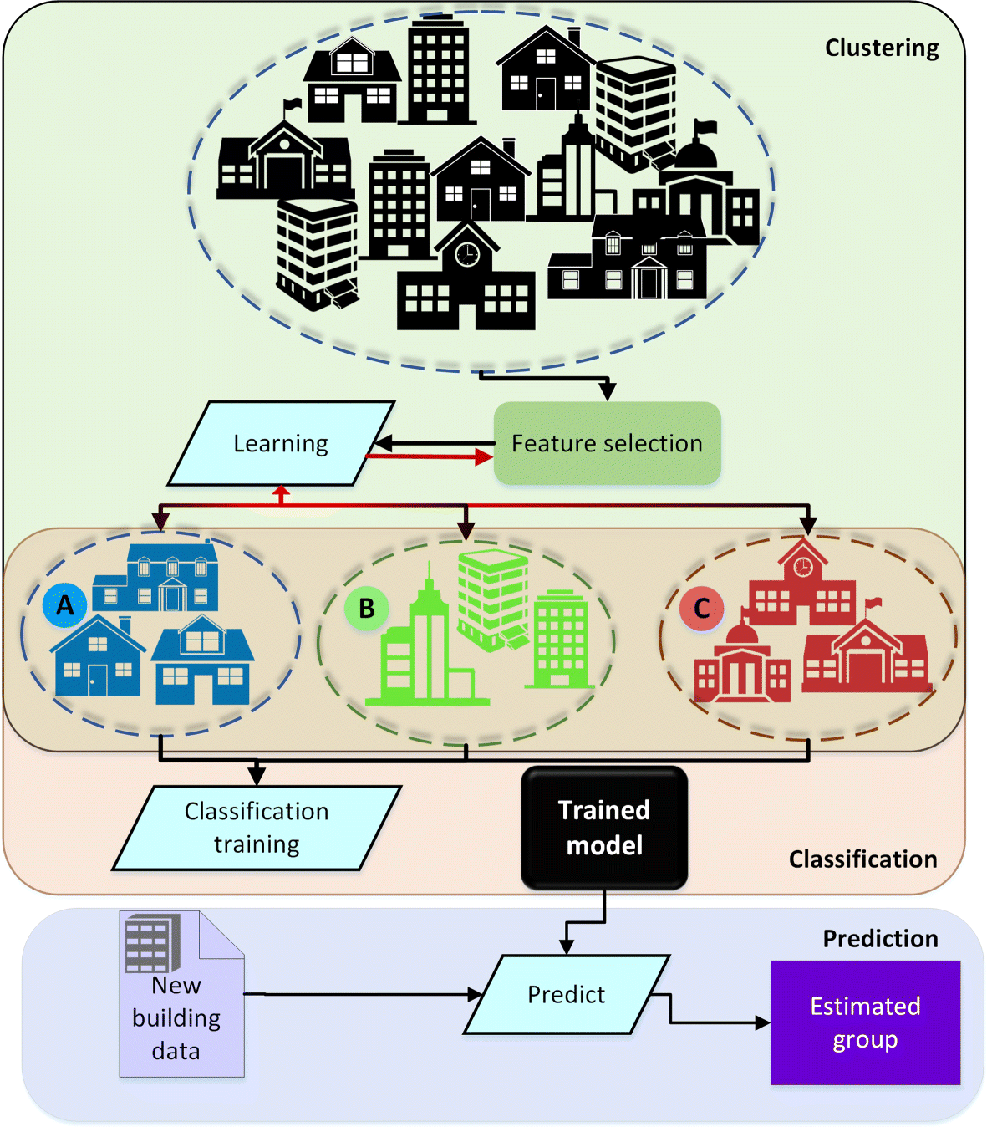
Examples
https://viejournal.springeropen.com/articles/10.1186/s40327-018-0064-7

Slide 17
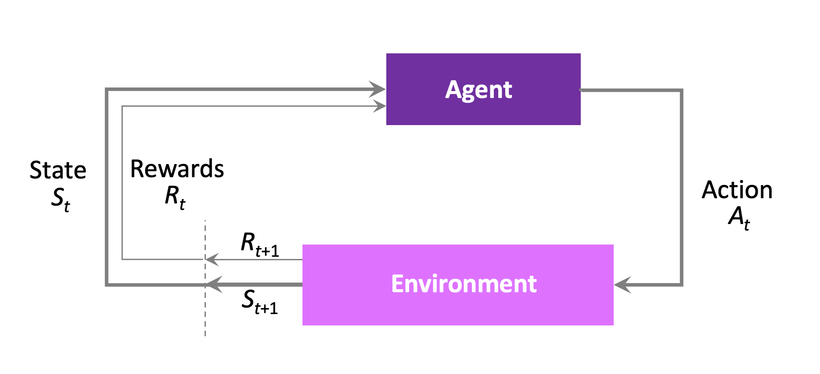
Reinforcement Learning
Definition: Reinforcement learning is a type of machine learning that focuses on decision-making and control mechanisms through interactions in an environment.
Key Component:
  Agent-Environment Interaction: Agent learns from its interaction with the environment.

Slide 18
Reinforcement Learning Applications
Application Scenarios:
  Teaching Multi-Step Processes: Teaches machines to perform multi-step tasks with defined rules.
  Response to Cues: Decides actions based on positive or negative cues to maximize rewards autonomously.

Slide 19
Reinforcement Learning Applications
Game Playing
Architecture (e.g., Autonomous design systems generating optimal building layouts.)
Engineering (e.g., Training robots for construction tasks or inspections.)
Urban Planning (e.g., Optimizing traffic flow or city infrastructure planning.)
Urban building energy management (e.g., aids in developing adaptive control systems or real-time optimization of heating, cooling, and lighting based on environmental factors and occupancy patterns)
Smart Grid (e.g., Precise energy prediction crucial for managing unpredictable local energy supply and demand)

Slide 20
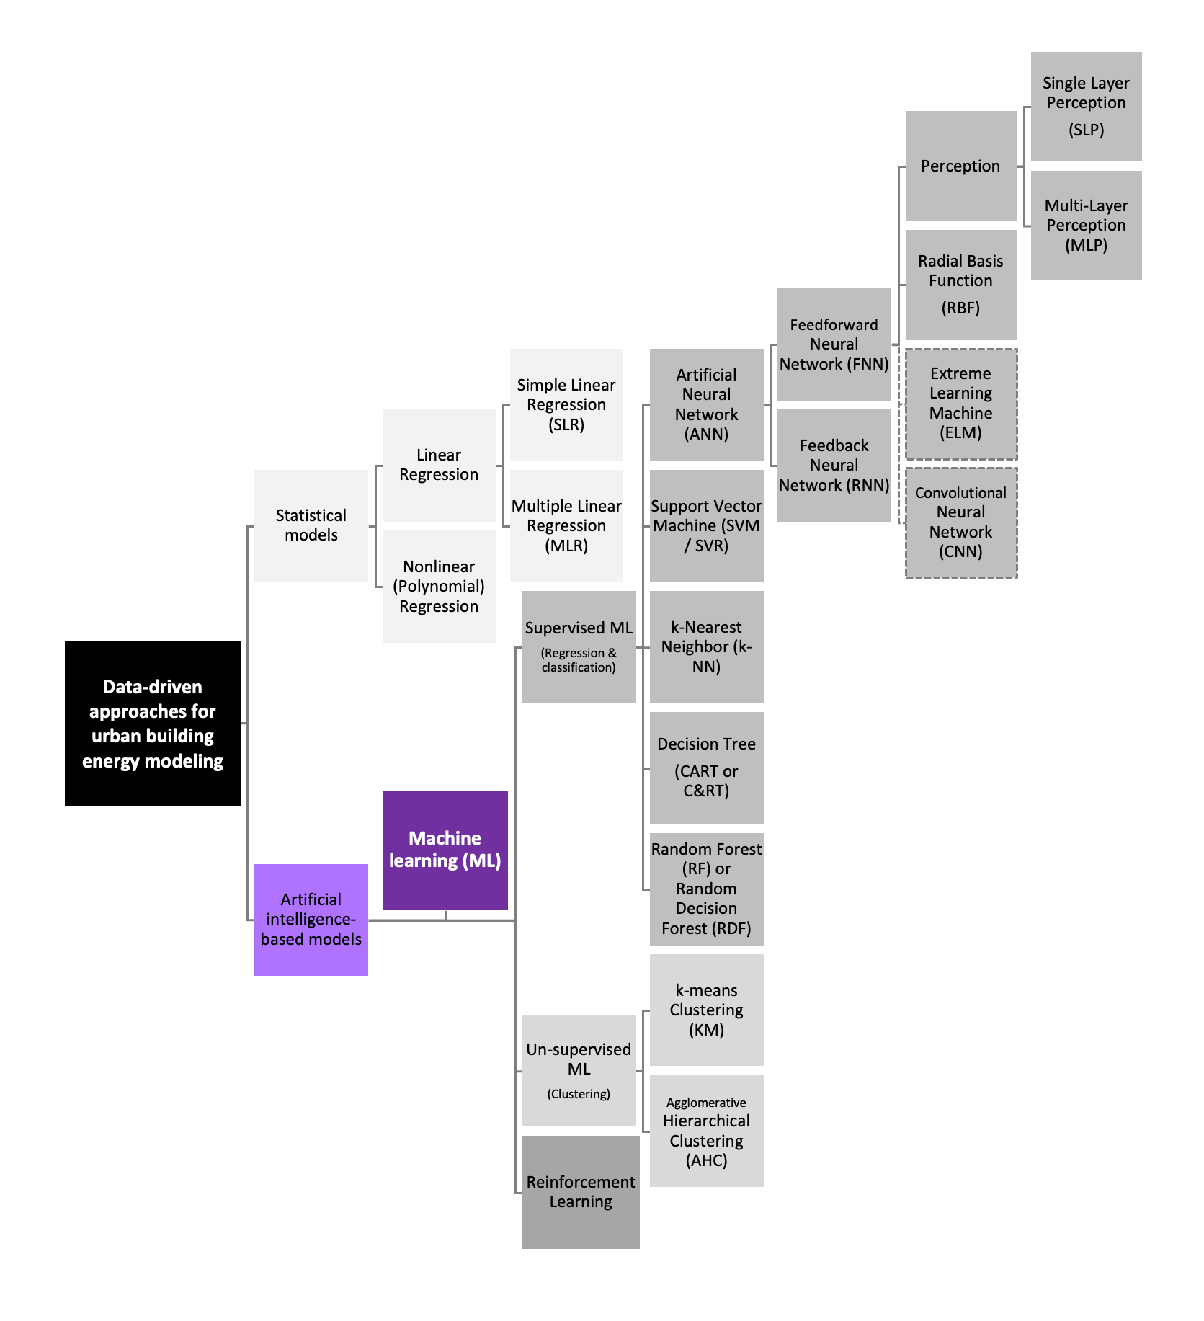
main machine learning (ML) algorithms
Abbasabadi, N., Ashayeri, M,. (Eds). (2024). Artificial Intelligence in Performance-driven Design: Theories, Methods and Tools, Wiley.

Slide 21
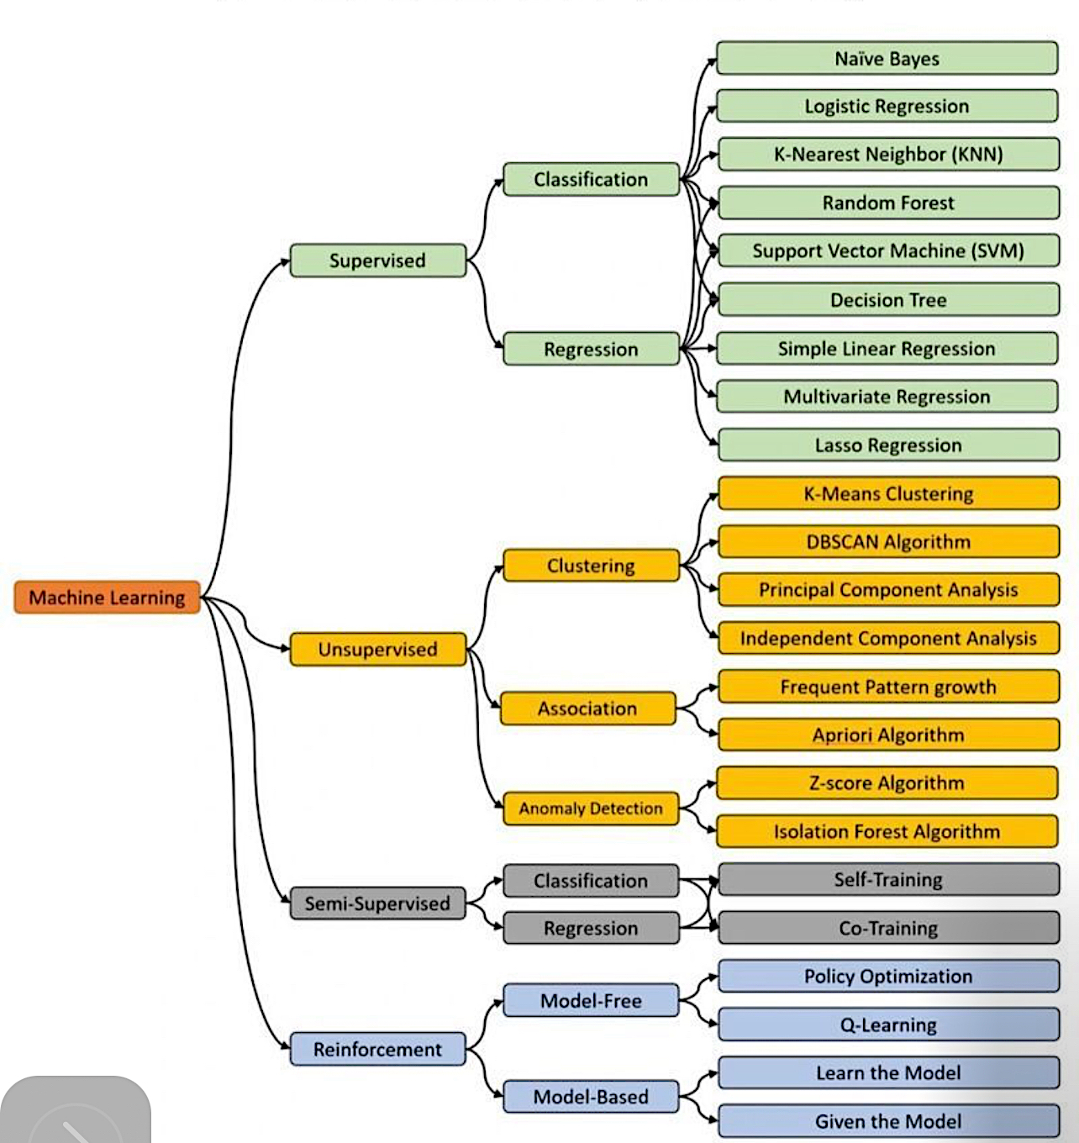
ML Algorithms

Slide 22
Supervised Learning

Slide 23

Prediction in Machine Learning

Slide 24
Prediction in Machine Learning
Machine learning involves predicting outcomes using features.
Two main components:
Outcome (what we predict)
Features (used to make those predictions).
Notes:
Today, we'll delve into the core concepts of predicting outcomes using data and features. In machine learning, our primary components are the outcome, representing what we aim to predict, and the features, which we use to make those predictions.

Slide 25
Prediction in Machine Learning
Algorithm: Take feature values as input and predict the outcome.
Feature 1
Feature 2
Feature 3
Algorithm
Outcome
Feature p
Notes:
Let's explore the role of data and prediction in machine learning. Our algorithms play a crucial role—they take in feature values and predict outcomes. To achieve this, we follow an approach where we train our algorithms using known outcome datasets to make predictions for future, unknown outcomes.

Slide 26
Prediction in Machine Learning
Algorithm: Take feature values as input and predict the outcome.
Approach: Train the algorithm with known outcome datasets for future predictions.
Notes:
Let's explore the role of data and prediction in machine learning. Our algorithms play a crucial role—they take in feature values and predict outcomes. To achieve this, we follow an approach where we train our algorithms using known outcome datasets to make predictions for future, unknown outcomes.

Slide 27
Notation
Outcomes as Y
Features as X
(X₁ to Xp)
Notes:
Outcomes denoted as capital Y; Features as capital X with an index (X1 to Xp).
Features may also be called predictors or covariates interchangeably.

Slide 28
Variables / Factors
X
Feature(s)
Input(s)
Independent Variable (s)
Predictor(s)
covariate(s)
Y
Outcome
Output
Dependent variable
Response
Target
Features and outcomes may also be called ……interchangeably.

Slide 29
Types of prediction problems
Categorical outcomes: Y with k classes (e.g., digits, words, spam or not spam, building typology).
Continuous outcomes: Prediction tasks where Y is continuous (e.g., building energy use).
Notes:
Machine learning involves various prediction problems. For instance, categorical outcomes are represented by 'Y' with 'k' classes, whereas in continuous outcomes, 'Y' denotes the prediction in continuous tasks

Slide 30
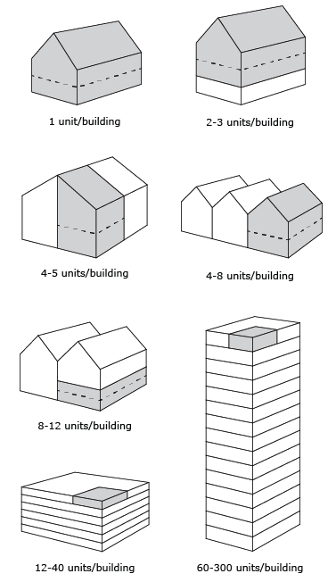
Examples of Categorical Outcome Predictions
Building Typology Prediction
  Categorical outcome: Buildings categorized into distinct classes. (e.g., residential, commercial, industrial)
  Features Influencing Building Typology
    Architectural features and purposes. (e.g., Building size, architectural style, and functionality).
Image Source; https://www.next.cc/journey/discovery/building-types

Slide 31
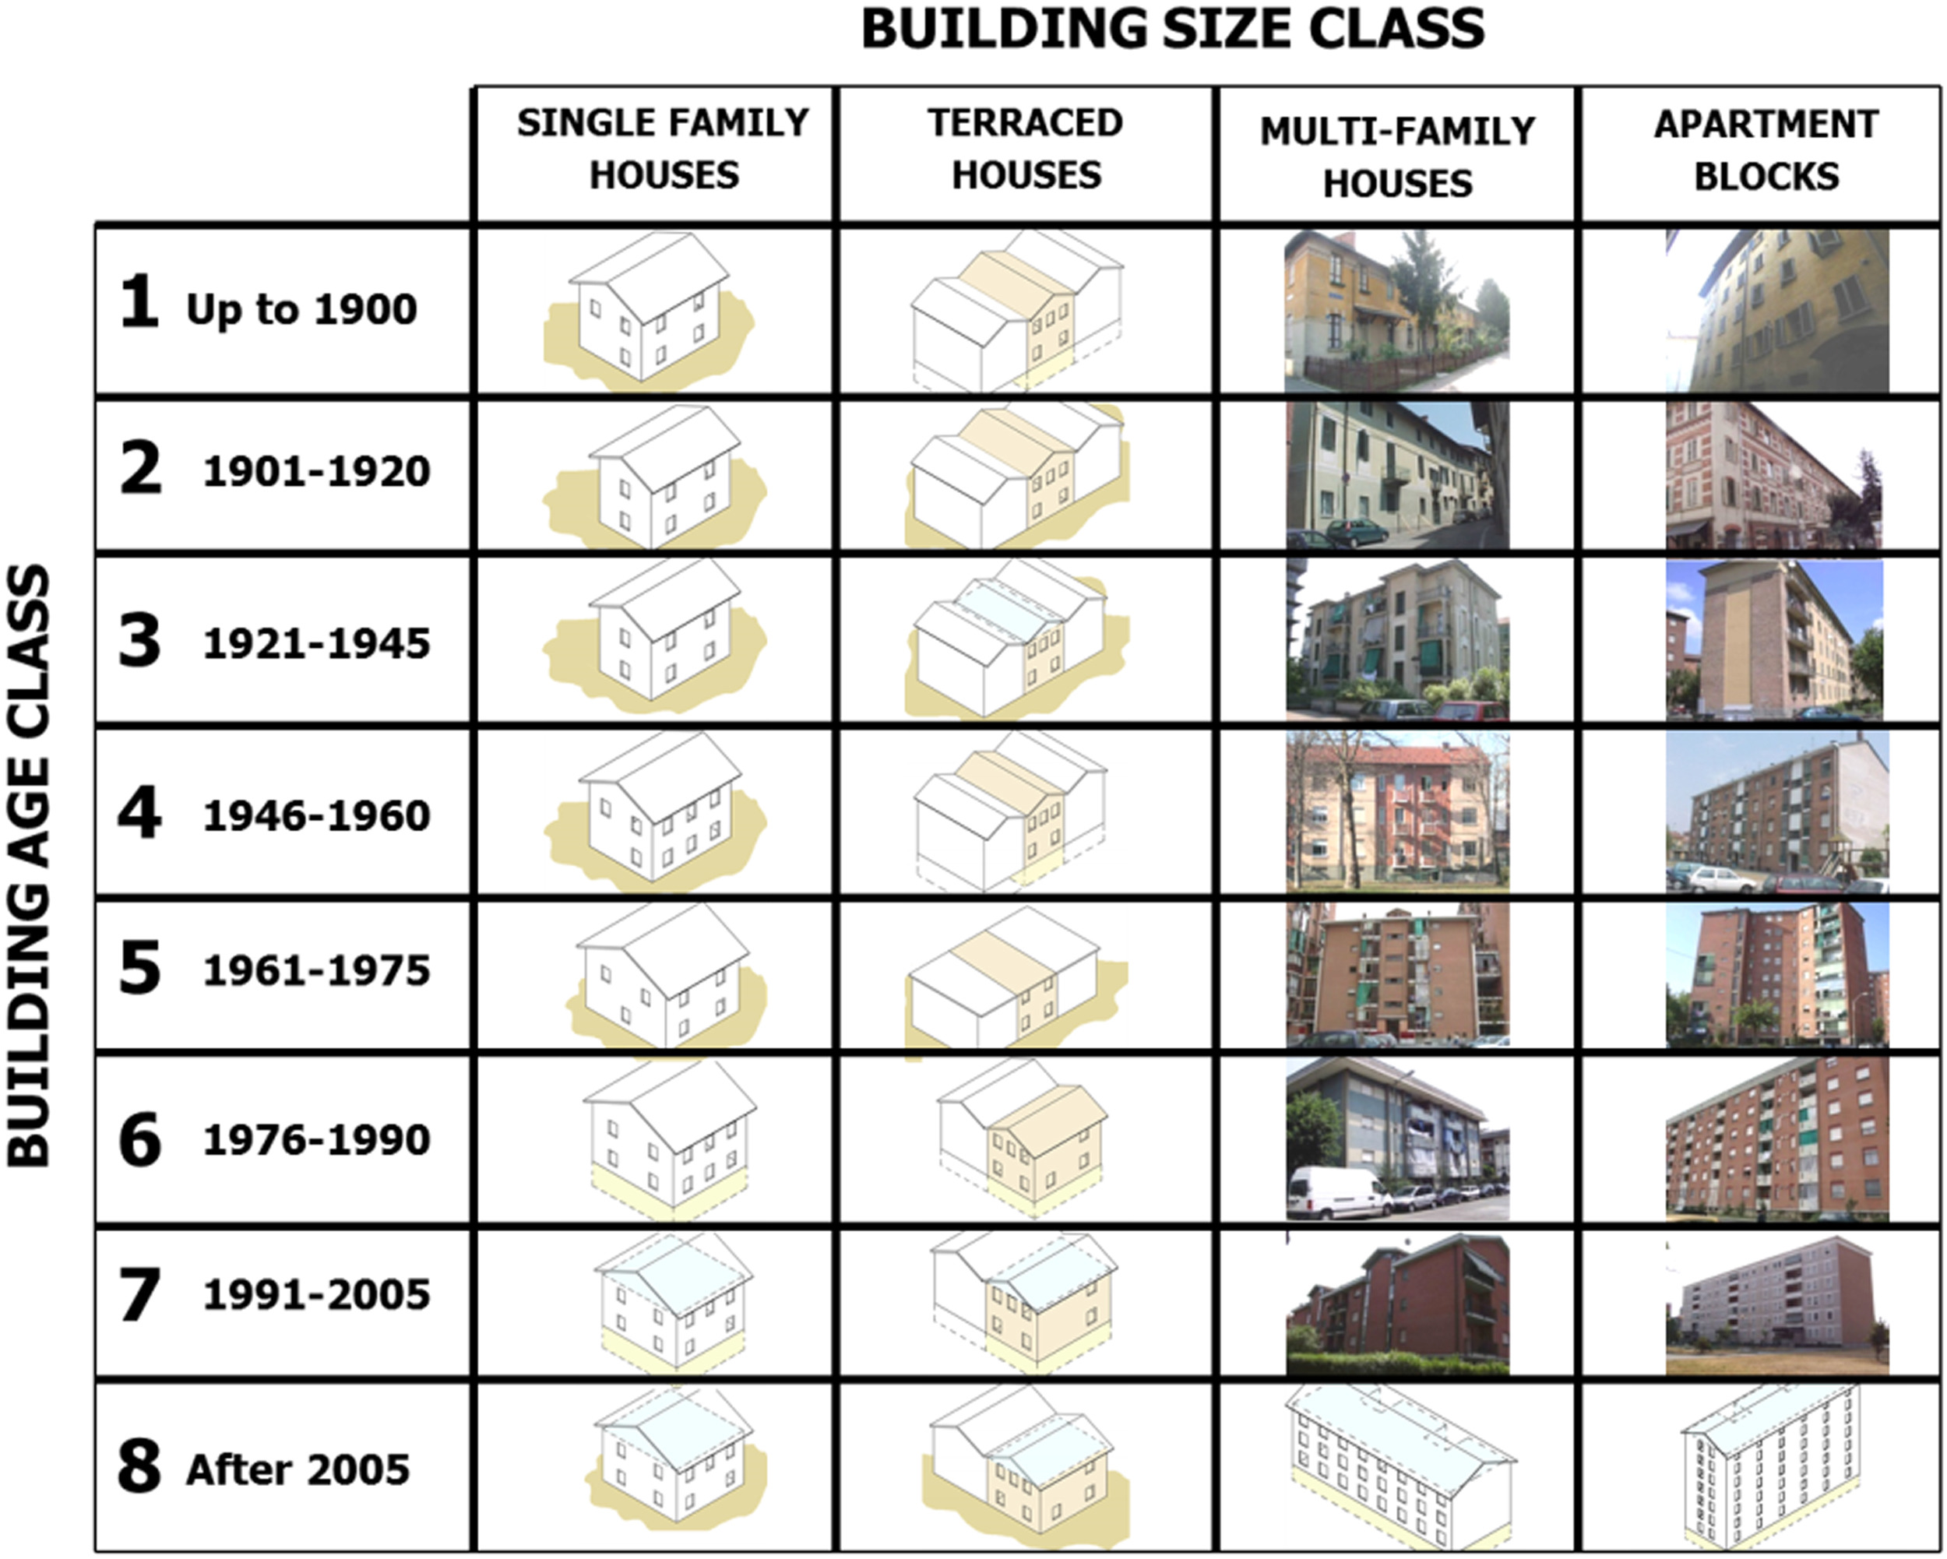
Examples of Continuous Outcome Predictions
Energy Consumption Prediction
  Continuous outcome: Energy consumption values vary on a continuous scale.
Features Affecting Building Energy Consumption
  Design features and environmental factors. (Size, Window placement, insulation, lighting, HVAC systems, and building materials, micro cliamet)
Image Source: https://www.sciencedirect.com/science/article/pii/S0301421517301015#f0005

Slide 32

General Setup for Predictive Modeling
Goal: Predicting unknown continuous outcomes using known data with observable features
Features
(X₁)
(X₂)
Outcome ?
(X₃)
$$\hat{y}​$$
(X_{p})
X_{1,1}
X_{1,2}
…
X_{1, P}
Y₁
X_{2,1}
X_{2,2}
…
X_{2, P}
Y₂
X_{n,1}
X_{n,2}
…
X_{n, P}
Y_{n}

Slide 33
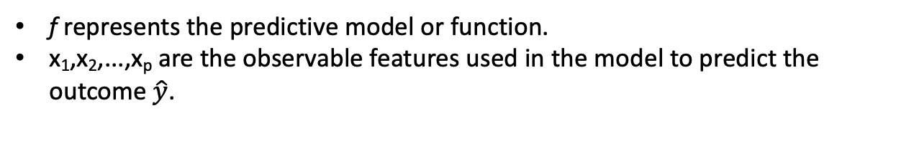
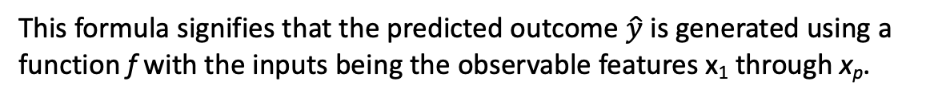

Prediction in machine learning
When the outcome is continuous
Predicted Outcome:
$$\left(\hat{y}​\right)=f\left(x1​,x2​,…,xp​\right)$$
f represents the predictive model or function.
x₁,x₂,...,x_{p} are the observable features used in the model to predict the outcome $\hat{y}​$.
This formula signifies that the predicted outcome $\hat{y}​$ is generated using a function f with the inputs being the observable features x₁​ through x_{p}​.
Notes:
a function 'f' generates predictions denoted as 'y hat' for x1 through xp.”

Slide 34
Feature Selection
Feature selection is a process to choose the most relevant variables (also known as features or predictors) for use in model construction.

Slide 35
The main objectives of feature selection:
Improving Model Performance: By eliminating irrelevant or redundant data, the model can often make more accurate predictions.
Reducing Overfitting: Fewer data points can mean less chance of making decisions based on noise.
Enhancing Comprehensibility: Models with fewer variables are often easier to understand.
Decreasing Training Time: Fewer data points can lead to faster model training.

Slide 36
Understanding VIF in Feature Selection
VIF Explained: Variance Inflation Factor (VIF) measures how much the variance of an estimated regression coefficient increases if your predictors are correlated.
VIF Thresholds:
  VIF = 1: Implies no correlation between this variable and others.
  1 < VIF < 5: Indicates moderate correlation; the variable can typically remain in the model.
  VIF >= 5: Suggests high correlation; consider removing the variable to reduce multicollinearity.
  VIF >= 10: Strong multicollinearity; warrants closer investigation.

Slide 37
Understanding VIF in Feature Selection Con.
Contextual Decision-Making:
  VIF values are guidelines, not strict rules.
  Retain variables with VIF 5-10 if they are theoretically important or key to model accuracy.
  For sensitive analyses, even a VIF just over 1 could merit scrutiny.
Actionable Insights:
  Use VIF to identify and address potential issues affecting regression coefficients.
  Combine VIF analysis with domain expertise and additional diagnostics for informed decision-making.

Slide 38
Challenges of Multicollinearity in Datasets
Multicollinearity Issues: Redundant information among variables complicates isolating individual effects on the response variable.
Inflated Standard Errors: High correlation leads to less precision in coefficient estimates, widening confidence intervals.
Unstable Coefficients: Small data changes can result in large shifts in coefficient values, reducing model reliability.
Difficulty in Model Interpretation: Correlated variables obscure the understanding of variable impacts and relationships.
Model Overfitting: The model may perform well on training data but poorly on new, unseen data due to excessive complexity.

Slide 39
Note: Prediction Terminology
Varied terms: "Prediction" often used for both categorical and continuous outcomes.
While 'regression' might refer specifically to the continuous case.
  Avoid confusion with linear regression terms.

Slide 40
Regression

Slide 41
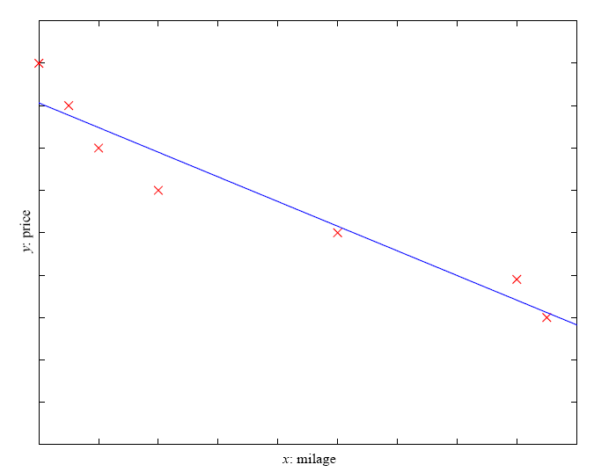
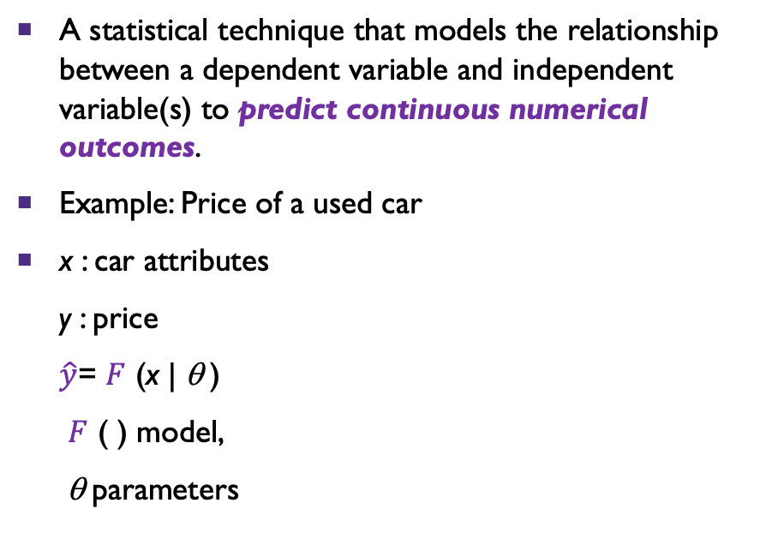
Regression
A statistical technique that models the relationship between a dependent variable and independent variable(s) to predict continuous numerical outcomes.
Example: Price of a used car
x : car attributes
y : price
$\hat{y}​$= $F$ (x | θ )
$F$ ( ) model,
θ parameters
Notes:
Regression predicts numeric outputs, e.g., estimating a car's price based on attributes.
Machine learning learns the relationship between attributes (X) and the output (Y).
Regression and Classification are supervised learning problems with input (X) and output (Y).
The machine learning model is defined by parameters, represented as y = g(x|θ) or y = g(x|q).
"y = g of x given q," where g is the model function, and q are the parameters.

Slide 42
Types of Regression
Linear Regression: One independent variable (the predictor).
Multiple Linear Regression: More than one predictor (independent variables) affects the dependent variable.
Polynomial Regression: Models a non-linear relationship by using polynomial terms.
Logistic Regression
Ridge and Lasso Regression

Slide 43
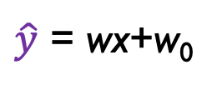
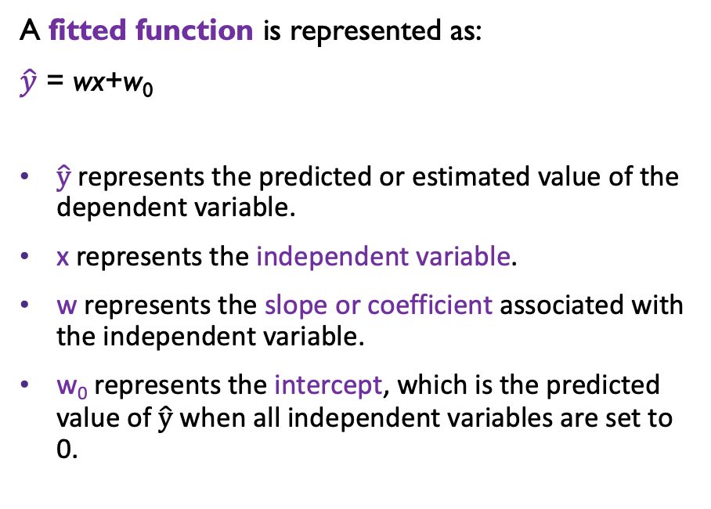
Regression
Linear Regression:
A fitted function is represented as:
$\hat{y}​$ = wx+w₀
$\hat{y}​$ represents the predicted or estimated value of the dependent variable.
x represents the independent variable.
w represents the slope or coefficient associated with the independent variable.
w₀ represents the intercept, which is the predicted value of $\hat{y}​$ when all independent variables are set to 0.
$\hat{y}​$ = wx+w₀
Notes:
A fitted function is represented as y = wx + w0.
"y = w times x plus w-zero" or "y = w times x plus intercept w-zero.”
This formula describes the linear relationship between the independent variable(s) and the estimated value of the dependent variable in a simple linear regression model.

Slide 44
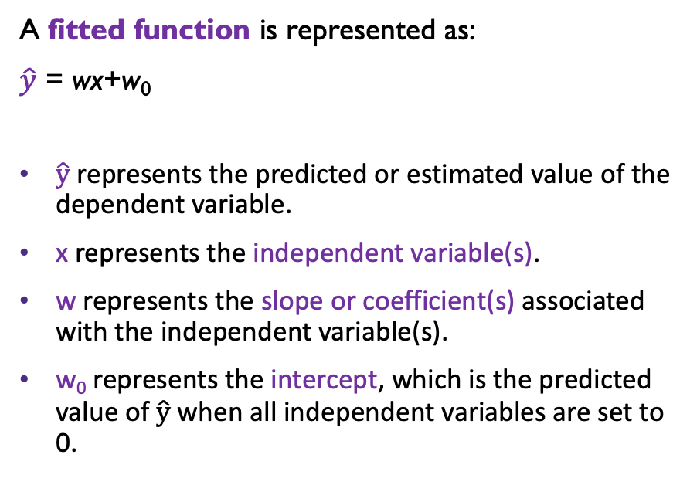
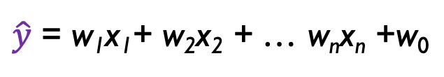
Regression
A fitted function is represented as:
$\hat{y}​$ = wx+w₀
$\hat{y}​$ represents the predicted or estimated value of the dependent variable.
x represents the independent variable(s).
w represents the slope or coefficient(s) associated with the independent variable(s).
w₀ represents the intercept, which is the predicted value of $\hat{y}​$ when all independent variables are set to 0.
Multiple Linear Regression:
$\hat{y}​$ = w₁x₁+ w₂x₂ + … w_{n}x_{n} +w₀
Notes:
A fitted function is represented as y = wx + w0.
"y = w times x plus w-zero" or "y = w times x plus intercept w-zero.”
In multiple linear regression, there may be multiple independent variables, each with its own coefficient, www.

Slide 45
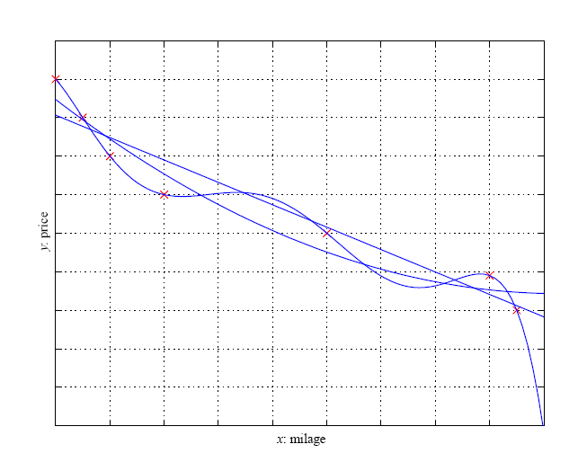
Regression
Polynomial regression is used to model complex relationships by fitting a curve to data points.
Predicts numeric values
Ex: Car price
Notes:
Regression predicts numeric values, unlike classification which deals with discrete classes.
It aims to find a function that fits a dataset of data points XXX and continuous labels, minimizing empirical errors.
Polynomial regression is used to model complex relationships by fitting a curve to data points.
The choice of model complexity is critical, balancing accuracy and simplicity based on the dataset's characteristics.

Slide 46
Regression
Notes:
different types of curves (linear, second-order, and sixth-order polynomials) are used to match a set of points. While the sixth-order curve perfectly fits the data, it's unlikely that the actual curve looks like that with this amount of data. The second-order curve seems better than the linear one in capturing the pattern shown in the data.

Slide 47
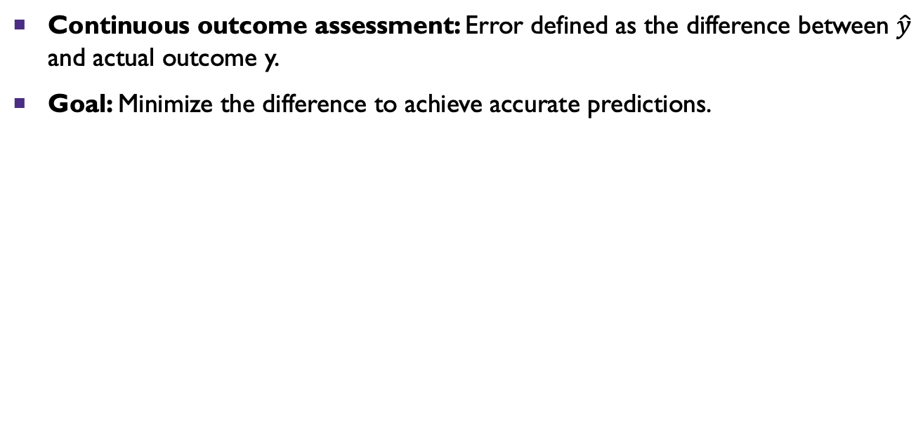

Prediction Error and Accuracy
Continuous outcome assessment: Error defined as the difference between $\hat{y}​$ and actual outcome y.
Goal: Minimize the difference to achieve accurate predictions.
Error= $Y−\hat{y}​$
There is no right or wrong outcome
Notes:
Assessing continuous outcomes involves understanding prediction error and accuracy. Error is defined as the difference between our predicted value 'y hat' and the actual outcome 'y.' Our aim is to minimize this difference for more accurate predictions.

Slide 48
The most common evaluation metrics for regression
Mean Absolute Error (MAE):
  MAE = (1 / n) * Σ |actual - predicted|
Mean Squared Error (MSE):
  MSE = (1 / n) * Σ (actual - predicted)^2
Root Mean Squared Error (RMSE):
  RMSE = √(MSE)
Mean Absolute Percentage Error (MAPE):
  MAPE = (1 / n) * Σ (|actual - predicted| / |actual|) * 100%
R-squared (R²):

Slide 49
The most common evaluation metrics for regression
R-squared (R²):
  R² quantifies the proportion of the variance in the dependent variable (target) that is predictable from the independent variables (features) in the model.
  It ranges from 0 to 1, where 1 indicates a perfect fit.
  R² can be interpreted as the goodness of fit of the regression model.
  R² = 1 - (SSR / SST)
  where SSR is the Sum of Squares of Residuals and SST is the Total Sum of Squares.
EX:
R-squared: 0.9183115. This indicates that approximately 91.83% of the variance in the dependent variable is explained by the model. It's a measure of the model's goodness of fit.

Slide 50
p-value
A p-value, short for "probability value," is a statistical measure used in hypothesis testing to assess the strength of evidence against a null hypothesis.
It helps you determine whether the results of a statistical test are statistically significant or if they could have occurred by random chance.
How to interpret it:
Low p-value (e.g., ≤ 0.05): If the p-value is small, it means your results are probably not due to chance. You might have found something significant.
High p-value (e.g., > 0.05): If the p-value is large, it suggests your results could be due to chance. You might not have found something significant.

Slide 51
Conclusion
Machine Learning
  Introduction on ML Types and Applications
  Supervised Learning
  Prediction
  Regression
  Feature Selection
  Model Evaluation

Slide 52

Lab Activity: Regression
Open up a web browser. Google “google colab” click on the first entry. You may also access the website by following https://colab.research.google.com/
Go to Canvas and download the file called “Regression- Predicting Building Energy Consumption at the UW Campus”

Slide 53
Computational Assignment
UW Energy Model
See the notes on Canvas

Slide 54

Main Textbooks
Abbasabadi, N., Ashayeri, M,. (Eds). (2024). Artificial Intelligence in Performance-driven Design: Theories, Methods and Tools, Wiley.
Alpaydin, E., (2020). Introduction to Machine Learning, 4th Edition, The MIT Press

Slide 55
Readings
Alpaydin, E., (2020). Introduction to Machine Learning. 4th Edition, The MIT Press.
  – Chapter 1 / What is Machine Learning?
  – Chapter 2 / Supervised Learning

Slide 56
Next Classe
  Con. Supervised Learning
    Classification
    Lab Activities

Slide 57
QUESTIONS?

