Slide 1
ARCH 594/508: AI Research Seminar/Studio—AI in Architecture
Spring 2026
AI Seminar Session
Synthesis · Reflection · Final Paper/ Review Preparation
Narjes Abbasabadi, Ph.D. Assistant Professor
Email: nabbasab@uw.edu
Department of Architecture
College of Built Environments
University of Washington
Website: https://silab.be.uw.edu

Slide 2
Our agenda will be:
Course synthesis and final reflection
Final presentation preparation / how to structure a clear 10-minute final presentation
Peer review activity
Final improvement plan

Slide 3
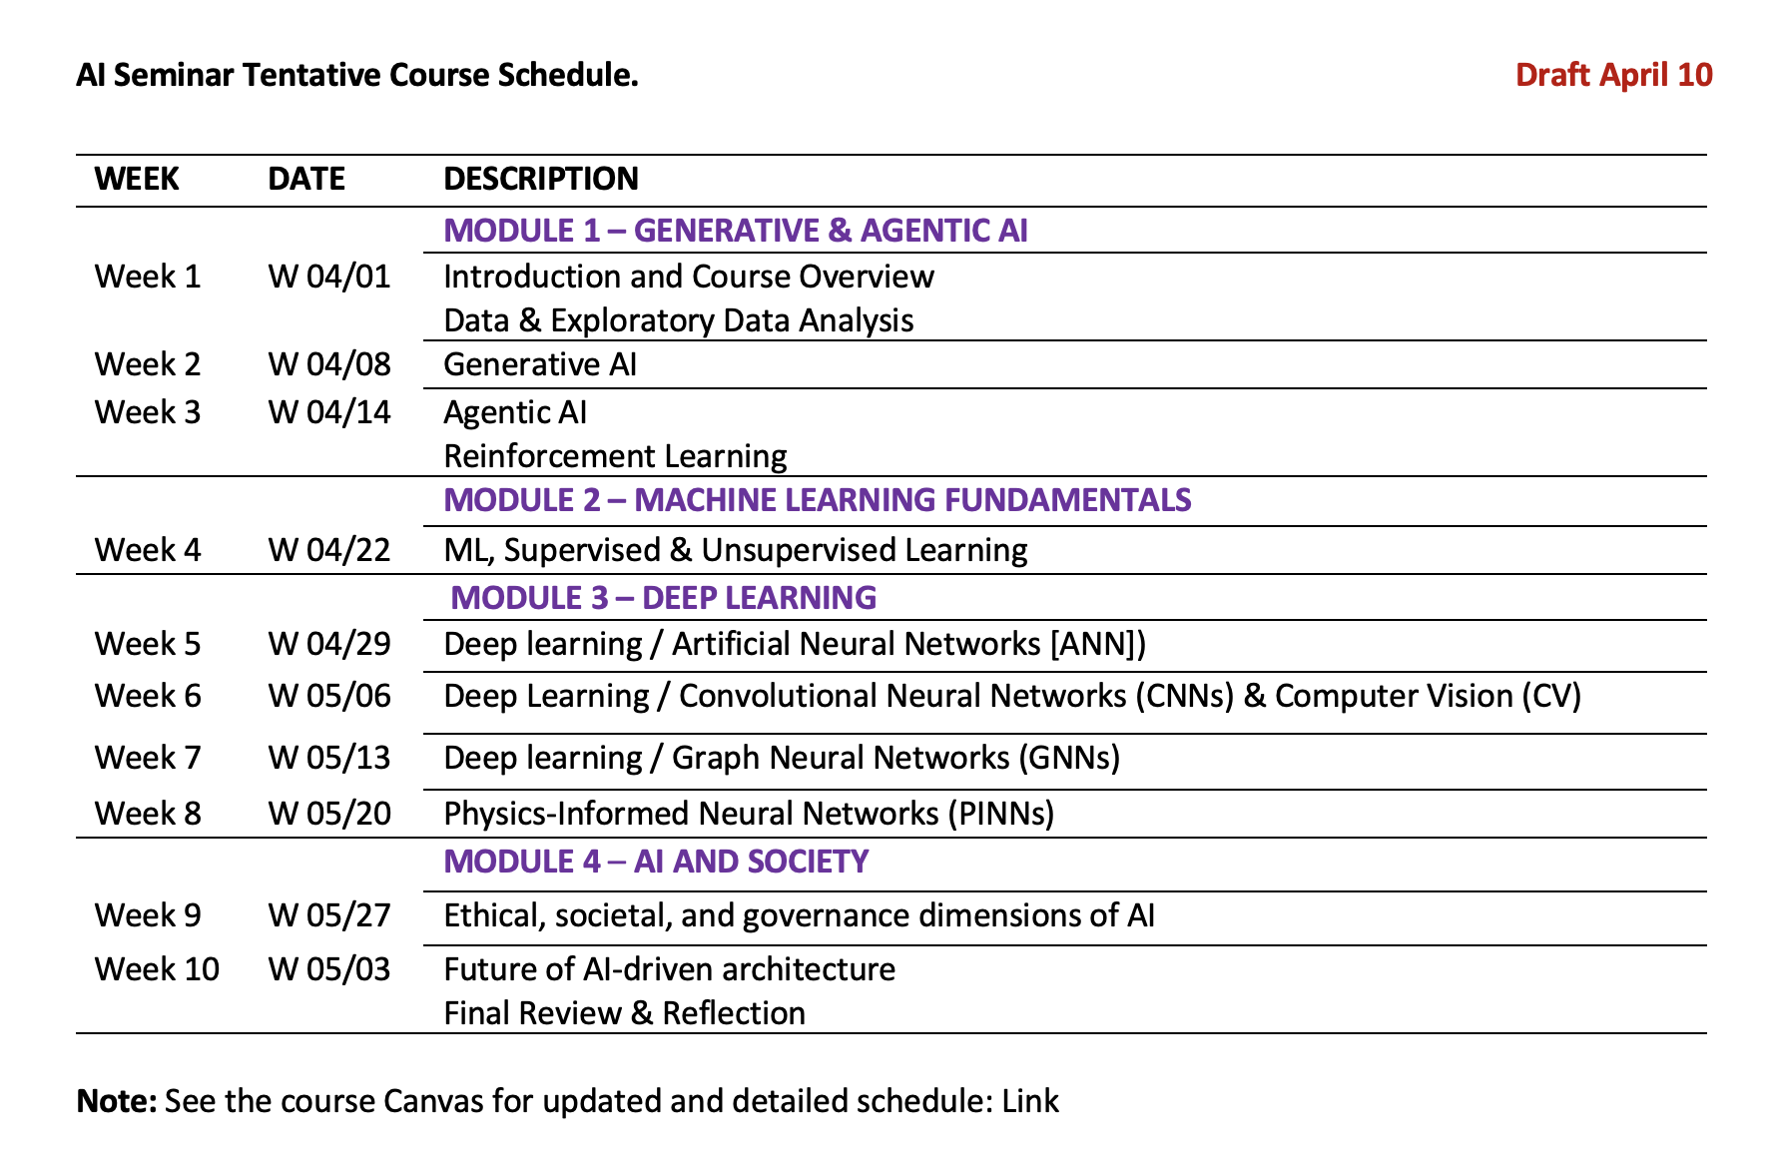
Course Schedule

Slide 4
Method map: where the projects sit
Representation layer
Parametric models
Images / CV
Graphs
Simulation data
Learning layer
ML / DL
CNN / ViT
GNN
PINN
Surrogate models
Decision layer
Optimization
RL
Agentic AI
Human-in-the-loop
Domain clusters
energy
daylight
retrofit
layout
façade
health
human-AI

Slide 5
The course arc: from data to design judgment
1
2
3
4
Representation
AI Models
Simulation + Evaluation
Design Decisions
Geometry, images, graphs, parameters, simulation inputs
ML / DL / CV / GNN / PINN / RL / agentic systems
Energy, daylight, comfort, health, layout, uncertainty
Interpret, compare, select, revise, communicate
AI is not the final answer. It is part of a research workflow that connects evidence, performance, uncertainty, and design judgment.

Slide 6
Final presentation: tell a research story
10 minutes, clear visuals, minimum text, one key message per slide.
Problem + motivation
Research question
Prior work / gap
1
2
3
Why does this matter?
What are you asking?
What is missing?
Workflow + data
AI method + baseline
Evaluation
4
5
6
What enters the pipeline?
What model is tested?
How do you judge it?
Results
Discussion + limits
Contribution + next steps
7
8
9
What did you find?
What does it mean?
What does it add?

Slide 7
Suggested 10-minute structure
Use this as a timing guide. Adjust slightly based on your project, but do not let methods consume the whole presentation.
0–1
1–2
2–3
3–5.5
5.5–7.5
7.5–8.5
8.5–9.5
9.5–10
Motivation
Question
Gap
Method
Results
Meaning
Limits
Close
problem + why it matters
objective / hypothesis
precedent + why AI
workflow + model
key figures + comparison
interpretation
what cannot be claimed
contribution + next step
Best test: rehearse out loud once before Friday. If you exceed 10 minutes, cut slides before shrinking font.

Slide 8
Move from “tool demo” to research contribution
Tool demo
Research project
• Shows a workflow
• Describes what was built
• Reports outputs
• Focuses on novelty of tools
• Ends with “it works”
• Frames a research question
• Explains why the method fits the question
• Evaluates results against evidence
• Interprets what the outputs mean
• Ends with contribution + limitations
“Our contribution is not only that we created a workflow; it is what the workflow reveals about AI-supported design decision-making.”
“A strong final project is not one where everything worked perfectly. It is one where the method is clear, the results are interpreted accurately, and the limitations are understood.”
06

Slide 9
What reviewers need to understand quickly
Use this as the standard for both presentation and poster.
Research
question
Method /
workflow
Evidence /
results
Contribution
What problem are you investigating?
How did you test it?
What did you find or demonstrate?
Why does this matter?
A strong project does not show everything you did. It shows the logic of the research clearly enough that reviewers can follow the question, method, evidence, and contribution.

Slide 10
Activity 1A: Project lightning round/ 3-minute rehearsal
Each group presents a compressed version of the final presentation. This tests clarity and timing.
1
Research question
What problem are you investigating?
3 min
AI method
2
What model/workflow are you using?
Keep it brief. The goal is clarity, not completeness.
3
Main result
What is the strongest finding so far?
Presenter rule
4
Limitation
● Do not explain every technical detail. Test whether the story makes sense.
What must be explained honestly?
Audience rule
● Listen as reviewers: what is clear, what is missing, and what question would you ask?

Slide 11
Activity 1B: project-logic slide sprint
Work in your group for 10 minutes. Your goal is one clear slide, not a polished slide.
1
Deliverable after 10 minutes
Write the research question
2
Include the workflow
A single slide that a reviewer can understand without hearing your full explanation.
3
Choose the strongest result
Do not spend this time on animation, formatting, or finding a perfect image.
4
State one limitation honestly
5
Write the contribution sentence
Minimum content on this slide
✓ One research question
✓ One main result or finding
✓ One workflow diagram
✓ One contribution statement
7

Slide 12
Exercise: write a one-sentence contribution
Formula
This project develops / tests / evaluates [AI-supported method] for [design or performance problem] and shows that [main finding], while revealing [important limitation].
Our project investigates [problem] by using [AI method] with [data/input] to evaluate [performance/design issue]. The main result shows [finding], which contributes to [design/research value].
Examples of stronger verbs
develops
compares
evaluates
quantifies
● Remove vague words: “use AI,” “explore,” “optimize,” “improve.” Be specific.
● This sentence can become your opening or closing contribution statement.
reveals
demonstrates
challenges
extends
08

Slide 13
Feedback sheet for each group
Use this during peer review. Each group should leave with a revision list.
Feedback prompt
Notes
What is working well?
What needs improvement before Friday?
What reviewer question should they prepare for?
Which figure, diagram, or result needs clarification?
What should be cut or shortened for timing?
Each group should record at least 3 specific edits to make before the final review.

Slide 14
Peer feedback protocol: Glow / Grow / Question
Give fast, specific, useful feedback after each 3-minute rehearsal.
Glow
Grow
Question
What is already clear or strong?
What needs improvement before Friday?
What might reviewers ask?
Feedback should be specific: slide, figure, sentence, missing explanation, or timing issue.
9

Slide 15
Workflow peer review rubric
Reviewer groups: mark Yes / Partly / No and write one concrete suggestion.
Criteria
Yes / Partly / No
Feedback
1. The research question is clear
2. The workflow has a clear beginning, middle, and end
3. Inputs and outputs are labeled
4. The AI method is named and placed correctly
5. The evaluation step is visible
6. The result or contribution is clear
7. The diagram can be understood without verbal explanation
8. The workflow avoids unnecessary technical clutter

Slide 16
Fast feedback protocol
Each peer group gives three comments. Keep feedback specific and useful.
Clear
Missing or confusing
Improve before final
What is already working?
What is not yet understandable?
What should change now?
“The relationship between input data and model output is easy to follow.”
“The evaluation step is not visible. How do you know the model works?”
“Add a final box showing how the result informs a design decision.”
Feedback should help the group revise the diagram today — not just describe whether you liked it.

Slide 17
Workflow revision sprint
After feedback, revise the workflow immediately while the comments are fresh.
10-MINUTE TASK
Revise your workflow figure and mark the changes you made.
□ Start with a clear problem, question, or input
□ Name the AI method / computational method
□ Use arrows to show process logic
□ Add evaluation, validation, or comparison
□ Connect output to design or research impact
□ Make labels readable from a distance
AI Seminar | Final Project Preparation

Slide 18
Results: do not just report outputs — interpret them
1
2
3
4
Evidence
Finding
Meaning
Limitation
Figure, table, metric, comparison, or visual result
The specific pattern or performance outcome you observed
Why this matters for design, research, or evaluation
What the result cannot prove yet
Good result sentence: “The model improves / fails / shifts / overestimates / underestimates ___, which suggests ___, but this should be interpreted cautiously because ___.”
10

Slide 19
Discussion: what should the audience learn?
Technical
Design / domain
Research
• What did the AI method do well?
• Where did it fail or behave unexpectedly?
• Was the baseline comparison fair?
• How does this affect design reasoning?
• What does it reveal about performance trade-offs?
• What would a designer do differently?
• What is the contribution?
• What is generalizable?
• What needs future validation?
Discussion is not a summary. It is where you translate technical results into implications for architecture, design, and AI research.
Discussion is where the project becomes research.

Slide 20
Final ethical reflection: AI needs critical framing
Bias + data
Overconfidence
Interpretability
Who or what is missing from the dataset?
Where might the model sound more certain than it is?
Can the designer explain why the model behaves this way?
Environmental cost
Human judgment
Equity + impact
What computation, energy, or resource cost is involved?
Where should experts, users, or communities remain in the loop?
Who benefits, who is burdened, and who decides?
Identify one ethical or societal issue that is specific to your project — not a generic AI concern.
Notes:
For example, a computer vision project should discuss image-source bias or material classification uncertainty; an RL project should discuss reward design and optimization goals; an agentic project should discuss trust, control, and verification.

Slide 21
Align the final paper and presentation
Paper = detailed research document
Presentation = clear research story
Abstract
Opening claim
Introduction
Research question
Literature
Gap
Methods
Workflow diagram
Results + Discussion
Key result visuals
Conclusion
Contribution
Reminder: include all required figures, workflow diagrams, result visuals, and tables in the paper. Use the presentation to tell the clearest version of that same work.

Slide 22
Common fixes before the final review
Most presentations improve quickly by fixing these issues.
✓ Move the research question earlier.
Cut list
✓ Show the workflow before model details.
● Long literature review slides
✓ Replace “we tried many things” with a clear method sequence.
● Dense tables with unreadable text
✓ Show fewer results, but interpret them more carefully.
● Duplicate process diagrams
✓ Add one slide on limitations and what cannot be claimed.
● Results that are not discussed
✓ End with contribution: what does this add to AI + architecture research?
When in doubt, cut content that does not support your research question, results, or contribution.

Slide 23
Final presentation checklist
For 10 minutes, aim for 10–20 slides maximum.
✓ Title + team
✓ AI method or computational logic
✓ Motivation / problem
✓ Evaluation metrics / comparison
✓ Research question
✓ Key results
✓ Literature gap / precedent
✓ Interpretation of results
✓ Method / workflow diagram
✓ Limitations
✓ Data / inputs / simulation setup
✓ Contribution + next steps
Every major claim should be supported by a figure, result, comparison, or clear reasoning.
12

Slide 24
Prepare for reviewer questions
Use these questions to strengthen your presentation and your Q&A.
Method
Why is this AI method appropriate for the problem?
Design value
How does this support design decisions, not only prediction?
Data
Where did the data come from, and what are its limitations?
Ethics
What bias, uncertainty, or societal issue should be acknowledged?
Evaluation
How do you know the result is meaningful or reliable?
Next step
What would you do with one more week or one more month?
Do not hide limitations. A clear limitation often makes the research more credible.

Slide 25
Work block: make one concrete improvement now
Use the last part of class to revise the presentation while the feedback is fresh.
1
Revise the project-logic slide
2
Update the workflow or result slide
● What is one edit your group made today?
3
Add one limitation / interpretation slide
● What is one edit still needed before Friday?
4
Cut or merge slides for timing
● What reviewer question are you preparing for?
5
Write your closing contribution sentence
Final review preparation: clear question, clear method, clear evidence, clear contribution.

Slide 26
Course reflection: what changed in your thinking?
1
What AI concept or method do you understand better now?
2
What was technically or conceptually difficult?
3
What surprised you about applying AI to design research?
4
How might you use AI differently in future design or research work?
5
What advice would you give to the next cohort?

Slide 27
Closing message
You turned ambitious and uncertain questions into research workflows.
That was the main goal of the AI seminar/studio.
Be clear
Be honest
Be confident
Question · method · evidence
Uncertainty · limitations · ethics
Contribution · design relevance · next steps
Looking forward to the final review.
Notes:
Thank you all for your work, experimentation, and willingness to learn difficult tools. Remember that perfect results are not required; clear research framing and honest interpretation are what matter.

Slide 28
Thank You!

