Slide 1
Summary
Nov. 23

Slide 2
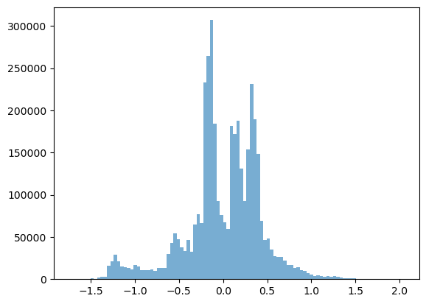
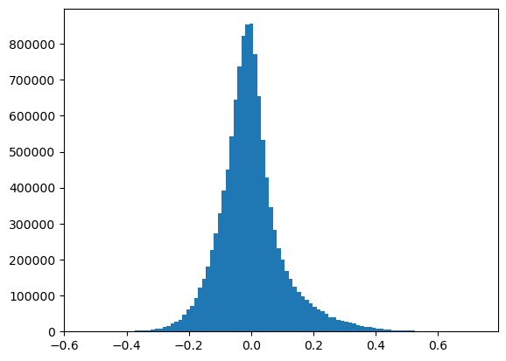
Log-transformed data
DNA data vs RNA data

Slide 3
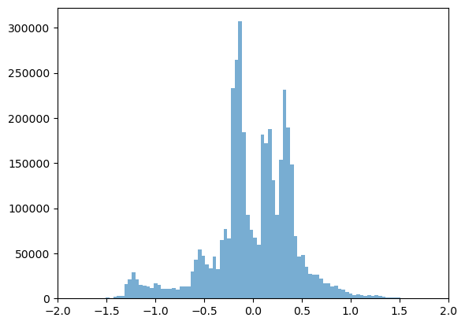
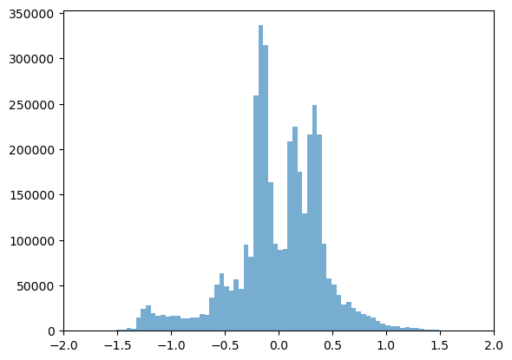

scRNA data (new source from copykat)
Pre-processing
Freeman–Tukey transformation (for expression data to stabilize variance)
$X=log⁡(\sqrt{X}+\sqrt{X+1})$
Polynomial dynamic linear modeling (DLM) (smooth the outliers)
Try to use it for scDNA data

Slide 4
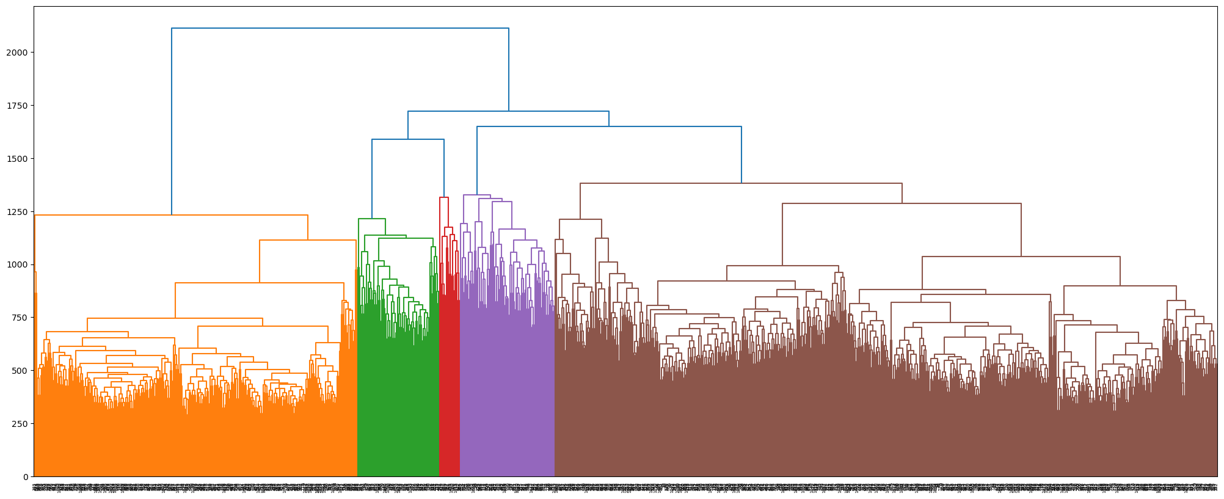
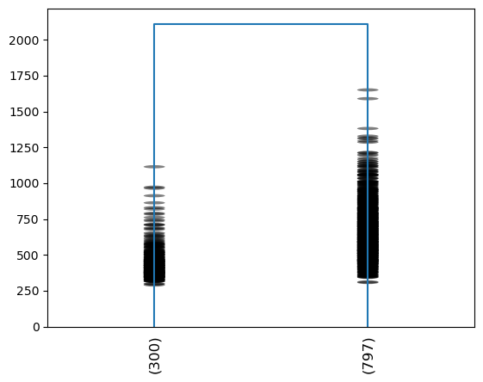
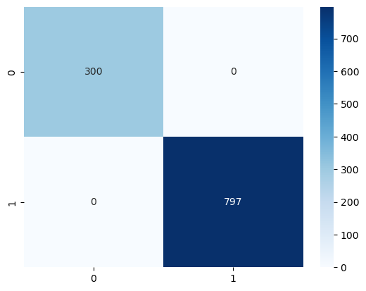
scRNA data (new source from copykat)
Using exactly the same method from 10X to generate the tree
pair-wise L1-norm distance
hierarchical clustering using the complete linkage method
Can match the prediction of diploid/aneuploid cells provided by the paper

Slide 5
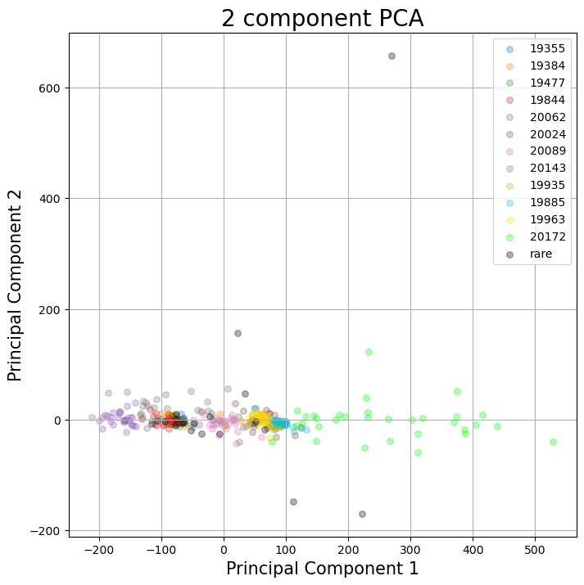
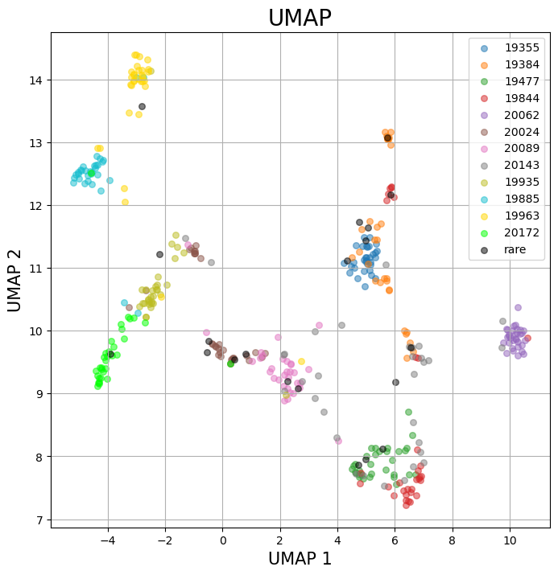
scDNA data

Slide 6
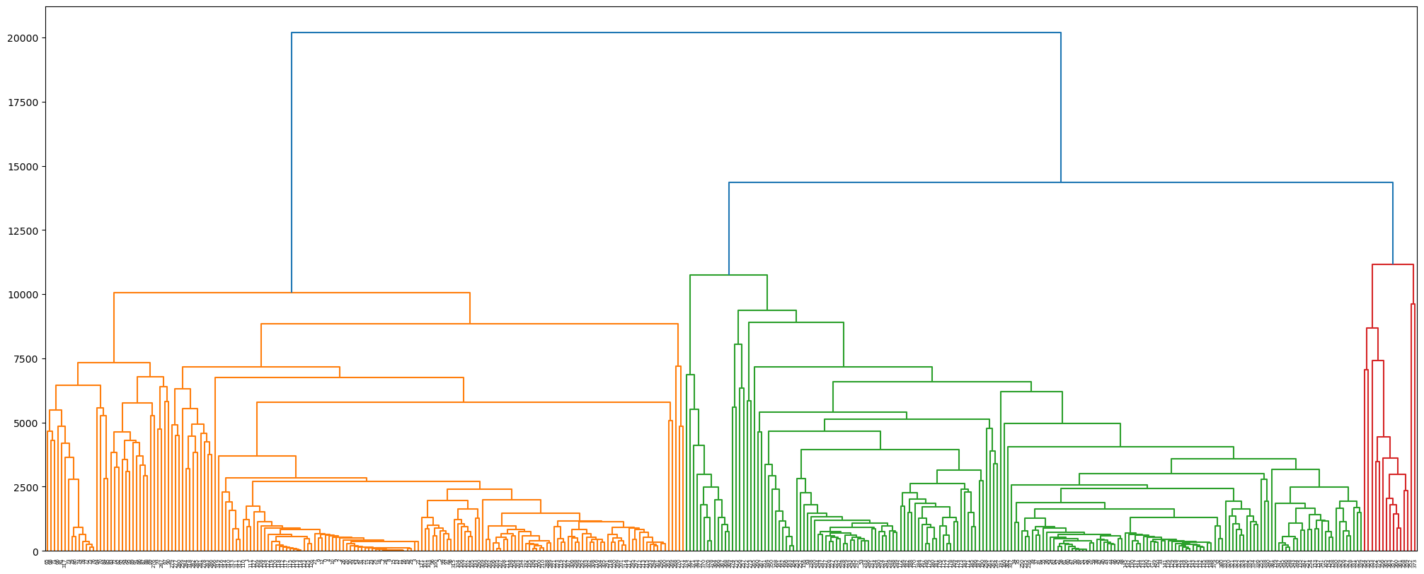
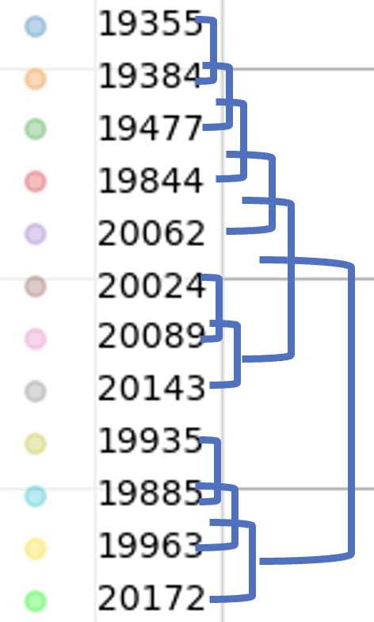
scDNA data
It’s possible that we didn’t get enough information.
Predicted and provided labels are also not matched
predicted
provided

