Slide 1

Rotation Summary
Ruiqi Lyu
Dec 16

Slide 2
Paired scDNA/scRNA data 20 cells from 2 groups

Slide 3
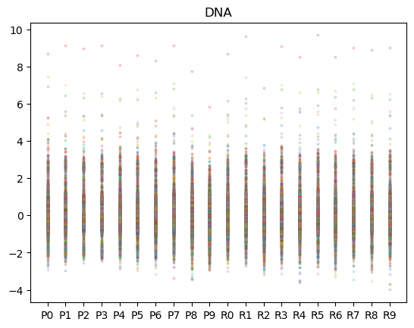
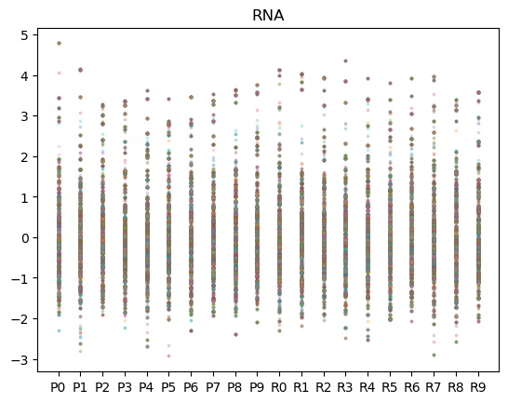

Correlation Analysis
Input: paired scDNA CNV and scRNA CNV (inferred by CopyKat).
Preprocess:
Log-transform DNA data (clearer pattern than exp(RNA))
Normalization: for each cell: $Z= \frac{X−\overline{X}}{S}$

Slide 4
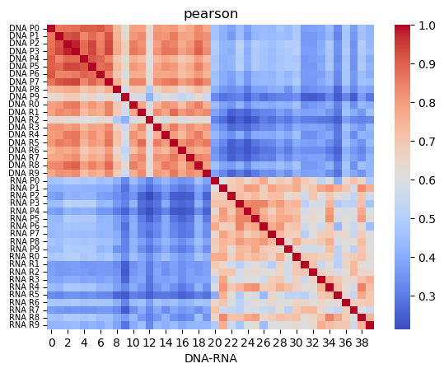
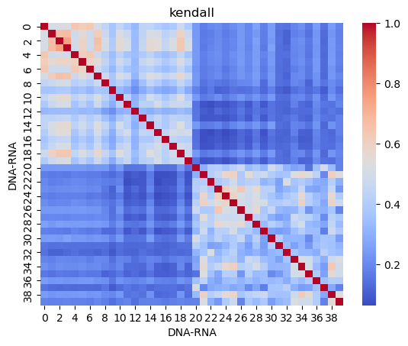
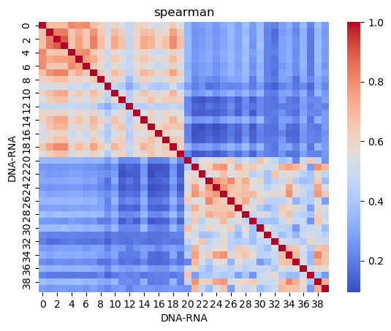
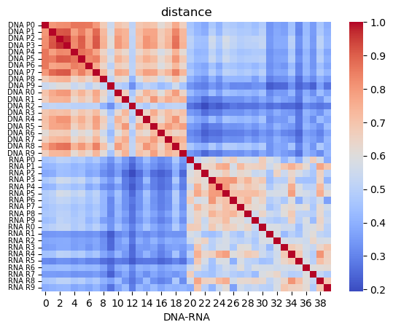
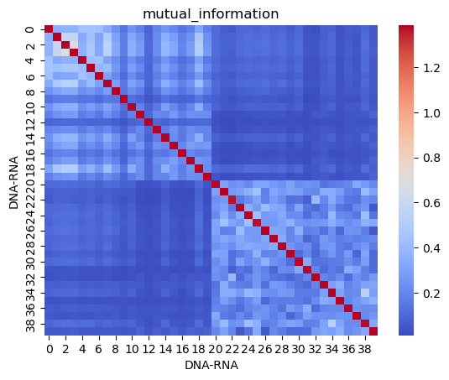
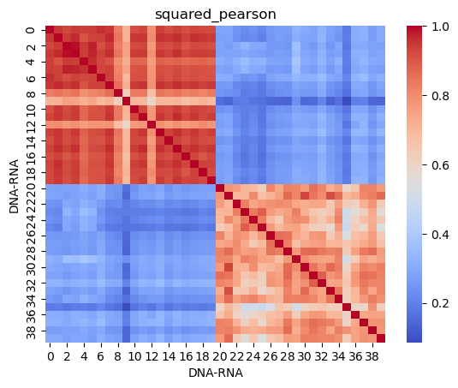
Correlation Analysis
Test different types of correlation.

Slide 5
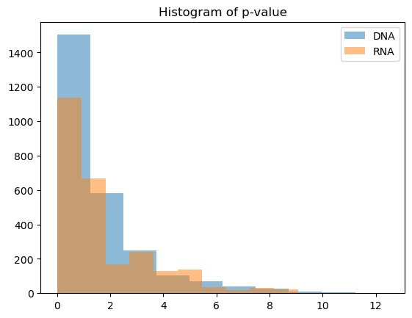
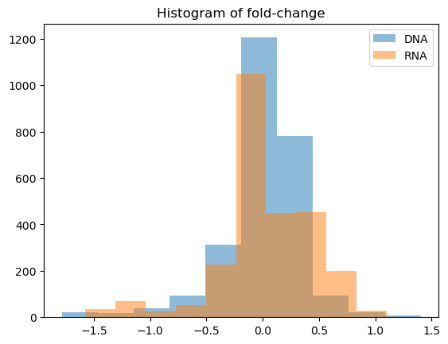
Feature selection
Reason:
Redundant noisy features
Linkage disequilibrium - collinearity
2593 genes for 2 classes*10 cells
Differential analysis
Select only 1 gene in the 5,000,000 bp gene window (like clumping)

Slide 6
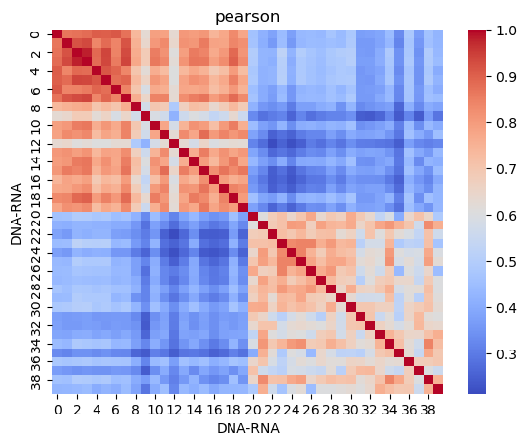
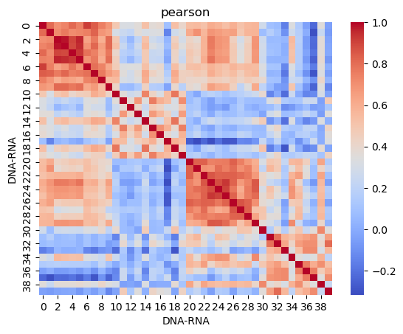
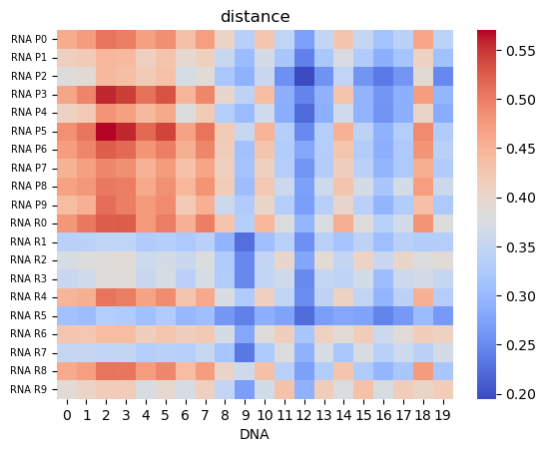
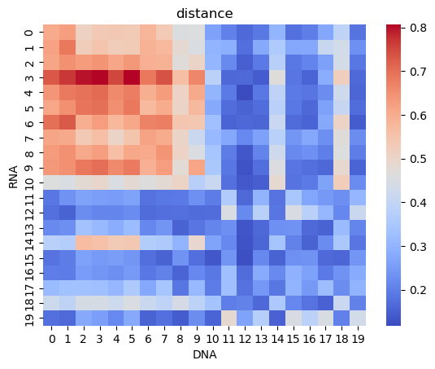
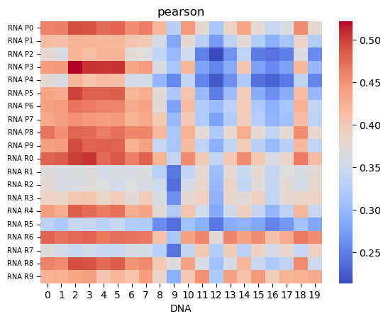
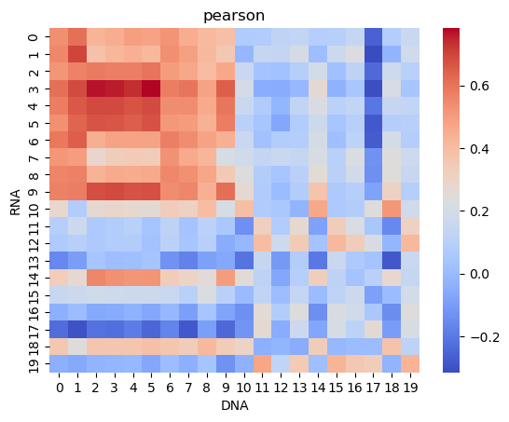
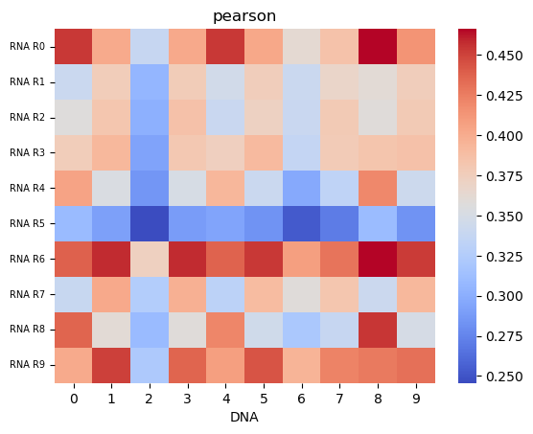
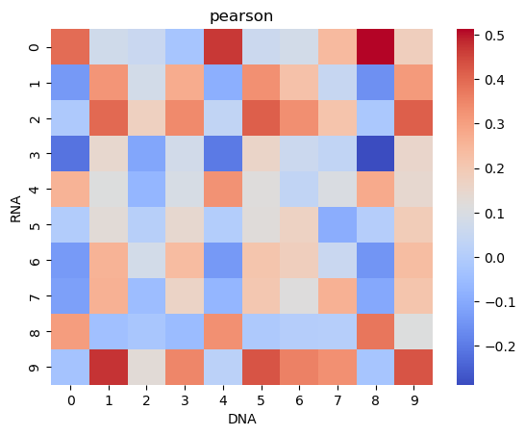
Feature selection
raw
214 w/o window 0.005
raw
214 w/o window 0.005

Slide 7
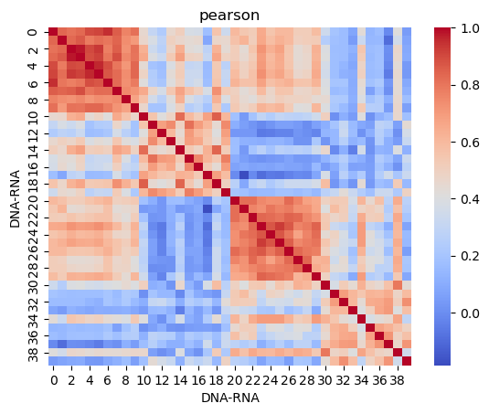
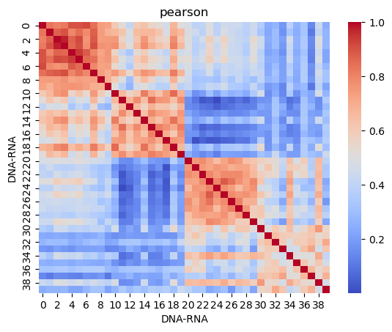
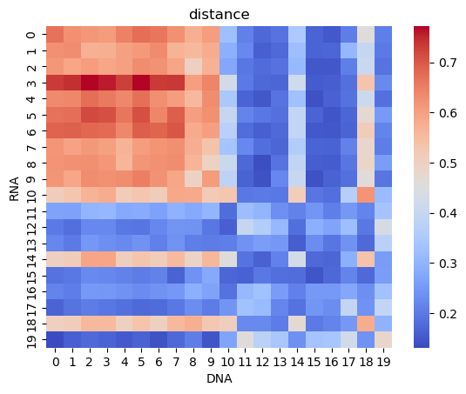
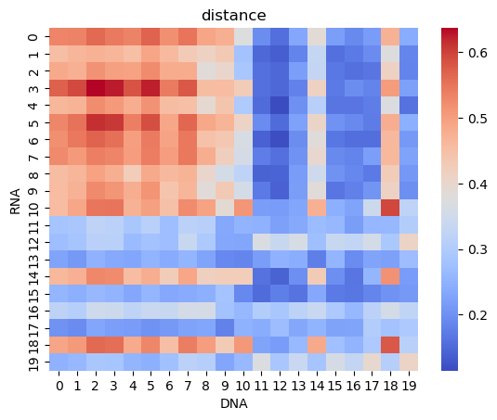
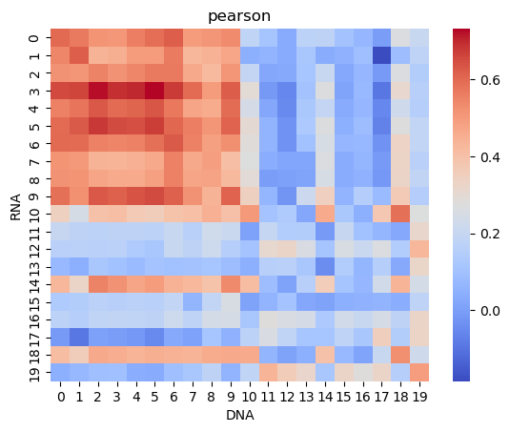
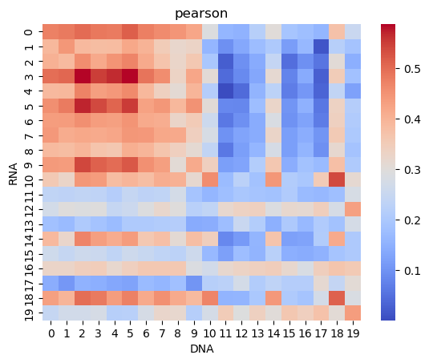
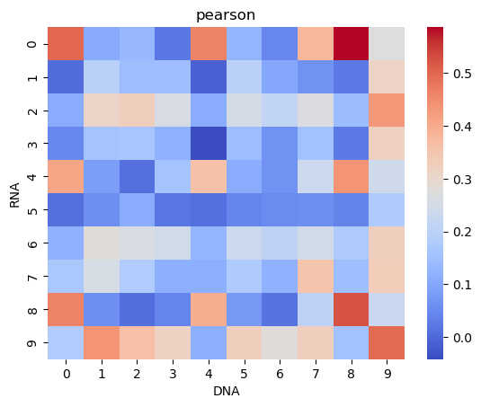
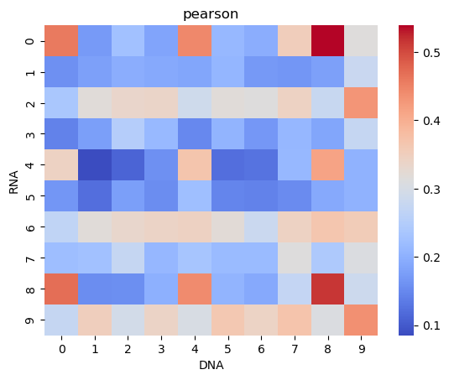
Feature selection
103 w/ window 0.01
230 w/ window 0.05
103 w/ window 0.01
230 w/ window 0.05

Slide 8
Previously used public data larger scale

Slide 9
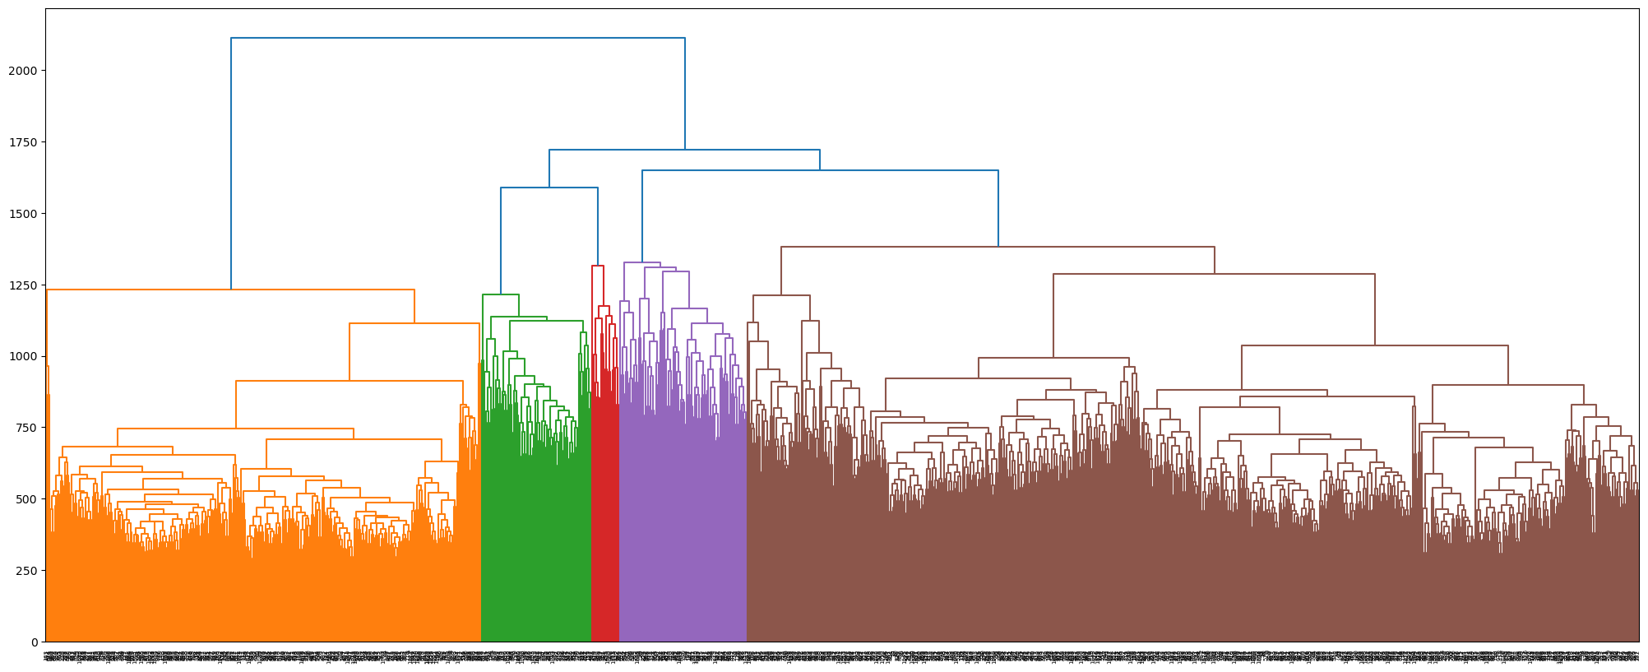
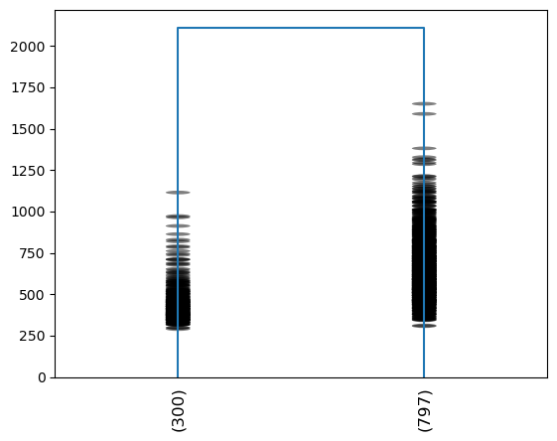
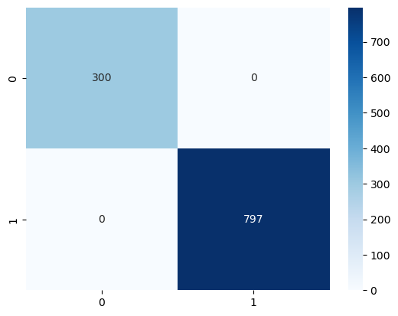
scRNA data (from copykat)
Using exactly the same method from 10X to generate the tree
pair-wise L1-norm distance
hierarchical clustering using the complete linkage method
Can match the prediction of diploid/aneuploid cells provided by the paper

Slide 10
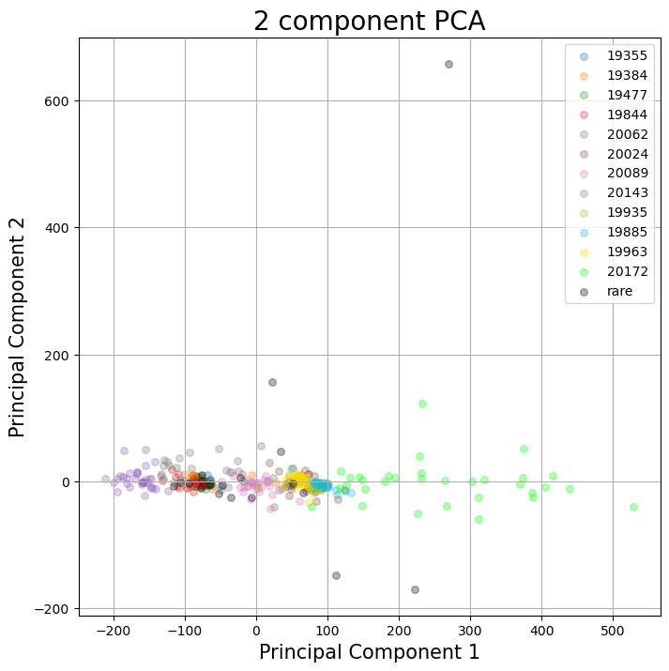
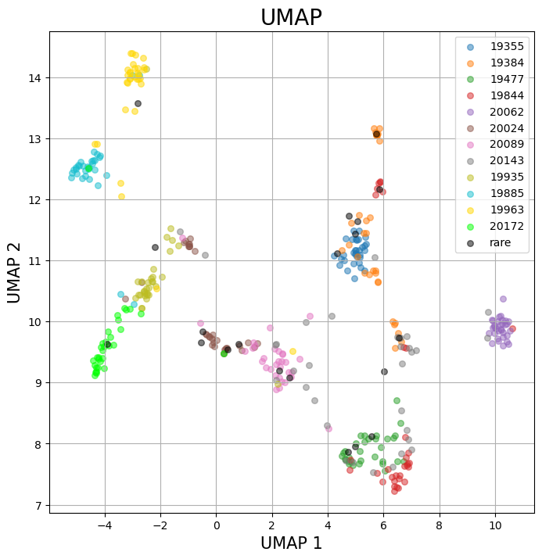
scDNA data

Slide 11
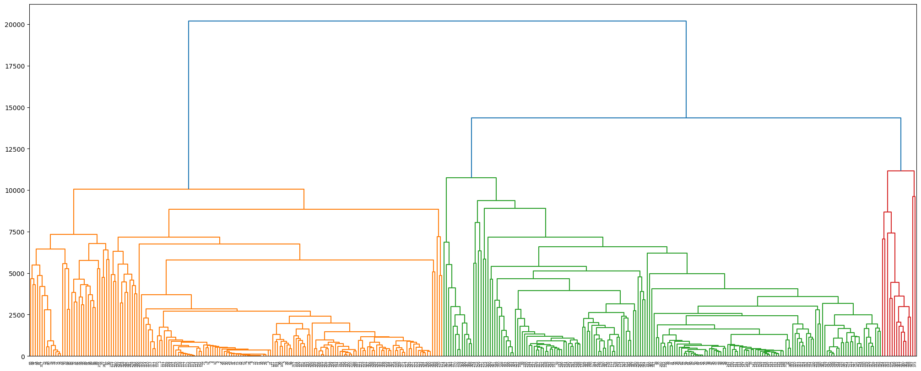
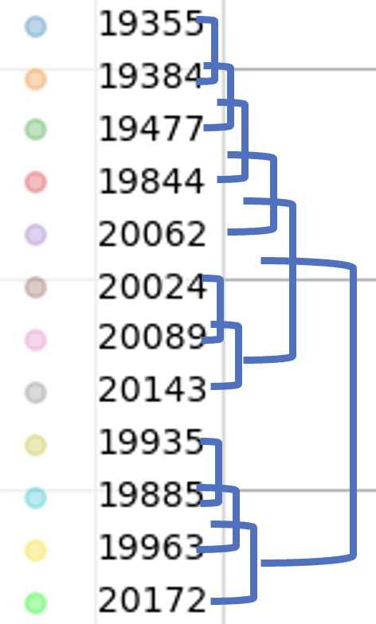
scDNA data
predicted
provided

Slide 12
Thank you! ☺

