Slide 1
Medical Appointment No Shows
Outreach prioritization, threshold economics, and responsible healthcare AI

Slide 2
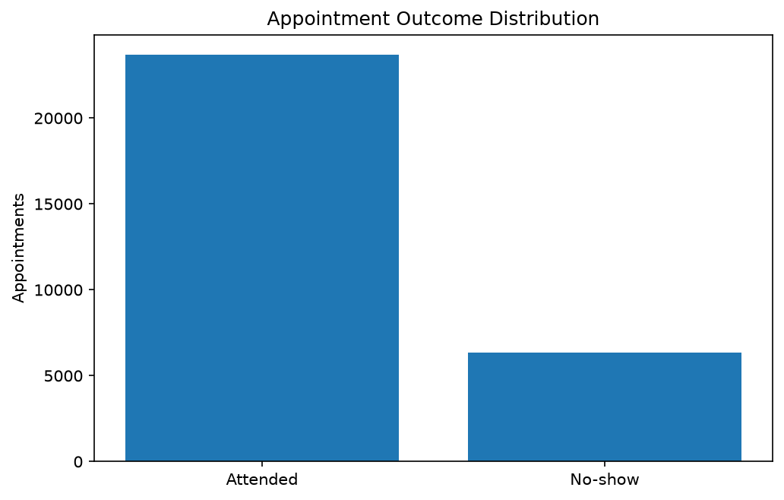
2. Business Problem
Support attendance without restricting access
Missed appointments waste capacity and can delay care.
Blanket outreach consumes staff time.
Prioritize supportive reminders and care navigation.

Slide 3
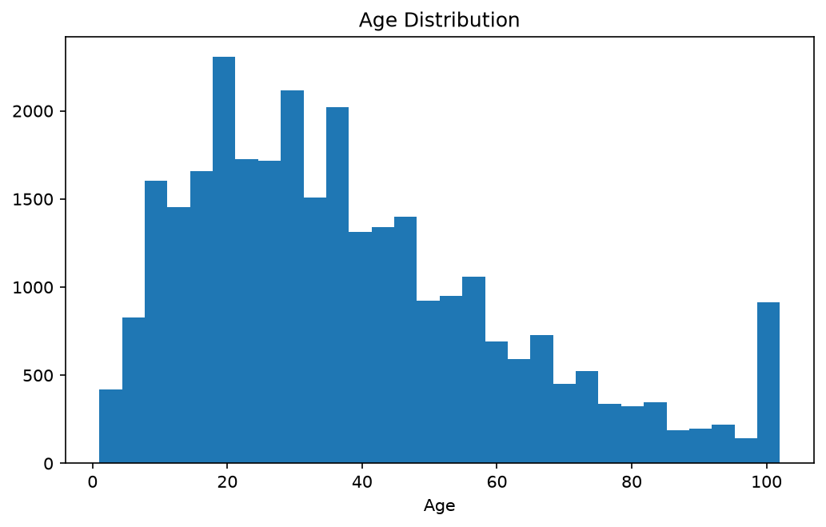
3. Dataset
Kaggle Medical Appointment No Shows
110,527 appointment records
14 source columns
Approximately 20.2% no-shows
Brazilian context and limited time coverage

Slide 4
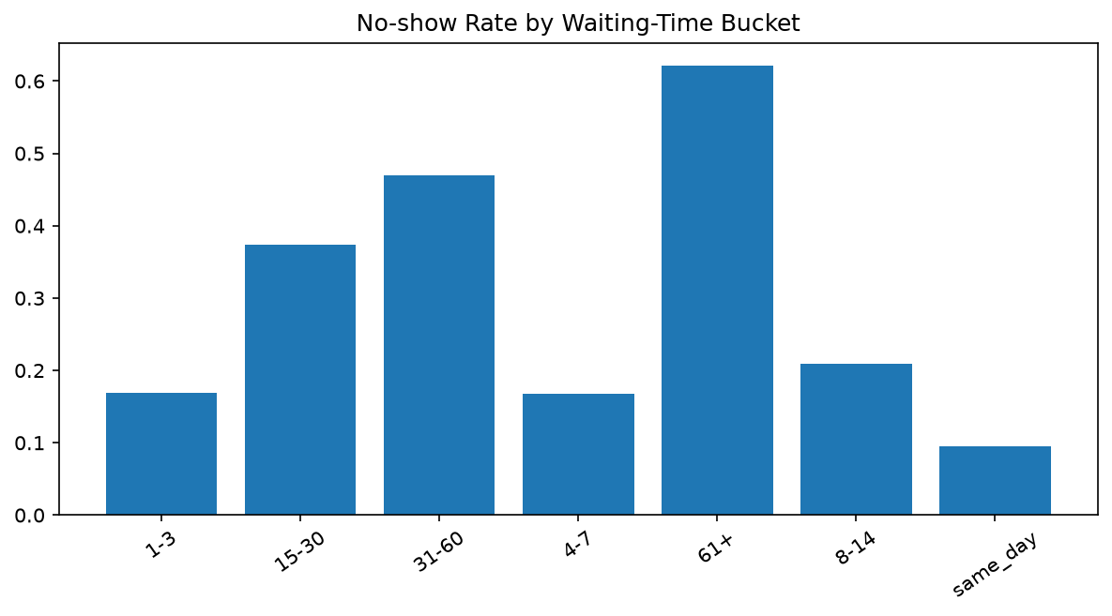
4. Exploratory Analysis
Lead time, age, location, and policy context
Longer waits are associated with risk.
Class imbalance makes accuracy misleading.
SMS status is observational.
Identifiers and invalid records require controls.

Slide 5
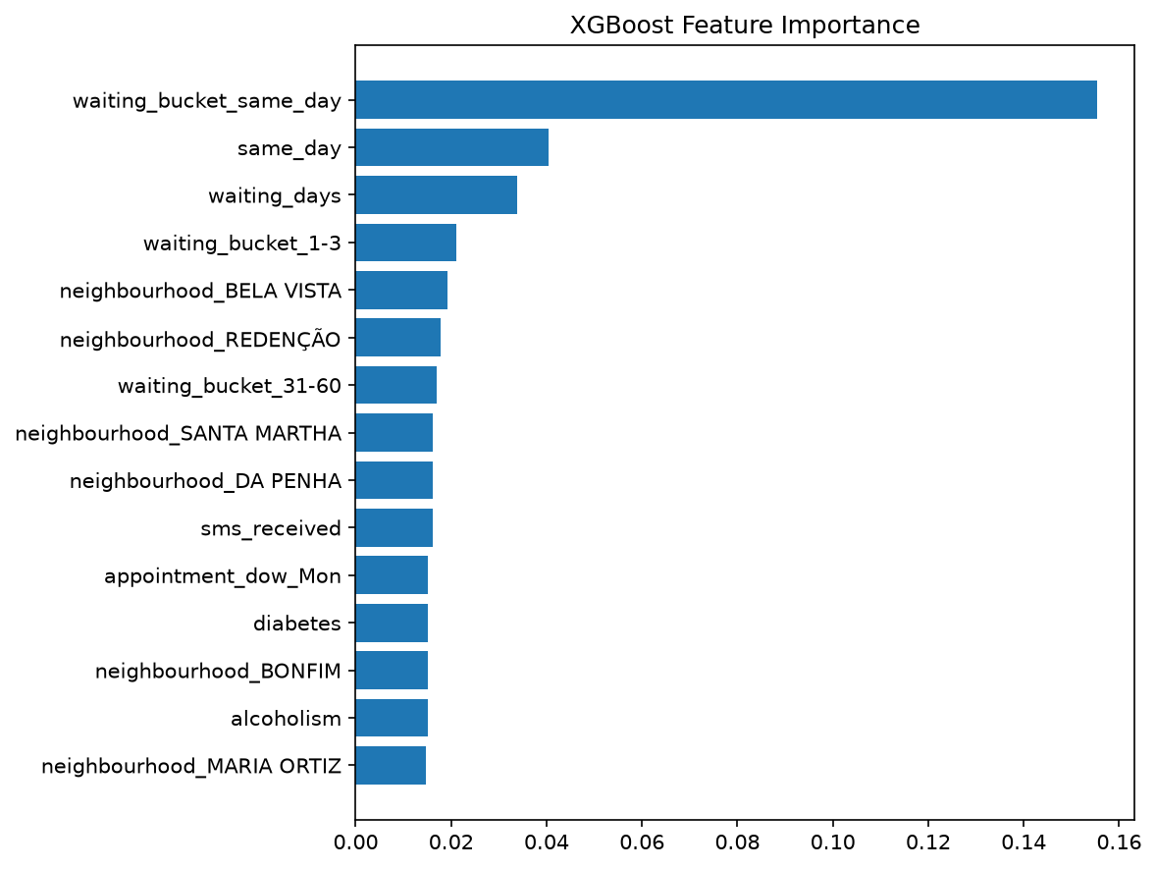
5. Modeling
Transparent baseline versus nonlinear challenger
Class-weighted Logistic Regression
Regularized XGBoost
Chronological 70/15/15 split
Validation-only threshold selection

Slide 6
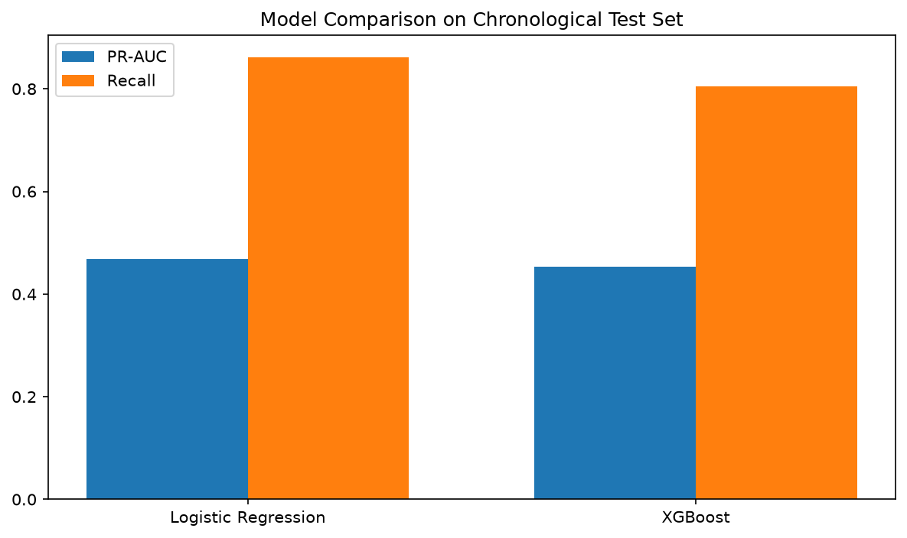
6. Results
Deterministic demonstration benchmark
Logistic test PR-AUC: 0.468
XGBoost test PR-AUC: 0.454
Validation-selected model: XGBoost
Official Kaggle rerun required

Slide 7
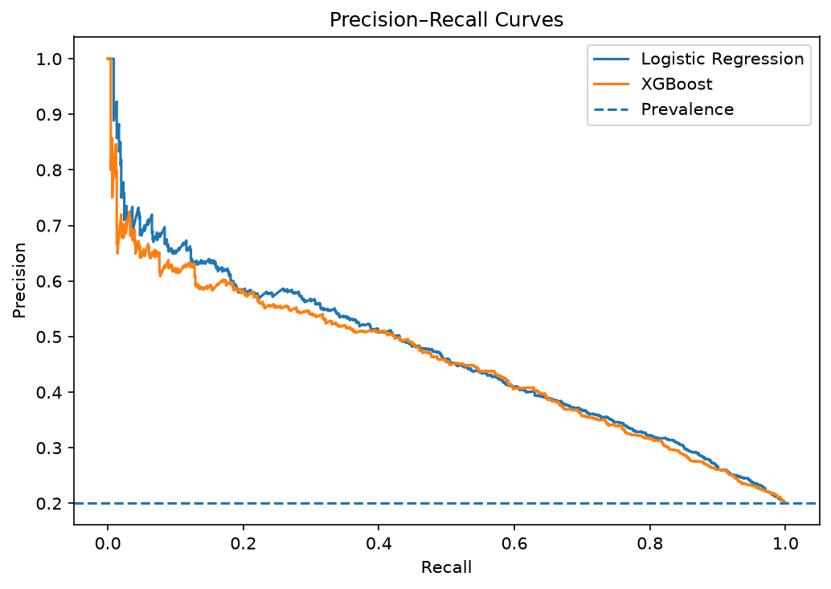
7. Key Insights
Ranking and operating policy are separate
High recall can require substantial outreach.
XGBoost reduces false alerts at its threshold.
Logistic ranks better on the demo test set.
Keep champion and challenger models.

Slide 8
8. Recommendations
Use patient-centered risk bands
Low risk: standard reminders
Medium risk: automated options
High risk: human support or rescheduling
Never deny care based on a score

Slide 9
9. Future Work
Move to institutional decision support
Time-safe attendance history
Appointment, provider, travel, and language features
Calibration and temporal cross-validation
Randomized intervention evaluation

Slide 10
10. Conclusion
Responsible no-show prediction combines leakage-aware modeling, transparent outreach thresholds, patient-centered interventions, equity monitoring, and human oversight.

