Slide 1
Phase 2c 实测生育期降雨诊断
目标：使用实测 planting_date -> harvest_date 替代 Phase 2b fallback。
范围：只诊断真实试验年份，不训练 PPO，不修改 reward。

Slide 2
背景
Phase 2b 的 planting + 150 days 是临时窗口。
Phase 2c 使用实测播种、吐丝、成熟、收获日期。
本阶段判断真实试验年份是否足以代表降雨梯度。

Slide 3
输入数据
实测物候：observed_phenology_dates.csv
天气：weather_clean_qc/*_weather_cleaned_qc.csv
对比：selected_years_qc.csv 与 Phase 2b 报告。

Slide 4
方法
完整窗口：planting_date -> harvest_date。
成熟窗口：planting_date -> mature_date。
差异：harvest_window_rain - mature_window_rain。

Slide 5
日期 QC 结果
station_code | year | harvest_window_days | phenology_qc_flag
FQA | 2008 | 103 | pass
FQA | 2010 | 109 | pass
HLA | 2007 | 152 | pass
HLA | 2011 | 142 | pass
HLA | 2009 | 154 | pass
LCA | 2010 | 114 | pass
LCA | 2011 | 105 | pass
LCA | 2008 | 106 | pass
LCA | 2009 | 102 | pass
SYA | 2014 | 148 | pass
SYA | 2015 | 158 | pass
SYA | 2012 | 132 | pass

Slide 6
天气 RAIN QC 结果
station_code | year | weather_days_expected | weather_days_available | rain_qc_flag
FQA | 2008 | 103 | 103 | pass
FQA | 2010 | 109 | 109 | pass
HLA | 2007 | 152 | 152 | pass
HLA | 2011 | 142 | 142 | pass
HLA | 2009 | 154 | 154 | pass
LCA | 2010 | 114 | 114 | pass
LCA | 2011 | 105 | 105 | pass
LCA | 2008 | 106 | 106 | pass
LCA | 2009 | 102 | 102 | pass
SYA | 2014 | 148 | 148 | pass
SYA | 2015 | 158 | 158 | pass
SYA | 2012 | 132 | 132 | pass

Slide 7
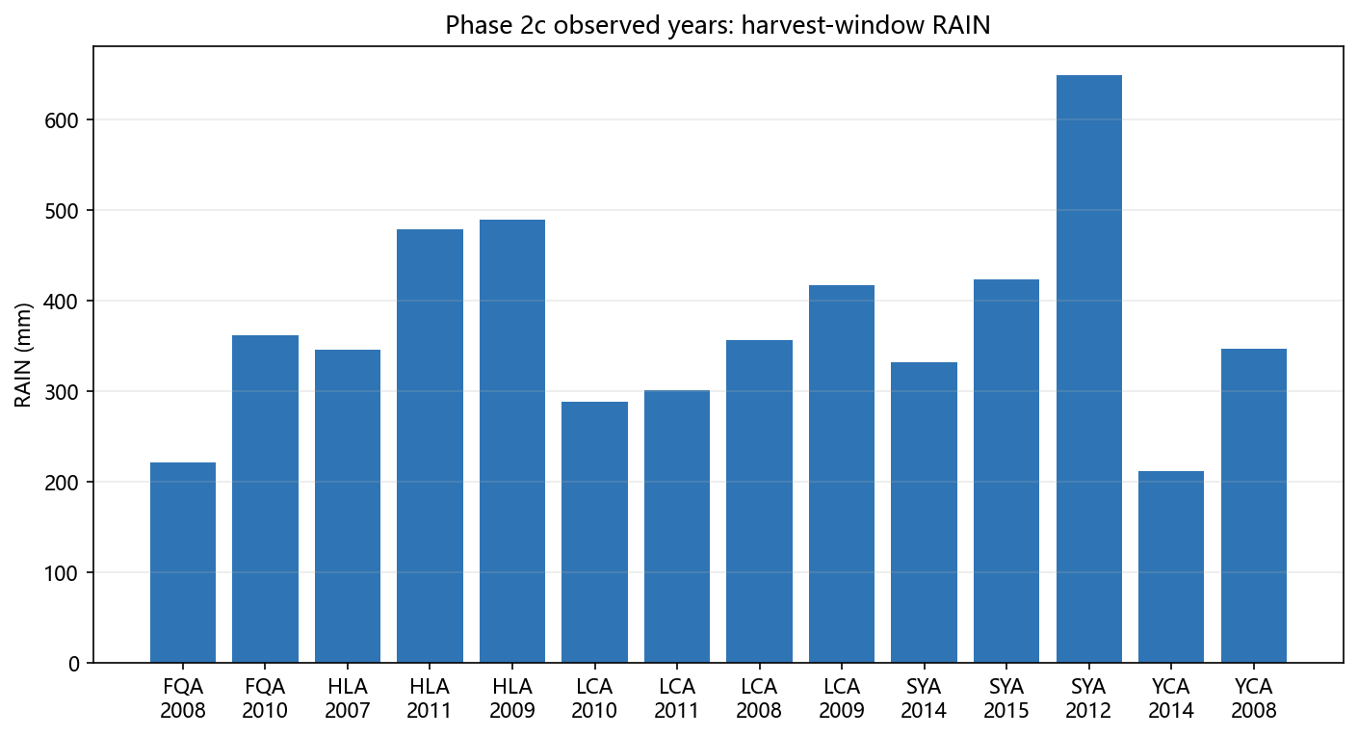
Harvest-window RAIN 对比

Slide 8
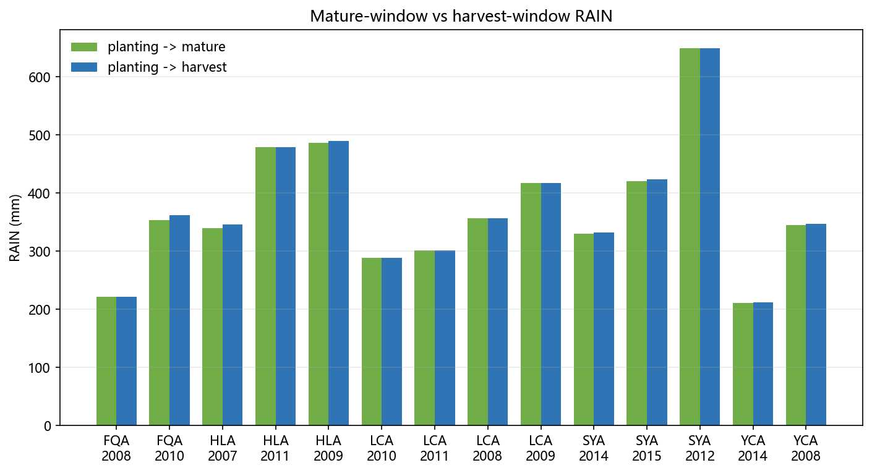
Mature-window 与 Harvest-window 对比

Slide 9
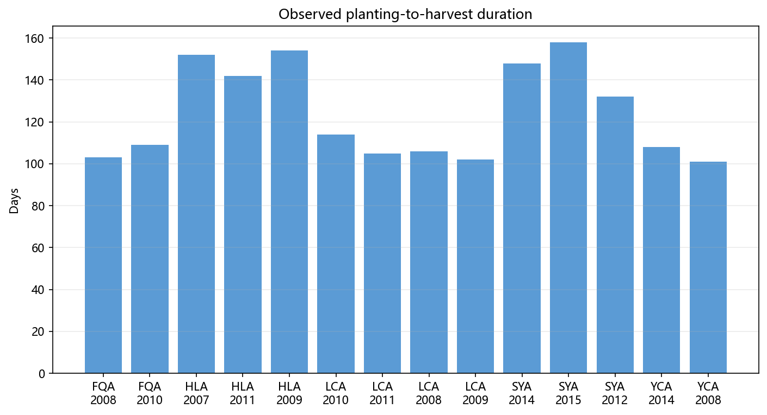
生育期长度

Slide 10
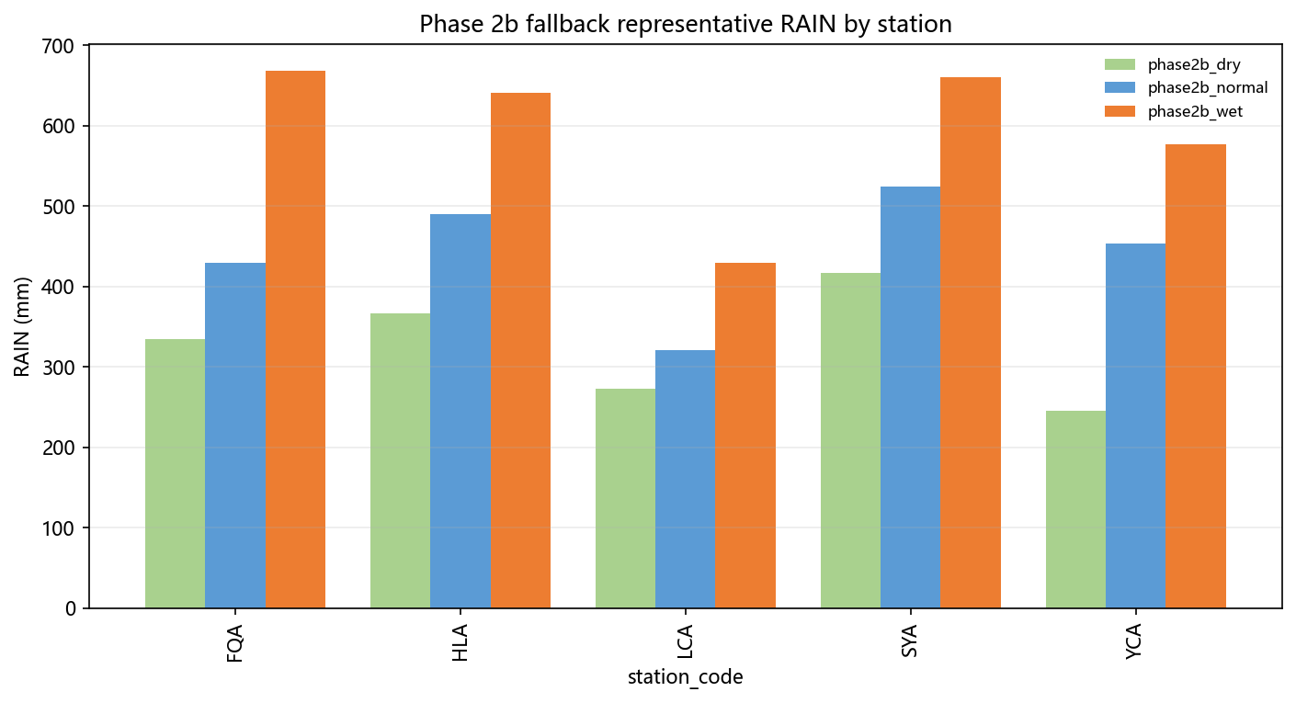
Phase 2b 代表年份对比

Slide 11
真实年份降雨排序
station_code | year | harvest_window_rain_mm | observed_rain_label | can_use_relative_low_mid_high
FQA | 2008 | 221.8 | observed_lower_rain_year | limited
FQA | 2010 | 362.3 | observed_higher_rain_year | limited
HLA | 2007 | 345.6 | observed_low_rain_year | yes
HLA | 2011 | 479.2 | observed_mid_rain_year | yes
HLA | 2009 | 489.5 | observed_high_rain_year | yes
LCA | 2010 | 288.5 | observed_low_rain_year | yes
LCA | 2011 | 300.9 | observed_mid_rain_year | yes
LCA | 2008 | 357.1 | observed_intermediate_rain_year_3 | yes
LCA | 2009 | 417.1 | observed_high_rain_year | yes
SYA | 2014 | 331.8 | observed_low_rain_year | yes
SYA | 2015 | 424.1 | observed_mid_rain_year | yes
SYA | 2012 | 649.4 | observed_high_rain_year | yes

Slide 12
是否足以代表低雨/中雨/高雨
至少 3 个真实年份且降雨跨度明显的站点，可作为 observed years 内部相对候选。
只有 2 年记录的站点不能强行命名为中雨年。
这些候选不代表 2000-2022 长期气候分位数。

Slide 13
推荐下一步 smoke test 年份
station_code | year | observed_rain_label | recommended_for_smoke_test
FQA | 2008 | observed_lower_rain_year | yes
FQA | 2010 | observed_higher_rain_year | yes
HLA | 2007 | observed_low_rain_year | yes
HLA | 2011 | observed_mid_rain_year | yes
HLA | 2009 | observed_high_rain_year | yes
LCA | 2010 | observed_low_rain_year | yes
LCA | 2011 | observed_mid_rain_year | yes
LCA | 2008 | observed_intermediate_rain_year_3 | yes
LCA | 2009 | observed_high_rain_year | yes
SYA | 2014 | observed_low_rain_year | yes
SYA | 2015 | observed_mid_rain_year | yes
SYA | 2012 | observed_high_rain_year | yes

Slide 14
后续情景方案建议
observed_year_smoke_test：NullAgent 与固定低/中/高氮策略。
historical_weather_substitution_scenario：固定真实试验管理，替换历史代表年天气。
rainfall_scaling_sensitivity_scenario：RAIN x 0.6/0.8/1.0/1.2/1.4。

Slide 15
文件输出和 GitHub 备份说明
本阶段文件已本地生成。
是否提交/推送 GitHub 需要用户确认，当前未自动 push。
关键文件位于 data/、docs/、scripts/、Leave_One_experiments/year_classification/ 和 figures/。

