Slide 1
006_16 all-year offline schedule search
Selected station-years: 55
Water-stress years: 20
Irrigation-responsive years: 6
No PPO training; no rainfall scaling; no my_data modification.

Slide 2
Why this stage
006_15 showed that all-year weather increases swfac samples compared with observed-year-only.
This stage builds expert schedules first, then trains imitation priors.
The goal is an interpretable prior for later constrained PPO, not a final RL result.

Slide 3
Schedule search design
N events: DAP 1, 30, 60; total N cap 250 kg/ha.
Irrigation events: DAP 20, 35, 50, 65, 80, 95 for stress/response years; simplified events for low-response years.
Expert schedules keep profit, yield, Pareto-balanced, low-input, and irrigation-positive categories.

Slide 4
Key counts
Schedule evaluations: 2180
Expert schedules retained: 217
Expert schedules with irrigation > 0: 124
Imitation rows: 25298

Slide 5
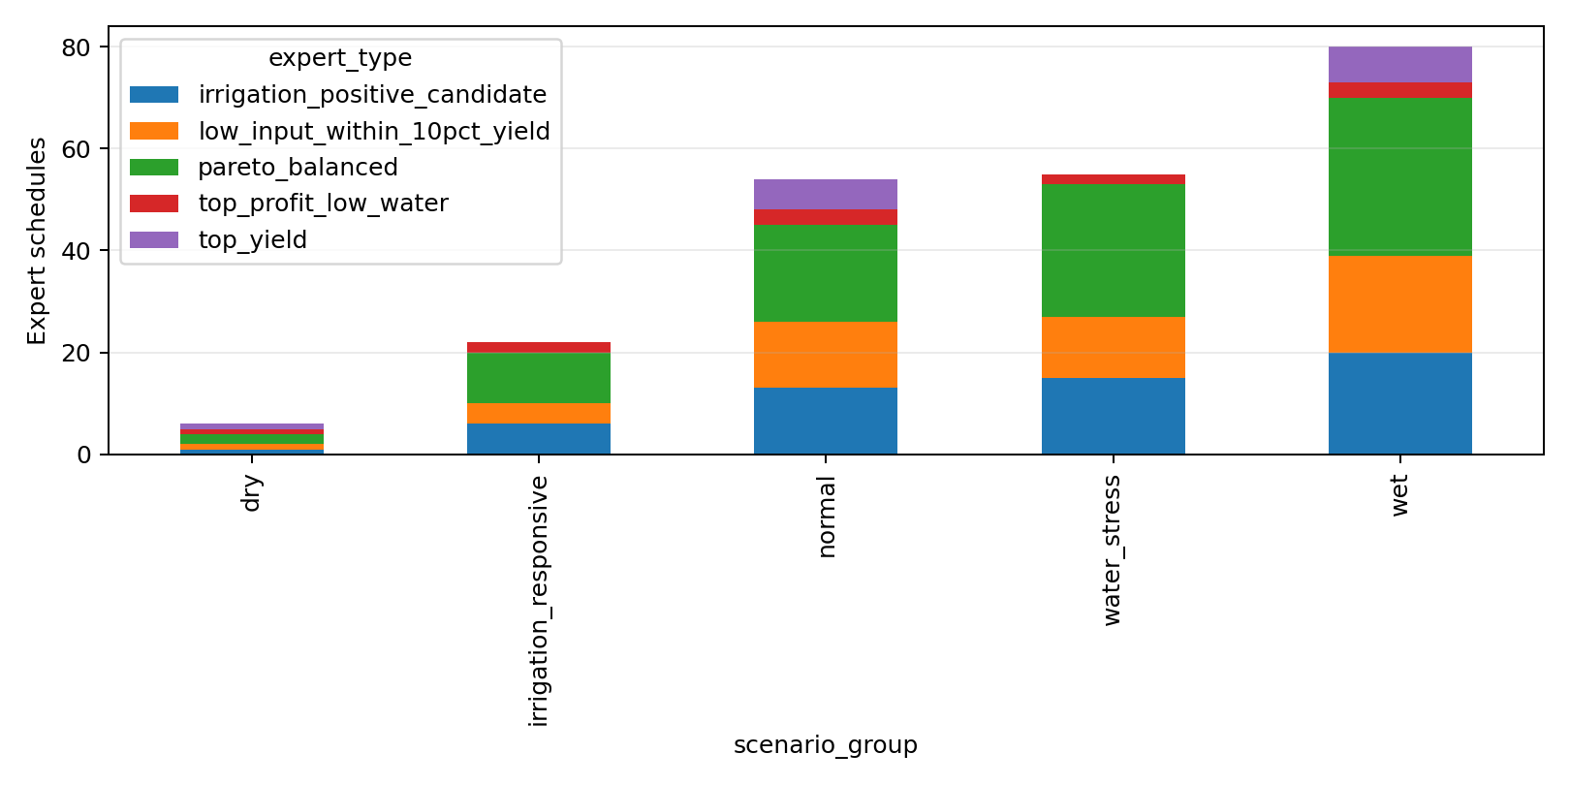
Expert library coverage

Slide 6
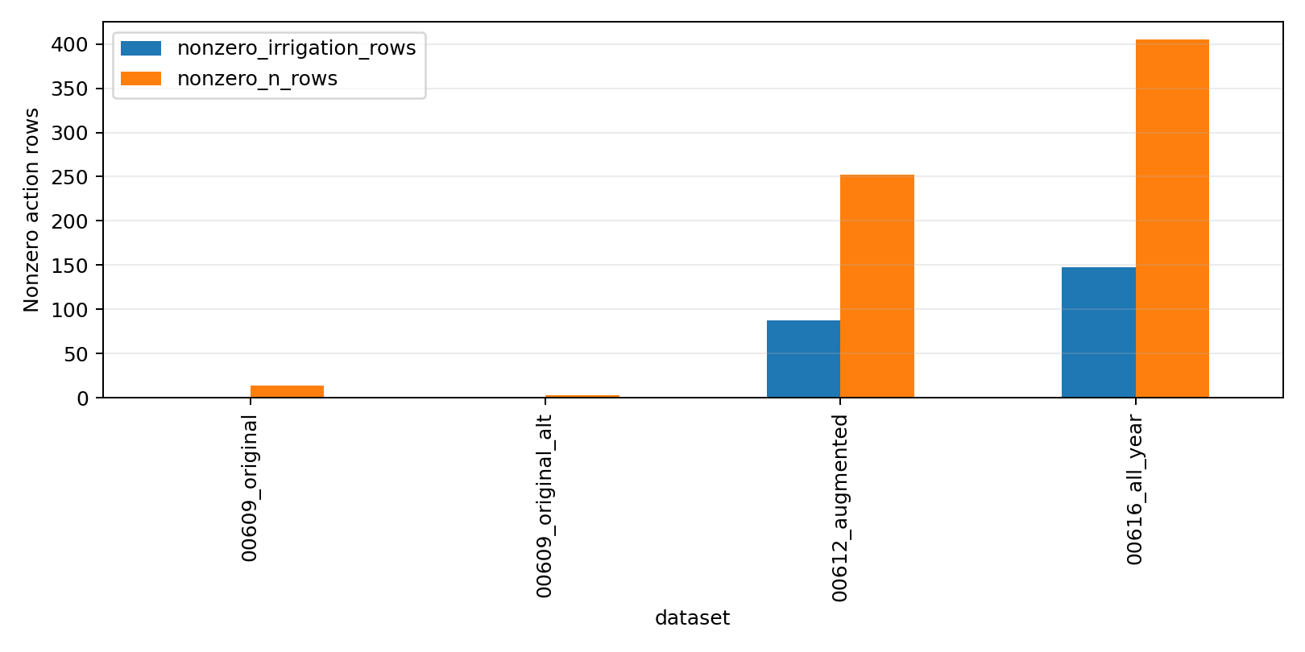
Action distribution

Slide 7
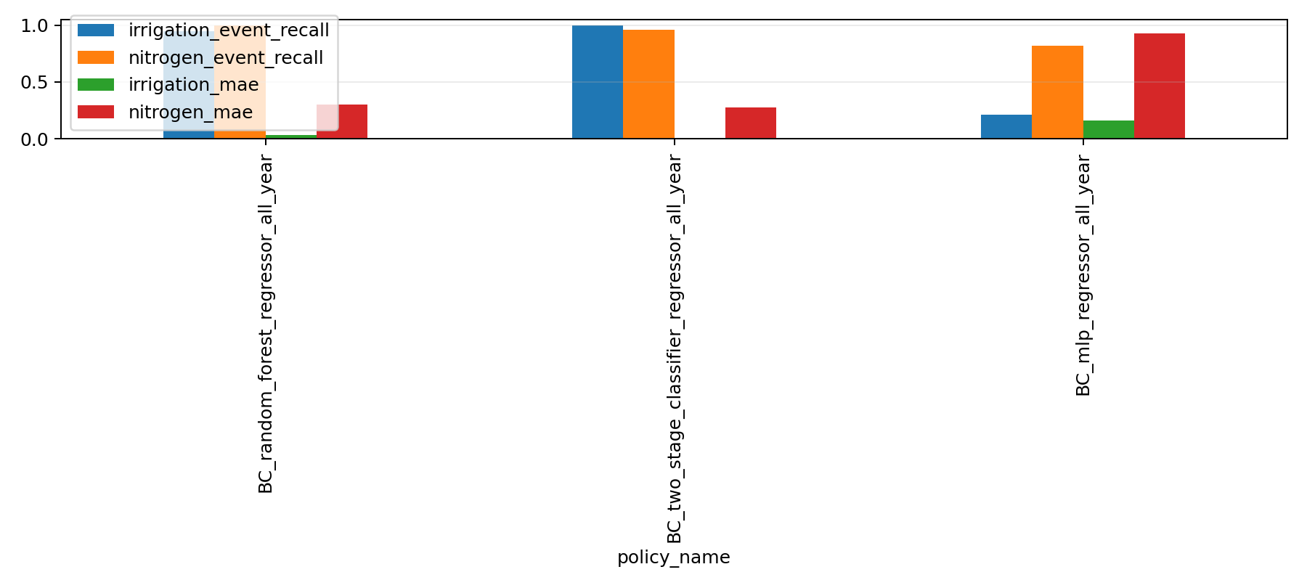
BC supervised metrics

Slide 8
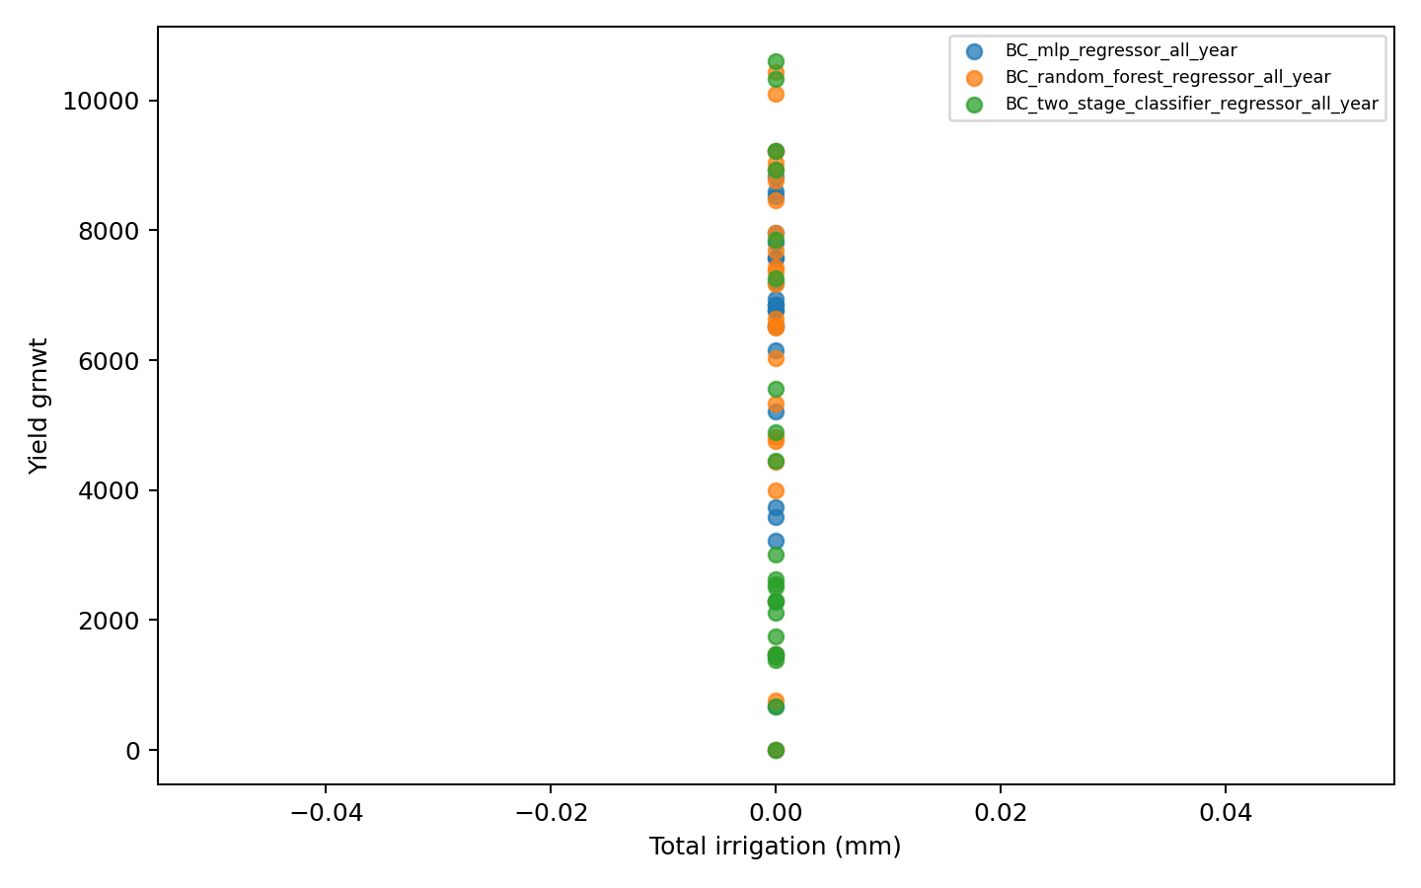
Policy yield vs input

Slide 9
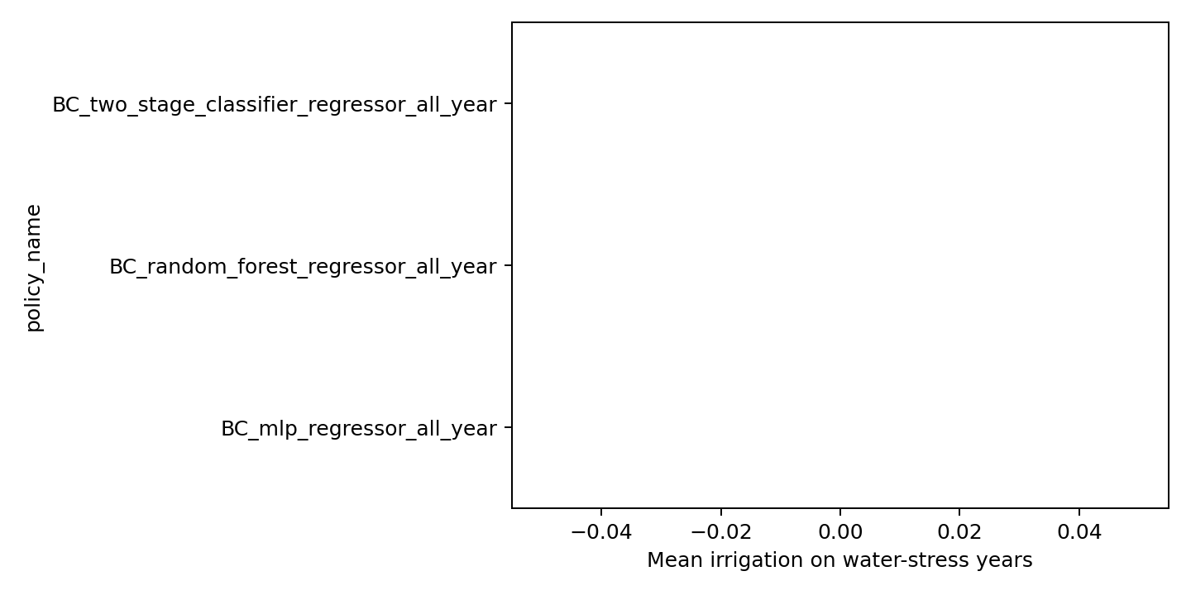
Water-stress policy comparison

Slide 10
Recommendation
policy_name: BC_random_forest_regressor_all_year
recommended: False
mean_irrigation: 0.0
mean_n: 128.70979864418192
mean_yield_loss_vs_best_expert: -0.4189502526421728
water_stress_nonzero_irrigation_rate: 0.0
supervised_irrigation_event_recall: 0.9508196721311476
reason: does_not_pass_basic_all_year_prior_gate

