Slide 1
007_01 Direct PPO Cost and Cap Sensitivity
Goal: test whether changing only water_cost, nitrogen_cost, season irrigation cap, and season N cap can avoid cap saturation.
No RF, imitation learning, offline schedule search, expert replay, rainfall scaling, reward redesign, or action-design changes were used.
Train/eval years, seed, PPO hyperparameters, action scaling, and direct PPO structure are inherited from 006_17.

Slide 2
Scenario Rollup
scenario | water_cost | nitrogen_cost | season_irrigation_cap | season_n_cap | n_cases | ok_cases | cap_saturated_cases | cap_saturation_rate | recommended_cases | recommended_rate | mean_irrigation | mean_n | mean_final_grnwt | mean_final_topwt | mean_profit_simple | min_yield_fraction_vs_baseline | mean_yield_fraction_vs_baseline
C_cap_low | 0.1 | 0.25 | 100.0 | 180.0 | 45 | 45 | 45 | 1.0 | 0 | 0.0 | 100.0 | 180.0 | 7833.742 | 15962.215 | 23.337 | 0.573 | 0.96
A_baseline | 0.1 | 0.25 | 160.0 | 250.0 | 45 | 45 | 45 | 1.0 | 0 | 0.0 | 160.0 | 250.0 | 8189.76 | 16416.548 | 3.398 | 1.0 | 1.0
D_cost_high_cap_low | 0.3 | 0.5 | 100.0 | 180.0 | 45 | 45 | 45 | 1.0 | 0 | 0.0 | 100.0 | 180.0 | 7833.503 | 15962.052 | -41.665 | 0.573 | 0.96
B_cost_high | 0.3 | 0.5 | 160.0 | 250.0 | 45 | 45 | 45 | 1.0 | 0 | 0.0 | 160.0 | 250.0 | 8187.62 | 16412.123 | -91.124 | 0.99 | 1.0

Slide 3
Recommended Configuration
scenario | water_cost | nitrogen_cost | season_irrigation_cap | season_n_cap | n_cases | ok_cases | cap_saturated_cases | cap_saturation_rate | recommended_cases | recommended_rate | mean_irrigation | mean_n | mean_final_grnwt | mean_final_topwt | mean_profit_simple | min_yield_fraction_vs_baseline | mean_yield_fraction_vs_baseline | recommendation_status | recommendation_reason | advantages | limitations | suitable_as_main_thesis_result
C_cap_low | 0.1 | 0.25 | 100.0 | 180.0 | 45 | 45 | 45 | 1.0 | 0 | 0.0 | 100.0 | 180.0 | 7833.742 | 15962.215 | 23.337 | 0.573 | 0.96 | fallback_for_mentor_discussion_not_final | No scenario met the strict non-saturation criterion; this fallback keeps yield near baseline with lower input caps, but still saturates its cap. | Keeps TOPWT/GRNWT workflow comparable to 006_17, but still saturates caps. | No tested parameter set fully solved cap saturation; not suitable as final thesis result yet. | False

Slide 4
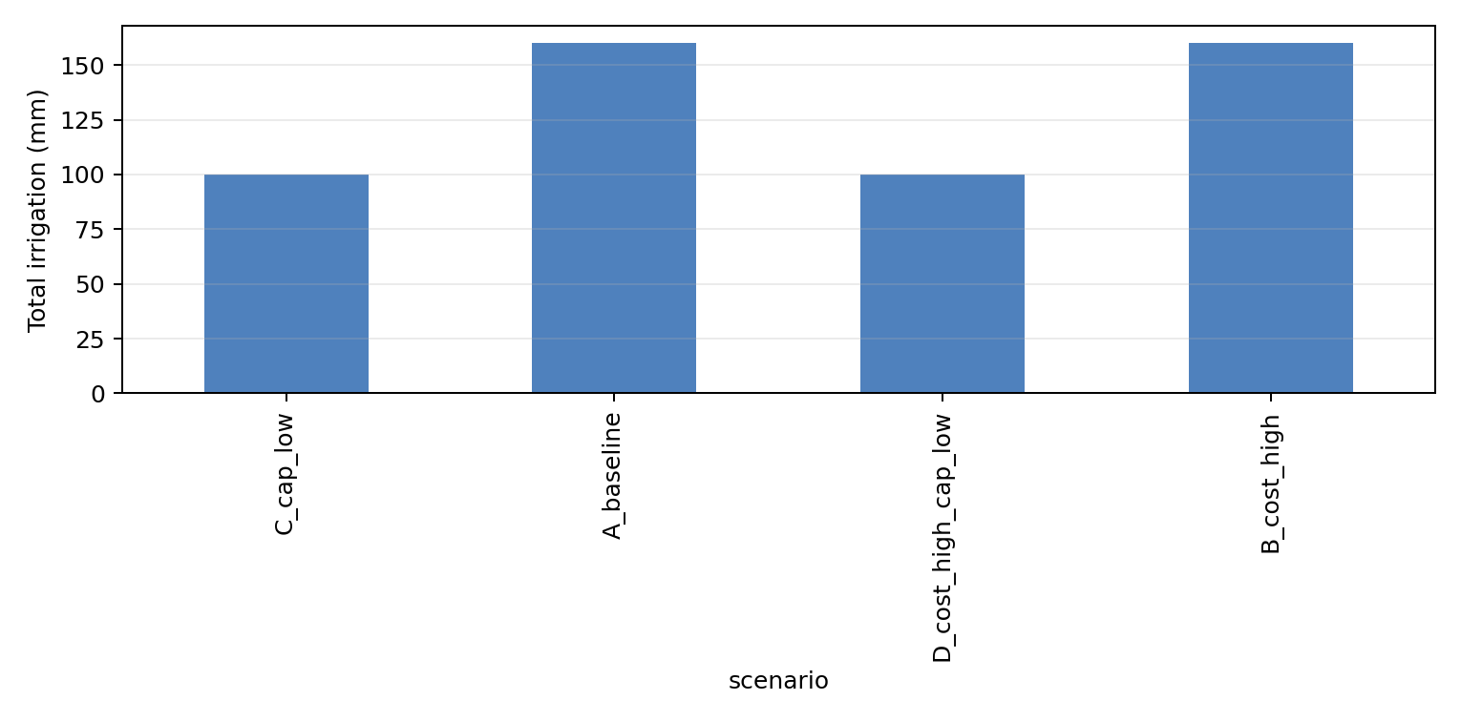
total irrigation comparison

Slide 5
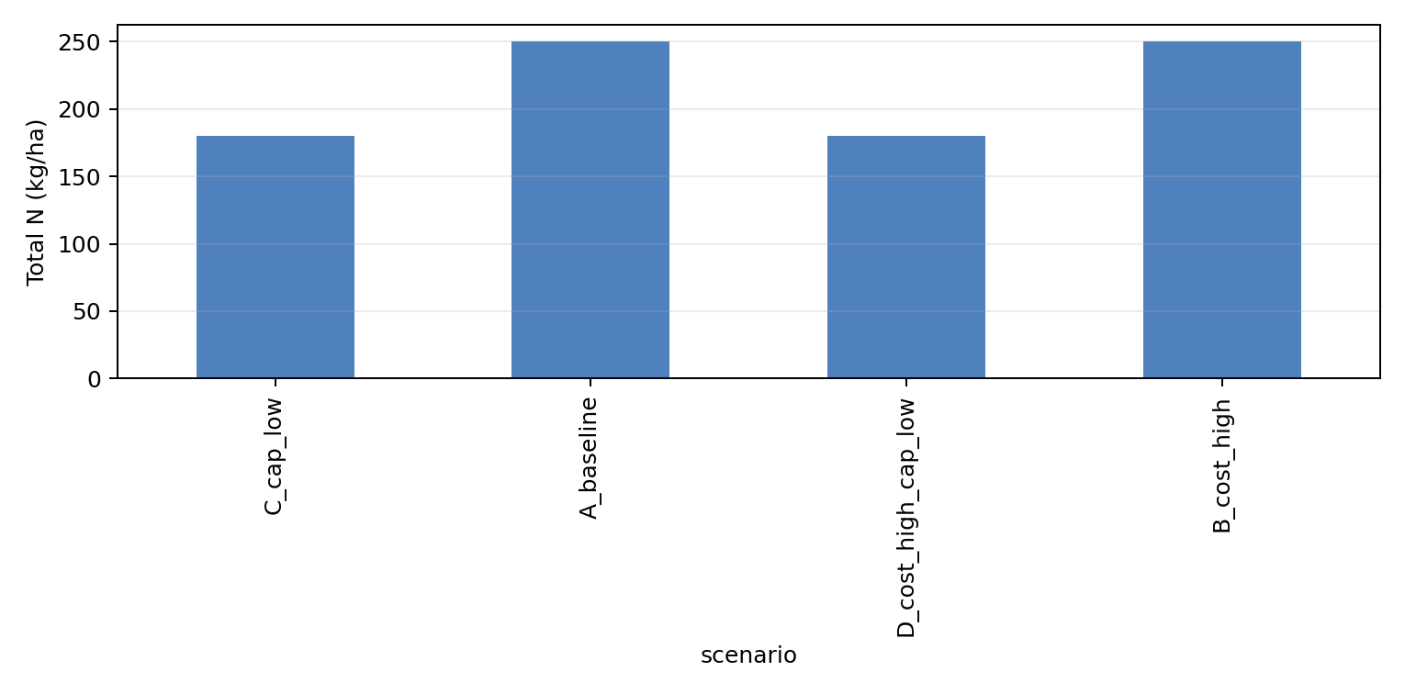
total n comparison

Slide 6
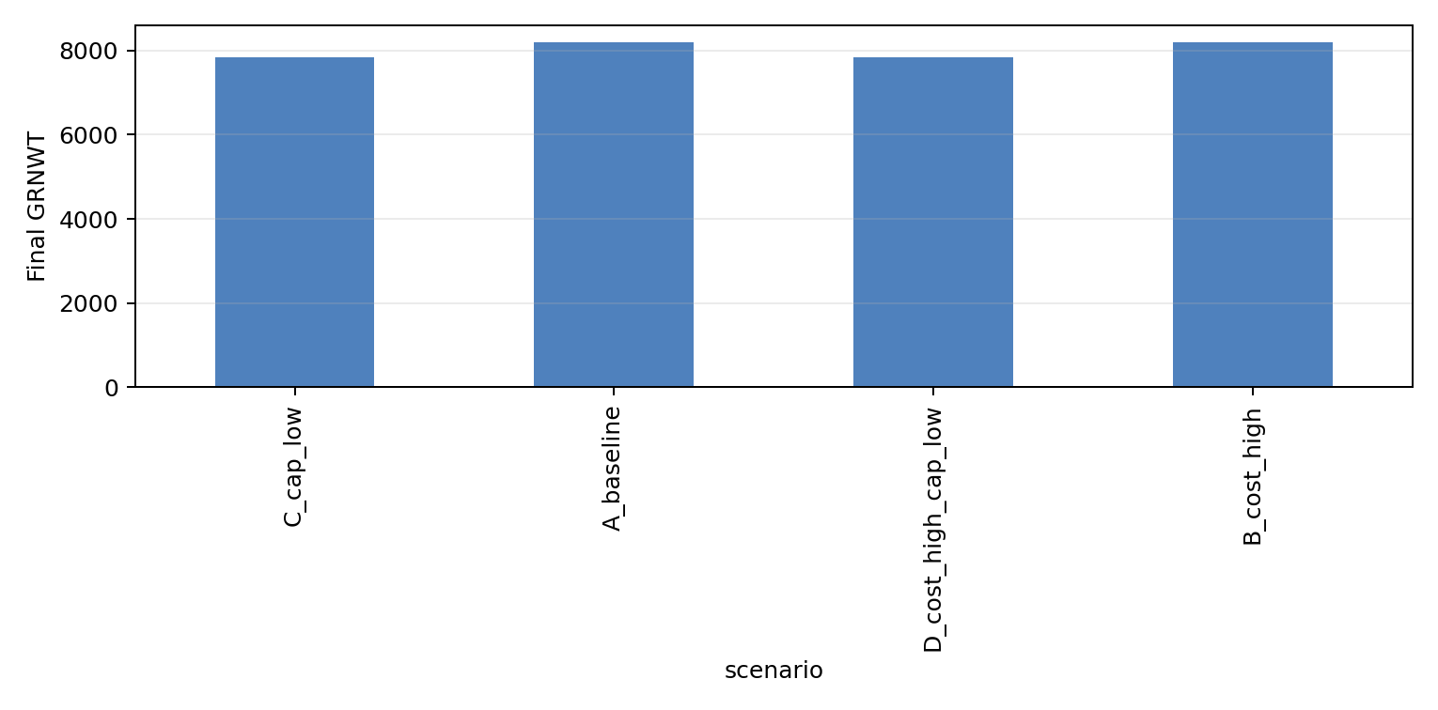
final grnwt comparison

Slide 7
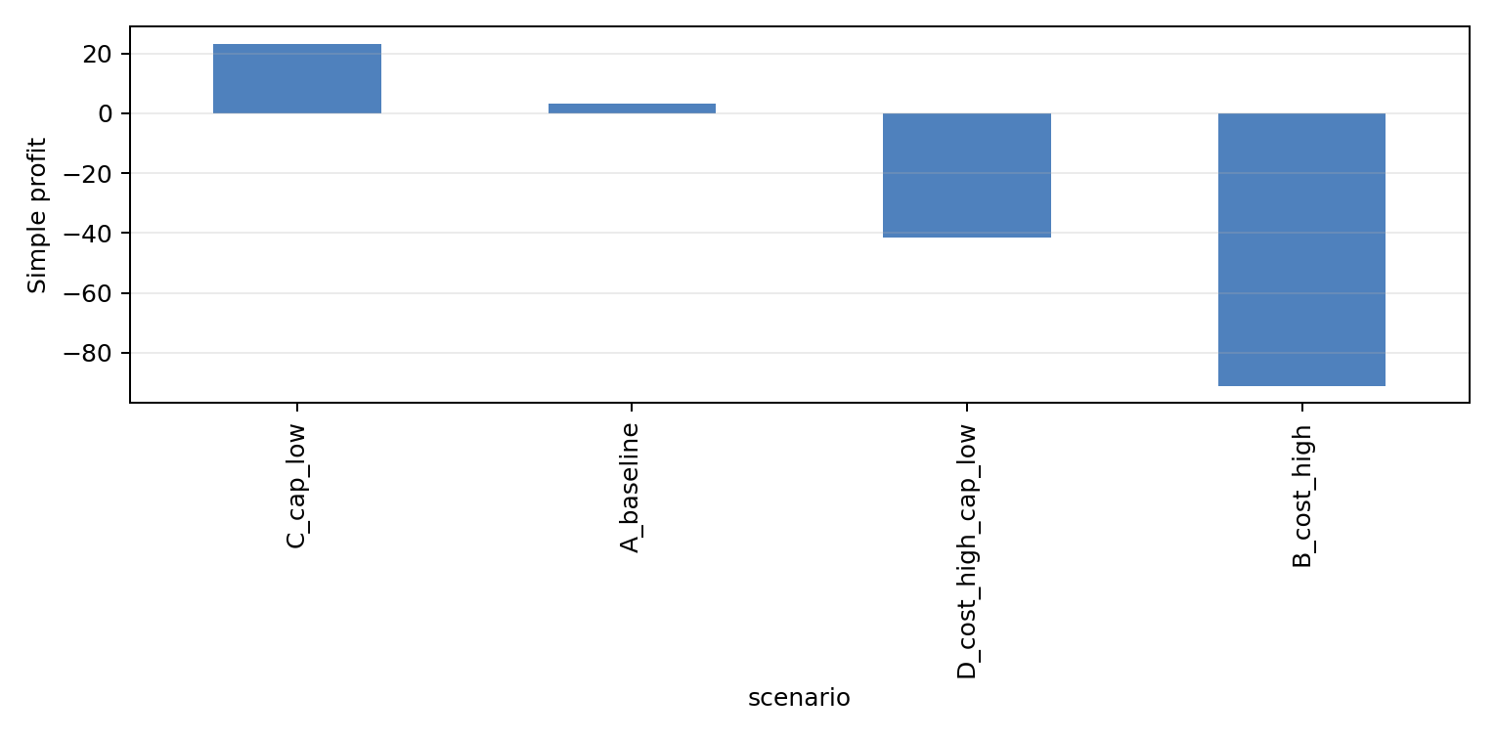
profit simple comparison

Slide 8
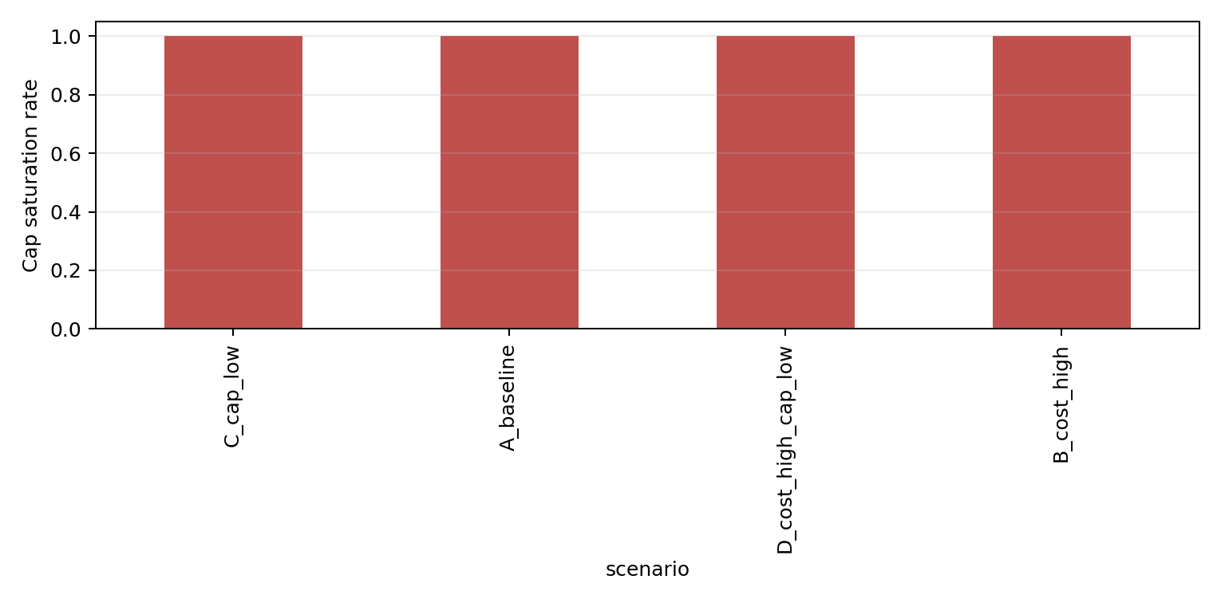
cap saturation rate comparison

Slide 9
Method Sources and Project Results
Literature supports crop-management RL with process-based simulators and input-cost tradeoffs.
This project's tested result is the sensitivity of the five-station all-year direct PPO baseline to four cost/cap settings.
A scenario should be shown to the mentor only if it avoids cap saturation while maintaining reasonable TOPWT/GRNWT.

