Slide 1
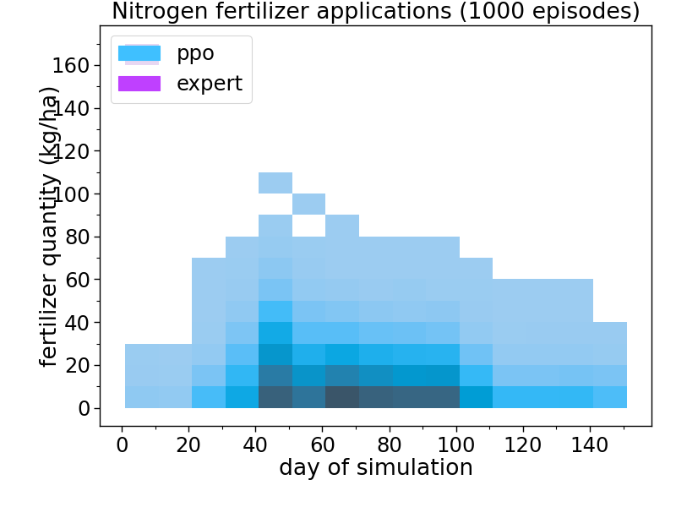
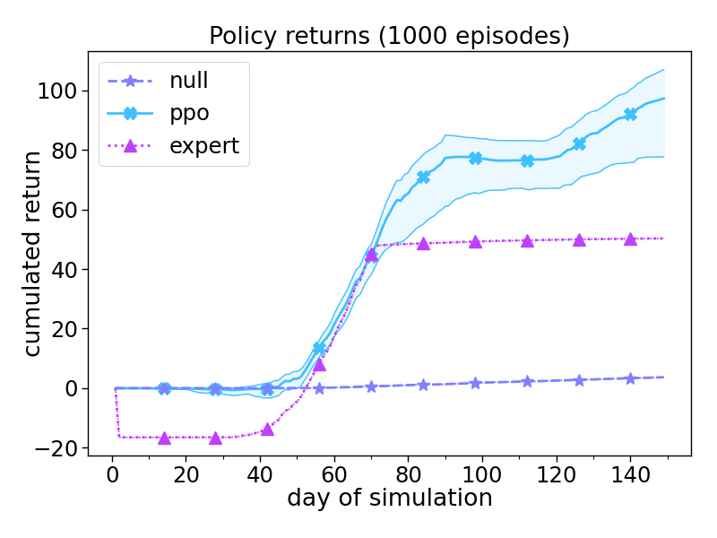
coef0.5_pen0.1 (coef=0.5, penality=0.1)
Nitrogen fertilizer applications
Policy returns

Slide 2
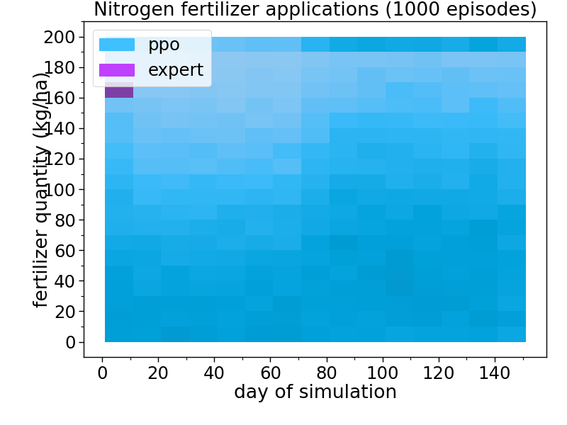
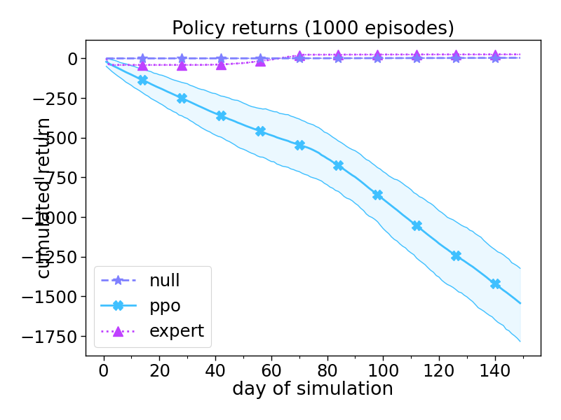
coef0.5_pen0.25 (coef=0.5, penality=0.25)
Nitrogen fertilizer applications
Policy returns

Slide 3
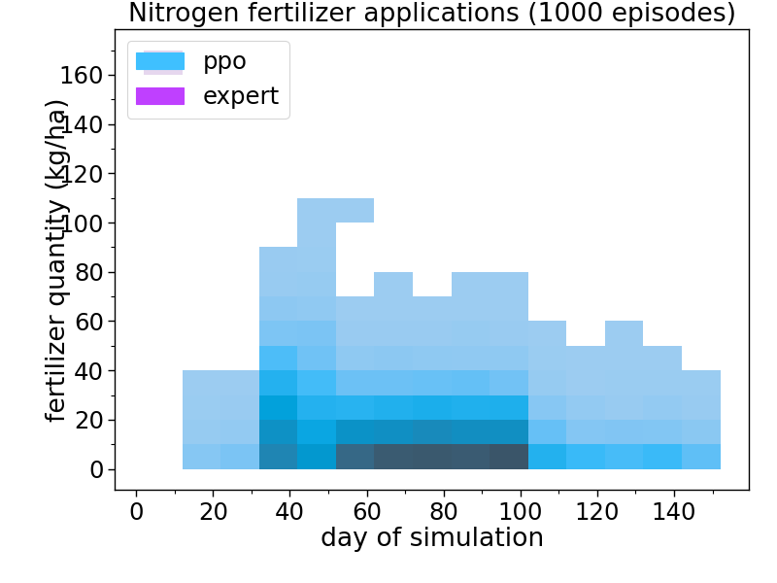
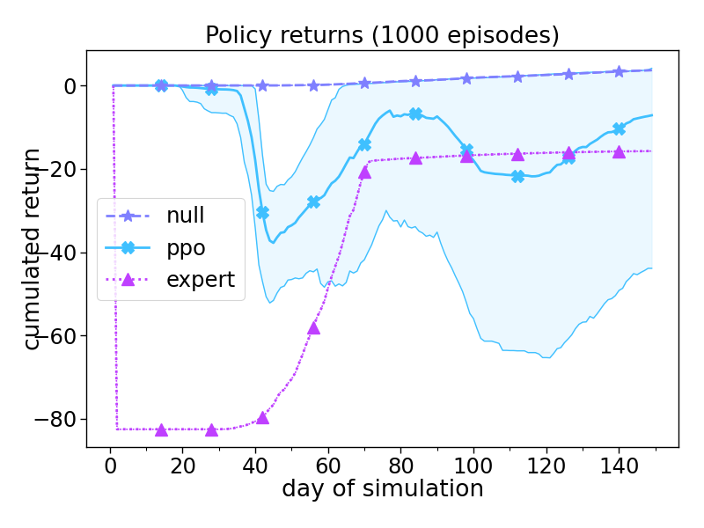
coef0.5_pen0.5 (coef=0.5, penality=0.5)
Nitrogen fertilizer applications
Policy returns

Slide 4
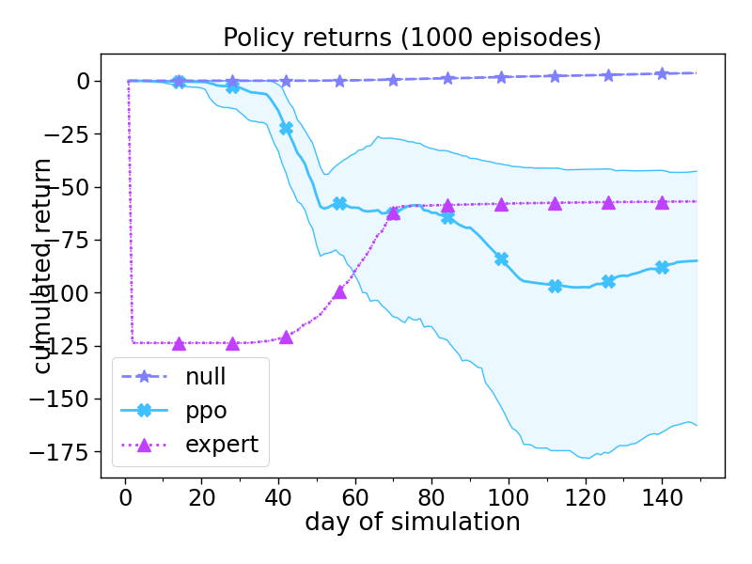
coef0.5_pen0.75 (coef=0.5, penality=0.75)
Nitrogen fertilizer applications
Policy returns

Slide 5
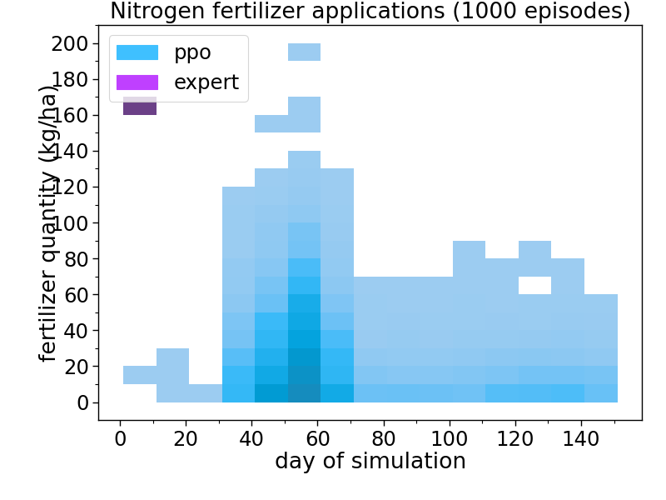
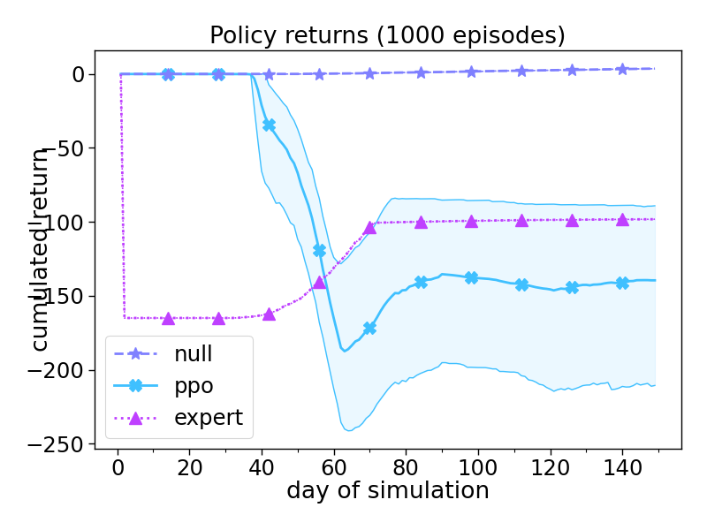
coef0.5_pen1 (coef=0.5, penality=1)
Nitrogen fertilizer applications
Policy returns

Slide 6
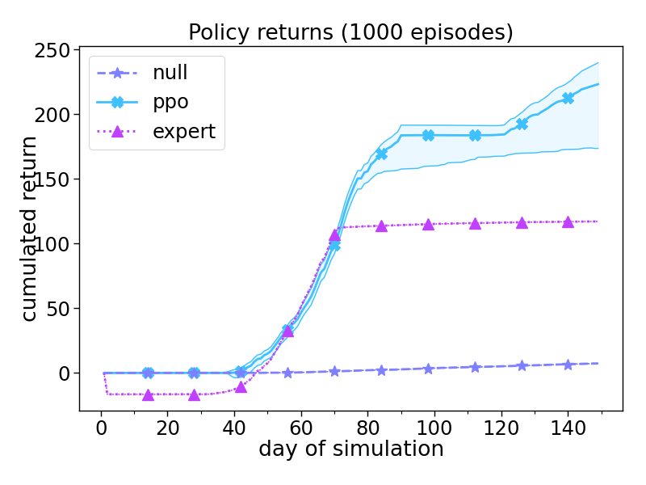
coef1_pen0.1 (coef=1, penality=0.1)
Nitrogen fertilizer applications
Policy returns

Slide 7
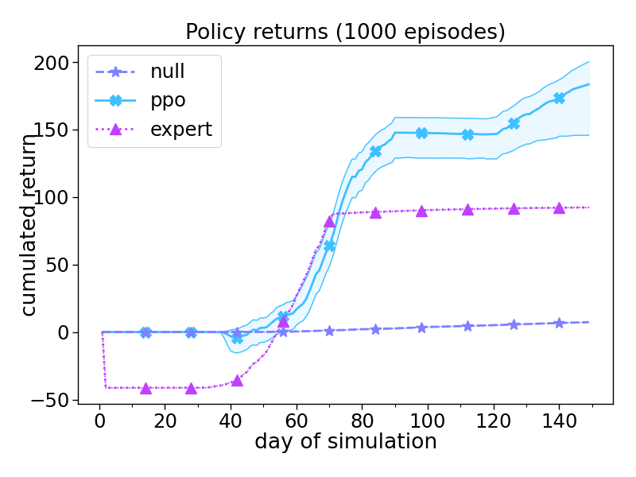
coef1_pen0.25 (coef=1, penality=0.25)
Nitrogen fertilizer applications
Policy returns

Slide 8
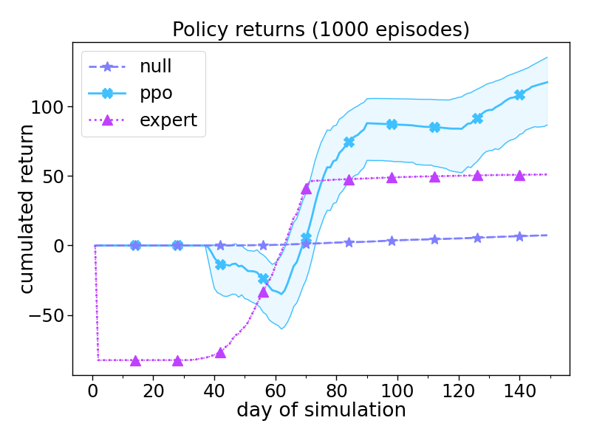
coef1_pen0.5 (coef=1, penality=0.5)
Nitrogen fertilizer applications
Policy returns

Slide 9
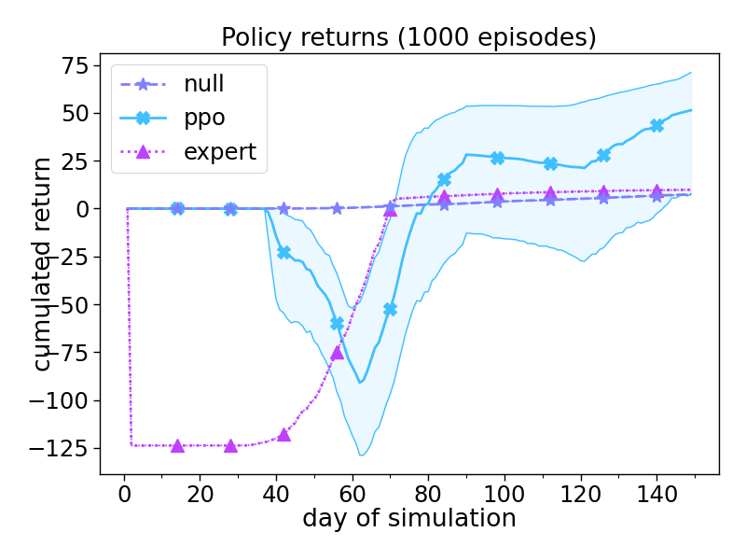
coef1_pen0.75 (coef=1, penality=0.75)
Nitrogen fertilizer applications
Policy returns

Slide 10
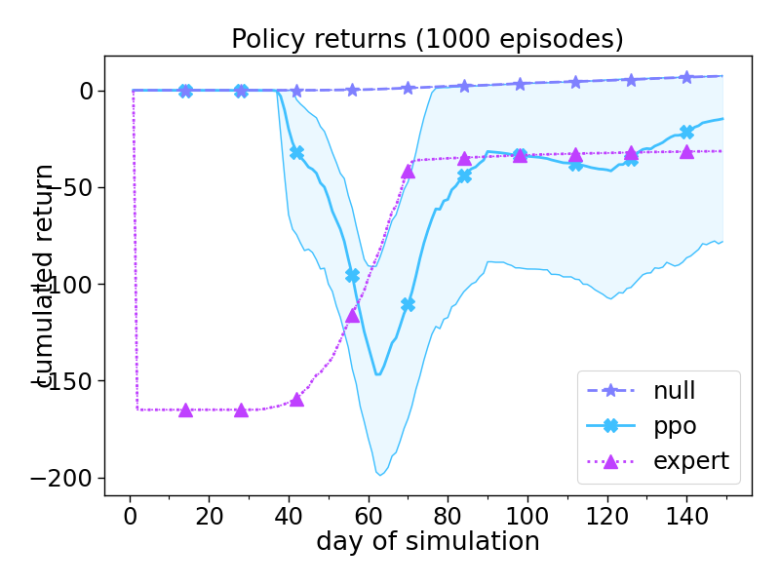
coef1_pen1 (coef=1, penality=1)
Nitrogen fertilizer applications
Policy returns

Slide 11

coef1.5_pen0.1 (coef=1.5, penality=0.1)
Nitrogen fertilizer applications
Policy returns

Slide 12
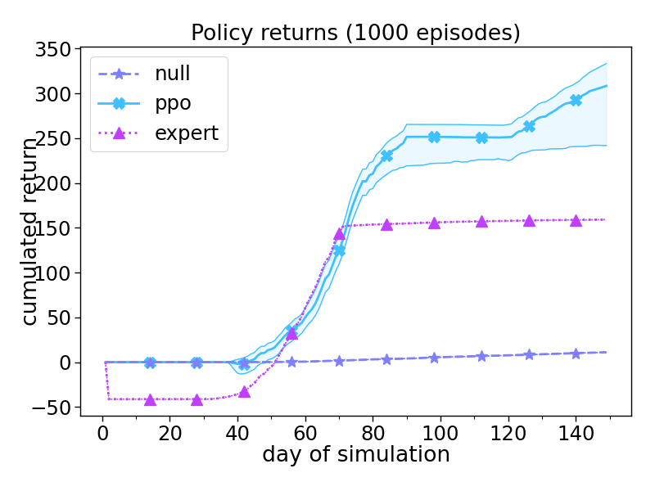
coef1.5_pen0.25 (coef=1.5, penality=0.25)
Nitrogen fertilizer applications
Policy returns

Slide 13
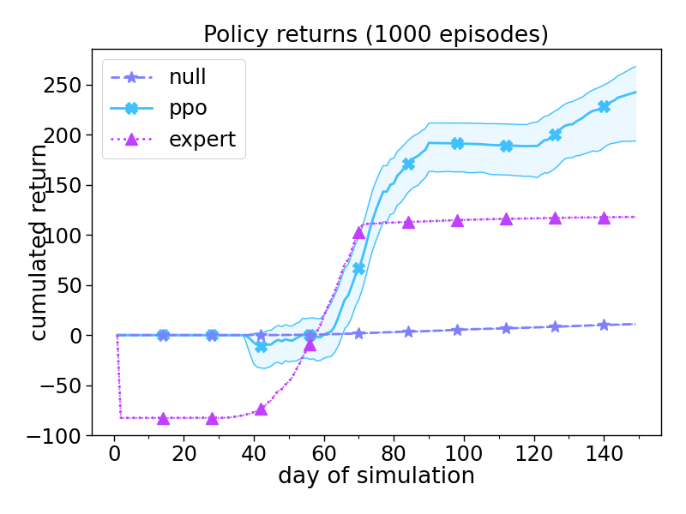
coef1.5_pen0.5 (coef=1.5, penality=0.5)
Nitrogen fertilizer applications
Policy returns

Slide 14
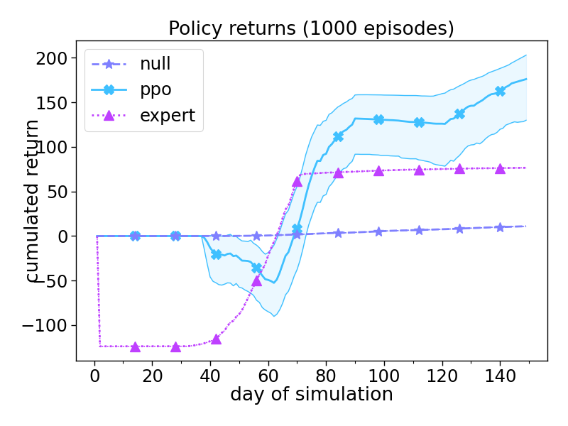
coef1.5_pen0.75 (coef=1.5, penality=0.75)
Nitrogen fertilizer applications
Policy returns

Slide 15
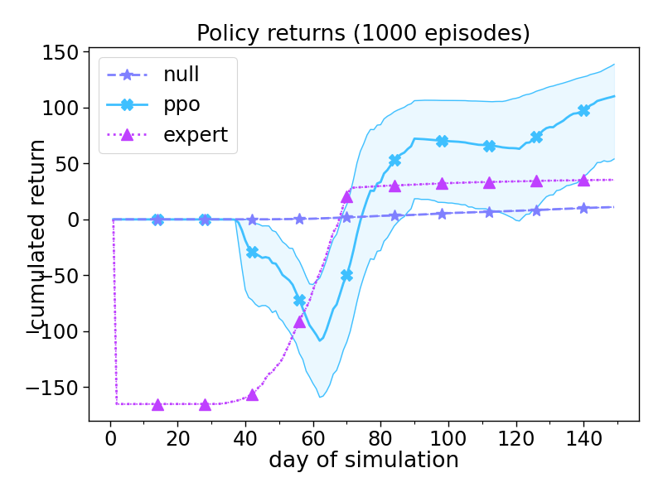
coef1.5_pen1 (coef=1.5, penality=1)
Nitrogen fertilizer applications
Policy returns

Slide 16

coef2_pen0.1 (coef=2, penality=0.1)
Nitrogen fertilizer applications
Policy returns

Slide 17

coef2_pen0.25 (coef=2, penality=0.25)
Nitrogen fertilizer applications
Policy returns

Slide 18
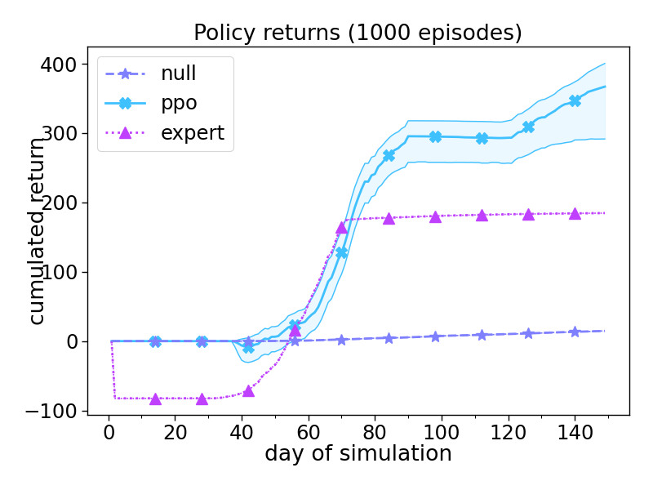
coef2_pen0.5 (coef=2, penality=0.5)
Nitrogen fertilizer applications
Policy returns

Slide 19
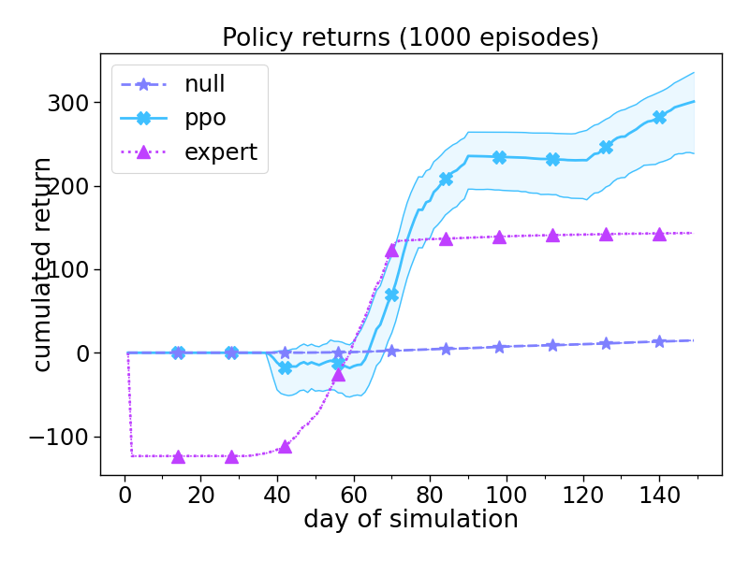
coef2_pen0.75 (coef=2, penality=0.75)
Nitrogen fertilizer applications
Policy returns

Slide 20

coef2_pen1 (coef=2, penality=1)
Nitrogen fertilizer applications
Policy returns

