Slide 1
?????? all ???????
? reward ??????????????????????????
????
??? 2007 ????????????????????? 60% ?????????
????
?? reward ??????????????? + ????????????????????????
All-mode water-nitrogen RL experiment record | 1

Slide 2
?????????
?????????????????????/?????????????
?????????????????????????????????????
???????????????????????????? 0.6 ?????????
???????reward ???? ? ??????? ? ????? wrapper?
?????? Null / Expert / PPO ??????? yield?total_anfer?total_amir?swfac/nstres ?????
All-mode water-nitrogen RL experiment record | 2

Slide 3
???????????????????
?? fertilization_reward ??????reward = trnu ? coef - penality ? anfer?
??????????? coef/penality????????????????
????????????????????????????
???????????????????????????
?? all mode ???????????????? PPO ??????????????/?????
???? reward
maize: coef=1.0, penality=0.5??????????????????
all ????
??? + ?????/??? + ??? + ??????????????????????
????
??????????PPO ???????????????????????????????
All-mode water-nitrogen RL experiment record | 3

Slide 4
????????? PPO ?????????
?? | ?? | ????
max_grnwt | ??/?????? proxy | ????
total_anfer | ?????? kg/ha | ????????????
total_amir | ?????? mm | ??????????????
swfac | ???????gym ??? 1 - ?? | ?????0 ?????
nstres | ??????gym ??? 1 - ?? | ?????0 ?????
reward | ?? reward ??????? | ???????????????
??
maize ? swfac/nstres ? gym ?????? 1 - ????????????????????????????????? note?
All-mode water-nitrogen RL experiment record | 4

Slide 5
???????????? 0.6
?????????????????????????????
?????????????????? HL scale0.6??????? 60%?
??? PRCP = 207.3 mm?ETCP = 496.0 mm??????? -288.7 mm?
Null ?????????????????????
???????????????????????????????????????
Agent | Yield | N kg/ha | Irr. mm | swfac days | nstres days
Null | 469 | 0 | 0 | 0 | 114
Expert | 6276 | 165 | 30 | 18 | 34
??
Null ???????????? 469 kg/ha?Expert ??????????? 6276 kg/ha??????????? PPO ??????????
All-mode water-nitrogen RL experiment record | 5

Slide 6
??????????
?? | ?? | ?????? | ??
1 | ?? reward ?? | ?? reward ??????? PPO ???? | ?????????
2 | ??????? | ? PPO ???????????? | ????????????????
3 | ????? | ?????????? 0?? PPO ? timing | ??????????
4 | 100k ?? | ???????????? | ????? 50k ??
????
PPO ????????????????????????????????????????reward ???????
All-mode water-nitrogen RL experiment record | 6

Slide 7
?? 1???? reward ??
??????????? PPO ??????/?????
?????/???????????? limit ?? cost ???
?????????????? swfac ??????????????
????pen20_icost20_ns50_nlim220_nex15_ilim80_iex30?
  pen20??????? 20?icost20??????? 20?ns50???????????? 50?
  nlim220/nex15?????? 220 ?? 15 ???ilim80/iex30?????? 80 ?? 30 ???
All-mode water-nitrogen RL experiment record | 7

Slide 8
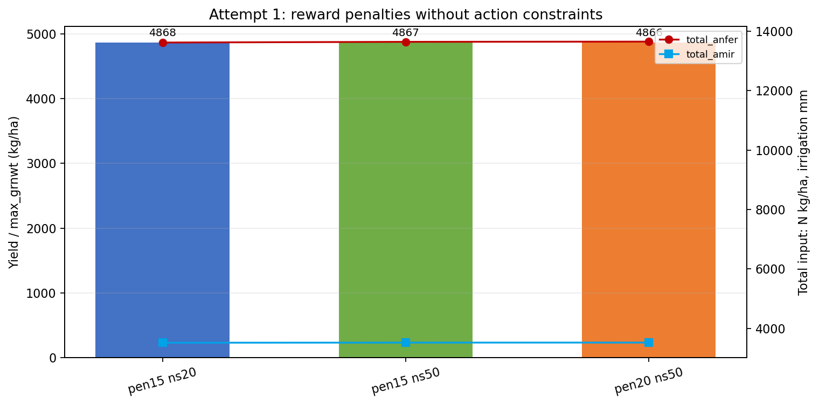
?? 1 ???reward ???????????
?? 50k ???????
PPO ???? 13,600 kg/ha????? 3,500 mm?
??? 4,866-4,868 kg/ha??? Expert ? 6,276 kg/ha?
???PPO ?????????????????????????????????
???????????????????? reward ???
All-mode water-nitrogen RL experiment record | 8

Slide 9
?? 2???????? Safe Action Wrapper
?? SafeActionGymDssatWrapper?????? DSSAT ???
??????????????????? clip?????? PPO ? [-1,1] ??? [0, safe_cap]?
?? PPO ?????????????????
?????safe20_5 ???????? 20 kg/ha??????? 5 mm?
?????safe60_20 ???????? 60 kg/ha????? 20 mm?
????????
???? clip?PPO ????????????????????????????????????????????
???????
?????????????????????????????PPO ?????????????????
All-mode water-nitrogen RL experiment record | 9

Slide 10
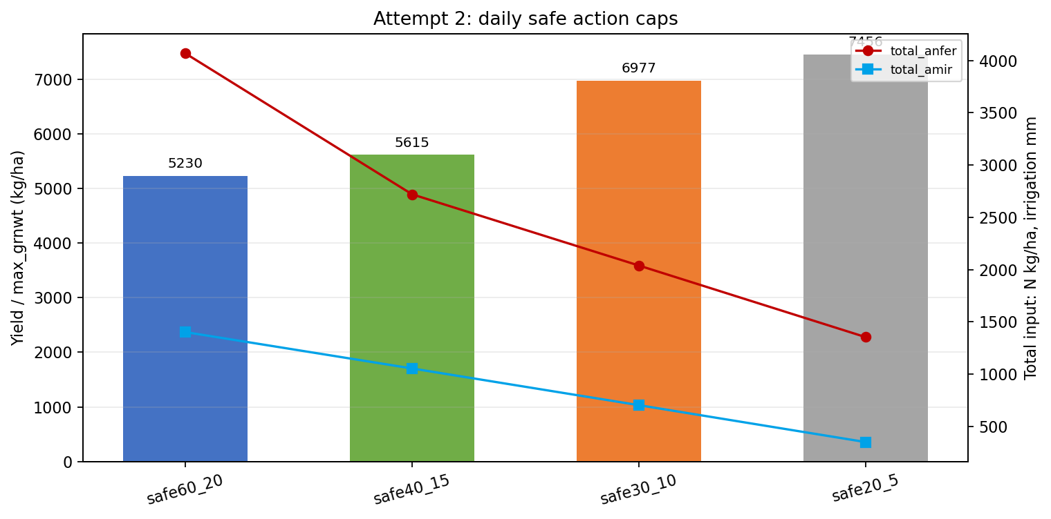
?? 2 ????????????????
safe20_5 ?????????????
50k: yield ? 7456?total_anfer ? 1355?total_amir ? 352?
100k follow-up: yield ? 7457?total_anfer ? 1350?total_amir ? 351?
????????????? Expert?
????????????????????????
All-mode water-nitrogen RL experiment record | 10

Slide 11
?? 3?????? Budgeted Safe Action Wrapper
?? BudgetedSafeActionGymDssatWrapper?????? + ??????
?? reset ??????????
?? step ???????????????????????
?????????????? 0?
???? PPO ???????????????????????????
?????budget220_100
budget220_100 ???????? 220 kg/ha??????? 100 mm?
daily20_5
daily20_5 ???????? 20 kg/ha??????? 5 mm?
pen20
pen20 ???? reward ?? anfer ?????? 20??????? reward????????? wrapper ?????
All-mode water-nitrogen RL experiment record | 11

Slide 12
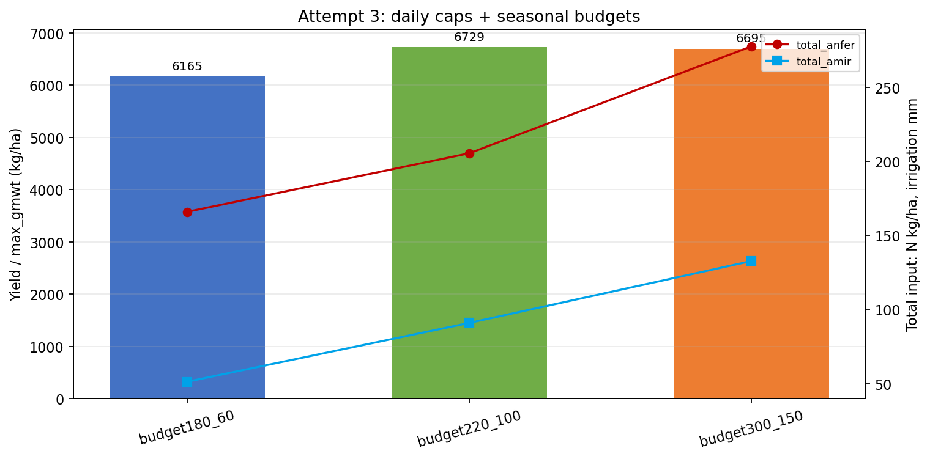
?? 3 ????????????????
budget180_60????????? Expert???????
budget220_100???????????? Expert??????????????
budget300_150???????????????????????
???????????????????????????????
All-mode water-nitrogen RL experiment record | 12

Slide 13
?????????HL scale0.6, 50k?
?? | ?? kg/ha | ?? kg/ha | ??? mm | swfac?? | nstres?? | ??
Expert | 6276 | 165 | 30 | 18 | 34 | ??????
budget180_60 | 6165 | 166 | 51 | 21 | 32 | ?????????
budget220_100 | 6729 | 206 | 91 | 17 | 23 | ?????????
budget300_150 | 6695 | 278 | 133 | 18 | 16 | ?????????
??? budget220_100 ???
?? Expert?budget220_100 ????? 453 kg/ha?????? 41 kg/ha?????? 61 mm??? budget300_150??????????????
??? budget180_60 ????
budget180_60 ????????????????????? 111 kg/ha????????????????
All-mode water-nitrogen RL experiment record | 13

Slide 14
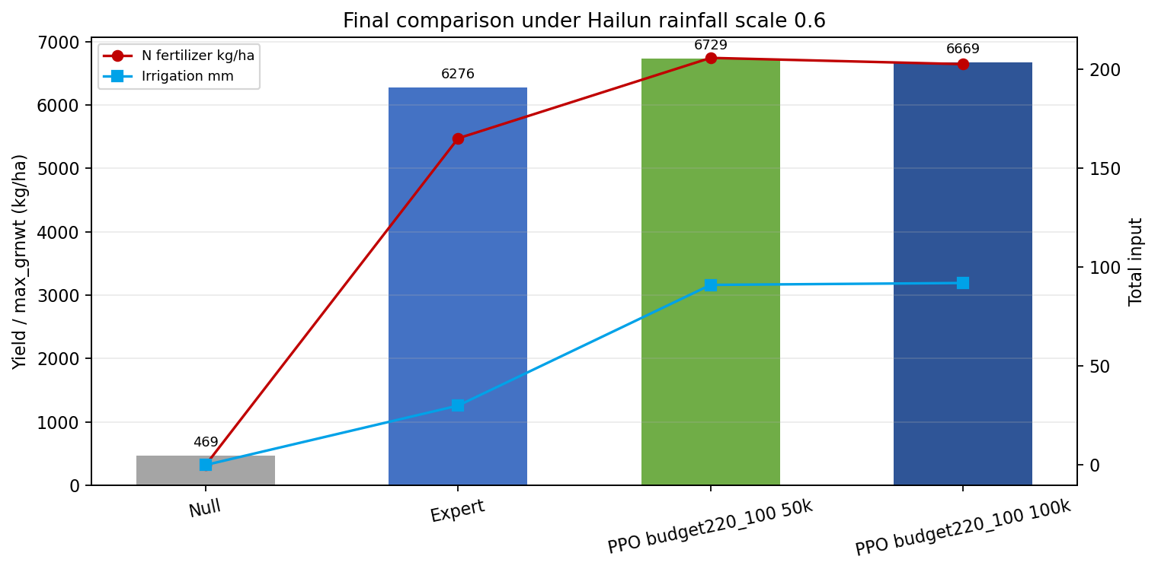
100k ???budget220_100 ????
? 50k ??? budget220_100 ????? 100k?
100k PPO?yield ? 6669?total_anfer ? 202?total_amir ? 92?
? 50k PPO?yield ? 6729?total_anfer ? 206?total_amir ? 91 ???
?????????????????????????????
????????????????????
All-mode water-nitrogen RL experiment record | 14

Slide 15
?????????
?? | ???? | PPO?? | PPO?? | PPO??? | ??
Reward?? | pen20 ns50 | 4866 | 13650 | 3524 | ?????????
??? | safe20_5 | 7456 | 1355 | 352 | ??????
???? | budget220_100 | 6729 | 206 | 91 | ????
100k?? | budget220_100 | 6669 | 202 | 92 | ????
???????????
PPO ???????????????????????????????????????? reward ?????????????
All-mode water-nitrogen RL experiment record | 15

Slide 16
?????????
1. ? DSSAT ????-??-???????
2. ?????????????????????????????????
3. PPO ???????????????????
4. PPO ???????
5. BudgetedSafeActionWrapper ????????????????
6. DSSAT ??????????????trnu ????????????
?????????
???????????????????????????????????????????????????????????????
????? wrapper ??
?????????????????????????????????????? reward ???????
All-mode water-nitrogen RL experiment record | 16

Slide 17
?????????
??/?? | ??
sb3_safe_action_wrapper.py | SafeAction ? BudgetedSafeAction wrapper
train_hl_all_multisite_safe.py | ?????????
train_hl_all_multisite_budget.py | ??? + ????????
run_hl_scale0p6_safe_penalty_scan.py | safe ??????
run_hl_scale0p6_budget_scan.py | ??????
diagnose_all_water_stress_sites.py | ?? PPO + safe/budget wrapper ???
output_hl/rain_scaling_train/... | ??????summary ? findings ??
GitHub??
???????bd155ff Add safe action all-mode scan?65da954 Add seasonal budget all-mode scan?
All-mode water-nitrogen RL experiment record | 17

Slide 18
?????????????????
HL scale0.6 ????????????????????????????
????????????????????????????? seed ?????
budget220_100 ??????????????????????????????????
turfac ????????????? swfac/nstres ?????????
????????????????????????????
All-mode water-nitrogen RL experiment record | 18

Slide 19
?????
1. ? budget220_100 ???? action trace ??????/??????? DAP ??????
2. ? 3-5 ??????????????????
3. ??????????????????????????? rain scale0.6?
4. ???????????????????????? PPO ?????????
5. ????????????? = ???????????????????????
All-mode water-nitrogen RL experiment record | 19

Slide 20
?????
?? reward ?????? all mode ????????
??????????????????????????
????? wrapper ???????? PPO ???????????????
???????budget220_100_daily20_5_pen20?
? HL scale0.6 ????PPO 100k ??? 6669 kg/ha??? Expert ? 6276 kg/ha???? 202 kg/ha????? 92 mm?
????????????????????????????? seed??????????????
All-mode water-nitrogen RL experiment record | 20

