Slide 1
006_15 All-Year Weather Scenario Pool
Purpose: expand from observed-year-only to all available QC weather years before any further PPO.
No PPO training, no rainfall-scaling, no unrestricted PPO, and no my_data overwrite were performed.
2020-2023 are checked for cultivar calibration / validation, while all years are screened for swfac/nstres and irrigation response.

Slide 2
Available Weather Years by Station
station_code | n_years | years
FQA | 24 | 2000,2001,2002,2003,2004,2005,2006,2007,2008,2009,2010,2011,2012,2013,2014,2015,2016,2017,2018,2019,2020,2021,2022,2023
HLA | 24 | 2000,2001,2002,2003,2004,2005,2006,2007,2008,2009,2010,2011,2012,2013,2014,2015,2016,2017,2018,2019,2020,2021,2022,2023
LCA | 24 | 2000,2001,2002,2003,2004,2005,2006,2007,2008,2009,2010,2011,2012,2013,2014,2015,2016,2017,2018,2019,2020,2021,2022,2023
SYA | 23 | 2001,2002,2003,2004,2005,2006,2007,2008,2009,2010,2011,2012,2013,2014,2015,2016,2017,2018,2019,2020,2021,2022,2023
YCA | 24 | 2000,2001,2002,2003,2004,2005,2006,2007,2008,2009,2010,2011,2012,2013,2014,2015,2016,2017,2018,2019,2020,2021,2022,2023

Slide 3
2020-2023 Weather Availability
station_code | 2020 | 2021 | 2022 | 2023
FQA | ok | ok | ok | ok
HLA | ok | ok | ok | ok
LCA | ok | ok | ok | ok
SYA | ok | ok | ok | ok
YCA | ok | ok | ok | ok

Slide 4
Scenario Pool Summary
station_code | water_stress_years | nitrogen_stress_years | irrigation_responsive_years | ppo_train_years | ppo_eval_years
FQA | 11 | 19 | 3 | 19 | 7
HLA | 1 | 20 | 1 | 20 | 7
LCA | 1 | 19 | 0 | 19 | 7
SYA | 4 | 19 | 1 | 19 | 7
YCA | 3 | 20 | 1 | 20 | 8

Slide 5
Water Stress / Irrigation Response Years
station_code | year | scenario_type | growing_season_rain | swfac_stress_days_gt_0p05 | max_swfac | yield_gain_from_irrigation_at_same_N | profit_gain_from_irrigation_low_water_cost
FQA | 2005 | wet_year;water_stress_year;nitrogen_stress_year | 535.1 | 6.0 | 0.378 | 436.643 | -1.634
FQA | 2007 | normal_year;water_stress_year;nitrogen_stress_year;irrigation_responsive_year | 325.8 | 13.0 | 0.462 | 763.76 | 1.638
FQA | 2008 | normal_year;water_stress_year;nitrogen_stress_year;irrigation_responsive_year | 221.8 | 20.0 | 0.603 | 708.898 | 0.249
FQA | 2011 | wet_year;water_stress_year;nitrogen_stress_year | 1051.2 | 5.0 | 0.463 | 252.39 | -3.921
FQA | 2015 | normal_year;water_stress_year;nitrogen_stress_year | 299.6 | 10.0 | 0.599 | 222.659 | -3.773
FQA | 2016 | normal_year;water_stress_year;nitrogen_stress_year;irrigation_responsive_year | 262.8 | 22.0 | 0.581 | 2081.274 | 8.813
FQA | 2017 | normal_year;water_stress_year;nitrogen_stress_year | 270.5 | 6.0 | 0.371 | 472.969 | -1.27
FQA | 2018 | normal_year;water_stress_year;nitrogen_stress_year | 348.2 | 10.0 | 0.557 | 0.0 | -6.0
FQA | 2019 | dry_year;water_stress_year;nitrogen_stress_year | 201.3 | 14.0 | 0.557 | 425.672 | -7.451
FQA | 2020 | normal_year;water_stress_year;nitrogen_stress_year | 411.0 | 7.0 | 0.201 | 461.557 | -1.384
FQA | 2023 | normal_year;water_stress_year;nitrogen_stress_year | 389.9 | 5.0 | 0.348 | 270.614 | -3.689
HLA | 2004 | dry_year;water_stress_year;nitrogen_stress_year;irrigation_responsive_year | 51.5 | 18.0 | 1.0 | 6383.542 | 51.835
LCA | 2017 | dry_year;water_stress_year;nitrogen_stress_year | 175.2 | 1.0 | 0.12 | 100.792 | -5.677
SYA | 2009 | normal_year;water_stress_year;nitrogen_stress_year | 332.0 | 9.0 | 0.594 | 598.743 | -3.588
SYA | 2014 | normal_year;water_stress_year;nitrogen_stress_year | 331.8 | 12.0 | 0.801 | 922.98 | -1.276
SYA | 2017 | dry_year;water_stress_year;nitrogen_stress_year;irrigation_responsive_year | 301.7 | 13.0 | 0.818 | 1058.022 | 2.281

Slide 6
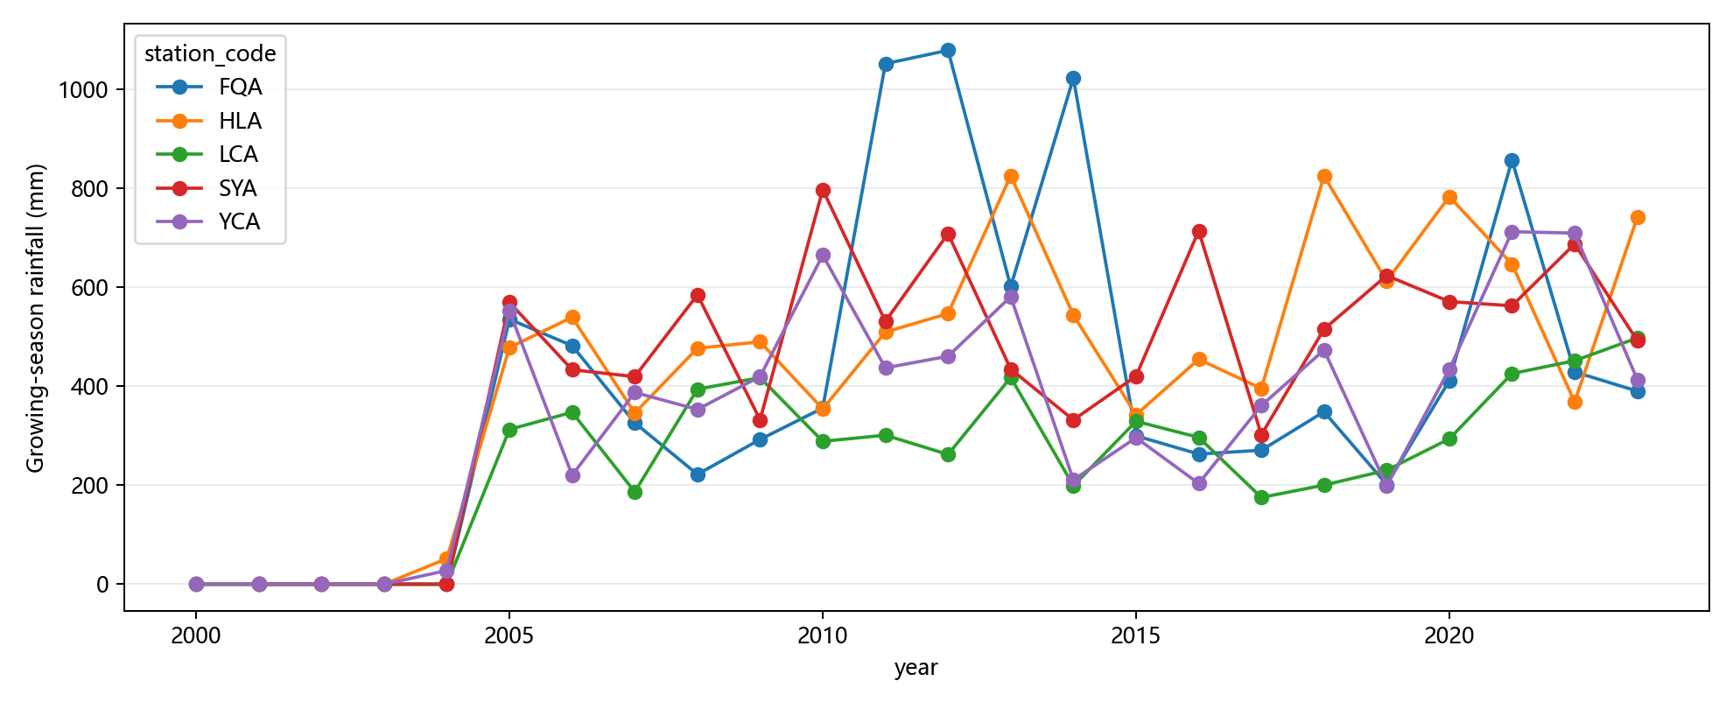
Growing Season Rain by Year

Slide 7
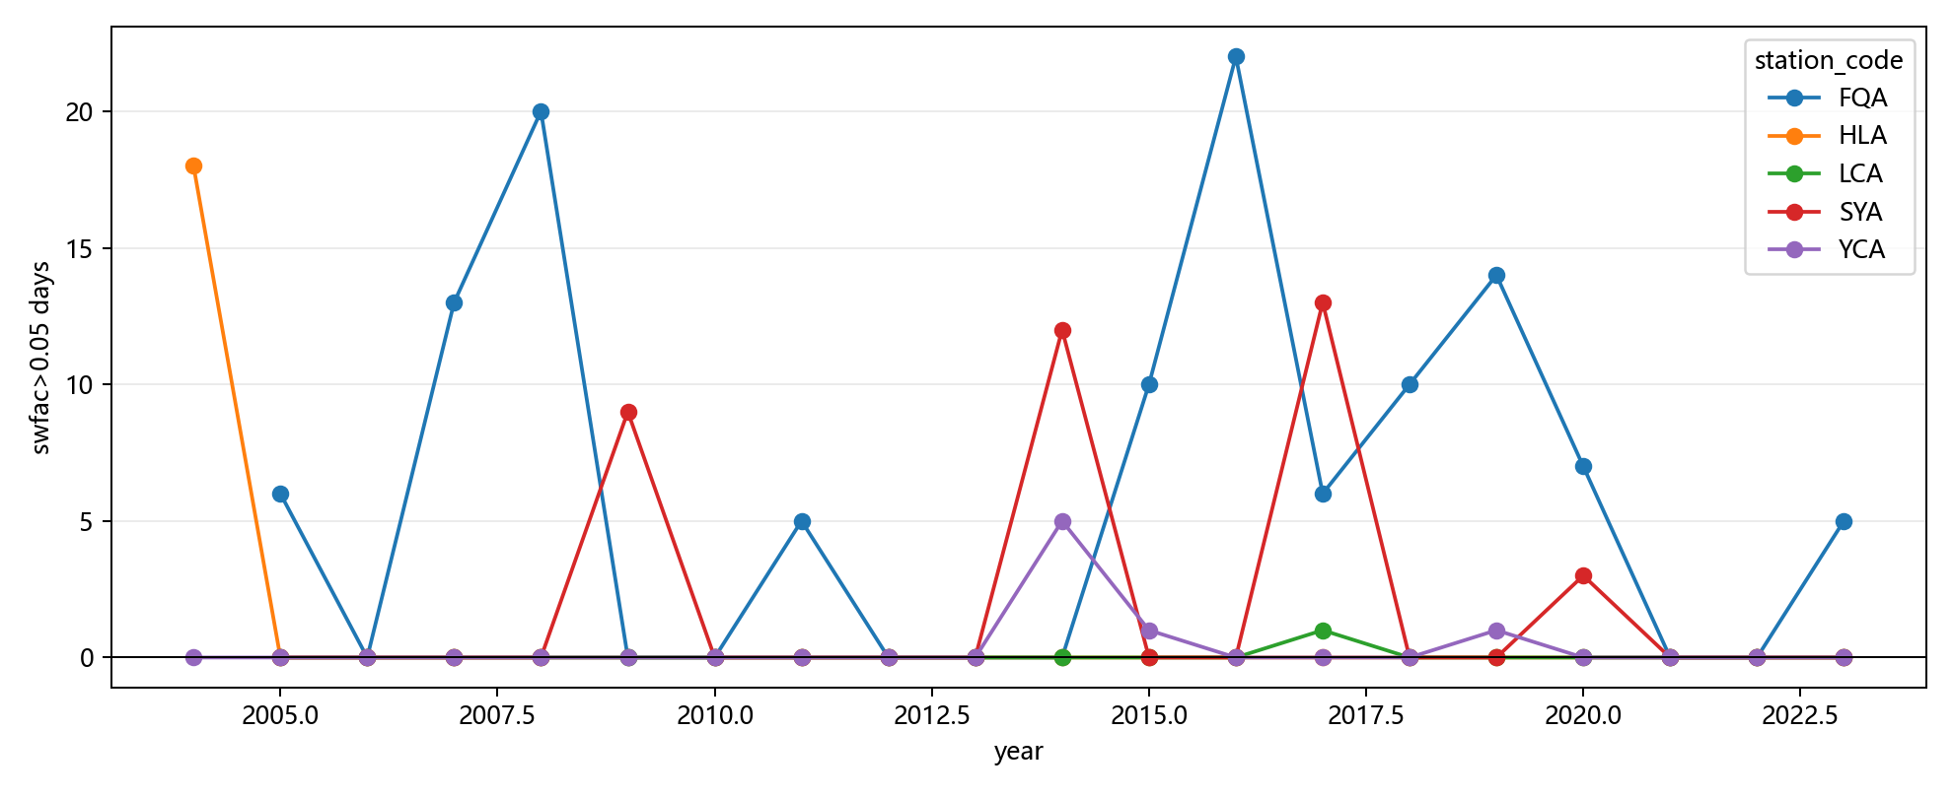
SWFAC Stress Days

Slide 8
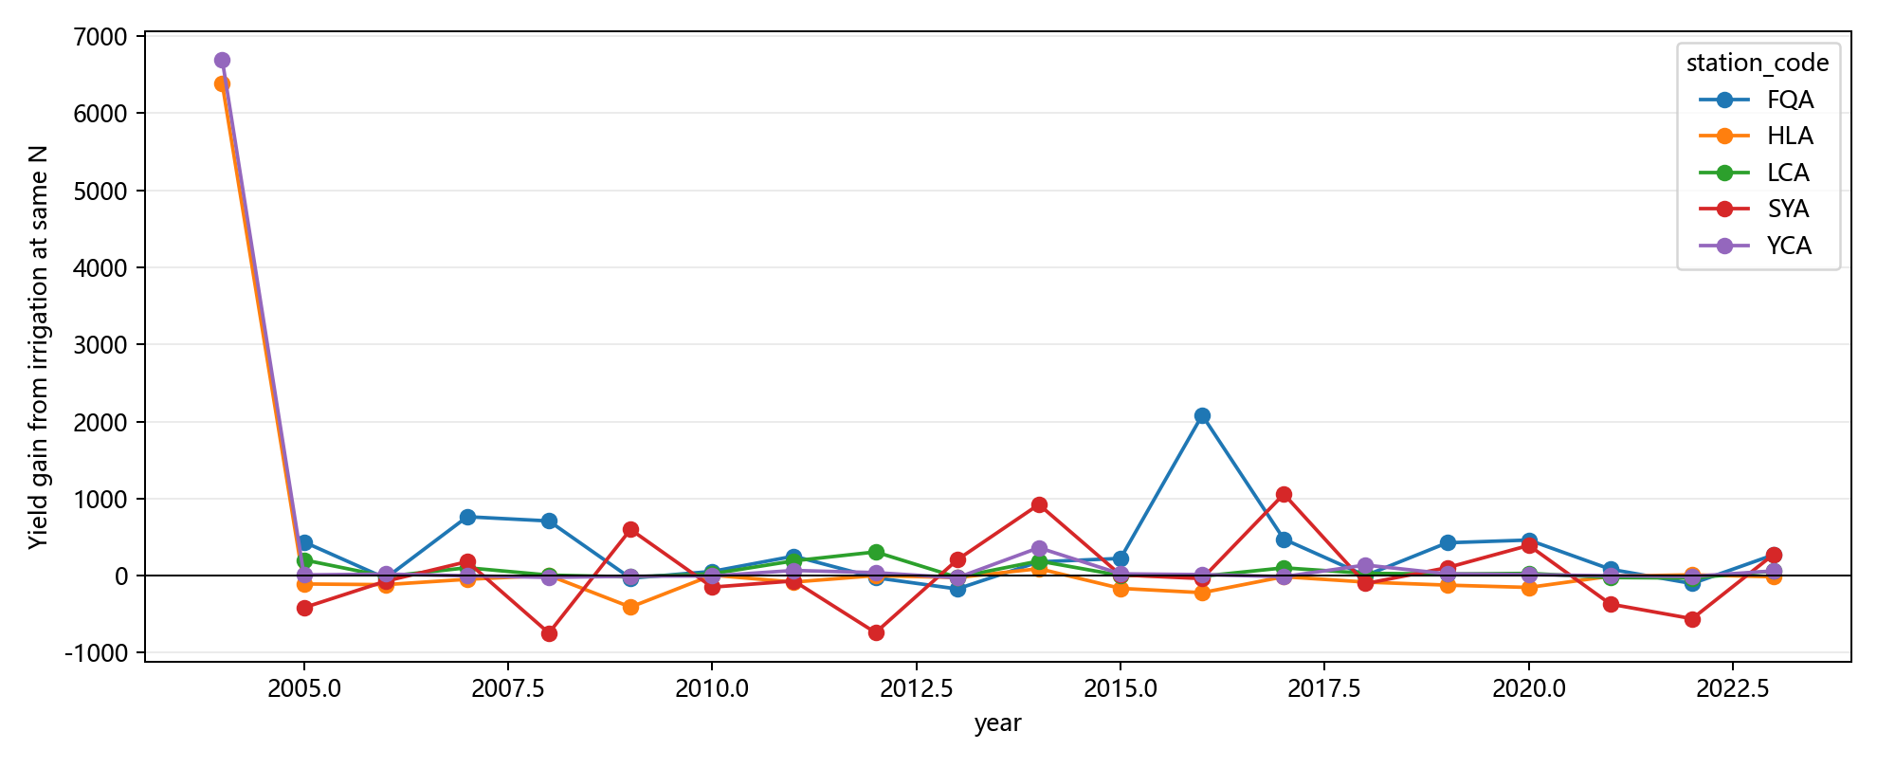
Irrigation Yield Gain at Same N

Slide 9
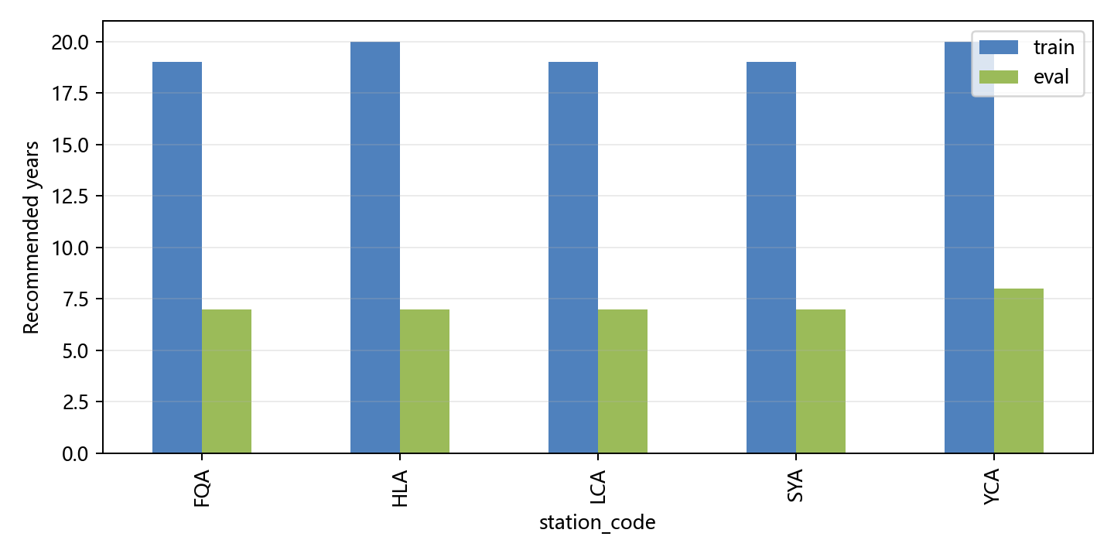
PPO Train/Eval Scenario Pool

Slide 10
Recommended Next Step
Recommended next prompt: 006_16_all_year_offline_schedule_search_and_imitation_prior
If enough water-stress / irrigation-responsive years exist, proceed to all-year offline schedule search before PPO.
If not, prioritize cultivar calibration and nitrogen-management focus.

