Slide 1
006_17 All-Year Direct Action-Safe PPO
Goal: train a simple direct PPO baseline using the 006_15 all-year scenario pool.
Excluded: RF / behavior cloning / expert replay / offline schedule search / rainfall-scaling / reward tuning.
Reward: 0.1*delta_TOPWT + delta_GRNWT - 0.1*irrigation - 0.25*N.
Action safety: season irrigation cap 160.0 mm; season N cap 250.0 kg/ha.

Slide 2
Selected Train/Eval Years
station_code | year | scenario_type | selected_for_train | selected_for_eval
FQA | 2005 | wet_year;water_stress_year;nitrogen_stress_year | False | True
FQA | 2007 | normal_year;water_stress_year;nitrogen_stress_year;irrigation_responsive_year | True | False
FQA | 2008 | normal_year;water_stress_year;nitrogen_stress_year;irrigation_responsive_year | True | False
FQA | 2011 | wet_year;water_stress_year;nitrogen_stress_year | False | True
FQA | 2015 | normal_year;water_stress_year;nitrogen_stress_year | False | True
FQA | 2016 | normal_year;water_stress_year;nitrogen_stress_year;irrigation_responsive_year | True | False
FQA | 2019 | dry_year;water_stress_year;nitrogen_stress_year | False | True
FQA | 2020 | normal_year;water_stress_year;nitrogen_stress_year | True | False
FQA | 2023 | normal_year;water_stress_year;nitrogen_stress_year | True | False
HLA | 2004 | dry_year;water_stress_year;nitrogen_stress_year;irrigation_responsive_year | True | False
HLA | 2012 | wet_year;nitrogen_stress_year;low_response_year | False | True
HLA | 2013 | wet_year;nitrogen_stress_year;low_response_year | False | True
HLA | 2015 | dry_year;nitrogen_stress_year;low_response_year | False | True
HLA | 2018 | wet_year;nitrogen_stress_year;low_response_year | False | True
HLA | 2020 | wet_year;nitrogen_stress_year;low_response_year | True | False
HLA | 2021 | wet_year;nitrogen_stress_year;low_response_year | True | False
HLA | 2022 | normal_year;nitrogen_stress_year;low_response_year | True | False
HLA | 2023 | wet_year;nitrogen_stress_year;low_response_year | True | False

Slide 3
Training Summary
station_code | train_years | seed | total_timesteps | run_status | model_path | mean_train_reward | final_train_reward | notes
FQA | 2007,2008,2016,2020,2023 | 0 | 5000 | ok | Leave_One_experiments/all_year_direct_action_safe_ppo/models/FQA/ppo_direct_action_safe_seed0.zip
HLA | 2004,2020,2021,2022,2023 | 0 | 5000 | ok | Leave_One_experiments/all_year_direct_action_safe_ppo/models/HLA/ppo_direct_action_safe_seed0.zip
LCA | 2017,2020,2021,2022,2023 | 0 | 5000 | ok | Leave_One_experiments/all_year_direct_action_safe_ppo/models/LCA/ppo_direct_action_safe_seed0.zip
SYA | 2009,2014,2017,2020,2022 | 0 | 5000 | ok | Leave_One_experiments/all_year_direct_action_safe_ppo/models/SYA/ppo_direct_action_safe_seed0.zip
YCA | 2004,2014,2015,2019,2022 | 0 | 5000 | ok | Leave_One_experiments/all_year_direct_action_safe_ppo/models/YCA/ppo_direct_action_safe_seed0.zip

Slide 4
Evaluation Summary
station_code | year | split | run_status | final_grnwt | total_irrigation | total_n | profit_simple
FQA | 2007 | train | ok | 7078.953 | 160.0 | 250.0 | -7.71
FQA | 2008 | train | ok | 7234.489 | 160.0 | 250.0 | -6.155
FQA | 2016 | train | ok | 7358.622 | 160.0 | 250.0 | -4.914
FQA | 2020 | train | ok | 7990.318 | 160.0 | 250.0 | 1.403
FQA | 2023 | train | ok | 8224.324 | 160.0 | 250.0 | 3.743
FQA | 2005 | eval | ok | 7339.745 | 160.0 | 250.0 | -5.103
FQA | 2011 | eval | ok | 5627.328 | 160.0 | 250.0 | -22.227
FQA | 2015 | eval | ok | 6931.539 | 160.0 | 250.0 | -9.185
FQA | 2019 | eval | ok | 7603.851 | 160.0 | 250.0 | -2.461
HLA | 2004 | train | ok | 6024.109 | 160.0 | 250.0 | -18.259
HLA | 2020 | train | ok | 6866.949 | 160.0 | 250.0 | -9.831
HLA | 2021 | train | ok | 5059.636 | 160.0 | 250.0 | -27.904
HLA | 2022 | train | ok | 7107.605 | 160.0 | 250.0 | -7.424
HLA | 2023 | train | ok | 6077.938 | 160.0 | 250.0 | -17.721
HLA | 2012 | eval | ok | 0.0 | 160.0 | 250.0 | -78.5
HLA | 2013 | eval | ok | 5172.479 | 160.0 | 250.0 | -26.775

Slide 5
Decision Reasonableness
station_code | year | total_irrigation | total_n | irrigation_during_or_before_swfac_stress | fertilization_during_or_before_nstres | decision_reasonableness_label
FQA | 2007 | 160.0 | 250.0 | True | True | cap_saturated
FQA | 2008 | 160.0 | 250.0 | True | True | cap_saturated
FQA | 2016 | 160.0 | 250.0 | True | True | cap_saturated
FQA | 2020 | 160.0 | 250.0 | True | True | cap_saturated
FQA | 2023 | 160.0 | 250.0 | True | True | cap_saturated
FQA | 2005 | 160.0 | 250.0 | True | True | cap_saturated
FQA | 2011 | 160.0 | 250.0 | True | True | cap_saturated
FQA | 2015 | 160.0 | 250.0 | True | True | cap_saturated
FQA | 2019 | 160.0 | 250.0 | True | True | cap_saturated
HLA | 2004 | 160.0 | 250.0 | True | True | cap_saturated
HLA | 2020 | 160.0 | 250.0 | True | True | cap_saturated
HLA | 2021 | 160.0 | 250.0 | True | True | cap_saturated
HLA | 2022 | 160.0 | 250.0 | True | True | cap_saturated
HLA | 2023 | 160.0 | 250.0 | True | True | cap_saturated
HLA | 2012 | 160.0 | 250.0 | True | True | cap_saturated
HLA | 2013 | 160.0 | 250.0 | True | True | cap_saturated

Slide 6
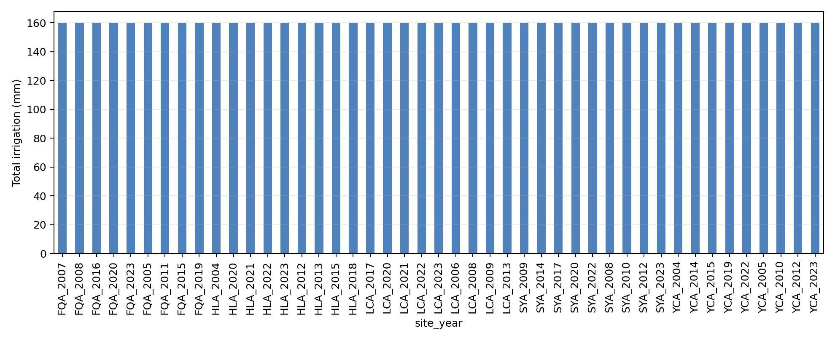
ppo total irrigation by station year

Slide 7
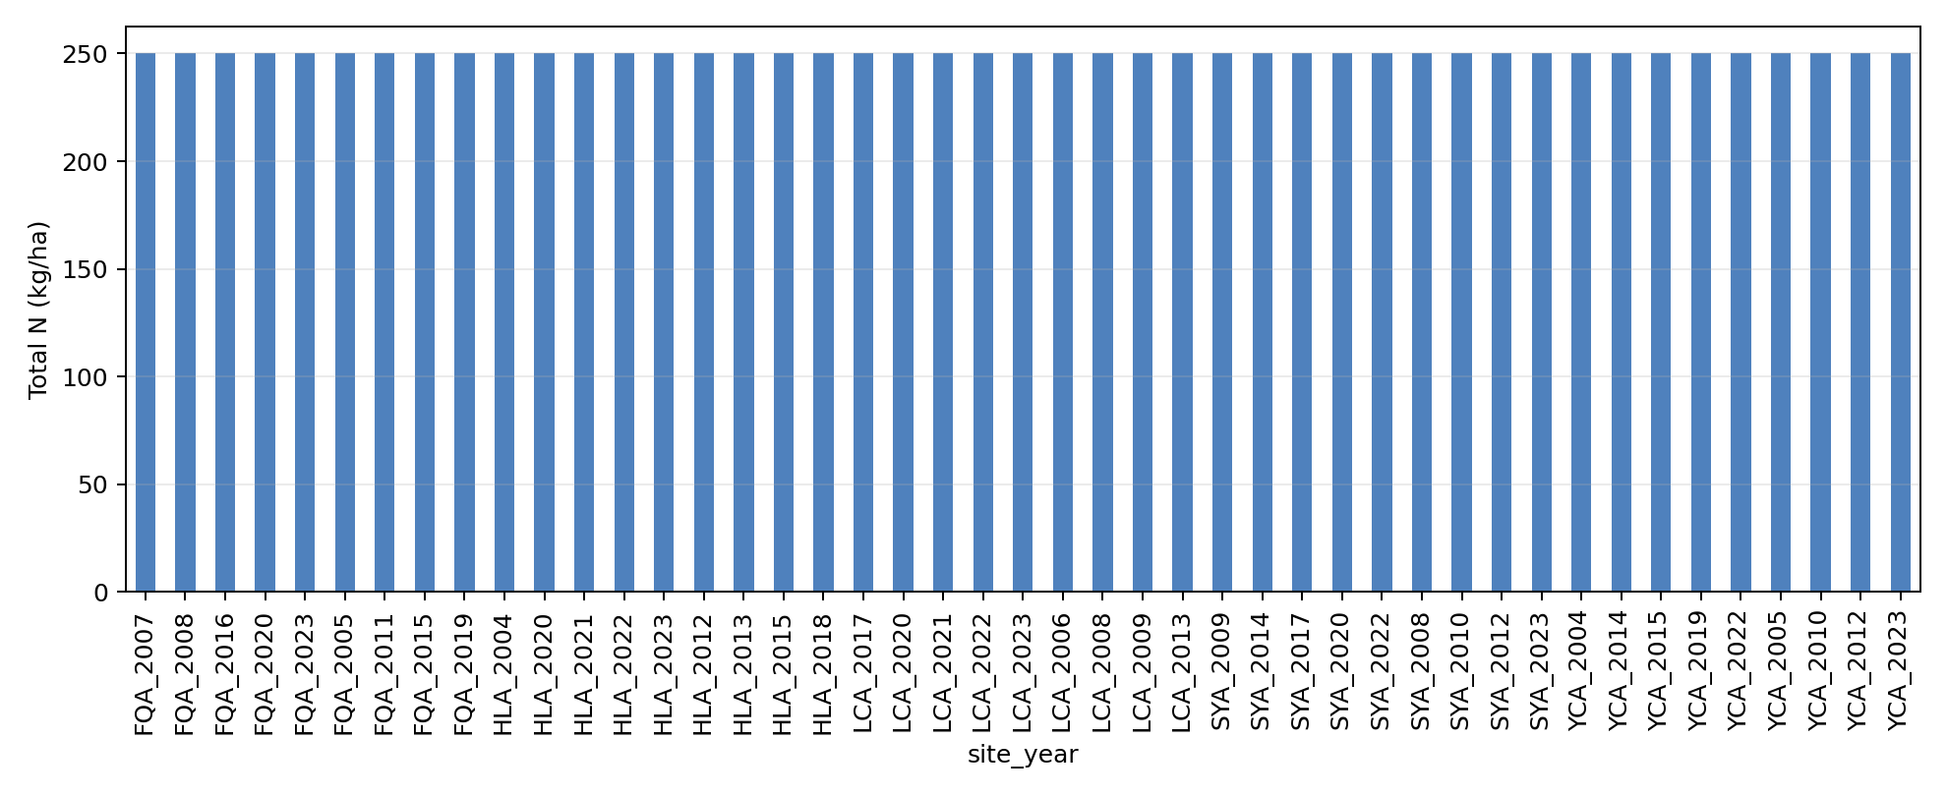
ppo total n by station year

Slide 8
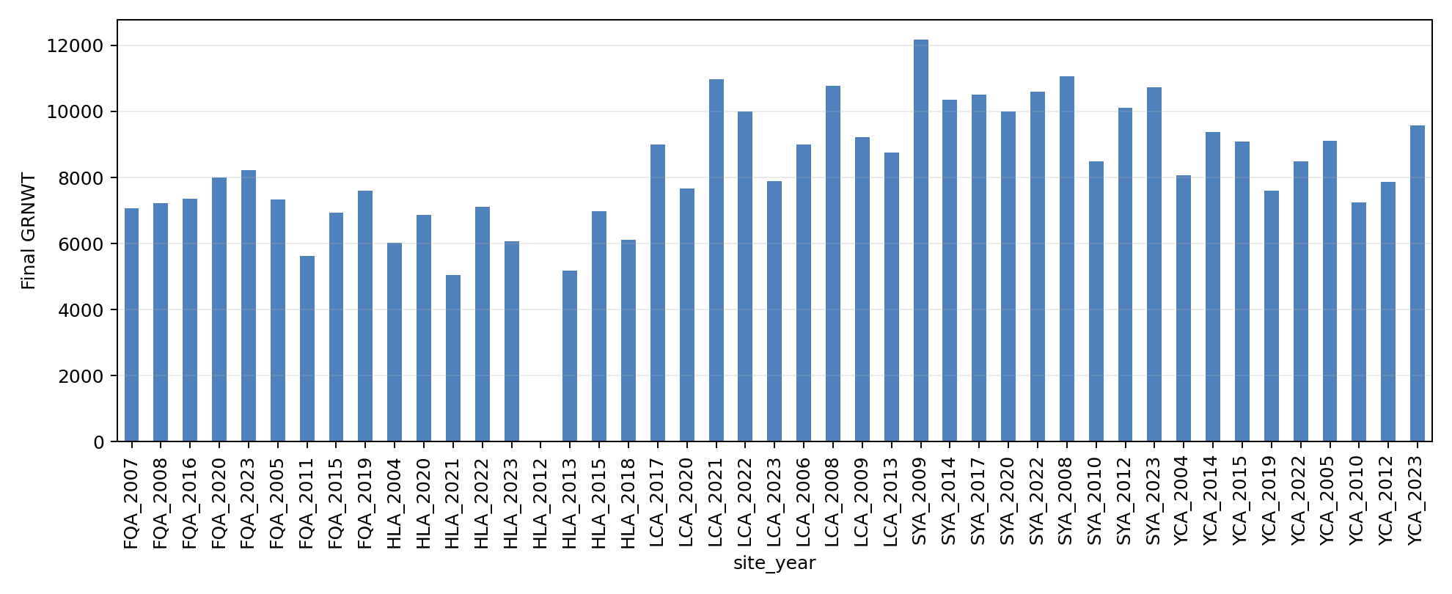
ppo final grnwt by station year

Slide 9
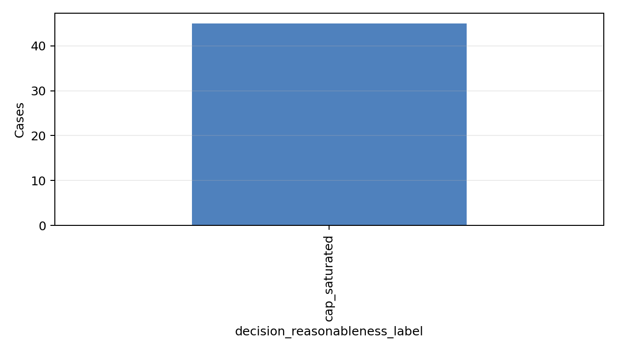
ppo decision reasonableness summary

Slide 10
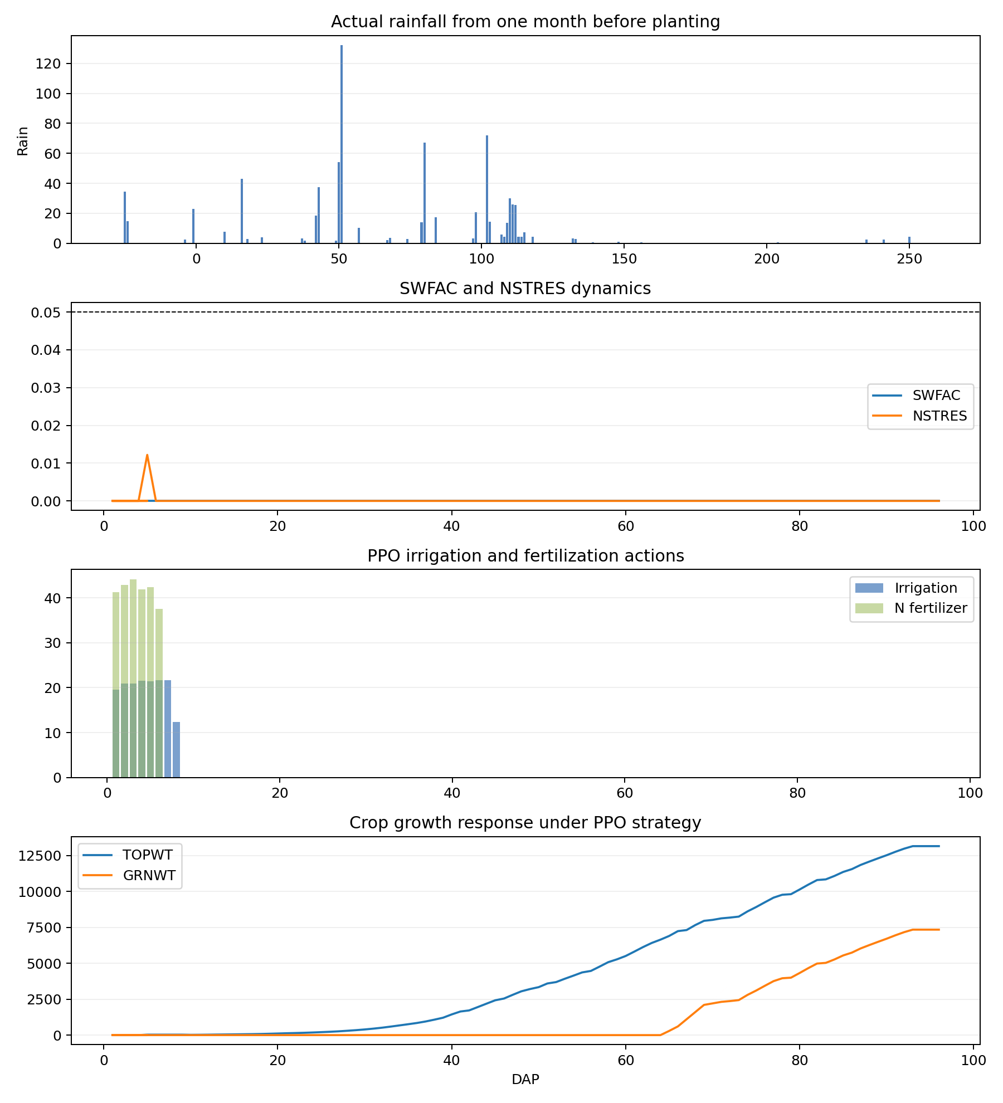
FQA_2005_four_panel

Slide 11
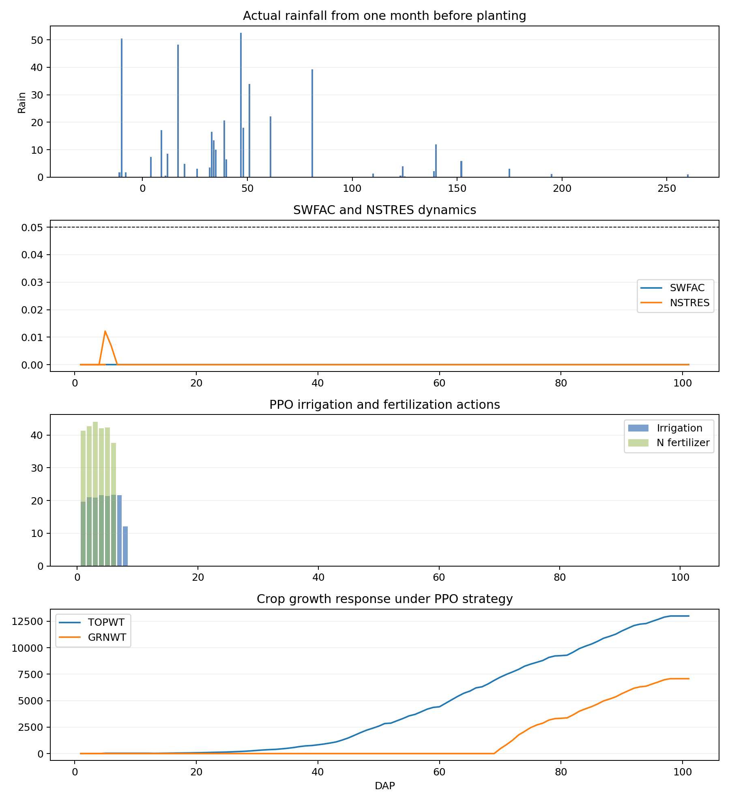
FQA_2007_four_panel

Slide 12
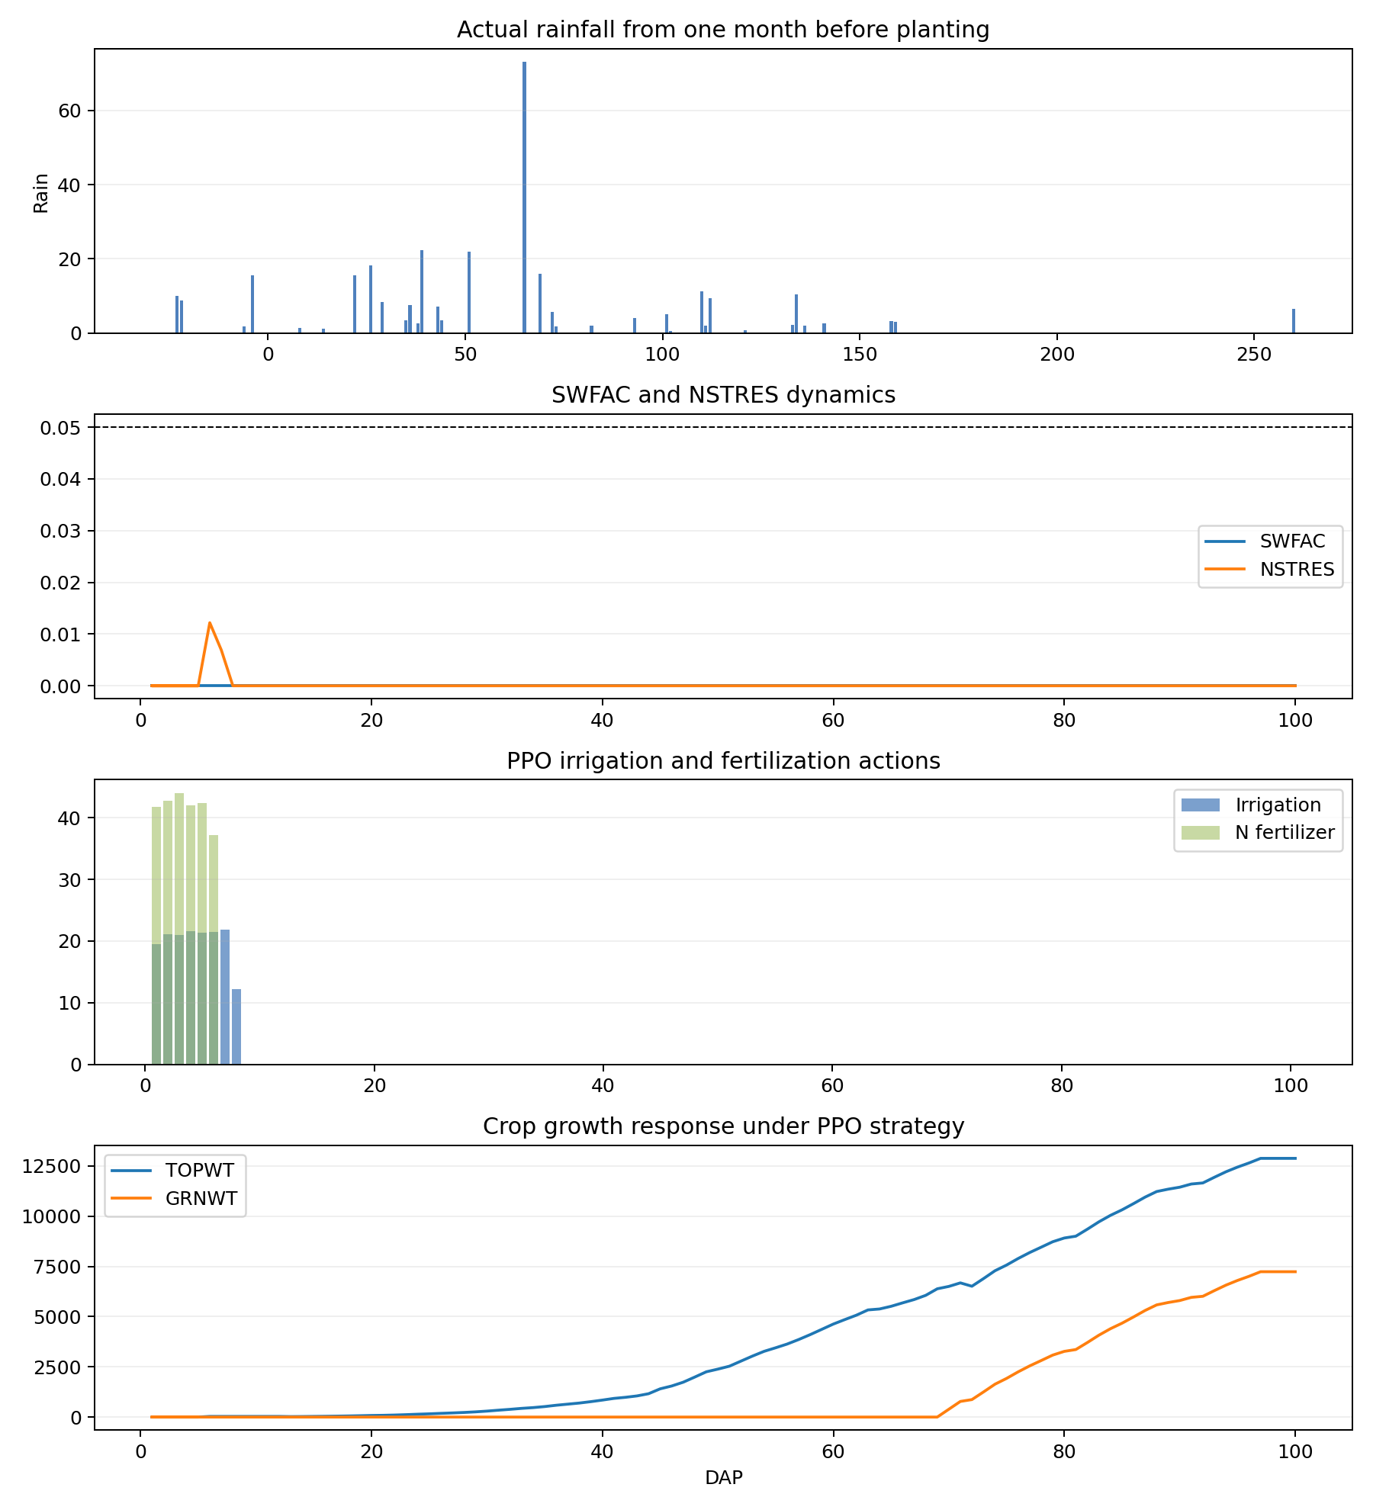
FQA_2008_four_panel

Slide 13
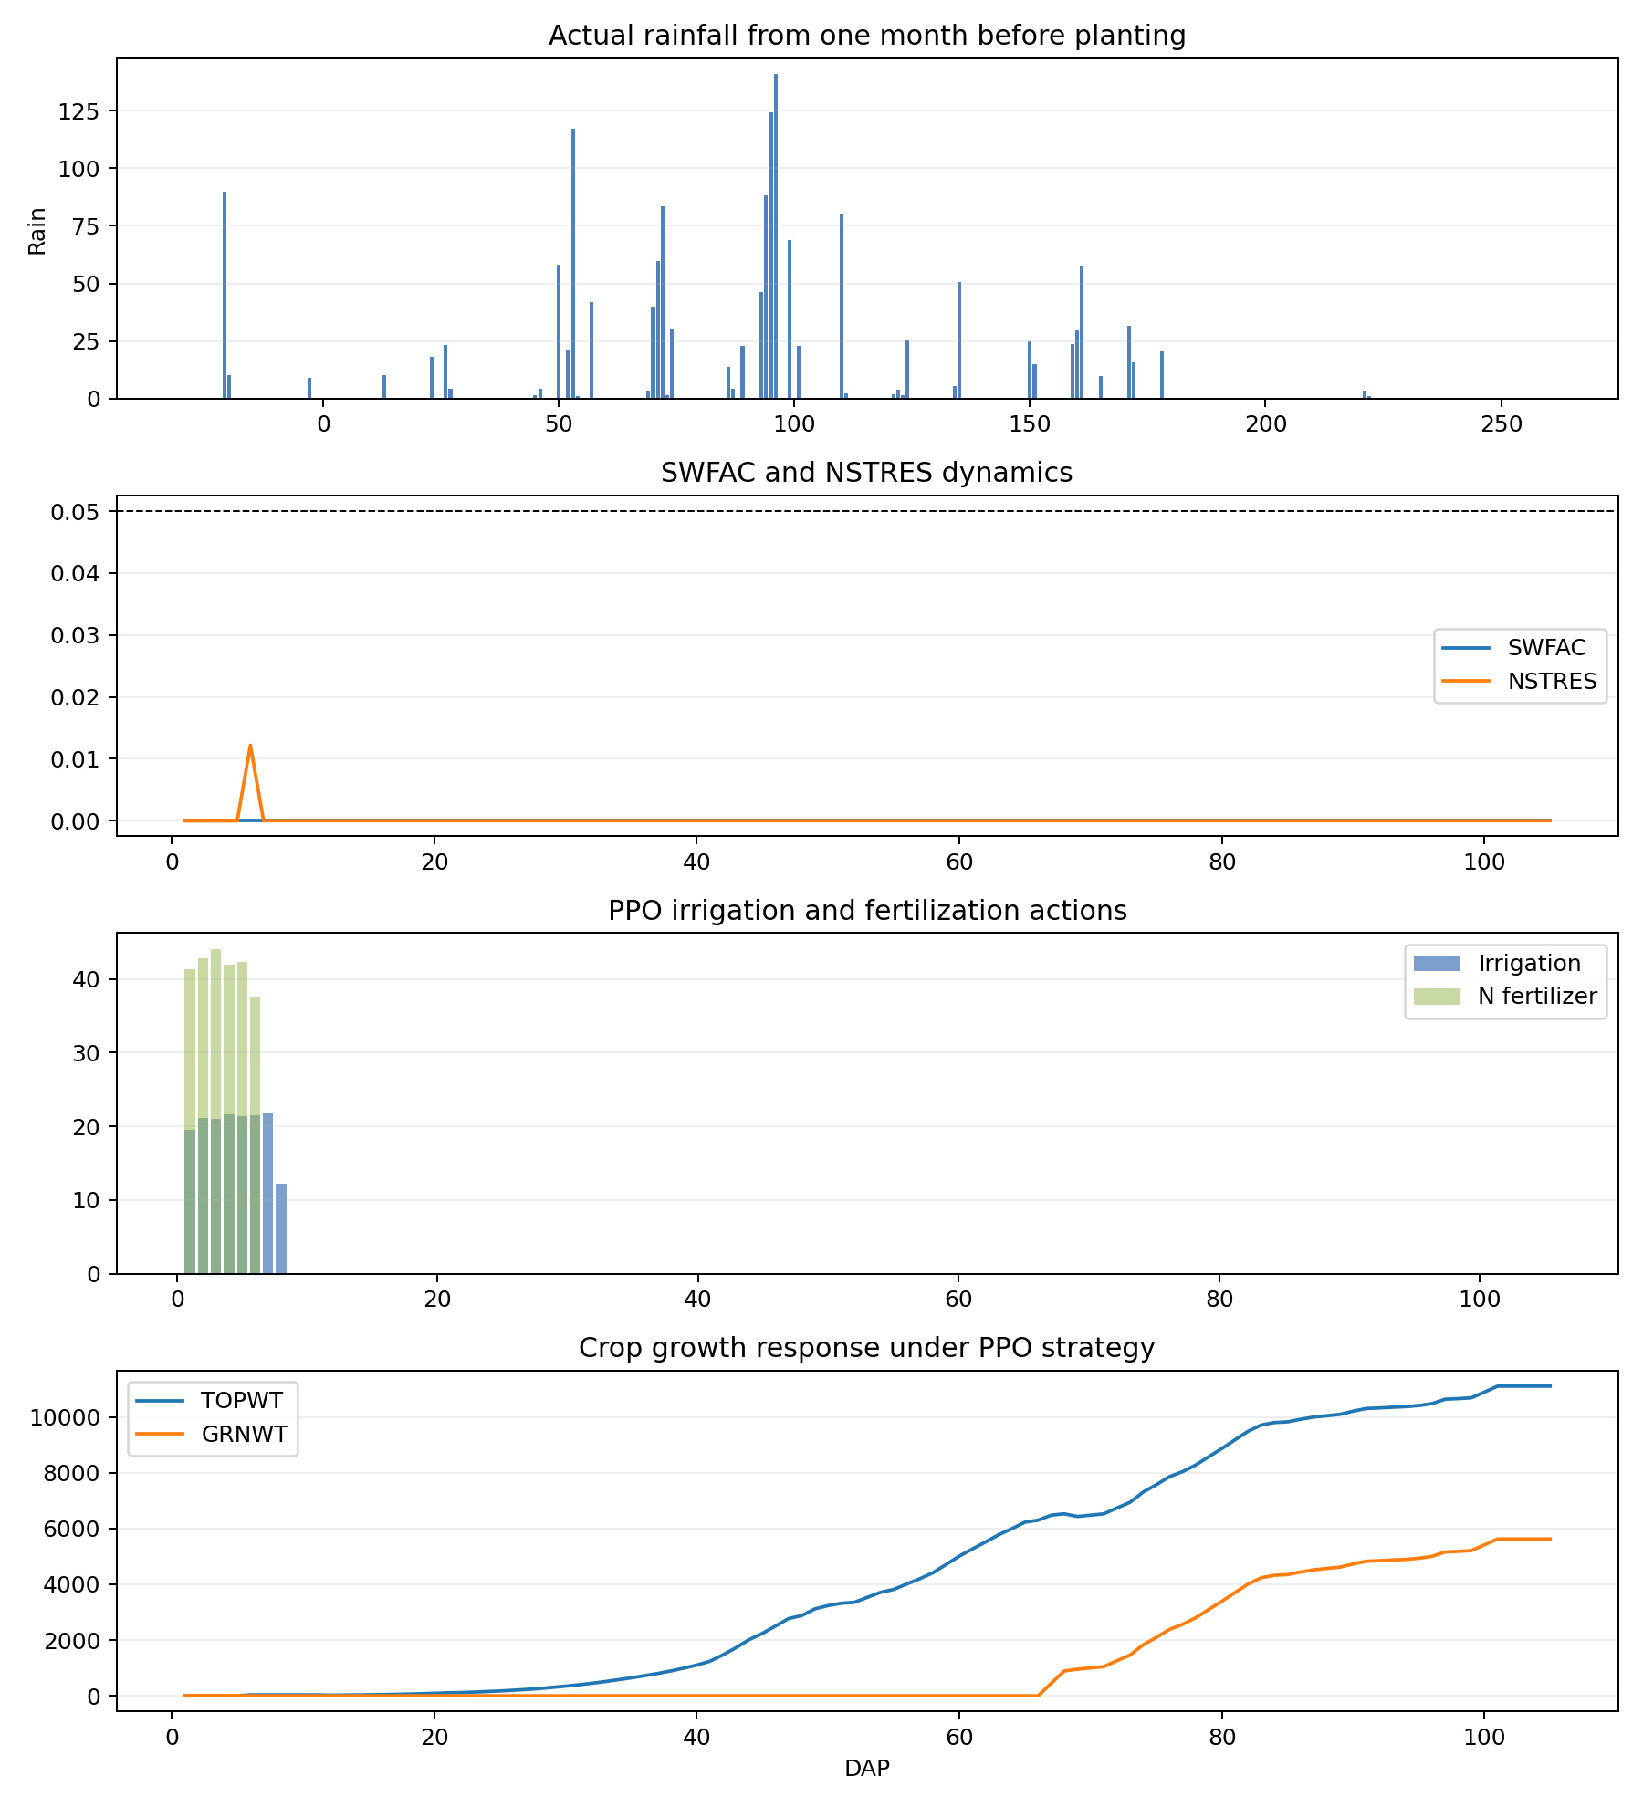
FQA_2011_four_panel

Slide 14
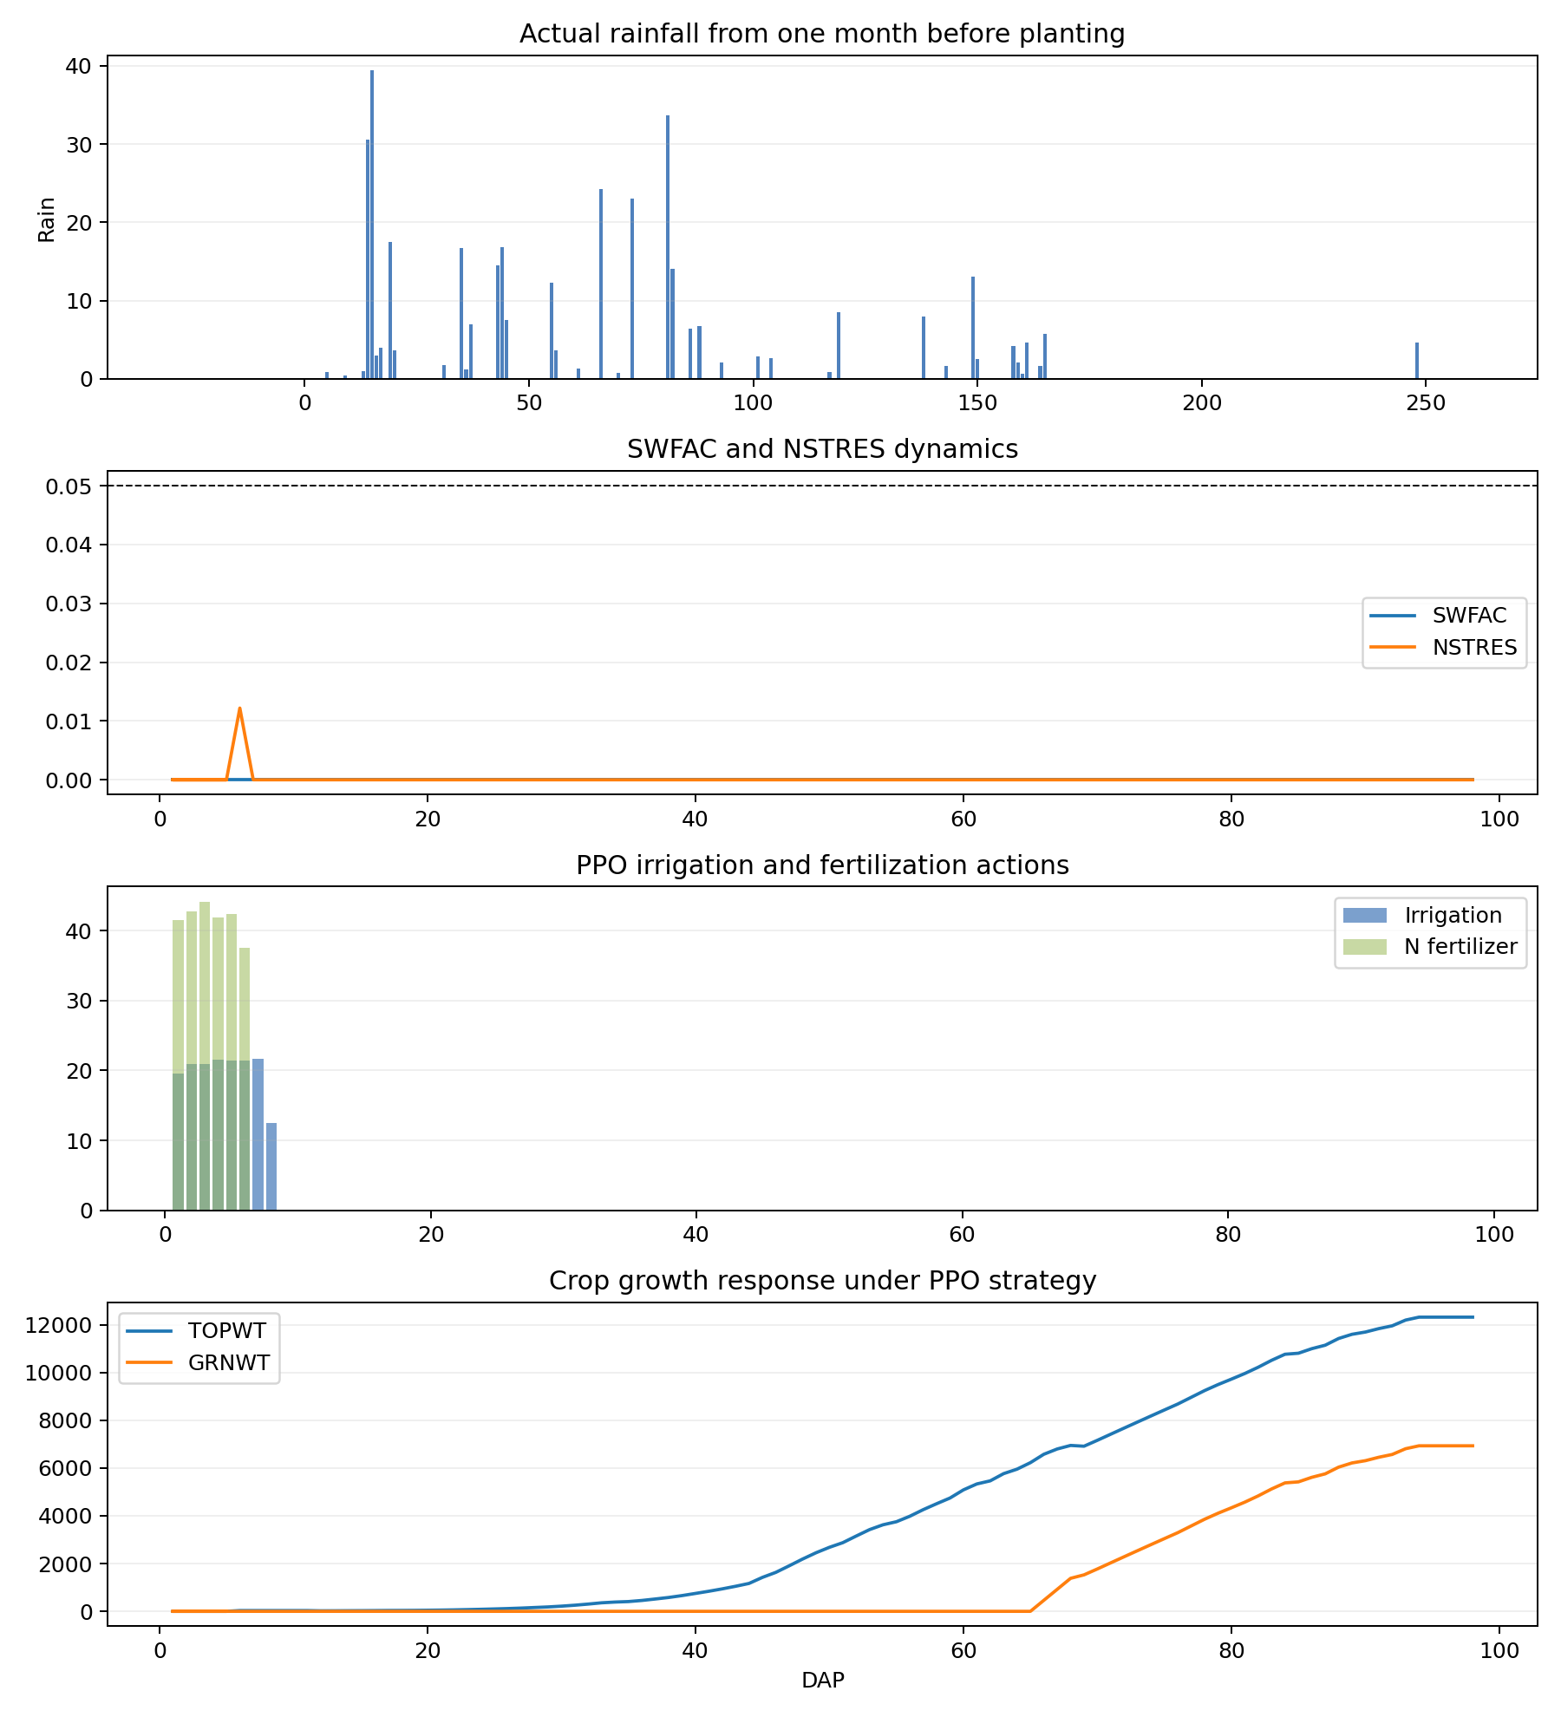
FQA_2015_four_panel

Slide 15
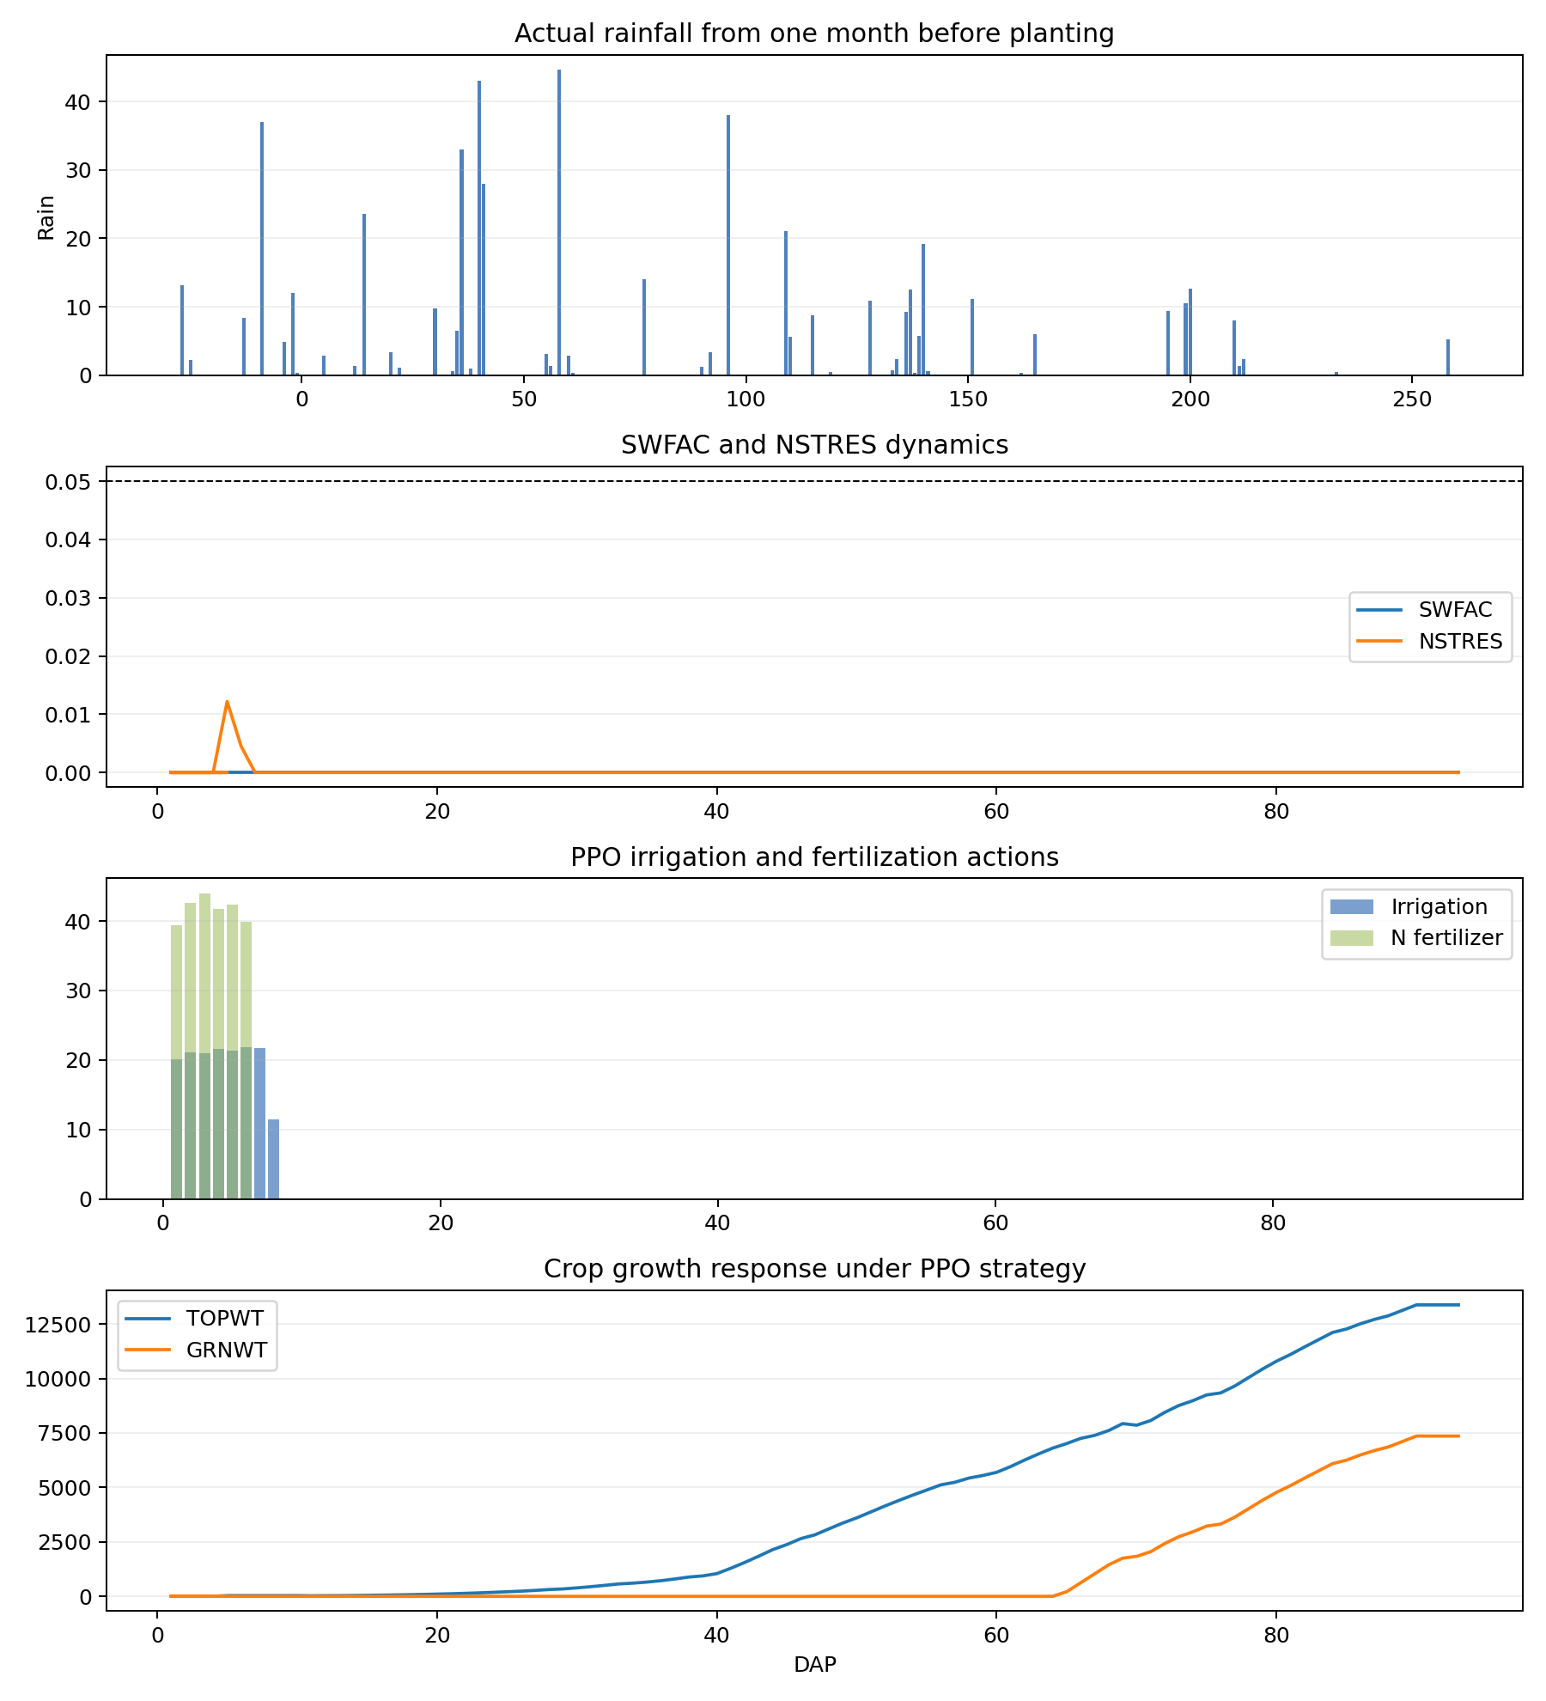
FQA_2016_four_panel

Slide 16
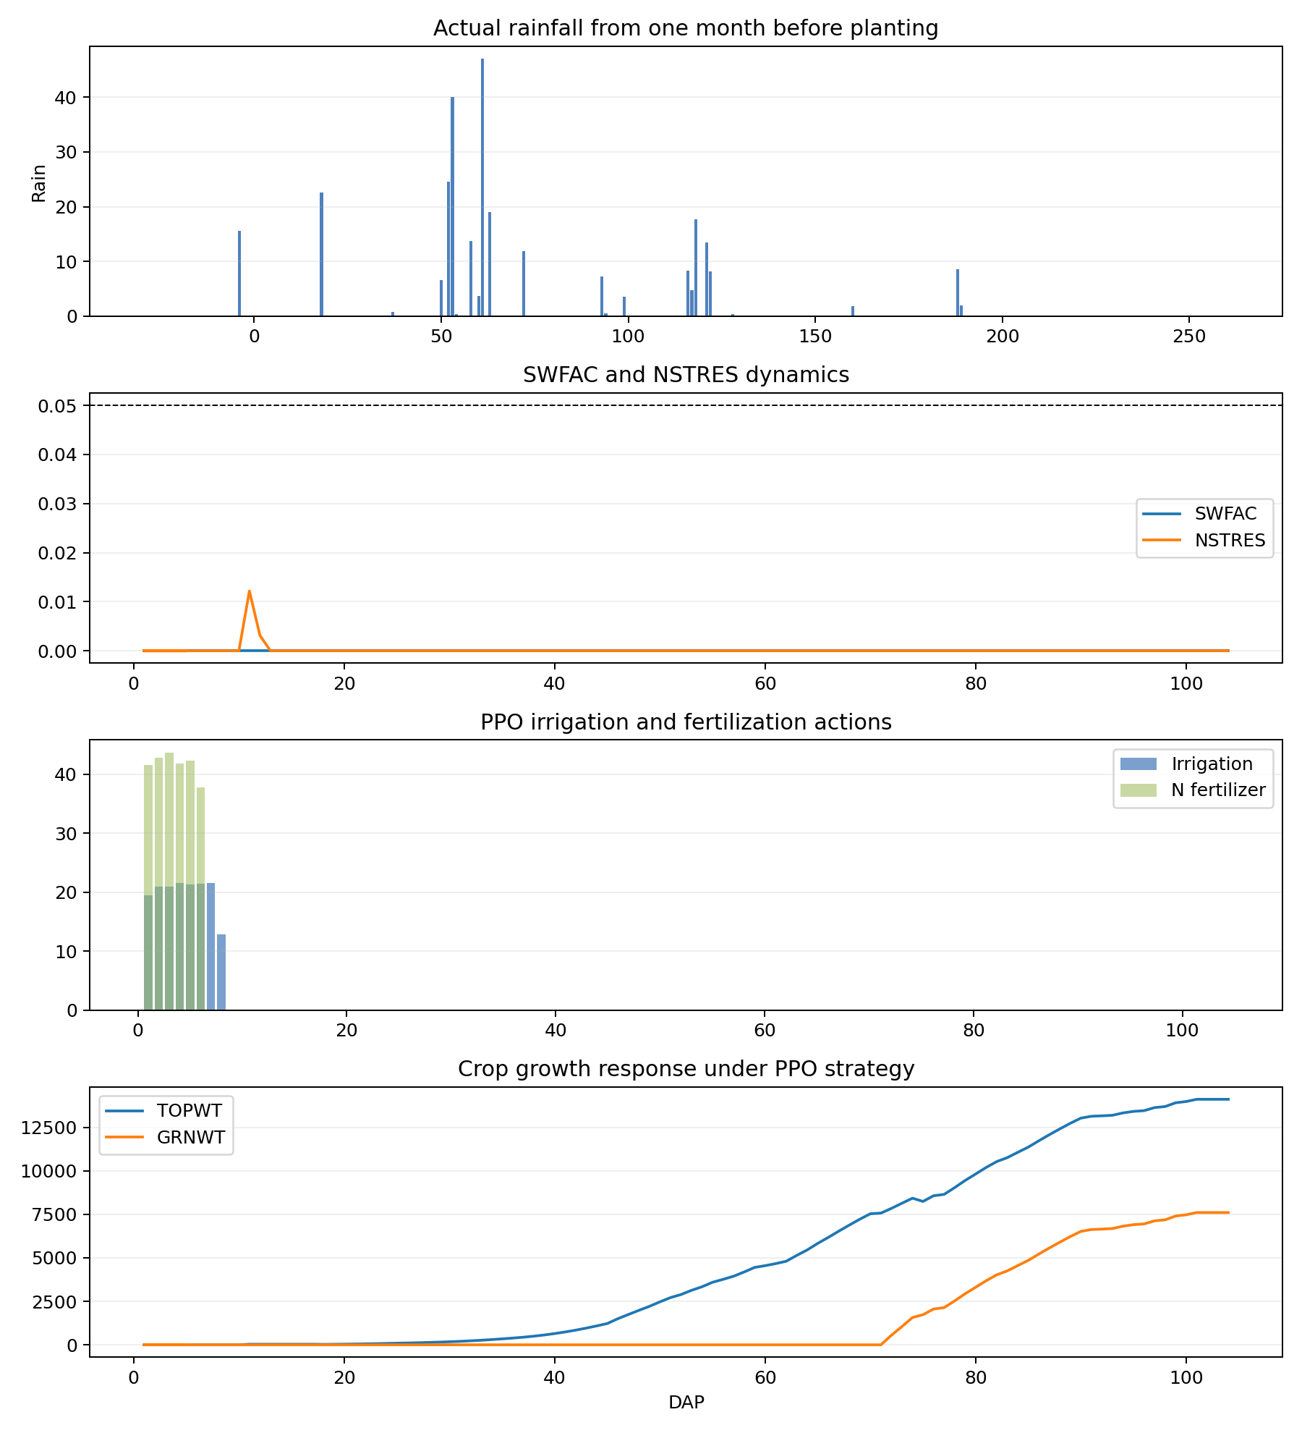
FQA_2019_four_panel

Slide 17
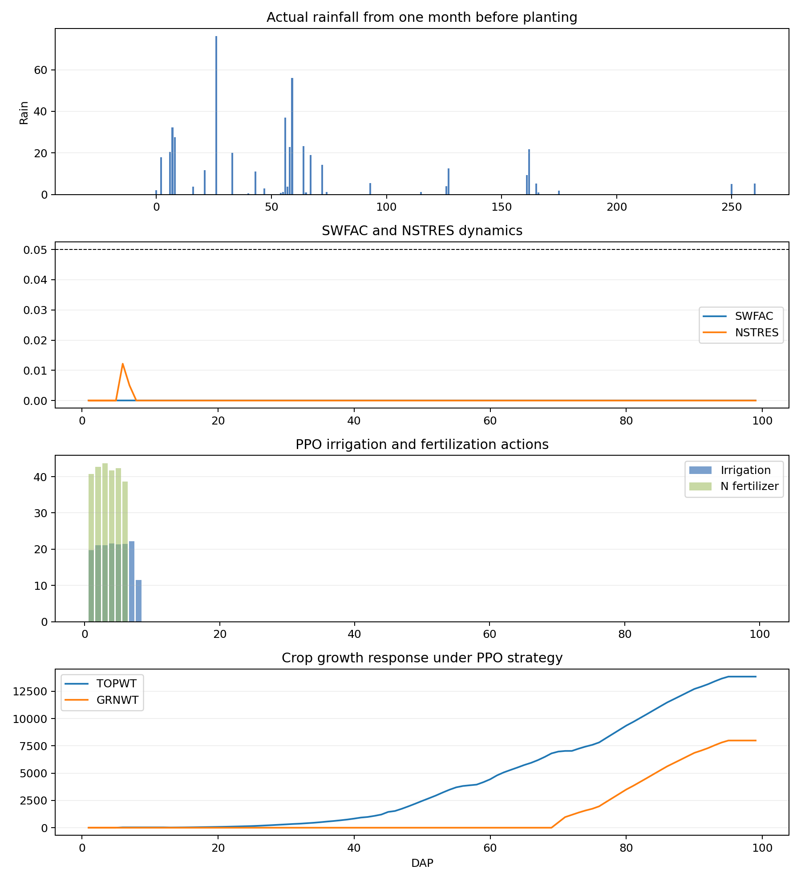
FQA_2020_four_panel

Slide 18
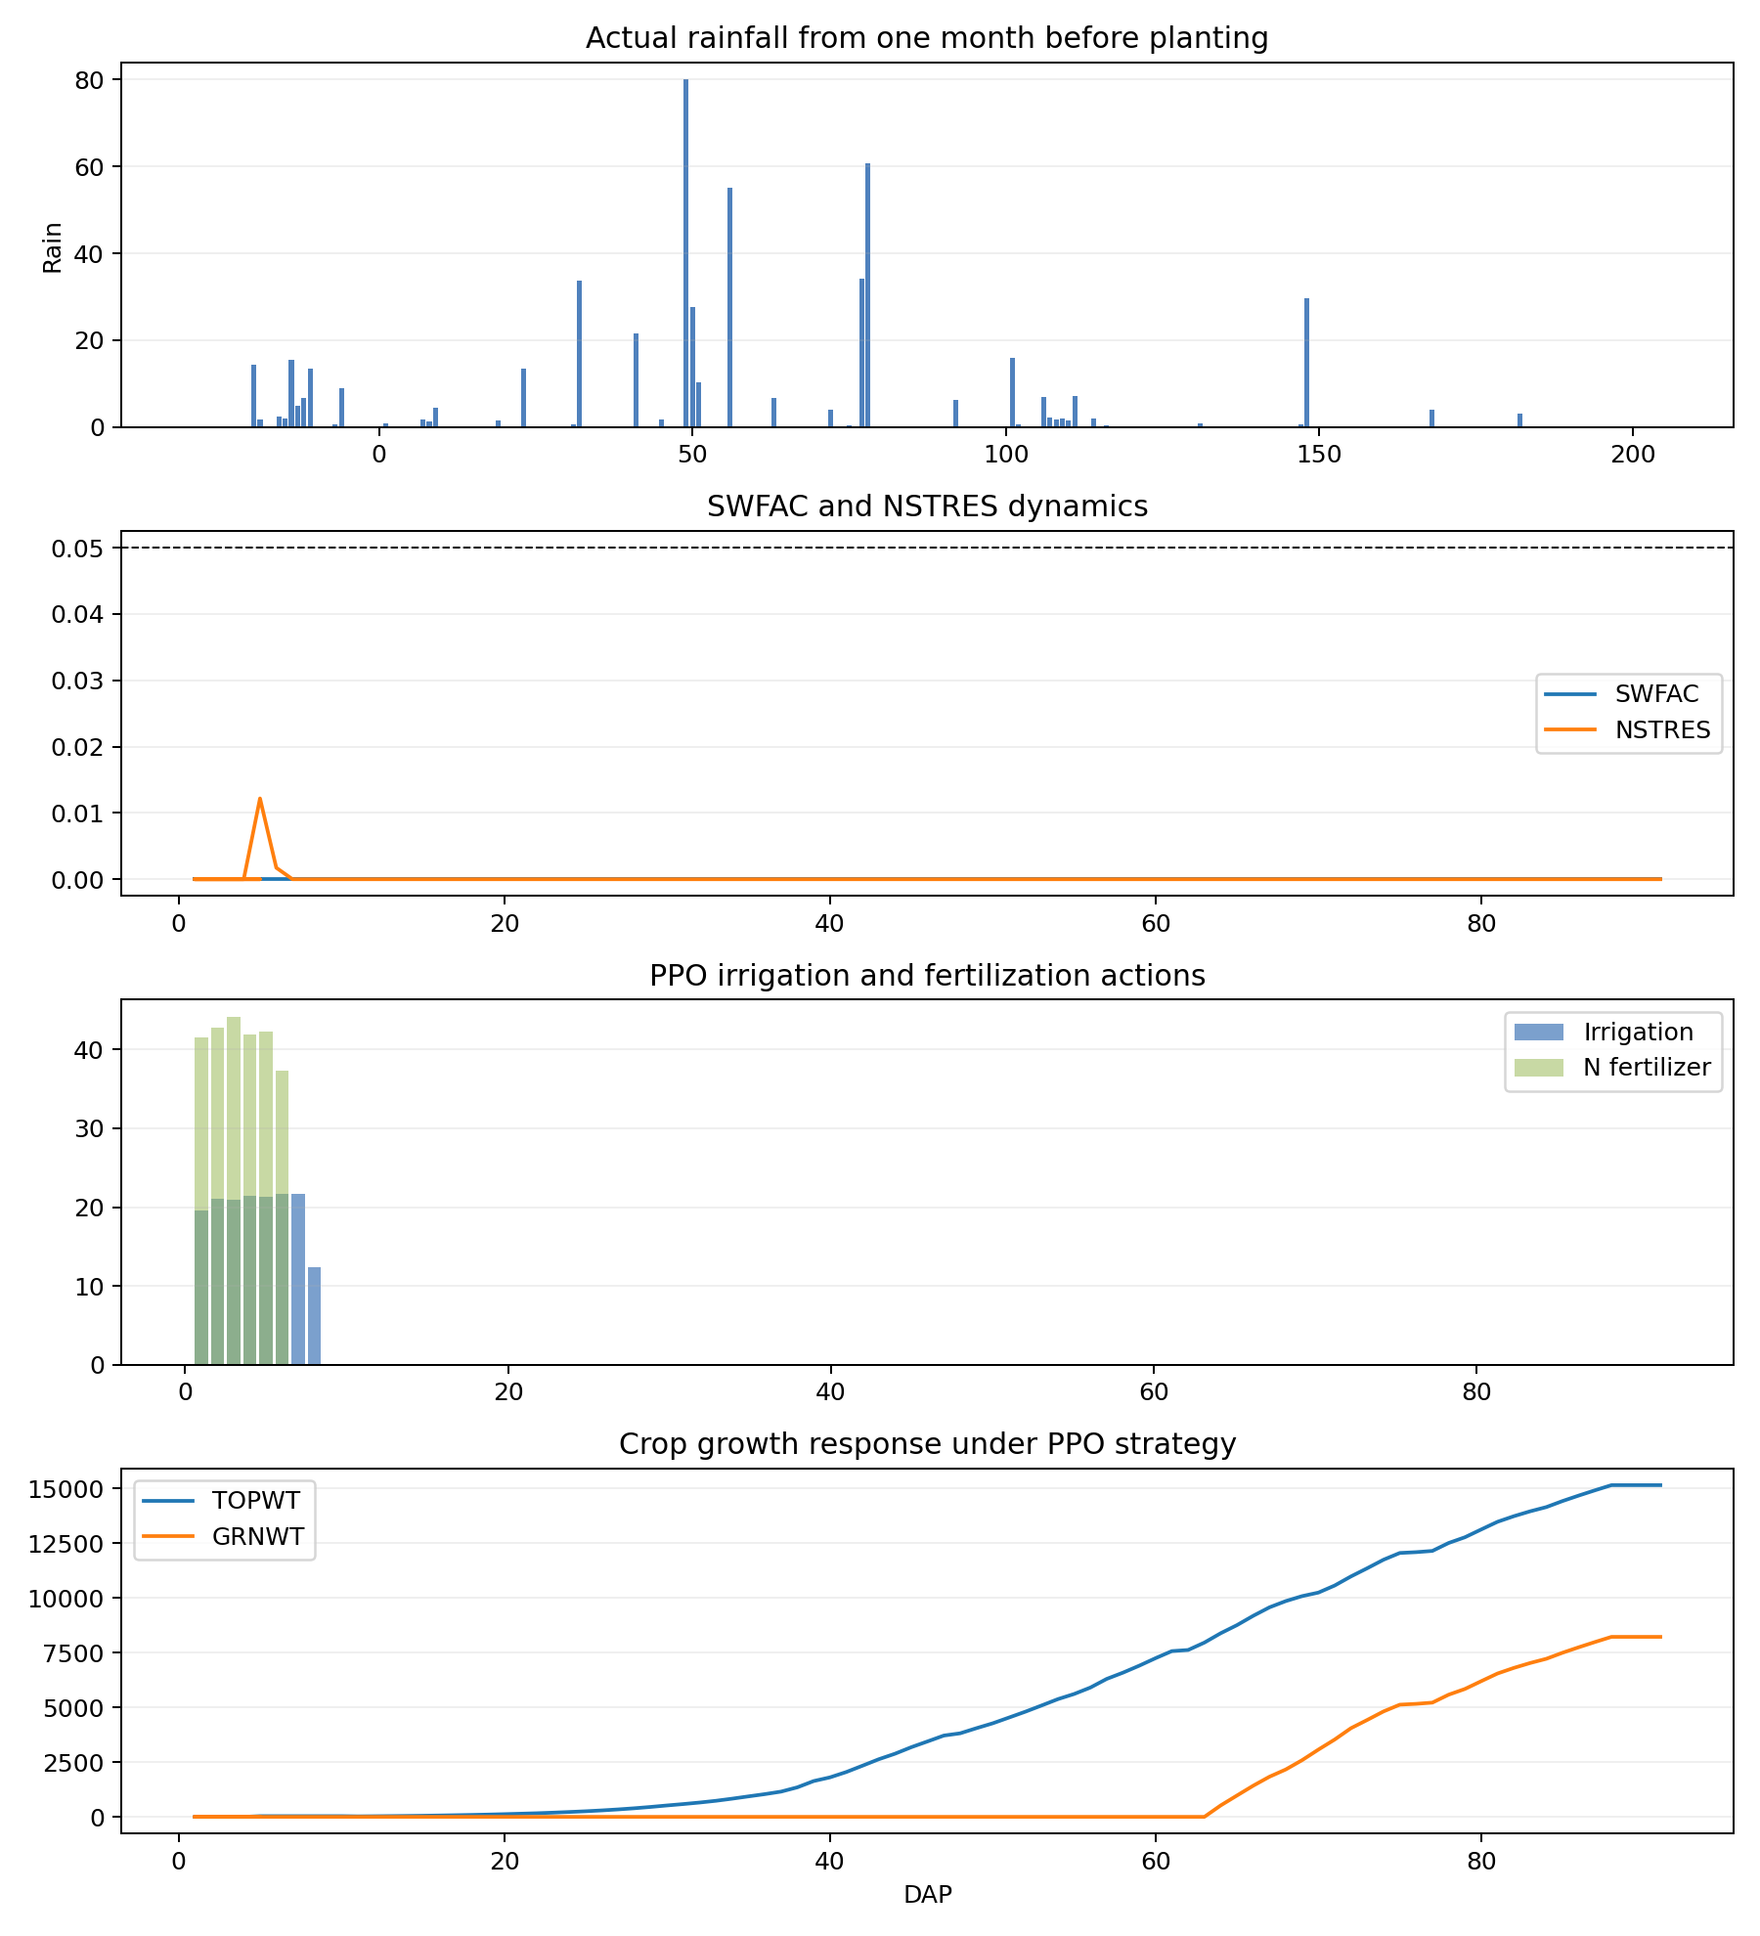
FQA_2023_four_panel

Slide 19
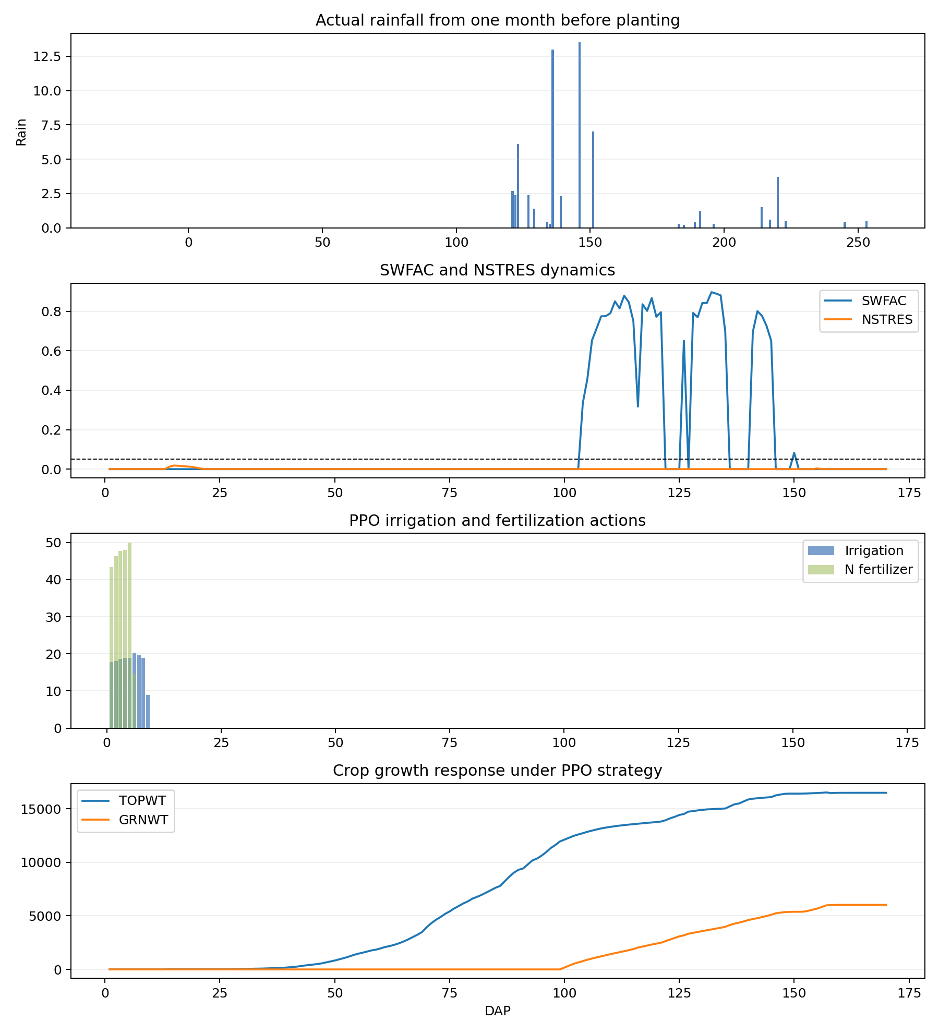
HLA_2004_four_panel

Slide 20
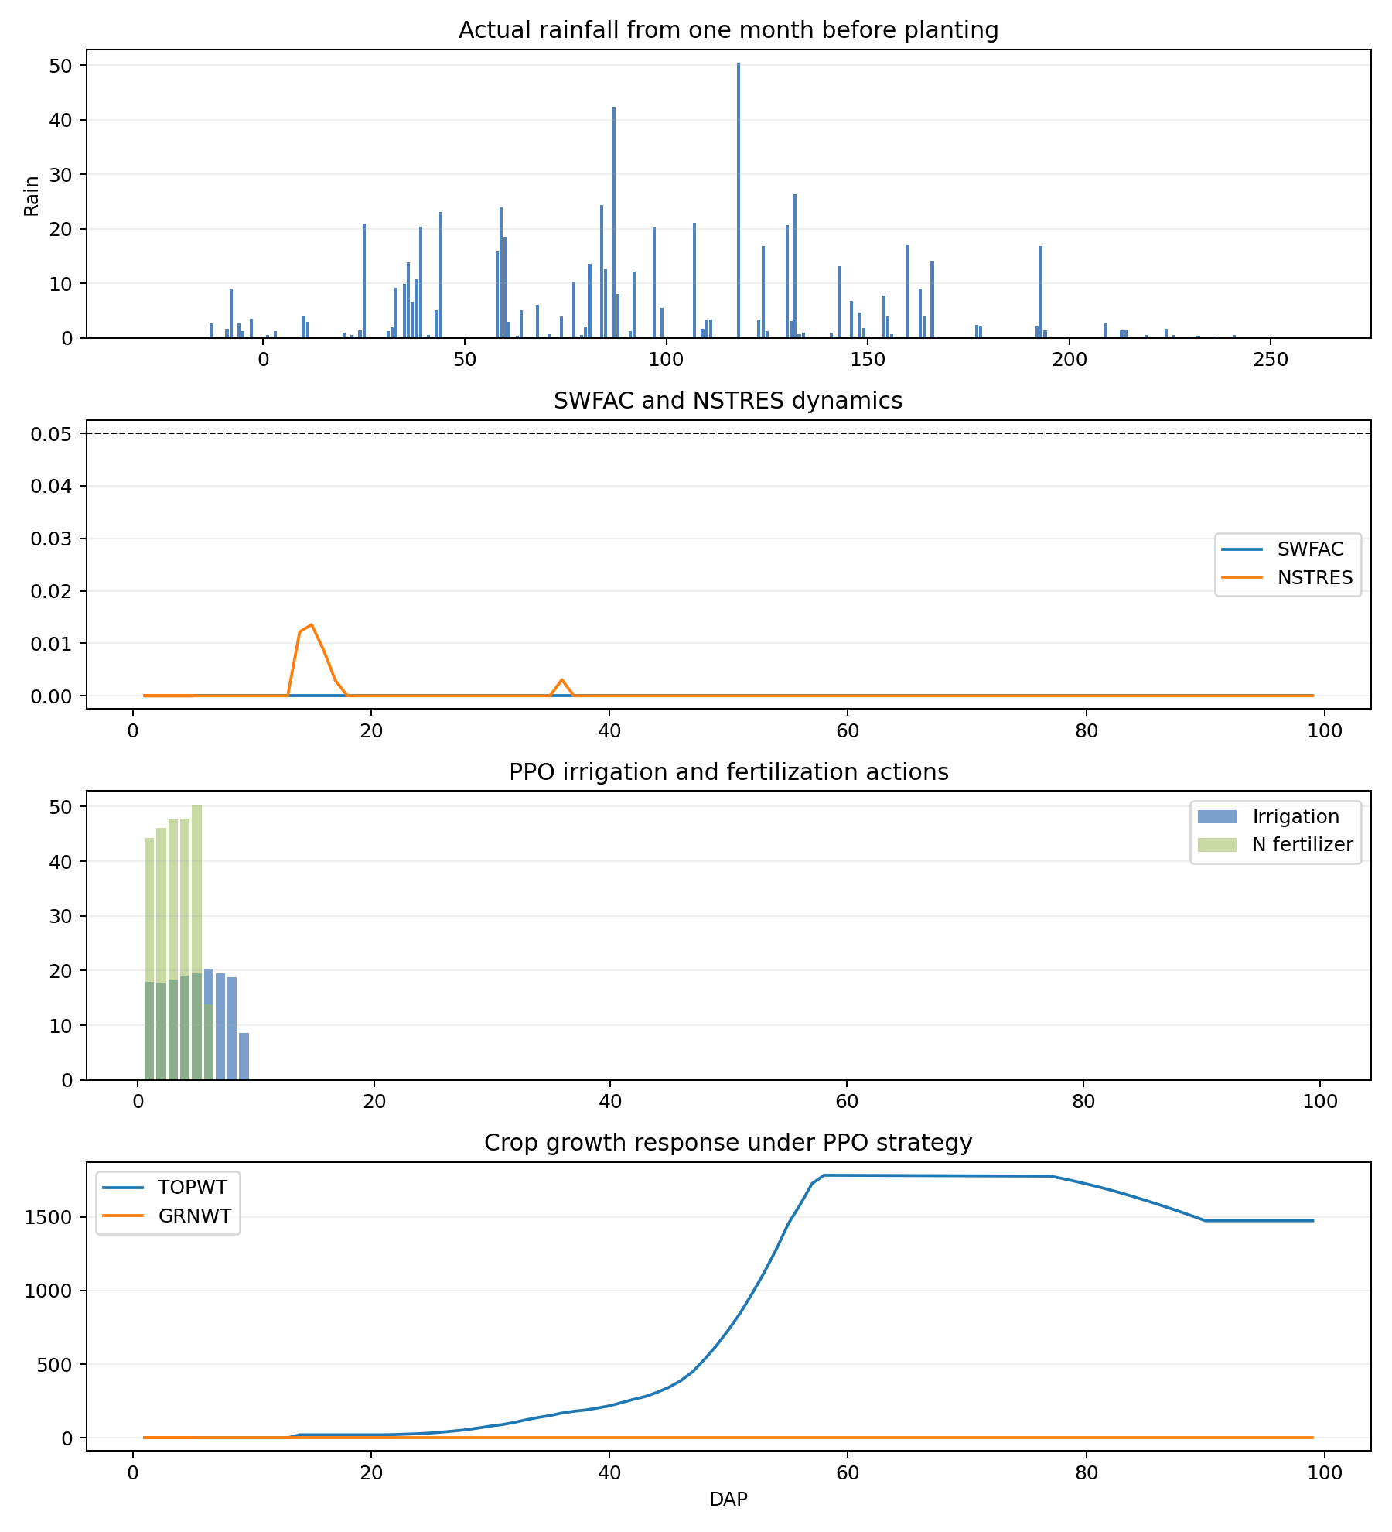
HLA_2012_four_panel

Slide 21
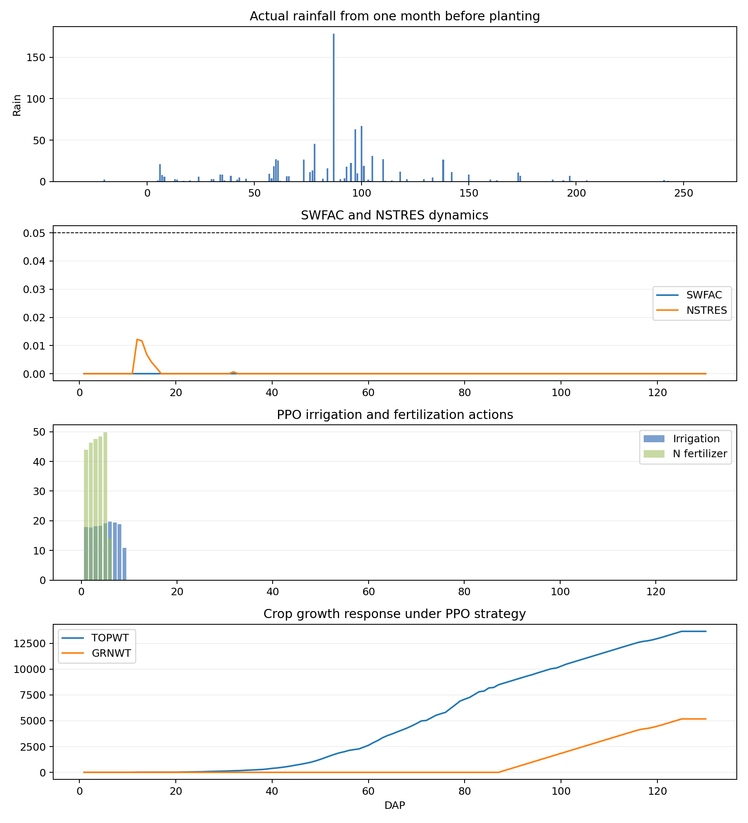
HLA_2013_four_panel

Slide 22
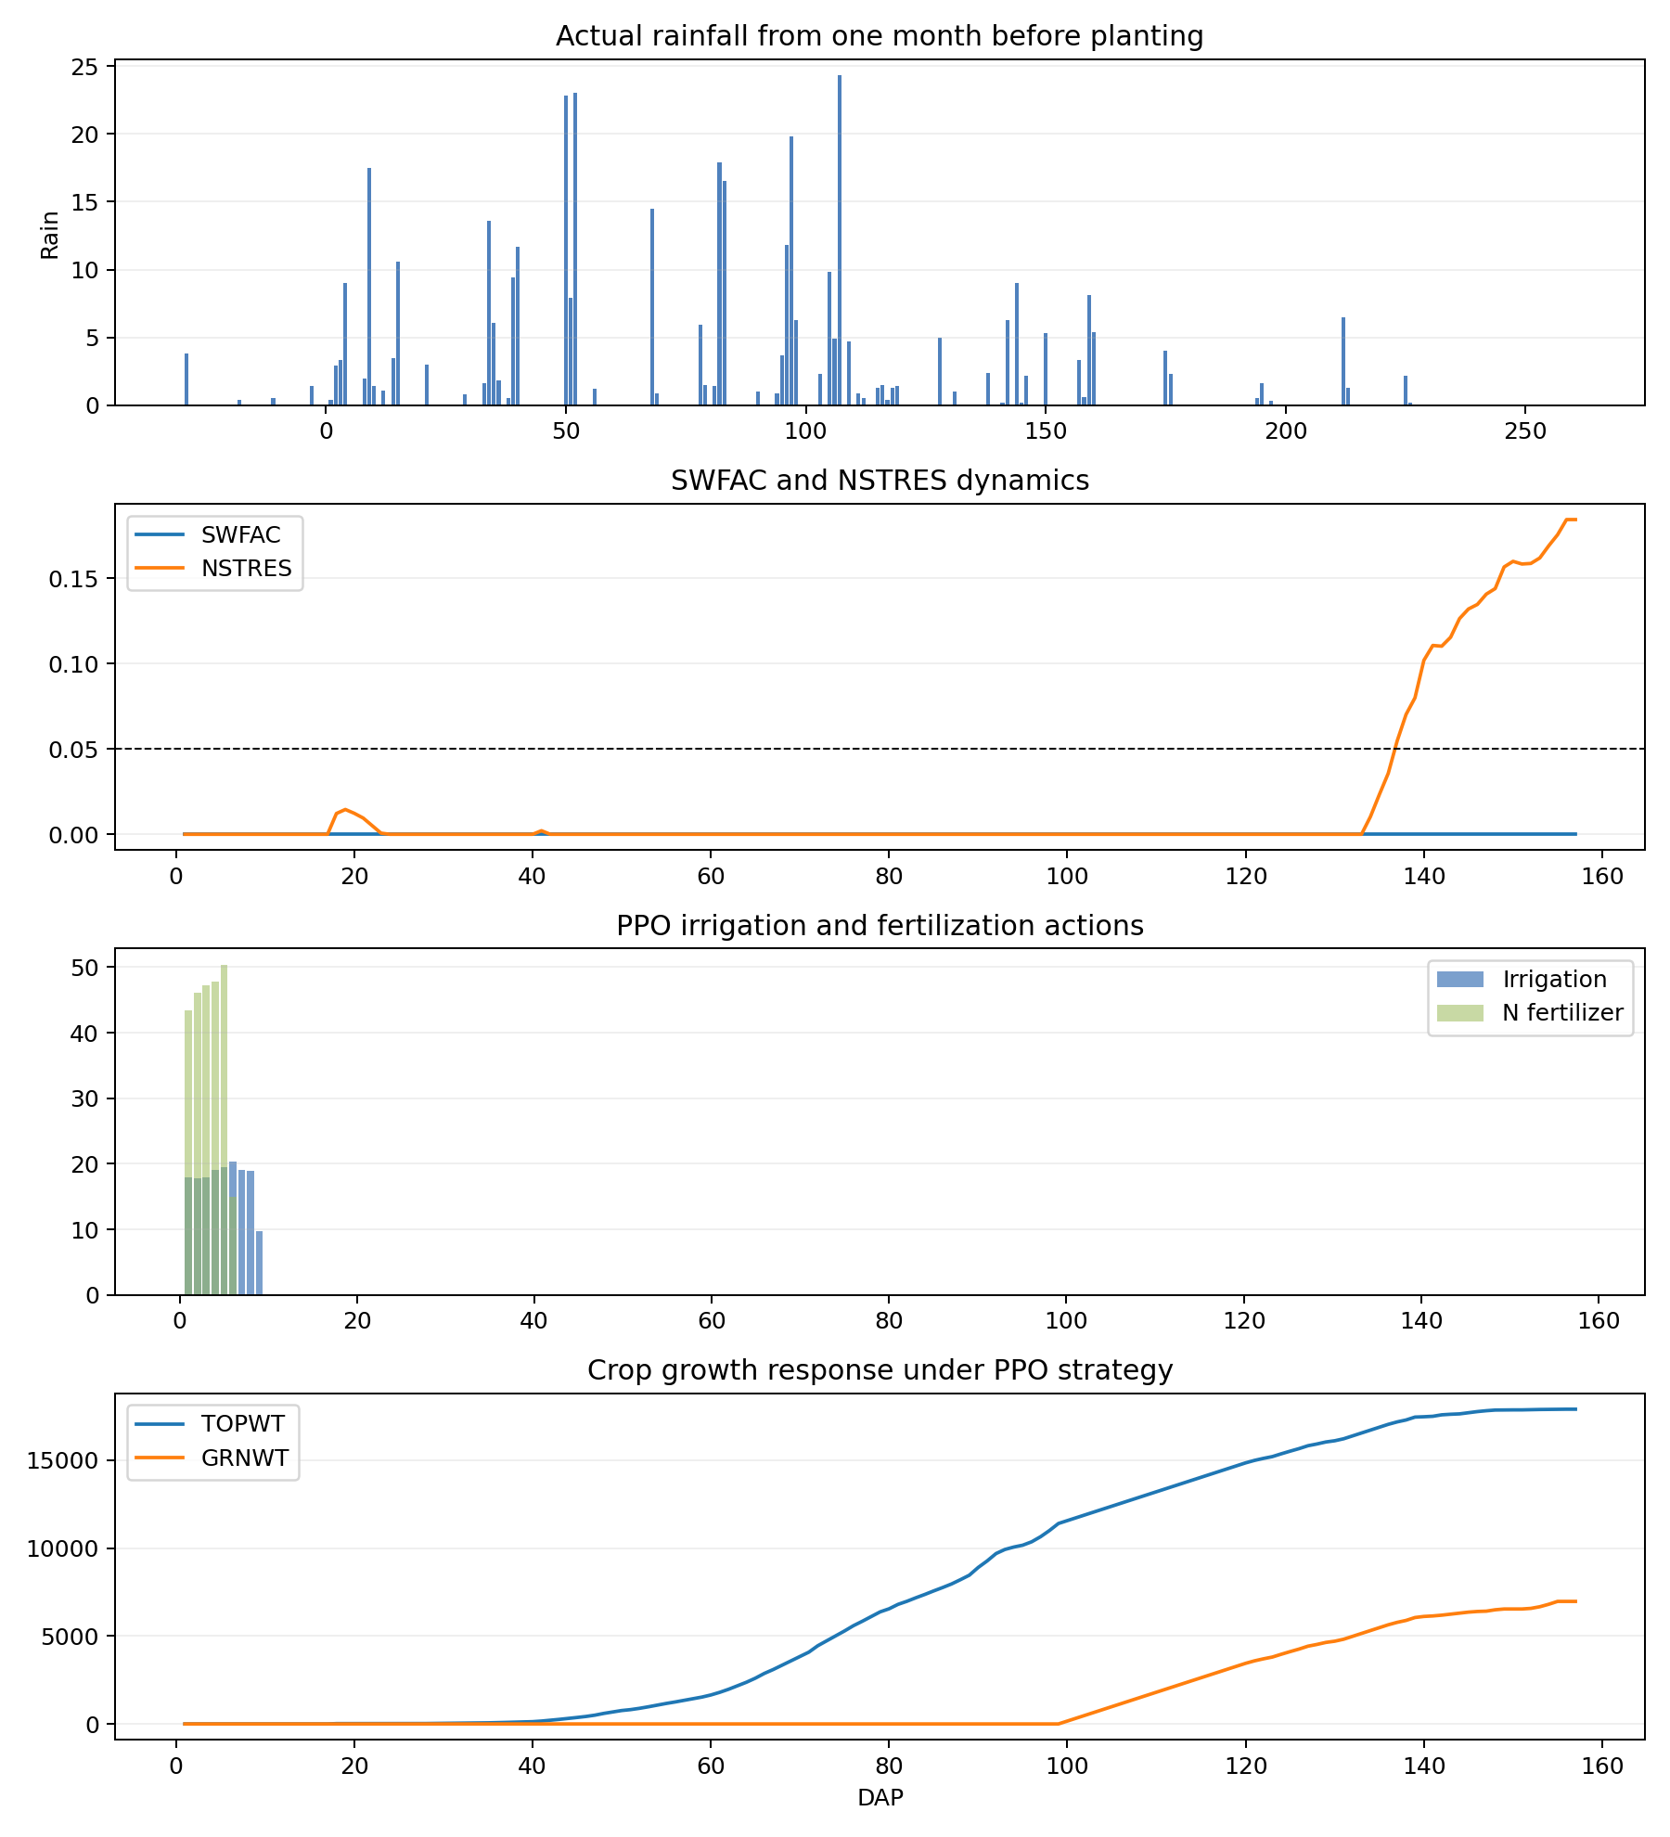
HLA_2015_four_panel

Slide 23
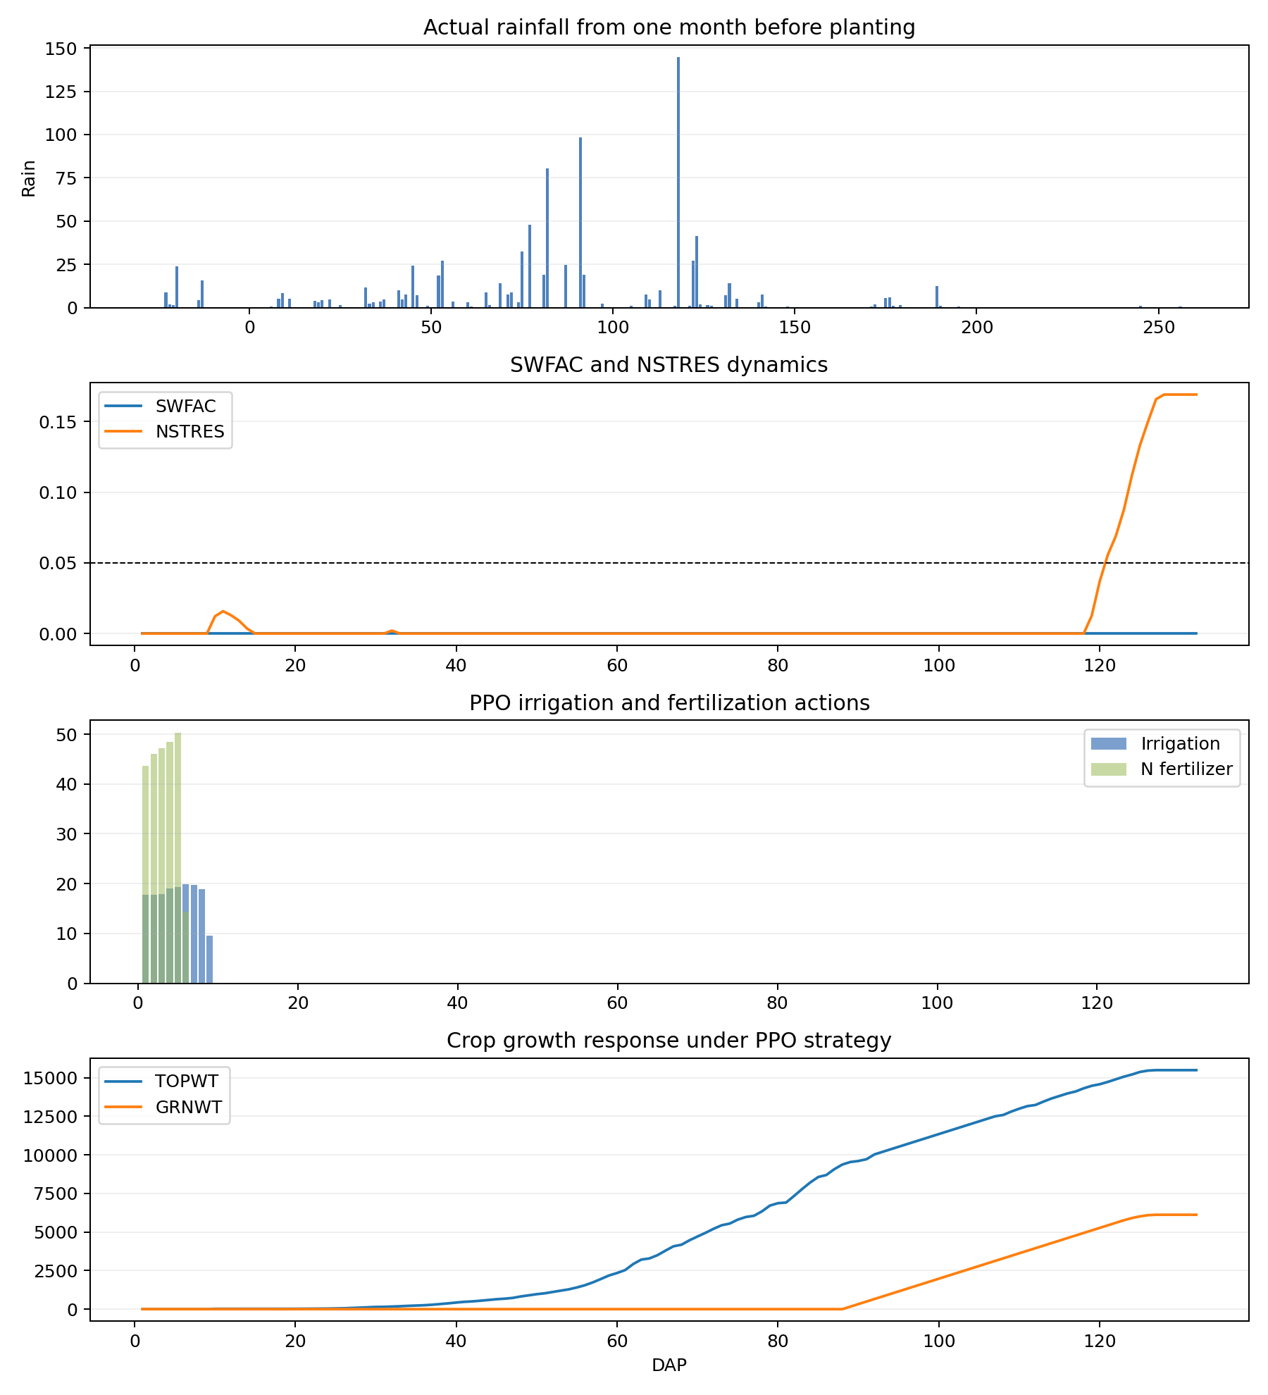
HLA_2018_four_panel

Slide 24
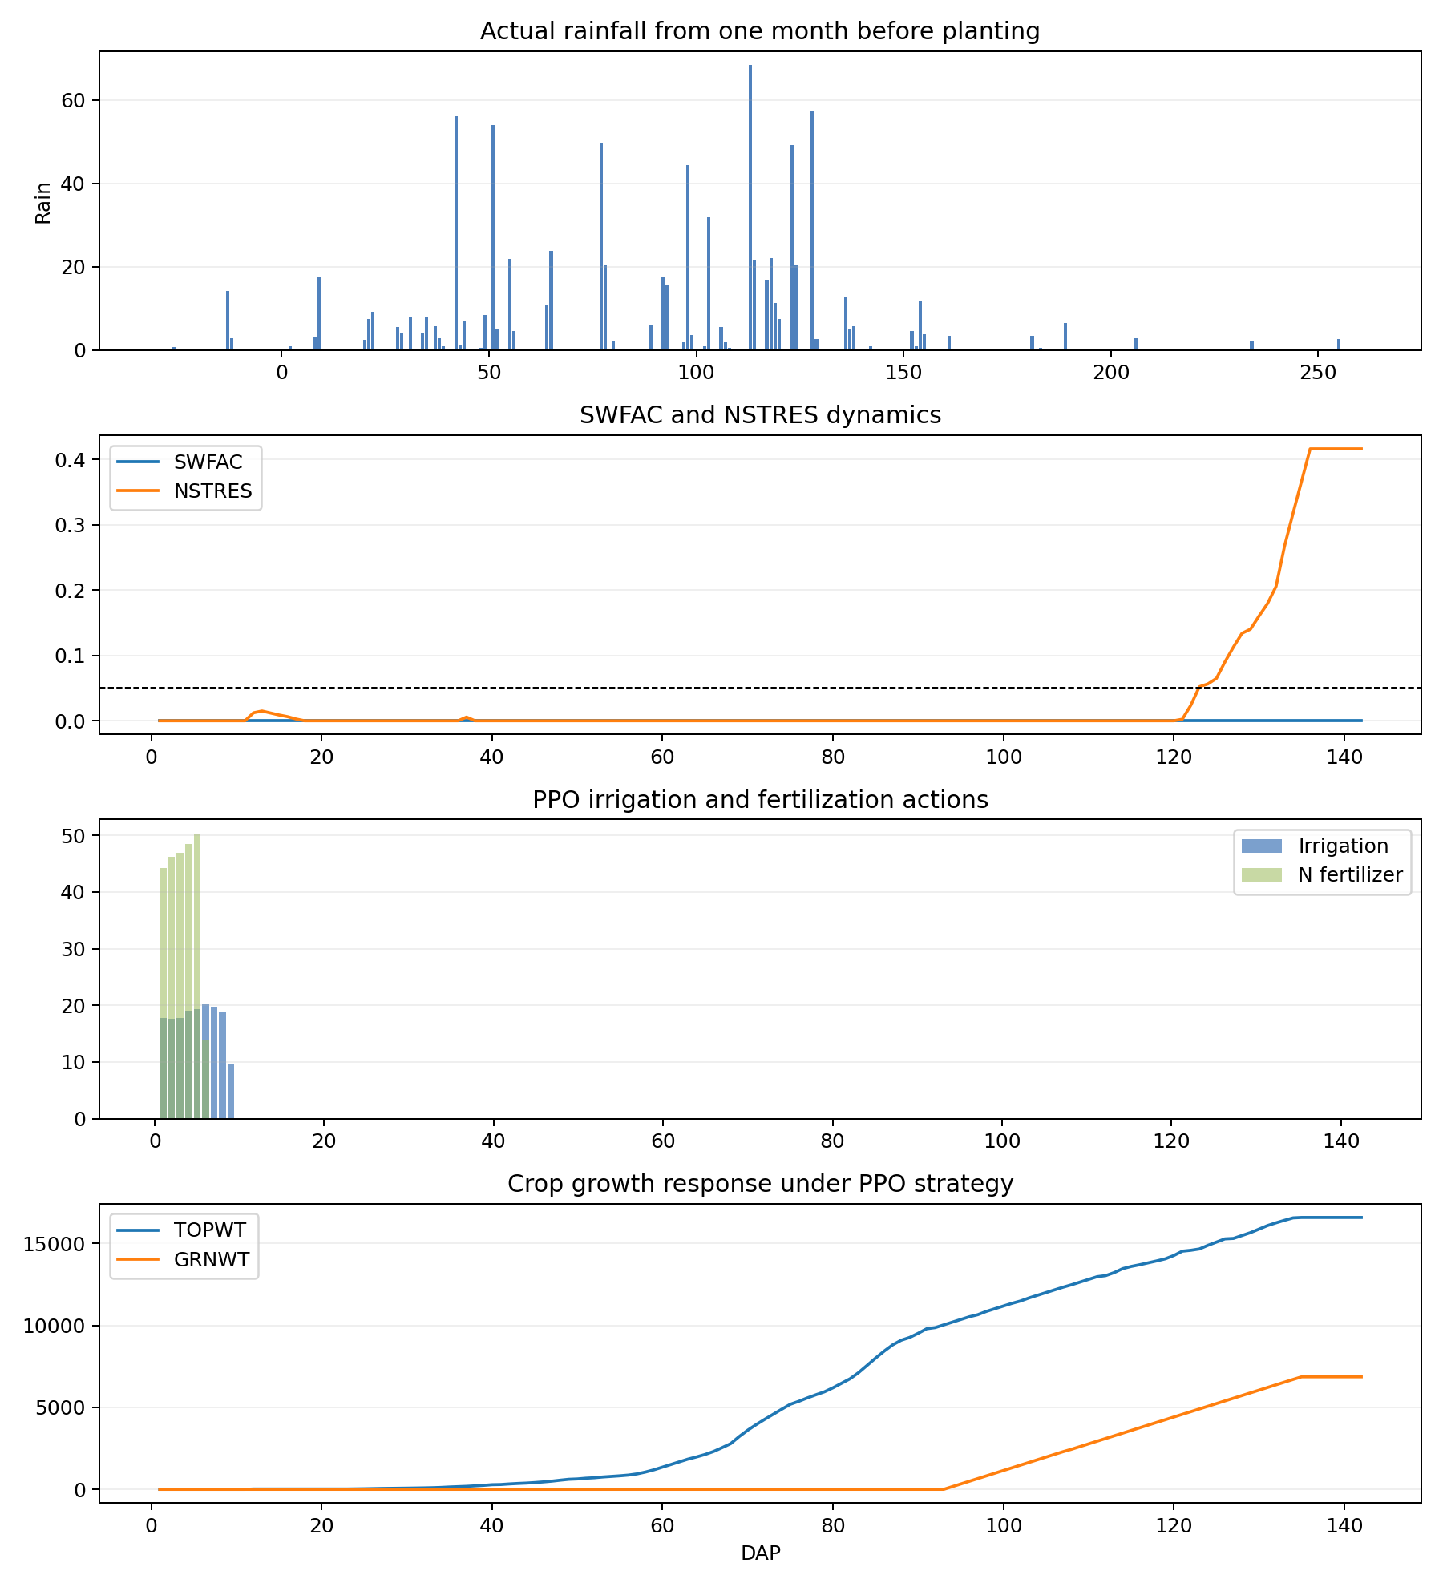
HLA_2020_four_panel

Slide 25
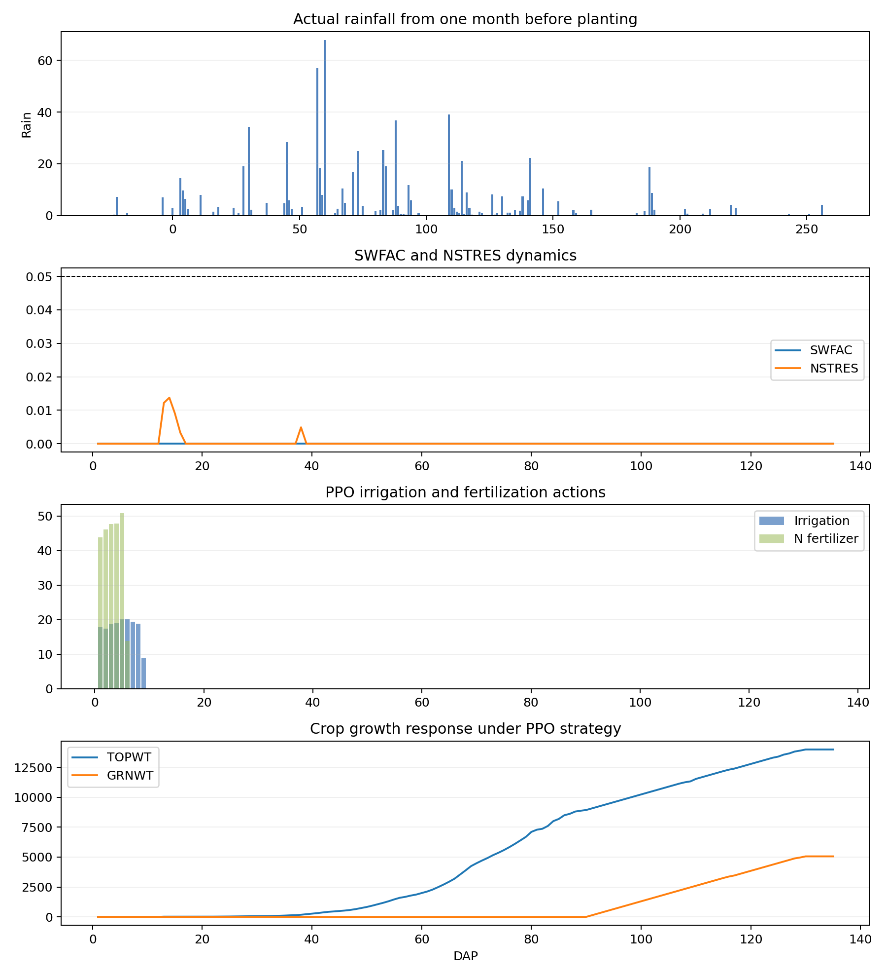
HLA_2021_four_panel

Slide 26
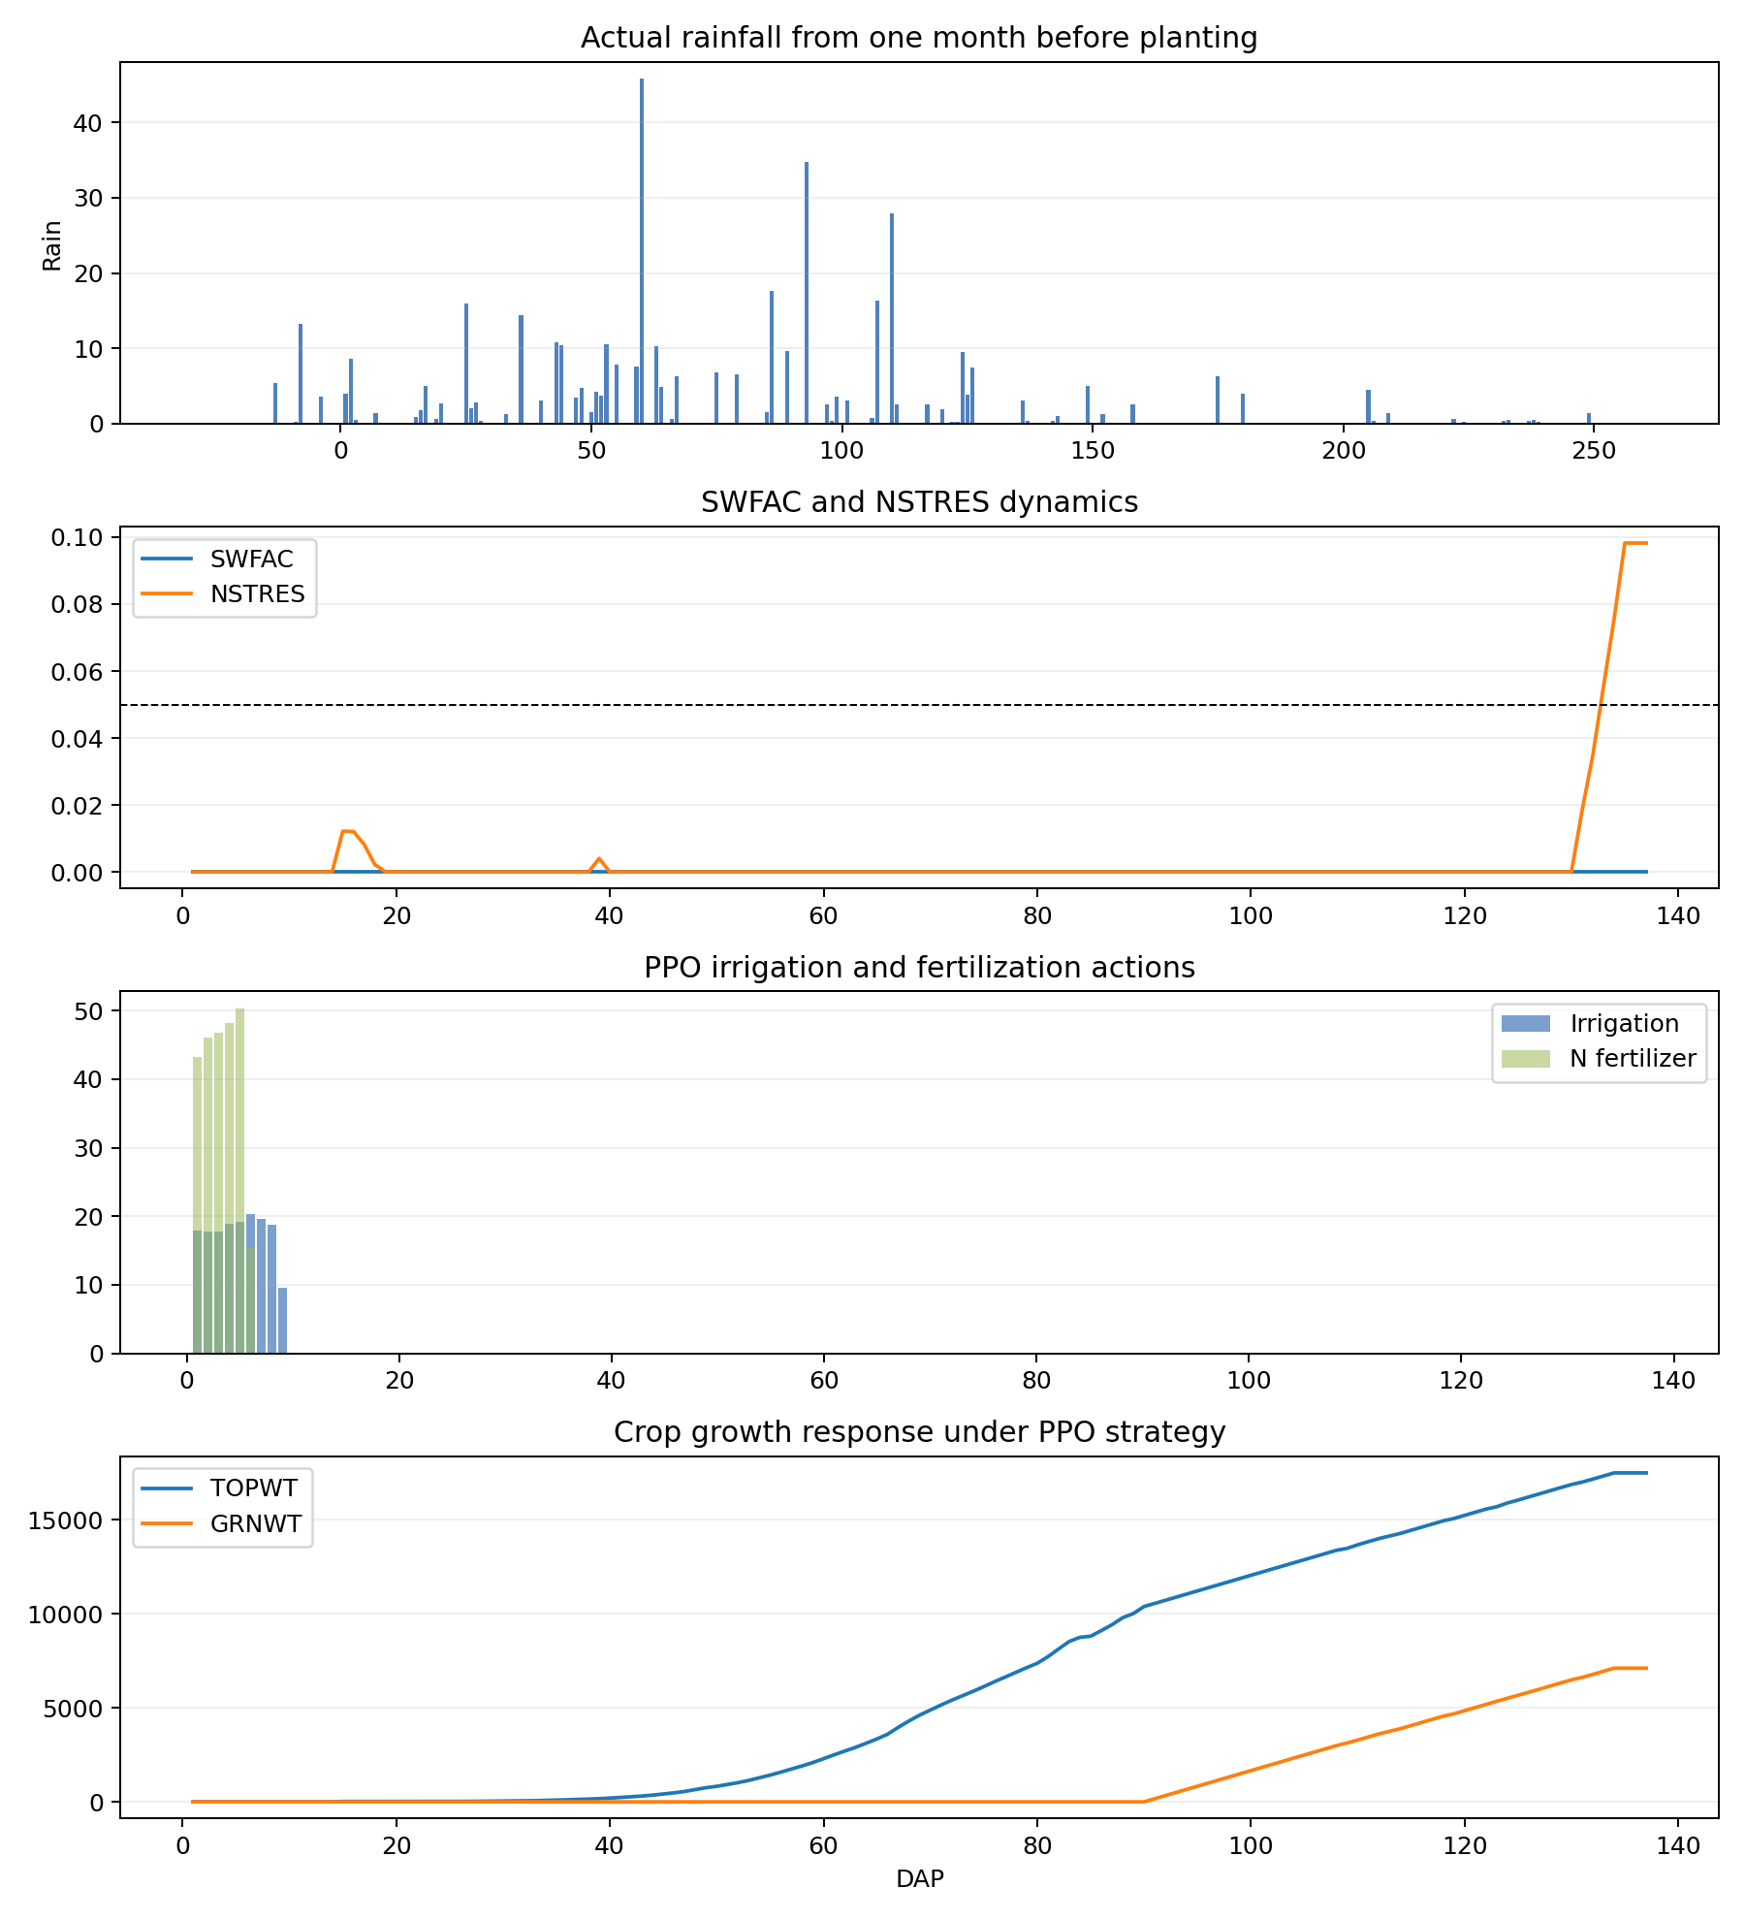
HLA_2022_four_panel

Slide 27
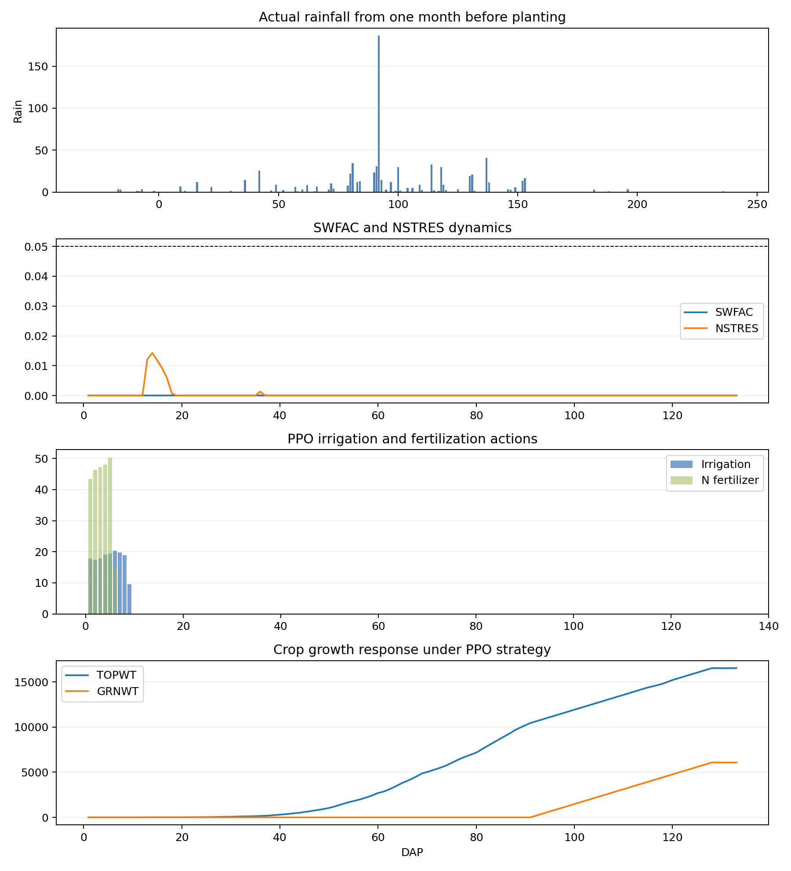
HLA_2023_four_panel

Slide 28
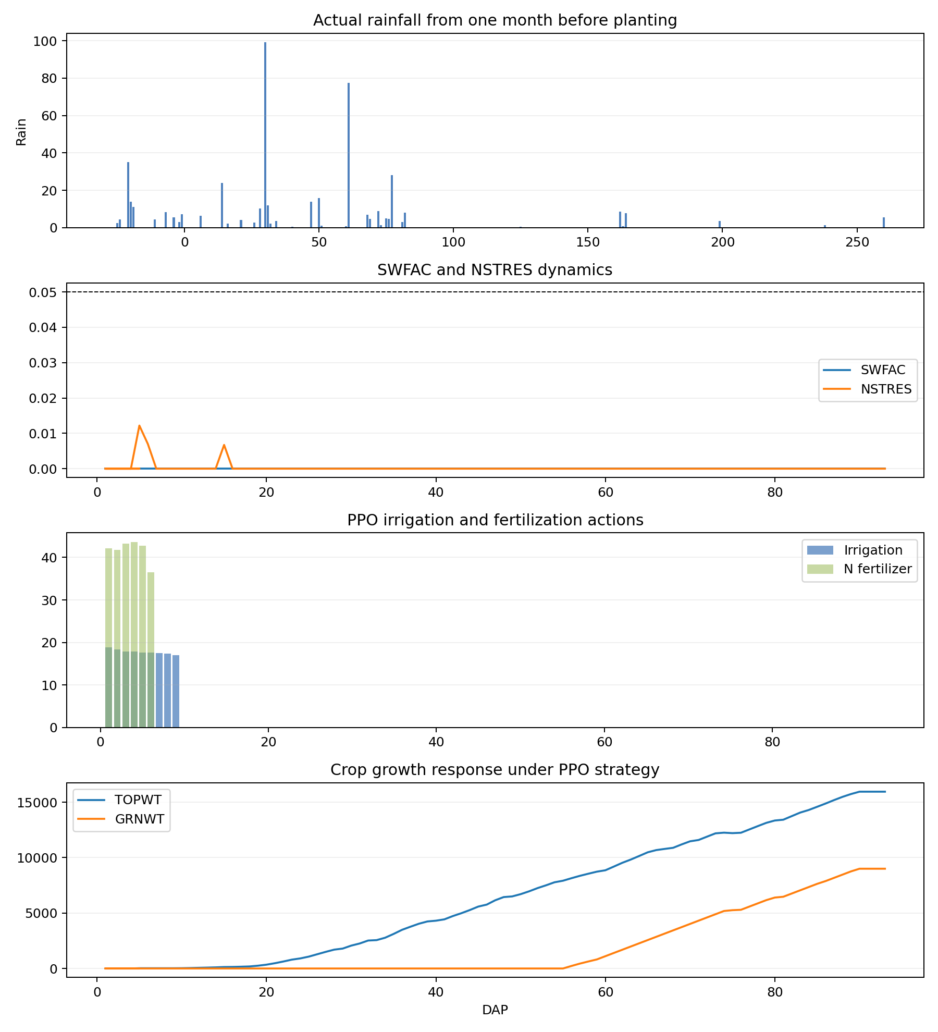
LCA_2006_four_panel

Slide 29
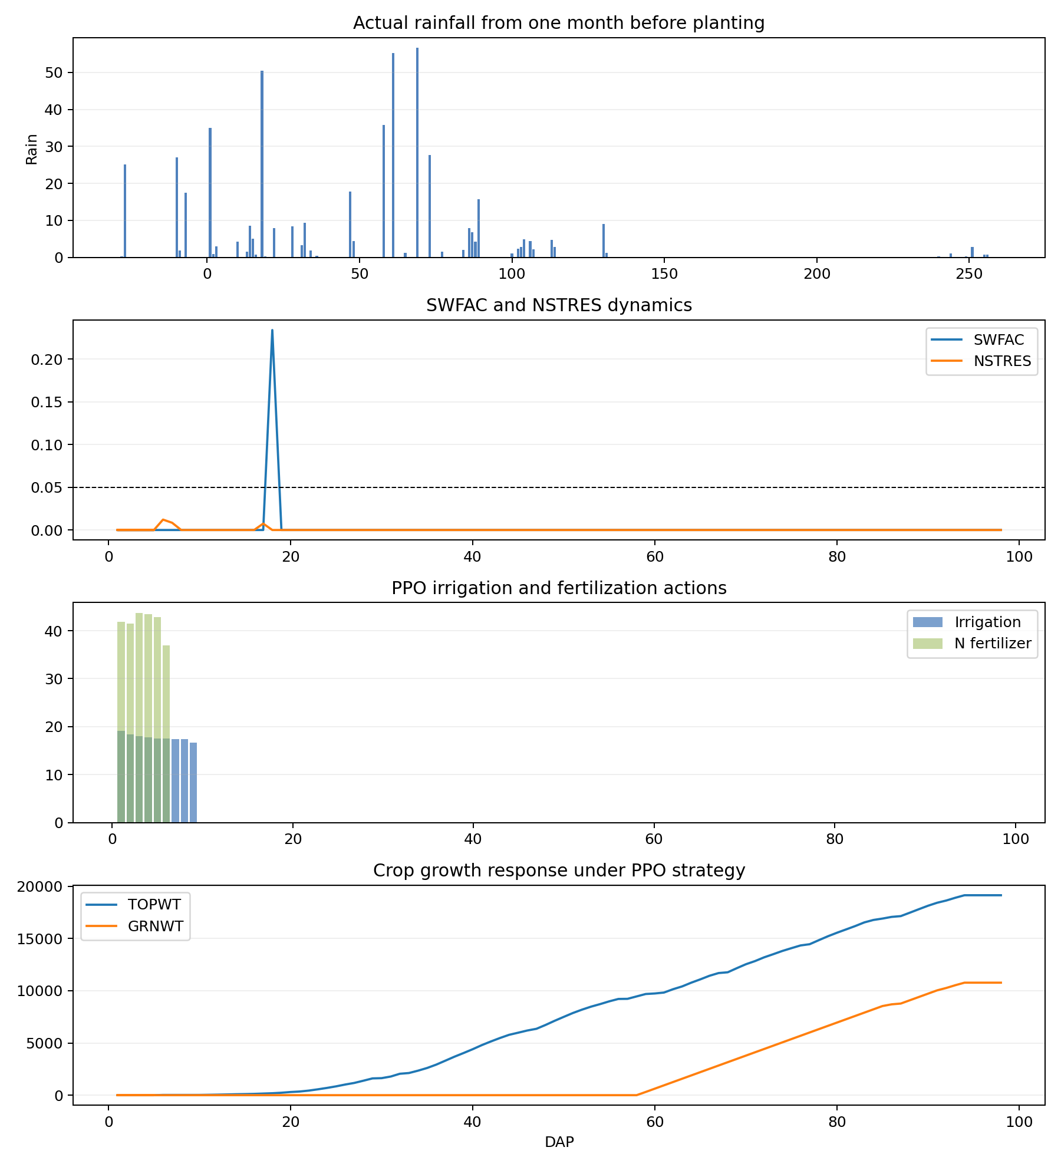
LCA_2008_four_panel

Slide 30
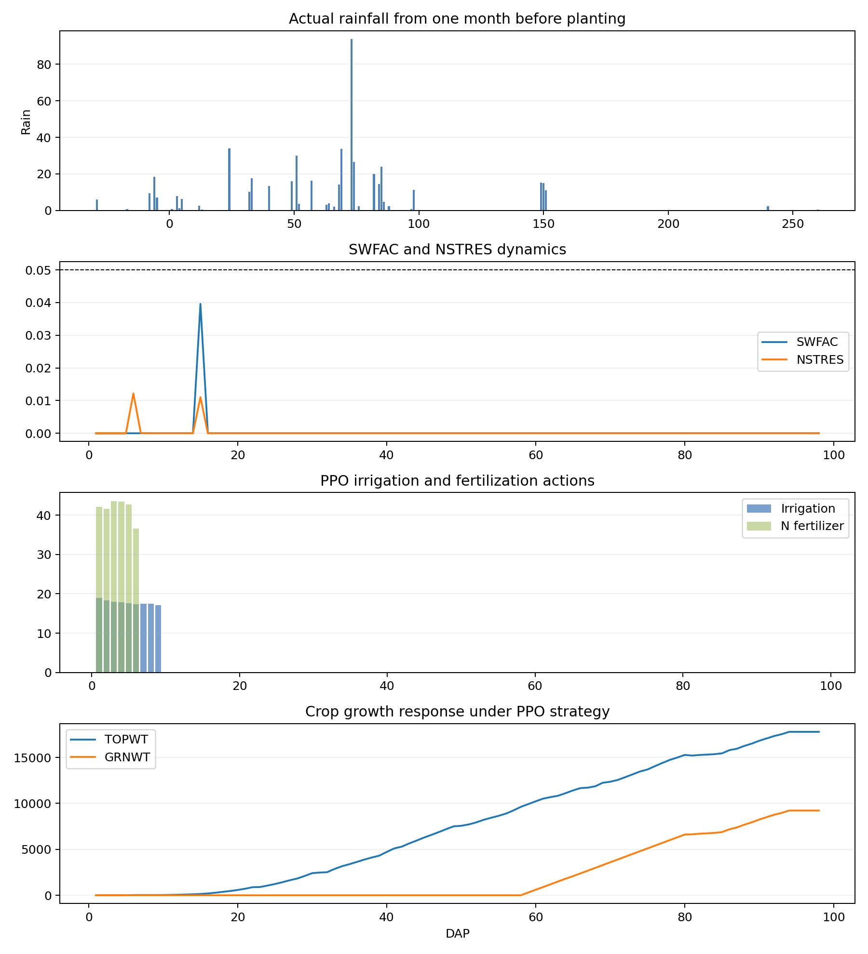
LCA_2009_four_panel

Slide 31
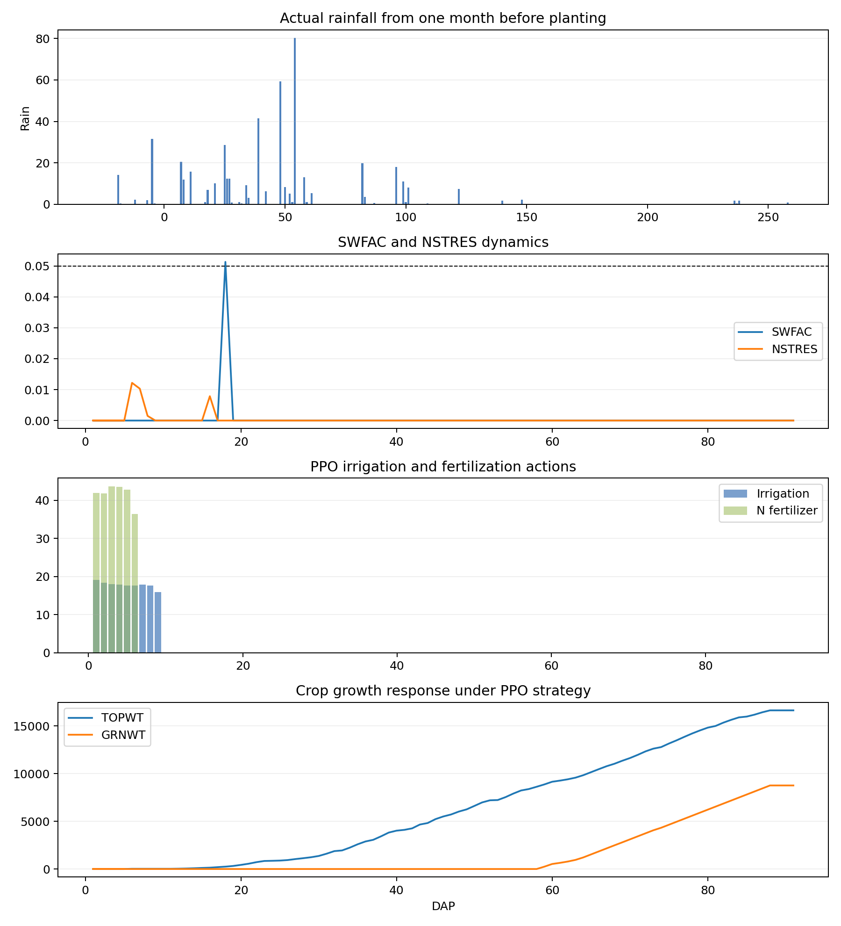
LCA_2013_four_panel

Slide 32
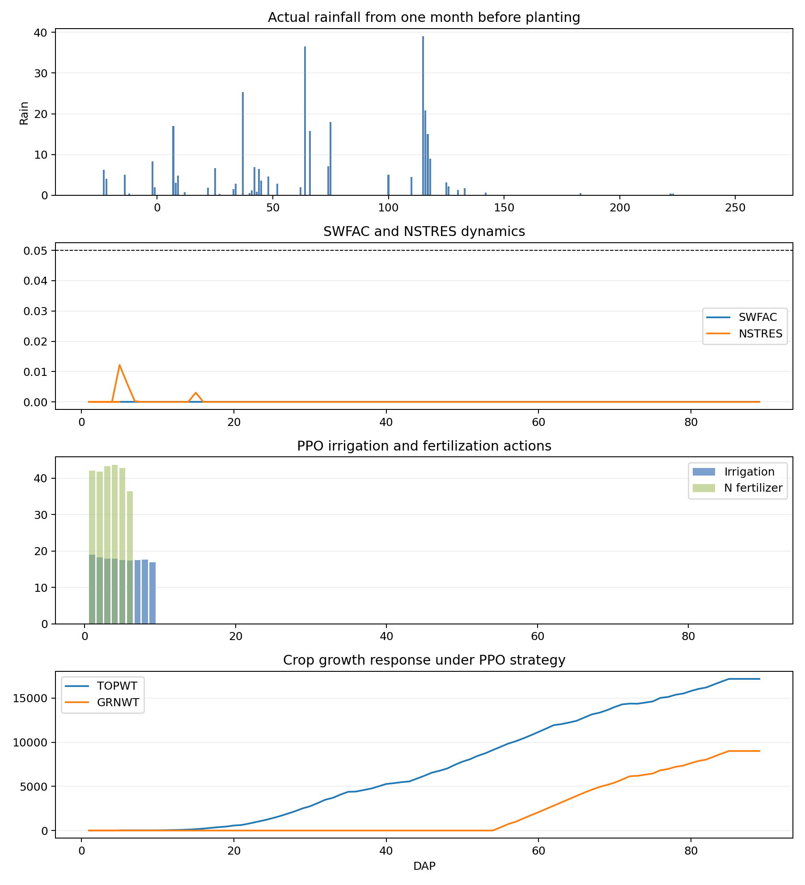
LCA_2017_four_panel

Slide 33
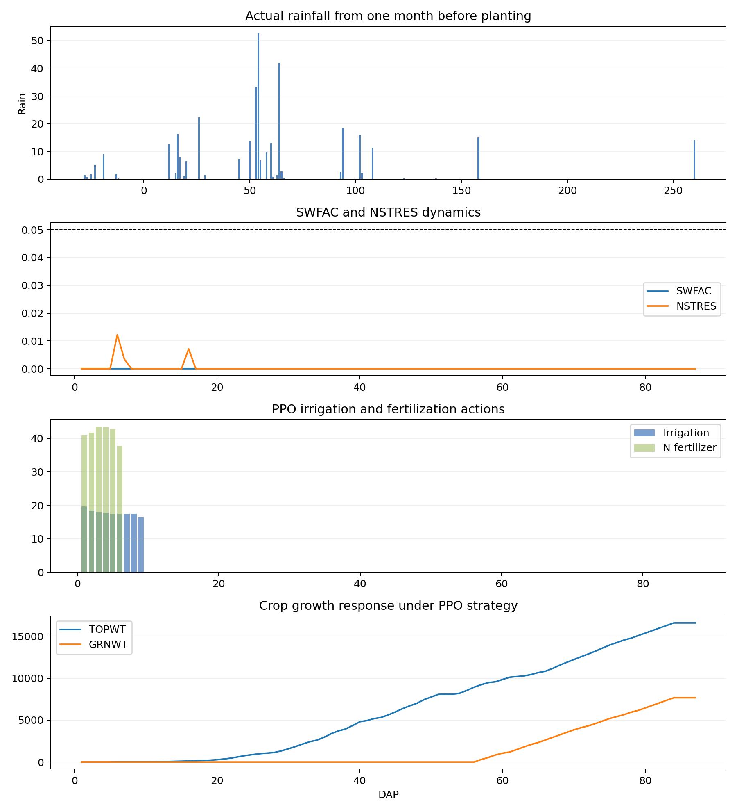
LCA_2020_four_panel

Slide 34
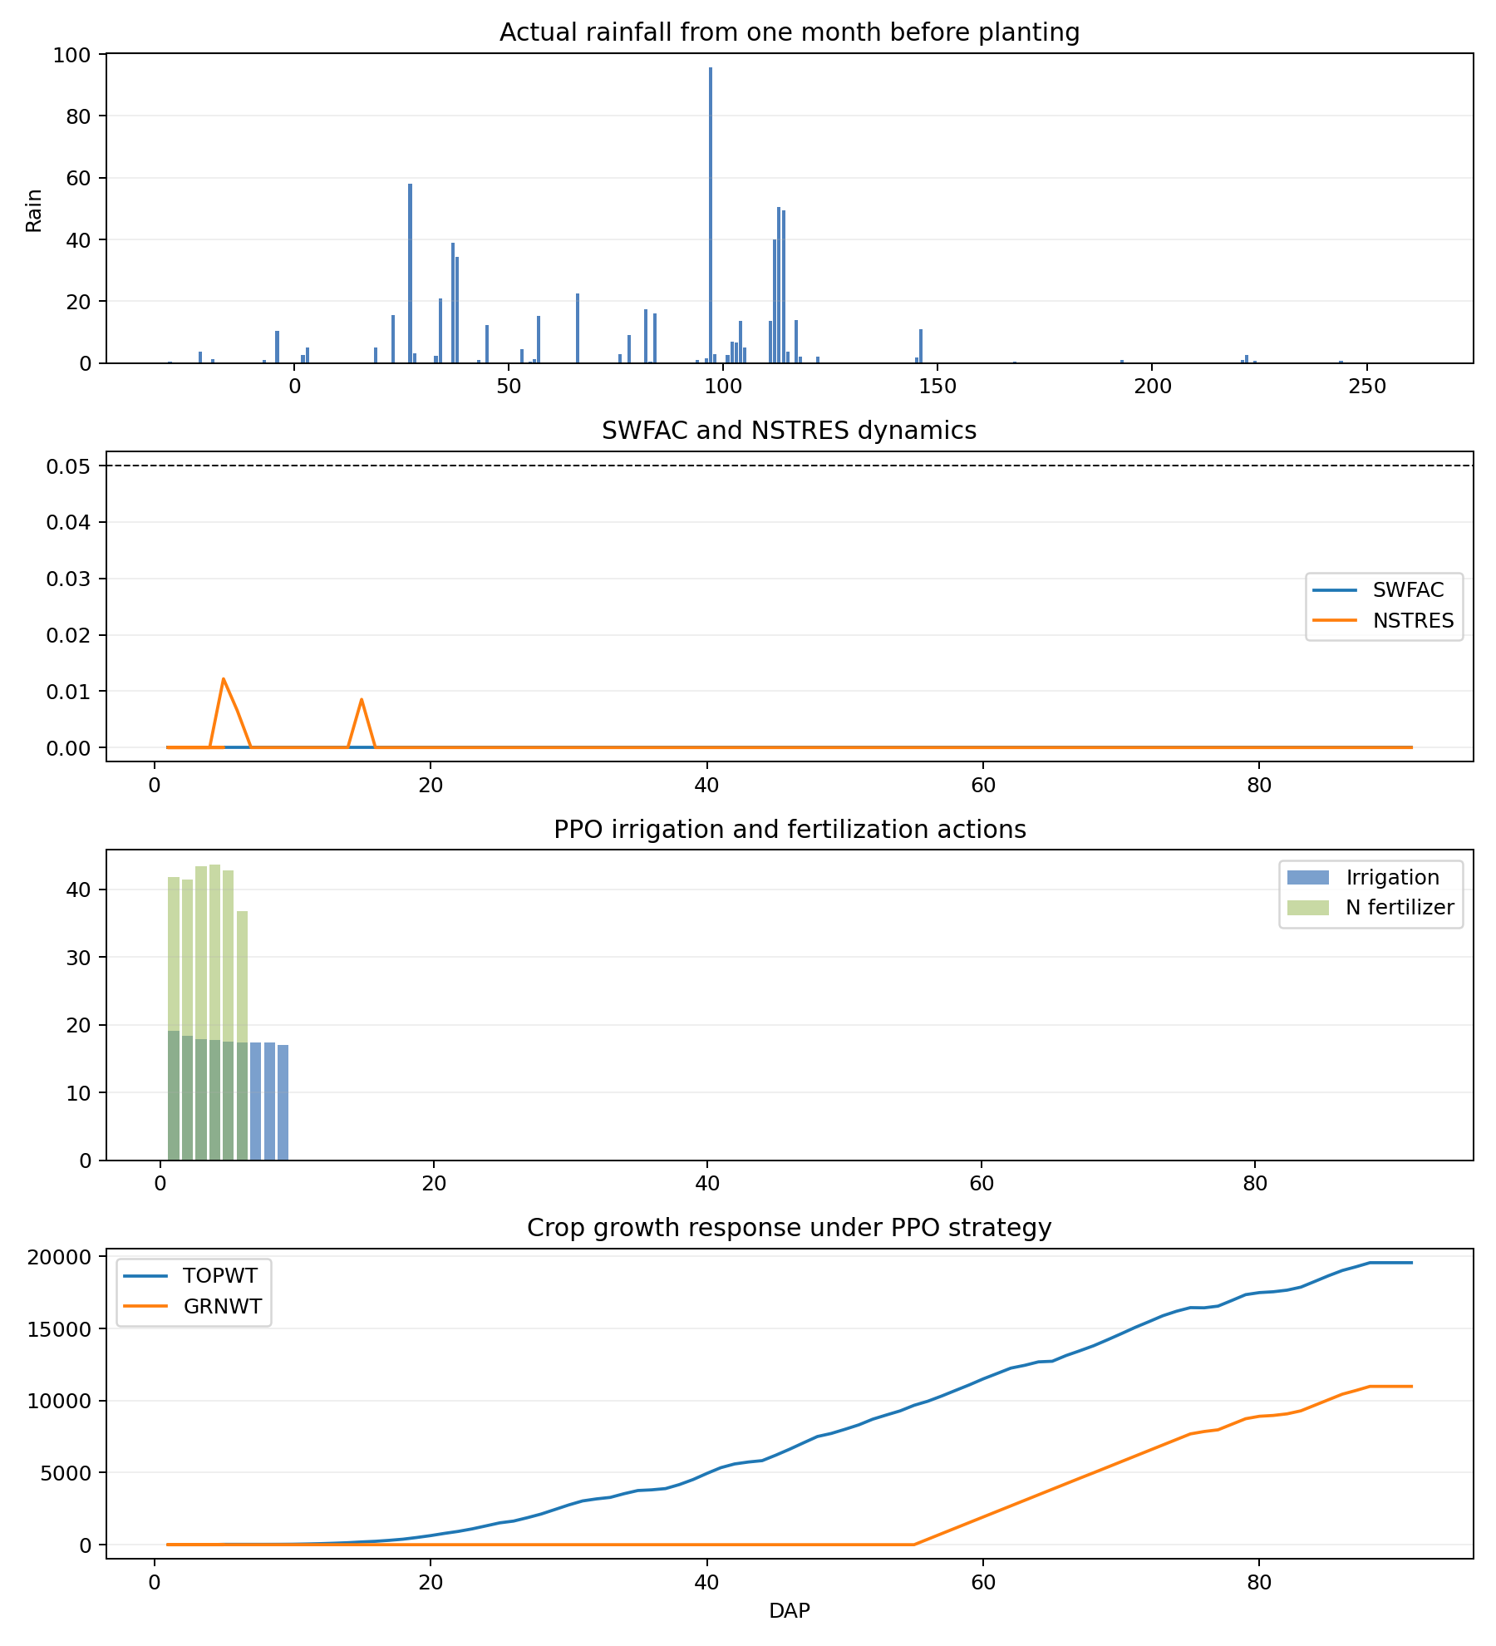
LCA_2021_four_panel

Slide 35
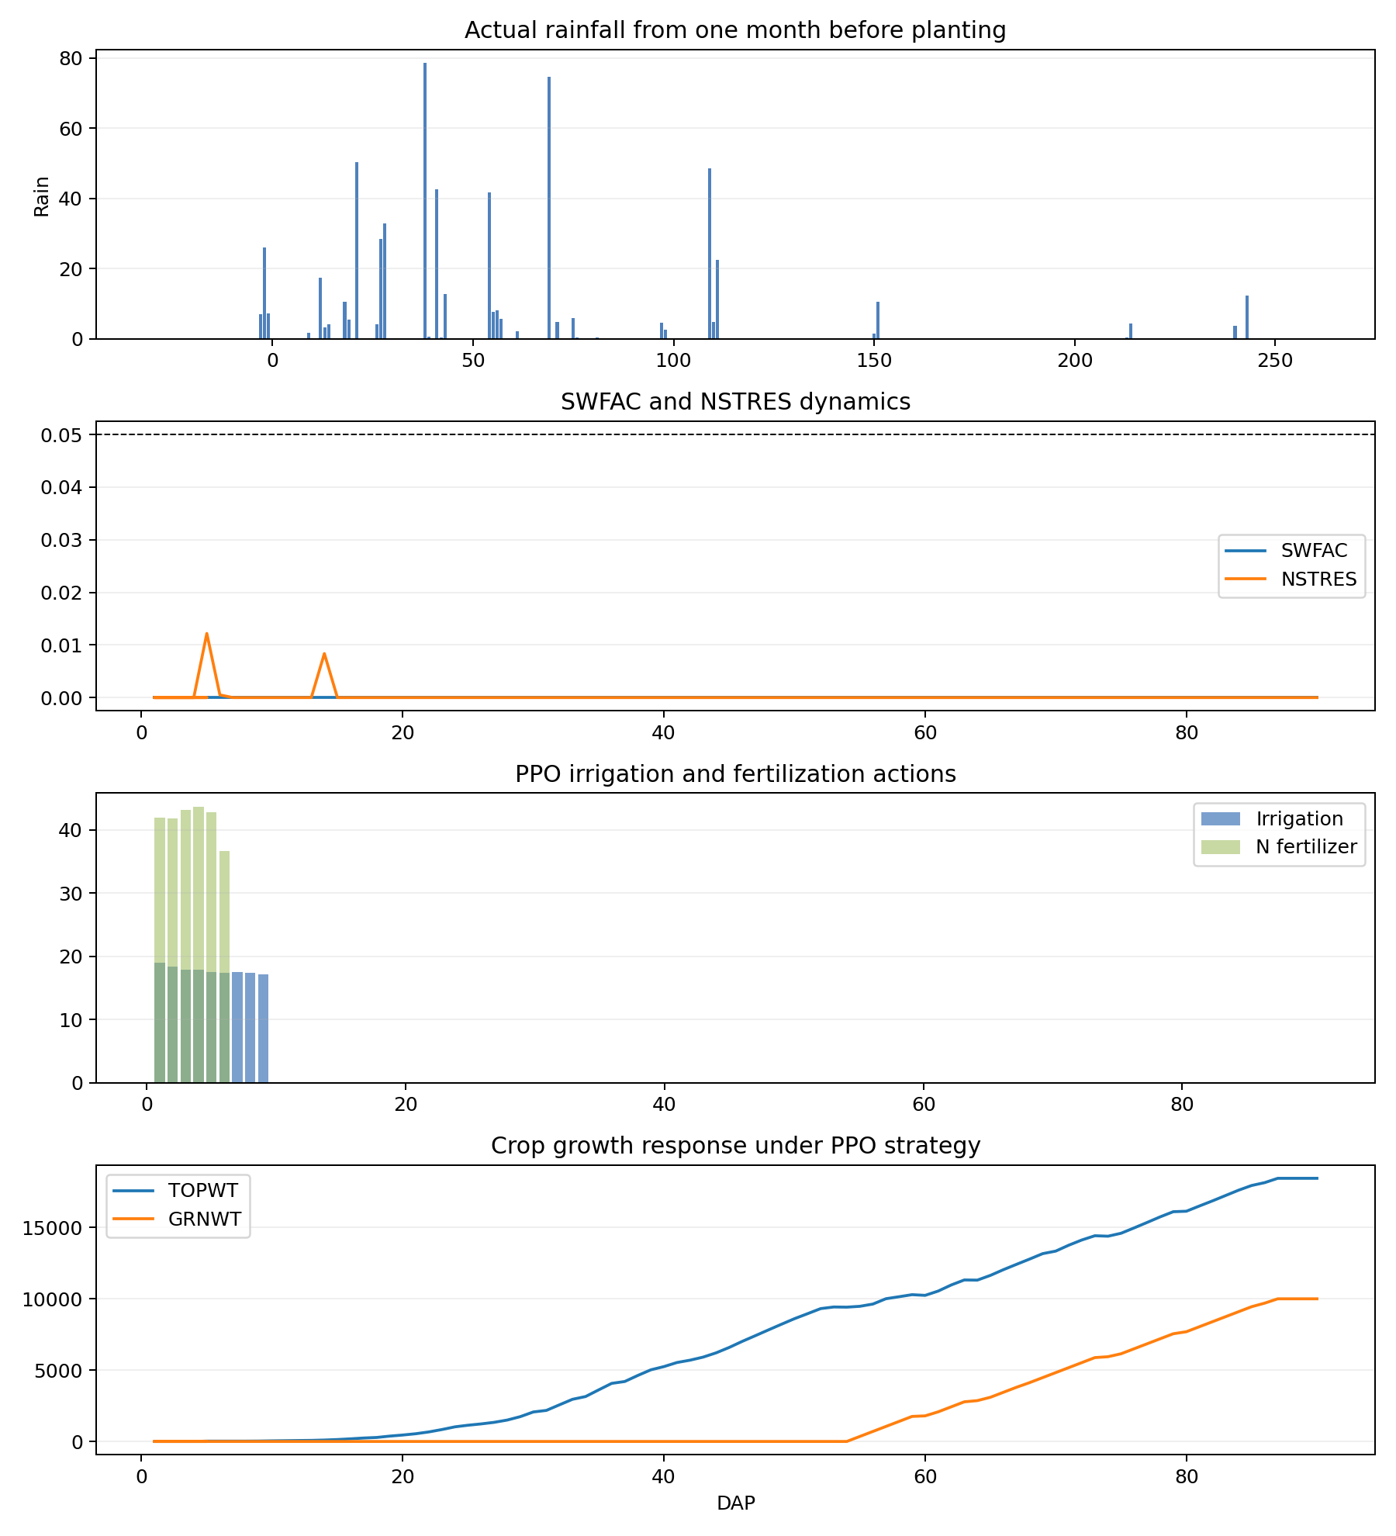
LCA_2022_four_panel

Slide 36
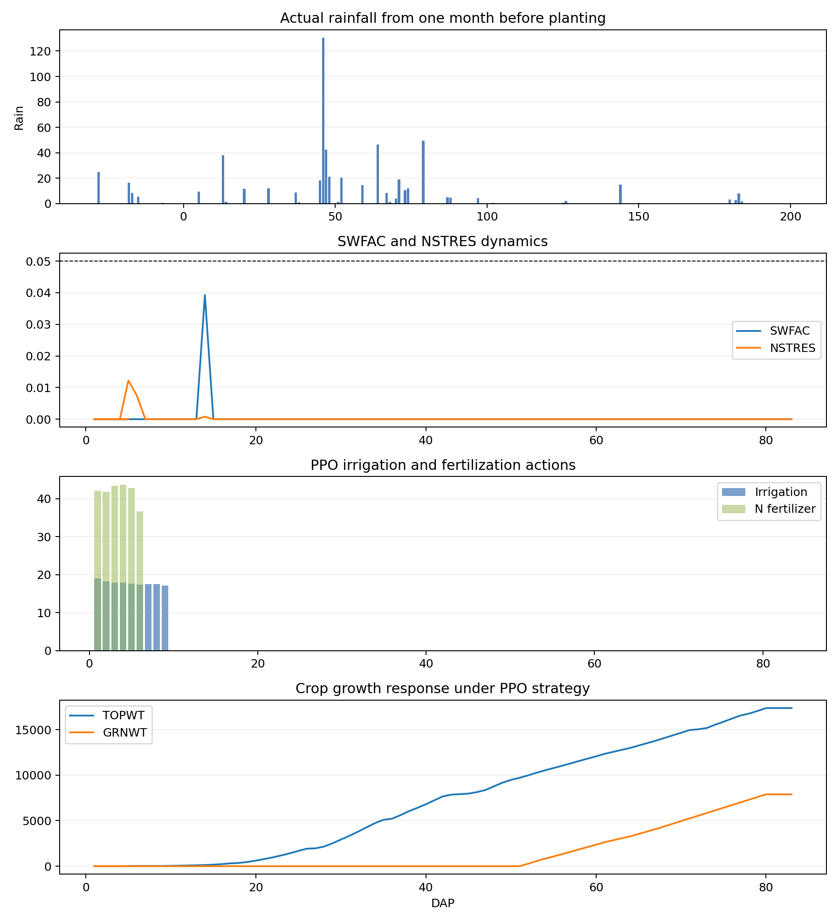
LCA_2023_four_panel

Slide 37
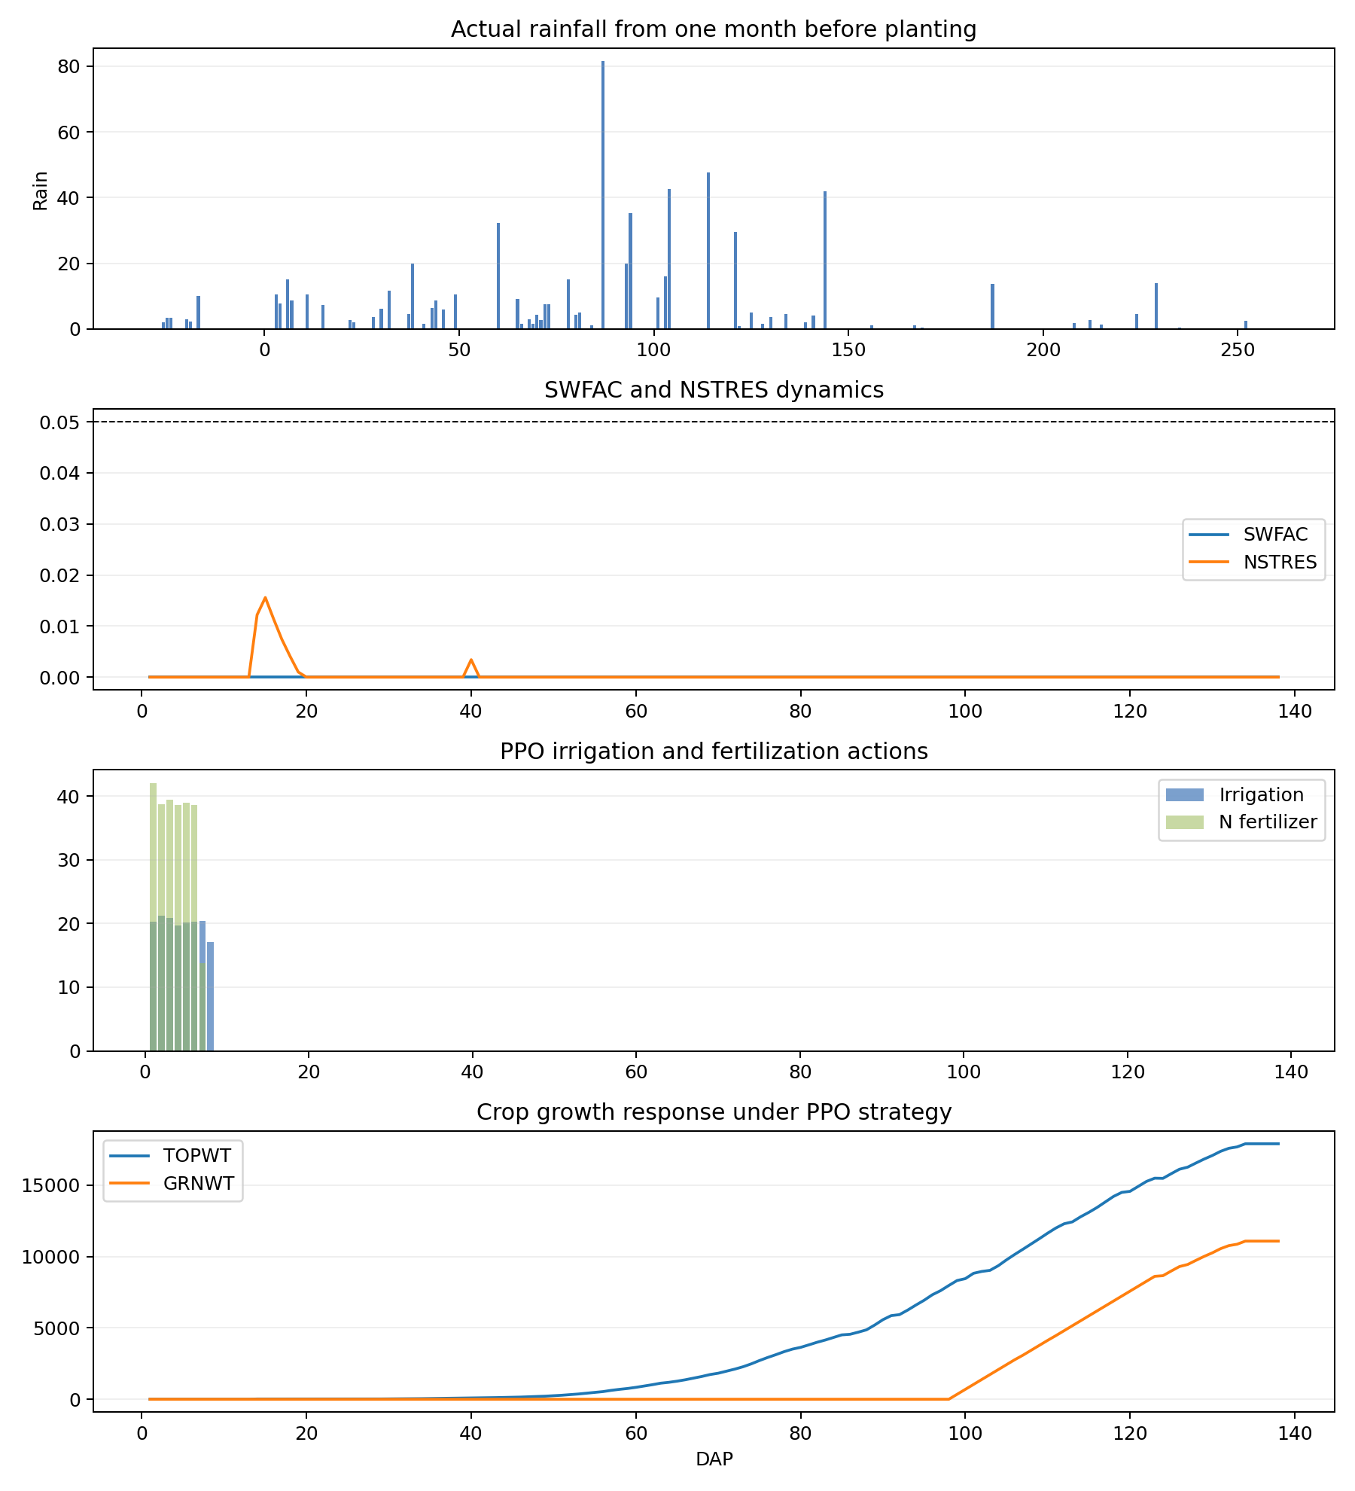
SYA_2008_four_panel

Slide 38
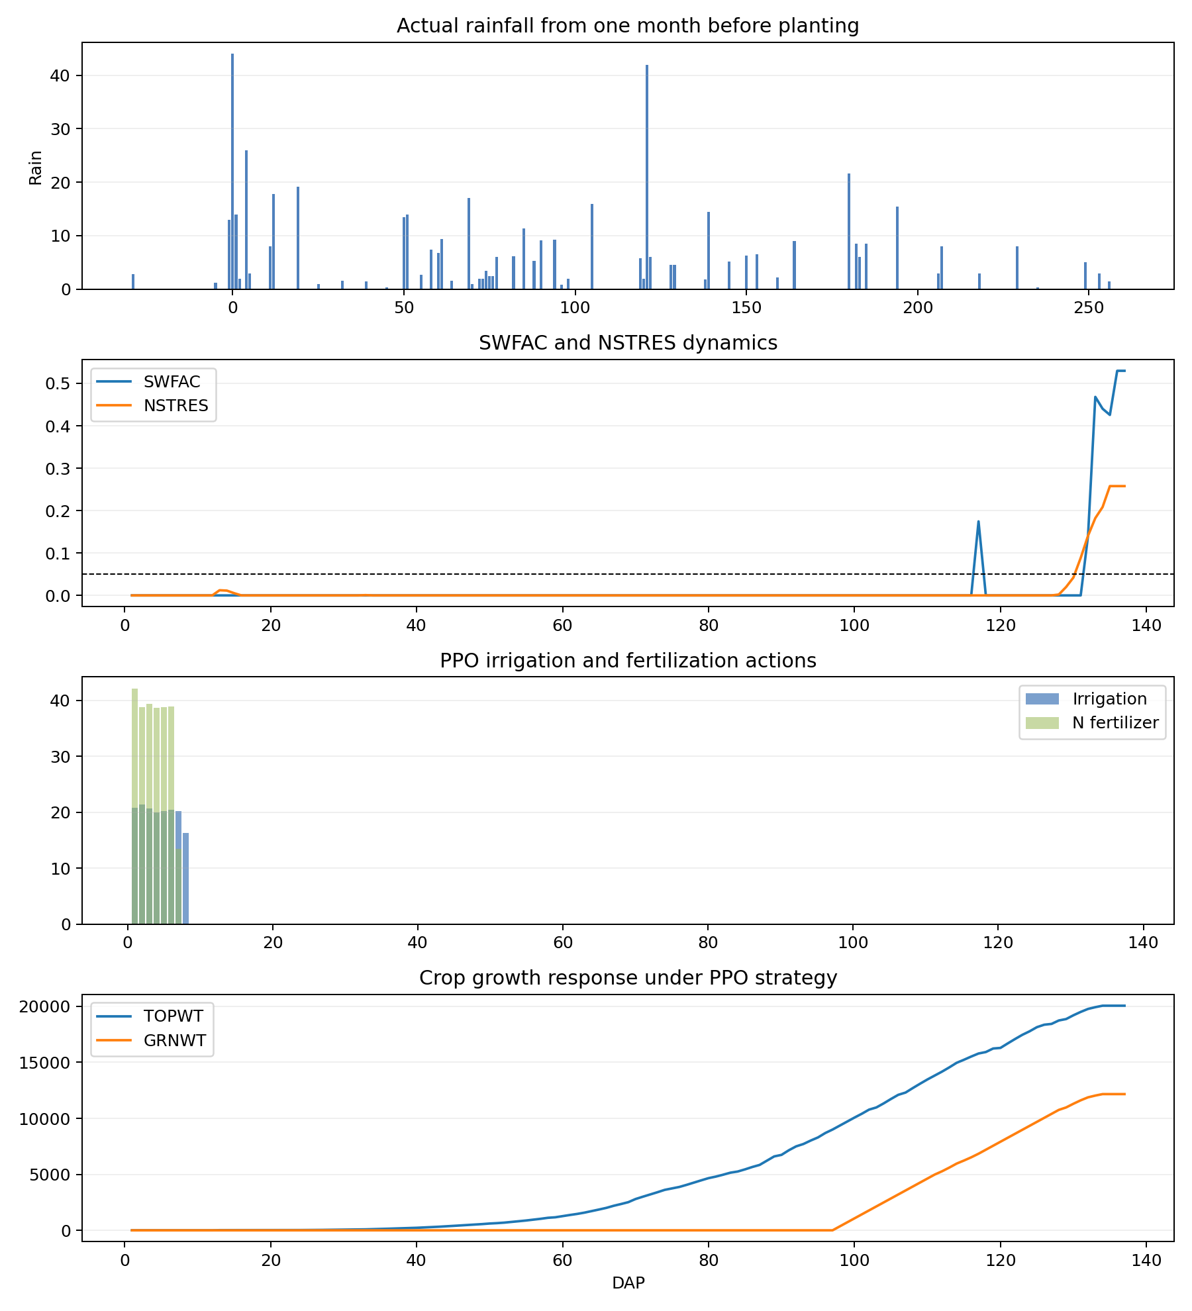
SYA_2009_four_panel

Slide 39
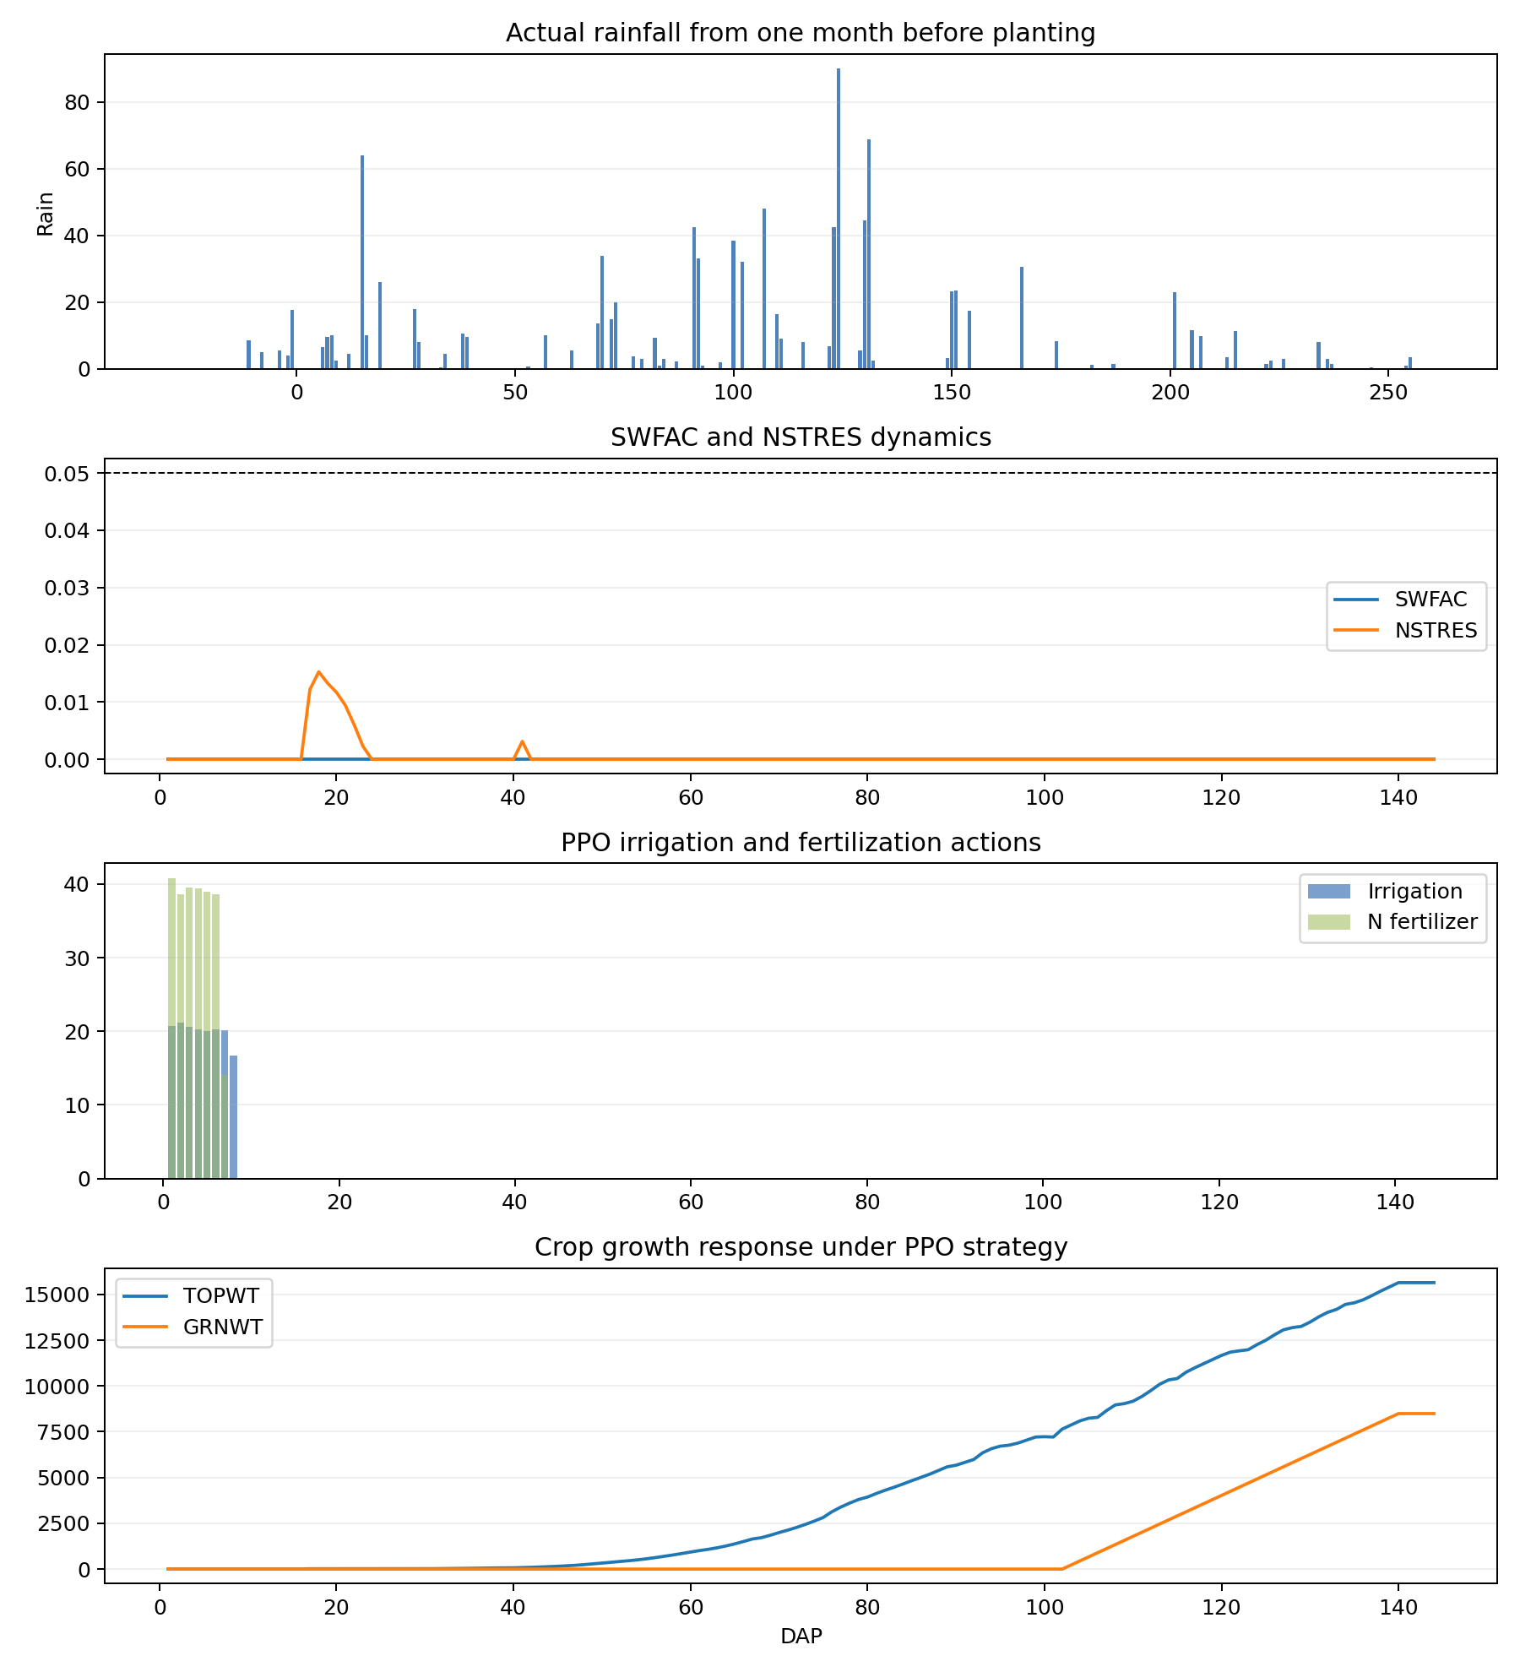
SYA_2010_four_panel

Slide 40
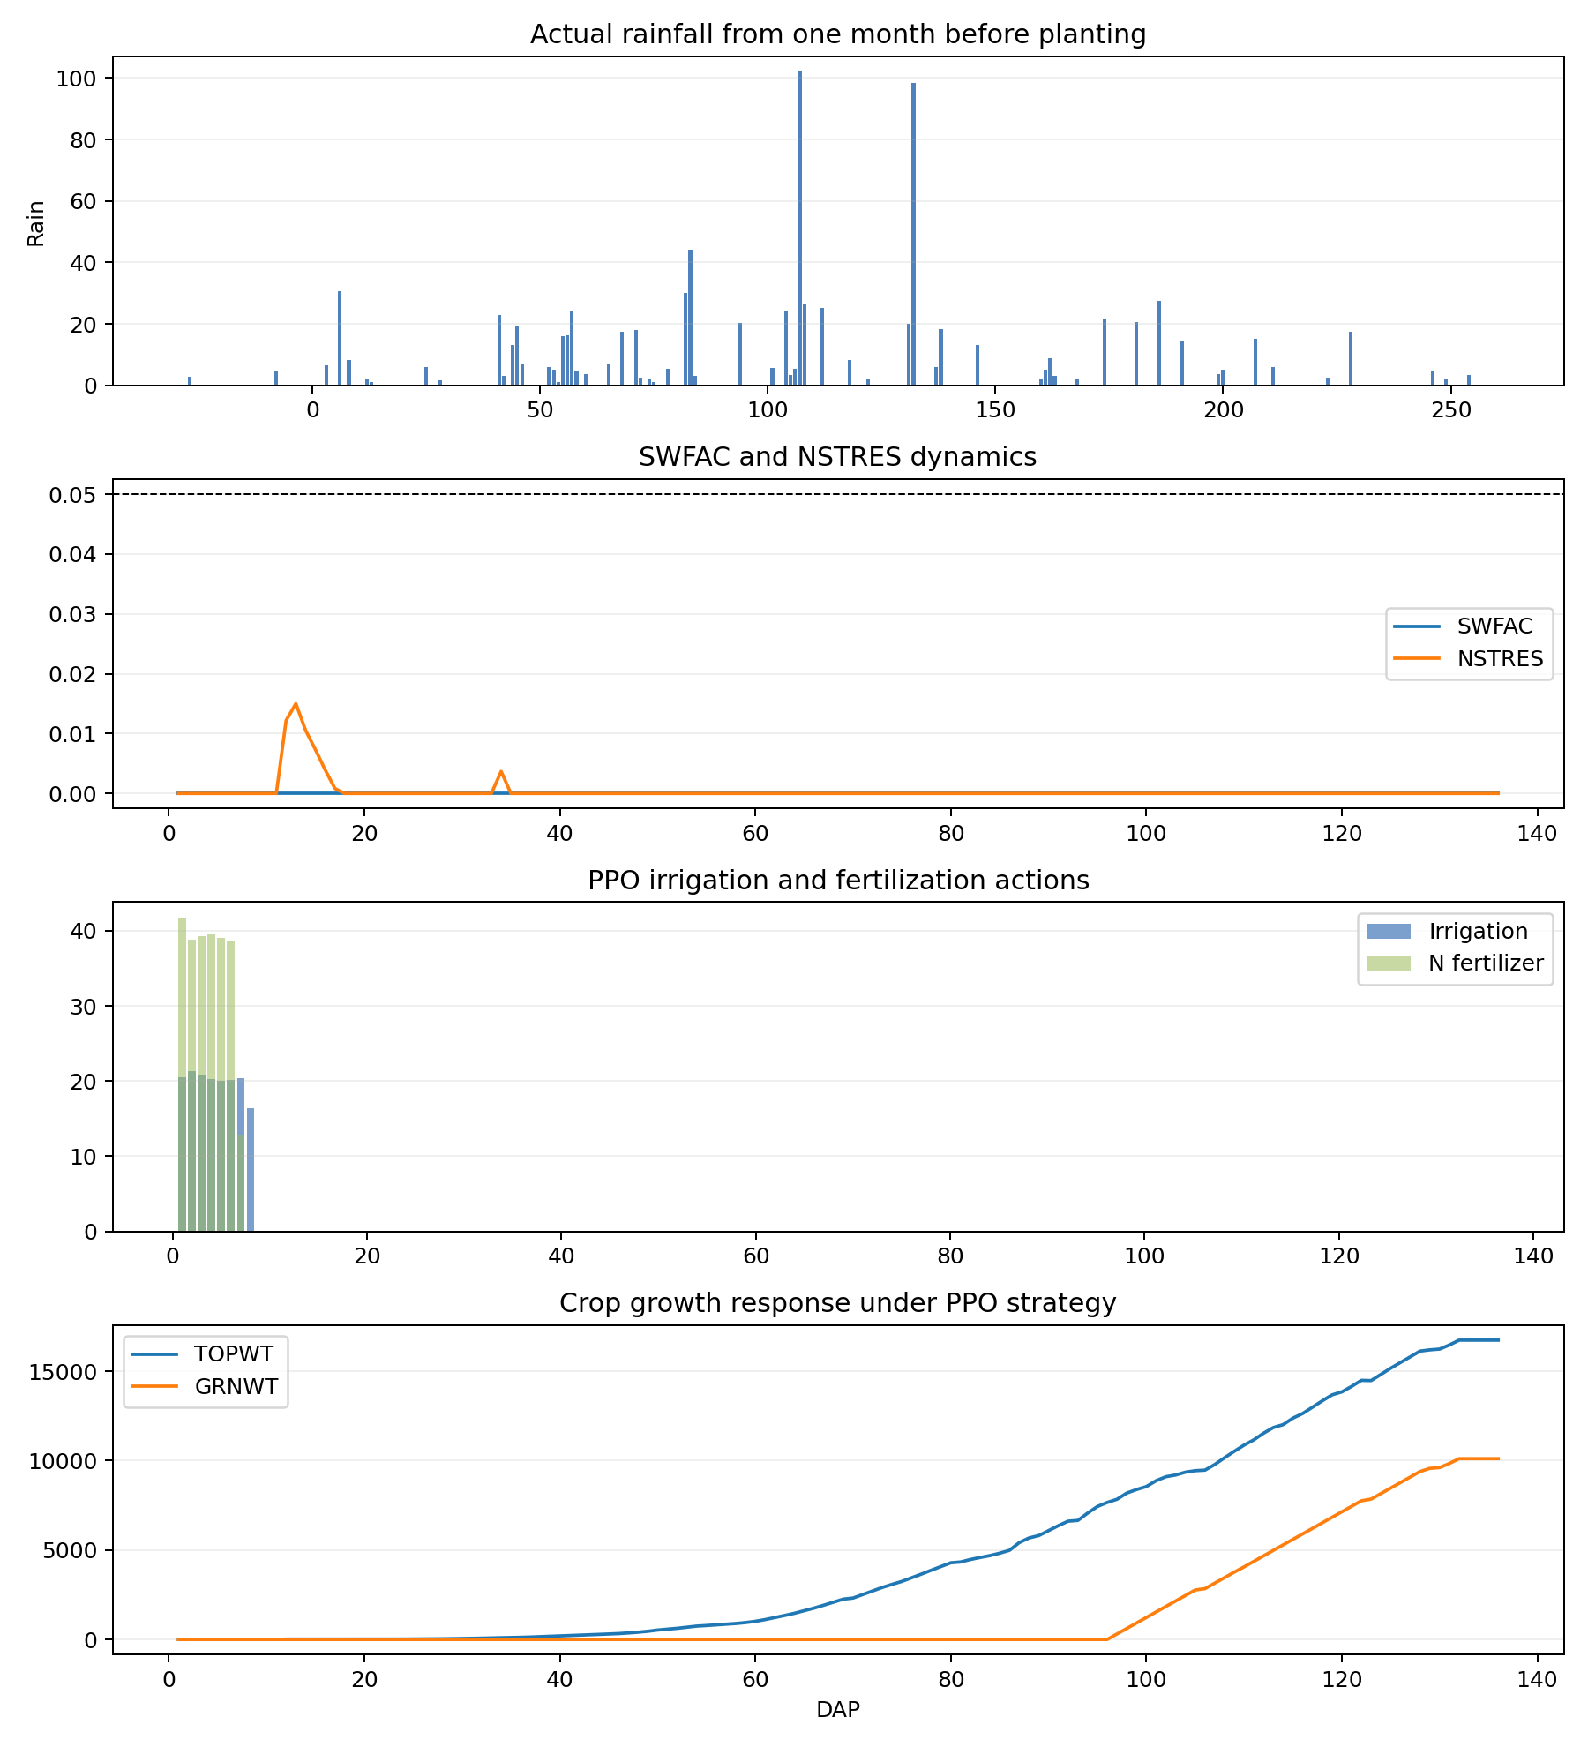
SYA_2012_four_panel

Slide 41
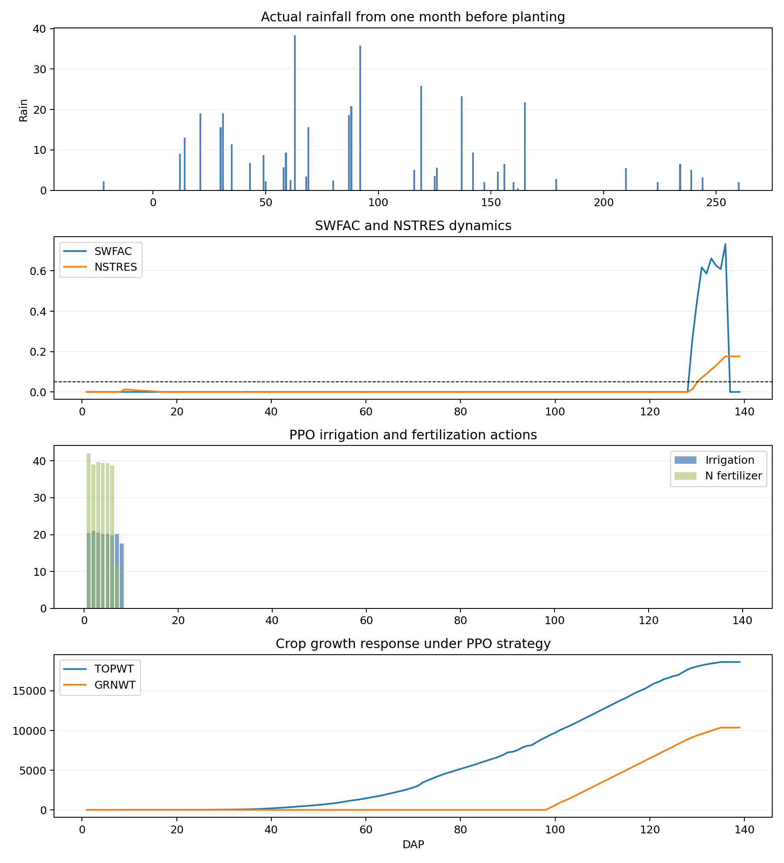
SYA_2014_four_panel

Slide 42
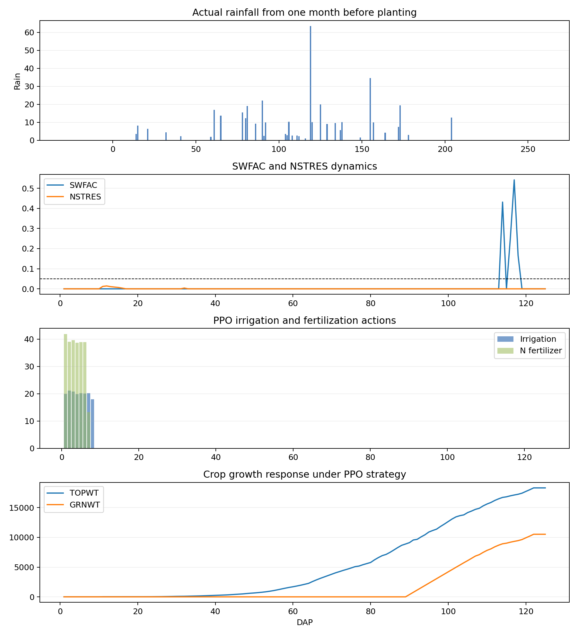
SYA_2017_four_panel

Slide 43
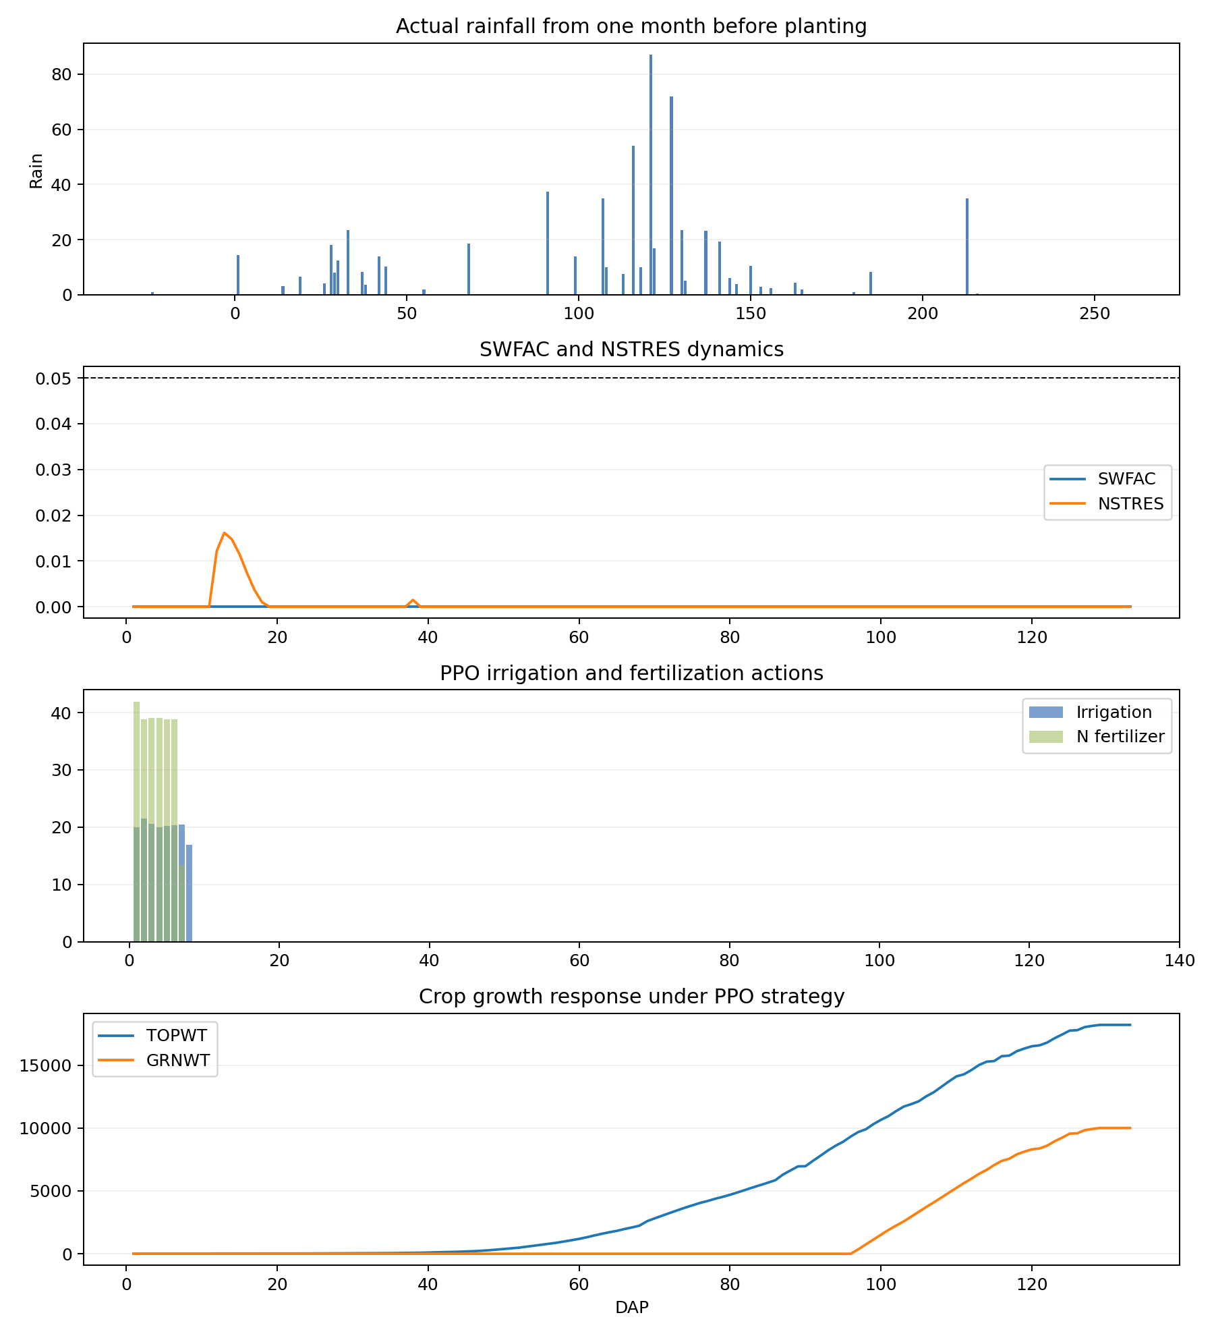
SYA_2020_four_panel

Slide 44
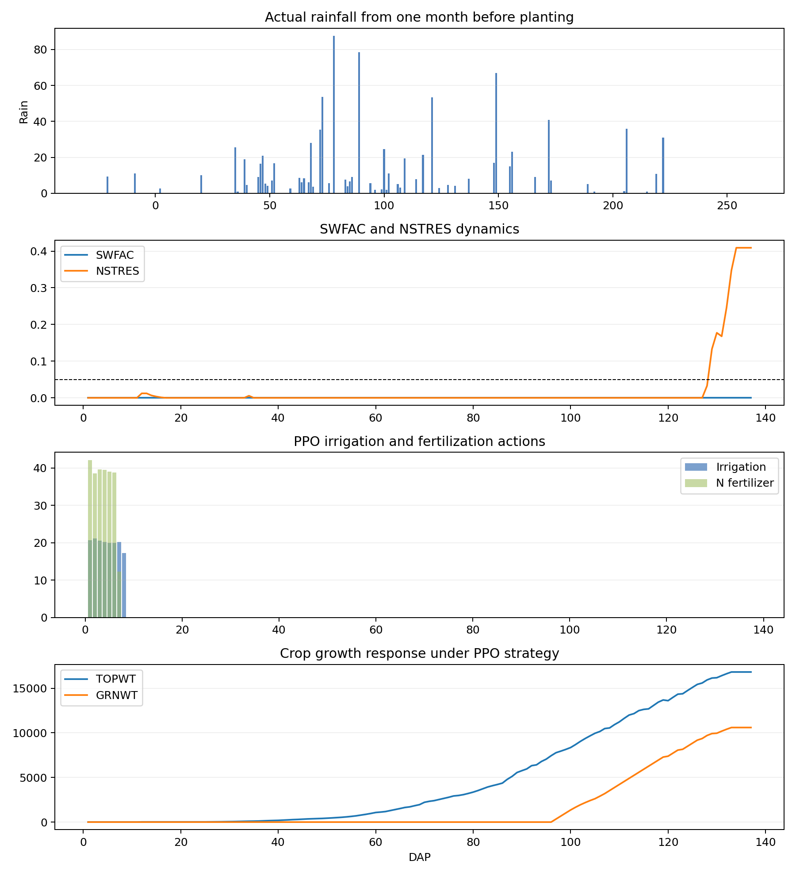
SYA_2022_four_panel

Slide 45
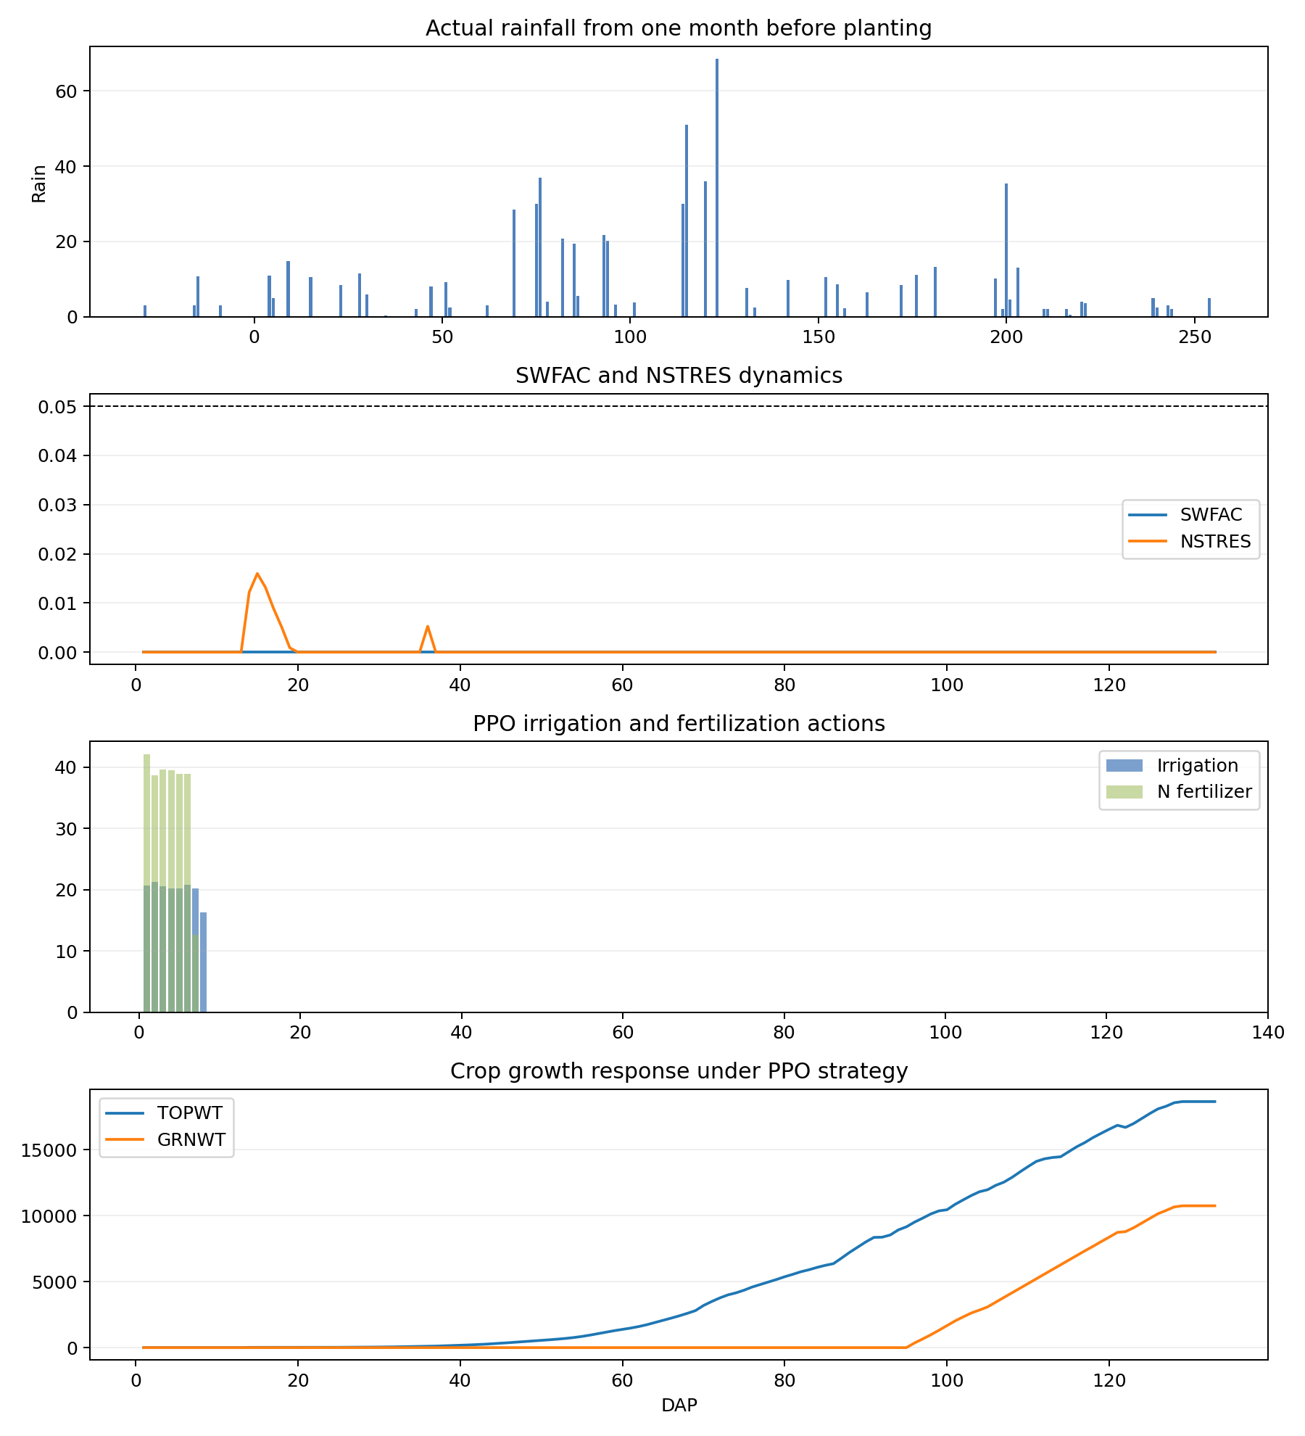
SYA_2023_four_panel

Slide 46
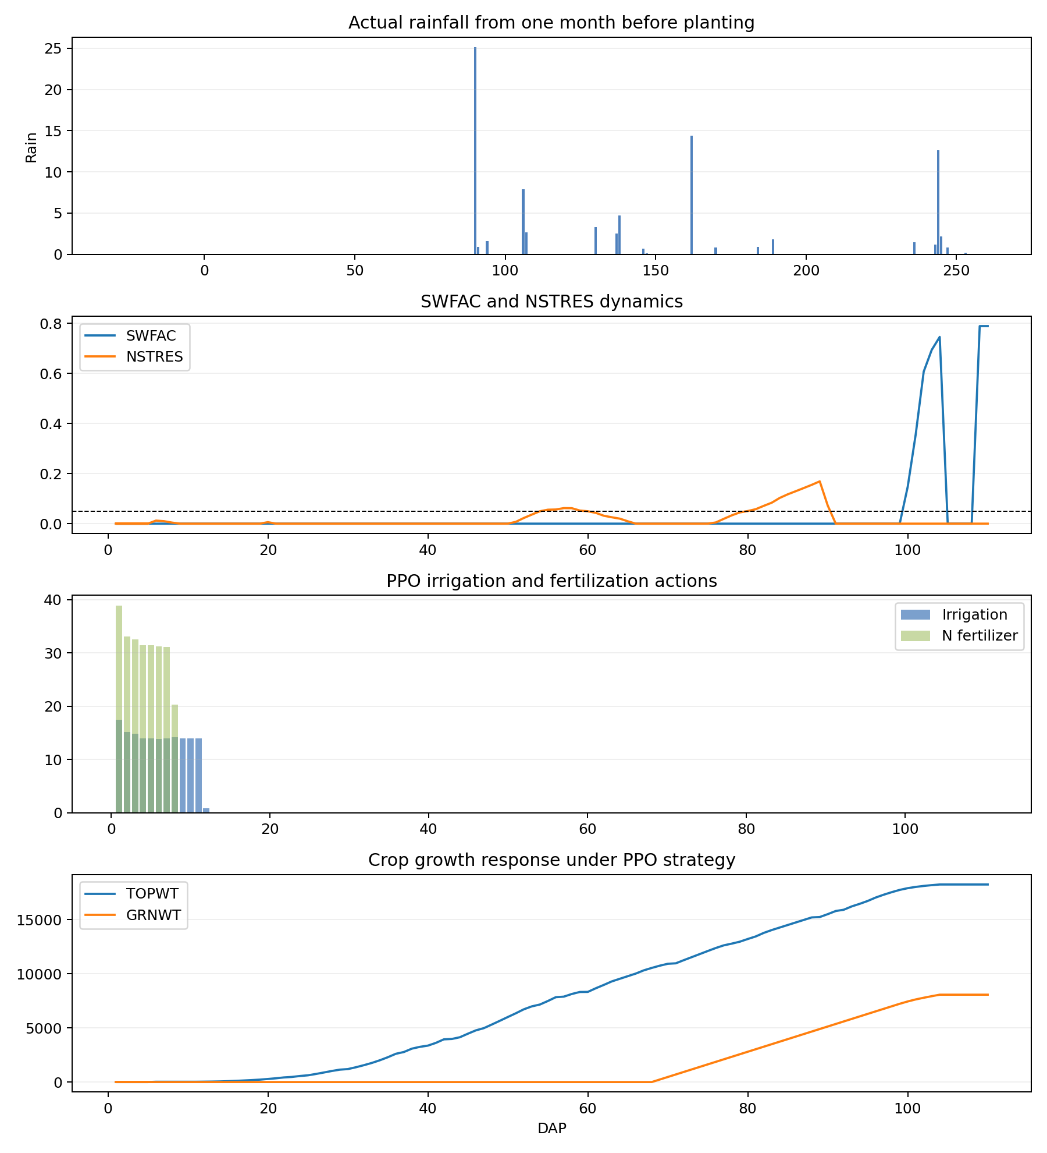
YCA_2004_four_panel

Slide 47
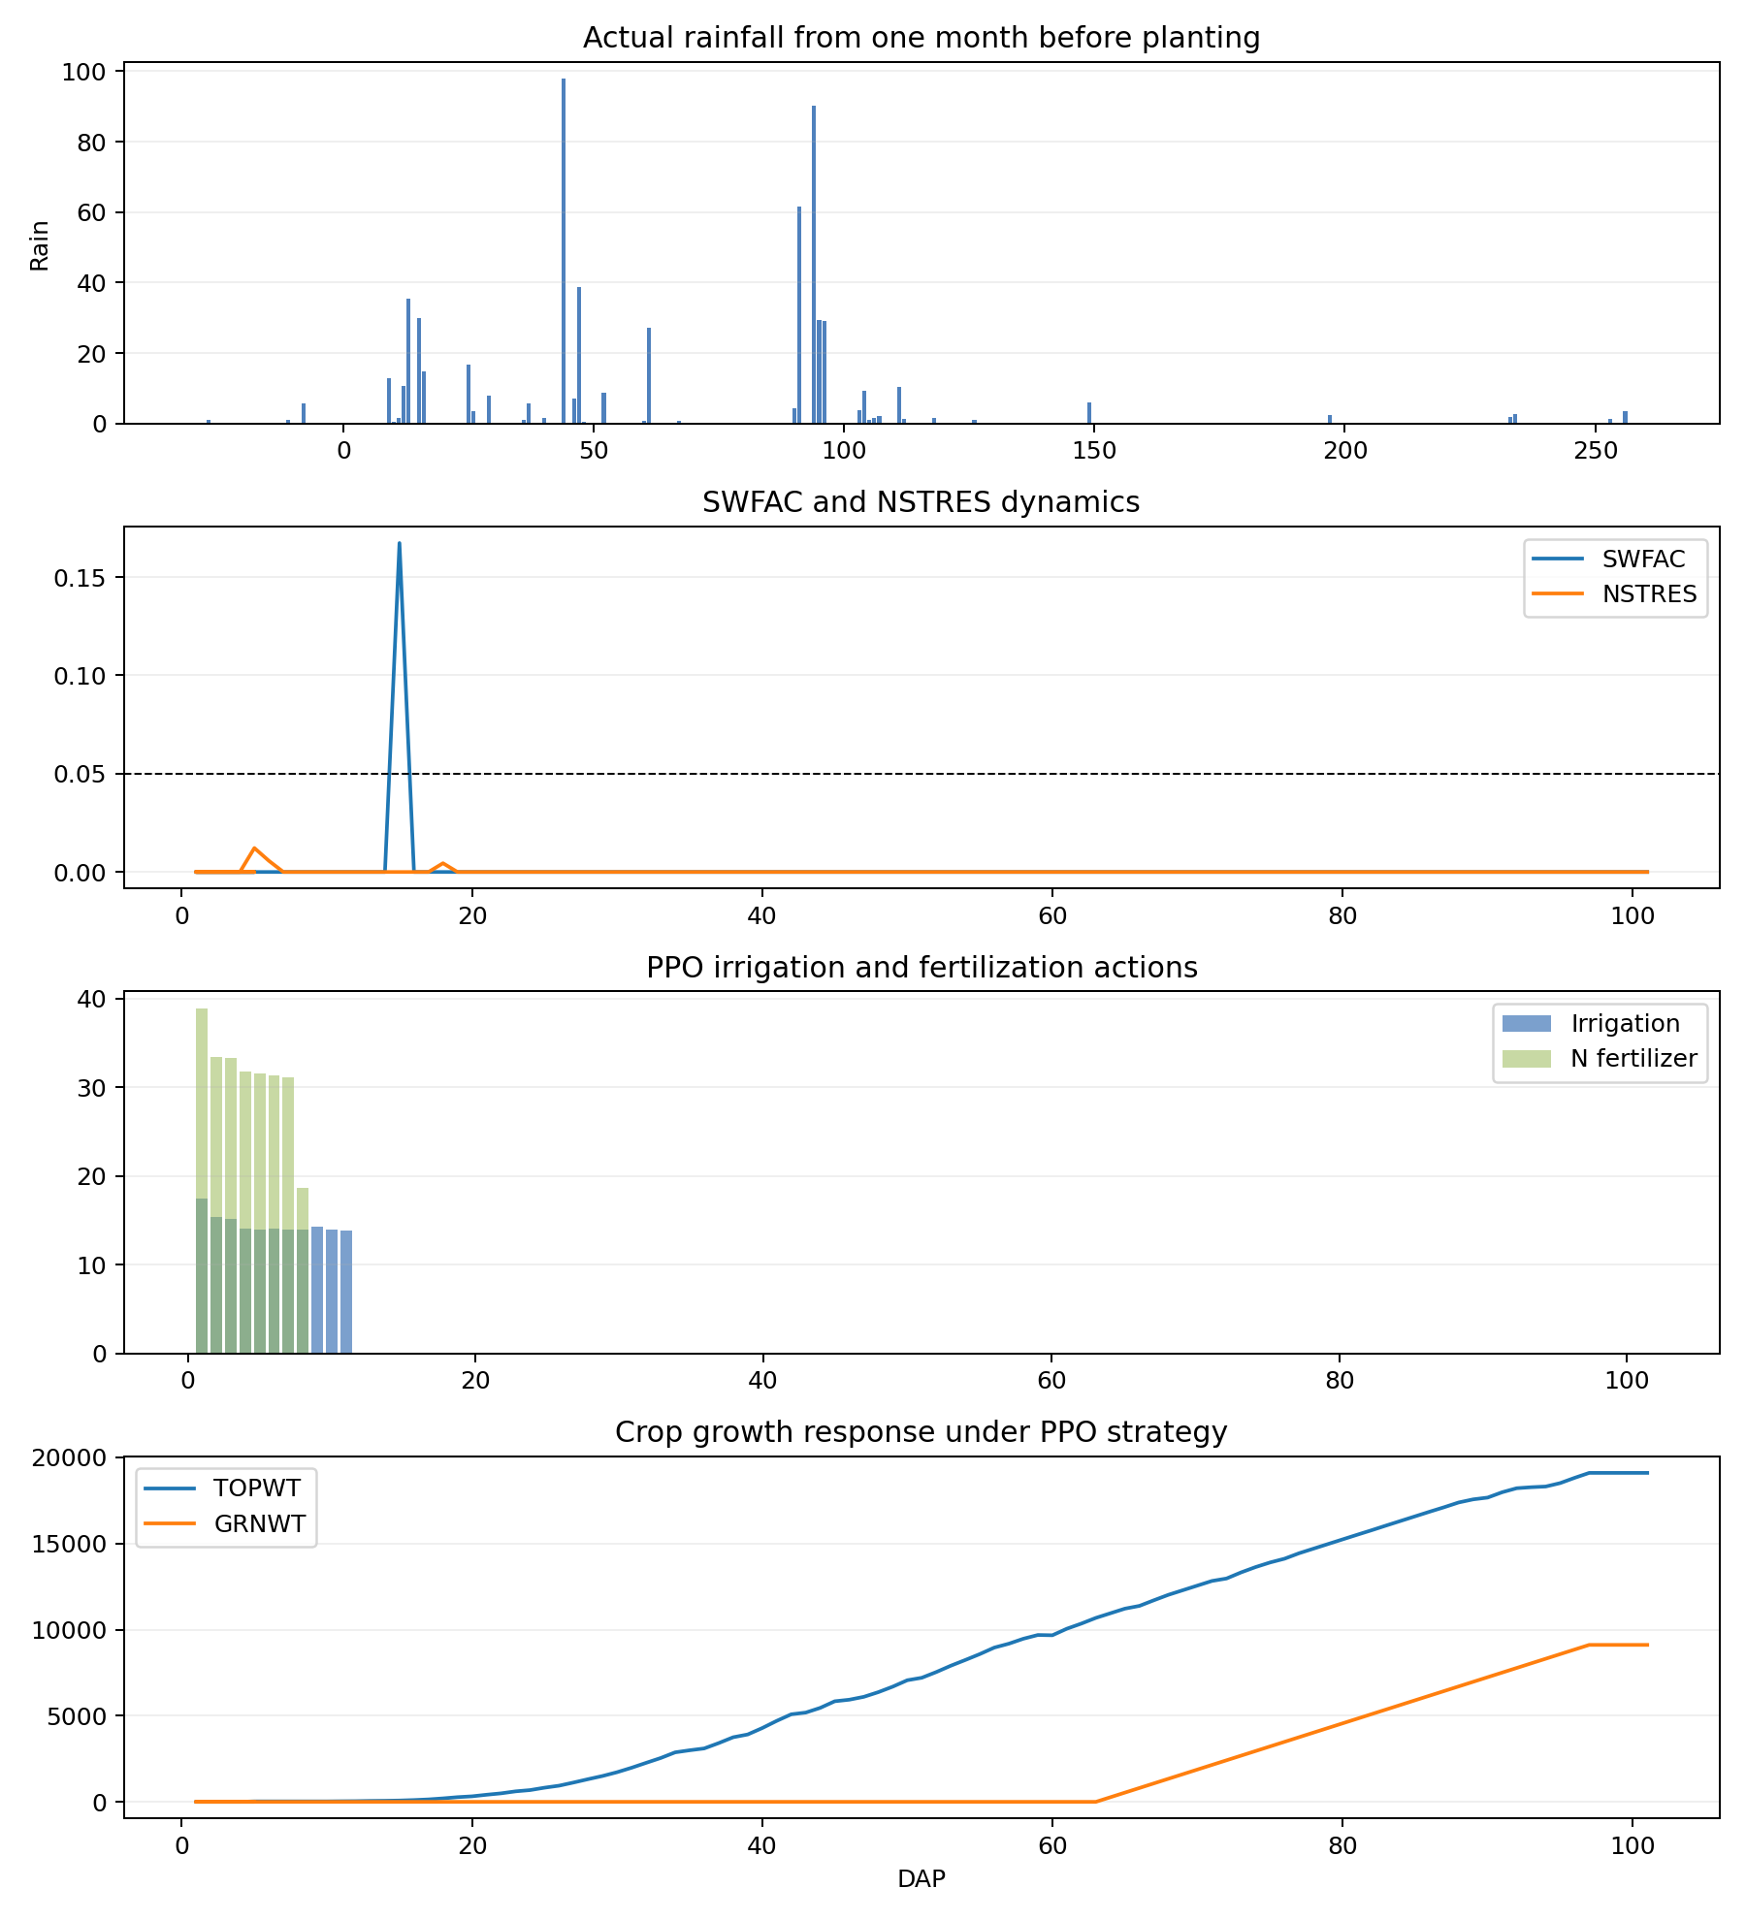
YCA_2005_four_panel

Slide 48
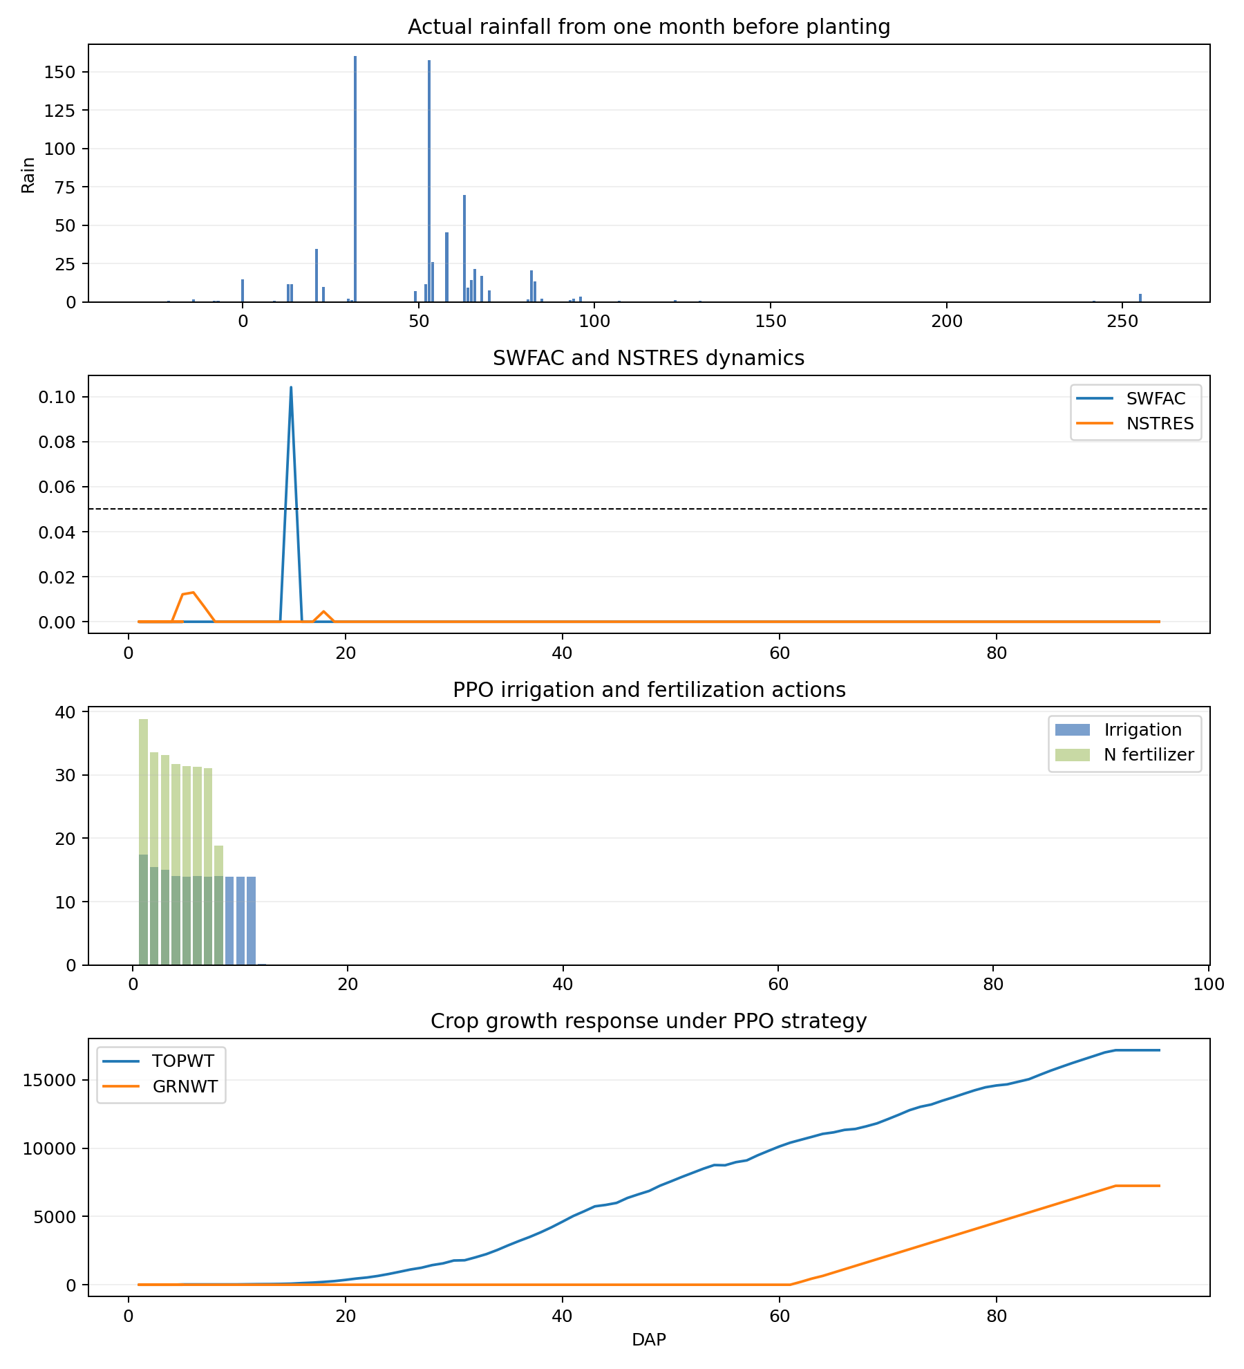
YCA_2010_four_panel

Slide 49
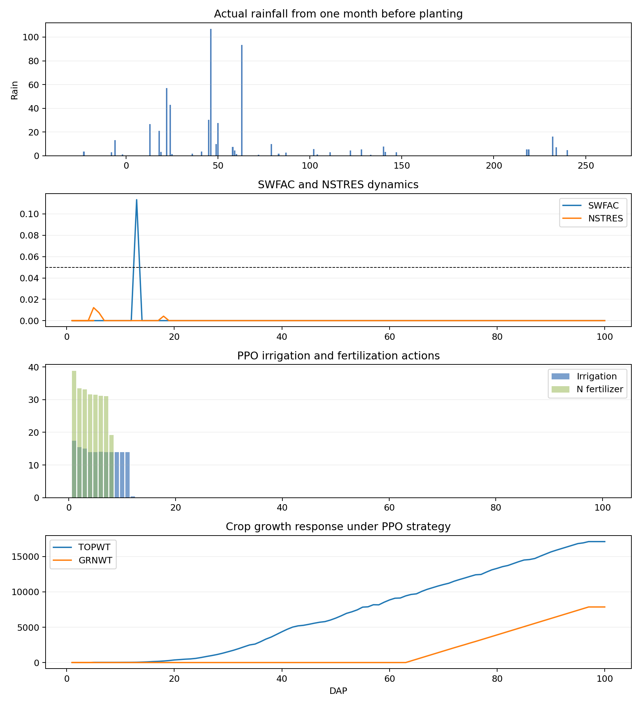
YCA_2012_four_panel

Slide 50
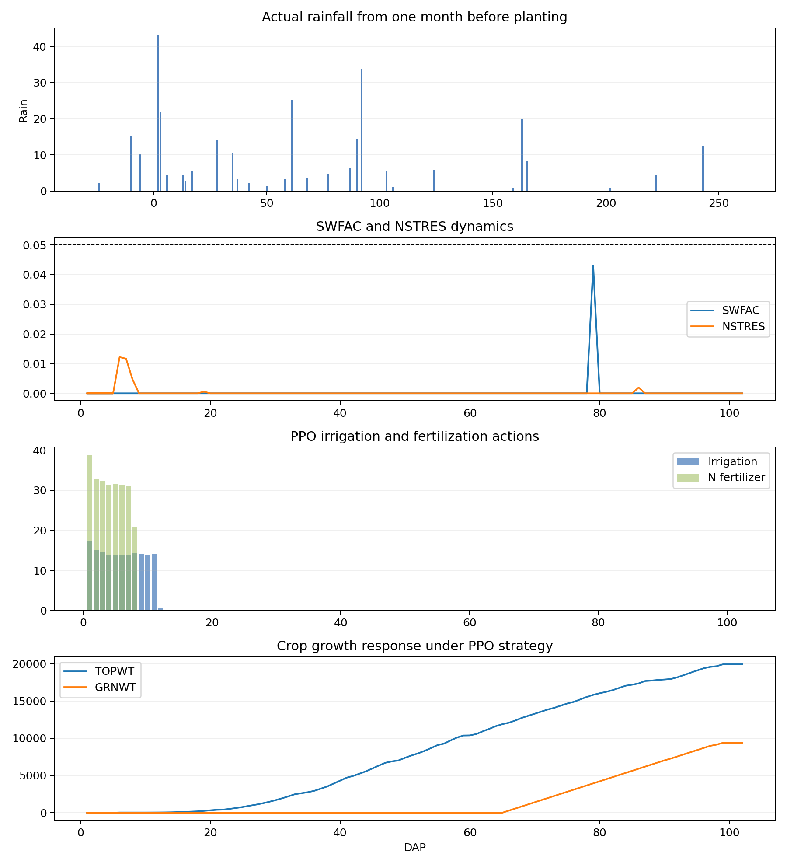
YCA_2014_four_panel

Slide 51
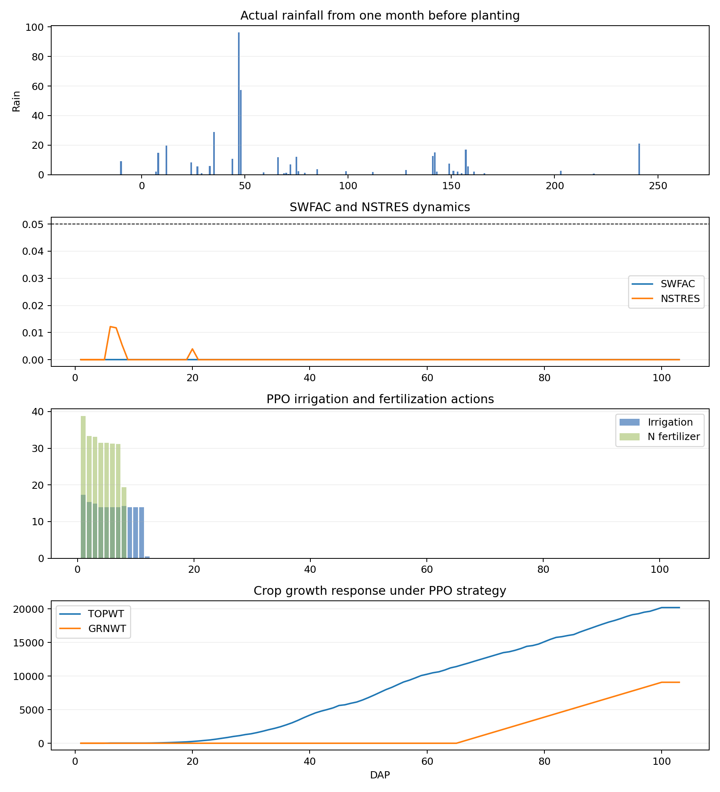
YCA_2015_four_panel

Slide 52
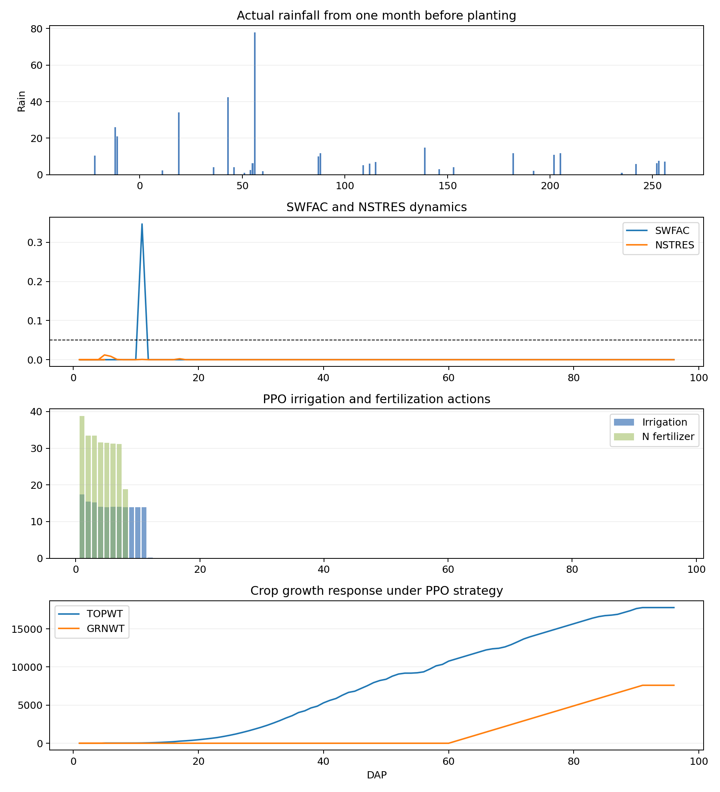
YCA_2019_four_panel

Slide 53
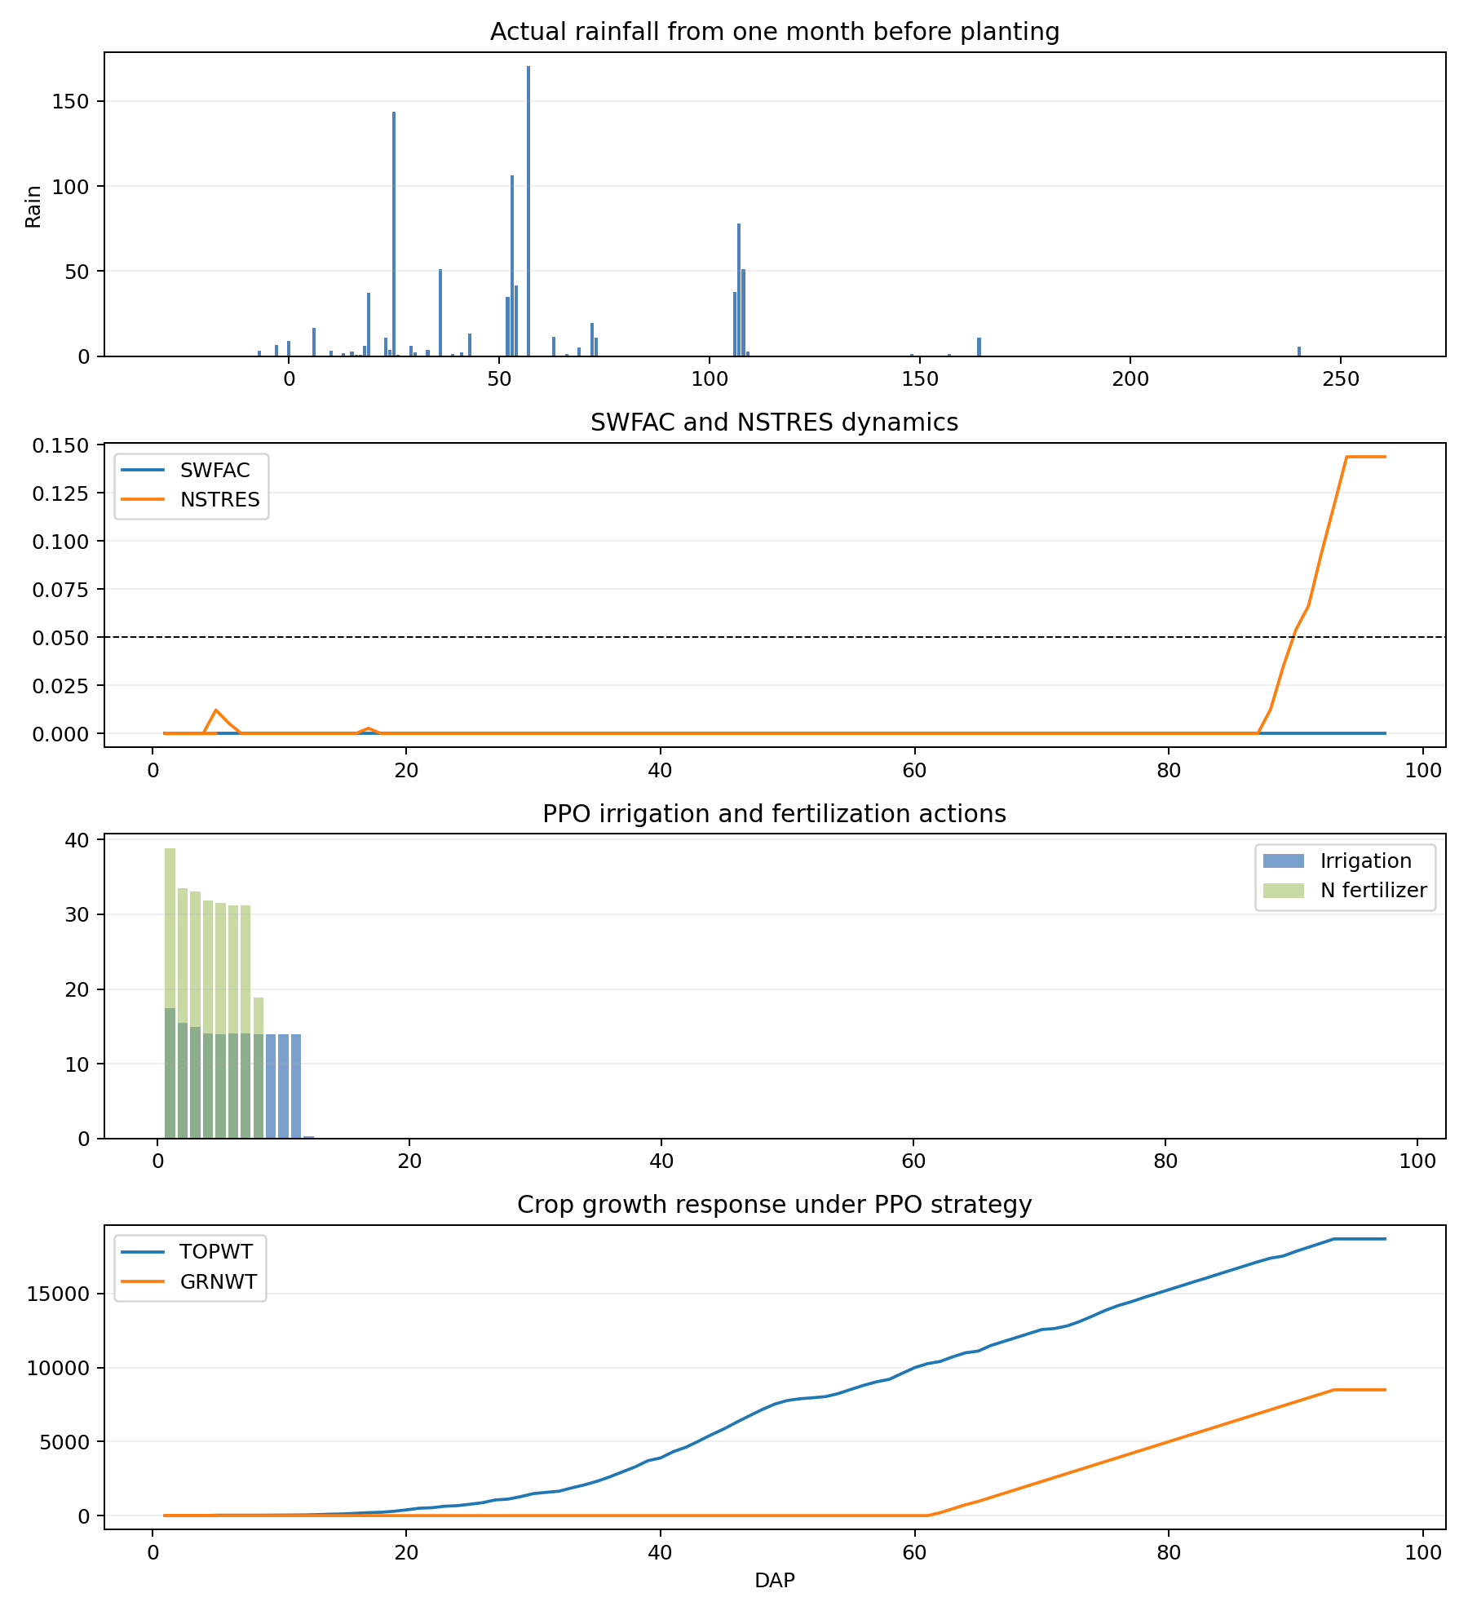
YCA_2022_four_panel

Slide 54
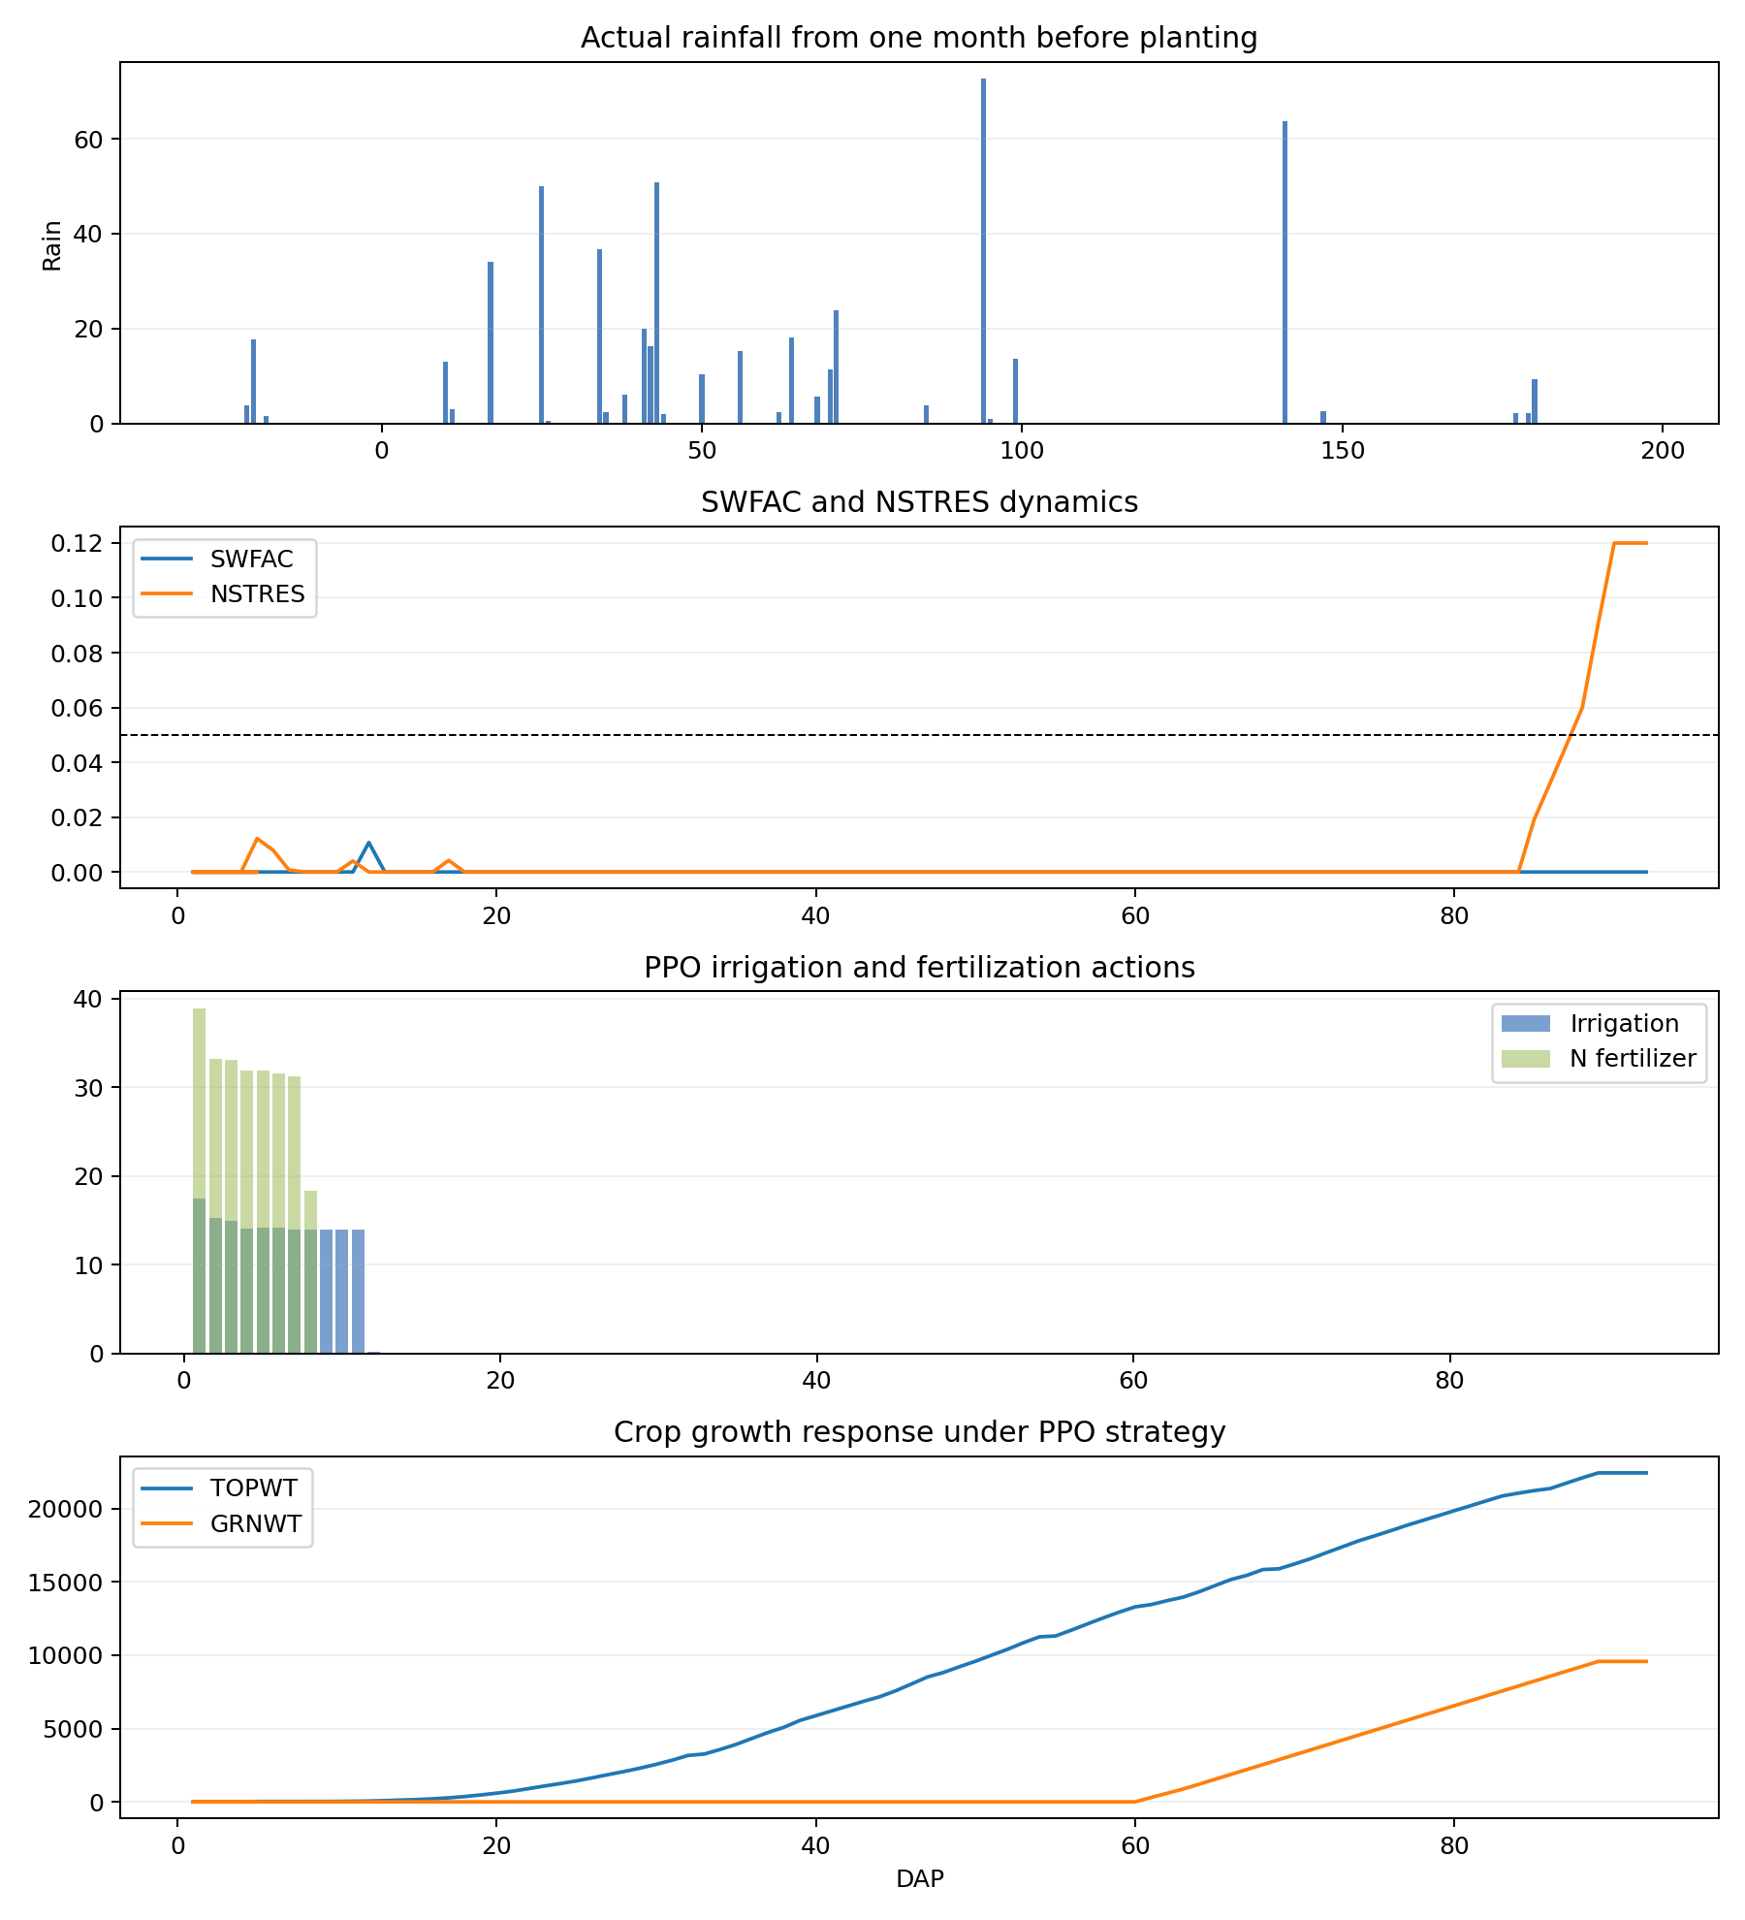
YCA_2023_four_panel

Slide 55
Conclusion
This file records whether the simple direct PPO baseline is presentable.
If outputs are cap-saturated, the result should be shown as a baseline limitation rather than a final management recommendation.
The four figure types allow mentor-facing inspection of weather, stress, actions, and crop growth.

