Slide 1
Library Service Management System
DesignBy: Wanhong Zhang, Haoran Zu ,Yanni Ye

Slide 2
Member responsibility
Task | Who responsible for
Front End | Wanhong Zhang
Physical model | Yanni Ye
Data Logistics | Haoran Zu
Demo/Documentation | Haoran Zu, Yanni Ye, Wanhong Zhang

Slide 3
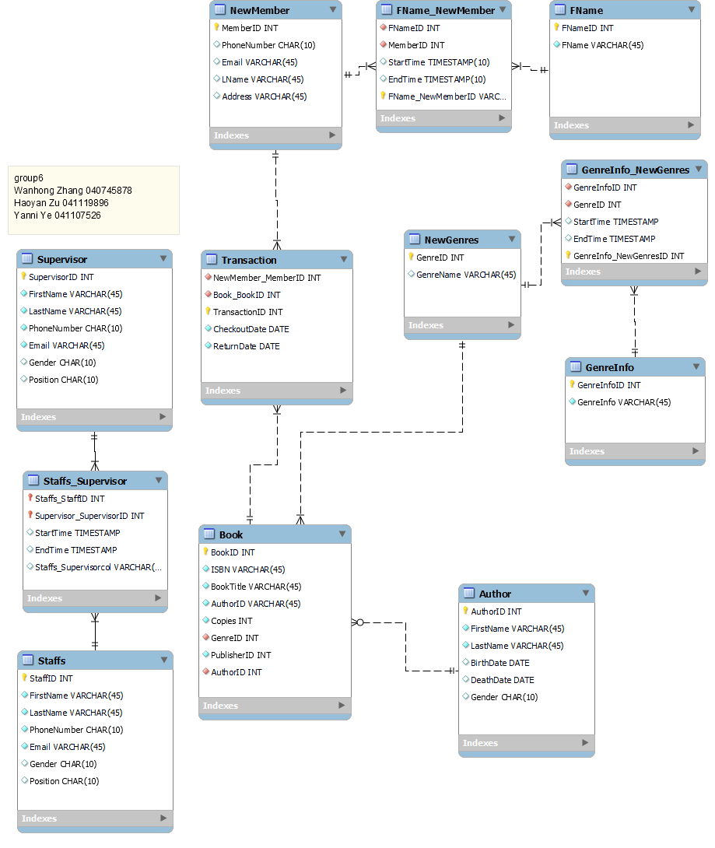
Physical model

Slide 4
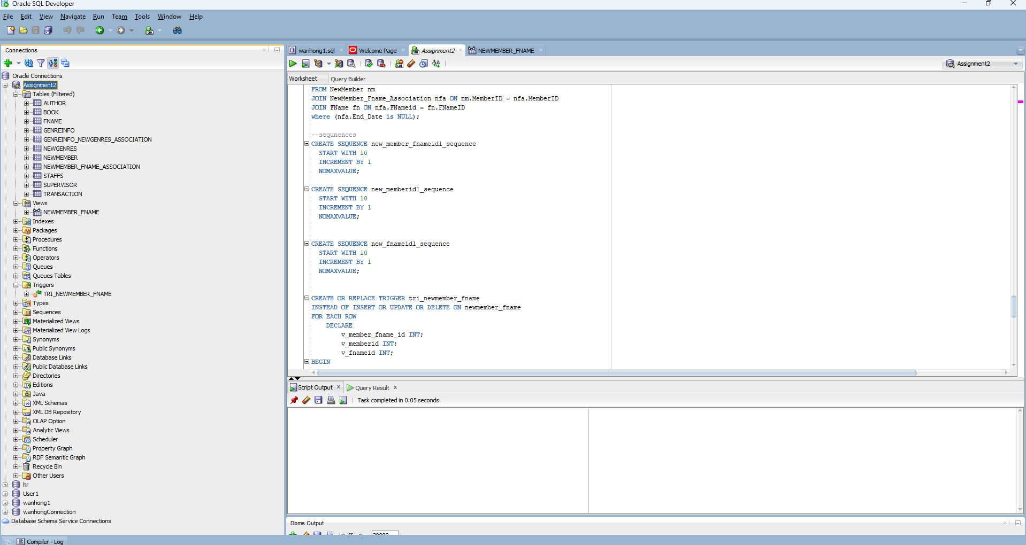
Back End

Slide 5
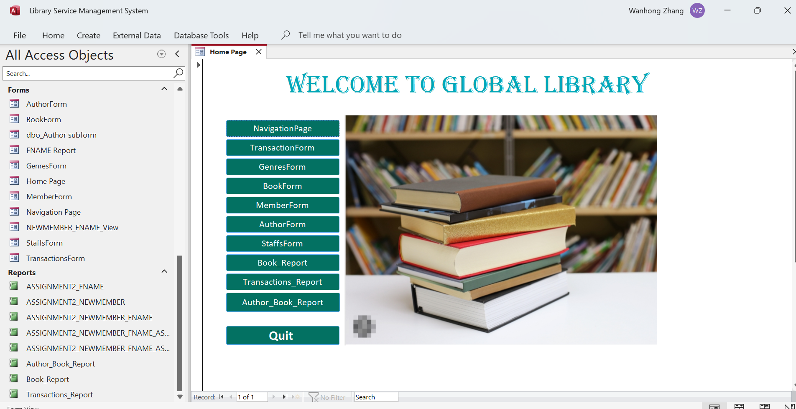
Front End

Slide 6
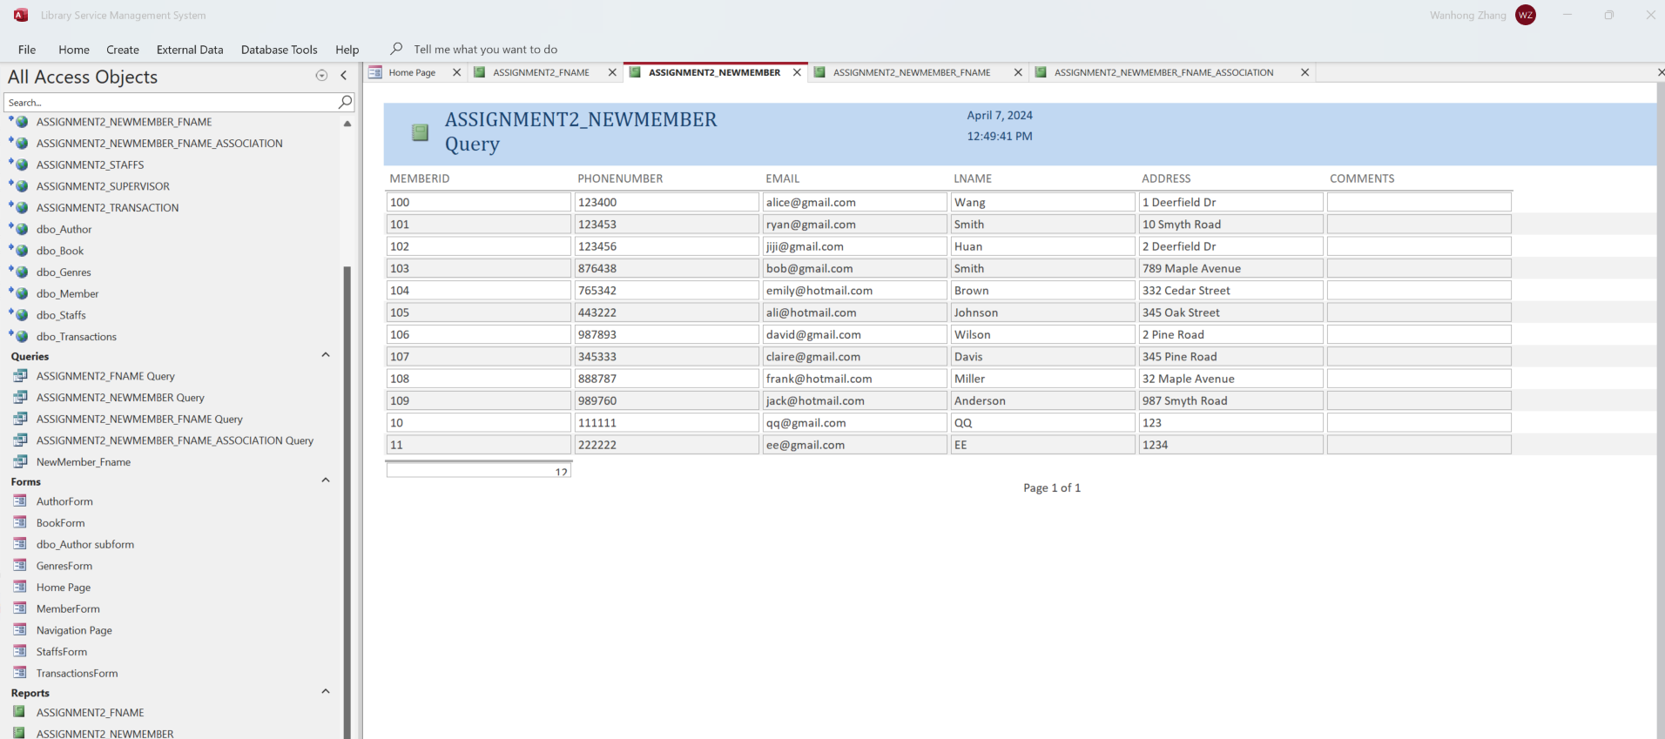
Report example

Slide 7
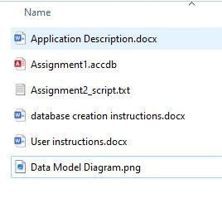
Thank you and Demo!

