Slide 1
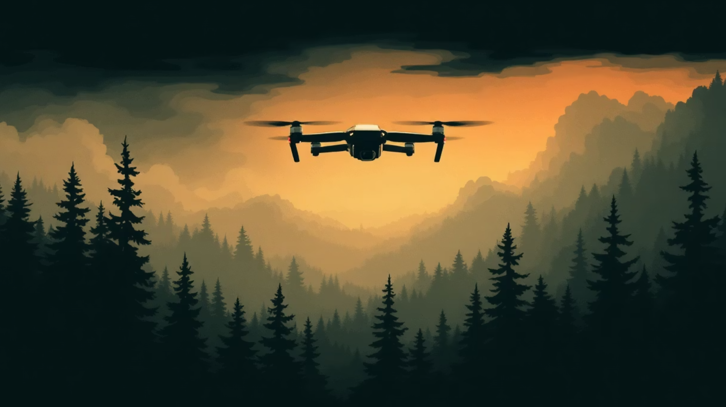
Drone For Your Safety
By Rachel Sade, Yuval Pery, Shaked Horesh

Slide 2

Adverse-Weather Drone Object Detection
In fires or smoke, visibility decreases - rapid identification is needed to support rescue and warning in order to save lives.
Task
Metrics
Object Detection (Bounding Boxes)
Precision, Recall, mAP
Models
YOLOv8 and YOLOv11

Slide 3
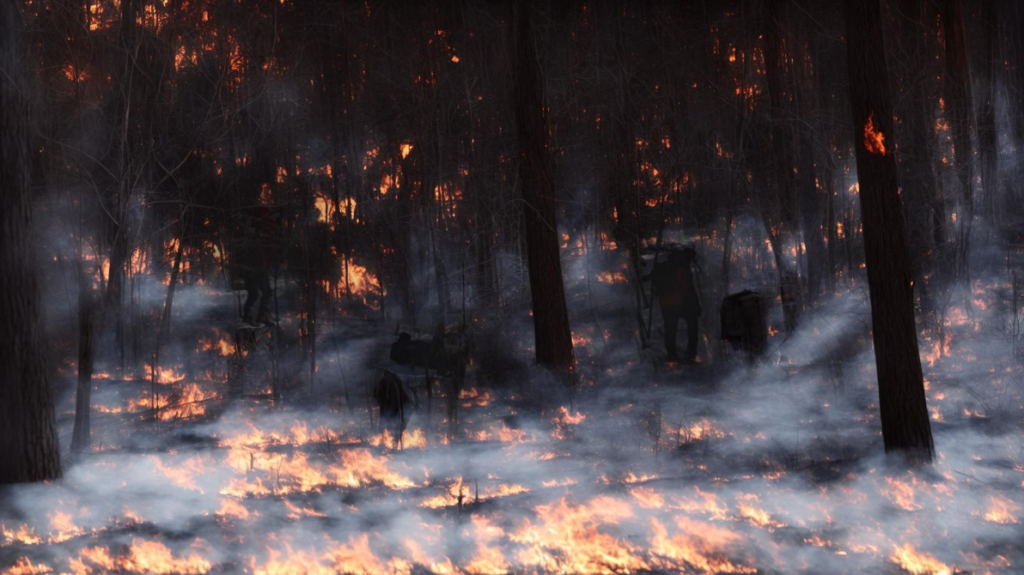
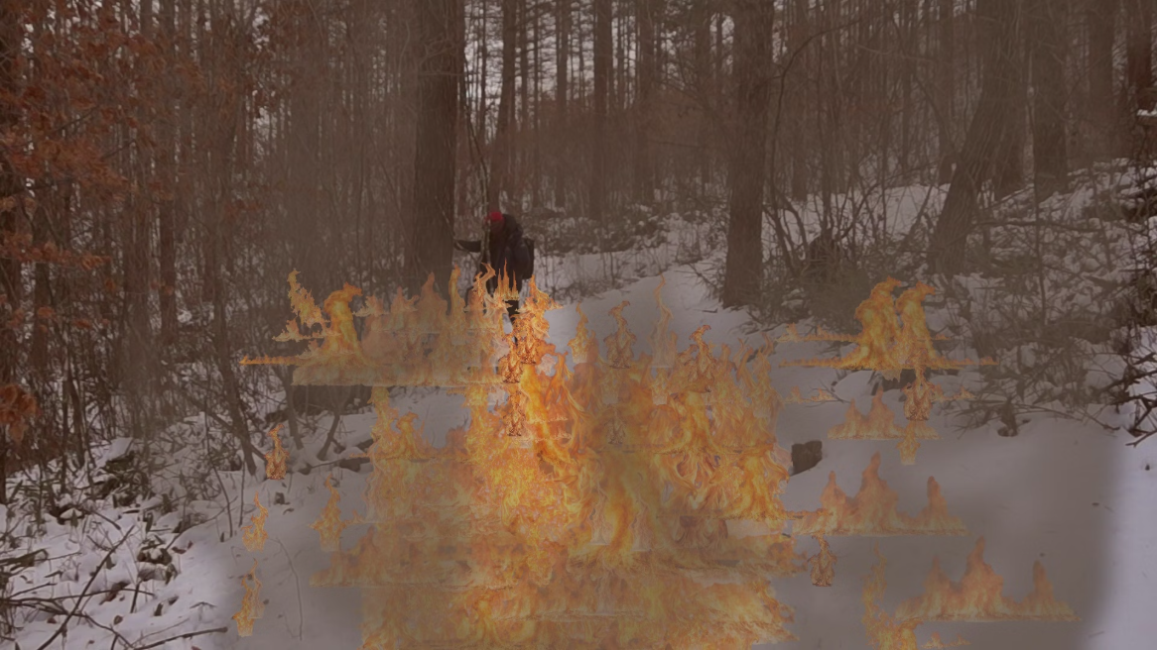
Key Achievements & Novelty
Project Achievements
Novelty & Innovation
YOLO dataset: train/ val/ test
Labels: person, fire, smoke
Creating extreme conditions: fire + smoke on forest images
YOLOv8 training + best.pt + evaluation on test
Results: precision / recall / mAP + recognition examples
Taking forest images and creating fire / smoke for an existing data collection
Using the model even in low-quality image conditions
Generating the fire and smoke to cover the people in the dataset

Slide 4
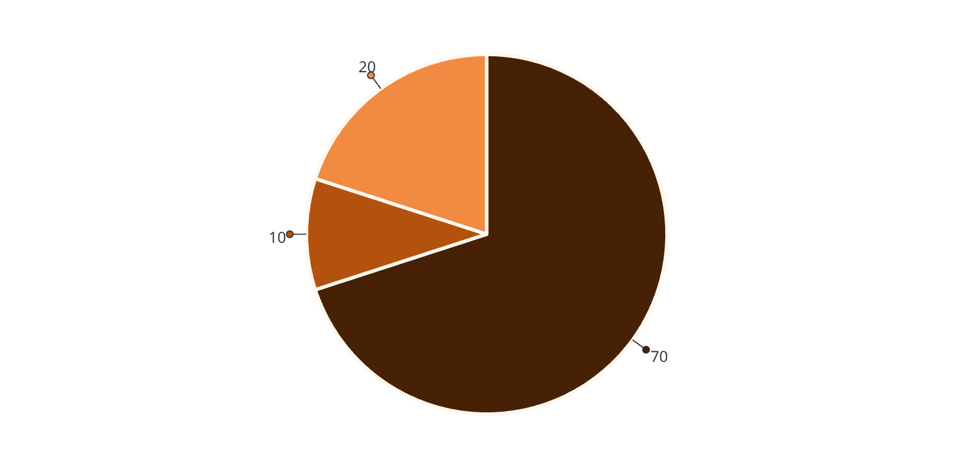
Dataset Composition by Generation Method
Why we used all three
Synthetic Compositing (70%) – Provides precise ground truth and full control over labels for synthetic compositing.
Stable Diffusion version 1.5 (10%) – Improves realism, especially for complex smoke / fire appearance and lighting consistency.
Clean (20%) – Reduces false positives and trains the model on "no-fire / no-smoke" scenarios for robust detection.
Synthetic Compositing
Stable Diffusion
Clean Images

Slide 5
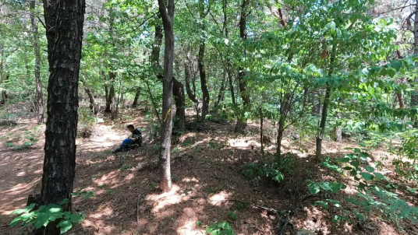
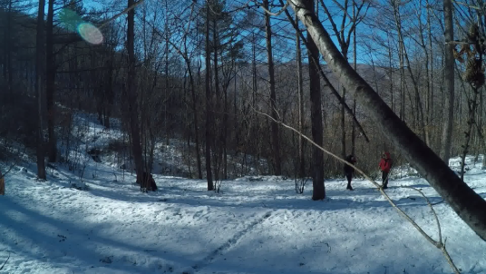
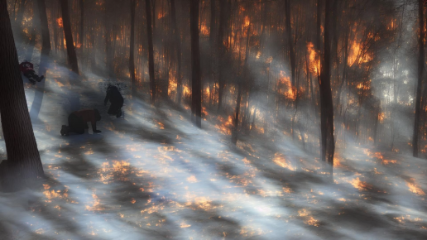
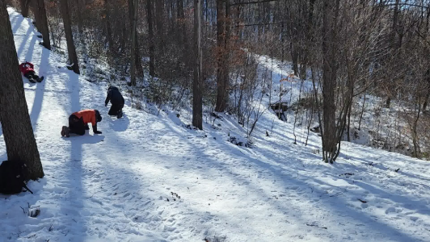
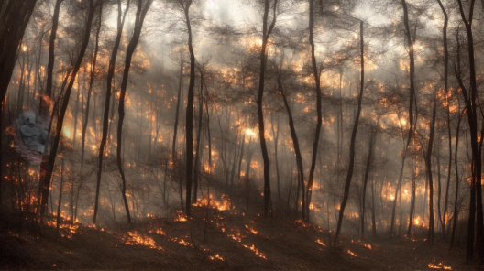
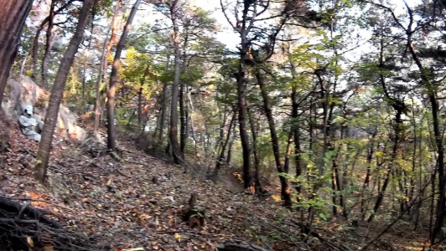
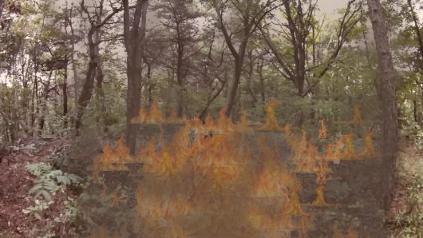
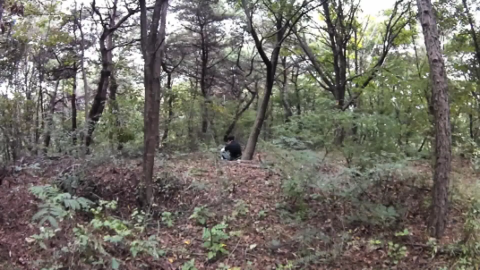
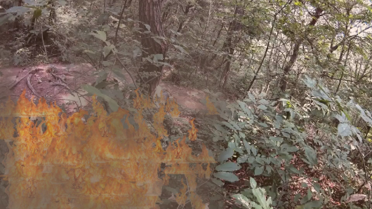
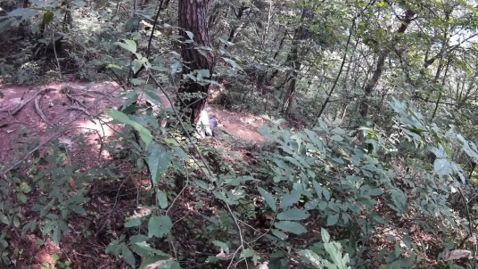
Dataset Samples: Before vs After (Total = 2,500)
Augmented Output
Source Image (Clean)
Sample Count
Original forest images
(without fire)
None
500
Fire and smoke generated with Stable Diffusion
250
Fire and smoke generated with Synthetic Compositing
1750

Slide 6
Development Pipeline & Evaluation
Data Collection
1
Forest images + creating versions with fire/smoke
Labels
2
person/fire/smoke in YOLO format
Division
3
Train/ val/ test
Model Training
4
Fine-tuning → pretrained YOLOv8 and YOLOv11
Effort
5
We ran the image creation several times and tried different prompts until we got fire and smoke that looked real enough to train YOLO on.

Slide 7
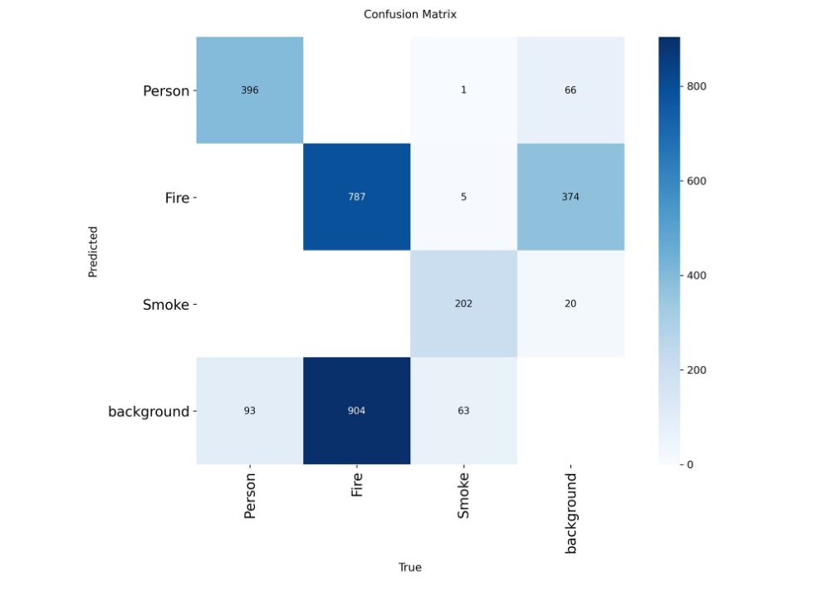
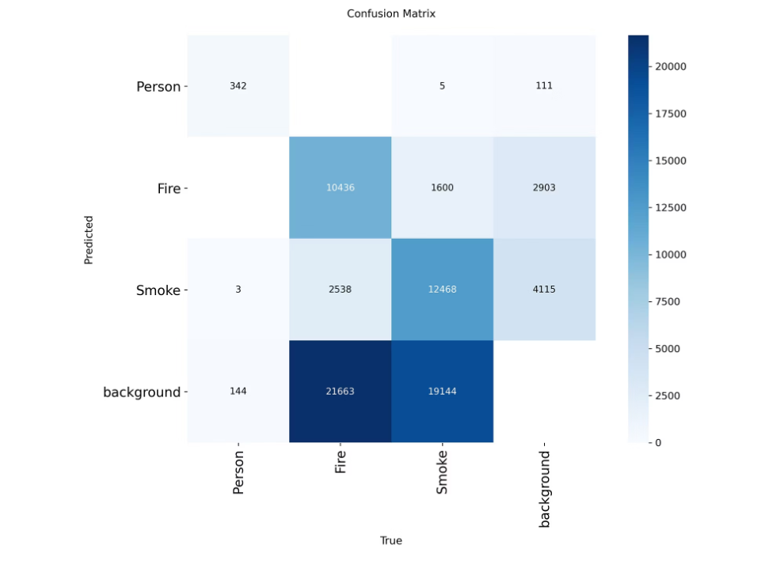
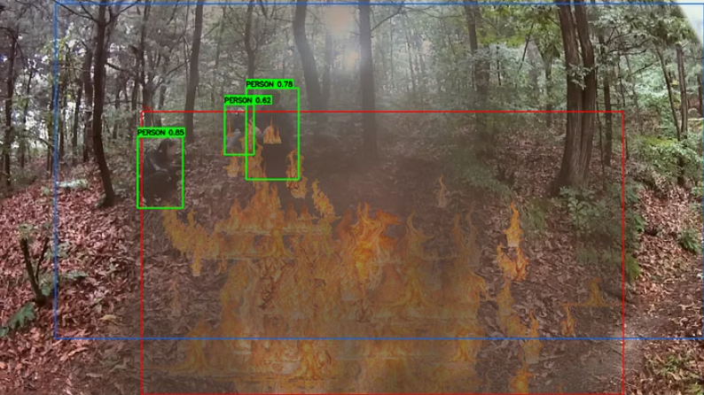
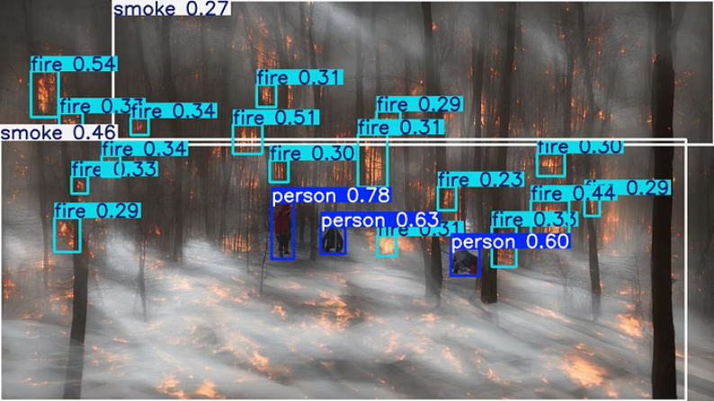
Human Detection Performance:
Person Detection Accuracy (Comparison: YOLOv8 vs. YOLOv11)
YOLOv8:
YOLOv11:
Precision = 69%
Precision = 84.4%
Measures the accuracy of positive predictions.
Recall = 70.9%
Recall = 79.6%
Indicates the model's ability to find all relevant instances.
mAP50 = 71.9%
mAP50 = 82%
Mean Average Precision at IoU 0.5, measuring bounding box accuracy.

Slide 8
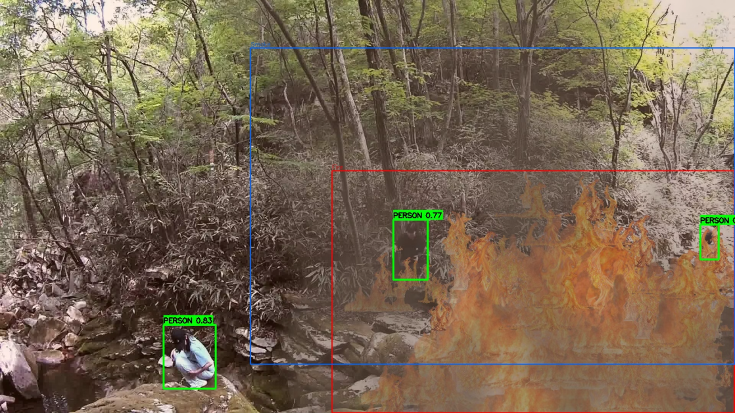
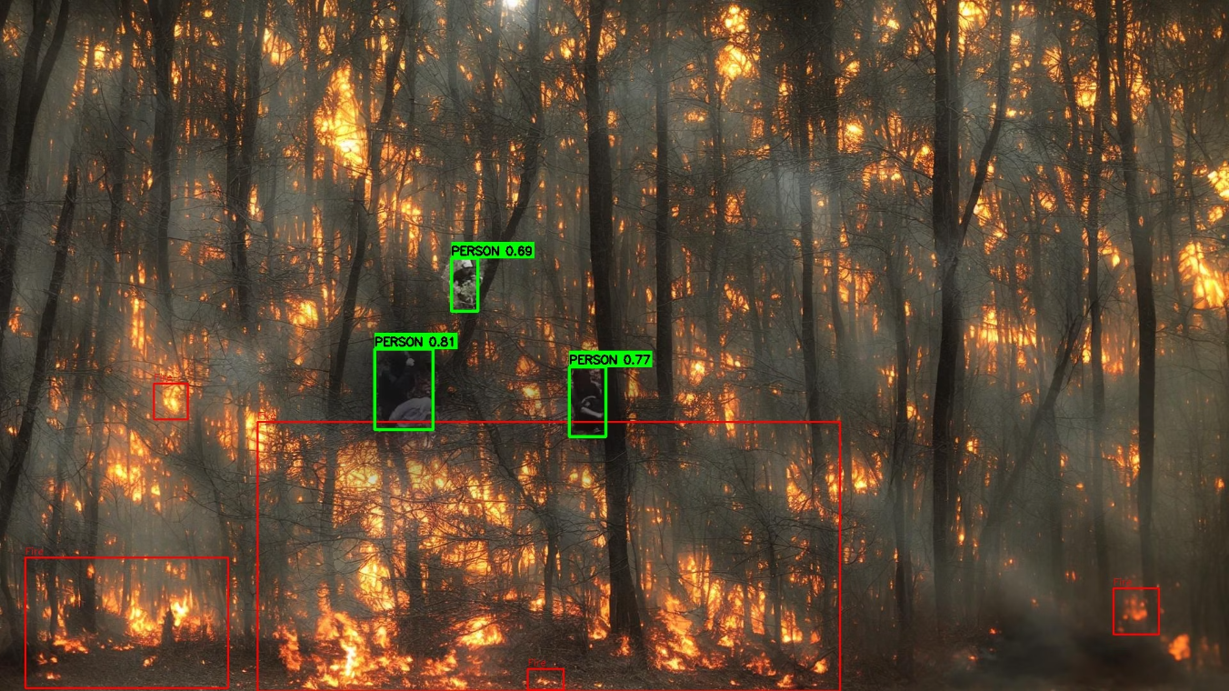
Project Outlook: Achievements, Learnings & Next Steps
We were able to train YOLOv8 & YOLOv11 to recognize people and fire
Key Takeaways & Learnings
Future Work & Next Steps
We learned that data is the most important factor, we need more variety
In smoky conditions, objects simply disappear into the background, so we need data that simulates this so the model can learn to cope.
Expand and clean the data, then train again and compare improvement against the baseline
Add real wildfire images for more realistic performance
Extend beyond forests and fires to additional extreme scenarios at different places to support more rescue missions

