Slide 1


EAI 320
Practical 1
Written by: Steven Pinto
Updated by: Heinrich Keyser and Liebet Joubert
23 February 2023
UNIVERSITY OF PRETORIA
Presentation to the Board of Directors
International Studies
February 7, 2019

Slide 2


Clarification purposes
There have been some common misconceptions as well as confusion from previous years regarding the following.
How to implement your own agent to interact with the opposing agent.
The decision tree with regards to Task 3.
The purpose of BFS and DFS.
The break sequence.
What sort of results to give.
How to use rpsrunnerdebug
This document will attempt to clarify these items for you.

Slide 3
1) How to implement your own agent to interact with the opposing agent
To interact with RPS runner you need to use these two variables:
input: This is the object played (‘R’,’P’ or ‘S’) by the opposing agent in the previous round.
output: This is the object(‘R’,’P’ or ‘S’) that you want your agent to play in that round.
These two variables do not get initialized on your end. The rpsrunner already understands them. So just use them.
The last assignment of output will be the object played. Please look at the next slide.
The first input that your agent will receive will be empty “”. This is so that you can initialize your agent accordingly. Please look at the next slide.

Slide 4
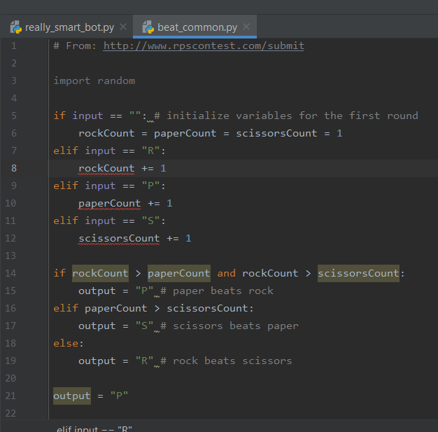
1) How to implement your own agent to interact with the opposing agent
There are multiple instances of output being assigned.
Please look at the sample agent folder. Reading the code for yourself will provide good clarification.
Check for when input is empty. This is when you initialize your agent.
Even though output has been set before, it will be overwritten with the object ‘P’. This is the object that will be sent to rpsrunner.

Slide 5
2) The decision tree with regards to Task 3
Your decision tree is the same tree you implemented in Task 1. It is not based on the input from the opposing agent.
The tree is made this way so that you will attempt every possible solution until you find the break sequence. (This is similar to brute force)
You will play against the opposing agent using the tree from Task 1. You will then use BFS or DFS to decide which object to play against the opposing agent whilst it plays randomly. This is done until you have found the break sequence.
You must try both BFS or DFS. You are comparing the performances of both using the same tree structure. Which is better at finding the break sequence sooner?

Slide 6
3) The purpose of BFS and DFS
You will use BFS and DFS, on different runs, to iterate through your search tree until you find the break sequence.
We want you to compare the performances of BFS or DFS. Therefore you must use both and report on them.
You may try other search algorithms for personal educational gain and compare them to BFS and DFS. Be aware that you have to use BFS and DFS for this practical.
We know from Task 2 that you will get a node with a sequence as “RSR”. This is a sequence that you should play, but you play it an object at a time. So this round you will play “R”, the next round will be “S”, then “R” again. Do not set output to “RSR”.

Slide 7
4) The break sequence
The break sequence is generated at the start of each match.
This sequence has a random length between 2 and 5. For example, it could be “RP” or “RSPR” or “RRRRR”.
The opposing agent will store your moves, if your moves correlate with the break sequence the bot will be in its’ “Broken” phase. It is like a password.
It will then repeat the last played object for a random number of rounds. So, if the bot played “S” previously and it breaks that round, it will continue to play “S” for a random number of rounds and then go back to playing randomly.
The break sequence is still the same even when it returns to playing randomly. So simply replay the break sequence.

Slide 8
5) What sort of results to give
This is up to you!
Your main requirement is to compare the performance of BFS and DFS.
You must use your own engineering judgement to obtain the relevant metrics that you deem valuable in comparing the two.
You need to ask yourself what parameters do BFS and DFS affect and obtain data on those parameters.

Slide 9
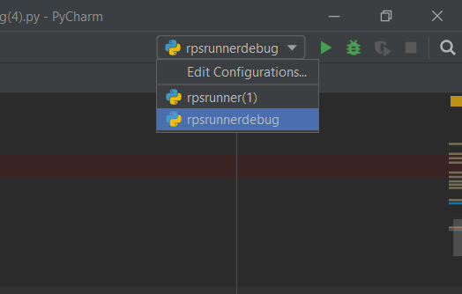
6) How to use rpsrunnerdebug
I will be using the Pycharm IDE for this. You will need to figure out how to use it with accordance to your own IDE.
Firstly setup the configuration like you would normally do it for rpsrunner. Except use rpsrunnerdebug instead as the main.

Slide 10
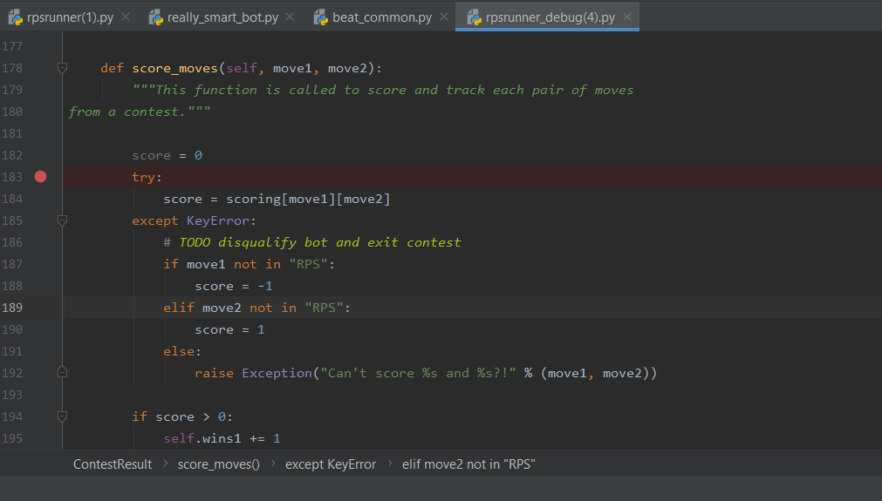
6) How to use rpsrunnerdebug
Once the configuration has been setup, you need to set a break point in rpsrunnerdebug.
Place your break point in the section you are attempting to check.

Slide 11
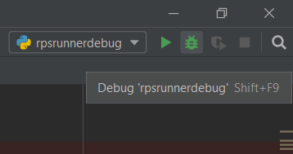
6) How to use rpsrunnerdebug
Now you will have to debug the code. Instead of running the code press the debug button instead. It is the little bug looking button.

Slide 12
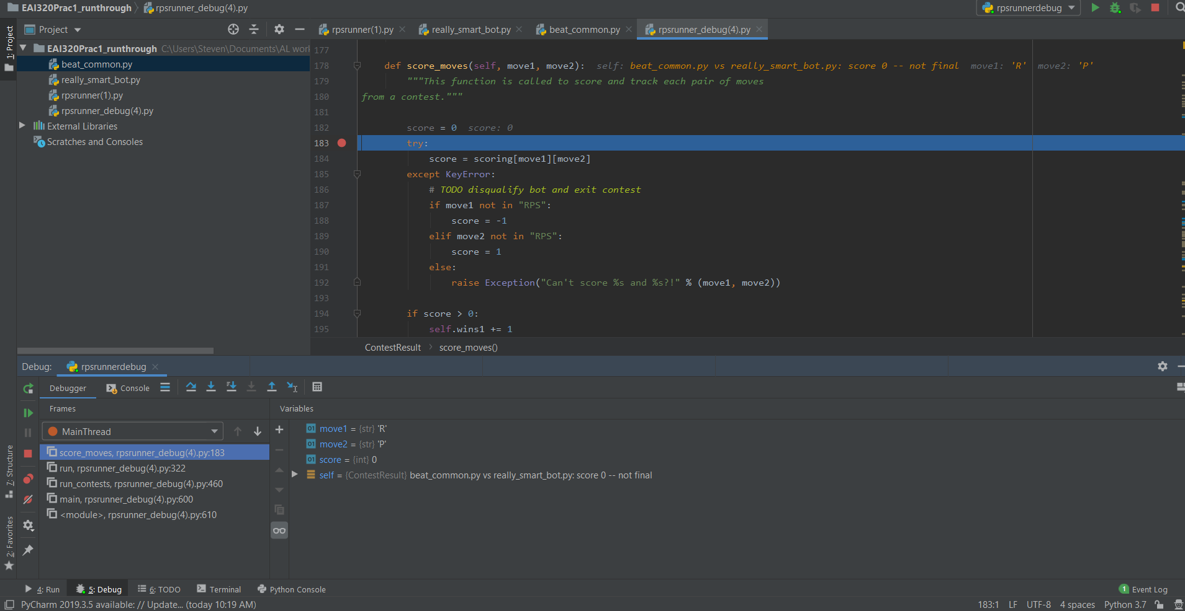
6) How to use rpsrunnerdebug
Once you have done this the debug process will begin.

Slide 13

6) How to use rpsrunnerdebug
As you can see the line it is currently paused on is highlighted in blue.
At the bottom it illustrates the view and controls of the debugger. The main thing you want to see are the variables. This will show move1 and move2. These are the respective outputs from your agent and the enemy agent. This is how you can check what is going on.
These are the controls you can use to step through the rpsrunnerdebug.

Slide 14
Submission details
For the code, only submit the final implementation of Task 3.
File name standard for both the code and report submission: eai320_prac_{Practical number}_{Group Number}.extension
Turnitin does not accept .py files. Submit your code as .txt
You will have to submit your code to the AMS as well.
Due date: 8 March 2023
Group allocation end date: 2 March 2023
1 Week to sort out the groups, 1 week for the practical. Please email us if you don’t have a partner.

Slide 15
Good luck!

