Slide 1

Front Page
By Rachel Finlayson
2025

Slide 2
Agenda
Project Overview
Data Cleaning & Preprocessing
Exploratory Data Analysis (with visuals)
Modeling Workflow
Model Evaluation & Final Model
Power BI Dashboard
Conclusion & Future Work

Slide 3
Project Overview
Forecast daily vegetable prices using ML & time-series analysis
Workflow: Cleaning → EDA → Modeling → Evaluation → Dashboard
Identify stable vs volatile vegetables
Build interpretable & reliable forecasting models

Slide 4
Data Cleaning & Preprocessing
Fixed missing dates using daily frequency
Interpolated missing values
Removed extreme outliers (especially Methi spikes)
Added lag & rolling features for modeling

Slide 5
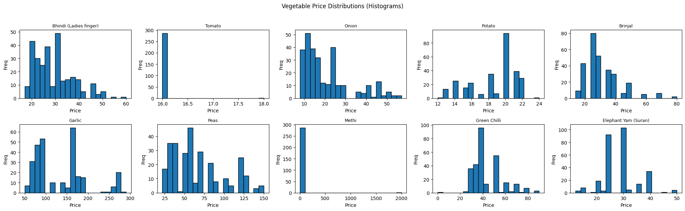
EDA: Price Distributions
Histograms reveal skewness & variation in vegetable prices
Tomato extremely stable; Garlic & Peas highly volatile

Slide 6
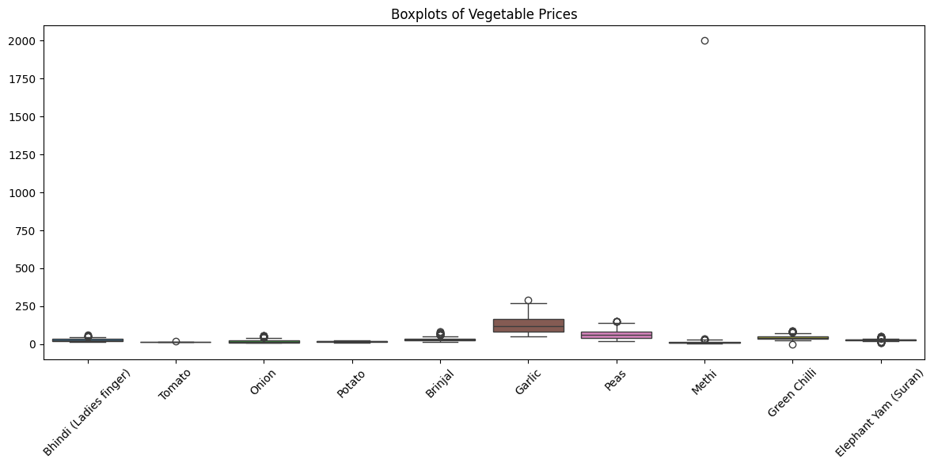
EDA: Boxplots
Distribution ranges visualized
Outliers clearly visible, especially in Methi & Garlic

Slide 7
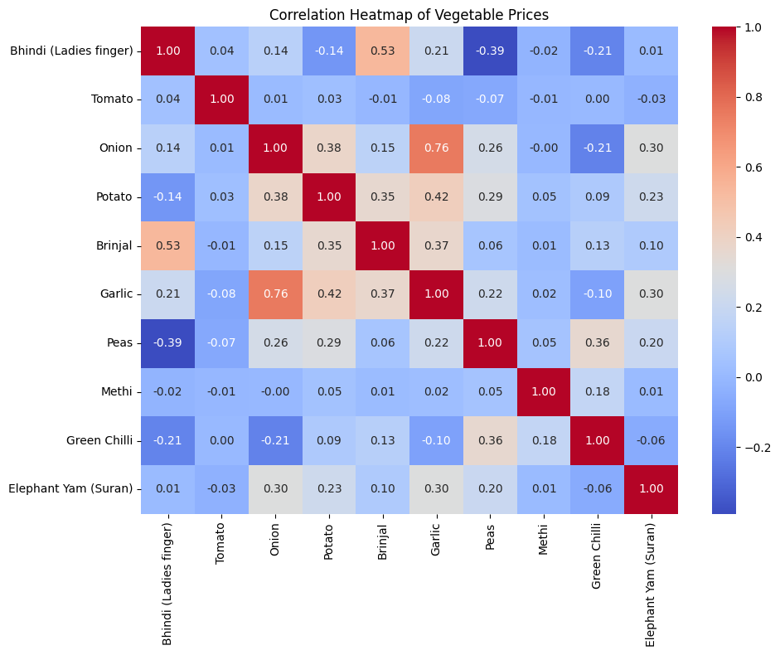
EDA: Correlation Heatmap
Shows relationships between vegetable price movements
Some strong correlations (e.g., Onion–Garlic), most weak

Slide 8
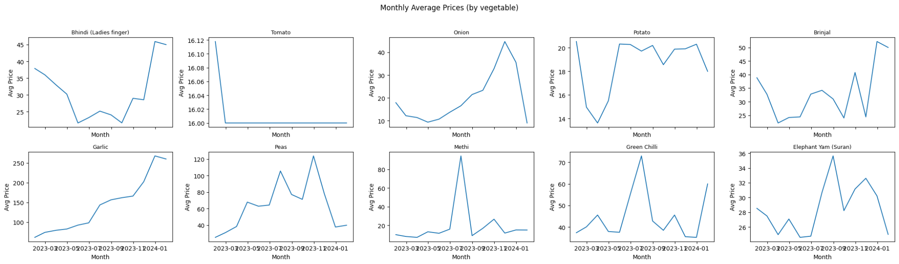
Monthly Trends
Monthly averages help reveal general trend direction
Garlic shows increasing trend; others fluctuate moderately

Slide 9
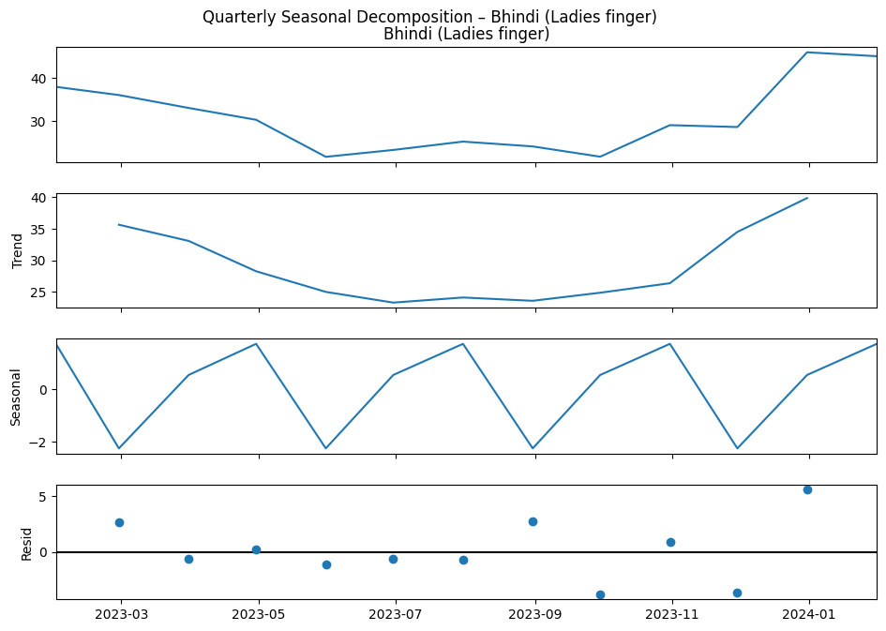
Seasonal Analysis
Quarterly seasonal decomposition performed
Weak seasonality due to short dataset
Quarterly Seasonal
Decomposition Example

Slide 10
Modeling Approach
Models tested:
Naïve Baseline
ARIMA(3,1,2)
Lagged Linear Regression
Random Forest
XGBoost
Feature Engineering:
Lag features: 1, 7, 14, 30 days
Rolling averages: 7 & 30 days

Slide 11
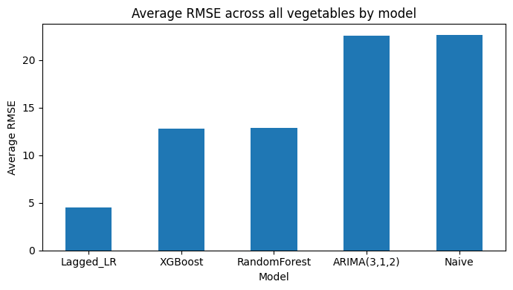
Model Evaluation Summary
Lagged Linear Regression best for 9/10 vegetables
Random Forest best only for Elephant Yam
ARIMA best for Tomato (flat series)
Final model selected: Lagged Linear Regression

Slide 12
Final Model: Lagged Linear Regression
Why chosen:
• Best accuracy overall
• Interpretable and stable
• Excels on volatile vegetables
Features:
• Lags: 1, 7, 14, 30
• Rolling means: 7 & 30 days

Slide 13
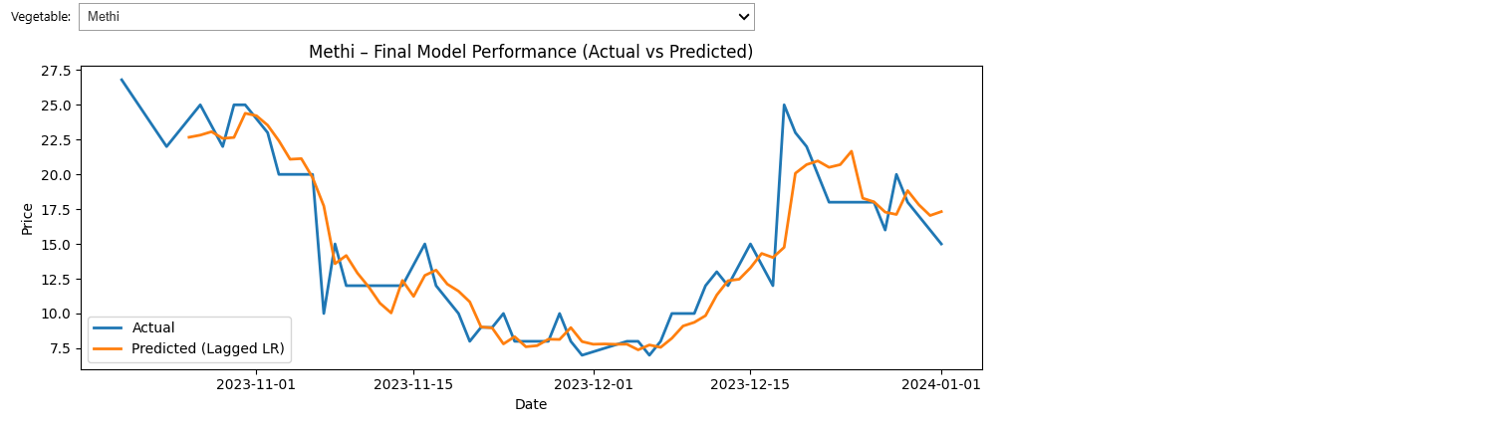
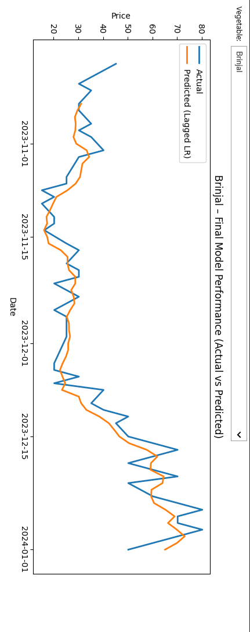
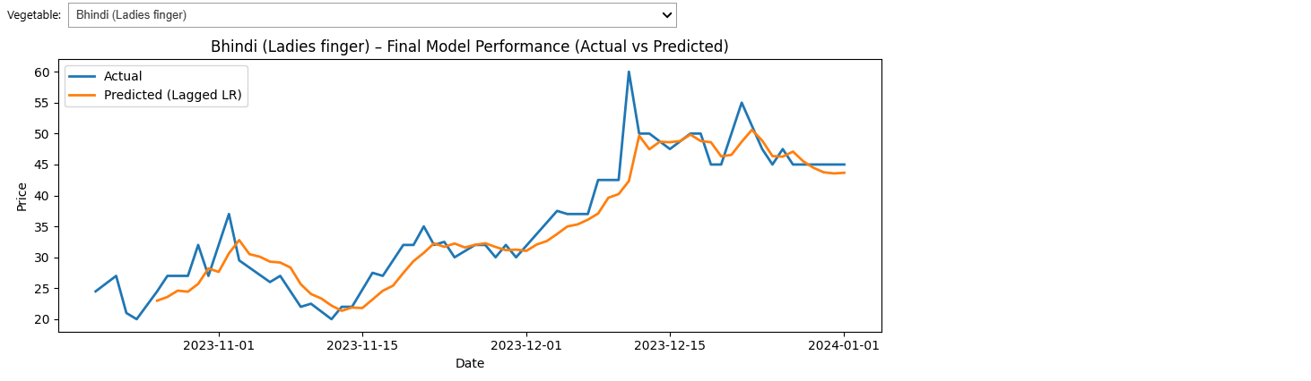
Final model examples

Slide 14
Conclusion
• Full forecasting workflow successfully implemented
• Lagged Linear Regression chosen as final model
• Dashboard provides interactive business insights

Slide 15
Future Work
• Add more years of historical data
• Include weather & supply-chain regressors
• Explore advanced deep learning models (LSTM, TFT)
• Automate forecasting pipelines
• Expand Power BI with what-if forecasting

